Slide 1

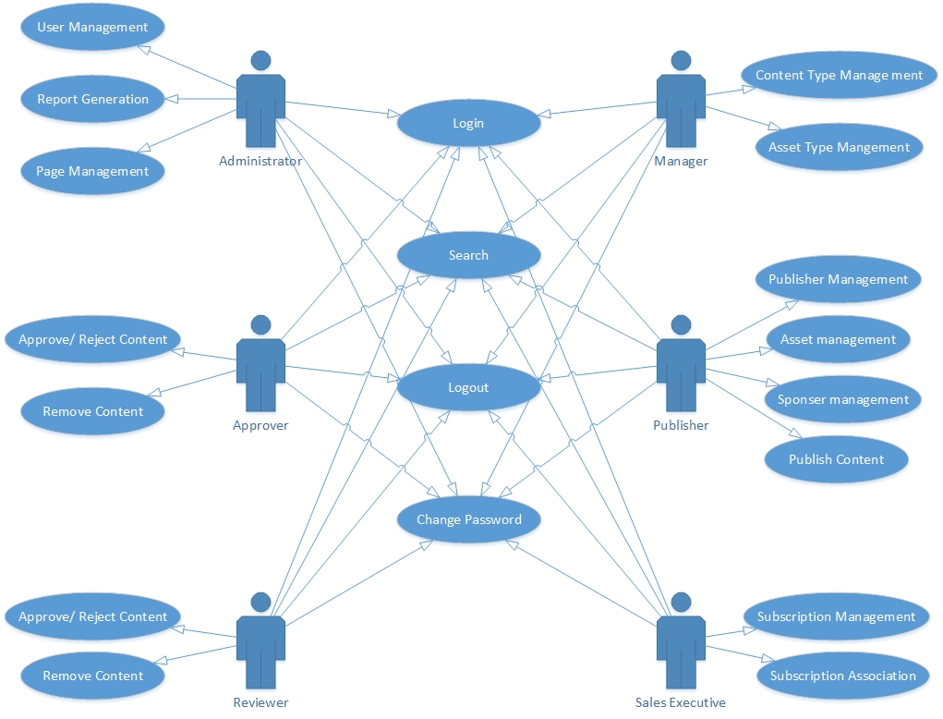
FRAMEWORK FOR INTERACTIVE CONTENT GENERATION AND PUBLISHING
SIDDHARTH AYER (12BCE175), YAMINI RATHOD (11BCE078), GUIDED BY DR. MADHURI BHAVSAR
INSTITUTE OF TECHNOLOGY, NIRMA UNIVERSITY, AHMEDABAD, INDIA
INTRODUCTION
The scope for this project is limited only by the imagination of the organization that uses this. This system can support and publish all kind of media regardless of dependencies that content requires . Educational and training institutes can generate content that is highly interactive and are highly complicated with ease. Publishing houses can focus onto content generation rather that dealing with complex technologies that can convert this content to publishable form and then actually publishes it on standard platform.
This project is an apparent solution to the problems faced by the organizations in generating and publishing content. The solution is to provide the coupling facility between the tools of generating and publishing, which in turn proposes the new challenges that are related to cross domain functionality, and are by nature hard to accomplish or at least not achievable without complex and sophisticated solutions. The solution is to provide the framework that does the publishing and generation for us. And this solution can be converted into the need if implemented properly. No existing system are available, as this the inception of this kind of system.
RESULT AND CONCLUSION
This framework is provided as an intelligent web application to the users who could access it from the wide range of heterogeneous products and environments, and will provides the means of generating the content that they wish to publish and then finally push the generated content to the standard publishing portal that will showcase the outcome of the generated content. Our plan is to release the proposed system at the completion of major project under semester 8.
SYSTEM DESIGN
User Types
Administrator
Manager
Publisher
Approver
Reviewer
Sales Executive
Methodology : RAD
Web Server : WAMP
Database Platform : MYSQL
Technologies : PHP, JavaScript, HTML, Jquery
Project Accepted by Azure Knowledge Corporation.
Goal is to release the proposed system at the completion of major project.

