Slide 1
Hypothesis Testing Exercise
A F&B manager wants to determine whether there is any significant difference in the diameter of the cutlet between two units. A randomly selected sample of cutlets was collected from both units and measured? Analyze the data and draw inferences at 5% significance level. Please state the assumptions and tests that you carried out to check validity of the assumptions.
Minitab File : Cutlets.mtw

Slide 2
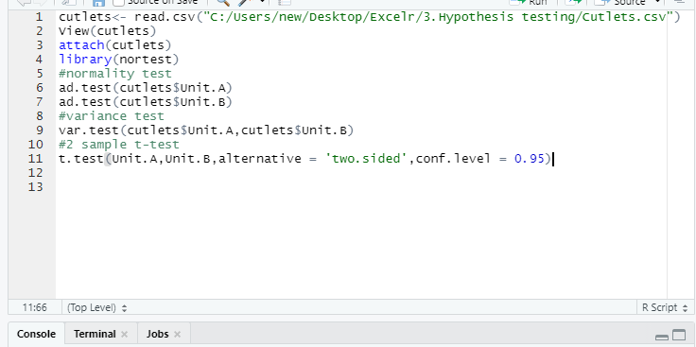
Code:

Slide 3
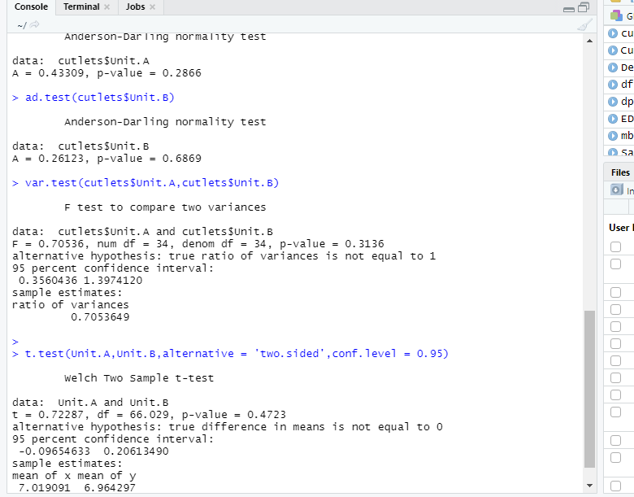
Output:

Slide 4
Explanation:
#Normality Test:
Ho: No action, if Y1 & Y2 are normal
Ha: Take action, if Y1 or Y2 are not normal
Anderson-Darling normality test data: cutlets$Unit.A A = 0.43309, p-value = 0.2866
Anderson-Darling normality test data: cutlets$Unit.B A = 0.26123, p-value = 0.6869
Both data are assume to be normal as p-value for both is high, p-high -> Null fly
# External conditions:
As external conditions are different, we will go with Variance Test
# Variance Test:
Ho -> Variances are equal (Var of Y1 = Var of Y2)
Ha -> Variances are not equal (Var of Y1 != Var of Y2)
F test to compare two variances data: cutlets$Unit.A and cutlets$Unit.B F = 0.70536, num df = 34, denom df = 34, p-value = 0.3136
Variances are assume to be equal as P high Null Fly (p-value > 0.05)

Slide 5
#2 sample T test for equal variances:
Ho -> Diameter of cutlet from unit A = Diameter of cutlet from unit B
Ha -> Diameter of cutlet from unit A != Diameter of cutlet from unit B
p-value >0.05, P High Null Fly which means Fail to reject null hypothesis.
Conclusion: There is no significant difference in the diameter of the cutlet between two units.

Slide 6
Hypothesis Testing Exercise
A hospital wants to determine whether there is any difference in the average Turn Around Time (TAT) of reports of the laboratories on their preferred list. They collected a random sample and recorded TAT for reports of 4 laboratories. TAT is defined as sample collected to report dispatch.
Analyze the data and determine whether there is any difference in average TAT among the different laboratories at 5% significance level.
Minitab File: LabTAT.mtw

Slide 7
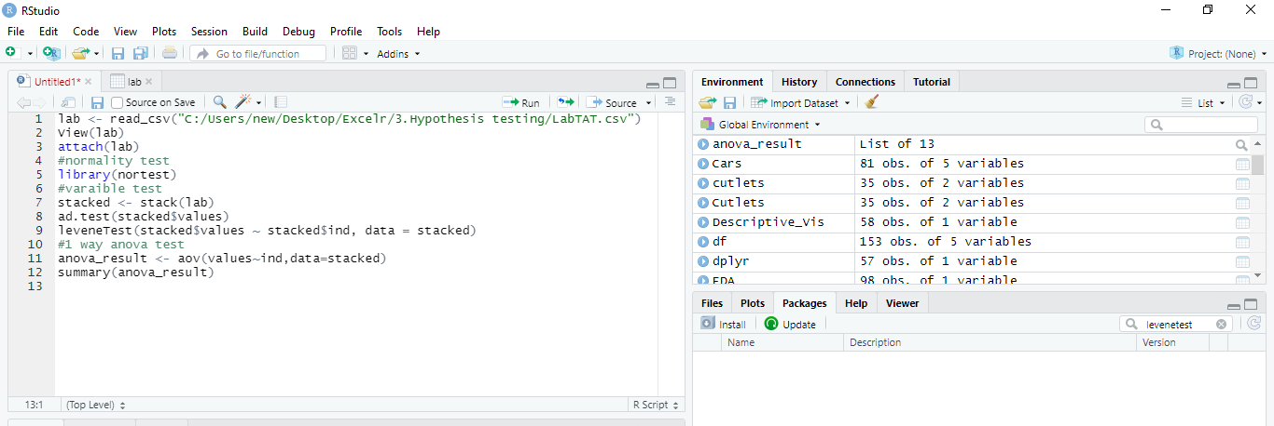
Code:

Slide 8
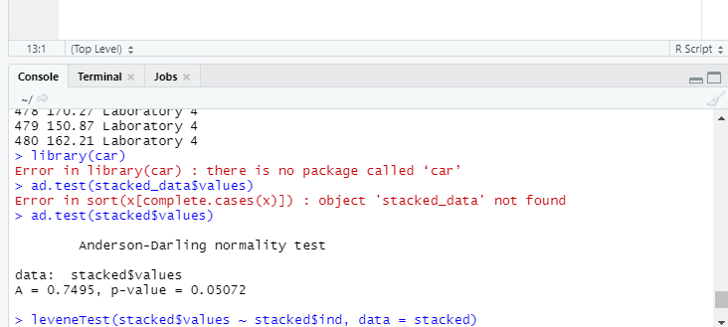
Output:
#Normality Test:
Ho: No action, if Y1 & Y2 & Y3 & Y4 are normal
Ha: Take action, if Y1 or Y2 or Y3 or Y4 are not normal

Slide 9
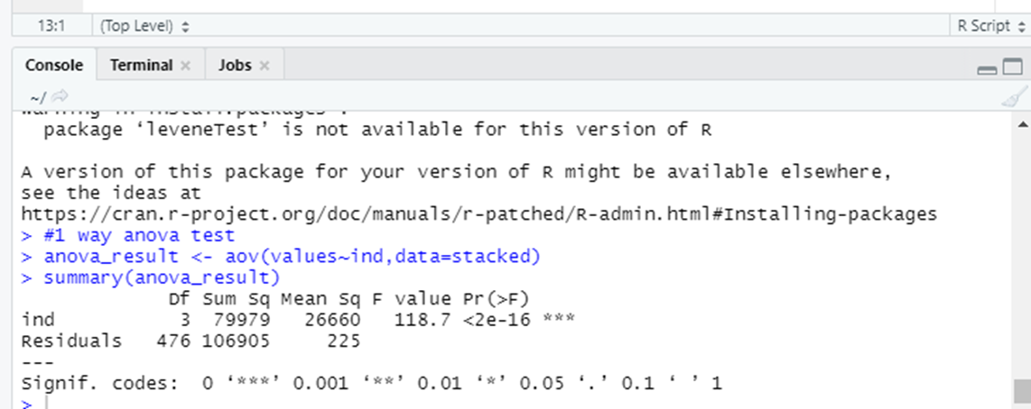
Explanation:
#Variance Test:
Ho: Variances are equal
Ha: Variances are not equal
#Final Test: One way Anova
Ho: Avg TAT are equal i.e. Laboratory1= 2 = 3 =4
Ha: Avg TAT are Not equal.
P Low Null Go -> Reject Null hypothesis , i.e Avg TAT are Not equal
There is no TAT.

Slide 10
Hypothesis Testing Exercise
Sales of products in four different regions is tabulated for males and females. Find if male-female buyer rations are similar across regions.
 | East | West | North | South
Males | 50 | 142 | 131 | 70
Females | 550 | 351 | 480 | 350
Check p-value
If p-Value < alpha, we reject Null Hypothesis
H0
All proportions are equal
Ha
Not all Proportions are equal
Buyer Ratio.mtw

Slide 11
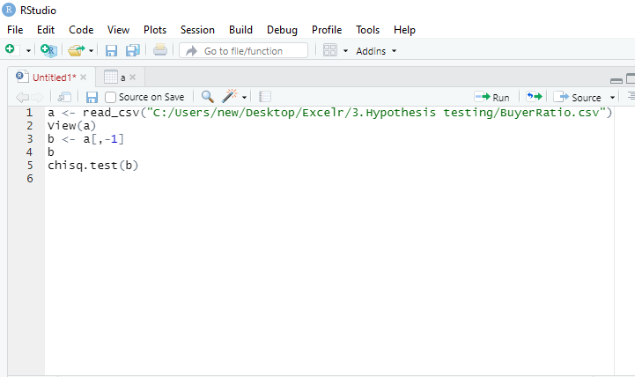
Code:

Slide 12
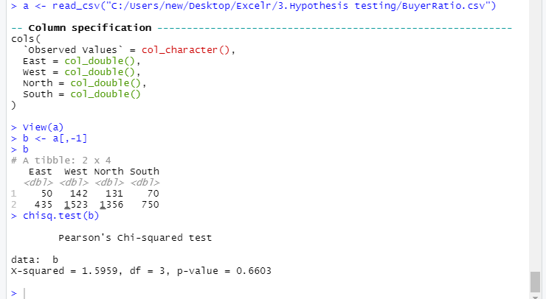
Output:

Slide 13
Explanation:
P-value>0.05.Hence we fail to reject Null.
So, proportion of male and female across regions is same.

Slide 14
Hypothesis Testing Exercise
TeleCall uses 4 centers around the globe to process customer order forms. They audit a certain % of the customer order forms. Any error in order form renders it defective and has to be reworked before processing. The manager wants to check whether the defective % varies by centre. Please analyze the data at 5% significance level and help the manager draw appropriate inferences
Minitab File: CustomerOrderForm.mtw

Slide 15
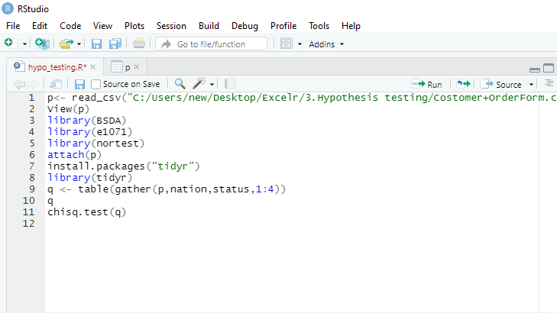
Code:

Slide 16
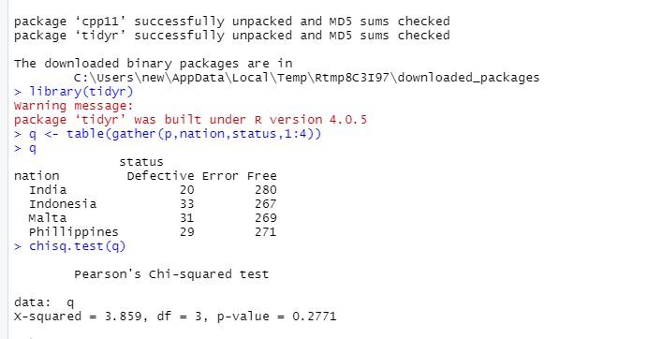
Output:

Slide 17
Explanation:
P-value>0.05.Hence we fail to reject Null.
Hence, No action needed.
Defective % does not vary by centre.

