Slide 1
SPEECH EMOTION RECOGNITION
2nd Review
13-03-2023
Team members
S.YAMINI(211419104312)
NILOPHER NISHA (211419104242)
Guided by
Dr.T.TAMILVIZHI, M.E., Ph.D.,
DEPARTMENT OF CSE,
PANIMALAR ENGINEERING COLLEGE.

Slide 2
ABSTRACT
The human voice is very versatile and carries a multitude of emotions. Emotion in speech carries extra insight about human actions. Through further analysis, we can better understand the motives of people, whether they are unhappy customers or cheering fans.
cntd…

Slide 3
Humans are easily able to determine the emotion of a speaker, but the field of emotion recognition through machine learning is an open research area. In this proposed project, we perform speech data analysis on speaker discriminated speech signals to detect the emotions of the individual speakers involved in the conversation

Slide 4
LITERATURE SURVEY
TITLE: Speech Emotion Recognition Based on Self-Attention Weight Correction for Acoustic and Text Features
Author: Jennifer Santoso; Takeshi Yamada
Volume: 10
Publisher: IEEE
Year: 2022

Slide 5
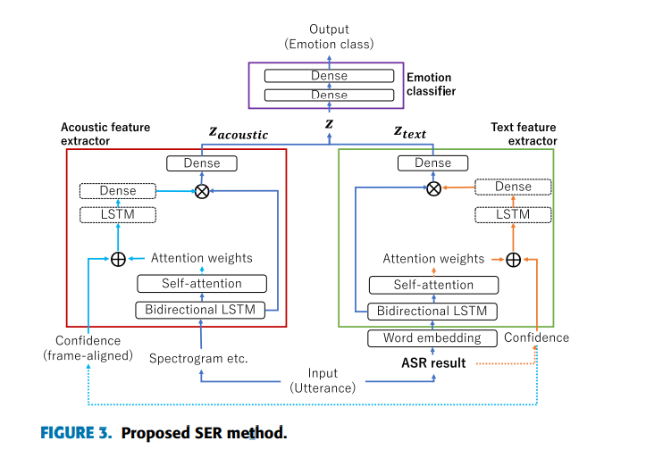
METHODOLOGY
Screenshot from Base paper

Slide 6
The acoustic and text feature extractors of the basic SER method use BLSTM and a self-attention mechanism. Focusing on the words incorrectly recognized by ASR results in many incorrectly recognized emotions and one of the solutions to this problem is to improve ASR performance to be robust to emotions through retraining or fine-tuning.
The essential information regarding the presence of emotion in segments containing speech recognition errors, which can be focused on by a self-attention mechanism in acoustic feature extraction.

Slide 7
The idea is to mitigate the effects of ASR error on text feature extraction by reducing the weight of the words with low CM, which are likely to be a speech recognition error, and to emphasize the speech segments with low CM
DRAWBACKS
BLSTM-based networks have one demerit: information loss after going through long sequences which causes some of the information in the earlier sequences to be considered not important in the end

Slide 8
TITLE: Design of Efficient Speech Emotion Recognition Based on Multi Task Learning
Author: Liu Yunxiang;Zhang Kexin
Volume: 11
Publisher: IEEE
Year: 2023
METHODOLOGY:
Feature space is divided into shared LSTM and private LSTM, which are used to extract shared features and private features respectively.
ASP-MTL model is divided into feature extraction layer, confrontation and orthogonal constraint layer and specific task layer

Slide 9
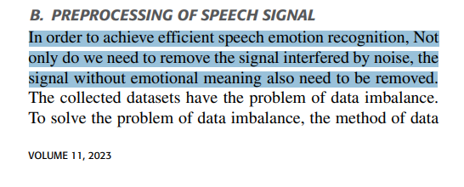
The preprocessing operations of speech signal include pre-emphasis, framing and windowing, and endpoint detection.
Pre emphasis is realized by digital filter to enhance the high-frequency part of speech.
Speech signal is divided into frames in the range of 10ms and 30ms, and the framing operation is realized through Hamming window.

Slide 10
DRAWBACKS
The problem of limited data is not solved.
Compared with emotion types in real life, Design of Efficient Speech Emotion Recognition Based on Multi Task Learning iment contains too few emotion types.
It is not enough to use acoustic modal only, which will cause confusion of different emotions.

Slide 11
TITLE: Hybrid LSTM-Transformer Model for Emotion Recognition From Speech Audio Files
Author: Felicia Andayani; Lau Bee Theng; Mark Teekit Tsun; Caslon Chua
Volume: 10
Publisher: IEEE
Year: 2022

Slide 12
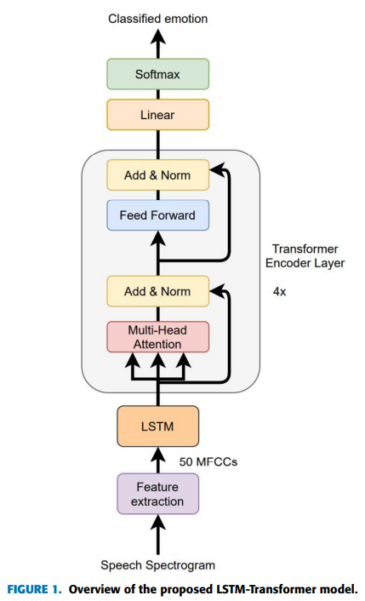
DRAWBACKS
The Transformer’s weakness is that
it loses sequential information of its
position and needs to re-compute the
entire history in the context window at
each time step.

Slide 13
PROPOSED WORK
Proposed system includes the following steps
Inputting the audio signal
Feature extraction
Feature enhancement
Classifier training
Emotion detection
MFCC-Feature extraction- Extract the desirable features to extract emotion (Loudness,pitch,energy,rhythm,Zero crossing rate)

Slide 14
The audio signal input is preprocessed before feature extraction to remove unwanted noise signal
The features are extracted using MFCC technique .Other techniques are LPC and PLP.
Classification is performed which maps the features to emotion.
Deep learning algorithm CNN is used for classifying the emotions which shows larger learning rate.

Slide 15
INPUT
DATASET
The Ryerson Audio-Visual Database of Emotional Speech and Song (RAVDESS) and SAVEE dataset
LIBRARIES
librosa==0.6.2
matplotlib==2.2.3
numpy==1.15.1
pandas==0.23.4
torchvision==0.2.1
wave==0.0.2
pyaudio==0.2.11

Slide 16
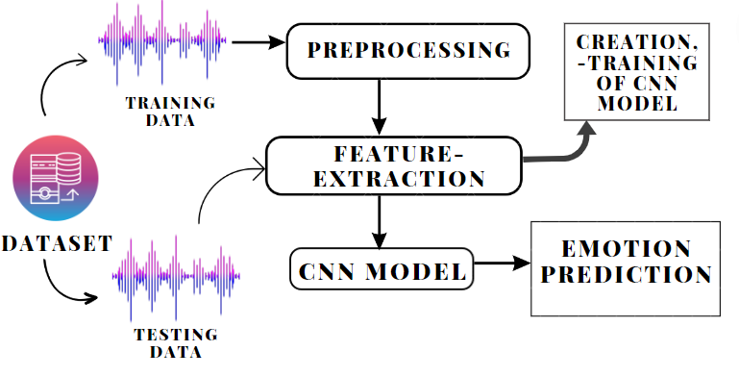
ARCHITECTURE DIAGRAM

Slide 17
OUTPUT
Hence our project presents a new way to give the ability to machine to determine the emotion with the help of the human voice. It will give the machine the ability to have a 10 better approach towards having a better conversation and seamless conversation like human does.

Slide 18
PROPOSED SYSTEM ALGORITHM
Input the audio speech signals
Librosa library in Python to process and extract features from the audio files using MFCC which are widely used in automatic speech and speaker recognition.
Process the signal in the frequency domain through the (Fast) Fourier Transform
Use windowed samples to get accurate representations of the frequency content of the signal at different points in time
Cntd…

Slide 19
We pass an input audio to the first convolutional layer. The convoluted output is obtained as an activation map.
The output is then generated through the output layer and is compared to the output layer for error generation.

Slide 20
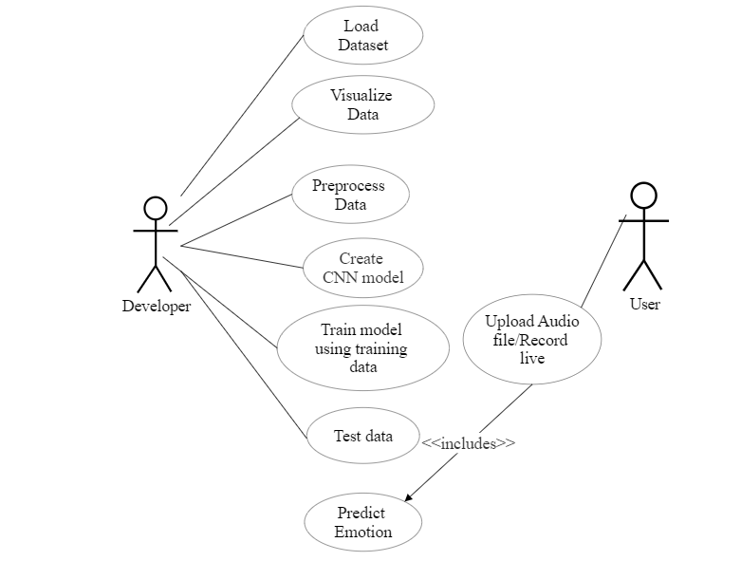
Use Case Diagram

Slide 21
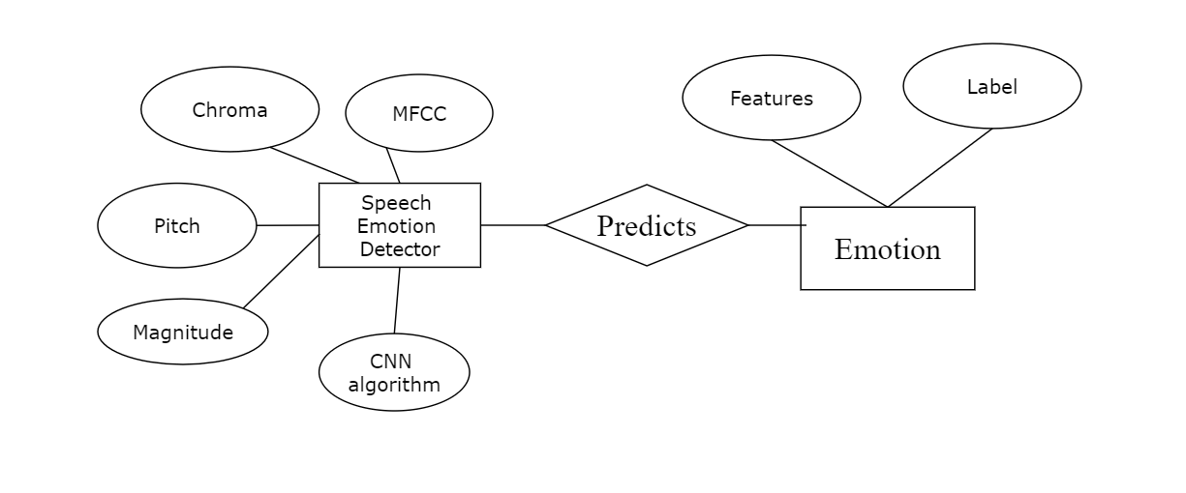
ER Diagram

Slide 22
Modules
Data preprocessing
Data Visualization
Feature extraction
Model Creation
Training and Evaluation
Test set Prediction
Deployment

Slide 23
Module Description
Data Preprocessing
Data preprocessing is required tasks for cleaning the data and making it suitable for a machine learning model which also increases the accuracy and efficiency of a machine learning model.It involves below steps:
Getting the dataset
Importing libraries
Importing datasets
Finding Missing Data
Encoding Categorical Data
Splitting dataset into training and test set
Feature scaling
Librosa and TorchAudio (Pytorch) are two Python packages that used for audio data pre-processing.

Slide 24
Data Visualization
Data visualization is defined as a graphical representation that contains the information and the data.
By using visual elements like charts, graphs, and maps, data visualization techniques provide an accessible way to see and understand trends, outliers, and patterns in data.
Data Visualization Libraries used are
Matplotlib
Plotly
It is definitely faster to gather some insights from the data using data visualization rather than just studying a chart.
Data Visualization provides a perspective on data by showing its meaning in the larger scheme of things

Slide 25
Feature Extraction
To train any statistical model, we need to first extract useful features from an audio signal.
Audio feature extraction is a necessary step in audio signal processing, which is a subfield of signal processing. It deals with the processing or manipulation of audio signals. It removes unwanted noise and balances the time-frequency ranges by converting digital and analog signals. It focuses on computational methods for altering the sounds.
Deep Learning approach considers unstructured audio representations such as the spectrogram or MFCCs.
Other features extracted are Magnitude, Pitch, Chroma

Slide 26
REFERENCES
[1] LIU YUNXIANG AND ZHANG KEXIN “Design of Efficient Speech Emotion Recognition Based on Multi Task Learning”,vol. 11,Jan. 2023.
[2] JENNIFER SANTOSO 1 , TAKESHI YAMADA 1 , (Member, IEEE), KENKICHI ISHIZUKA2 ,et al“Speech Emotion Recognition Based on Self-Attention Weight Correction for Acoustic and Text Features”,vol 10,Nov 2022.
[3] FELICIA ANDAYANI 1 , LAU BEE THENG1 et al “FELICIA ANDAYANI 1 , LAU BEE THENG1”,vol 11,March 2022.
[4] Qiuju Zhang, Hongtao Zhang, Keming Zhou, and Le Zhang,” Developing a Physiological Signal-Based, Mean Threshold and Decision-Level Fusion Algorithm (PMD) for Emotion Recognition”,vol28,2023

Slide 27
THANK YOU

