Slide 1
BY: Yamini Suru
KEYLOGGER AND SECURITY
3/21/2024 Annual Review

Slide 2

Keylogger and Security A keylogger is a software or hardware tool that records the keys pressed on a computer keyboard, often without the user's knowledge or consent. This allows a person to monitor and potentially gain access to sensitive information, such as passwords and login credentials.
3/21/2024 Annual Review

Slide 3


AGENDA 1. Problem Statement A high-level look at our proposed solution 2.Project Overview We'll define the key challenge we're aiming to solve. 3..End User Needs Highlighting the unique advantages of our approach. 4.Value Proposition Highlighting the unique advantages of our approach. 5.Our solution and modelling Outline the solution and analytical models
3/21/2024 Annual Review

Slide 4

PROBLEM STATEMENT Develop a keylogger to monitor and record keystrokes on a computer system to analyze user behavior, enhance security, and detect unauthorized access, while ensuring compliance with ethical guidelines and legal regulations.
3/21/2024 Annual Review

Slide 5

PROJECT OVERVIEW Key features: Capture key presses, holds, and releases.Log data in text and JSON files.Simple GUI for starting and stopping the keylogger. Technologies: Python, Tkinter, Pynput, JSON. Educational Goals: Learn keylogging mechanics and GUI development.Understand ethical considerations.
3/21/2024 Annual Review

Slide 6

WHO ARE THE END USERS?
Small Businesses
Our solution is tailored to the needs of small business owners who struggle with security issues.
Freelancers
Freelance professionals in any industry will benefit from the streamlined workflow our tool provides.
Entrepreneurs
Early-stage entrepreneurs launching new ventures can leverage our platform.
Cybersecurity Professionals Studying the behaviour of keyloggers for defensive purposes.
3/21/2024 Annual Review

Slide 7

YOUR SOLUTION AND ITS VALUE PROPOSITION
Solution:
"Implement a keylogger software that accurately captures and logs keystrokes, providing detailed insights into user activity and potential security breaches."
Value Proposition:
"Our keylogger enhances system security by detecting unauthorized access and user behavior anomalies, helping organizations protect sensitive data and ensure compliance with security policies."
3/21/2024 Annual Review

Slide 8

THE WOW IN YOUR SOLUTION
User-Friendly GUI:
Easy start/stop functionality.
Comprehensive Logging:
Saves keystrokes in both text and JSON formats.
Educational Value:
Hands-on experience in Python and GUI development.
Ethical Focus:
Promotes responsible and legal use.
Practical Applications:
Useful for cybersecurity training and ethical hacking.
Expandable:
Solid foundation for future enhancements.
3/21/2024 Annual Review
8

Slide 9
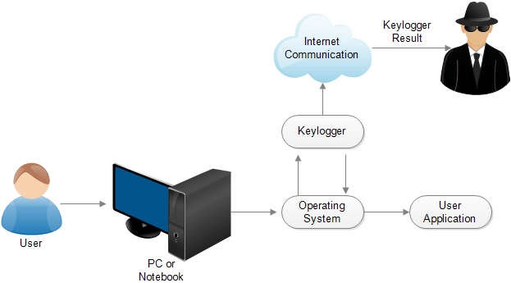
MODELLING
STEP-1: Start Keylogger
User initiates the keylogging process via the GUI.
STEP-2: Capture Keystrokes
Keystrokes are captured and categorized as pressed, held, or released.
STEP-3: Log Data
Keystroke data is saved in both text and JSON formats.
STEP-4: Stop Keylogger
User stops the keylogging process via the GUI.
3/21/2024 Annual Review
9

Slide 10
RESULTS
Effective Keystroke Logging:
-Successfully captures and logs all keystrokes, including press, hold, and release events.
-Generates comprehensive text and JSON logs for detailed analysis.
Structured Data Output:
-Text logs offer a straightforward view of keystroke activity.
-JSON logs provide structured data, facilitating advanced analysis and integration with other tools.
Practical Applications:
-Valuable tool for cybersecurity training, helping users learn how to detect and analyze keystroke patterns.
-Provides a foundation for developing more sophisticated security tools.
3/21/2024 Annual Review
10

