Slide 1
GIT
Presented By
Valameti Yamini

Slide 2
About Git
Created by Linus Torvalds, who also created Linux
Prompted by Linux-BitKeeper separation
Started in 2005
Written in Perl and C
Runs on Linux, OS X, Windows, and many other operating systems
Design goals Speed – Simplicity – Strong branch/merge support – Distributed – Scales well for large projects

Slide 3
BASIC CONCEPTS OF GIT
Git is a distributed revision control and source code management system with an emphasis on speed.
Git was initially designed and developed by Linus Torvalds for Linux kernel development.
Git is a free software distributed under the terms of the GNU General Public License version 2.

Slide 4
Advantages of Git
Free and open source - GPL’s open source license.
Fast and small
Implicit backup
Security - SHA1
No need of powerful hardware

Slide 5
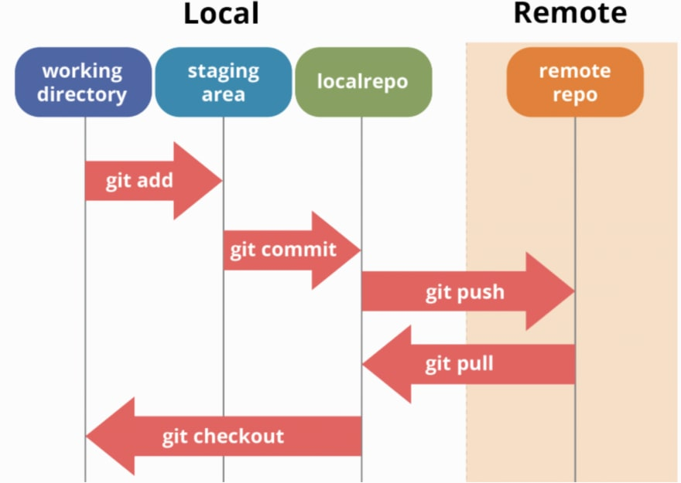
Basic workflow of Git
Step 1: You modify a file from the working directory.
Step 2: You add these files to the staging area.
Step 3: You perform commit operation that moves the files from the staging area. After push operation, it stores the changes permanently to the Git repository.

