Slide 1
Load Forecasting with Statistical and Machine Learning Models
01 Data Preprocessing
02 Data Preparation
03 Analyzing Time-Series
04 Forecast with Statistical Models
05 Forecast with Machine Learning models
06 Forecast with Deep Learning models
07 Tuning Parameters

Slide 2
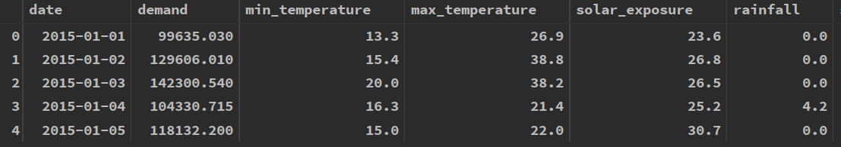
01 Data Preprocessing-Have a look at data
What does the data look like ?

Slide 3
01 Data Preprocessing-Data Cleaning
Check data type: not datetime
Type conversion: convert by pd.to_datetime()
Fill NA: interpolation
not by mean or median
Reindex: important for darts
Extract Temporal information:
Timestamp.week
Timestamp.month
Merge Columns: min_temperature and max_temperature

Slide 4
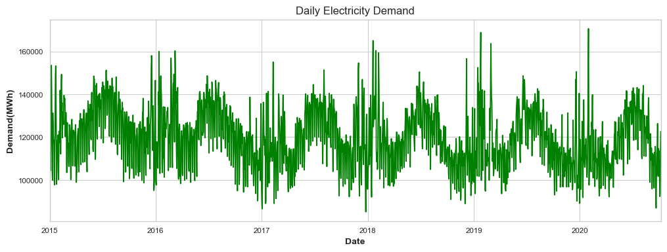
01 Data Preprocessing-Visualization

Slide 5
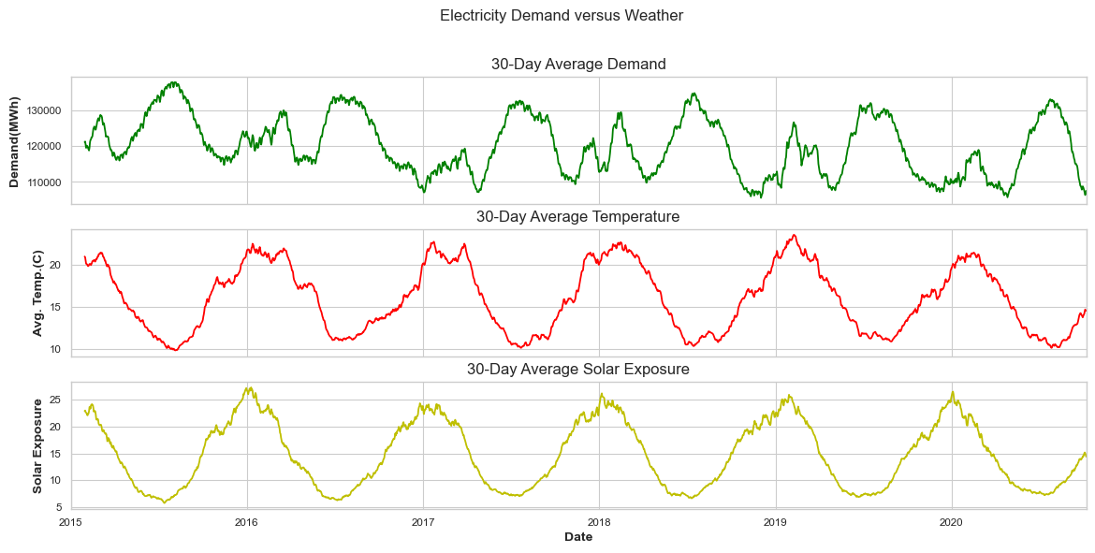
01 Data Preprocessing-Visualization

Slide 6
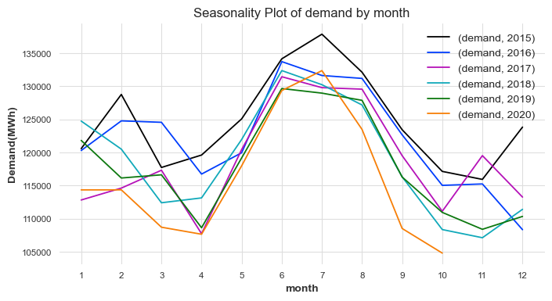
01 Data Preprocessing-Visualization

Slide 7
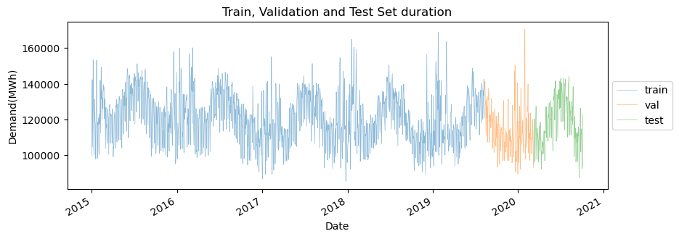
02 Data Preparation
Load to Darts:
Target: Electricity Demand
Covariates: Temperature, Rainfall, Solar Exposure
Precision conversion
float64 to float32
Train-Test Spliting

Slide 8
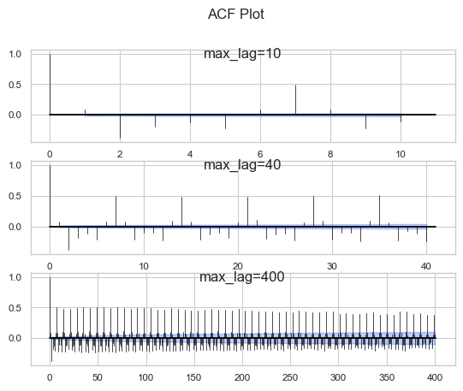
03 Analyzing Series
Statistical Test
Stationary and Trend:
ADF Test, KPSS Test
Detrend
Seasonality
ACF Plot
check_seasonality()
Heteroscedasticity
White Test

Slide 9
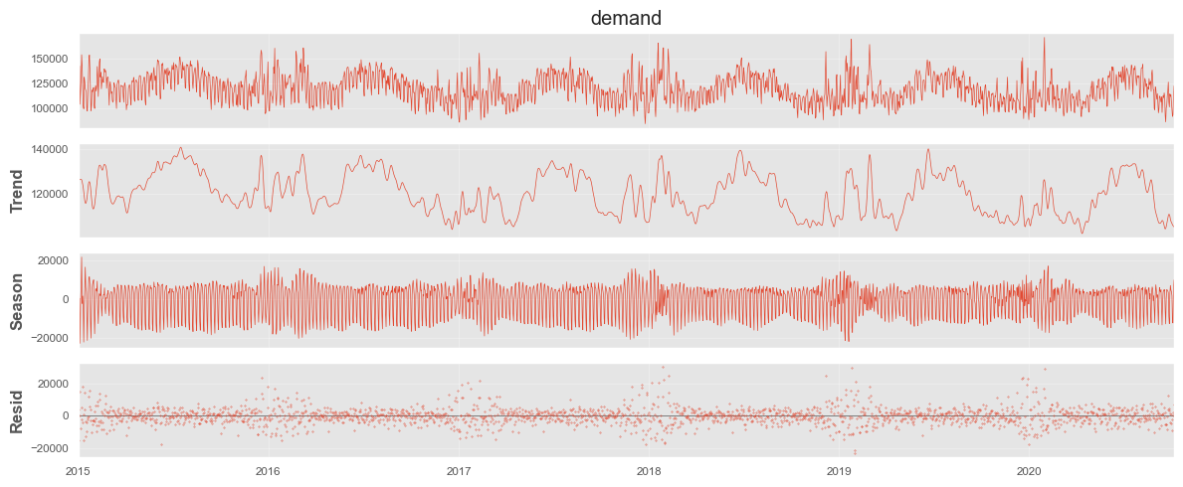
03 Analyzing Series-Decomposing
Decomposition:

Slide 10
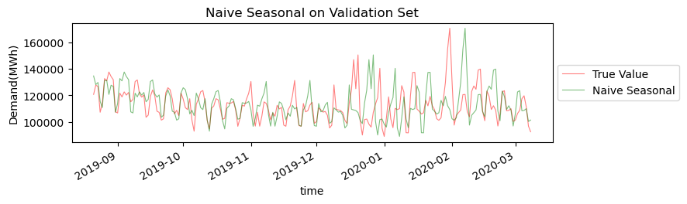
04 Forecasting with Statistical Methods
Naïve Seasonal :
Always predict with the value appeared k days ago

Slide 11
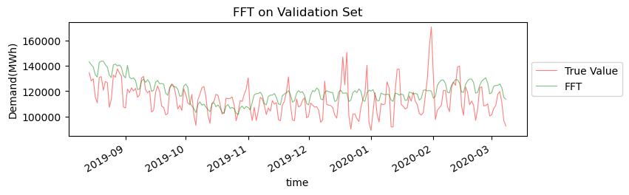
04 Forecasting with Statistical Methods
Fast Fourier Transformation :
Decompose series to frequency domain, and them transform back inversely.

Slide 12
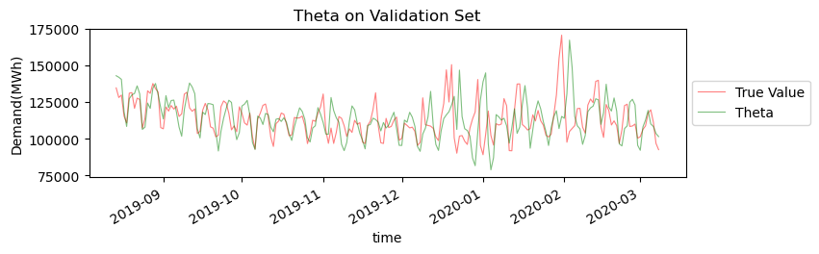
04 Forecasting with Statistical Methods
Theta Method:
Parameters: theta
How to find values for theta?
Cross-validation
ARIMA:
Auto-regression + Moving Average
Parameters: p, d, q
Very slow
How to find values for p, d, q ?
Statistical Test
Cross-validation
Variates:
Auto-ARIMA
Seasonal-ARIMA

Slide 13
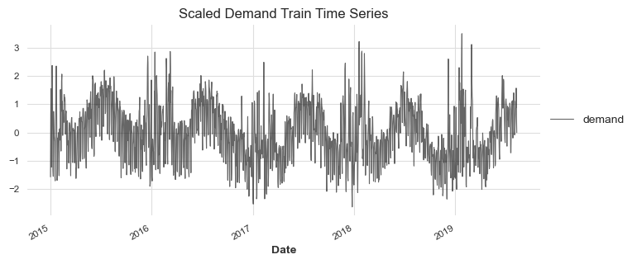
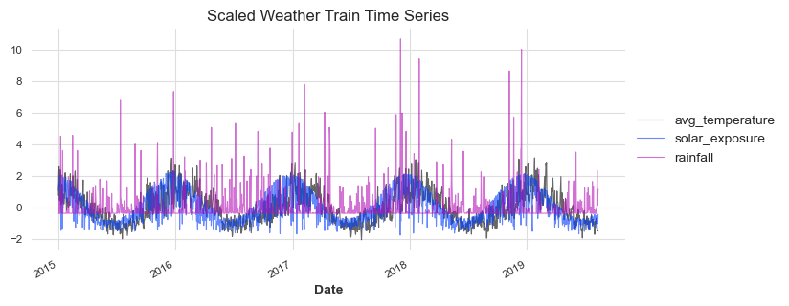
05 Forecasting with ML
Data Transformation:
target: standardization
input: standardization
Covariates:
future covariates
past covariates
static covariates
Output chunk
Horizon
if horizon <= output
No worries
one-shot prediction
horizon >= output
auto-regressive prediction

Slide 14
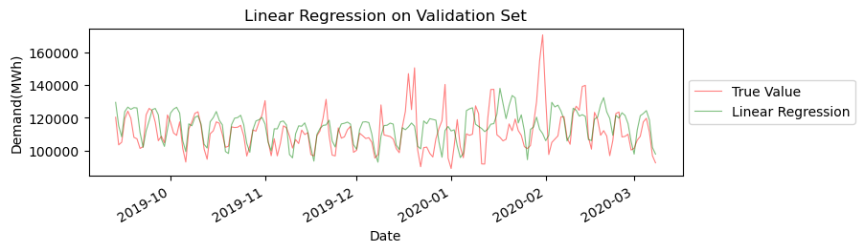
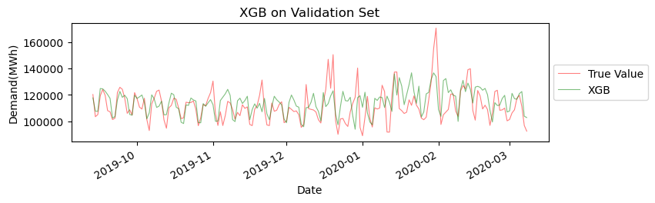
05 Forecasting with ML
Linear regression:
XG BOOST:

Slide 15
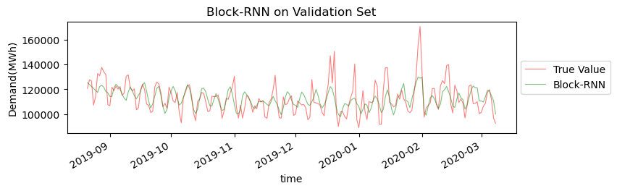
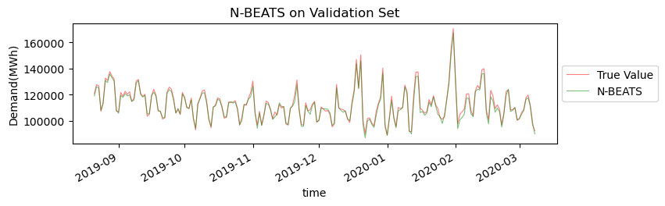
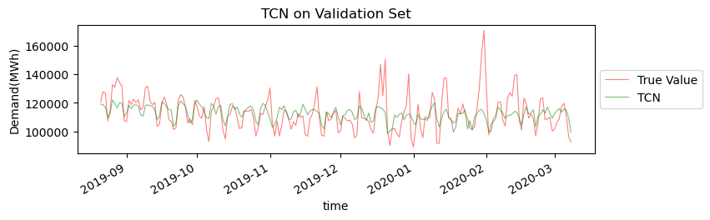
06 Forecasting with DL
LSTM
updated version of RNN
memory cell controlled by forget gate, input gate, output gate
N-BEATS
not based on RNN
can learn seasonality and trend
accept covariates
TCN
Apply 1-dim CNN for forecast

Slide 16
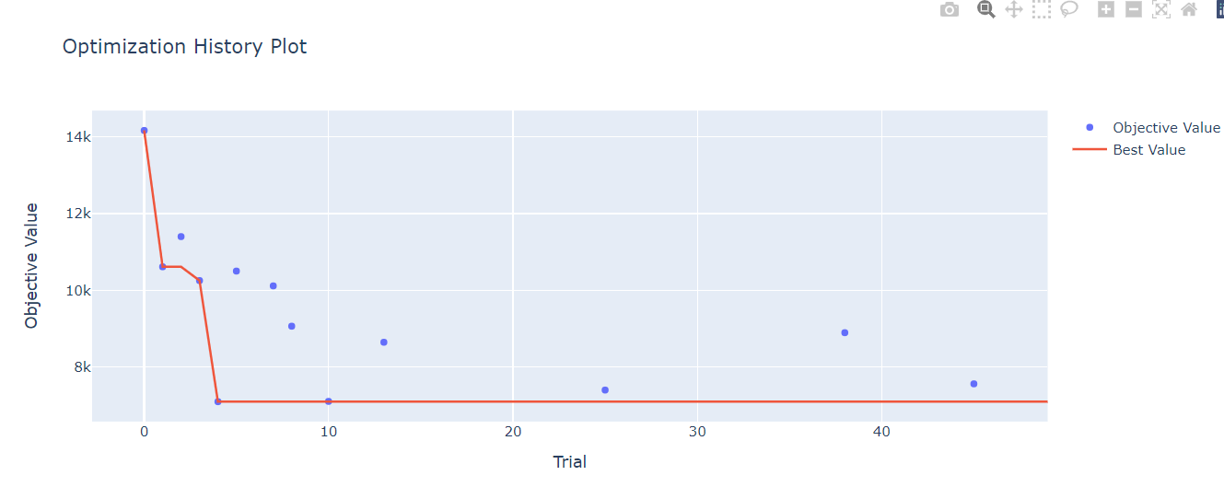
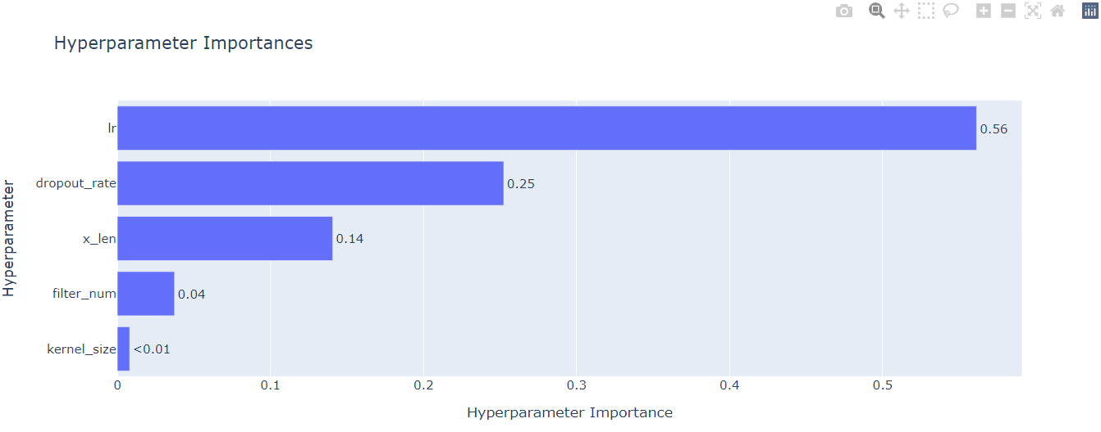
07 Tuning with Optuna
Grid search
Too slow
Random search
Too much randomness
low efficiency
Bayes search
Apply bayes optimization to search large space
have ‘directions’ to search

