Slide 1
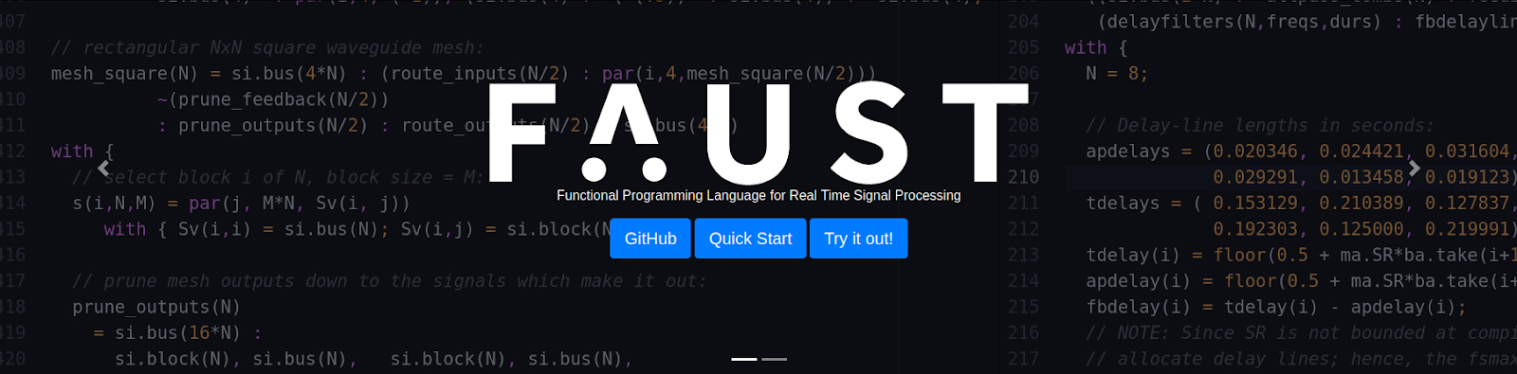
Building a Synth (plugin) in Faust
Tim-Tarek Grund
Gonzalo Gallo Robador

Slide 2
Introduction

Slide 3
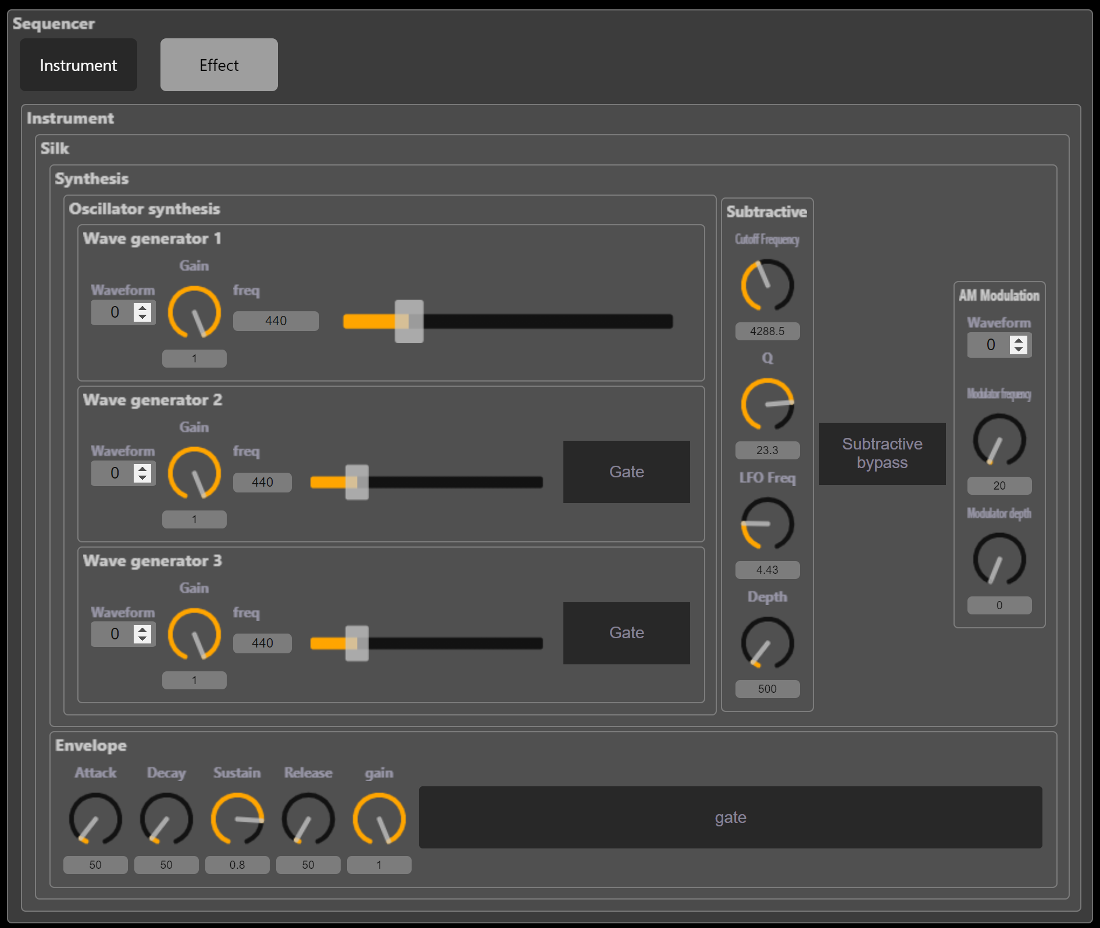
The synth
3 wave generators. Different waveforms:
Sine
Triangle
Square
Sawtooth
Subtractive filter
AM Modulation
Envelope
Zita reverb

Slide 4
Background
Goal: Using faust to create a plug-in and instrument to use in Logic Pro X
Problem: Logic Pro X only supports AudioUnit format
Multiple Approaches:
faust2au ❌ didn‘t work for us
faust2juce -> juce ✅ worked
faust2cpp (engine) -> juce/ build yourself ✅ kind of worked
faust2vst(i) -> metaplugin ✅ worked
Different results!

Slide 5
Demo
Walkthrough

Slide 6
Workflows
Comparison of faust2vst and faust2juce

Slide 7
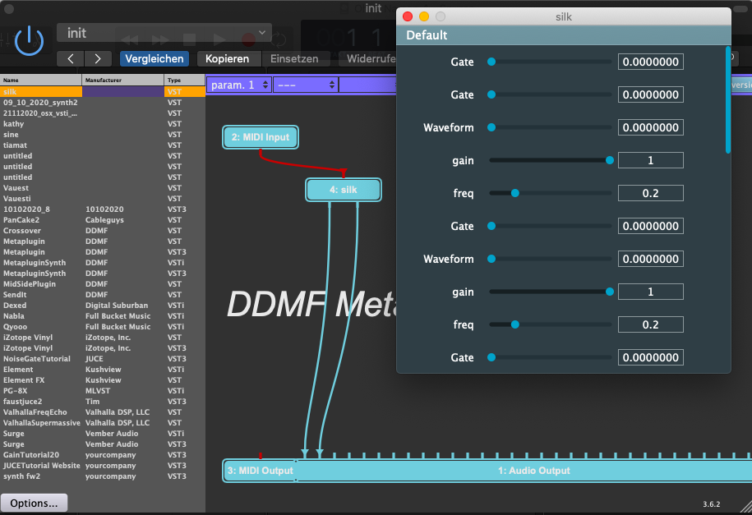
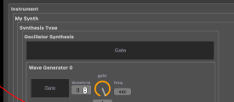
faust2vst -> -metaplugin
The plug-in within
a wrapper
within a DAW
Big drawback:
All GUI parameters are sliders (No knobs, checkboxes, etc.)
For comparison:

Slide 8
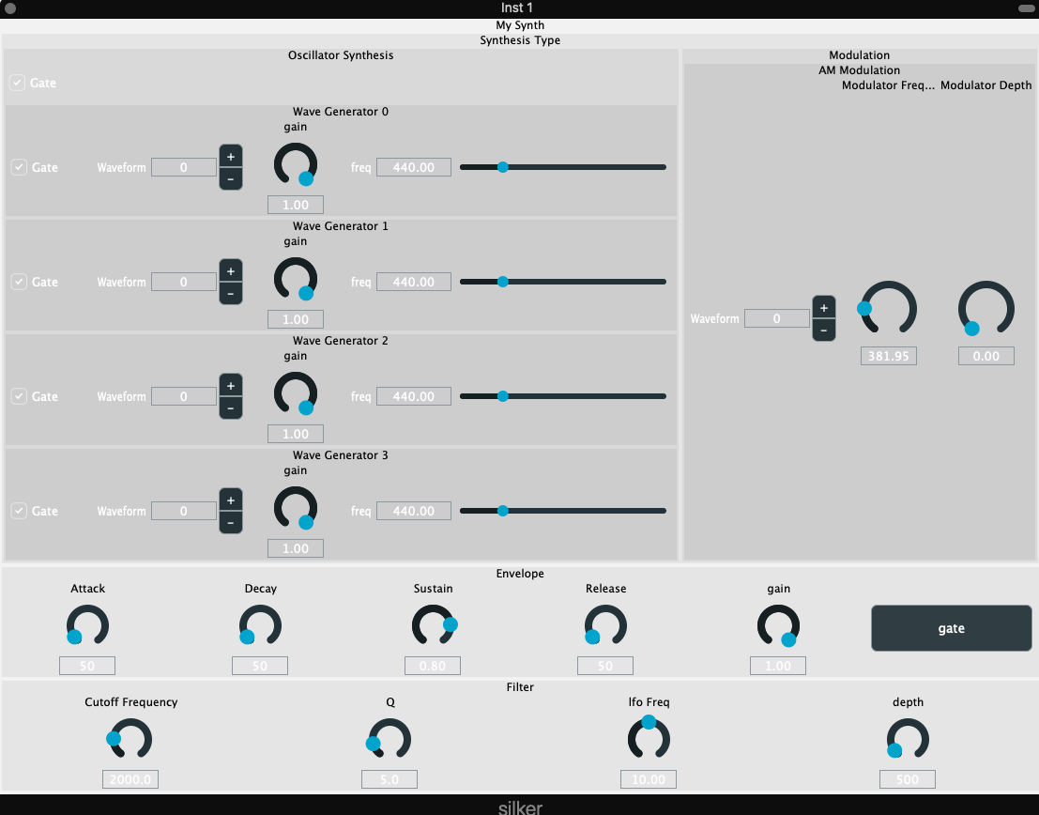
faust2juce

Slide 9
faust2vst -> -metaplugin: Fazit
PRO | CONTRA
Moving very fast from faust code to plug-in | No midi support
No additional programming needed | Layout very counter intuitive
No additional programming knowledge needed | MIDI Mapping not possible
No need to install additional requirements | GUI-slider range of values [0, 1]
 | Only GUI-slider elements
Applications of this workflow:
- Effect-plugins (vst instead of vsti), (No MIDI needed)
- One-Slider instruments
- Drones
- Sounddesign

Slide 10
faust2juce: Fazit
PRO | CONTRA
Aesthetically pleasing ☺ | Still no MIDI support, but probably fixable using juce
Limited amount of understanding of code needed in general | More amount of coding knowledge needed than for faust2vst
Intuitive GUI (faust) (& actual GUI elements) | A lot of things can go wrong
Midi-Mapping possible! | Very discouraging workflow
 | Need of installation (and a little understandin)g of JUCE
 | Takes more time than faust->vst
Applications of this workflow:
- Building performable instruments
- Build understanding of how plug-ins and plug-in environments work during workflow

Slide 11
Thank you!

