Slide 1

Executive Overview and Key Performance Indicators
Quarterly Business Review 2026-Q2
$1.28B
+4.5%
49.8
Total Revenue
QoQ Growth
Average NPS
EXECUTIVE SUMMARY
NovaRetail delivered $1.28B in total revenue for 2026-Q2, achieving +4.5% QoQ growth and an average NPS of 49.8. APAC led growth at +8.2%, while Latin America declined -6.7%. Latin America presents significant operational and customer experience risks requiring immediate intervention.
NovaRetail Quarterly Business Review — Capstone Template
1

Slide 2
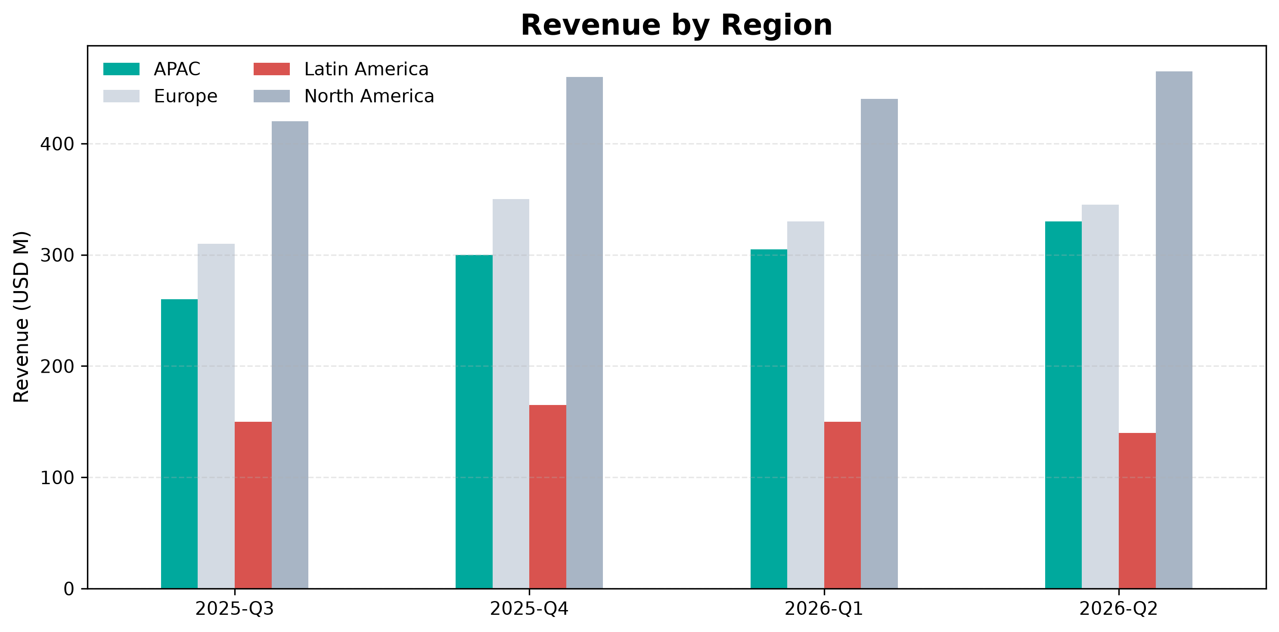

Regional Revenue Performance and Growth Trends
• APAC led regional growth at 8.2 percent with 330 million dollars in revenue.
• North America remained the largest revenue contributor at 465 million dollars.
• Europe achieved steady growth of 4.5 percent with 345 million dollars in revenue.
• Latin America underperformed as the only region with a revenue decline of 6.7 percent.
NovaRetail Quarterly Business Review — Capstone Template
2

Slide 3
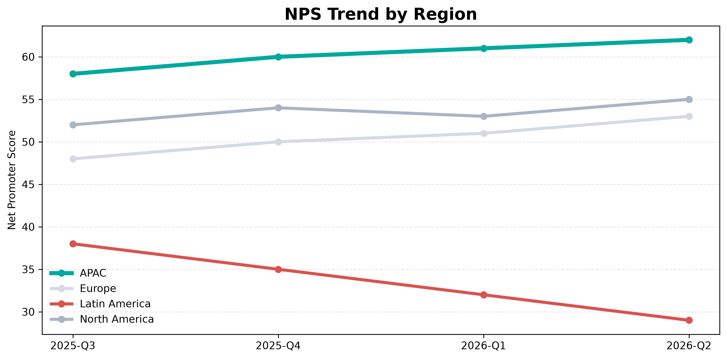

Customer Experience Varies Significantly Across Regions
• APAC achieved the highest customer satisfaction score at 92 percent and an NPS of 62.
• Latin America lagged significantly with an NPS of 29 and a low CSAT of 74 percent.
• Average delivery times reached 7.5 days in Latin America compared to 2.2 days in APAC.
• Support ticket volume peaked in Latin America at 31 thousand tickets during 2026-Q2.
NovaRetail Quarterly Business Review — Capstone Template
3

Slide 4
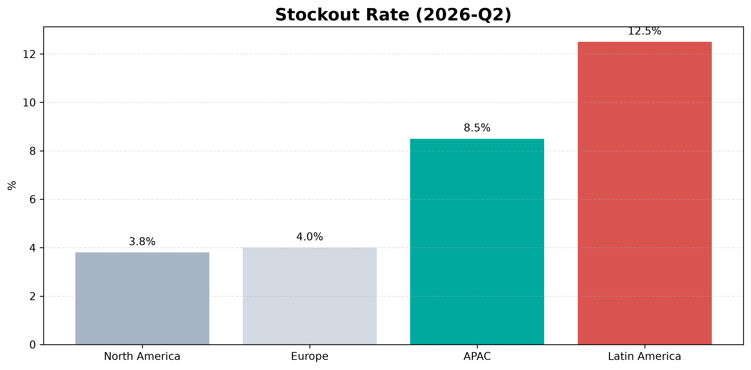

Operational Risks Highlight Critical Regional Vulnerabilities
• Latin America exhibited the highest operational risk with a stockout rate of 12.5 percent.
• Return processing time in Latin America extended to 10 days compared to 4 days elsewhere.
• Fraud incidents were highest in Latin America at 30 incidents during 2026-Q2.
• APAC warehouse capacity utilization reached 92 percent, indicating emerging capacity pressure.
NovaRetail Quarterly Business Review — Capstone Template
4

Slide 5

Recommended Actions & Next Steps
• Address operational failures in Latin America to reduce the 12.5 percent stockout rate.
• Improve logistics performance in Latin America to lower delivery times from 7.5 days.
• Expand warehouse capacity in APAC to manage high utilization of 92 percent.
• Enhance fraud prevention controls to mitigate the 30 incidents reported in Latin America.
Prioritize operational stabilization in Latin America and capacity expansion in APAC.
NovaRetail Quarterly Business Review — Capstone Template
5

