Slide 1

Q2 2026 Executive Review
Executive Business Review
$1.28B
▲ 4.5%
49.8
Total Revenue
QoQ Growth
Average NPS
EXECUTIVE SUMMARY
Q2 revenue reached $1.28B, growing 4.5% quarter-over-quarter. APAC led performance with 8.2% revenue growth and the strongest customer metrics. Latin America remains the key concern due to declining revenue, weak customer experience, and elevated operational risk.
NovaRetail Quarterly Business Review — Capstone Template
1

Slide 2
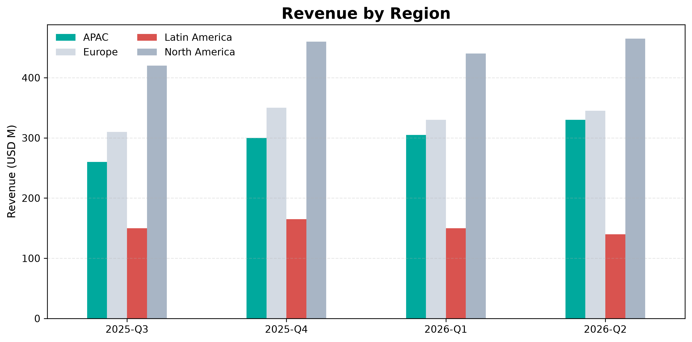

APAC Accelerates While Latin America Continues to Contract
• APAC was the fastest-growing region (+8.2%).
• North America remained the largest revenue contributor ($465M).
• Europe maintained stable revenue growth and profitability.
• Latin America declined 6.7% amid rising returns and service issues.
NovaRetail Quarterly Business Review — Capstone Template
2

Slide 3
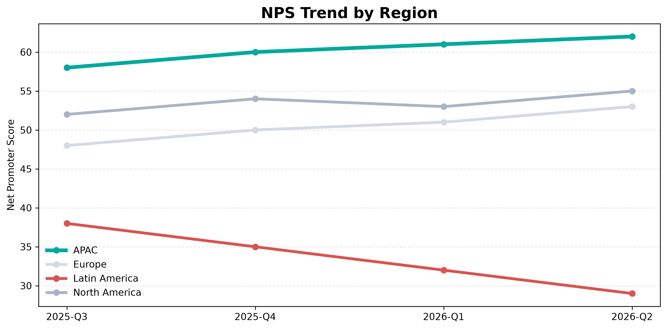

Customer Experience Improves Everywhere Except Latin America
• APAC led customer experience with NPS 62 and CSAT 92%.
• Europe improved consistently, reaching NPS 53.
• North America maintained strong satisfaction and delivery performance.
• Latin America fell to NPS 29 with delivery delays of 7.5 days.
NovaRetail Quarterly Business Review — Capstone Template
3

Slide 4
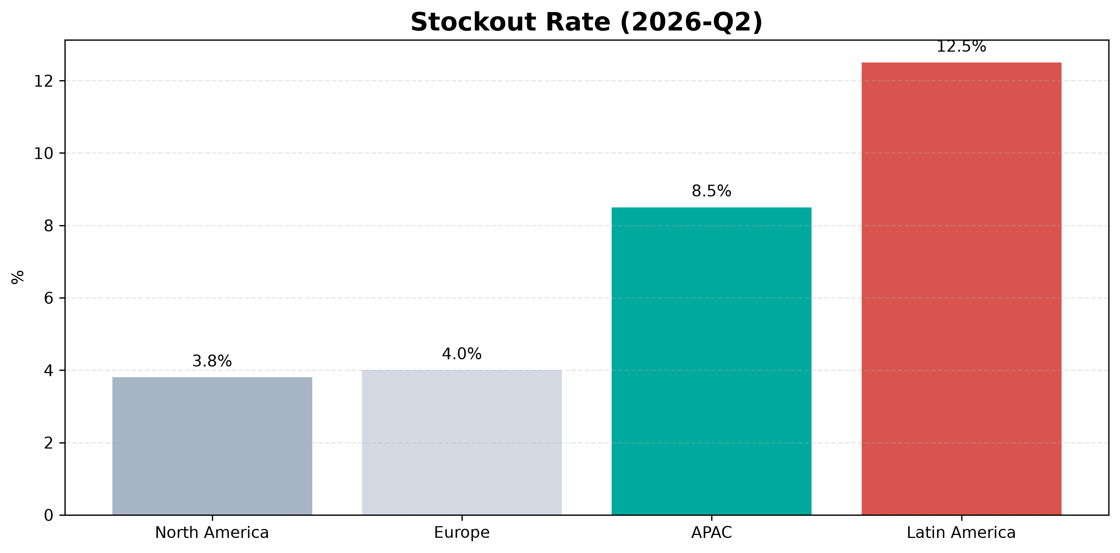

Latin America Deteriorates as APAC Capacity Tightens
• Latin America recorded the highest stockout rate at 12.5%.
• Fraud incidents in Latin America increased to 30.
• Return processing time reached 10 days in Latin America.
• APAC warehouse utilization reached 92%, creating capacity pressure.
NovaRetail Quarterly Business Review — Capstone Template
4

Slide 5

Recommended Actions & Next Steps
• Stabilize inventory and fulfillment operations in Latin America.
• Reduce fraud exposure and accelerate returns processing.
• Expand APAC warehouse capacity before demand exceeds limits.
• Protect customer satisfaction through operational excellence.
Prioritize Latin America recovery while investing ahead of APAC growth.
NovaRetail Quarterly Business Review — Capstone Template
5

