Slide 1
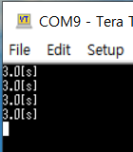
Mbed Exercise 1
Required Classes: Timer, Tick, InterruptIn, Serial (Use all of these)
You need to create codes to function as follows.
  Set the baud-rate of uart communication as 9600[bps]
  ‘count’ value should be increased by 1 for every 0.1 [sec]. Use ‘Tick’.
  If ‘count’ becomes 30, print out the time-duration(unit: [s]) of counting 30 to Tera-Term.
  Use ‘Timer’ and ‘Serial’.
  If push-button is pressed, ‘count’ and timer value should be reset. Use ‘InterruptIn’.
Result

