Slide 1
CSS Stylin’
Unit 12
The Data Bootcamp

Slide 2
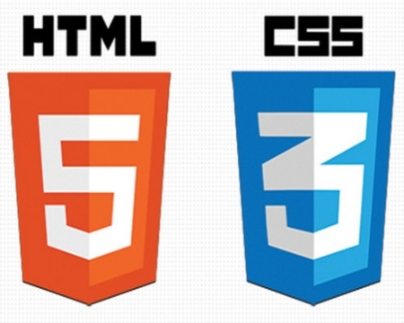

HTML / CSS Definitions (*yawn* unimportant)
HTML: Hypertext Markup Language – (Content)
CSS: Cascading Style Sheets – (Appearance)
HTML/CSS are the “languages of the web.” Together they define both the content and the aesthetics of a webpage – handling everything from the layouts, colors, fonts and content placement. (JavaScript is the third – handling logic, animation, etc.)

Slide 3


HTML / CSS Analogy
HTML Alone
Like writing papers in “Notepad.”
Can only write unformatted text.
HTML / CSS
Like writing papers in Microsoft Word.
Can format text, page settings, alignment, etc. based on “highlighting” and menu options.

Slide 4
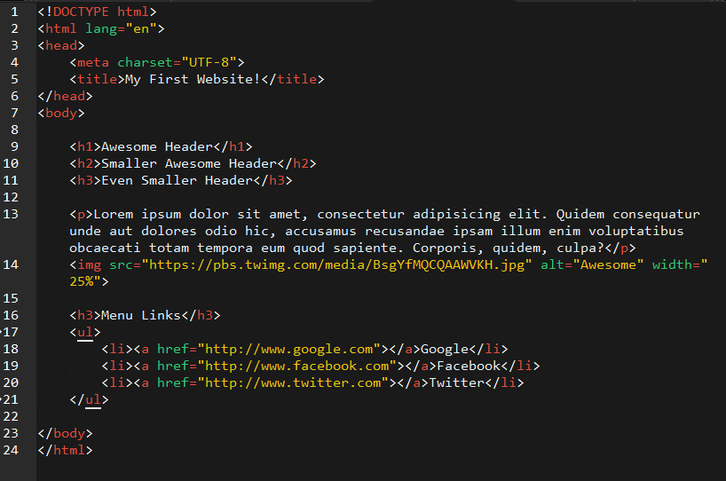
Basic HTML Page

Slide 5
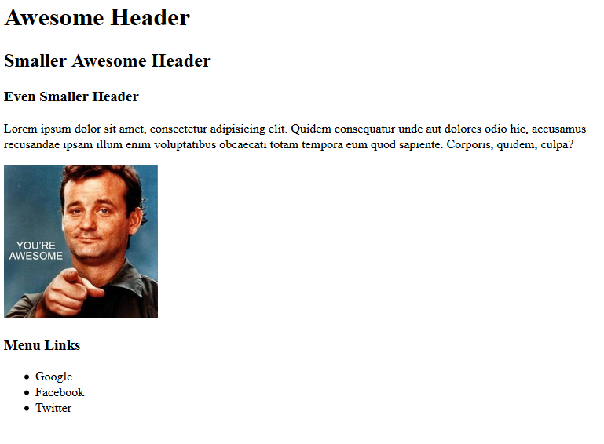
Basic HTML Page - Result

Slide 6
Basic HTML Page - Result
Boring…

Slide 7
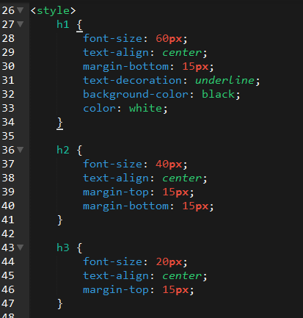
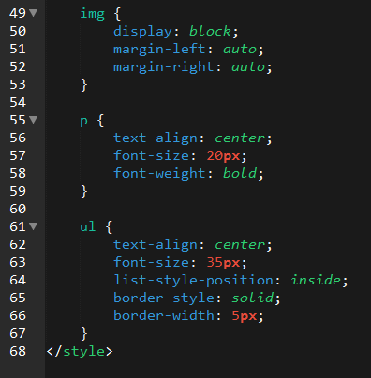
Enter CSS

Slide 8
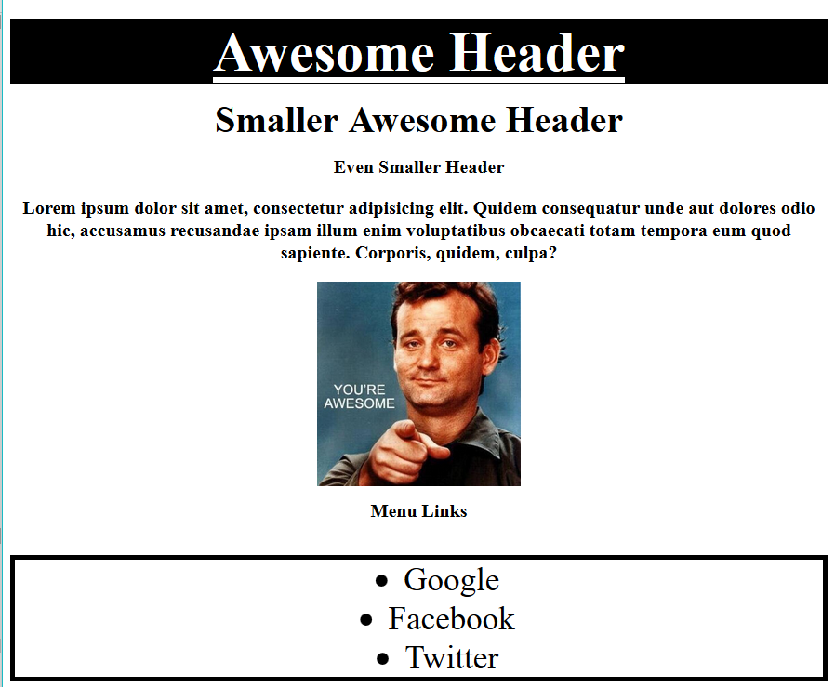
Enter CSS - Result

Slide 9
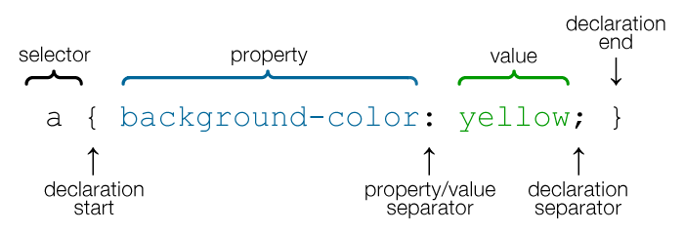
CSS Syntax
A CSS rule-set defines both the styles to be applied and the HTML elements to which they should be applied.
The selector identifies the specific HTML element(s) to style.
The declaration defines property/values to be applied.
Notes:
For example, this selector is saying that all `a` tags should have the background-color yellor.

Slide 10
Key CSS Attributes
Font / Color:
color: Sets color of text.
font-size: Sets size of the font.
font-style: Sets italics.
font-weight: Sets bold.
Alignment / Spacing:
Padding-top(bottom/left/right): Adds space between element and its own border.
margin-top (bottom/left/right): Adds space between element and surrounding elements.
float: Forces elements to the sides, centers, or tops.
Background:
background-color: sets background color.
background-image: sets background image.
Notes:
There are a ton of CSS Attributes. We don’t need to know them all. But, they can change things like…

Slide 11
INSTRUCTOR DEMO
Instructor: Demo CSS

Slide 12
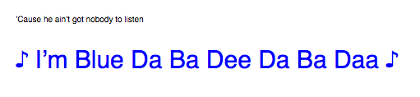
CSS Example
HTML:
<p>’Cause he ain’t got nobody to listen</p>
<p class=“bigBlue”> ♪ I’m Blue Da Ba Dee Da Ba Daa ♪</p>
CSS:
.bigBlue {
font-size: 30px;
color: blue;
}
Notes:
In this example, the second paragraph is turned blue and MUCH larger because of the CSS.
We can incorporate an element’s class or ID to apply a CSS style to a particular part of the document.
Just remember to include the necessary symbol before the CSS: “.” for class, “#” for ID.

Slide 13
Box Model

Slide 14
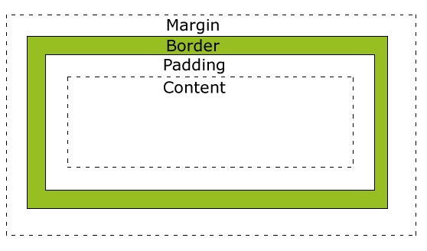
Boxes Upon Boxes
In CSS, every element rests within a series of boxes.
Each box has customizable space properties:
margin, border, and padding.
Typical spacing value: 20px 10px 10px 20px (top, right, bottom, left)
Notes:
Explain that each HTML element is bounded by a "box" that is split up into four distinct parts; Margin, border, padding, and content.
* The "margin" property determines the spacing between one HTML element and the next
* The "padding" property is used to generate space around content
* The "border" property is between the margin and the padding and is often used to create a frame around content
* Using the margin, border, and padding properties, you can position HTML elements on the page more specifically. Each property can be modified as a whole (order is top, right, bottom, left) OR you can modify the sides of an element individually.
* One at a time: `margin-top: 10px; margin-bottom: 10px;`
* All at once: `margin: 10px 20px 10px 20px;`

Slide 15
CSS Positioning

Slide 16
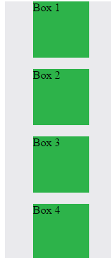
Position: Static (Default)
Four boxes placed statically (default)

Slide 17
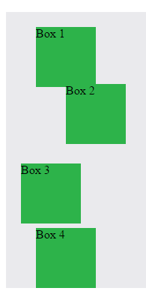
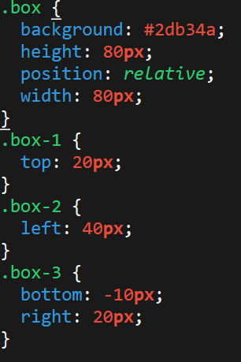
Position: Relative
Switching the boxes to relative will nudge the boxes in relation to their “original” location.

Slide 18
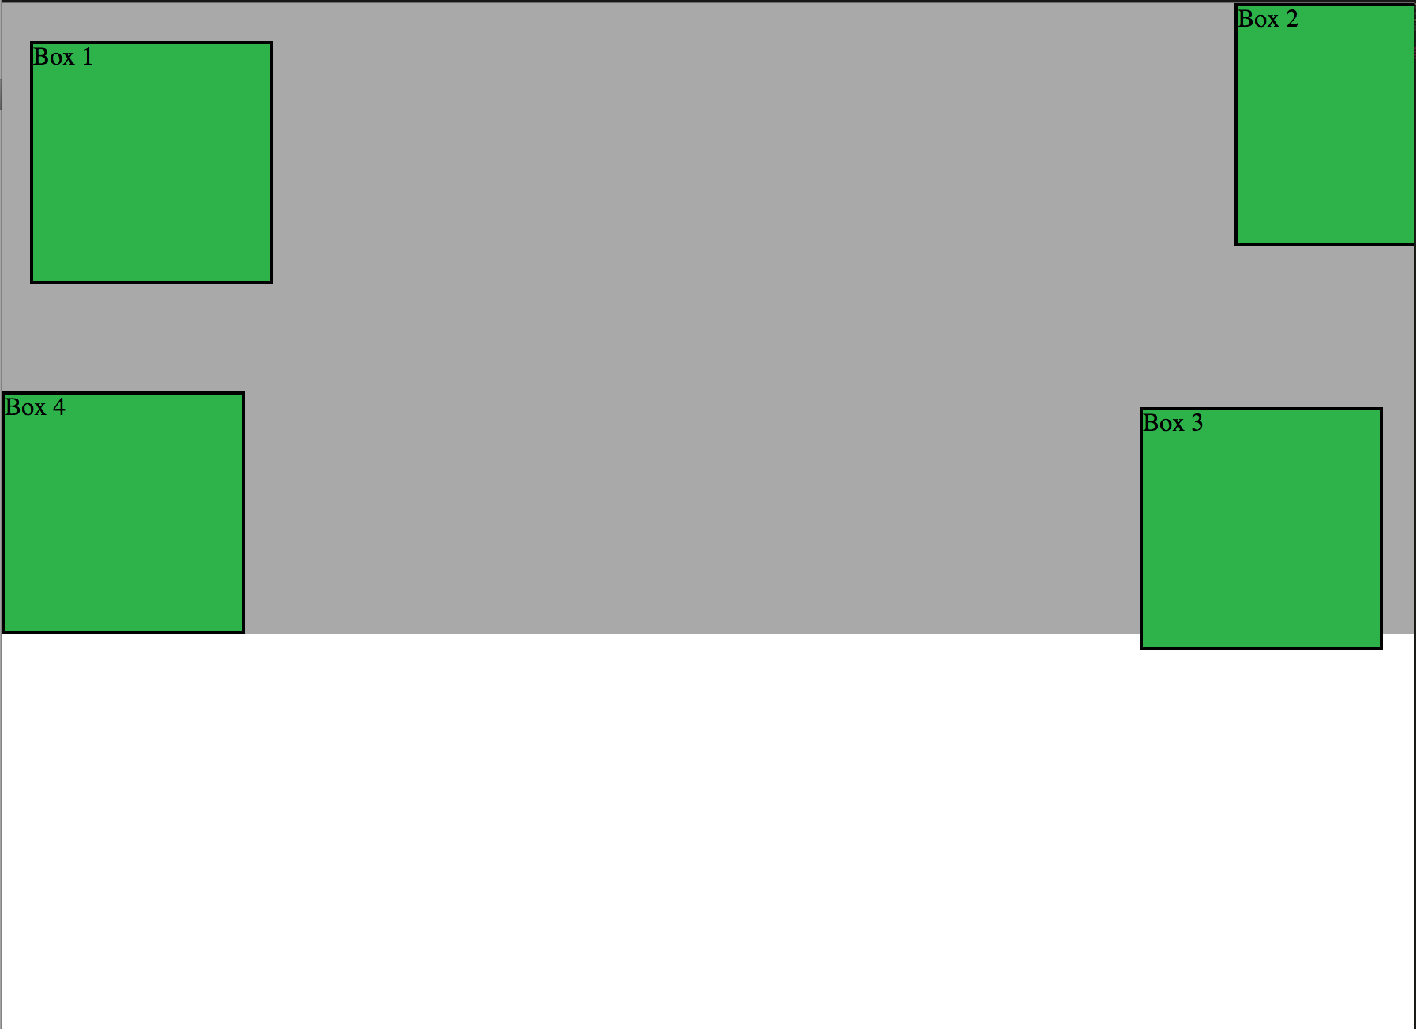
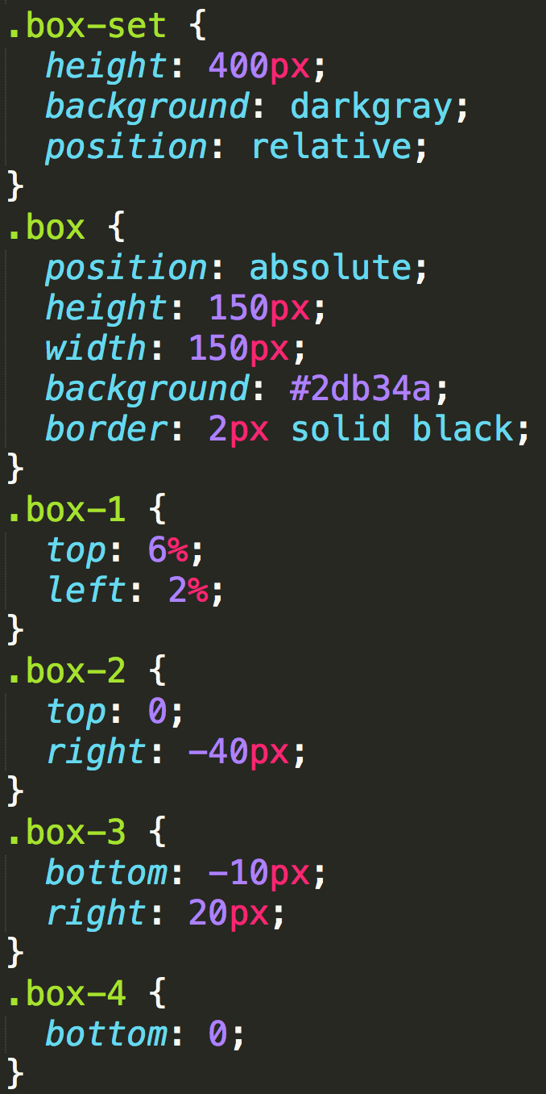
Position: Absolute
Positioned relative to nearest positioned ancestor
Notes:
An element that is positioned absolutely is taken out of the flow and thus takes up no space when placing other elements.
The absolutely positioned element is positioned relative to nearest positioned ancestor (non-static).
If a positioned ancestor doesn't exist, the initial container (body) is used.

Slide 19
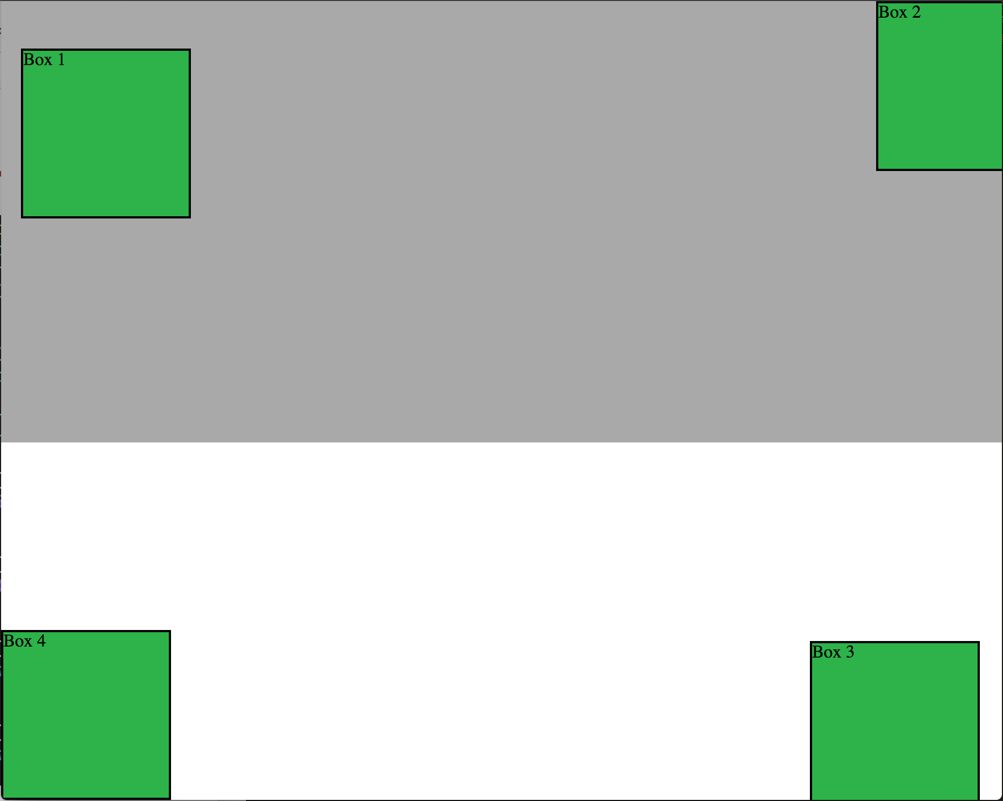
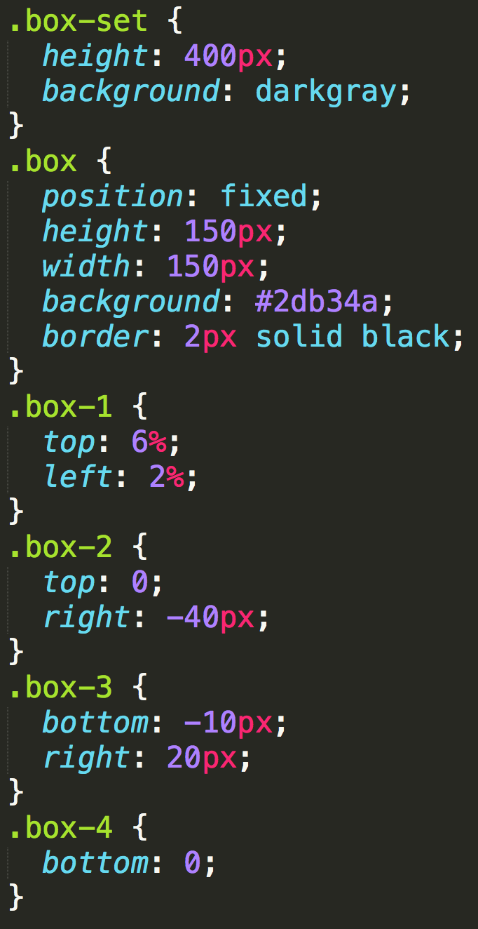
Position: Fixed
Position with exact coordinates to the browser window

Slide 20
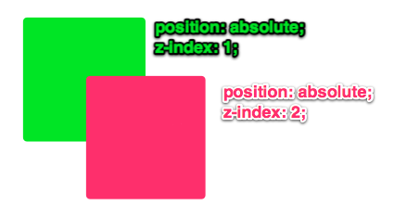
Layering with Z-Index
Z-Index allows you to layer elements on top of each other when they’re positioned.
Notes:
The elements must be positioned (any position other than static)

Slide 21
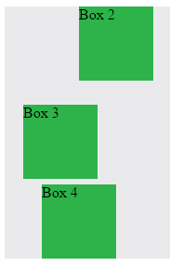

Hiding Things
“display: none;” allows us to hide elements from view.
We can use this to show/hide elements based on user input later …

Slide 22
Flow and Float

Slide 23
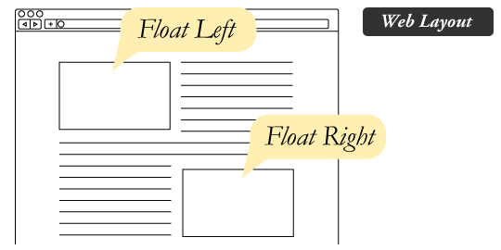
The Concept of “Flow”
By default, every HTML element displayed in the browser is governed by a concept called flow.
This means that HTML elements force their adjacent elements to flow around them.

Slide 24
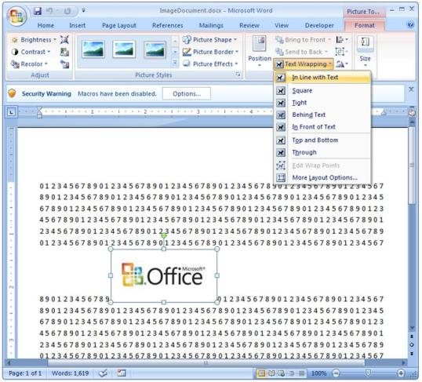
Flow Analogy to MS Word
This concept of “flow” is very similar to the wrap-text options you may be familiar with in Microsoft Word.
Just as in MS Word, you can have images in-line with text, on-top of text, etc.

Slide 25
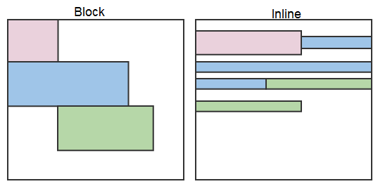
Block Elements
By default, web clients render many HTML elements as block elements. Paragraphs, headers and more receive this treatment.
A block element will take up an entire line of space—unless you intervene with CSS properties.

Slide 26
Block Elements vs. Inline Elements
Now contrast the block elements with inline elements.
By using float CSS properties, we can command our website to display multiple HTML elements adjacently.

Slide 27
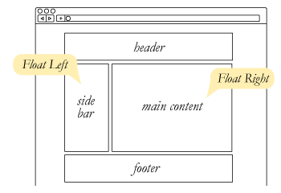
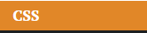
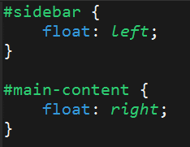
Floating
To transform these block elements into inline elements, we use a CSS property called float.
Floats are necessary for building web layouts.
Notes:
The "float" property can also be used to position elements on a page. By floating an element to the right or the left, it will be placed on either the left or right side of the page and other content will wrap around it.

Slide 28
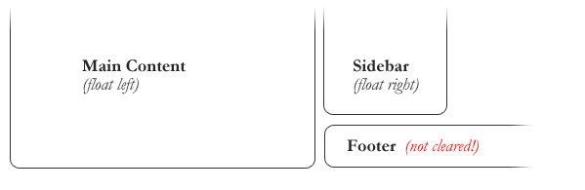
Clearing the Float
Floats often get in the way of our layouts.
Sometimes we don’t want to give each element the “inline” treatment.

Slide 29
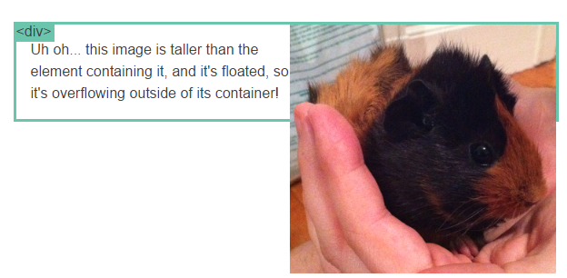
Clearfix Hack
Sometimes when elements don’t match up in size, we get situations like the above…

Slide 30
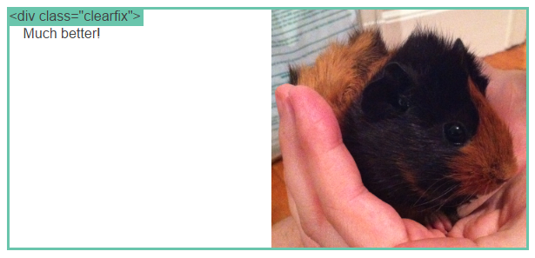
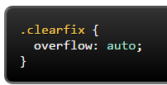
Clearfix Hack
We can get around this by using “the clearfix hack.”
By including the CSS property overflow: auto, the first element will fill up the empty parts of the flow.

