Slide 1
EXCEL INTERNAL ASSESSMENT 1
YAMUNA V
4407

Slide 2
Q1) Summary of gender and ethnicity
Used pivot table
Gender - columns
Ethnicity -rows
Count of gender - values

Slide 3
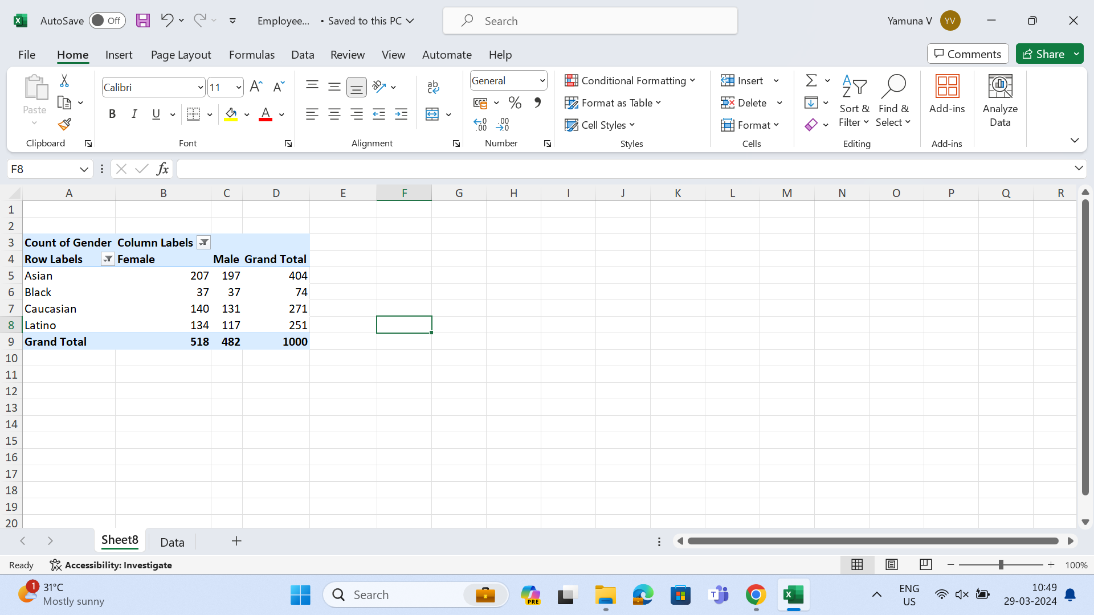

Slide 4
Q2) on average , employees stay for 4.87 years

Slide 5
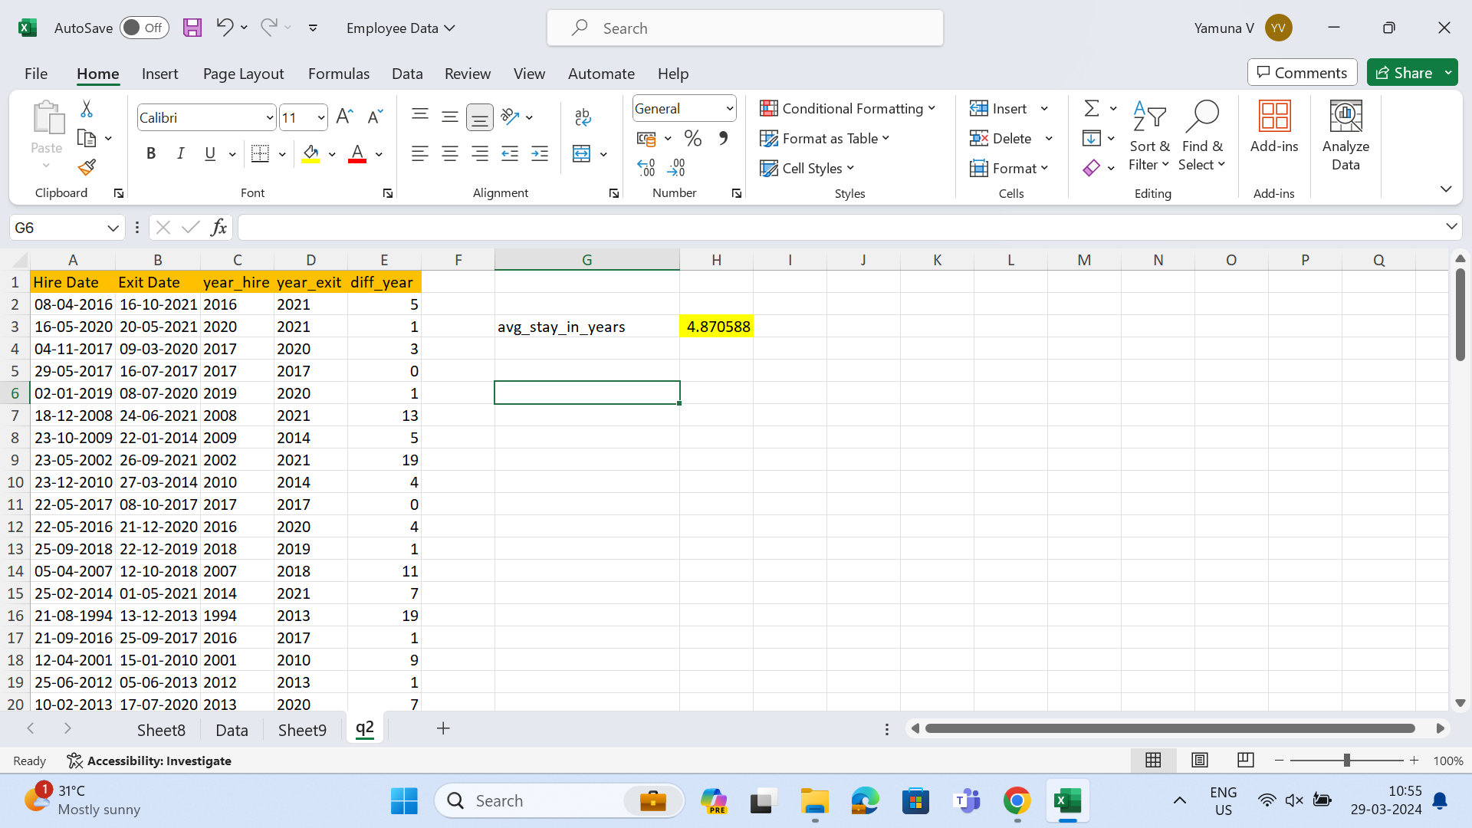

Slide 6
Q3) no significant difference in average salary

Slide 7
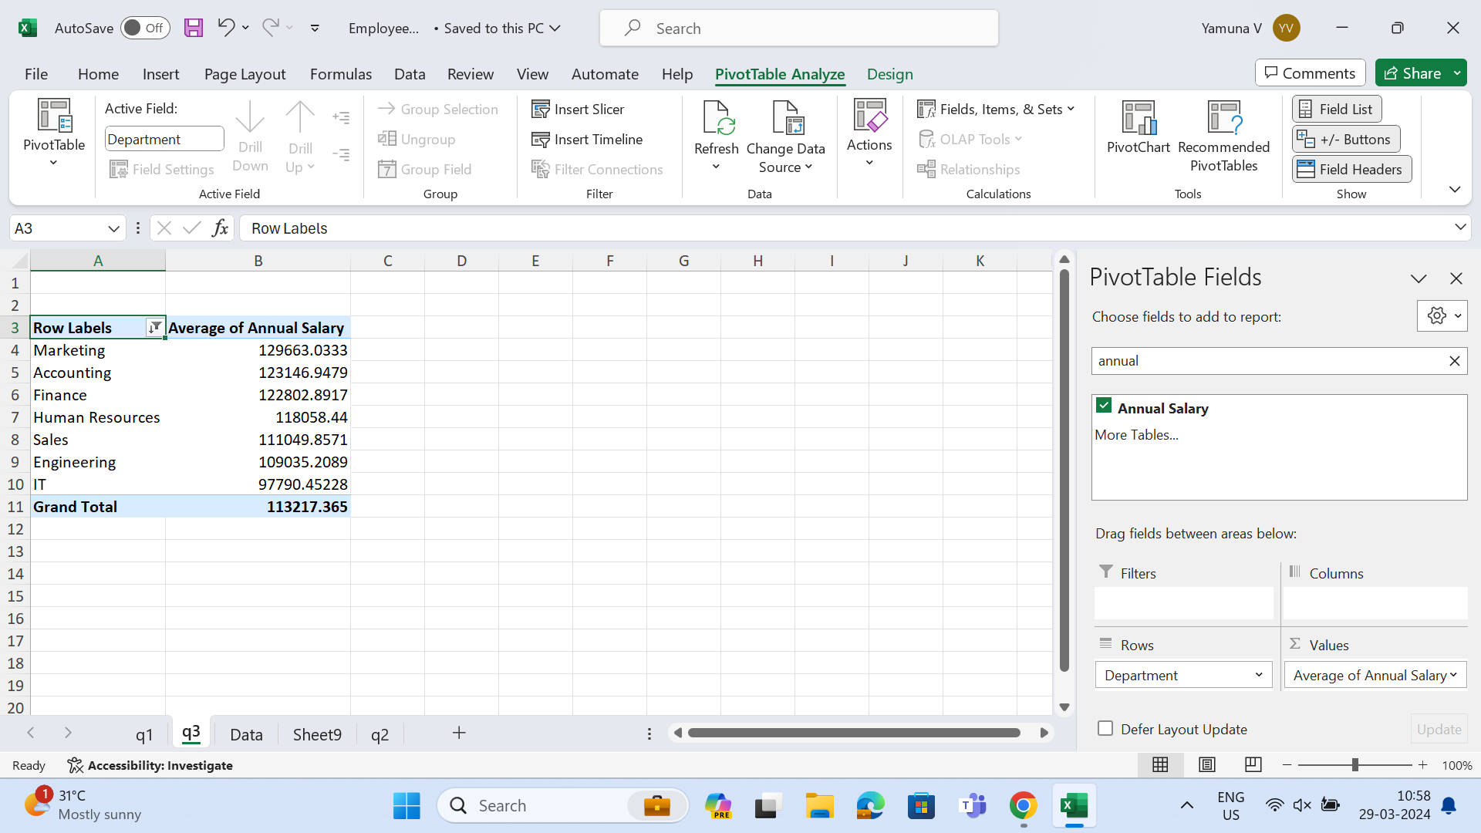

Slide 8
Q4) highest number
united state =643

Slide 9
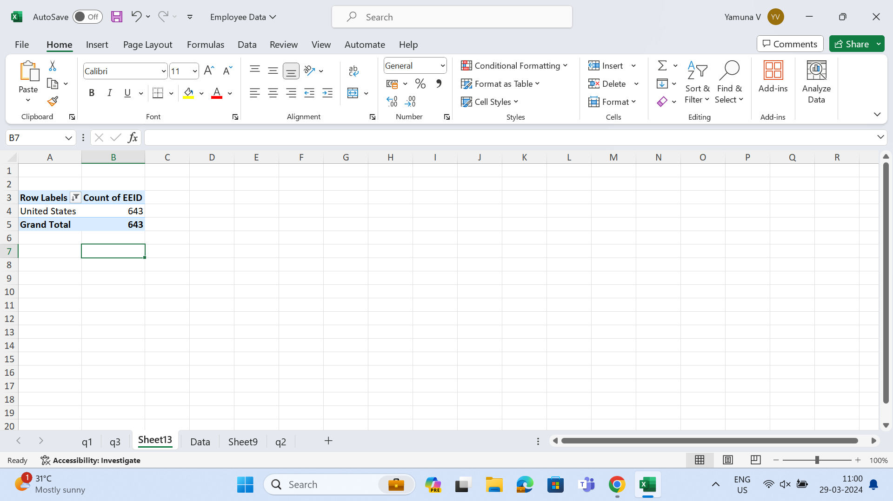

Slide 10
Q5) common age range

Slide 11
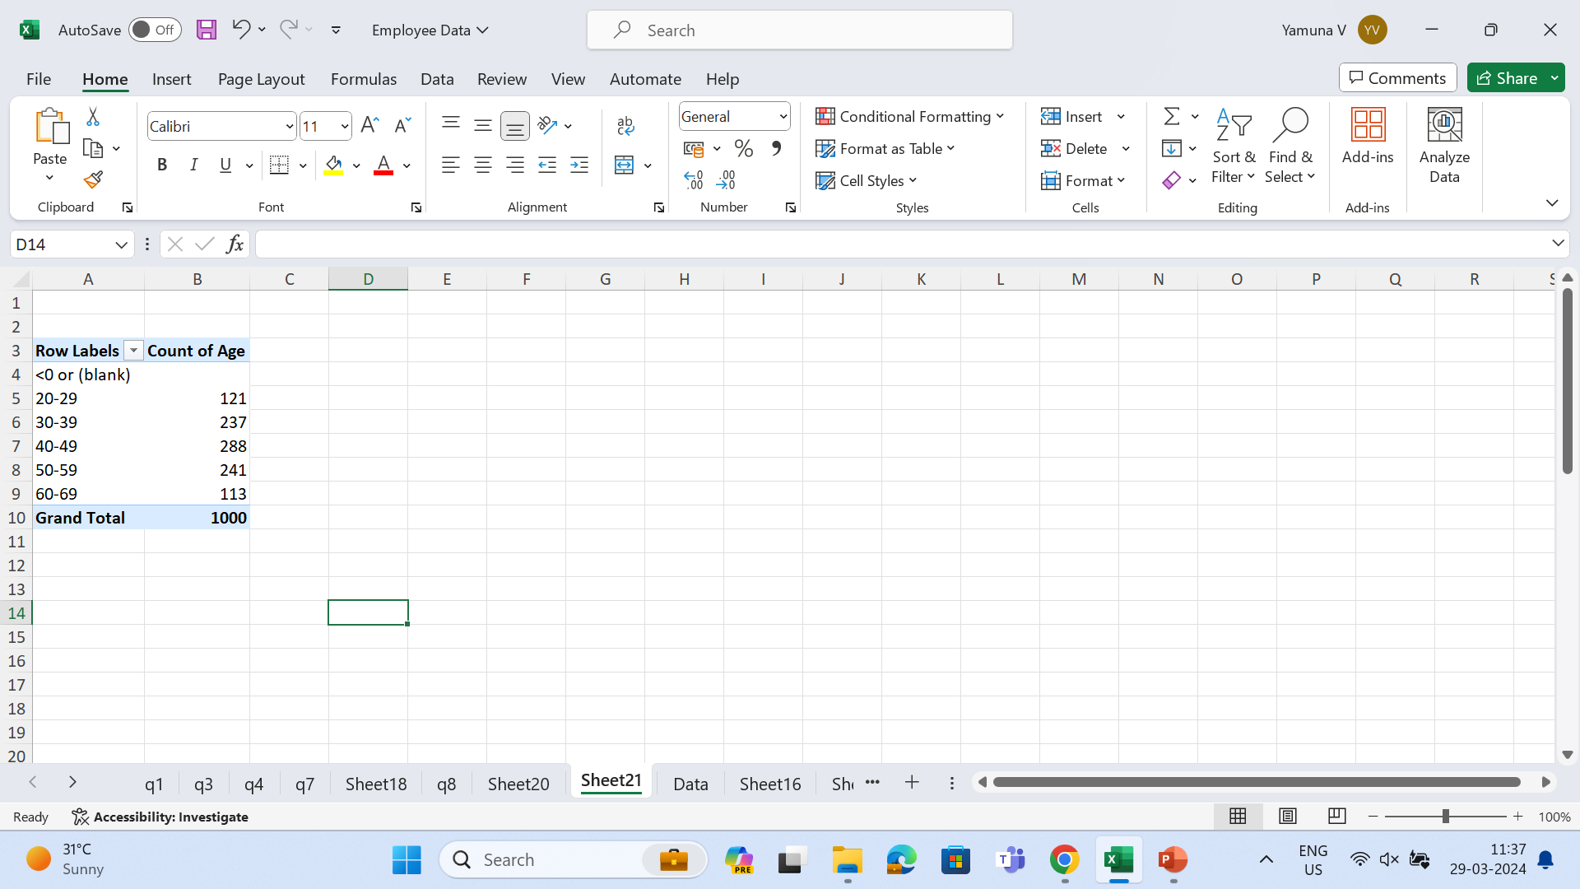

Slide 12
Q6) Average bonus% = 0.218919

Slide 13
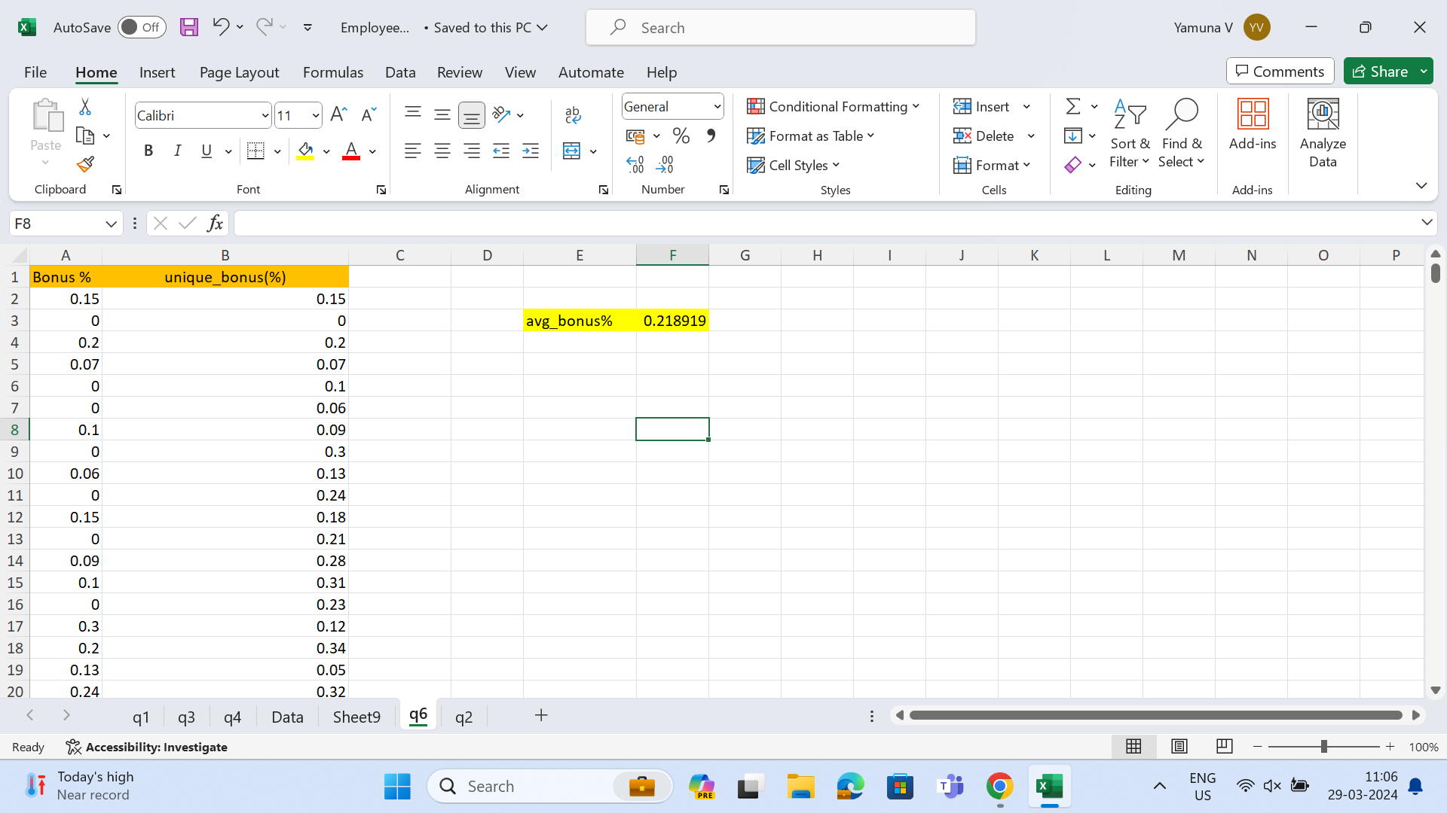

Slide 14
Q7) most frequent job title is director

Slide 15
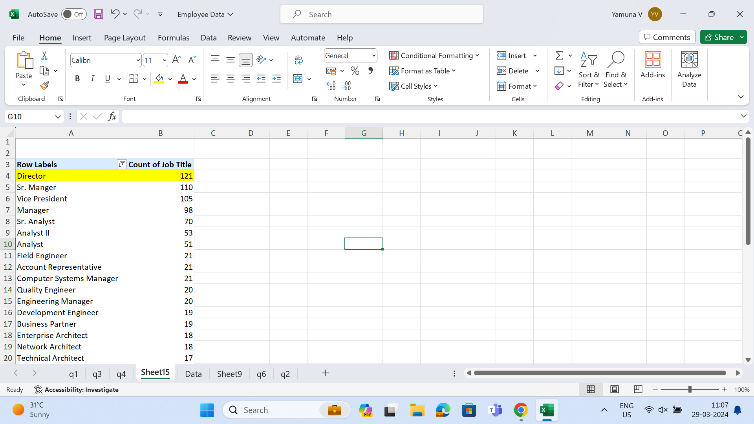

Slide 16
Q8) primary reason for employee exist
country is united states with low bonus

Slide 17
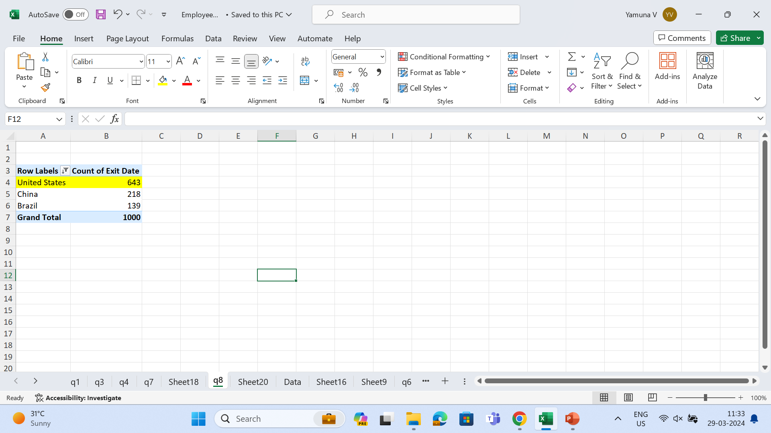

Slide 18
Q9) more diverse in ethnicity

Slide 19
