Slide 1

Database solution
Efficient Query processing, Data Organization, Response time, Scalable Database infrastructure
By: Yamuna Nagasandra Rajaiah
29th May, 2019
Roche Diagnostics automation solutions GmbH Mrs. Dr. Yin Cai (Head of Sample Quality)
Kornwestheim, Salamander Paltz 2-6 Mr. Romain Guerre
Stuttgart, Germany Mr. Michael Hein

Slide 2

About me...
Master’s in Data and Knowledge Engineering
Data Mining
Machine Learning
In-memory Technologies
2018 - 2020
Advanced Database Topics
Scientific Research
Distributed Data Management
Information Retrieval
Advanced Database Models
Projects:
Information Extraction from Legal Document - SpaCy
Parsing XML Files into SAP-HANA
Present Focus: Google Cloud Platform for Big data and Machine Learning

Slide 3

About me… [cont…]
Senior Analyst Delivery Specialist
Solution Architect, Enterprise Storage Implementations
Experience with VMware administration, LINUX, NAS, SAN
Implementation Specialist for Enterprise EMC Storage Products
Solution for D@RE (Unified data Encryption)
Solution for CAVA (Anti-virus NAS solution)
Cloud Automation (ViPR SRM)
Disaster Recovery Solution and Implementation
Data Replication over IP (NAS based solution)
2015 - 2018
Awarded as On-the spot achievement: to be able to deliver ad-hoc solutions

Slide 4
My Motivation @ Roche
Building technology for a purpose for betterment of people around me
Passion into technological arenas
Bring University knowledge and research to live to share at industry level
Innovation starts by bringing ideas into the team
A platform to work with a motivated team
To kick start new journey of my career

Slide 5
use-case
Machines generate huge volume of sensor / image data with various attributes.
Output from machines are raw image data and structures text data format stored into database.
Motivation:
Quick query processing : Query intensive operations
Constraints:
Stored data objects in database is easy to access for regression tests
Data objects high input/output capabilities for CRUD operations
Parallel processing: Multiple software development projects access data simultaneously

Slide 6
Use case constraints
Regression Testing: Continuous data availability, Multiple I/O operation, Response time
Persistent data storage and access
High I/O throughput:
include indexes that can be configured to optimize data access and query performance.
Concurrent data access for development team
concurrent reads and writes, be highly available.

Slide 7
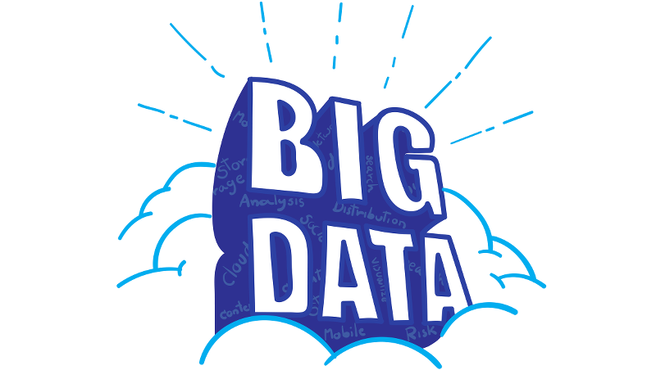
Data Source
Near-real time data produced by cameras and sensor images, text files
Huge amount of sensor data (high resolution )
Medical image data : unstructured | Text files : Structured
variety with the various modalities (e.g. dictations, EEG, CT, MRI, DTI, PET, SPECT, MRS, fMRI, etc.)
DICOM (Digital Imaging and Communication in Medicine) Standard for medical images:

Slide 8
Requirement Analysis: Database Architecture
Scalable, Reliable
Distributed Data architecture to capture data from metrology workstations
Parallel working ability on multiple clusters
Purpose: Store, Extract, Transform, Load data for Testing, Development, user input / output
Solution: Multi Node Framework
Transformation: Data compression
Gain storage capacity, transmission time, management eﬃciency and querying

Slide 9
Requirement Analysis: Data Framework
Handle structure and unstructured medical data to fulfill such query
unstructured data should be converted into analysis-ready datasets
complexity of data modeling
multidimensional data models
Data generated from large scale heterogeneous data sources

Slide 10
Regression Testing
Support constant modification in the produced data.
Focus: Provide better runtime / response time
Test database can grow and database should be scalable.
Introducing parallel testing architecture: Run tests on ‘N’ nodes (N>1)
Validation: If a particular test case has executed and there is no response but more likely to be finished, one or more nodes have been failed.

Slide 11
Data access solution
Data objects should be added or deleted at later point.
Persistent data storage
Ability of data retention for long duration
Achieve high throughput with improved Update and Delete operations
I/O capability

Slide 12
Parallel access to Database
Software Development projects need access to data as a repository for multiple data access
Hybrid architecture with Hadoop Framework provides ability to access data concurrently
Apache Mesos on the job would track job with zookeeper

Slide 13
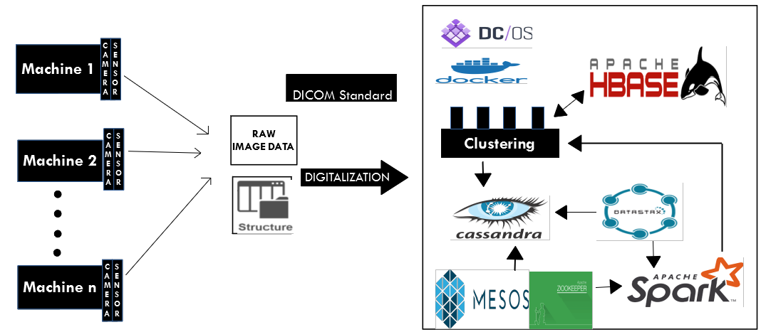
High-Level Design

Slide 14
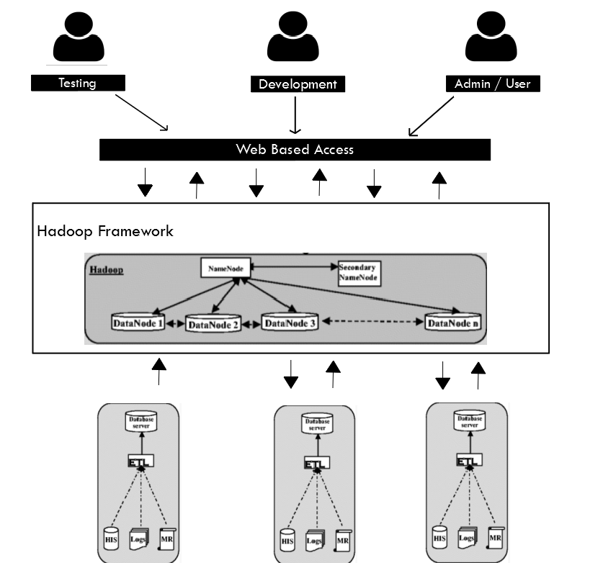
Hadoop Data Framework

Slide 15
Why HBase for Storage
HBase provides random read/write operations
Parallel data storage via underlying Cassandra operability
Handle petabytes of data on thousand nodes
Integrate Hadoop Framework with Spark Framework for performance benefits
Constraint match:
Allows Multiple test runs on different nodes
Random R/W operation for efficient query processing
Performance benefits to run Development applications

Slide 16
Cassandra - A Column Database
Reliable, efficient, highly scalable architecture.
NOSQL Database / Open Source Database Management System
designed to run on cheap hardware and handle high write throughput while not sacrificing read efficiency.
Cassandra offers continuous availability.
can store any type of data from structured to unstructured data.
Data is compressed up to 80% without much performance overhead and thereby storage costs are reduced. Since Cassandra has high throughput and can handle images, we consider Cassandra to store our medical images.
For our use-case: read-intensive Database
Advantage of Cassandra over Cassandra File System removes the single points of failure that are associated with HDFS

Slide 17
Why Cassandra
Schema-free
Analytical Queries:
Create and read queries are fast
High performance
Elastic scalability
NoSQL database can support biomedical images available in other commonly used formats, and also DICOM data
Constraint match:
Allows schema free, to process sensor generated structured and unstructured data by machines
Elastic scalability without down time allows to process large volume of sensor data in case of business critical situations
Cassandra used by: GitHub, Netflix, Reddit

Slide 18
Apache Spark
Apache Spark is a fast, in-memory data processing engine with elegant and expressive development APIs to allow data workers to efficiently execute streaming, machine learning or SQL/ CQL workloads that require fast iterative access to datasets.
In-Memory processing engine
Spark includes all libraries used to automate image workﬂow process
Future enhancement in MLlib, AI feasible
Constraint match:
Allows Development team to run high computing automation tools and Provide MLlib libraries
In-case of multiple resource accessing the database, load balancing is achieved
Continuous updates to database is achieved via Fault Tolerant ability

Slide 19
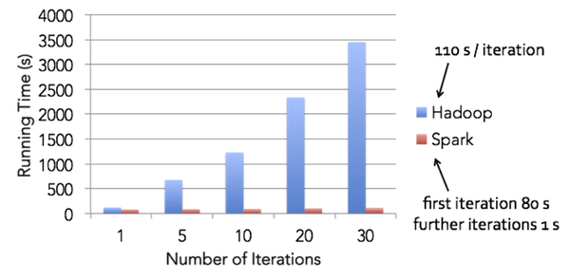
Why Apache Spark?
Re-Usability:
code can be reused for batch-processing
In-Memory Computation:
saves time by caching data
reduced read writes to disc
Fault Tolerance
loss of data is reduced to zero using fault tolerant file system
(HDFS, Cassandra)

Slide 20
Apache Mesos
Scalability to thousands of nodes
Cloud Operating System
Fault-tolerant replicated master using zookeeper
Dynamic resource sharing through mesos drives higher utilization and throughput
Zookeeper : large-scale data handling requests for data retrieval and update
Integration of new services and new Nodes in production

Slide 21
Future Enhancements
Introducing Internet of Things
IoT is the concept of basically connecting any device with an on and off switch to the Internet (and/or to each other)
IoT includes sensor data and data analysis.
Real time, Near- real time data analysis
Large amount of heterogeneous image and sensor data.
Need for Storage solution to ensure:
High Performance
Reliability
Flexibility
Scalability

Slide 22
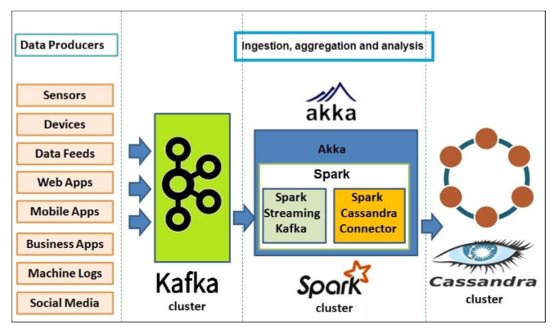
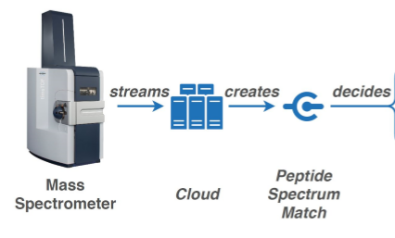
Future Enhancements [cont…]
Architecture Enhancements: FAST Data Architecture
Leverage SMACK Stack : SMACK integrates all technology at right place
Tool enhancement:
Apache Kafka: Stream based multiple consumer
Akka
Use-case: Internet of Metaproteomics

Slide 23
References
Haftmann, Florian, Donald Kossmann, and Eric Lo. "A framework for efficient regression tests on database applications." The VLDB Journal 16.1 (2007): 145-164.
Kumar, Sunil, and Maninder Singh. "Big data analytics for healthcare industry: impact, applications, and tools." Big Data Mining and Analytics 2.1 (2019): 48-57.
Sebaa, Abderrazak, et al. "Medical big data warehouse: architecture and system design, a case study: improving healthcare resources distribution." Journal of medical systems 42.4 (2018): 59.
Lowe, Henry J., et al. "Building a medical multimedia database system to integrate clinical information: an application of high-performance computing and communications technology." Bulletin of the Medical Library Association 83.1 (1995): 57.
Wang, Yichuan, LeeAnn Kung, and Terry Anthony Byrd. "Big data analytics: Understanding its capabilities and potential benefits for healthcare organizations." Technological Forecasting and Social Change 126 (2018): 3-13.
Rebecca, D. Revina, and I. Elizabeth Shanthi. "Analyzing the Suitability of Storing Medical Images in NoSQL Databases." International Journal of Scientific & Engineering Research 7.6 (2016).
Döller M., Kosch H. (2018) Image Database. In: Liu L., Özsu M.T. (eds) Encyclopedia of Database Systems. Springer, New York, NY
https://link.springer.com/article/10.1007/s10916-018-0894-9
https://developer.ibm.com/tutorials/iot-lp301-iot-manage-data/
https://www.ncbi.nlm.nih.gov/pmc/articles/PMC6032968/
https://bioinformatics-ua.github.io/dicoogle-learning-pack/docs/introduction/
https://link.springer.com/referenceworkentry/10.1007%2F978-1-4614-8265-9_1007
https://link.springer.com/referenceworkentry/10.1007%2F978-1-4614-8265-9_1007

Slide 24
References [cont…]
https://www.sciencedirect.com/science/article/pii/S1361841516300883
https://www.ncbi.nlm.nih.gov/pmc/articles/PMC6032968/pdf/ABI2018-4059018.pdf
Maktoubian, Jamal, and Keyvan Ansari. "To IoT architecture for preventive maintenance of medical devices in healthcare organizations." Health and Technology (2019): 1-11.
Kouanou, Aurelle Tchagna, et al. "An optimal big data workflow for biomedical image analysis." Informatics in Medicine Unlocked11 (2018): 68-74.
https://opensource.com/life/16/5/basics-cassandra-and-spark-data-processing
http://sci-hub.se/10.1007/978-981-13-1280-9_1
https://github.com/datastax/spark-cassandra-connector
http://datastax.github.io/spark-cassandra-connector/
https://blog.panoply.io/cassandra-vs-mongodb

Slide 25


