Slide 1
Movie Recommendation System
190428996
FYP Project Demo
Theme: CM3015 Machine Learning and Neural Network
Project Idea 2: Deep Learning on a public dataset

Slide 2

RECAP
Vision
A Deep Learning Model that can accurately recommend movies to the users is needed.
Value
Having an efficient movie recommendation system → movie streaming websites will have a competitive advantage over the other company → enhance user experience → This policy of recommendation system is really helpful in giving optimum results to an application profitability and to make the organisation more connected.

Slide 3
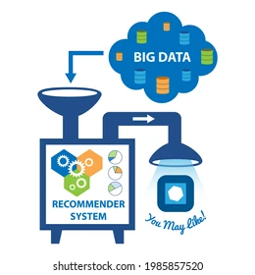
RECAP
Are the traditional collaborative filtering methods useful?
How will the model perform on datasets with different sizes?
Is the model able to predict ratings and recommend movies to the user?

Slide 4
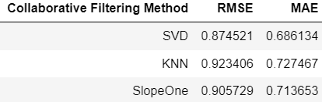
Are the traditional collaborative filtering methods useful?

Slide 5
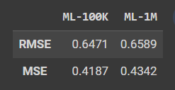
How will the model perform on datasets with different sizes?

Slide 6
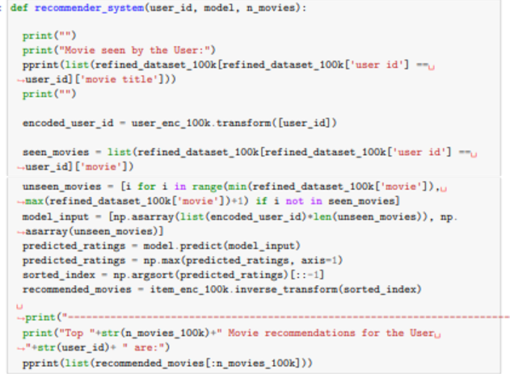
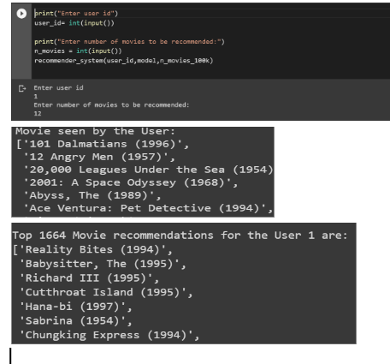
Is the model able to predict ratings and recommend movies to the user?

Slide 7
Thank you!! ☺
190428996

Slide 8
agenda
INTRODUCTION 3
PRIMARY GOALS 4
AREAS OF GROWTH 5
TIMELINE 10
SUMMARY 13

Slide 9
areas of growth
 | B2B | SUPPLY CHAIN | ROI | E-COMMERCE
Q1 | 4.5 | 2.3 | 1.7 | 5.0
Q2 | 3.2 | 5.1 | 4.4 | 3.0
Q3 | 2.1 | 1.7 | 2.5 | 2.8
Q4 | 4.5 | 2.2 | 1.7 | 7.0

Slide 10
primary goals

Slide 11
quarterly performance

Slide 12
RICHARD BRANSON
“Business opportunities are like buses. There's always another one coming.”

Slide 13
timeline
NOV 20XX
disseminate standardized metrics
SEP 20XX
synergize scalable e-commerce
JAN 20XX
coordinate e-business applications
MAR 20XX
foster holistically superior methodologies
MAY 20XX
deploy strategic networks with compelling e-business needs

Slide 14

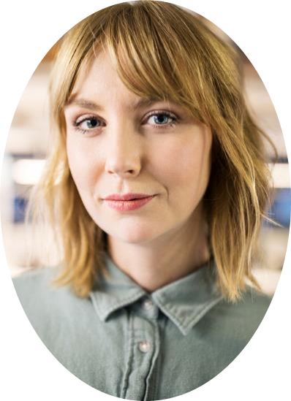
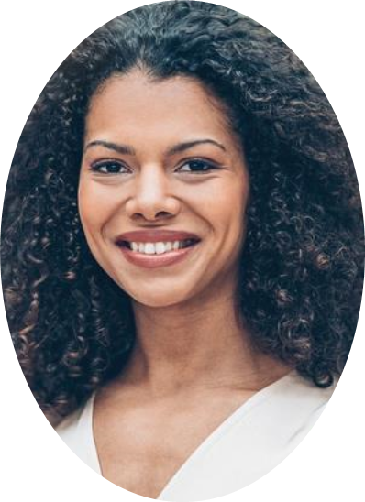
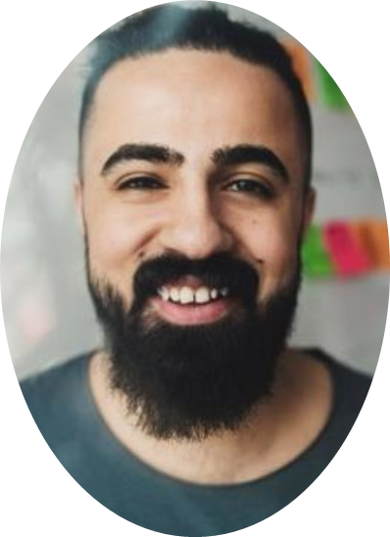
meet our team
TAKUMA HAYASHI
MIRJAM NILSSON​
FLORA BERGGREN​
RAJESH SANTOSHI
president
chief executive officer
chief operations officer
vp marketing

Slide 15
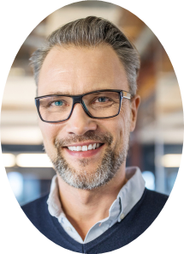



meet our extended team
TAKUMA HAYASHI
MIRJAM NILSSON​
FLORA BERGGREN​
RAJESH SANTOSHI
president
chief executive officer
chief operations officer
vp marketing
GRAHAM BARNES
ROWAN MURPHY
ELIZABETH MOORE
ROBINE KLINE
vp product
SEO strategist
product designer
content developer

Slide 16
areas of focus
B2B MARKET SCENARIOS
Develop winning strategies to keep ahead of the competition
Capitalize on low-hanging fruit to identify a ballpark value
Visualize customer directed convergence​
CLOUD-BASED OPPORTUNITIES
Iterative approaches to corporate strategy
Establish a management framework from the inside

Slide 17
how we get there
ROI
NICHE MARKETS
SUPPLY CHAINS
Envision multimedia-based expertise and cross-media growth strategies
Visualize quality intellectual capital
Engage worldwide methodologies with web-enabled technologies
Pursue scalable customer service through sustainable strategies
Engage top-line web services with cutting-edge deliverables
Cultivate one-to-one customer service with robust ideas
Maximize timely deliverables for real-time schemas

Slide 18

summary
At Contoso, we believe in giving 110%. By using our next-generation data architecture, we help organizations virtually manage agile workflows. We thrive because of our market knowledge and great team behind our product. As our CEO says, "Efficiencies will come from proactively transforming how we do business."​

