Slide 1
AI FOR INDUSTRY 4.0
HACKATHON
Introduction of the scenario

Slide 2
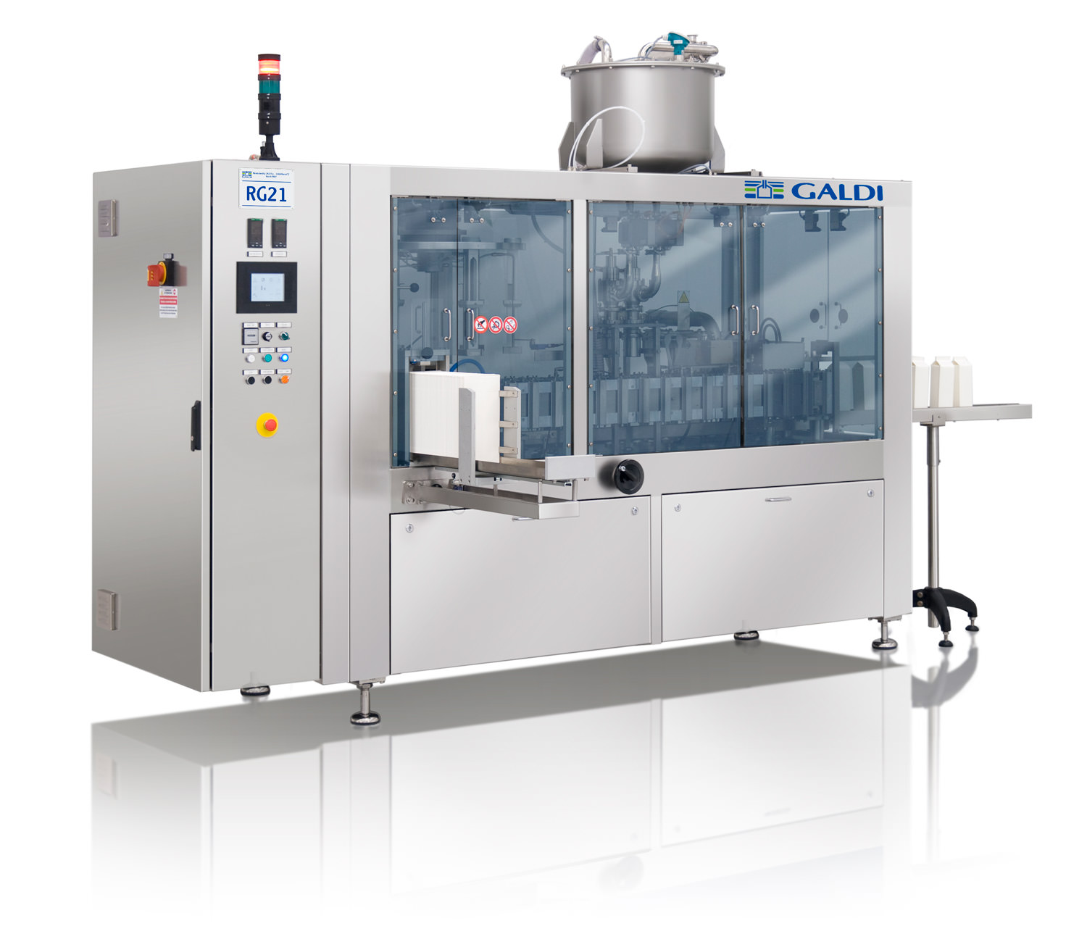
Scenario: Dairy Product Packaging
A factory receives containers (pots of yoghurt) and stocks of consumable (yoghurt) from suppliers. Containers are filled and packaged at the factoy to be sold for retail.
Image: Integrated filling/packaging machine for dairy products – www.galdi.it

Slide 3
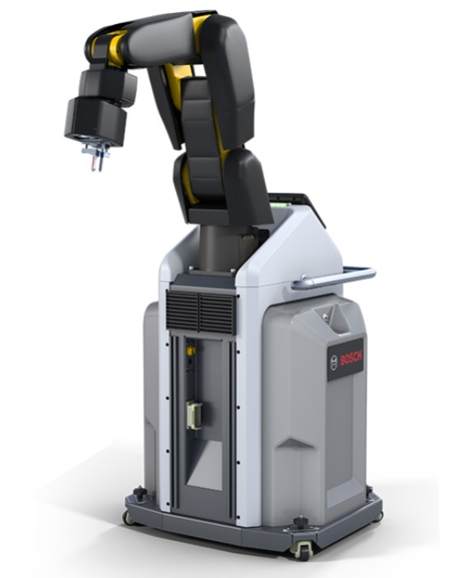
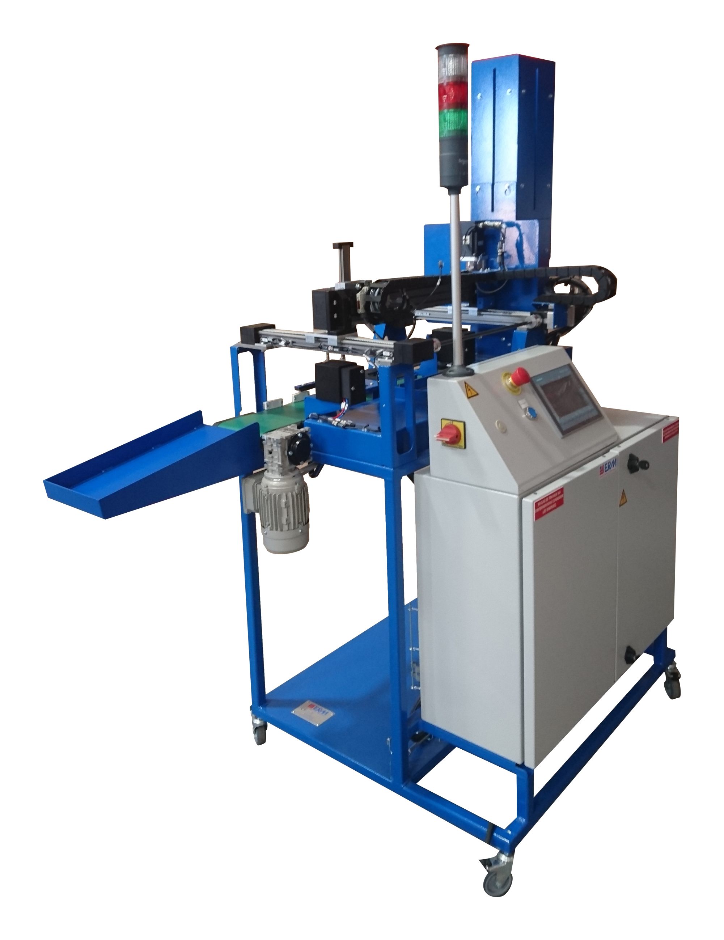
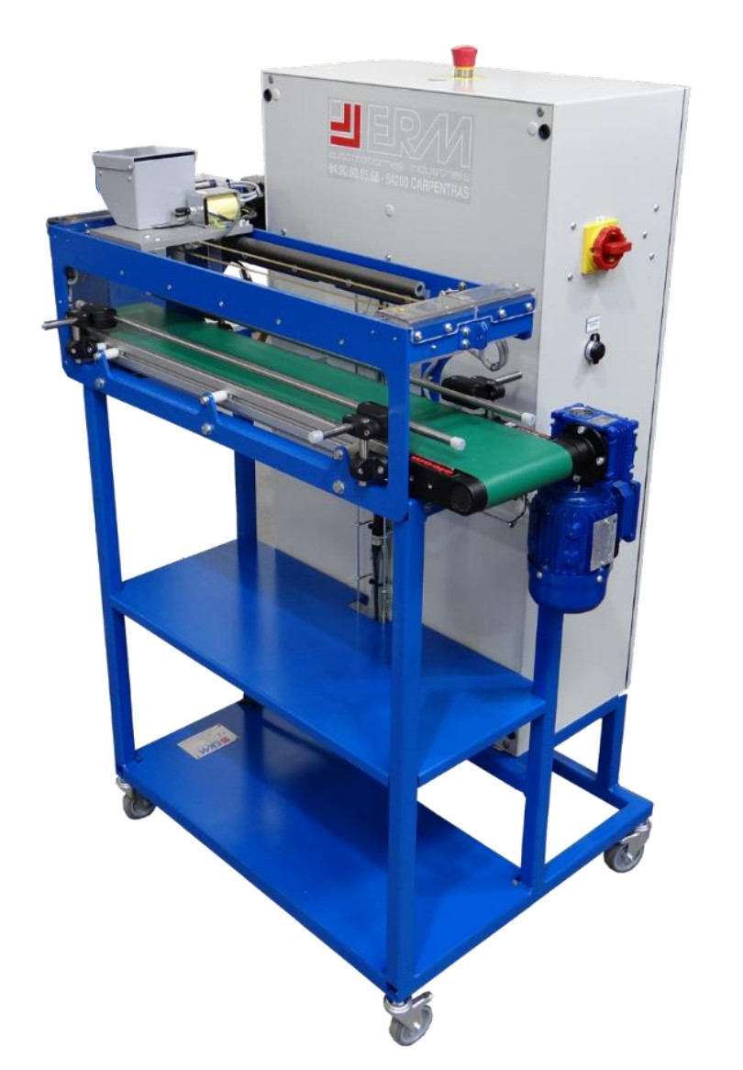
Scenario: Dairy Product Packaging
A factory receives containers (pots of yoghurt) and stocks of consumable (yoghurt) from suppliers. Containers are filled and packaged at the factoy to be sold for retail.
Image: reconfigurable workstations for filling and packaging – www.erm-automatismes.com and apps.boschrexroth.com

Slide 4
Scenario: Dairy Product Packaging
A factory receives containers (pots of yoghurt) and stocks of consumable (yoghurt) from suppliers. Containers are filled and packaged at the factoy to be sold for retail.
Image: reconfigurable workstations for filling and packaging – www.erm-automatismes.com and apps.boschrexroth.com
Industry 4.0

Slide 5
Packaging Process: Four Steps
Pick container from storage rack
Fill container with consumable
Close container with a lid
Package container (size 4 or 6)

Slide 6
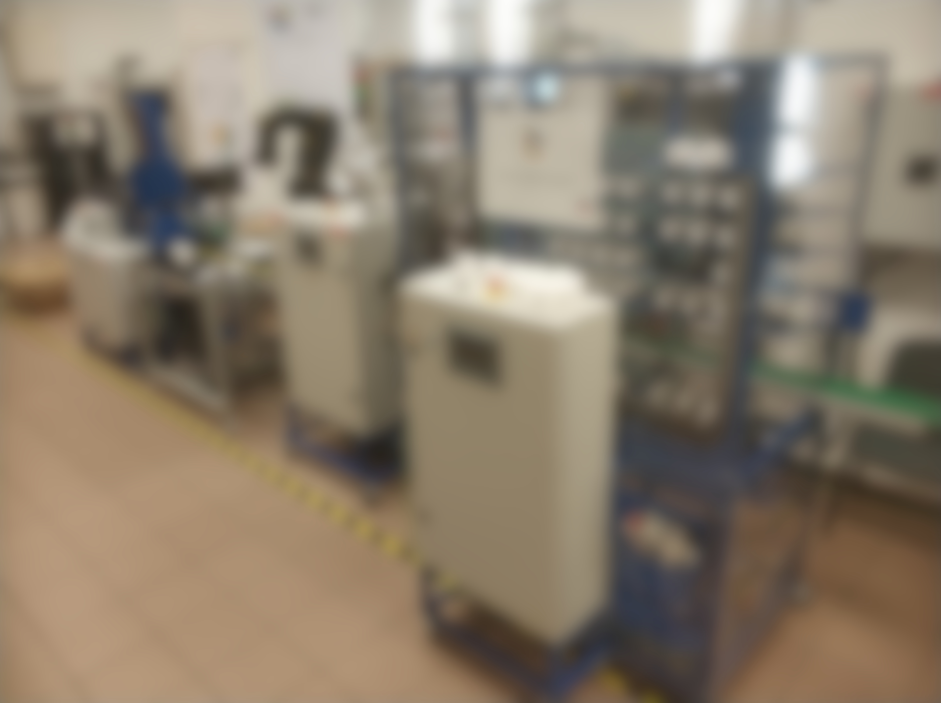
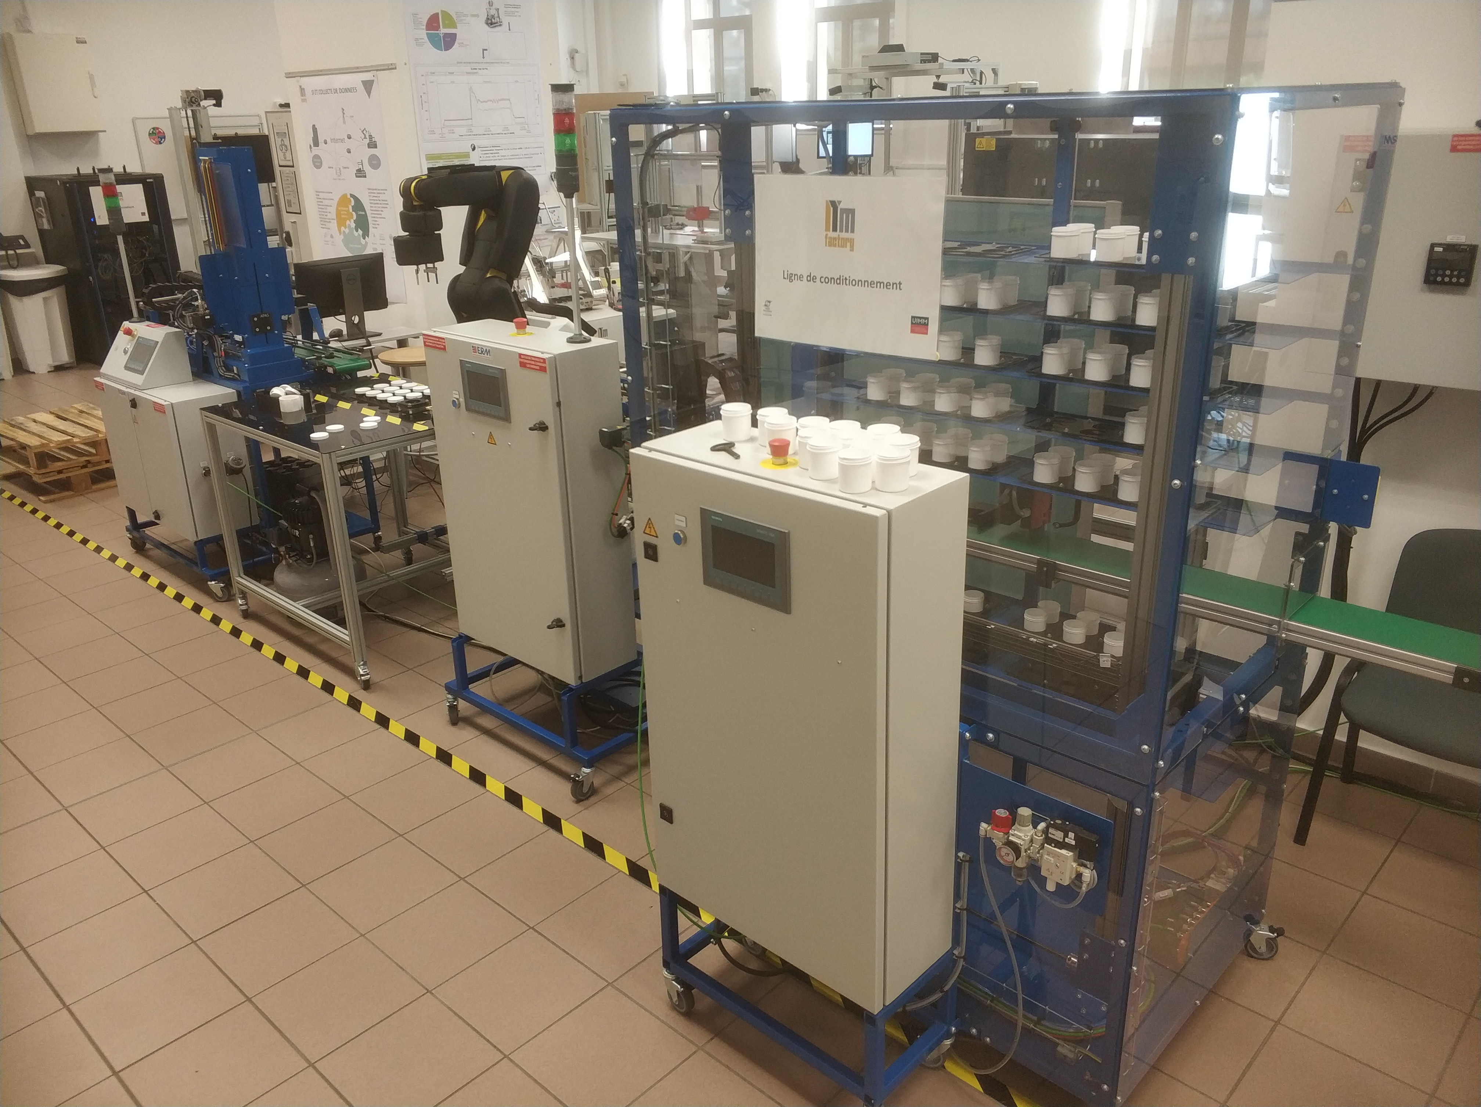

Slide 7
4
3
2
1

Slide 8
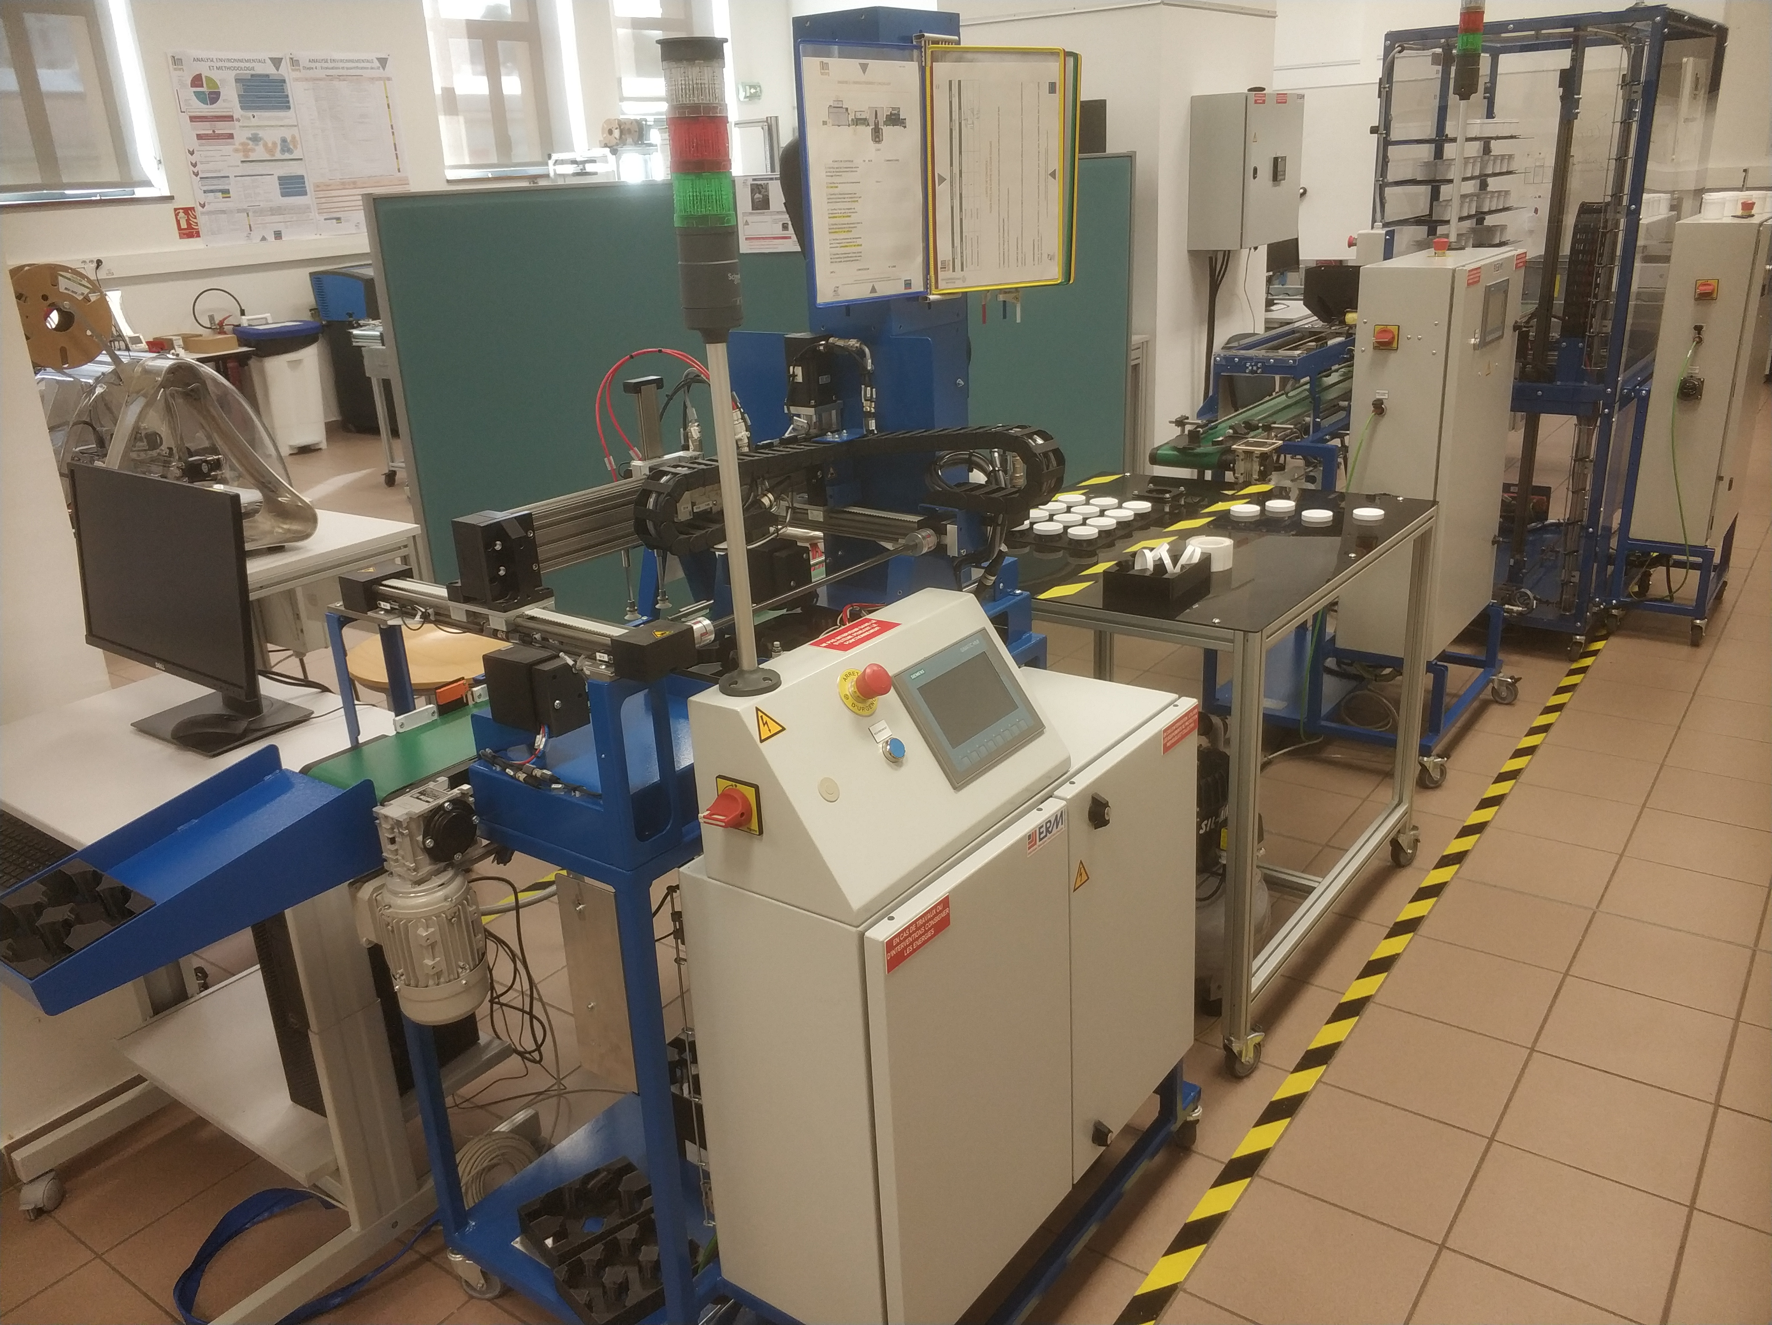
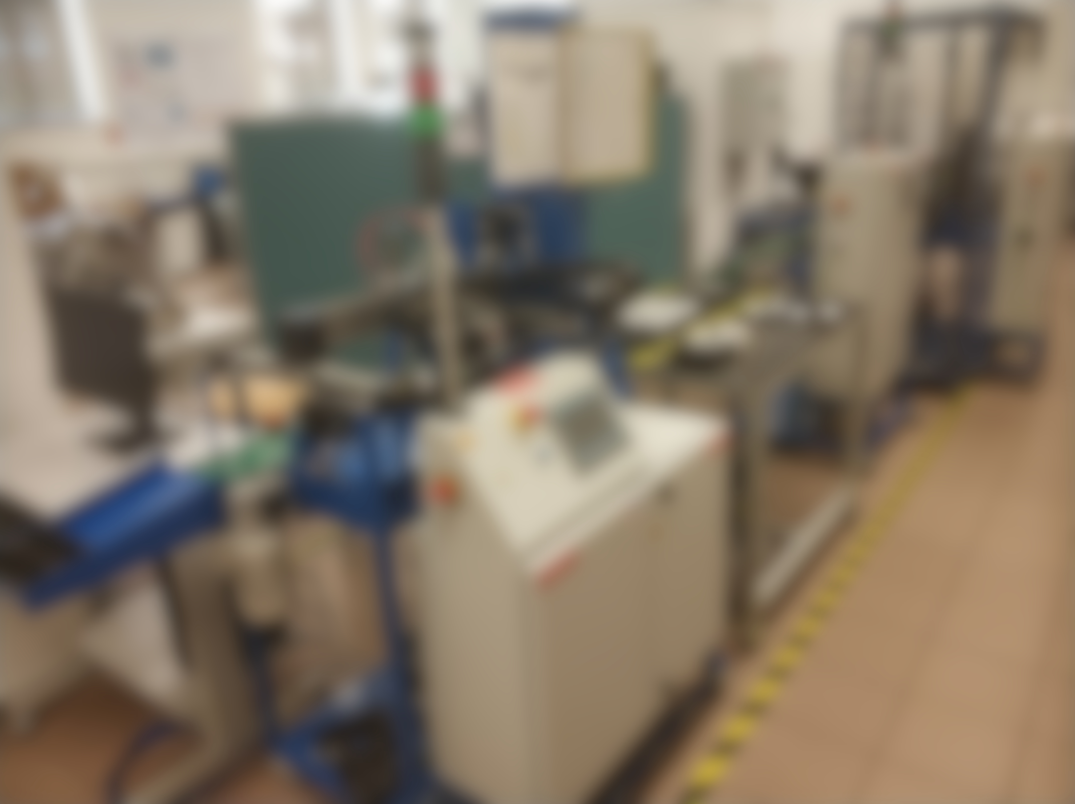

Slide 9
1
2
3
4

Slide 10
(Simulated) Factory line
Filler
Storage rack
Package buffer
Potting workshop (APAS)
Filling workshop (DX10)
Conveying workshop (VL10)
Packaging workshop (XY10)
Conveyor belt
Optical sensor

Slide 11
(Simulated) Factory line
Cartesian robot
Potting workshop (APAS)
y
Filling workshop (DX10)
z
x
x
y
x
Conveying workshop (VL10)
x
Packaging workshop (XY10)
y
z
Robot arm
x
z

Slide 12
(Simulated) Factory line
[ 2.7 , -0.5 , 0.8 ]
[ 2.2 , 0 , 1 ]
[ 3.2 , 0 , 1 ]
[ 0 , 0 , 1 ]
Potting workshop (APAS)
Filling workshop (DX10)
Conveying workshop (VL10)
Packaging workshop (XY10)
y
1.2m
1m
1m
1.2m
x
z

Slide 13
(Simulated) Factory line
Potting workshop (APAS)
d
Filling workshop (DX10)
a
b
c
e
Conveying workshop (VL10)
Packaging workshop (XY10)
Cartesian robot pick container
Container moves to head of conveyor
Filler opens valve and follows container
Robot arm moves container to next workshop
Container moves to first slot of first conveyor

Slide 14
(Simulated) Factory line
Potting workshop (APAS)
i
Filling workshop (DX10)
k
f
g
h
j
Conveying workshop (VL10)
Packaging workshop (XY10)
Cartesian robot pick container
Container moves to head of conveyor
Filler opens valve and follows container
Robot arm moves container to next workshop
Container moves to second slot of first conveyor
Cartesian robot puts pair of containers in package

Slide 15
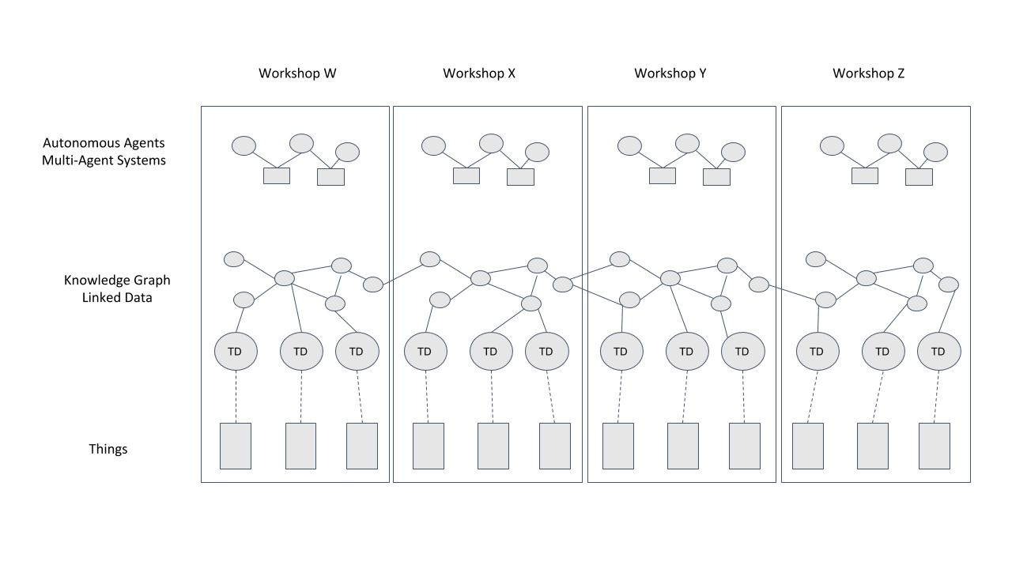
Scope of the Hackathon

Slide 16
Scope of the Hackathon
^{Monday}

Slide 17
Scope of the Hackathon
^{Tuesday}
^{Monday}

Slide 18
Scope of the Hackathon
^{Wednesday-Thursday}
^{Tuesday}
^{Monday}

Slide 19
Schedule
Monday | Tuesday | Wednesday | Thursday | Friday
 |  |  |  | Presentations (2h)
Lunch
Hackathon (3h)

Slide 20
Organization
Groups of six persons
Presentations (15 min each + Q&A)
  Technical demonstration
  Feedback to organizers
Gitlab for code and documentation
  https://gitlab.emse.fr/ai4industry/hackathon/
Mattermost for technical questions
  https://mattermost.emse.fr/hackathon/

Slide 21
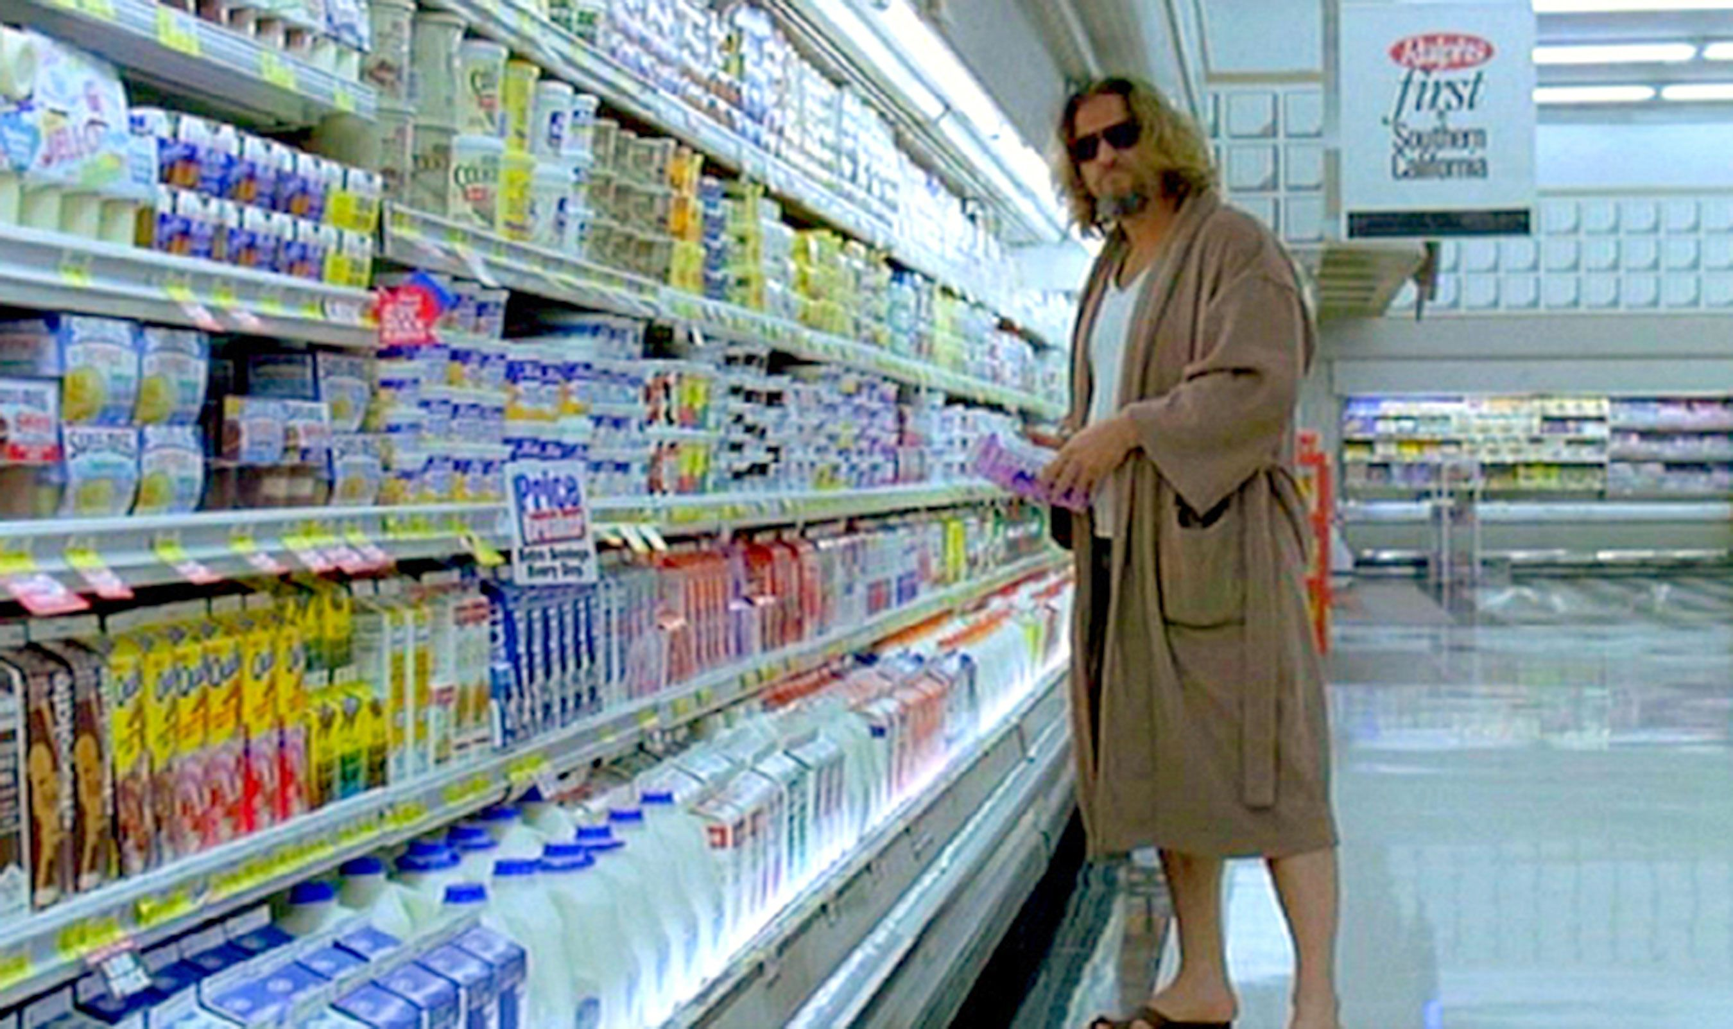
Good luck.

