Slide 1
COMPILER DESIGN
COMP 442/6421 – Compiler Design
AST generation using syntax-directed translation:
concrete examples
Joey Paquet, 2021-2022

Slide 2
COMP 442/6421 – Compiler Design
example 1
Joey Paquet, 2021-2022

Slide 3
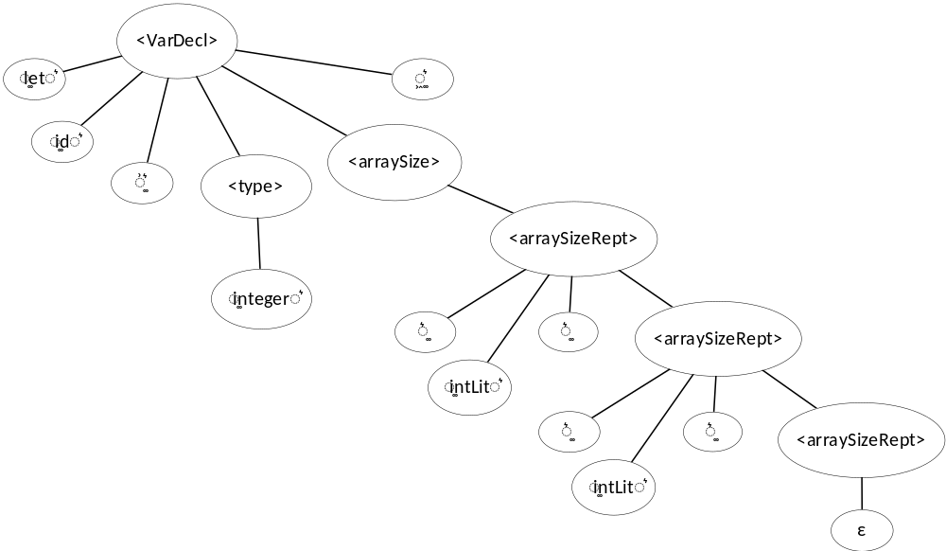
Example: let v : integer[2][3]; : grammar, parse tree
COMP 442/6421 – Compiler Design
<varDecl> ::= 'let' 'id' ':' <type> <arraySize> ';'
<type> ::= 'integer'
<type> ::= 'float'
<type> ::= 'id'
<arraySize> ::= <arraySizeRept>
<arraySizeRept> ::= '[' 'intLit' ']' <arraySizeRept>
<arraySize> ::= EPSILON
grammar
parse tree
Joey Paquet, 2021-2022

Slide 4
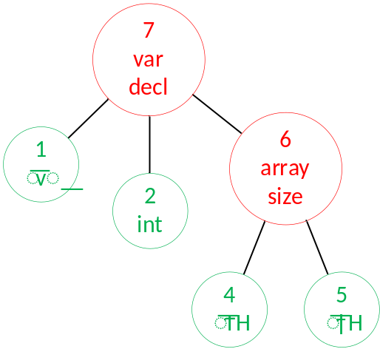
Attribute grammar, semantic actions, AST
COMP 442/6421 – Compiler Design
<varDecl> ::= 'let' 'id' V1 ':' <type> <arraySize> V2 ';'
<type> ::= 'integer' T
<type> ::= 'float' T
<type> ::= 'id' T
<arraySize> ::= A1 <arraySizeRept> A3
<arraySizeRept> ::= '[' 'intLit' A2 ']' <arraySizeRept>
<arraySize> ::= EPSILON
V1: push(createLeaf(id))
V2: push(createsubtree(varDecl,pop,pop,pop))
T: push(createLeaf(type))
A1: push(ε)
A2: push(createLeaf(intLit))
A3: push(createSubtree(arraySize,popuntilε))
attributegrammar
semantic actions
Leaves: Atomic Semantic Concepts
Subtrees: Composite Semantic Concepts
abstract syntax tree
Joey Paquet, 2021-2022

Slide 5
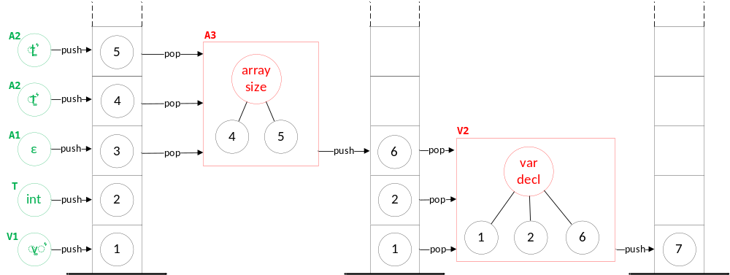
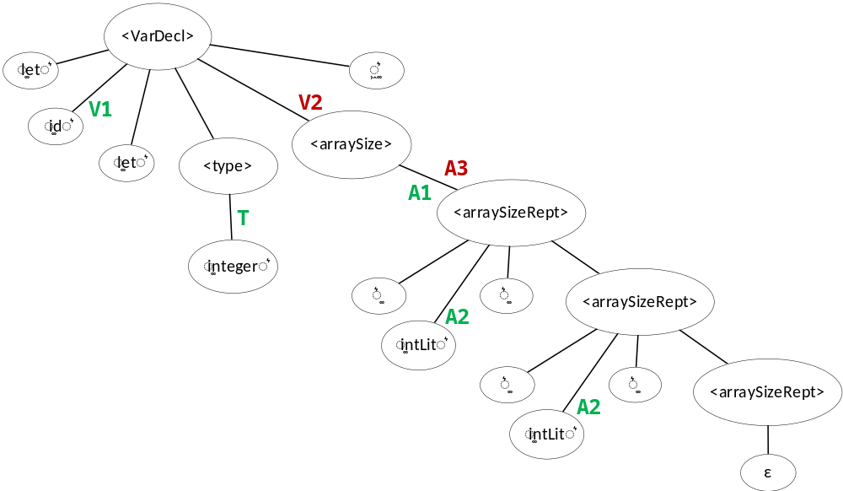
AST construction process
COMP 442/6421 – Compiler Design
<varDecl> ::= 'let' 'id' V1 ':' <type> <arraySize> V2 ';'
<type> ::= 'integer' T
<type> ::= 'float' T
<type> ::= 'id' T
<arraySize> ::= A1 <arraySizeRept> A3
<arraySizeRept> ::= '[' 'intLit' A2 ']' <arraySizeRept>
<arraySize> ::= EPSILON
V1: push(createLeaf(id))
V2: push(createsubtree(varDecl,pop,pop,pop))
T: push(createLeaf(type))
A1: push(ε)
A2: push(createLeaf(intLit))
A3: push(createSubtree(arraySize,popuntilε))
AST construction process
Joey Paquet, 2021-2022

Slide 6
COMP 442/6421 – Compiler Design
example 2
Joey Paquet, 2021-2022

Slide 7
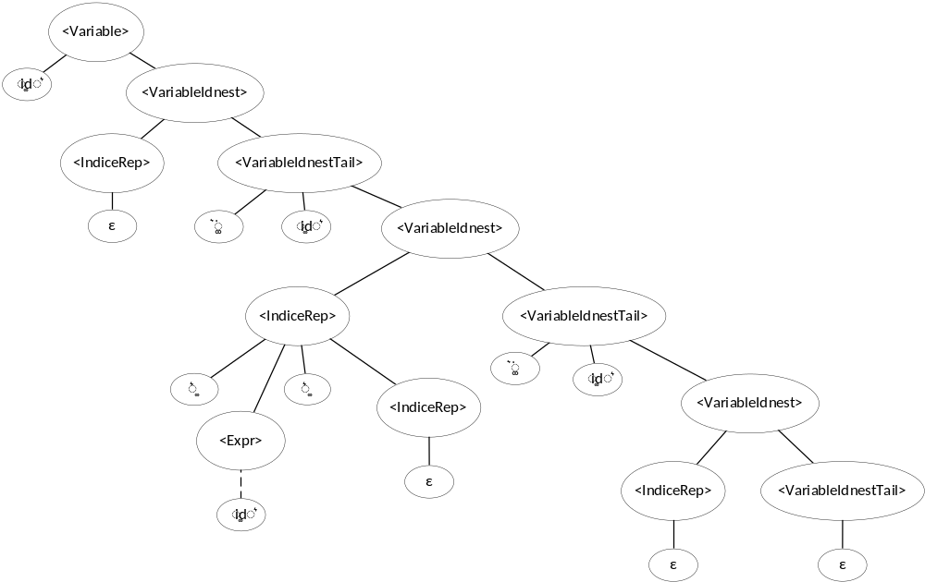
Example: a.b[c].d : grammar, parse tree
COMP 442/6421 – Compiler Design
<Variable> ::= 'id' <VariableIdnest>
<VariableIdnest> ::= <IndiceRep> <VariableIdnestTail>
<VariableIdnestTail> ::= '.' 'id' <VariableIdnest>
<VariableIdnestTail> ::= EPSILON
<IndiceRep> ::= '[' <Expr> ']' <IndiceRep>
<IndiceRep> ::= EPSILON
Joey Paquet, 2021-2022

Slide 8
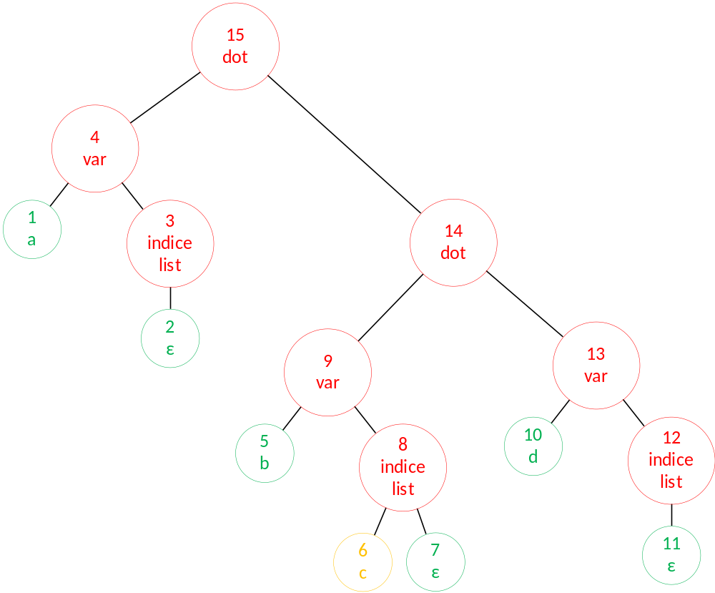
Attribute grammar, semantic actions, AST
COMP 442/6421 – Compiler Design
Leaves: Atomic Semantic Concepts
Subtrees: Composite Semantic Concepts
<Variable> ::= 'id' A <VariableIdnest>
<VariableIdnest> ::= J <IndiceRep> C D <VariableIdnestTail>
<VariableIdnestTail> ::= '.' 'id' F <VariableIdnest> B
<VariableIdnestTail> ::= EPSILON
<IndiceRep> ::= '[' <Expr> ']' H <IndiceRep>
<IndiceRep> ::= EPSILON
A: push(createLeaf(id))
B: push(createSubtree(dot,pop,pop))
C: push(createSubtree(indicelist,popuntilε))
D: push(createSubtree(var,pop,pop))
F: push(createLeaf(id))
H: push(createLeaf(id)) // eventually createsubtree(expr)
J: push(ε)
Joey Paquet, 2021-2022

Slide 9
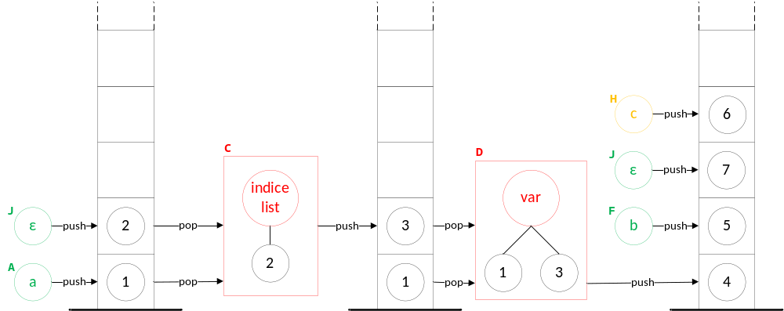
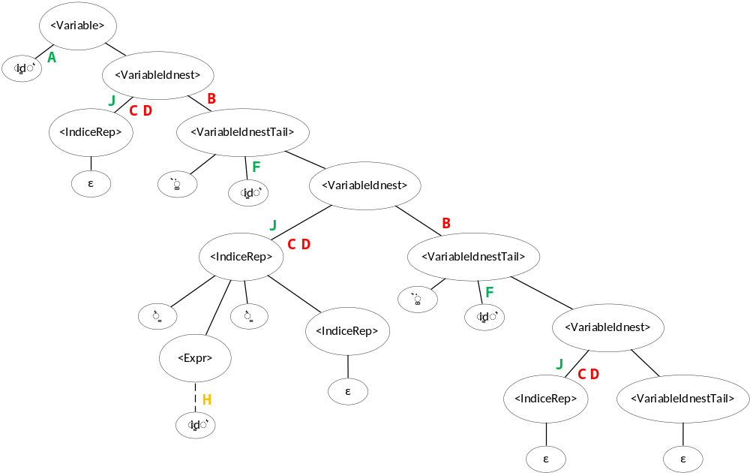

AST construction process
COMP 442/6421 – Compiler Design
<Variable> ::= 'id' A <VariableIdnest>
<VariableIdnest> ::= J <IndiceRep> C D <VariableIdnestTail>
<VariableIdnestTail> ::= '.' 'id' F <VariableIdnest> B
<VariableIdnestTail> ::= EPSILON
<IndiceRep> ::= '[' <Expr> ']' H <IndiceRep>
<IndiceRep> ::= EPSILON
A: push(createLeaf(id))
B: push(createSubtree(dot,pop,pop))
C: push(createSubtree(indicelist,popuntilε))
D: push(createSubtree(var,pop,pop))
F: push(createLeaf(id))
H: push(createLeaf(id)) // eventually createsubtree(expr)
J: push(ε)
Joey Paquet, 2021-2022

Slide 10
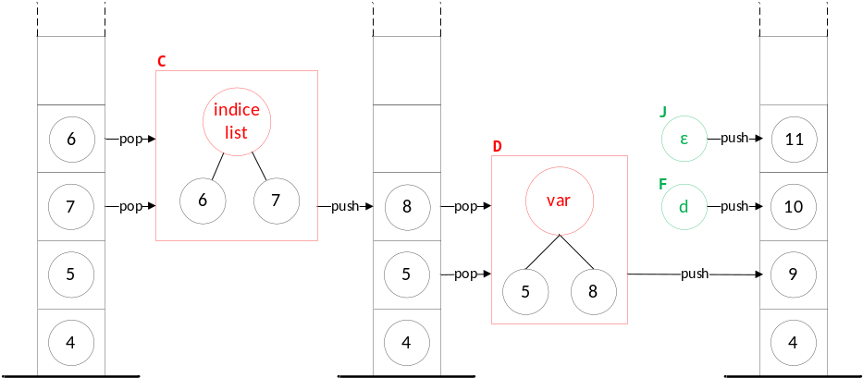
AST construction process
COMP 442/6421 – Compiler Design
<Variable> ::= 'id' A <VariableIdnest>
<VariableIdnest> ::= J <IndiceRep> C D <VariableIdnestTail>
<VariableIdnestTail> ::= '.' 'id' F <VariableIdnest> B
<VariableIdnestTail> ::= EPSILON
<IndiceRep> ::= '[' <Expr> ']' H <IndiceRep>
<IndiceRep> ::= EPSILON
A: push(createLeaf(id))
B: push(createSubtree(dot,pop,pop))
C: push(createSubtree(indicelist,popuntilε))
D: push(createSubtree(var,pop,pop))
F: push(createLeaf(id))
H: push(createLeaf(id)) // eventually createsubtree(expr)
J: push(ε)
Joey Paquet, 2021-2022

Slide 11
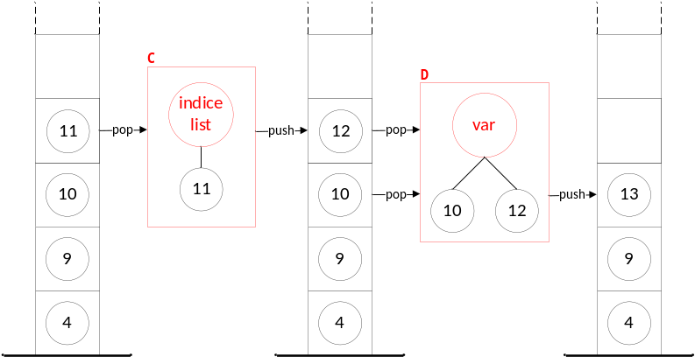
AST construction process
COMP 442/6421 – Compiler Design
<Variable> ::= 'id' A <VariableIdnest>
<VariableIdnest> ::= J <IndiceRep> C D <VariableIdnestTail>
<VariableIdnestTail> ::= '.' 'id' F <VariableIdnest> B
<VariableIdnestTail> ::= EPSILON
<IndiceRep> ::= '[' <Expr> ']' H <IndiceRep>
<IndiceRep> ::= EPSILON
A: push(createLeaf(id))
B: push(createSubtree(dot,pop,pop))
C: push(createSubtree(indicelist,popuntilε))
D: push(createSubtree(var,pop,pop))
F: push(createLeaf(id))
H: push(createLeaf(id)) // eventually createsubtree(expr)
J: push(ε)
Joey Paquet, 2021-2022

Slide 12
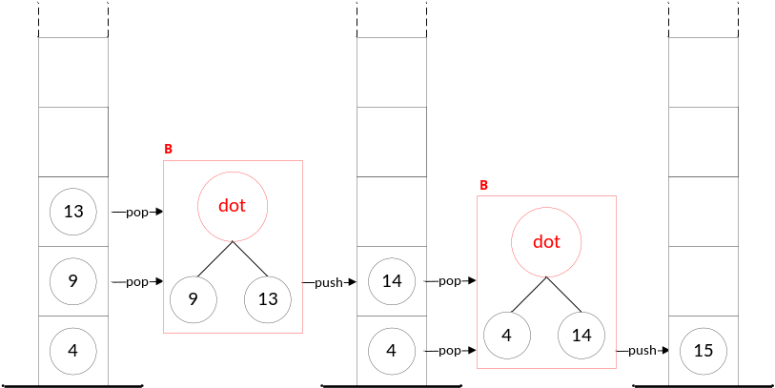
AST construction process
COMP 442/6421 – Compiler Design
<Variable> ::= 'id' A <VariableIdnest>
<VariableIdnest> ::= J <IndiceRep> C D <VariableIdnestTail>
<VariableIdnestTail> ::= '.' 'id' F <VariableIdnest> B
<VariableIdnestTail> ::= EPSILON
<IndiceRep> ::= '[' <Expr> ']' H <IndiceRep>
<IndiceRep> ::= EPSILON
A: push(createLeaf(id))
B: push(createSubtree(dot,pop,pop))
C: push(createSubtree(indicelist,popuntilε))
D: push(createSubtree(var,pop,pop))
F: push(createLeaf(id))
H: push(createLeaf(id)) // eventually createsubtree(expr)
J: push(ε)
Joey Paquet, 2021-2022

