Slide 1
COMPILER DESIGN
COMP 442/6421 – Compiler Design
Generating an Abstract Syntax Tree
using Syntax-Directed Translation
Joey Paquet, 2018-2022

Slide 2
Abstract Syntax Tree: Definition
COMP 442/6421 – Compiler Design
An abstract syntax tree (AST) is a tree representation of the abstract syntactic structure of source code.
Each node of the tree denotes a syntactic construct occurring in the source code.
The syntax is "abstract" i.e. it does not represent every detail appearing in the concrete syntax used in the source code, or some of the non-terminals in the grammar that do not directly represent syntactical/semantic constructs.
Such details are removed because they do not convey any form of meaning and are thus superfluous for further processing.
For instance:
  punctuation such as commas, semicolons, and grouping parentheses are removed
  syntactic construct like an if-then-else may be denoted by means of a single node with three branches
  non-terminals that were introduced as accessory to grammar transformations are removed
This distinguishes abstract syntax trees from concrete syntax trees, which are traditionally designated as parse trees.
Once built, additional information is added to the AST by means of subsequent processing steps such as semantic analysis and code generation.
Joey Paquet, 2018-2022

Slide 3
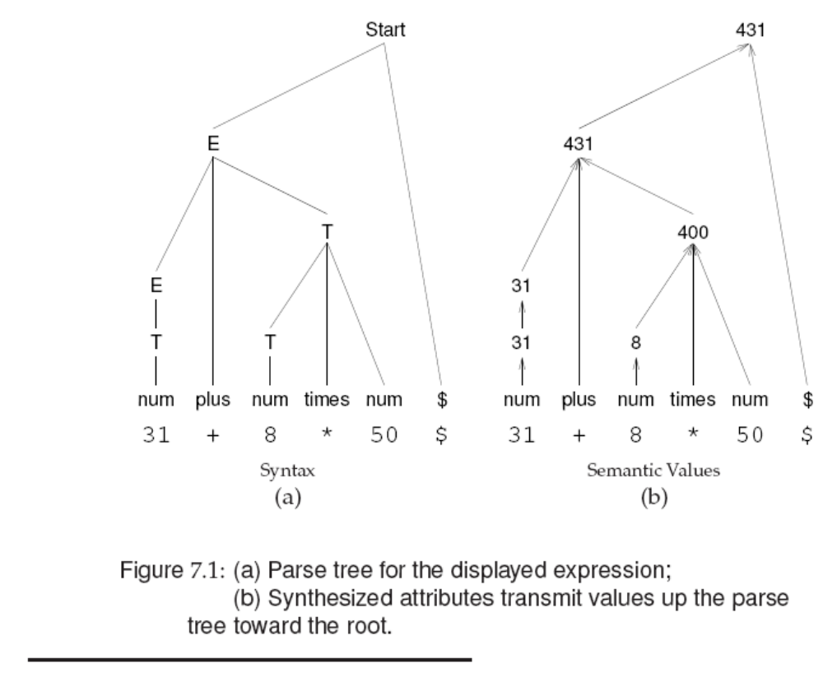
Abstract Syntax Tree: Goals
COMP 442/6421 – Compiler Design
Goals:
to aggregate information gathered during the parse in order to get a broader understanding of the meaning of whole syntactic constructs under a single subtree.
to represent the entire program in a data structure that can later be repeatedly traversed for further analysis and translation steps.
At the leaves of the tree is fine-grained syntactical concepts/information.
Intermediate nodes represent higher-level constructs created by aggregation of the information conveyed by its branches’ subtrees.
The root node contains all the information for an entire syntactical construct and its composing constructs.
Joey Paquet, 2018-2022

Slide 4
COMP 442/6421 – Compiler Design
AST data structure: requirements, design, implementation
Joey Paquet, 2018-2022

Slide 5
Abstract Syntax Tree: data structure requirements
COMP 442/6421 – Compiler Design
The AST structure is constructed bottom-up:
  A list of siblings nodes is generated and each is pushed on a semantic stack through the operation of a semantic action.
  The list elements are later popped from the semantic stack and adopted by a parent node and pushed onto the stack through the operation of another semantic action.
The AST structure should allow adding siblings at either end of the list of siblings.
Some AST nodes require a fixed number of children, e.g.
  Arithmetic operators
  if-then-else statement
Some AST nodes require zero or more number of children
  Parameter lists
  Statements in a statement block
  Members of a class
In order to be generally applicable, an AST node data structure should allow for any number of children.
Joey Paquet, 2018-2022

Slide 6
Abstract Syntax Tree: data structure requirements/design
COMP 442/6421 – Compiler Design
According to depth-first-search tree traversal.
Each node needs connection to:
  Parent: to migrate information upwards in the tree
    Link to parent
  Siblings: to iterate through (1) a list of operands or (2) members of a group, e.g. members of a class, or statements in a statement block.
    Link to right sibling (thus creating a linked list of siblings)
    Link to leftmost sibling (in case one needs to traverse the list as a sibling is being processed).
  Children: to generate/traverse the tree
    Link to leftmost child (who represents the head of the linked list of children, which are each other’s siblings).
Joey Paquet, 2018-2022

Slide 7
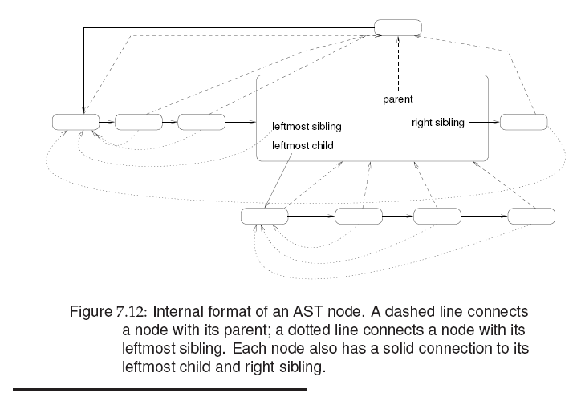

Abstract Syntax Tree: data structure design
COMP 442/6421 – Compiler Design
Joey Paquet, 2018-2022

Slide 8
Abstract Syntax Tree: data structure implementation
COMP 442/6421 – Compiler Design
makeNode(t)
A factory method that creates/returns a node whose members are adapted to the type of the parameter t. For example:
  makeNode(intNum i): instantiates a node that represents a numeric literal value. Offers a get method to get the value it represents.
  makeNode(id n): instantiates a node that represents an identifier. Offers get/set methods to get/set the symbol table entry it represents, which stores information such as its type/protection/scope.
  makeNode(op o): instantiates a node that represents composite structures such as operators, statements, or blocks. There should be one for each such possible different nodes for each different kind of composite structures in the language. Each offers get/set methods appropriate to what they represent.
  makeNode(): instantiates a null node in order to represent, e.g. the end of siblings list.
Joey Paquet, 2018-2022

Slide 9
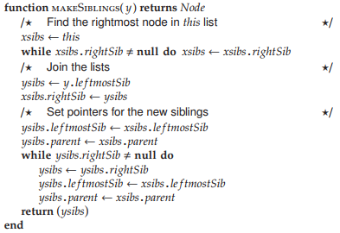
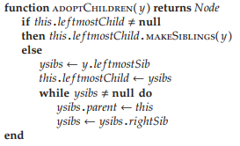
Abstract Syntax Tree: data structure implementation
COMP 442/6421 – Compiler Design
x.makeSiblings(y)
inserts a new sibling node y in the list of siblings of node x.
x.adoptChildren(y)
adopts node y and all its siblings under the parent x.
Joey Paquet, 2018-2022

Slide 10

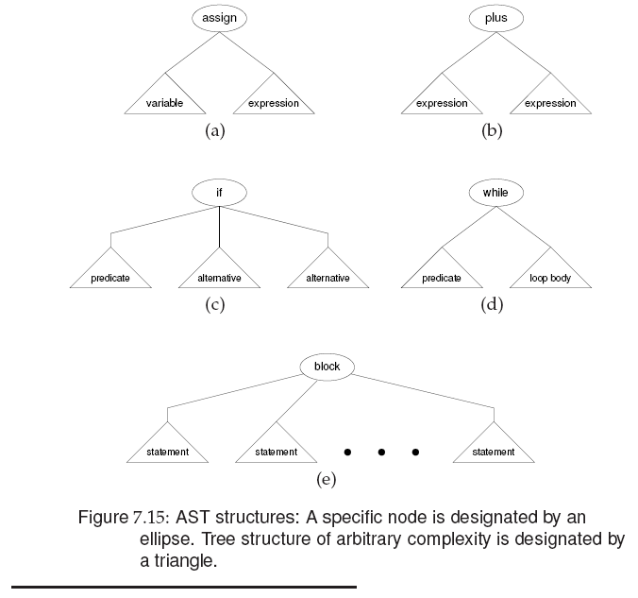
Abstract Syntax Tree: data structure implementation
COMP 442/6421 – Compiler Design
makeFamily(op, kid₁, kid₂, …, kid_{n}): generates a family with n children under a parent op. For example:
One such function to create each kind
of sub-tree, or one single variadic
function.
Some (many) programming languages do
not allow variadic functions.
Joey Paquet, 2018-2022

Slide 11
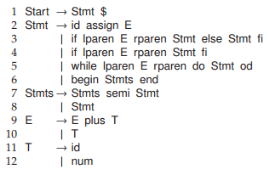
Insert semantic actions in the grammar/parser
COMP 442/6421 – Compiler Design
Example simple grammar:
Joey Paquet, 2018-2022

Slide 12
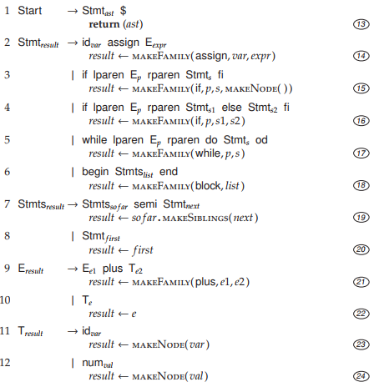
Insert semantic actions in the grammar/parser
COMP 442/6421 – Compiler Design
Example grammar with semantic actions added.
AST leaf nodes are created when the parse reaches leaves in the parse tree (23, 24) (makeNode).
Siblings lists are constructed as lists are processed inside a structure (19) (makeSiblings).
Subtrees are created when an entire structure has been parsed (14, 15, 16, 17, 18, 21) (makeFamily).
Some semantic actions are only migrating information across the tree (20, 22).
Joey Paquet, 2018-2022

Slide 13
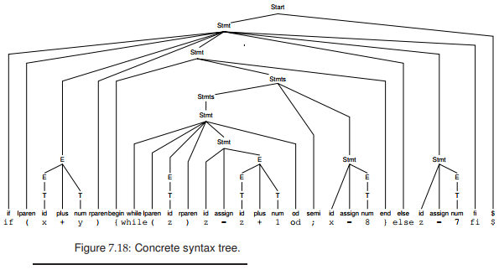
Example: parse tree
COMP 442/6421 – Compiler Design
Joey Paquet, 2018-2022

Slide 14
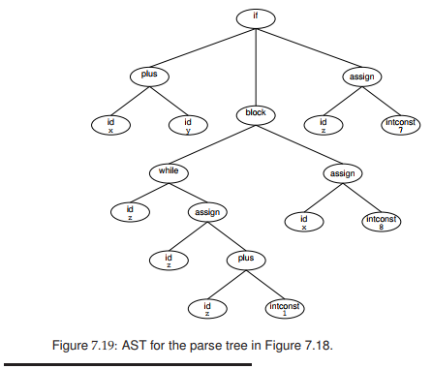
Example: corresponding AST
COMP 442/6421 – Compiler Design
Joey Paquet, 2018-2022

Slide 15
AST generation using Syntax-Directed Translation
COMP 442/6421 – Compiler Design
A language’s Semantic Concept is a building block of the meaning of a program
  literal value, variable, function definition, class and/or data structure, statement, expression, etc.
In an AST, each concept is represented by a node.
Atomic concepts (Ca) are represented by AST leaf nodes (CaN).
  Literal value, identifier, etc.
Composite concepts (Cc) represent higher-level concepts that aggregate n subordinate concepts (Cs).
Composite concepts are represented by an AST subtree (CcN) with n AST subtrees as children.
  class, function definition, statement, expression, etc.
Joey Paquet, 2018-2022

Slide 16
AST generation using Syntax-Directed Translation
COMP 442/6421 – Compiler Design
General Procedure:
  Upon reaching a parse tree leaf node where semantic information for atomic concept Ca is present
    call makeNode(Ca) to generate an AST node CaN for atomic concept Ca
    put the semantic information in CaN
    push CaN on the semantic stack
  As soon as a parsing subtree has gathered all necessary semantic information for composite concept Cc
    call makeNode(Cc) to generate an AST node CcN for composite concept Cc
    for each subordinate concept Cs of Cc
      pop the top of the semantic stack, yielding a node CsN representing Cs
      make CsN a child of CcN
    push CcN onto the semantic stack
  When the parse finishes, the semantic stack should contain only one node representing the full AST of the parsed program structure
Joey Paquet, 2018-2022

Slide 17
COMP 442/6421 – Compiler Design
AST creation in a recursive-descent predictive parser – using parameters for migration.
Joey Paquet, 2018-2022

Slide 18
AST generation: recursive-descent predictive parser -- using parameters
COMP 442/6421 – Compiler Design
AST variables represents tree nodes that are created, migrated and grafted/adopted in order to construct an abstract syntax tree.
Parse(){
AST Es //blank AST created
//before the call
lookahead = NextToken()
if (E(Es);Match('$')) //passed as a reference
//to parsing functions
//that will create the tree
return(true);
else
return(false);
}
Joey Paquet, 2018-2022

Slide 19
AST generation: recursive-descent predictive parser -- using parameters
COMP 442/6421 – Compiler Design
Each parsing function potentially (i.e. not necessarily all of them) defines its own AST nodes used locally that represents its own subtree.
Ts,E's are ASTs produced/used by the T() and E’() functions and returned by them to the E() function.
E(AST &Es){
AST Ts,E's
if (lookahead is in [0,1,(])
if (T(Ts);E'(Ts,E's);) // E' inherits Ts from T
write(E->TE')
Es = E's // Synthetised attribute sent up
return(true) // by way of the Es reference
else // parameter of E()
return(false)
else
return(false)
}
Joey Paquet, 2018-2022

Slide 20
AST generation: recursive-descent predictive parser -- using parameters
COMP 442/6421 – Compiler Design
E’(AST &Ti, type &E's){
AST Ts,E'2s
if (lookahead is in [+])
if (Match('+');T(Ts);E'(Ts,E'2s)) // (3) E' inherits Ts from T
write(E'->TE')
E's = makeFamily(+,Ti,E'2s) // (1) AST subtree creation
return(true) // sent up in the parse tree
else // by way of the E’s parameter
return(false)
else if (lookahead is in [$,)]
write(E'->epsilon)
E's = Ti // (2) Synth. attr. is inherited
return(true) // from T (sibling, not child)
else // and sent up
return(false)
}
Some semantic actions will do some semantic checking and/or semantic aggregation, such as a tree node adopting a child node, or inferring the type of an expression from two child operands (1).
Some semantic actions are simply migrating an AST subtree upwards in the parse tree (2), or sideways to a sibling tree (3).
Joey Paquet, 2018-2022

Slide 21
AST generation: recursive-descent predictive parser -- using parameters
COMP 442/6421 – Compiler Design
T(AST &Ts){
AST Fs, T's
if (lookahead is in [0,1,(])
if (F(Fs);T'(Fs,T's);) // T' inherits Fs from F
write(T->FT')
Ts = T's // Synthetized attribute sent up
return(true)
else
return(false)
else
return(false)
}
Joey Paquet, 2018-2022

Slide 22
AST generation: recursive-descent predictive parser -- using parameters
COMP 442/6421 – Compiler Design
T’(AST &Fi, type &T's){
AST Fs, T'2s
if (lookahead is in [*])
if (Match('*');F(Fs);T'(Fs,T'2s)) // T' inherits Fs from F
write(T'->*FT')
T's = makeFamily(*,Fi,T'2s) // AST subtree creation
return(true) // using left operand migrated
else // from left sibling parse tree
return(false) // received as Fi parameter
else if (lookahead is in [+,$,)]
write(T'->epsilon)
T's = Fi // Synthetized attribute is
// inhertied from F sibling
// and sent up the tree
return(true)
else
return(false)
}
Joey Paquet, 2018-2022

Slide 23
AST generation: recursive-descent predictive parser -- using parameters
COMP 442/6421 – Compiler Design
F(AST &Fs){
AST Es
if (lookahead is in [id])
if (Match('id'))
write(F->id)
Fs = makeNode(id) // create a leaf node
return(true) // and send it up the parse tree
else
return(false)
else if (lookahead is in [(])
if (Match('(');E(Es);Match(')'))
write(F->(E))
Fs = Es // Synthetized attribute from E
return(true) // i.e. AST of whole expression
else return(false) // sent up in the parse tree
else return(false) // as AST subtree representing
} // the ‘(E)’ successfully parsed
Joey Paquet, 2018-2022

Slide 24
Attribute migration: example
COMP 442/6421 – Compiler Design
a+b*c
+
AST
Es
a
*
E
E’s
makeFamily
b
c
Ts
T₁
Ti
E’₁
E’s
T’s
E’s
Fs
F₁
Fi
T’₁
T’s
+
Ts
T₂
Ti
E’₂
E’s
Fs
makeNode
ε
T’s
ε
id(v_{a}:τ)
makeFamily
Fs
F₂
Fi
T’₂
T’s
parse tree
Fs
T’s
makeNode
id(v_{b}:τ)
*
Fs
F₃
Fi
T’₃
T’s
Fs
ε
makeNode
id(v_{c}:τ)
Joey Paquet, 2000-2018-2022

Slide 25
COMP 442/6421 – Compiler Design
AST creation in a recursive-descent predictive parser – using a stack for migration.
Joey Paquet, 2018-2022

Slide 26
AST generation: recursive-descent predictive parser -- using stack
COMP 442/6421 – Compiler Design
Parse(){
ASTnode Es // empty semantic record created
push(Es) // and push before the call to E()
// any parsing function that needs
// to hold new semantic information
// creates semantic records and pushes
// them on the stack
lookahead = NextToken()
if (E();Match('$')) // parsing functions expect the
// semantic record on the stack
// and will use it
return(true);
else
return(false);
}
Joey Paquet, 2018-2022

Slide 27
AST generation: recursive-descent predictive parser -- using stack
COMP 442/6421 – Compiler Design
E(){
ASTnode Es = pop(Es) // will work on Es provided by calling
// function, so pop it.
if (lookahead is in [0,1,(])
ASTnode TsE’s // this right hand side needs two new
push(E’s) // semantic records: Ts and E’s
push(Ts) // to fill-in the Es that its
// calling function needs
if (T();E'();) // T() will pop Ts,
// fill it in and push it back for E’()
// to use it along with the empty E’s
write(E->TE')
Es = pop(E’s) // the E’s we got from E’() is sent up
push(Es) // the tree as Es
return(true)
else
return(false)
else
return(false)
}
Joey Paquet, 2018-2022

Slide 28
AST generation: recursive-descent predictive parser -- using stack
COMP 442/6421 – Compiler Design
E'(){
ASTnode Ti = pop(Ts) // get Ti we got by way of T() as Ts
ASTnode E's = pop(E's) // get the empty E’s sent from the
// calling function
if (lookahead is in [+])
ASTnode Ts,E'2s // we will need T() and E’()
push(E'2s) // to process Ts and E’2s, so
push(Ts) // we create and push them.
if (Match('+');T();E'()) // T() will pop Ts, fill it in
// and push it back for E’() to
// pop along with the empty E’2s.
// E’() will then push an Es
write(E'->TE')
E's = makeFamily(+,pop(Ti),pop(E’2s)) // create subtree
push(E's) // send up
return(true)
else
return(false)
else if (lookahead is in [$,)])
write(E'->epsilon)
E's = Ti // synth. attr. is inherited
push(E's) // from T (sibling, not child)
// and sent up
return(true)
else
return(false)
}
Joey Paquet, 2018-2022

Slide 29
AST generation: recursive-descent predictive parser -- using stack
COMP 442/6421 – Compiler Design
T(){
ASTnode Ts = pop(Ts) // the empty Ts pushed by the
// calling function for T() to fill in
if (lookahead is in [0,1,(])
ASTnode Fs, T's // we need F() and T’() to process
push(T's) // Fs and T’s, so we create it and
push(Fs) // push it on the stack for them
if (F();T'();) // F will pop the empty Fs, fill it in
// and push it back. T’ will pop it
// along with the empty T’s, create a
// T’s and push it.
write(T->FT')
Ts = pop(T's) // the T’s pushed by T’()
push(Ts) // is popped and pushed as Ts
return(true)
else
return(false)
else
return(false)
}
Joey Paquet, 2018-2022

Slide 30
AST generation: recursive-descent predictive parser -- using stack
COMP 442/6421 – Compiler Design
T'(){
ASTnode T's = pop(T's) // pop the empty T’s was pushed by the
ASTnode Fi = pop(Fs) // calling function. pop the Fs that
// was pushed by the calling function
// which is our inherited attribute from F (Fi)
if (lookahead is in [*])
ASTnode Fs, T's2 // we will need F() and T’()
push(T's2) // to process Fs and T’2s, so
push(Fs) // we create and push them.
if (Match('*');F();T'()) // F() will pop Fs, fill it in
// and push it back for T’() to
// pop along with the empty T’s2.
// E’() will then push an Es
write(T'->*FT')
T's = makeFamily(*,pop(Fi),pop(T’2s)) // make subtree
push(T’s) // send up
return(true)
else
return(false)
else if (lookahead is in [+,$,)])
write(T'->epsilon)
T's = Fi // synthetized attribute is
push(T’s) // inherited from F sibling
// and sent up the tree
return(true)
else
return(false)
}
Joey Paquet, 2018-2022

Slide 31
AST generation: recursive-descent predictive parser -- using stack
COMP 442/6421 – Compiler Design
F(){
ASTnode Fs = pop(Fs) // get empty Fs from calling function
if (lookahead is in [id])
if (Match('id'))
write(F->id)
Fs = makeNode(id) // create leaf node
push(Fs) // send up
return(true)
else
return(false)
else if (lookahead is in [(])
semrec Es // we need E() to process an Es
push(Es) // so we create an empty Es and
// send it to E() to fill in
if (Match('(');E();Match(')'))
write(F->(E))
Fs = pop(Es) // Es pushed by E()
// sent up the tree as Fs
return(true)
else return(false)
else return(false)
}
Joey Paquet, 2018-2022

Slide 32
COMP 442/6421 – Compiler Design
Abstract Syntax Tree structural elements
Joey Paquet, 2018-2022

Slide 33
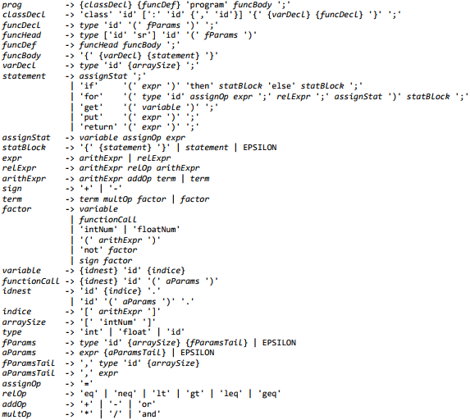
Example grammar
COMP 442/6421 – Compiler Design
Joey Paquet, 2018-2022

Slide 34
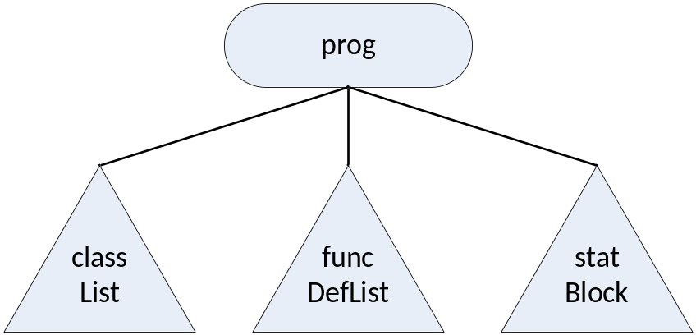
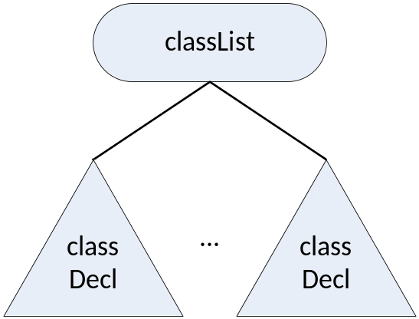
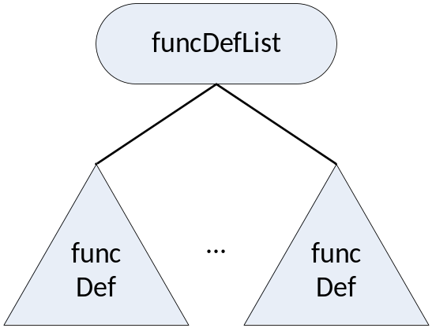
Abstract Syntax Tree structural elements
COMP 442/6421 – Compiler Design
Joey Paquet, 2018-2022

Slide 35
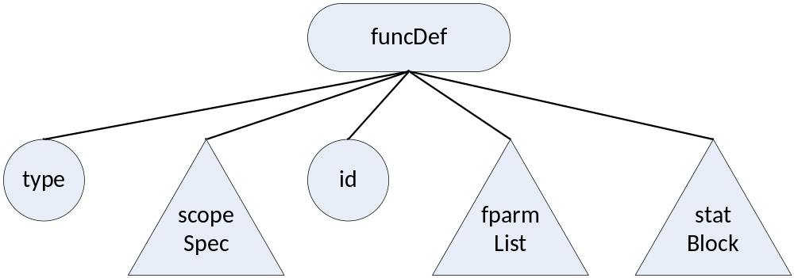
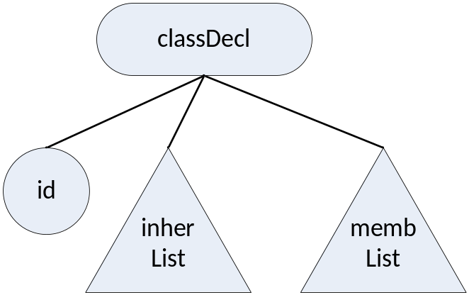
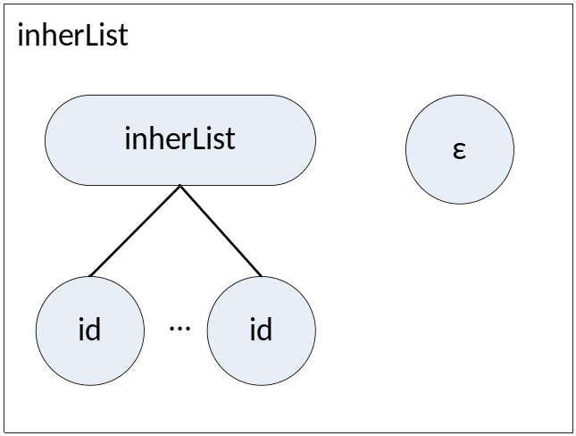
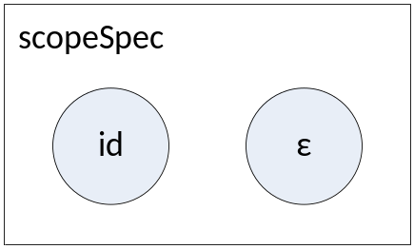
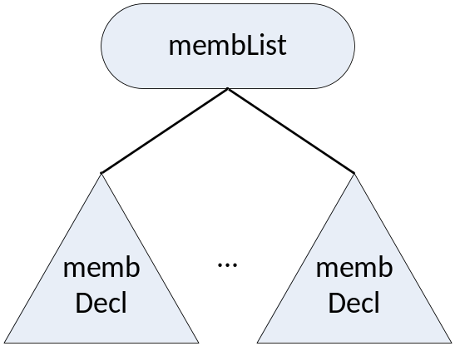
Abstract Syntax Tree structural elements
COMP 442/6421 – Compiler Design
Joey Paquet, 2018-2022

Slide 36
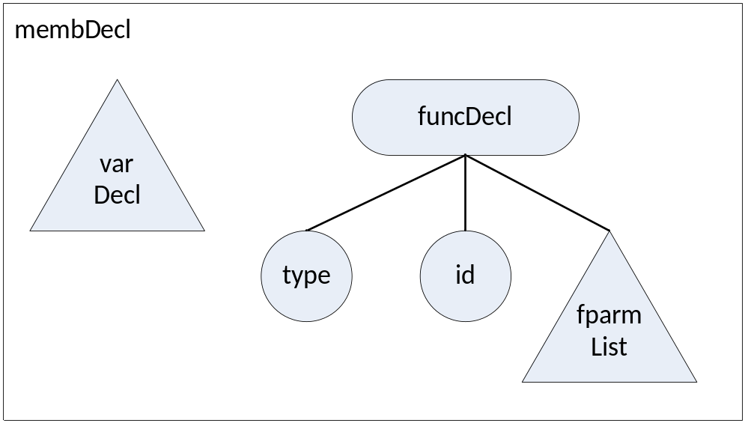
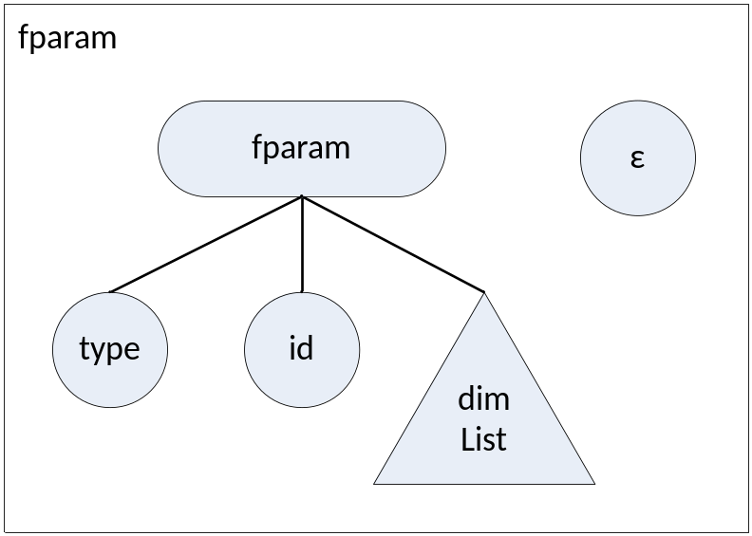
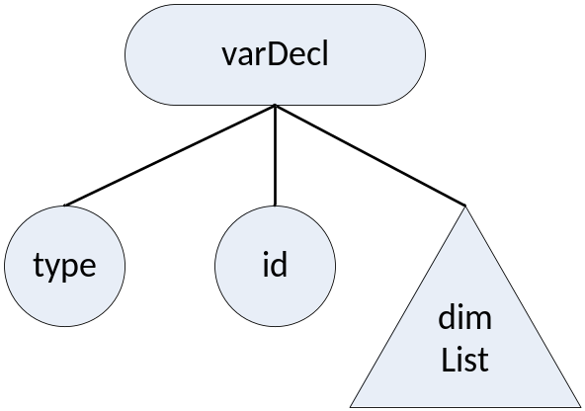
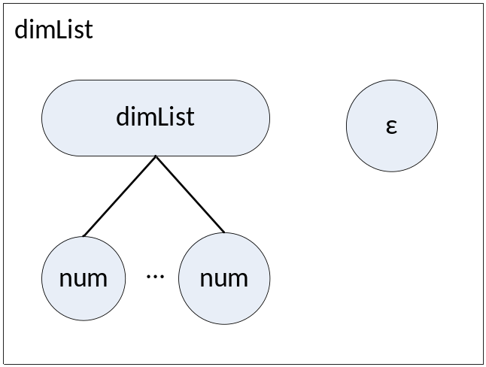
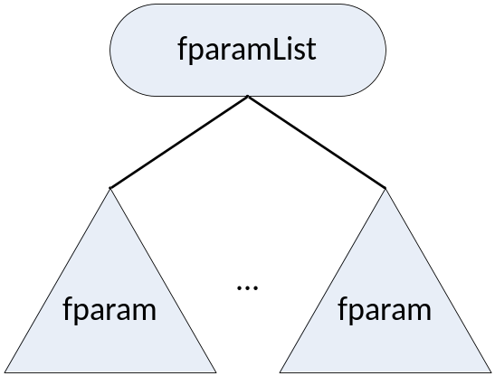
Abstract Syntax Tree structural elements
COMP 442/6421 – Compiler Design
Joey Paquet, 2018-2022

Slide 37
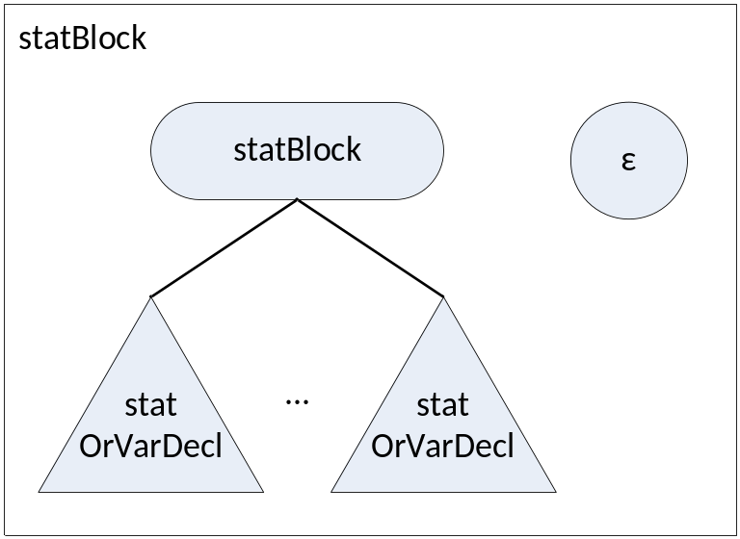
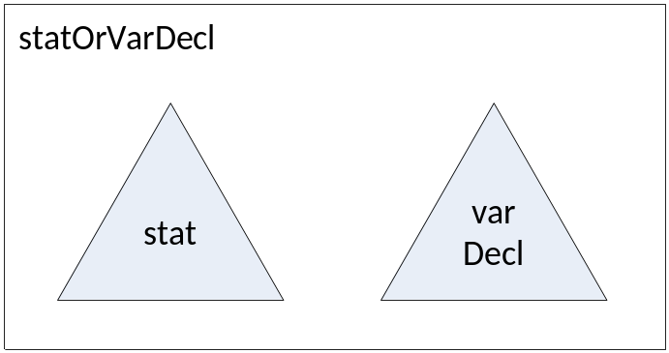
Abstract Syntax Tree structural elements
COMP 442/6421 – Compiler Design
Joey Paquet, 2018-2022

Slide 38
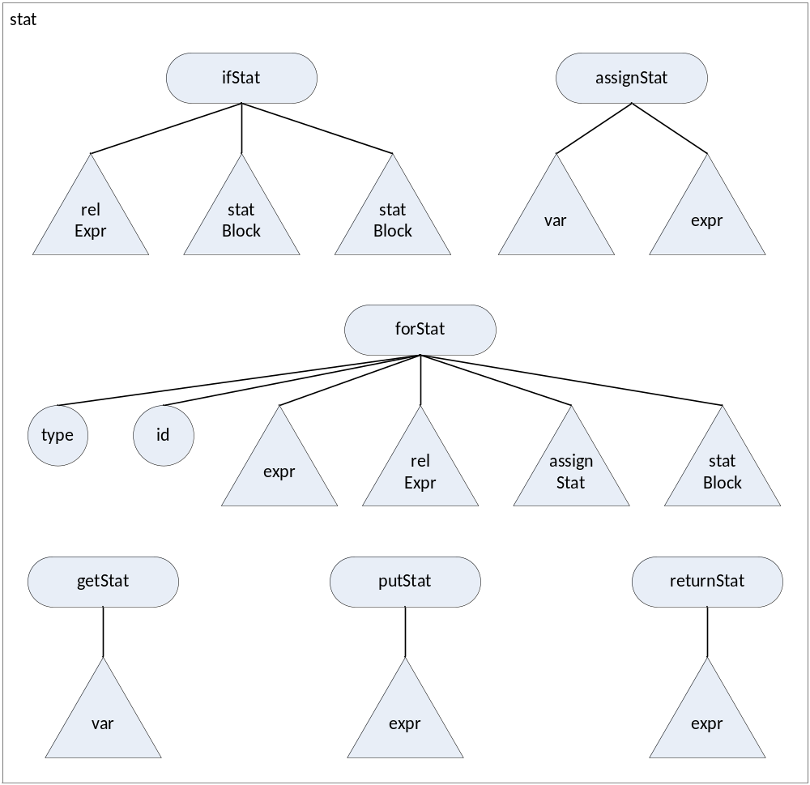
Abstract Syntax Tree structural elements
COMP 442/6421 – Compiler Design
Joey Paquet, 2018-2022

Slide 39
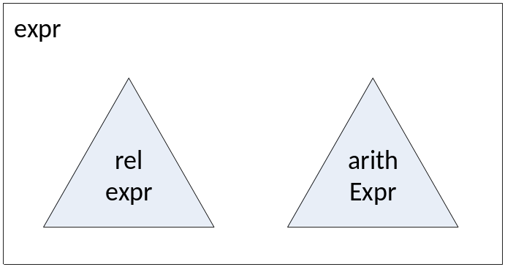
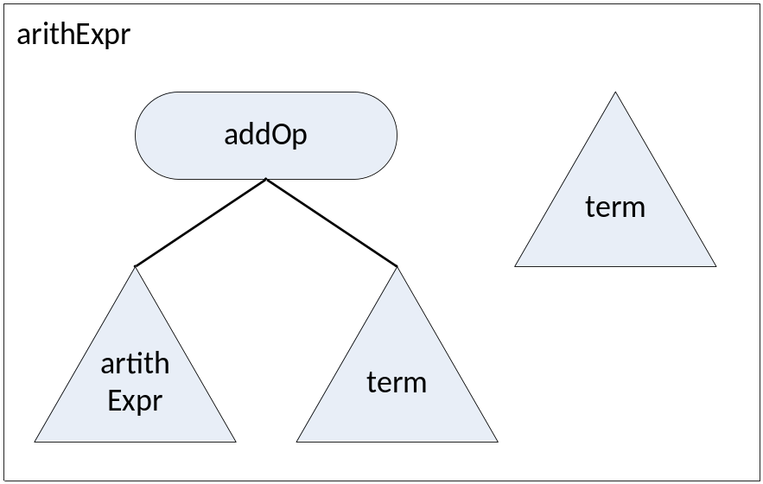
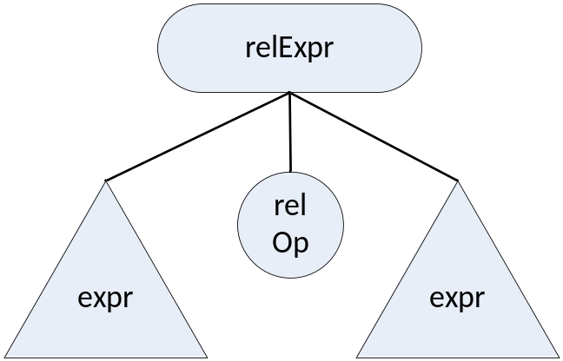
Abstract Syntax Tree structural elements
COMP 442/6421 – Compiler Design
Joey Paquet, 2018-2022

Slide 40
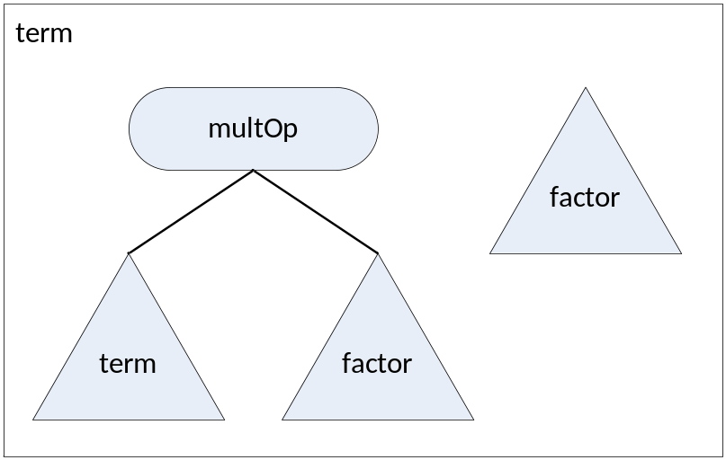
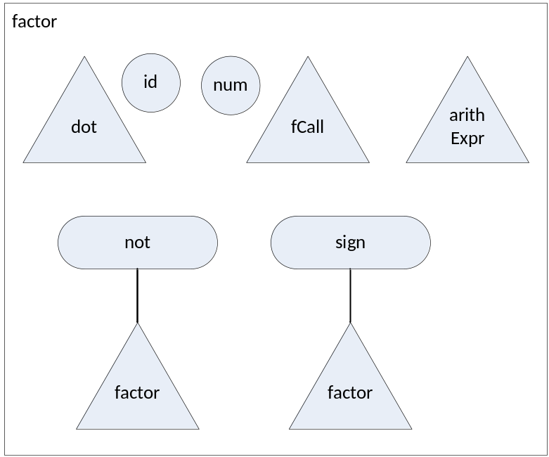
Abstract Syntax Tree structural elements
COMP 442/6421 – Compiler Design
Joey Paquet, 2018-2022

Slide 41
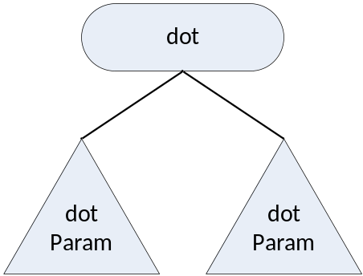
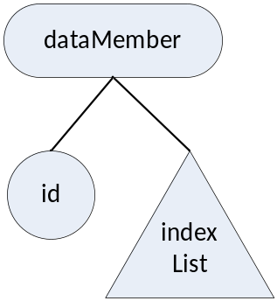
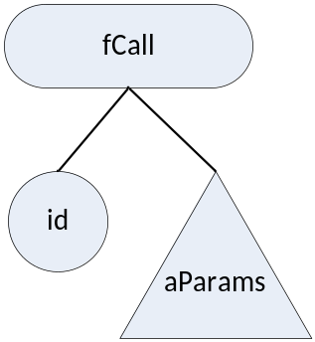
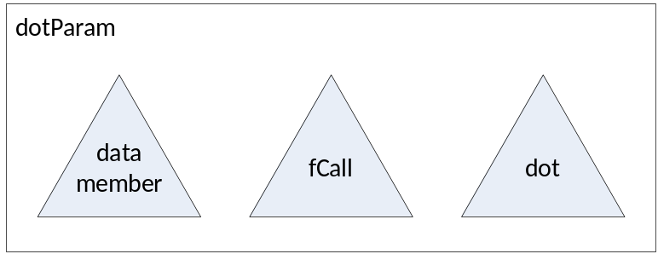
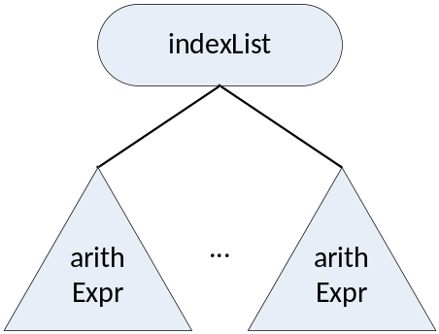
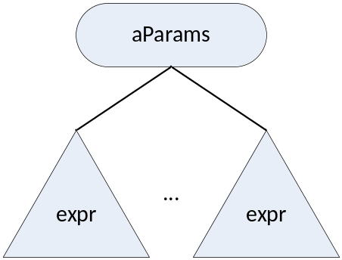
Abstract Syntax Tree structural elements
COMP 442/6421 – Compiler Design
Joey Paquet, 2018-2022

Slide 42
References
COMP 442/6421 – Compiler Design
Wikipedia. Abstract Syntax Tree.
C.N. Fischer, R.K. Cytron, R.J. LeBlanc Jr., Crafting a Compiler, Adison-Wesley, 2009. Chapter 7.
Joey Paquet, 2018-2022

