Slide 1
COMP 442 / 6421
Compiler Design
Abstract Syntax Tree (AST)
Instructor: TAs:
Dr. Joey Paquet
Hamed Jafarpour
Vashisht Marhwal
paquet@cse.concordia.ca hamed.jafarpour@concordia.ca
vmarhwal97@gmail.com

Slide 2
Outline
Abstract Syntax Tree (AST)
AST Data Structure
DOT files
Gephi Platform

Slide 3
Abstract Syntax Tree (AST)
AST is a tree representation of the abstract syntactic structure of source code written in a programming language.
Each node of the tree denotes a construct occurring in the source code.
The AST structure is constructed bottom-up.

Slide 4
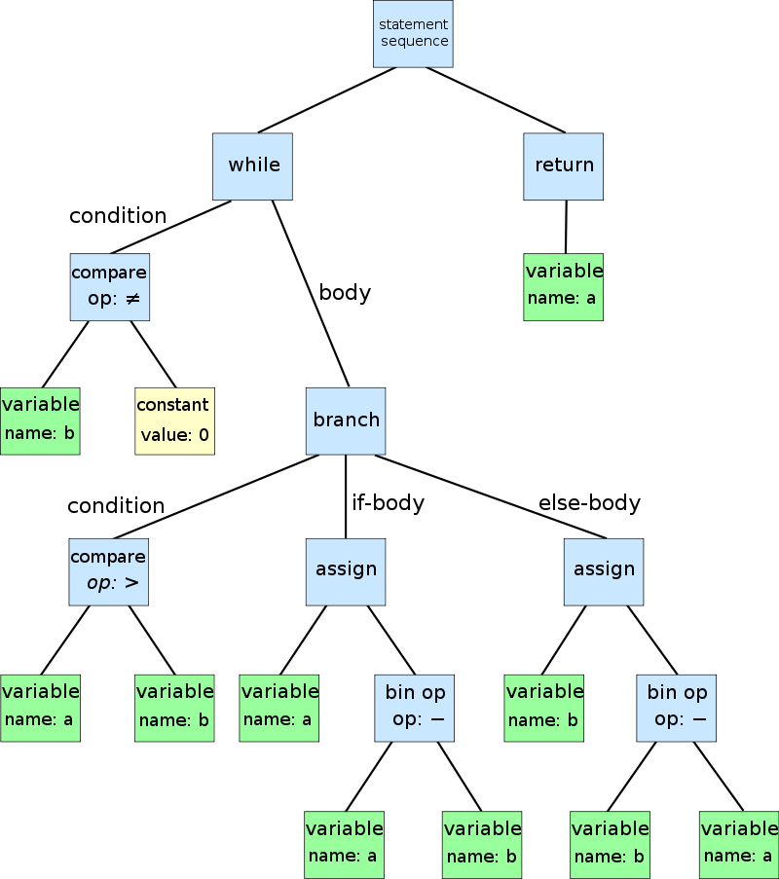
Abstract Syntax Tree (AST)
An abstract syntax tree for the following code:
while b ≠ 0
if a > b
a := a − b
else
b := b − a
return a

Slide 5
AST Data Structure
Each node needs connection to:
Parent: to migrate information upwards in the tree
Link to parent
Siblings: to iterate through (1) a list of operands or (2) members of a group, e.g. members of a class, or statements in a statement block.
Link to right sibling (thus creating a linked list of siblings)
Link to leftmost sibling (in case one needs to traverse the list as a sibling is being processed).
Children: to generate/traverse the tree
Link to leftmost child (who represents the head of the linked list of children, which are each other’s siblings).

Slide 6
Parent Connection for Each Node

Slide 7
Siblings Connection for Each Node
Siblings
Link to right sibling (thus creating a linked list of siblings) (Blue Arrows)
Link to leftmost sibling (in case one needs to traverse the list as a sibling is being processed). (Red Arrows)

Slide 8
Children Connection for Each Node
Children: to generate/traverse the tree
Link to leftmost child (who represents the head of the linked list of children, which are each other’s siblings).

Slide 9
AST Data Structure
Methods:
makeNode(): A method that creates a node.
x.makeSiblings(y): A method that inserts a new sibling node y in the list of siblings of node x.
x.adpotChidren(y): A method that adopts node y and all its siblings under the parent x.
makeFamily (Prnt, kid1, kid2, …, kidn): generates a family with n children under a parent Prnt. In fact, with this function you can find sub-tree.

Slide 10
DOT Files:
DOT is a graph description language.
DOT graphs are files with the filename extension gv or dot.
DOT can be used to describe an undirected or directed graph

Slide 11
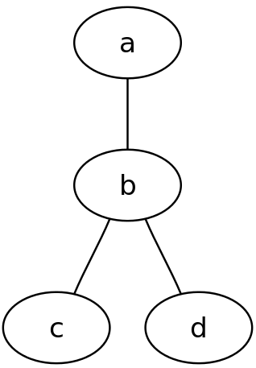
DOT Files:
Undirected graphs:
graph graphName {
a -- b -- c;
b -- d;
}
Note: The graph name and the semicolons are optional

Slide 12
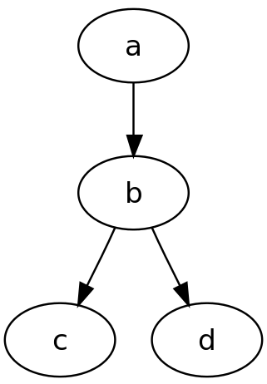
DOT Files:
Directed graphs:
digraph graphName {
a -> b -> c;
b -> d;
}

Slide 13
DOT Files:
Directed graphs:
B -> {C D}
is equivalent to
B -> C
B -> D
Note: For mor information about DOT file, visit the bellow link:
https://graphviz.org/doc/info/lang.html

Slide 14
Gephi Platform
Gephi is the leading visualization and exploration software for all kinds of graphs and networks.
Gephi is open-source and free.
Download Gephi Platform

Slide 15
Gephi Platform
Gephi is the leading visualization and exploration software for all kinds of graphs and networks.
Gephi is open-source and free.
Download Gephi Platform

Slide 16
Gephi Platform
digraph name {
A[label="program"]
B[label="class list"]
C[label="class: LINEAR"]
D[label="class: QUADRATIC"]
A->B
B->C
B->D
}

Slide 17
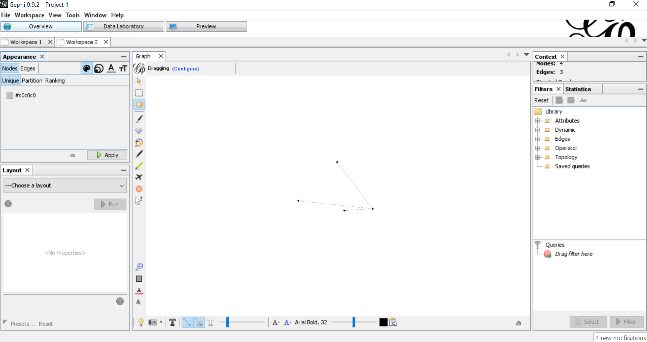
Gephi Platform

Slide 18
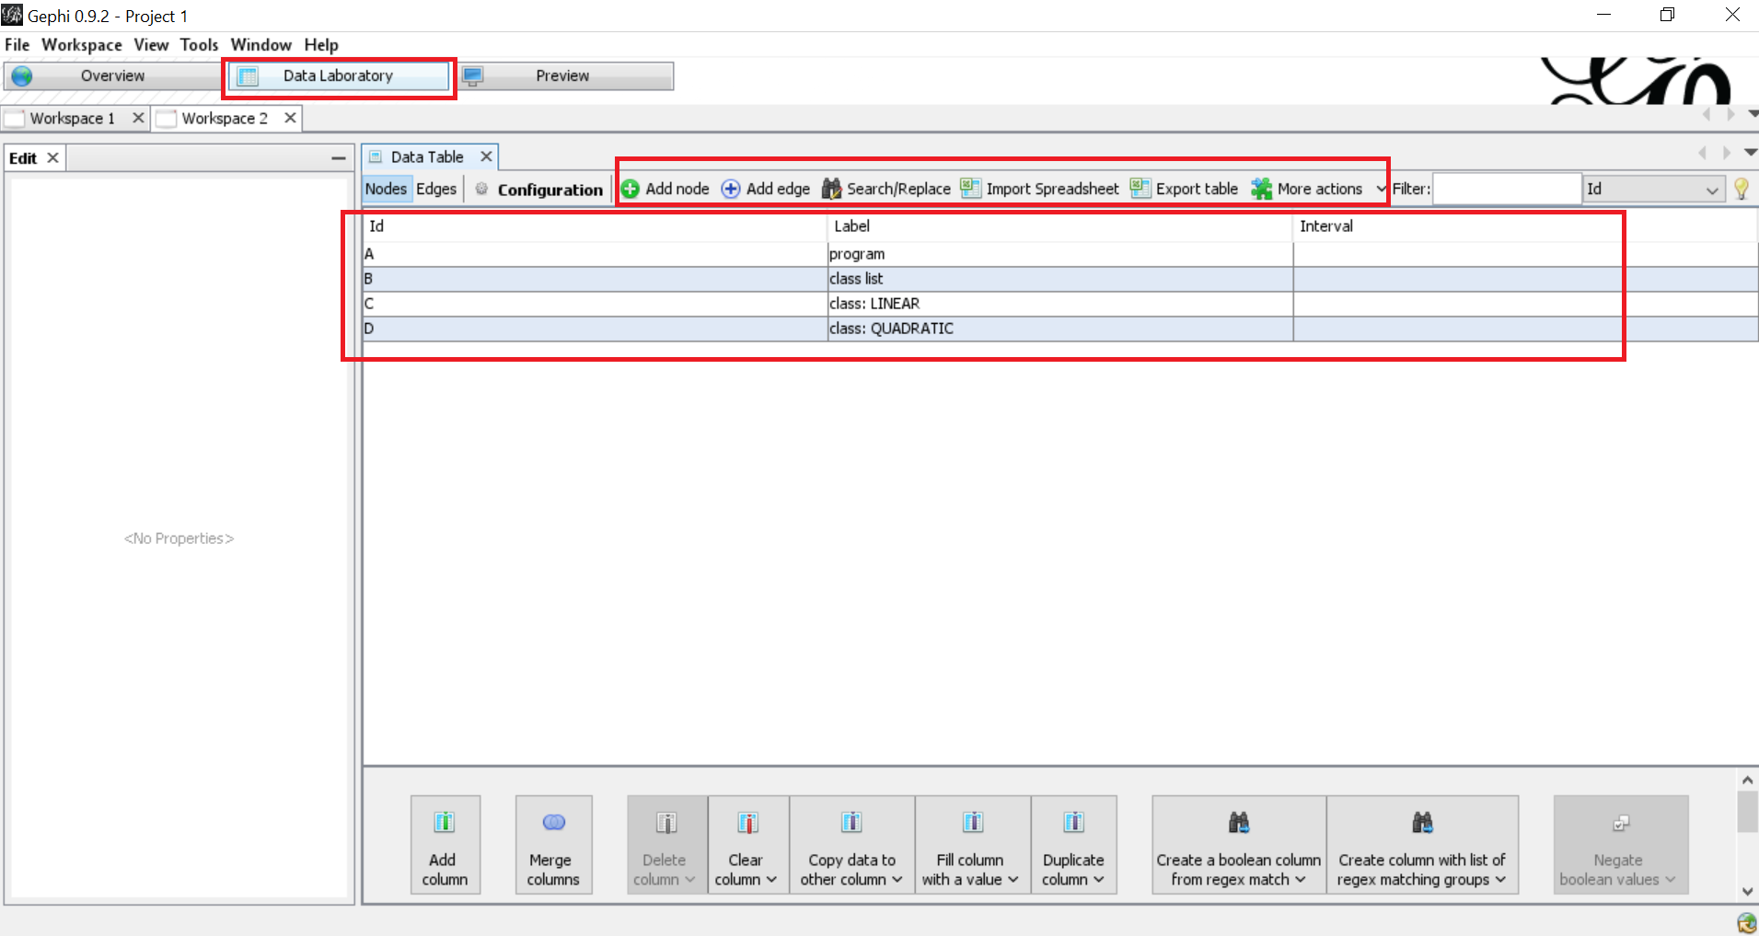
Gephi Platform

Slide 19
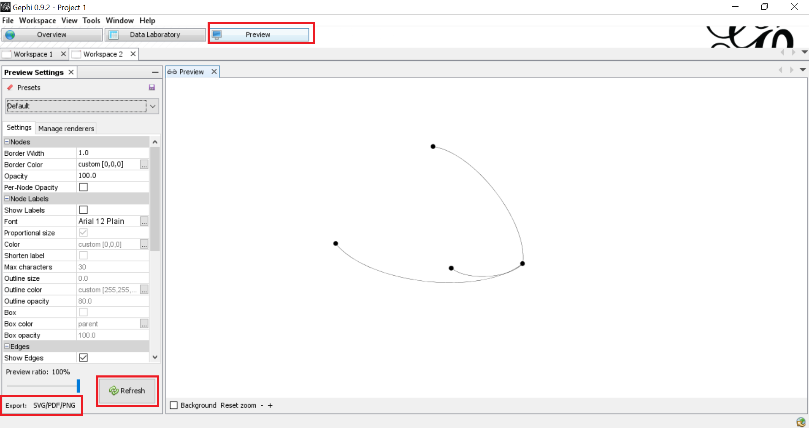
Gephi Platform

Slide 20
Gephi Platform ( a piece of a file)
digraph name {
0[label="program"]
0->1
1[label="class list"]
1->2
2[label="class"]
2->3
3[label="InheritedUtility"]
2->4
4[label="inheritance list"]
2->5
5[label="var+func decl list"]
5->6

Slide 21
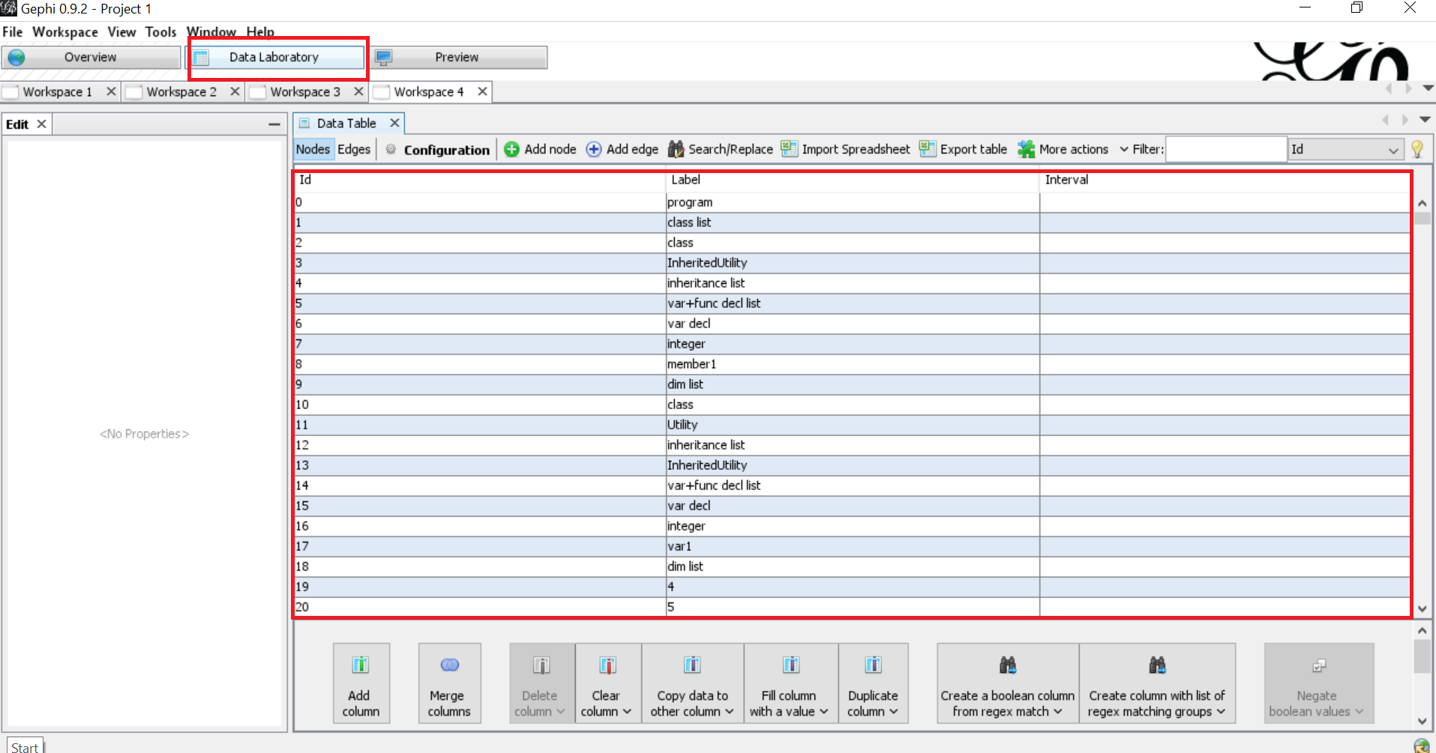
Gephi Platform

Slide 22
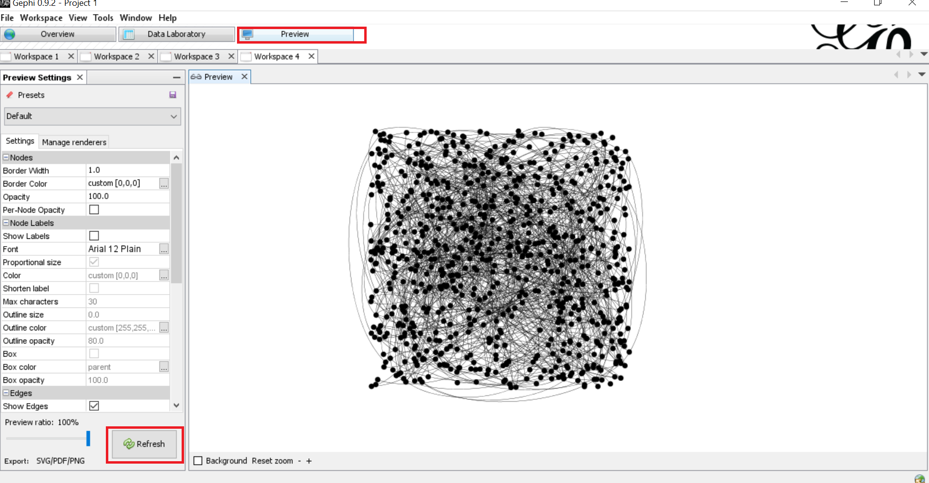
Gephi Platform

Slide 23
Thanks!

