Slide 1
COMPILER DESIGN
COMP 442/6421 – Compiler Design
Symbol table structure and generation
Type checking
Visitor pattern
Joey Paquet, 2018-2022

Slide 2
Symbol tables: processing declarations
COMP 442/6421 – Compiler Design
One of the objectives of the compiler is to verify that identifiers are properly used according to their specifications:
  Variables used according to their declarations (type, dimensionality)
  Functions called according to their declarations (return type, number and type of parameters)
  Objects are using members as defined in their class declaration
  Variables/functions are only used in the scope in which they were declared
In manifestly-typed languages, all identifiers have a declaration that specifies the types that they are statically bound to:
  Class and/or data structure declaration (global or embedded). Represent user-defined data types.
  Variable declaration (global/local variables, class/data structure members)
  Function declaration (free function, member function, embedded function)
Other languages minimize declarations by omitting types
  Often referred to as “dynamic languages”
  Limited analysis can still be done at compile-time, e.g. type inference
  Some of the analysis has to be delayed to run-time
In the project, our language is manifestly-typed.
Joey Paquet, 2018-2022

Slide 3
Symbol tables: processing declarations: tree traversal
COMP 442/6421 – Compiler Design
Declarations are processed as a tree is traversed:
  As an Abstract Syntax Tree intermediate representation was previously generated by the parse phase is traversed.
The processing of the declarations is made by aggregating and processing semantic information that is present at the leaves of the tree, and migrated/processed by intermediate nodes of the tree.
This migration/aggregation/processing is done using semantic actions that are triggered as the tree is traversed.
Specific semantic actions should be triggered when certain specific kind of nodes are reached as the tree is traversed.
If the processing is done upon an intermediate representation (e.g. an AST), further processing can be done in successive phases, where each phase is responsible for a specific part of the analysis/translation process.
Joey Paquet, 2018-2022

Slide 4
COMP 442/6421 – Compiler Design
Symbol table structure
Joey Paquet, 2018-2022

Slide 5
Symbol tables: scopes
COMP 442/6421 – Compiler Design
Generally, every scope defined in the language/program requires its own symbol table.
  The global scope contains an entry for all identifiers declared outside of any scope, e.g. global variables, globally-declared classes or data structures, free functions.
  Some named scopes (e.g. classes, functions) allow some identifiers to be declared, e.g. local variables, or even inner classes or inner functions – which we don’t have in the project.
  Some scopes are not named, e.g. a for loop’s statement block – these can also define their own sub-scope and corresponding sub-symbol table – it is suggested that you don’t implement local symbol tables for unnamed statement blocks.
Joey Paquet, 2018-2022

Slide 6
Symbol table: procedures to implement
COMP 442/6421 – Compiler Design
CreateNewTable – when a new scope is entered, a new empty symbol table is created, as well as the symbol table entry to be recorded in the higher-level symbol table.
Insert – while in a scope, for every declaration encountered, a symbol table record is created and inserted.
Search – when an identifier is referred to in a scope, the compiler needs to check if it has been previously declared, either in the current scope or one of its higher-level scopes. This requires a search method that searches across a table hierarchy. If information hiding descriptors are part of the language, they must be taken into consideration here.
Print – for utility, a facility to output a symbol table, along with its sub-tables.
Delete – some scopes cannot be referred to outside of their scopes. In which case their symbol tables have to be deleted, for efficiency. Some scopes, e.g. classes can be referred to from outside their own scope. These should be kept until the end of the compilation process.
Joey Paquet, 2018-2022

Slide 7
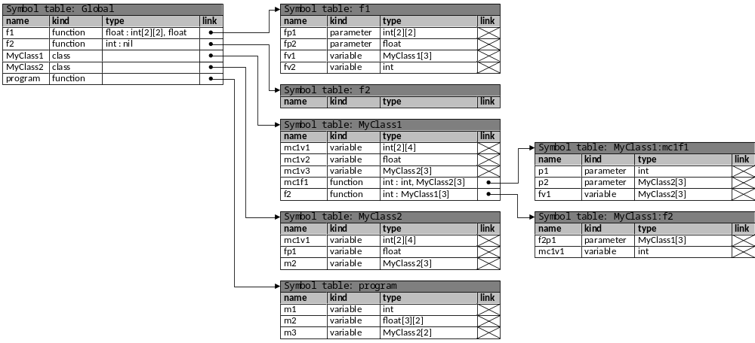
Symbol tables: example
COMP 442/6421 – Compiler Design
class MyClass1 {
int mc1v1[2][4];
float mc1v2;
MyClass2 mc1v3[3];
int mc1f1(int p1, MyClass2 p2[3]) {
MyClass2 fv1[3];
…
}
int f2(MyClass1 f2p1[3]) {
int mc1v1;
…
}
}
class MyClass2 {
int mc1v1[2][4];
float fp1;
MyClass2 m2[3];
…
}
program {
int m1;
float[3][2] m2;
MyClass2[2] m3;
...
}
float f1(int fp1[2][2], float fp2) {
MyClass1[3] fv1;
int fv2;
…
}
int f2() {
...
}
Joey Paquet, 2018-2022

Slide 8
COMP 442/6421 – Compiler Design
Symbol table generation
using Abstract Syntax Tree traversal
using the visitor pattern
Joey Paquet, 2018-2022

Slide 9
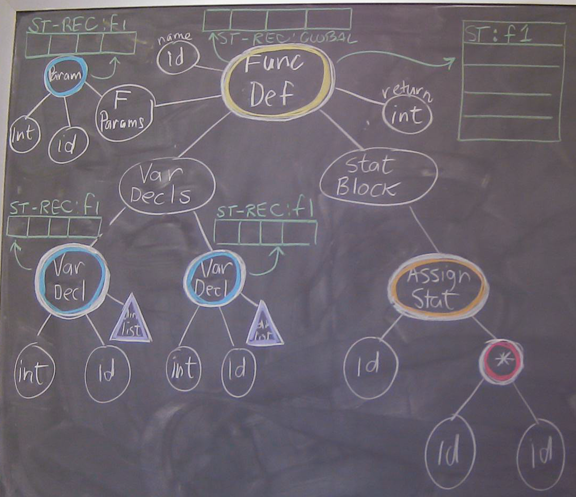
Example: function definition
COMP 442/6421 – Compiler Design
func f (int p1):int
{
localvars
{
int a;
int b;
}
a = a * b;
}
Joey Paquet, 2018-2022

Slide 10
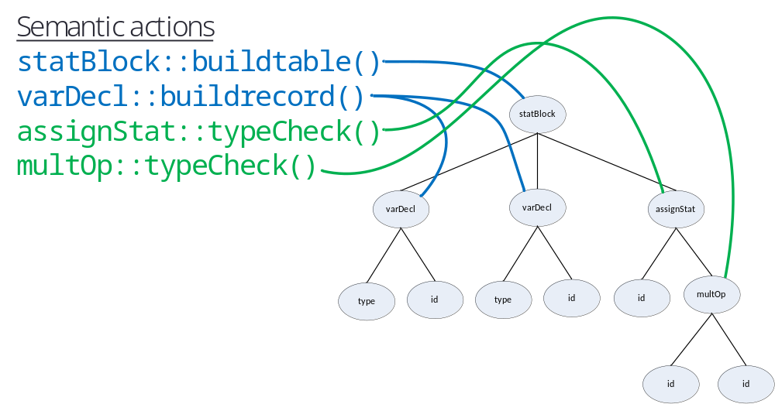
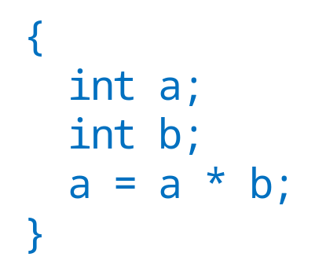
Tree traversal and semantic actions: example
COMP 442/6421 – Compiler Design
Semantic actions should be executed as the tree is traversed, either as the node is first reached, or as soon as each node’s subtree has been fully traversed.
Each node may potentially have to execute zero to several semantic actions. It may seem appropriate to define semantic actions as members of node classes.
However, some semantic actions require actions from other semantic actions to have taken place before.
Thus, semantic actions have to be grouped into phases, AND sill mapped to specific nodes.
The visitor design pattern is a structure that achieves all of this.
Joey Paquet, 2018-2022

Slide 11
COMP 442/6421 – Compiler Design
Visitor pattern :
- AST traversal
- firing semantic actions
- grouping of semantic actions in compilation phases
Joey Paquet, 2018-2022

Slide 12
COMP 442/6421 – Compiler Design
Visitor pattern: description
Motivation
  When many new operations are needed and an object structure consists of many different classes, it is inflexible to add new subclasses each time a new operation is required.
  Distributing all these new operations across the various classes leads to a system that's hard to understand, maintain, and change.
  Often, the new operations form groups that are related to cohesive groups of operations.
    Adding all of them in the same existing classes creates low cohesion.
    Often, only specific sub-groups of operations should be triggered.
Intent
  To create a structure/mechanism by which new operations are injected into existing classes, with minimal changes to be applied to these classes.
  To provide modularity and cohesion by creating groups of related new operations.
  Be able to inject/execute only a specific group of operations at a time.
Joey Paquet, 2018-2022

Slide 13
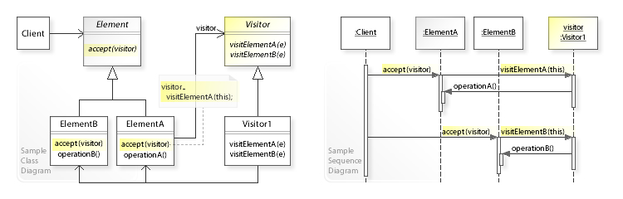
COMP 442/6421 – Compiler Design
Visitor pattern: structure
The classes/objects participating in the visitor pattern:
  Element – superclass of all the objects that are to be injected with new behavior.
  ConcreteElement – all the specific classes into which the new behavior is to be injected.
  Visitor – superclass of all injectable behavior groups.
  ConcreteVisitor – specific injectable behavior group.
  Client – piece of code that uses a group/structure of elements and wants to inject/execute new behavior in them.
Joey Paquet, 2018-2022

Slide 14
Visitor pattern: implementation
COMP 442/6421 – Compiler Design
The visitor pattern is made necessary when using a programming language that only supports single dispatch, as opposed to multiple dispatch. Under this condition, consider two objects, each of some class type; one is termed the Element, and the other is Visitor.
The Visitor class declares a visit() method, which takes the Element as an argument, for each class of Element that may be subject to new behavior injection, and provides the implementation of the injected behavior.
The Visitor class can be an abstract class or an interface.
In order to provide default empty behavior, it can be a regular class with empty methods for every Element type to be processed.
public class Visitor {
public void visit(Node node) {};
public void visit(IdNode node) {};
public void visit(NumNode numNode) {};
public void visit(TypeNode node) {};
public void visit(AddOpNode node) {};
public void visit(MultOpNode node) {};
public void visit(VarDeclNode node) {};
public void visit(DimListNode node) {};
}
Joey Paquet, 2018-2022

Slide 15
Visitor pattern: implementation
COMP 442/6421 – Compiler Design
ConcreteVisitors classes are derived from the Visitor class and implement these visit() methods, each of which implements part of a group of semantic actions operating on the AST, one for each type of node that needs to trigger a semantic action in the current phase.
public class SymTabCreationVisitor extends Visitor {
…
public void visit(VarDeclNode node){
// this is a semantic action implementation
// aggregate information from the subtree
String declrecstring;
// identify what kind of record that is
declrecstring = "localvar:";
// get the type from the first child node and aggregate here
declrecstring += node.getChildren().get(0).getData() + ':’;
// get the id from the second child node and aggregate here
declrecstring += node.getChildren().get(1).getData() + ':’;
// loop over the list of dimension nodes and aggregate here
for (Node dim : node.getChildren().get(2).getChildren())
declrecstring += dim.getData() + ':’;
// create the symbol table entry for this variable
// it will be picked-up by another node above later
node.symtabentry = new SymTabEntry(declrecstring, null);
// the symbol table entry now resides in the node
}
…
// semantic actions for other types of nodes are defined in this class
// they collectively implement a whole compilation phase
}
Joey Paquet, 2018-2022

Slide 16
Visitor pattern: implementation
COMP 442/6421 – Compiler Design
The Element declares an accept() method to accept the injection of the applicable methods of a Visitor, by taking the Visitor as an argument.
ConcreteElements, derived from the Element class, implement the accept() method, these effectively implement tree traversal.
  For atomic Elements, i.e. leaf nodes, this is a simple call to the visitor’s visit() method.
  For composite Elements (i.e. elements that contain references to other elements), each referenced element`s accept() method is called, propagating the injection of the new behavior throughout the structure and implementing tree traversal.
public class IdNode extends Node {
…
public void accept(Visitor visitor) {
visitor.visit(this);}
}
public class MultOpNode extends Node {
…
public void accept(Visitor visitor) {
for (Node child : this.getChildren() )
child.accept(visitor);
visitor.visit(this);
}
}
Joey Paquet, 2018-2022

Slide 17
Visitor pattern: implementation
COMP 442/6421 – Compiler Design
The Client creates the Element object structure and instantiates one ConcreteVisitor for each of the behavior group it wants to inject into the structure.
When it wants to execute the behavior implemented by a specific ConcreteVisitor, it calls the accept() method of the element that is the entry point of the structure, passing the specific ConcreteVisitor as a parameter.
The accept/visit methods calls are then propagated in the structure, effectively implementing the chosen behavior over the entire structure.
ConstructExpressionStringVisitor CEVisitor = new ConstructExpressionStringVisitor();
TypeCheckingVisitor TCVisitor = new TypeCheckingVisitor();
\\ d+e*f
Node d = new IdNode("d", "int");
Node e = new IdNode("e", "int");
Node f = new IdNode("f", "float");
Node times = new MultOpNode("*", e, f);
Node plus = new AddOpNode("+", d, times1);
plus.accept(TCVisitor);
plus.accept(CEVisitor);
Joey Paquet, 2018-2022

Slide 18
Visitor pattern: mechanism: double dispatch
COMP 442/6421 – Compiler Design
When the accept() method is called, its specific implementation is chosen based on both the dynamic type of the Element upon which it is called, and the static type of the Visitor that is passed to it as a parameter.
When the visit() method is called in the accept() method, its specific implementation is chosen based on both the dynamic type of the Visitor and the static type of the Element, as known from within the implementation of the accept() method, which is the same as the dynamic type of the element.
Thus, the implementation of the visit() method is chosen based on both the dynamic type of the element and the dynamic type of the visitor. This effectively achieves the same result as a double dispatch mechanism.
Joey Paquet, 2018-2022

Slide 19
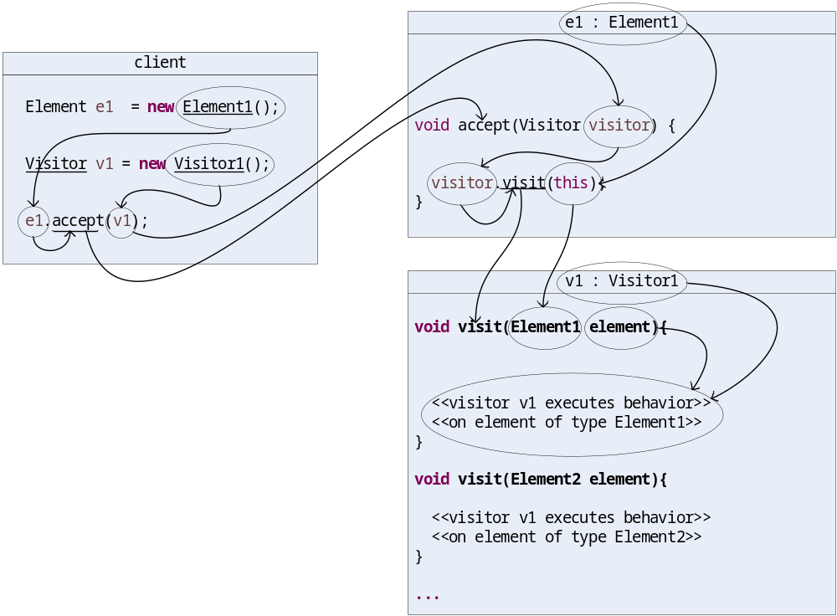
Visitor pattern: mechanism: double dispatch
COMP 442/6421 – Compiler Design
single dispatch
single dispatch
combined: double dispatch
Joey Paquet, 2018-2022

Slide 20
Visitor pattern: use in compiler design
COMP 442/6421 – Compiler Design
In this way, Element subtype-specific semantics actions can be implemented and applied as we do the traversal of a graph composed of subtypes of Elements.
Many different separate groups of related semantic actions can be performed during that traversal by supplying different ConcreteVisitors to interact with the elements based on the dynamic types of both the Elements and the Visitors.
In a compiler, the Elements are AST nodes, which are interconnected to form an Abstract Syntax Tree.
Different ConcreteVisitors can be designed to implement the different semantic analysis and translation phases, e.g.
  Construction of symbol table
  Type checking
  Translation into executable code
  Various optimization phases
Using the Visitor pattern, the implementation of all these phases can effectively be separated, thus decreasing the overall complexity of the compiler and increasing the flexibility of its implementation.
Joey Paquet, 2018-2022

Slide 21
COMP 442/6421 – Compiler Design
AST visitors for symbol table creation
Joey Paquet, 2018-2022

Slide 22
AST visitor : symbol tables creation : concept
COMP 442/6421 – Compiler Design
Each scope in the program should have its own symbol table
  global, class, function body: member function, free function, main function
  When we visit one of these node types:
    Create a new local symbol table that is a new data member of this node
    Aggregate id declarations’ symbol table records from its children subtrees
Joey Paquet, 2018-2022

Slide 23
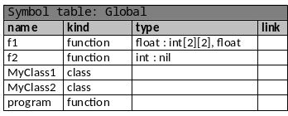
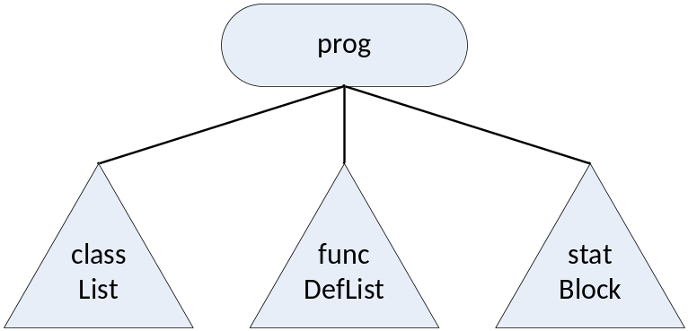

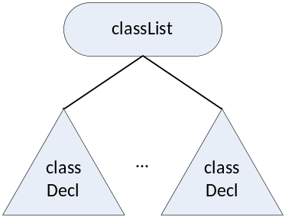
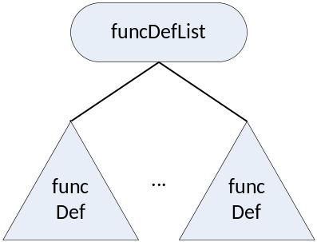
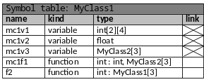

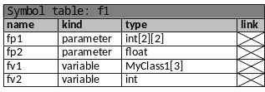

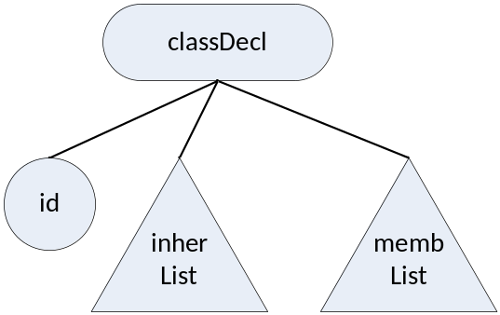


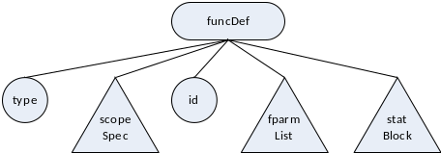
AST Visitor pattern : symbol tables creation : example
COMP 442/6421 – Compiler Design
program {
int m1;
float[3][2] m2;
MyClass2[2] m3;
...}
class MyClass1 {
int mc1v1[2][4];
float mc1v2;
MyClass2 mc1v3[3];
int mc1f1(int p1, MyClass2 p2[3]) {
MyClass2 fv1[3];
…
}
int f2(MyClass1 f2p1[3]) {
int mc1v1;
…
}
}
class MyClass2 {
int mc1v1[2][4];
float fp1;
MyClass2 m2[3];
…
}
int f2() {
...
}
float f1(int fp1[2][2], float fp2) {
MyClass1[3] fv1;
int fv2;
…
}
Joey Paquet, 2018-2022

Slide 24
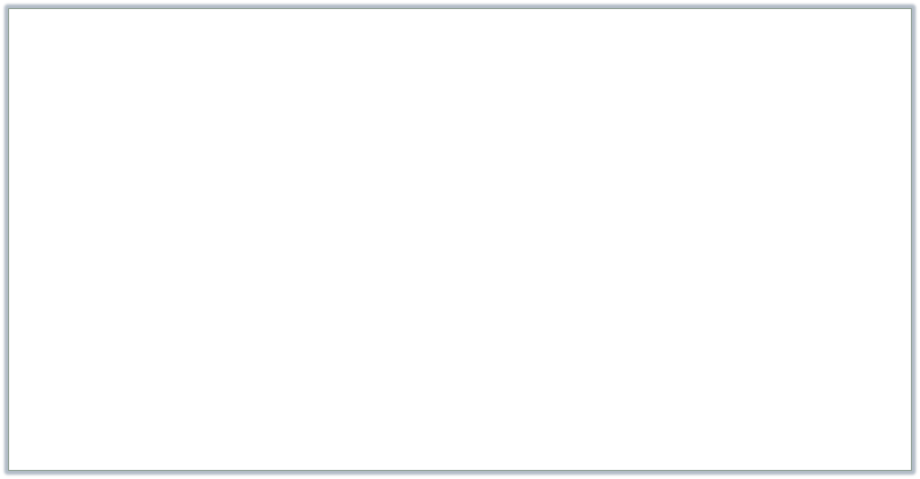
AST Visitor pattern : symbol tables creation : example
COMP 442/6421 – Compiler Design
public class SymTabCreationVisitor extends Visitor {
…
public void visit(ProgNode node){
node.symtab = new SymTab("global");
// for classes, loop over all class declaration nodes
for (Node classelt : node.getChildren().get(0).getChildren())
//add the symbol table entry of each class in the global symbol table
node.symtab.addEntry(classelt.symtabentry);
// for function definitions, loop over all function definition nodes
for (Node fndefelt : node.getChildren().get(1).getChildren())
//add the symbol table entry of each function definition in the global symbol table
node.symtab.addEntry(fndefelt.symtabentry);
// for the program function, get its local symbol table from node 2 and create
// an entry for it in the global symbol table
// first, get the table and set its name
SymTab table = node.getChildren().get(2).symtab;
table.m_name = "program";
node.symtab.addEntry("function:program", table);
};
…
}
Joey Paquet, 2018-2022

Slide 25
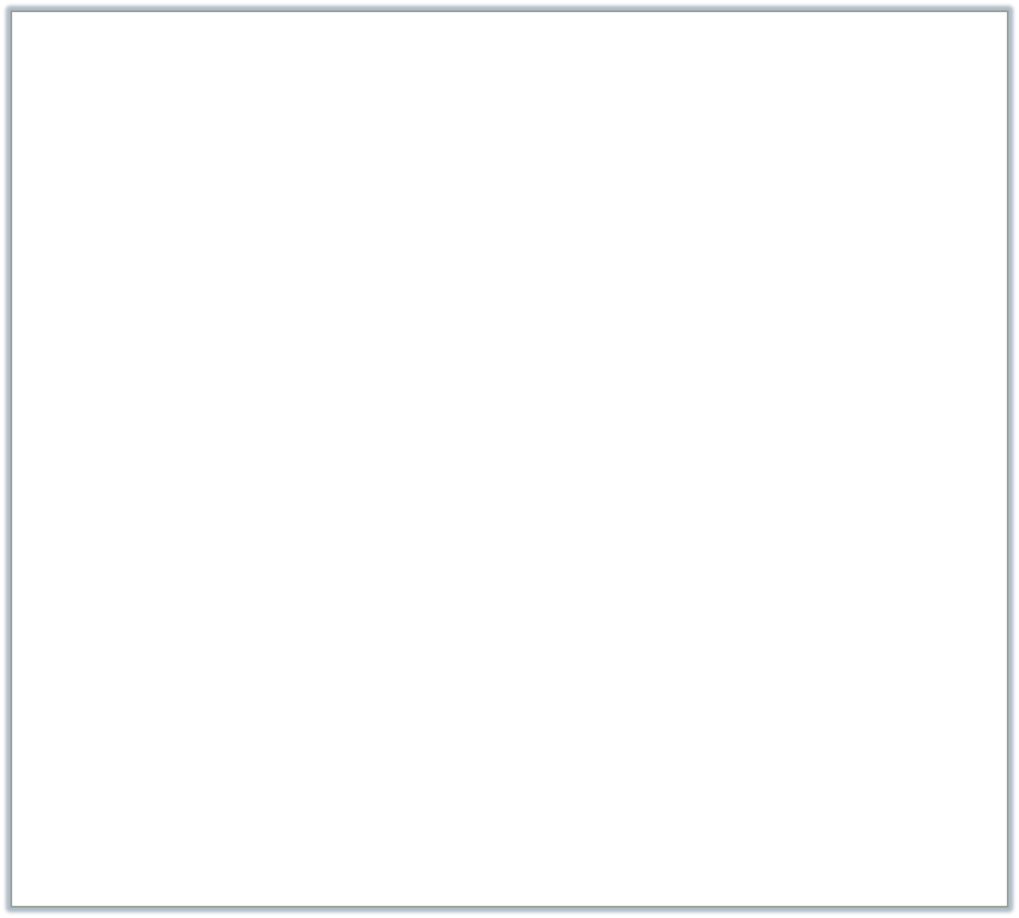
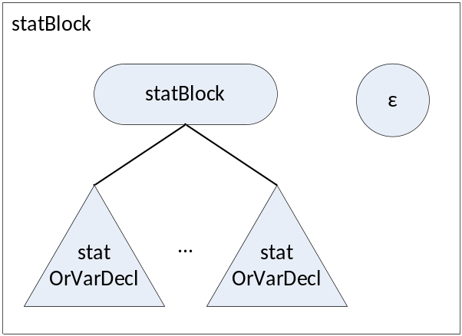
AST Visitor pattern : symbol tables creation : example
COMP 442/6421 – Compiler Design
public class SymTabCreationVisitor extends Visitor {
…
public void visit(ClassNode node){
// get the class name from node 0
String classname = node.getChildren().get(0).getData();
// create a new table with the class name
node.symtab = new SymTab(classname);
// loop over all children of the class and migrate their
// symbol table entries in class table
for (Node member : node.getChildren()){
if (member.symtabentry != null)
node.symtab.addEntry(member.symtabentry);
}
// create the symbol table entry for the class
node.symtabentry = new SymTabEntry("class:" + classname, node.symtab);
}
…
public void visit(StatBlockNode node){
node.symtab = new SymTab();
// add the symbol table entries of all the variables
// declared in the statement block
// they will later be picked-up by the higher-level
// table creation
for (Node stat : node.getChildren()){
if (stat.symtabentry != null)
node.symtab.addEntry(stat.symtabentry);
}
…
}
Joey Paquet, 2018-2022

Slide 26
AST Visitor pattern : symbol tables creation : concept
COMP 442/6421 – Compiler Design
Inside each scope, identifiers are declared
  class: data/function members
  function body: local variables, parameters
  When we visit one of these node types:
    Create a symbol table record
    It will be picked-up by the parent node’s semantic action when all its subtrees will have been traversed/processed (as done in the previous two slides).
Joey Paquet, 2018-2022

Slide 27

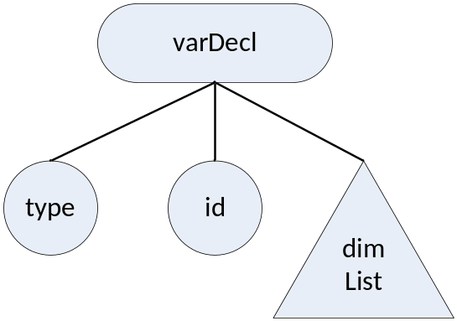
AST Visitor pattern : symbol tables creation : example
COMP 442/6421 – Compiler Design
public class SymTabCreationVisitor extends Visitor {
…
public void visit(VarDeclNode node){
// aggregate information from the subtree
String declrecstring;
// identify what kind of record that is
declrecstring = "localvar:";
// get the type from the first child node and aggregate here
declrecstring += node.getChildren().get(0).getData() + ':’;
// get the id from the second child node and aggregate here
declrecstring += node.getChildren().get(1).getData() + ':’;
// loop over the list of dimension nodes and aggregate here
for (Node dim : node.getChildren().get(2).getChildren())
declrecstring += dim.getData() + ':’;
// create the symbol table entry for this variable
// it will be picked-up by another node above later
node.symtabentry = new SymTabEntry(declrecstring, null);
}
Joey Paquet, 2018-2022

Slide 28
COMP 442/6421 – Compiler Design
AST visitors for semantic checking
Joey Paquet, 2018-2022

Slide 29
Semantic checking
COMP 442/6421 – Compiler Design
Multiply declared identifiers
  detected when we insert the symbol table records.
Undeclared identifiers
  As identifiers (variable or function) are encountered during the parsing of e.g. expressions, check if the identifier is declared in the current scope, or in the class it should be in, or one of its superclasses.
  For function calls, 3 cases:
    Function id does not exist in the scope in which it is called (or higher-level scope).
    Number of parameters does not match the function defined in this scope.
    Type of expressions passed as parameters does not match the function defined in this scope.
  For variables, 3 cases:
    Variable id does not exist in the current scope (or higher-level scope).
    Number of dimensions used does not match the number of dimensions as declared.
    An id uses the . operator on a member that is undefined in its class’ type.
Type checking
  Operators’ operand types are invalid.
  Type of expressions passed as parameters do not match the function’s parameter type.
  Type of an assignment statement’s right and left hand side do not match.
  Return statement does not match return type of the function .
Joey Paquet, 2018-2022

Slide 30

AST Visitor pattern : example
COMP 442/6421 – Compiler Design
public class TypeCheckingVisitor extends Visitor {
…
public void visit(AddOpNode node){
String leftOperandType = node.getChildren().get(0).getType();
String rightOperandType = node.getChildren().get(1).getType();
if( leftOperandType == rightOperandType )
node.setType(leftOperandType);
else{
node.setType("typeerror");
System.out.println("TYPE ERROR DETECTED between "
+ node.getChildren().get(0).getData()
+ " and “
+ node.getChildren().get(1).getData() );
}
}
public void visit(MultOpNode node){
String leftOperandType = node.getChildren().get(0).getType();
String rightOperandType = node.getChildren().get(1).getType();
if( leftOperandType == rightOperandType )
node.setType(leftOperandType);
else{
node.setType("typeerror");
System.out.println("TYPE ERROR DETECTED between "
+ node.getChildren().get(0).getData()
+ " and "
+ node.getChildren().get(1).getData());
}
}
Joey Paquet, 2018-2022

Slide 31

AST Visitor pattern: separate visitors
COMP 442/6421 – Compiler Design
You may separate various steps or phases as separate ConcreteVisitors.
In the example code, there are these three visitors:
  SymTabCreationVisitor
    Creates symbol tables and its entries
  TypeCheckingVisitor
    Implements a limited form of type inference on expression and assignment subtrees
  ConstructAssignmentAndExpressionStringVisitor
    Traverses an assignment subtree and re-creates its original form. Not required for the project, but similar to what needs to be done for code generation later.
When you implement the visitors, the semantic information you are gathering must be stored. In the example:
public abstract class Node {
…
// The following data members have been added
// during the implementation of the visitors
// These could be added using a decorator pattern
// triggered by a visitor
public String type = null;
public String subtreeString = null;
public SymTab symtab = null;
public SymTabEntry symtabentry = null;
…
}
Joey Paquet, 2018-2022

Slide 32
References
COMP 442/6421 – Compiler Design
Wikipedia. Symbol Table.
Wikipedia. Visitor Pattern.
Erich Gamma, Richard Helm, Ralph Johnson and John Vlissides, Design Patterns – Elements of Reusable Object-Oriented Software, Adisson-Wesley, 1995.
C.N. Fischer, R.K. Cytron, R.J. LeBlanc Jr., Crafting a Compiler, Adison-Wesley, 2009. Chapter 8.
Joey Paquet, 2018-2022

