Slide 1
COMP 442 / 6421
Compiler Design
Tree processing: visitor pattern
Instructor: TAs:
Dr. Joey Paquet Vashisht Marhwal
Hamed Jafarpour
paquet@cse.concordia.ca
vmarhwal97@gmail.com hamed.jafarpour@concordia.ca
1

Slide 2
Content
Symbol table
Visitor pattern
Example of symbol table generation with visitor pattern apply to AST

Slide 3
Symbol Table

Slide 4
What is a symbol table?
Symbol table is an important data structure used for scope manage, variable verification, type checking, code generation
Why we can’t assign an integer value to an string variable?
Why we can’t access variable declared in different scope?
Why we know how many memory we need to allocate for a declared variable?
- … …
Because we have symbol table! What kind of information we should store in a symbol table?

Slide 5
What is a symbol table?
The symbol table is used to store essential information about every symbol contained within the program.
This includes:
Keywords
Data Types
Operators
Functions
Variables
Procedures
Constants
Literals

Slide 6
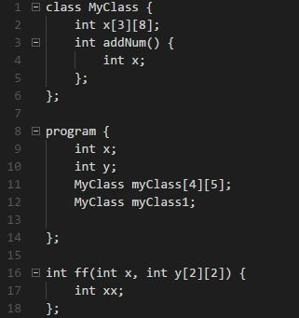
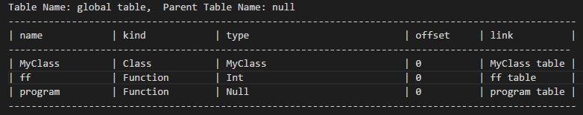
How a symbol table looks like?
Top Level

Slide 7
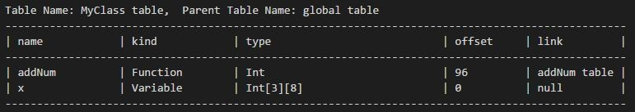
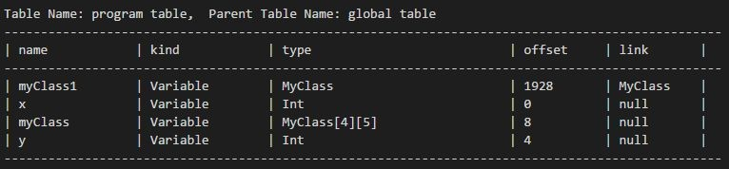
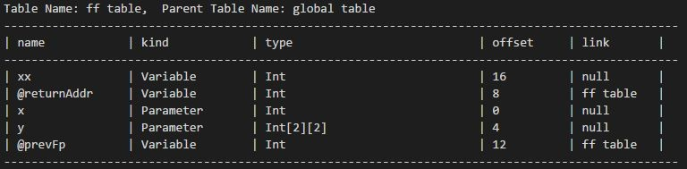
Secondary Level

Slide 8
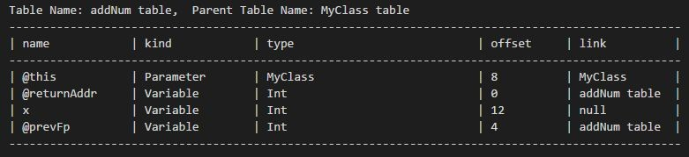
Third Level

Slide 9
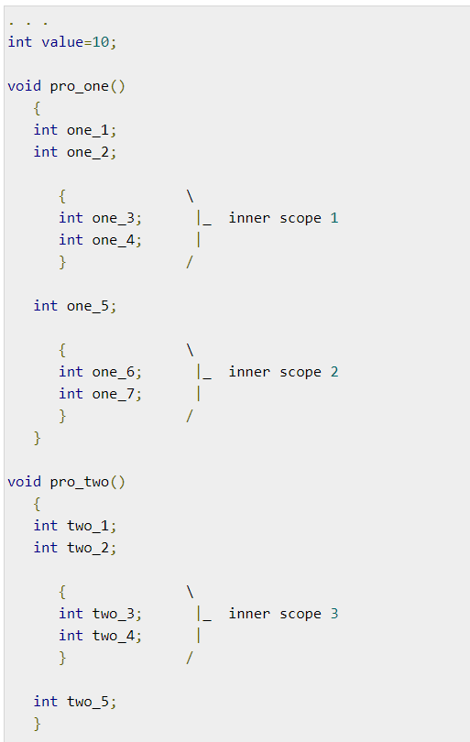
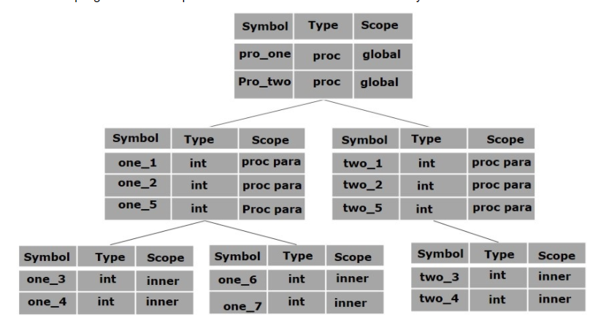
Another Example

Slide 10
Design Pattern
Design pattern is a general reusable solution to a commonly occurring problem when we design a software.
One fact is that without design pattern, we can still write code and it may work properly but with design pattern we can write more reusable, maintainable, robustic code.
Design pattern is something existing in the world not being invented by anyone but it becomes popular after “GoF ” publish their book which conclude total 23 patterns.
Visitor pattern is one of these 23 cataloged into behavioral pattern.

Slide 11
Visitor Pattern

Slide 12
Visitor Pattern
In Visitor pattern, we use a visitor class which changes the executing algorithm of an element class. By this way, execution algorithm of element can vary as and when visitor varies. This pattern comes under behavior pattern category. As per the pattern, element object has to accept the visitor object so that visitor object handles the operation on the element object.

Slide 13
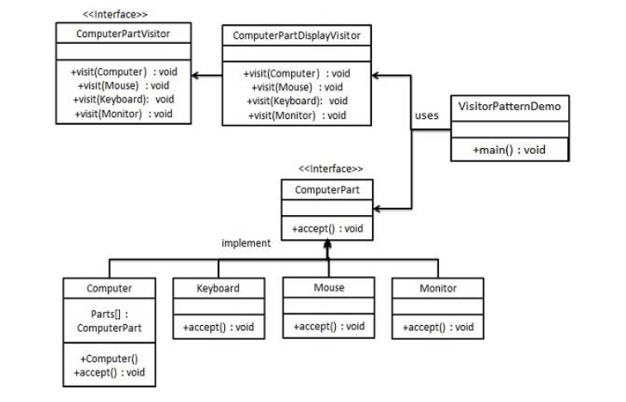
Example

Slide 14
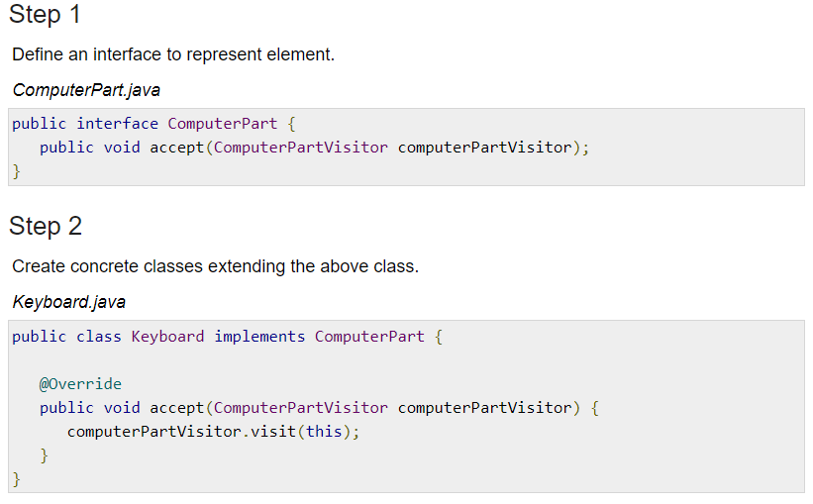
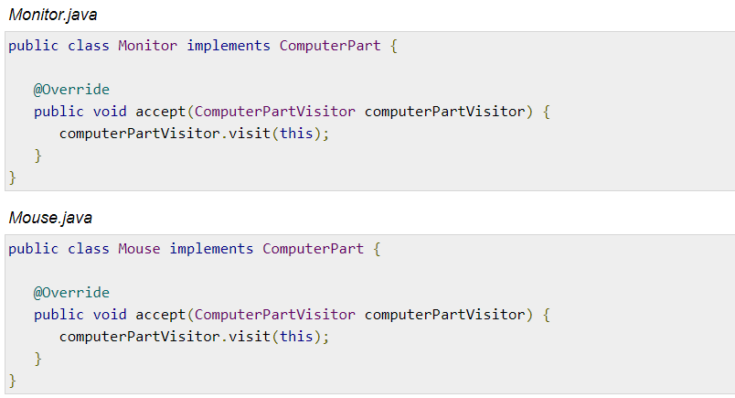
Example

Slide 15
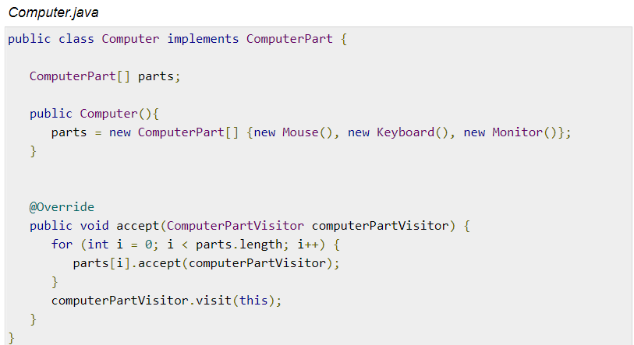
Example

Slide 16
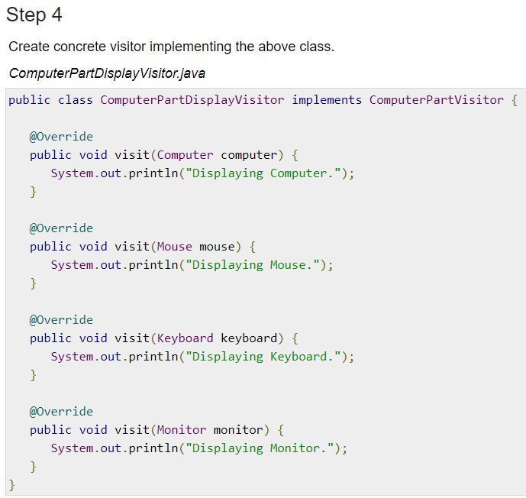
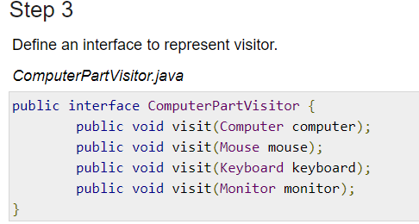
Example

Slide 17
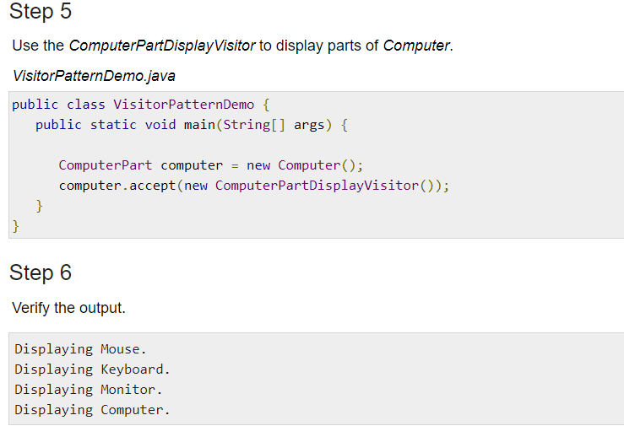
Example

Slide 18
Visitor Pattern
It should be possible to define a new operation for (some) classes of an object structure without changing the classes.
When new operations are needed frequently (visit node in the AST) and the object structure consists of many unrelated classes, it's inflexible to add new subclasses each time a new operation is required.
Sum up the demand up (for the project)
Want to visit the AST nodes for different purpose (execute different operation on the same node)
Don’t want to change the structure of the AST Node (hard to maintain, easy to mess up)

Slide 19
Visitor Pattern
Theoretical Level
Visitor
ConcreteVisitor
Element
ConreteElement
Map to our project
Visitor
SymbolTableGeneratoinVisitor
TypeCheckingVisitor
CodeGenerationVisitor
AstNode
ProgNode
ClassNode
- ………...

Slide 20
Example

Slide 21
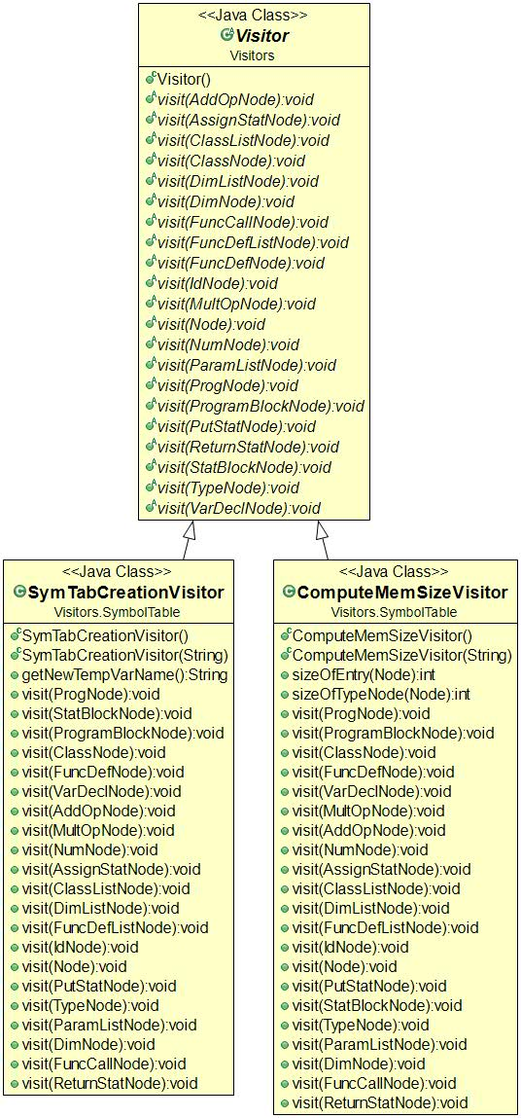
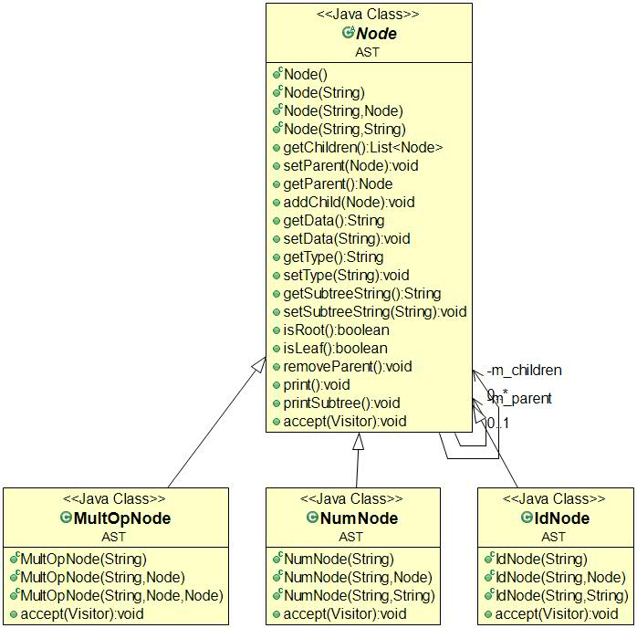
Visitor Pattern

Slide 22
Step of symbol table creation
[first-pass] In-order traverse the AST (assume you already have an AST)
Create classes’ symbol table
Create functions’ symbol table
Free function we don’t do any link so far
Member function should be linked with its class
Create a global table for “program” function
Add all classes to the global table
Add all free function to the global table
Add the program function itself to the global table

Slide 23
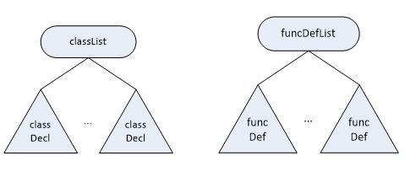
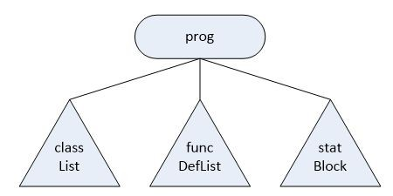

Slide 24
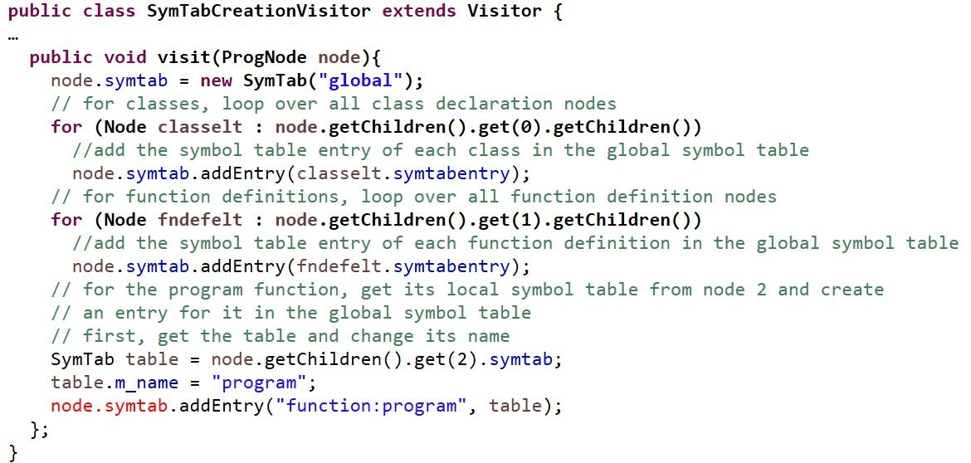

Slide 25
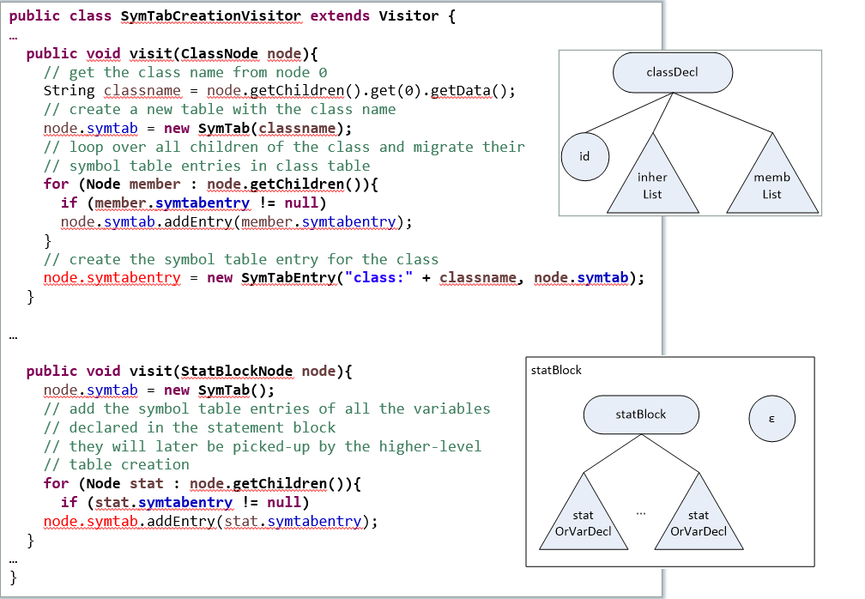

Slide 26
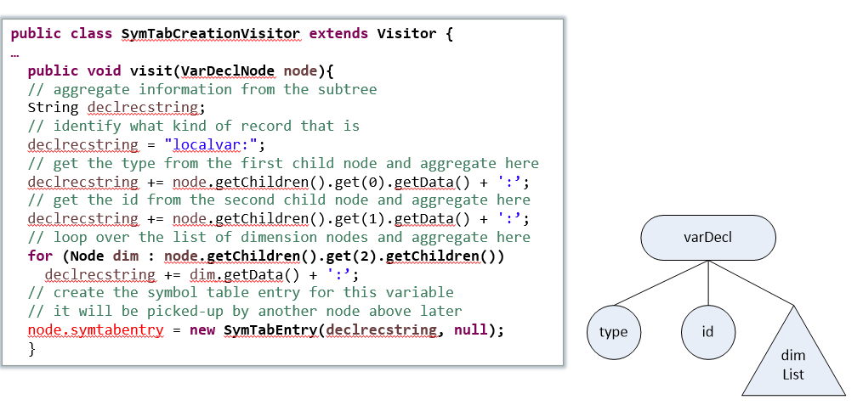

Slide 27
Thanks!

