Slide 1
COMPILER DESIGN
COMP 442/6421 – Compiler Design
Code generation
Joey Paquet, 2000-2020

Slide 2
COMP 442/6421 – Compiler Design
variable declarations and value access
Joey Paquet, 2000-2020

Slide 3
Variable declarations and value access/assignment
COMP 442/6421 – Compiler Design
Integer variable declaration:
where x is an alias to the fixed address of the memory cell containing the value of variable x. Such aliases are (unique) labels generated during the parse and stored in the symbol table.
Note that the labelling method of referring to values has great limitations, as it assumes that every variable in the program is unique and permanently and statically allocated. Later, we explain how to use a stack-based allocation that is not subject to this limitation.
To load or change the content of an integer variable:
where x is the label of variable x, r1 is the register containing the value of variable x and r0 is assumed to contain 0 (offset).
int x;
x res 4
lw r1,x(r0)
sw x(r0),r1
Joey Paquet, 2000-2020

Slide 4
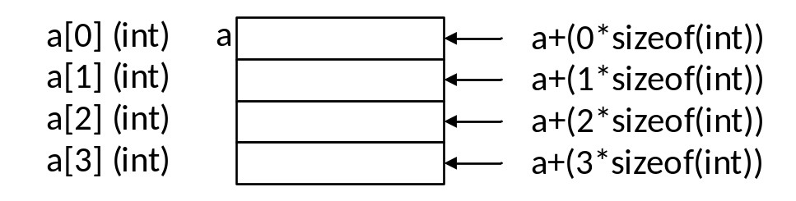
Variable declarations and access
COMP 442/6421 – Compiler Design
Array of integers variable declaration:
Accessing elements of an array of integers requires the use of offsets:
int a[4];
a res 16
x = a[2];
addi r1,r0,8
lw r2,a(r1)
sw x(r0),r2
Joey Paquet, 2000-2020

Slide 5
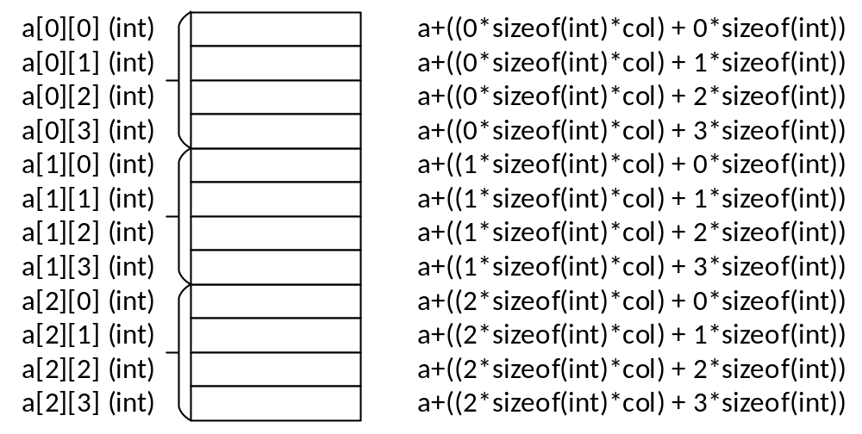
Variable declarations and access
COMP 442/6421 – Compiler Design
Multidimensional arrays of integers:
To access specific elements, a more elaborated offset calculation needs to be implemented.
int a[3][4];
a res 48
Joey Paquet, 2000-2020

Slide 6
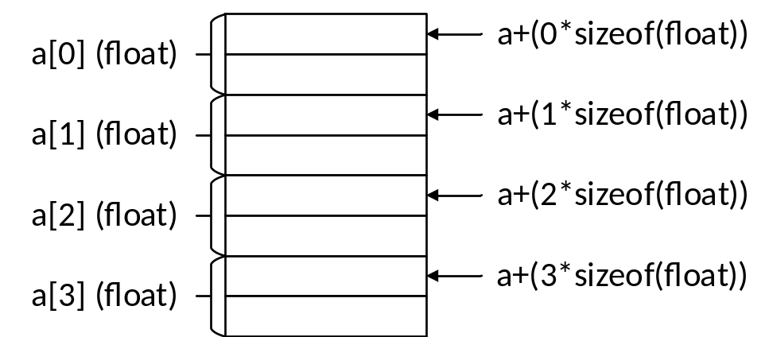
Variable declarations and access
COMP 442/6421 – Compiler Design
For arrays of elements of aggregate type, or arrays where each element takes more than one memory cell:
  The offset calculation needs to take into account to size of each element.
  For example, assuming a float takes 8 bytes (2 words):
float f[4];
f res 32
Joey Paquet, 2000-2020

Slide 7
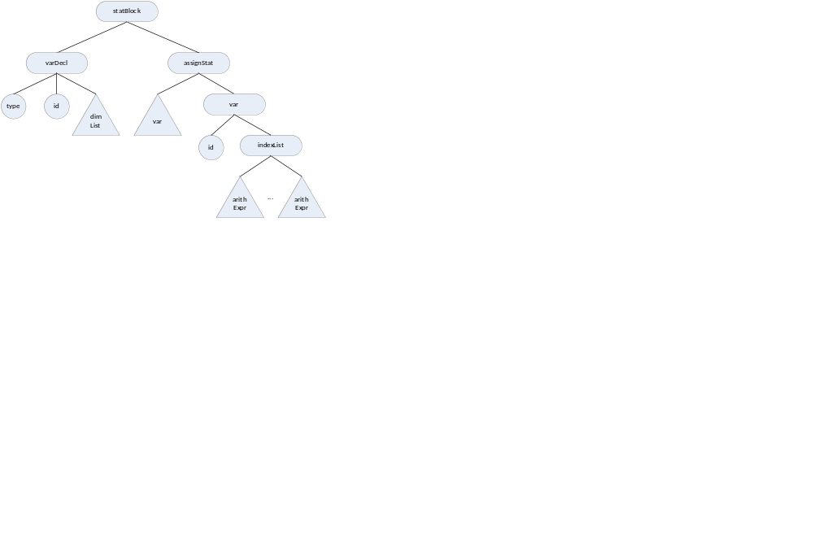
Variable declarations and access
COMP 442/6421 – Compiler Design
int a[3][4];
x = a[expr1][expr2];
a res 48 [1]
{code for expr1 yields t1 as result} [2]
lw r1,t1(r0) [3]
{code for expr2 yields t2 as result} [4]
lw r2,t2(r0) [5]
% a+((t1*sizeof(int)*4) + (t2*sizeof(int)))
muli r3,r1,16 [6]
muli r4,r2,4 [6]
add r5,r3,r4 [6]
lw r6,a(r5) [6]
sw x(r0),r6 [7]
[1]
[7]
[6]
[3][5]
[2:t1]
[4:t2]
Joey Paquet, 2000-2020

Slide 8
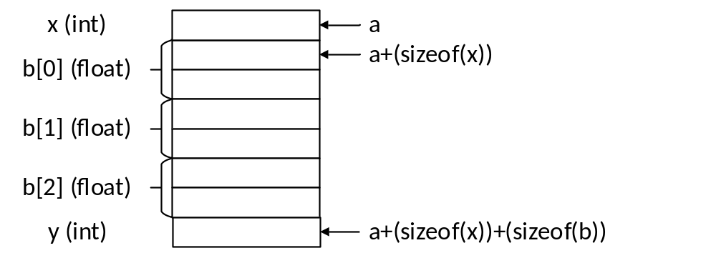
Variable declarations and access
COMP 442/6421 – Compiler Design
For an object variable declaration, each data member is stored contiguously in the order in which it is declared.
The offsets are calculated according to the total size of the data members preceding the member to access.
class MyClass{
int x;
float b[3]
int y;
}
Myclass a;
a res 32
addi r1,r0,4
addi r1,r1,16
lw r2,a(r1)
sw x(r0),r2
x = a.b[2]…
x = a + (sizeof(x)) + sizeof(float)*2)
Joey Paquet, 2000-2020

Slide 9
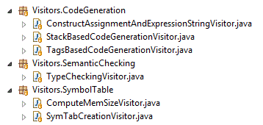
Variable declarations and access
COMP 442/6421 – Compiler Design
Offsets can be pre-calculated in a previous phase and stored in the symbol table.
This will eventually make code generation easier, and the generated code to be more concise.
=====================================================
| class | MyClass |
| =====================================================
| | table: MyClass scope size: 32 |
| =====================================================
| | var | x | int | 4 | 0 |
| | var | b | float | 24 | 4 |
| | var | y | int | 4 | 28 |
| =====================================================
| |
=====================================================
Joey Paquet, 2000-2020

Slide 10
COMP 442/6421 – Compiler Design
expressions
Joey Paquet, 2000-2020

Slide 11
Arithmetic operators
COMP 442/6421 – Compiler Design
a+b
lw r1,a(r0)
lw r2,b(r0)
add r3,r1,r2
t1 res 4
sw t1(r0),r3
a+8
lw r1,a(r0)
addi r2,r1,8
t2 res 4
sw t2(r0),r2
a*b
lw r1,a(r0)
lw r2,b(r0)
mul r3,r1,r2
t3 res 4
sw t3(r0),r3
a*8
lw r1,a(r0)
muli r2,r1,8
t4 res 4
sw t4(r0),r2
Joey Paquet, 2000-2020

Slide 12
Relational operators
COMP 442/6421 – Compiler Design
a==b
lw r1,a(r0)
lw r2,b(r0)
ceq r3,r1,r2
t5 res 4
sw t5(r0),r3
a==8
lw r1,a(r0)
ceqi r2,r1,8
t6 res 4
sw t6(r0),r2
Joey Paquet, 2000-2020

Slide 13
Logical operators
COMP 442/6421 – Compiler Design
The Moon machine’s and, or and not operators are bitwise operators.
In order to have logical operators, we need to code them with the assumption that false is 0 and anything else is true.
a and b
lw r1,a(r0)
lw r2,b(r0)
t7 res 4
bz r1,zero1
bz r2,zero1
addi r3,r0,1
j endand1
zero1 addi r3,r0,0
endand1 sw t7(r0),r0
not a
lw r1,a(r0)
t8 res 4
bz r1,zero2
addi r1,r0,1
sw t8(r0),r1
j endnot1
zero2 sw t8(r0),r0
endnot1
Joey Paquet, 2000-2020

Slide 14
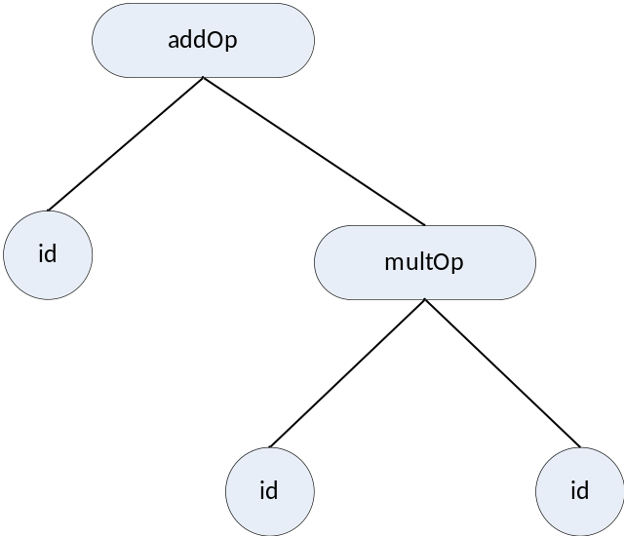
Expressions
COMP 442/6421 – Compiler Design
Each operator’s code generation in the previous examples is the result of translating a subtree with two leaves as the operands and one intermediate node as the operator.
For composite expressions, the temporary results become operands of operators higher in the tree.
a+b*c
lw r1,b(r0) [1]
lw r2,c(r0) [1]
mul r3,r1,r2 [1]
t8 res 4 [1]
sw t8(r0),r3 [1]
lw r1,a(r0) [2]
lw r2,t8(r0) [2]
add r3,r1,r2 [2]
t9 res 4 [2]
sw t9(r0),r3 [2]
[2:t9]
[1:t8]
Joey Paquet, 2000-2020

Slide 15
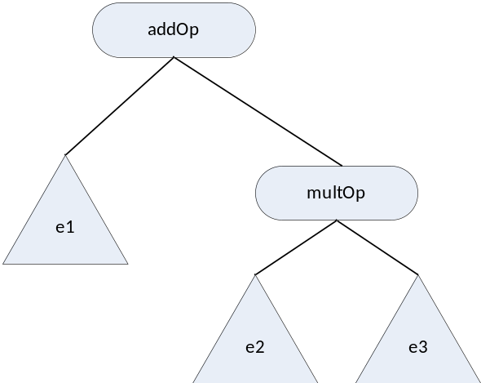
Expressions
COMP 442/6421 – Compiler Design
Considering that each of operand can be subtrees, then we have the following:
(…e1…)+(…e2…)*(…e3…)
{code for e1. yields t1 as a result} [1]
{code for e2. yields t2 as a result} [2]
{code for e3. yields t3 as a result} [3]
lw r1,t2(r0) [4]
lw r2,t3(r0) [4]
mul r3,r1,r2 [4]
t4 res 4 [4]
sw t4(r0),r3 [4]
lw r1,t1(r0) [5]
lw r2,t4(r0) [5]
add r3,r1,r2 [5]
t5 res 4 [5]
sw t5(r0),r3 [5]
[5:t5]
[4:t4]
[1:t1]
[2:t2]
[3:t3]
Joey Paquet, 2000-2020

Slide 16
COMP 442/6421 – Compiler Design
statements
Joey Paquet, 2000-2020

Slide 17
Assignment statement
COMP 442/6421 – Compiler Design
a := b;
lw r1,b(r0)
sw a(r0),r1
a := 8;
sub r1,r1,r1
addi r1,r1,8
sw a(r0),r1
a := b+c;
{code for b+c yields tn as a result}
lw r1,tn(r0)
sw a(r0),r1
Joey Paquet, 2000-2020

Slide 18
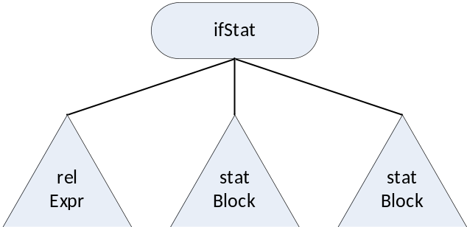
Conditional statement
COMP 442/6421 – Compiler Design
if expr then statblock1 else statblock2;
[1] [2] [3] [4] [5] [6]
{code for expr yields tn as a result} [1]
lw r1,tn(r0) [2]
bz r1,else1 [2]
{code for statblock1} [3]
j endif1 [4]
else1 [4] {code for statblock2} [5]
endif1[6] {code continuation}
[2][4][6]
[1:tn]
[3]
[5]
Joey Paquet, 2000-2020

Slide 19
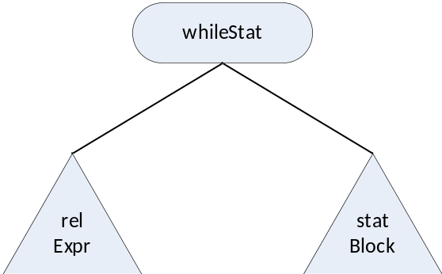
Loop statement
COMP 442/6421 – Compiler Design
while expr do statblock;
[1] [2] [3] [4] [5]
gowhile1 [1] {code for a<b yields tn as a result} [2]
lw r1,tn(r0) [3]
bz r1,endwhile1 [3]
{code for statblock} [4]
j gowhile1 [5]
endwhile1[5] {code continuation}
[1][3][5]
[2:tn]
[4]
Joey Paquet, 2000-2020

Slide 20
read and write statements
COMP 442/6421 – Compiler Design
Some function calls interact with the operating system, e.g. when a program does input/output
In these cases, there are several possibilities depending on the resources offered by the operating system, e.g.:
  treatment via special predefined ASM operations/subroutines
  access to the OS via calls or traps
In the Moon processor, we have two special operators: putc and getc
They respectively output some data to the screen and input data from the keyboard
They are used to directly translate read() and write() statements (see the Moon manual)
See the Visitor sample implementation code for code generation for read/write.
There are also a variety of libraries provided with the Moon code:
  lib.m: read/write strings to console/from keyboard, string/integer conversion, string operations
  util.m: read/write integer to console/from keyboard, string operations.
Joey Paquet, 2000-2020

Slide 21
read and write statements
COMP 442/6421 – Compiler Design
public void visit(ProgramBlockNode p_node) {
// generate moon program's entry point
m_moonExecCode += m_mooncodeindent + "entry\n";
m_moonExecCode += m_mooncodeindent + "addi r14,r0,topaddr\n";
// propagate accepting the same visitor to all the children
// this effectively achieves Depth-First AST Traversal
for (Node child : p_node.getChildren())
child.accept(this);
// generate moon program's end point
m_moonDataCode += m_mooncodeindent + "% buffer space used for console output\n";
m_moonDataCode += String.format("%-11s", "buf") + "res 20\n";
m_moonExecCode += m_mooncodeindent + "hlt\n";
}
public void visit(PutStatNode p_node) {
// propagate accepting the same visitor to all the children
// this effectively achieves Depth-First AST Traversal
for (Node child : p_node.getChildren())
child.accept(this);
// Then, do the processing of this nodes' visitor
// create a local variable and allocate a register to this subcomputation
String localRegister = this.m_registerPool.pop();
//generate code
m_moonExecCode += m_mooncodeindent + "% processing: put(" + p_node.getChildren().get(0).m_moonVarName + ")\n";
m_moonExecCode += m_mooncodeindent + "lw " + localRegister + "," + p_node.getChildren().get(0).m_moonVarName + "(r0)\n";
m_moonExecCode += m_mooncodeindent + "% put value on stack\n";
m_moonExecCode += m_mooncodeindent + "sw -8(r14)," + localRegister + "\n";
m_moonExecCode += m_mooncodeindent + "% link buffer to stack\n";
m_moonExecCode += m_mooncodeindent + "addi " + localRegister + ",r0, buf\n";
m_moonExecCode += m_mooncodeindent + "sw -12(r14)," + localRegister + "\n";
m_moonExecCode += m_mooncodeindent + "% convert int to string for output\n";
m_moonExecCode += m_mooncodeindent + "jl r15, intstr\n";
m_moonExecCode += m_mooncodeindent + "sw -8(r14),r13\n";
m_moonExecCode += m_mooncodeindent + "% output to console\n";
m_moonExecCode += m_mooncodeindent + "jl r15, putstr\n";
//deallocate local register
this.m_registerPool.push(localRegister);
};
Joey Paquet, 2000-2020

Slide 22
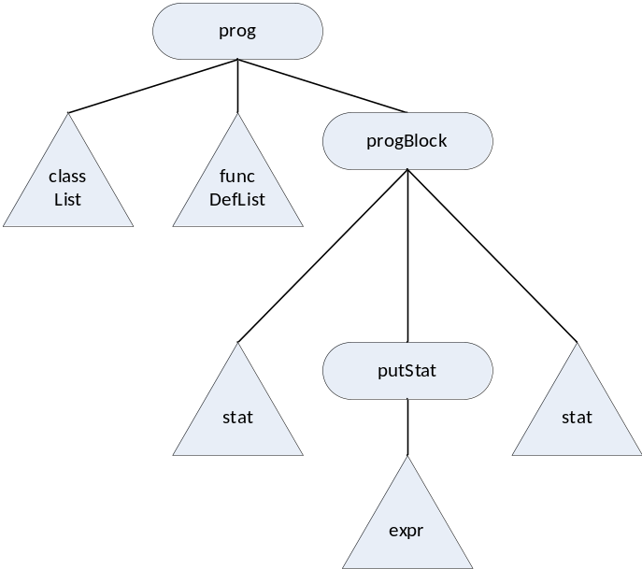
write statement
COMP 442/6421 – Compiler Design
{code for class A} [1]
{code for function fn} [2]
entry [3]
% use topaddr as top of stack
addi r14,r0,topaddr [3]
{code for statement1} [4]
{code for expr yields tn} [5]
% write(tn)
% put value to be printed on stack
lw r1,tn(r0) [6]
sw -8(r14),r1 [6]
% put address of buffer on stack
addi r1,r0,buf [6]
sw -12(r14),r1 [6]
% convert for output using intstr
% subroutine from lib.m
jl r15,intstr [6]
% intstr stores its result
% in r13. copy result on stack
% where putstr is expecting it
sw -8(r14),r13 [6]
% output to console using putstr
% subroutine from lib.m
jl r15,putstr [6]
{code for statementn} [7]
% console output buffer
% used by intstr
buf res 20 [8]
hlt [8]
class A{…}
int fn(…){…}
program{
statement1
write(expr);
statementn
}
[3][8]
[1]
[2]
[6]
[4]
[7]
[5:tn]
Joey Paquet, 2000-2020

Slide 23
COMP 442/6421 – Compiler Design
functions
Joey Paquet, 2000-2020

Slide 24
Functions
COMP 442/6421 – Compiler Design
There are two essential parts in translating programs that use functions:
  translating function definitions.
  translating function calls.
In the case of a function definition, code is generated for:
  receiving parameters (depends on the parameter passing scheme used)
  reserving memory for the variable declarations inside the function definition scope, or their offsets are calculated
  execution code is generated for statements inside the body of the function
  passing the return value to the calling function when a return statement is encountered
In the case of a function call, code is generated for:
  passing the parameters to the called function
  branching to the called function
  after branching back, retrieve the return value from the called function
Joey Paquet, 2000-2020

Slide 25
Functions
COMP 442/6421 – Compiler Design
The symbol table entry of the function contains the label of the first memory cell assigned to the executable code of the function.
This address/label will be used to jump to the function’s code when a function call is translated.
Function calls raise the need for semantic checking. At compile-time, the number and type of actual parameters must match with the information stored in the symbol table for that function.
Once the semantic check is successful, semantic translation can occur for the function call.
For modularity purposes, it is better to have all semantic checks in separate phases that runs prior to the code generation.
Joey Paquet, 2000-2020

Slide 26
COMP 442/6421 – Compiler Design
functions – code generation using statically allocated local variables
Joey Paquet, 2000-2020

Slide 27
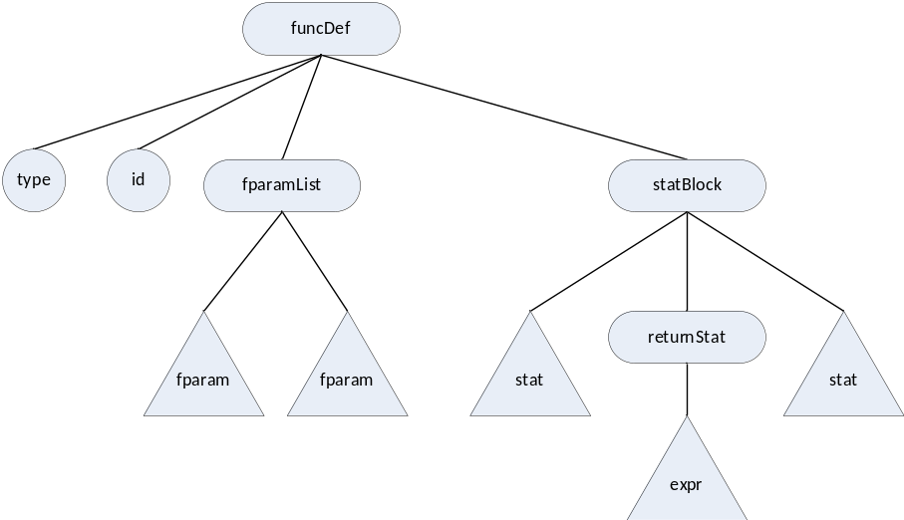
Function definitions
COMP 442/6421 – Compiler Design
Simplistic solution using labels (i.e. static memory allocation) for:
  Branching to the function’s code
  Passing/storing the parameter values
  Storing/passing the return value
int fn ( int a, int b ){ statement1; return(expr); statement2 };
[1] [2] [3] [4] [5] [6] [7]
fnres res 4 [1]
fnp1 res 4 [2]
fnp2 res 4 [3]
fn [4] {code for statement1} [5]
{code for expr yields tn} [6]
lw r1,tn(r0) [7]
sw fnres(r0),r1 [7]
jr r15 [7]
{code for statement2} [8]
jr r15 [9]
[1]
[4][9]
[7]
[2]
[3]
[5]
[8]
[6:tn]
Joey Paquet, 2000-2020

Slide 28
Function definitions
COMP 442/6421 – Compiler Design
fn is an alias to the memory cell containing the first instruction of the function.
fnres contains the return value of fn.
Assumes that the parameter values are copied in the local parameter variables (fnp1 and fnp2) before the function is branched upon.
r15 is reserved for linking back to the instruction following the jump at function call (see the following slides for function calls).
The above code uses static memory allocation for a function, which is assuming that there can be at most one instance of a function being executed at any time.
To allow more than one instance of a function to execute at the same time, a dynamic memory allocation scheme is necessary, i.e. a function call stack (see slides later).
Joey Paquet, 2000-2020

Slide 29
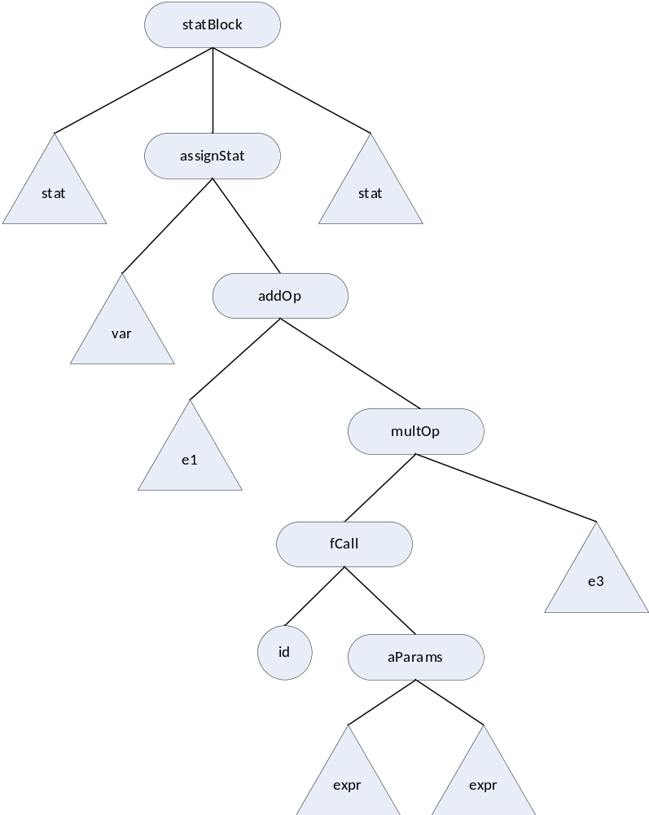
Function calls
COMP 442/6421 – Compiler Design
var = e1 + fn(pe1,pe2) * e3;
{code for e1 yields t1 as result} [1]
% passing parameters
{code for pe1 yields pt1 as result} [2]
lw r1,pt1(r0) [3]
sw fnp1(r0),r1 [3]
{code for pe1 yields pt2 as result} [4]
lw r1,pt2(r0) [5]
sw fnp2(r0),r1 [5]
% jump to function
jl r15,fn [6]
% fetch return value
lw r1,fnres(r0) [6]
sw t2(r0),r1 [6]
{code for e3 yields t3 as result} [7]
lw r1,t2(r0) [8]
lw r2,t3(r0) [8]
mul r3,r1,r2 [8]
t4 res 4 [8]
sw t4(r0),r3 [8]
lw r1,t1(r0) [9]
lw r2,t4(r0) [9]
add r3,r1,r2 [9]
t5 res 4 [9]
sw t5(r0),r3 [9]
lw r1,t5(r0) [10]
sw var(r0),r1 [10]
[10]
[9:t5]
[8:t4]
[1:t1]
[6]
[3][5]
[7:t3]
[2:pt1]
[4:pt2]
Joey Paquet, 2000-2020

Slide 30
COMP 442/6421 – Compiler Design
functions – code generation using a function call stack
Joey Paquet, 2000-2020

Slide 31
Function calls: passing parameters: multiple function call instances
COMP 442/6421 – Compiler Design
The function call method shown previously is only usable where only one instance of a function can be running at the same time.
For example, with recursive function calls, the problem is that several instances of the same function can be running at the same time, hence there is a need to store a separate state of each function instances of the same function.
To enable more than one function instance to run at the same time, all the variables and parameters of a running function are stored in a stack frame which is dynamically allocated on a function call stack.
This involves the elaboration of a primitive run-time system that manages the stack as part of the compiled code.
Another problem with multiple function instances is that r15 is used to store the return address that is going to be branched upon after a call. If there is more than one consecutive call (i.e. main calls f1, then f1 calls f2), then the return address needs to be stored in the function call’s stack frame.
Joey Paquet, 2000-2020

Slide 32
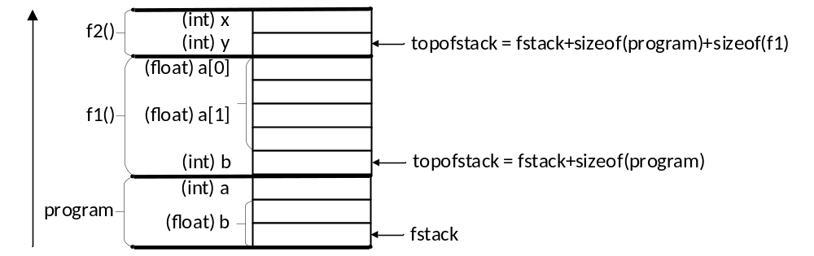
Function calls: function call stack and stack frames
COMP 442/6421 – Compiler Design
If multiple call instances are allowed, a function call stack is required:
  The function call stack is a fixed-size memory area that is statically reserved.
  For each function call, a stack frame is created on the function call stack.
  The stack frame contains the values of all the local variables declared in the function.
  The location of the stack frame on top of the stack (topofstack) is managed by adding/subtracting stack frame sizes as an accumulated offset from the base address of the stack (fstack).
  Before a function is called, topofstack is incremented by the stack frame size of the function currently being executed.
  Then, when the functions’ code uses its local variables, it refers to them using offsets relative to topofstack.
  After the function returns, the calling function “removes” the called function’s stack frame, i.e. topofstack is decremented by its function call stack frame size.
program{
int a;
float b;
… f1(…) … }
int f1(…){
float a[2];
int b;
… f2(…) …}
int f2(…){
int x,y; }
Joey Paquet, 2000-2020

Slide 33
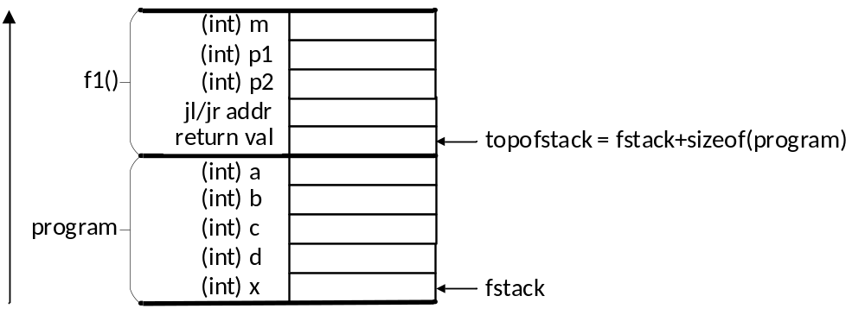
Function calls: function call stack
COMP 442/6421 – Compiler Design
Function stack frames also need to contain space necessary to store values used in the function call/return mechanism, i.e. not only the local variables, but also:
  The address stored in r15 by jl as the function is called (to allow a chain of functions to be called).
  The return value stored in a place predictable by the calling function. For example, from the perspective of the calling function, the return value of a called function may always be stored at:
    returnvalueadr = topofstack + sizeof(mystackframe) + sizeof(typeof(returnvalue))
  The parameters stored in a place predictable by both functions, e.g. for f1’s parameters:
    p1adr = topofstack
    + sizeof(typeof(return value))
    + 4
    + sizeof(typeof(parameter2))
    p2adr = topofstack
    + sizeof(typeof(return value))
    + 4
    + sizeof(typeof(parameter1))
    + sizeof(typeof(parameter2))
int f1(int p1, int p2){
int m1;
m1 = 5;
p1 = p1 * m1;
p2 = p2 * m1;
return(p1 + p2);
}
program{
int a;
int b;
int c;
int d;
int x;
a = 1;
b = 2;
c = 3;
d = 4;
x = a + f1(b,c) * d;
put(x);
} // result = 101
Joey Paquet, 2000-2020

Slide 34
Function calls: function call stack: compute variables/block sizes and offsets
COMP 442/6421 – Compiler Design
For code generation the most important thing is to proceed in stages. Do not try to resolve all code generation in a single batch.
  The first step is to compute the size of all variables involved in the compiled program.
  These can be stored in the symbol tables.
  Memory also needs to be reserved for intermediate results, and literal values used in the compiled program.
  Then you can compute the offset of each element in a reserved block.
program{
int a;
int b;
int c;
a = 1;
put(a);
b = 2;
put(b);
c = 3;
put(c);
a = a + b c;
put(a + 6);
} // result = 13
=====================================================
| table: global scope size: 0 |
=====================================================
| func | program | void |
| =====================================================
| | table: program scope size: 40 |
| =====================================================
| | var | a | int | 4 | 0 |
| | var | b | int | 4 | 4 |
| | var | c | int | 4 | 8 |
| | litval | t1 | int | 4 | 12 |
| | litval | t2 | int | 4 | 16 |
| | litval | t3 | int | 4 | 20 |
| | tempvar | t4 | int | 4 | 24 |
| | tempvar | t5 | int | 4 | 28 |
| | litval | t6 | int | 4 | 32 |
| | tempvar | t7 | int | 4 | 36 |
| =====================================================
=====================================================
Joey Paquet, 2000-2020

Slide 35
Function calls: function call stack: compute variables/block sizes and offsets
COMP 442/6421 – Compiler Design
Class scope: determine the size of memory block to reserve for object variables.
Function scope: determine the size of a function call stack frame required to execute that function.
Offsets: running total of sized of elements in a scope.
=====================================================
| class | class1 |
| =====================================================
| | table: class1 scope size: 12 |
| =====================================================
| | var | float1 | float | 8 | 0 |
| | var | int1 | int | 4 | 8 |
| =====================================================
| | func | int | func1 |
| =====================================================
| | table: func1 scope size: 220 |
| =====================================================
| | param | int235 | int | 120 | 0 |
| | param | float4 | float | 80 | 120 |
| | var | float7 | float | 8 | 200 |
| | tempvar | t1 | int | 4 | 208 |
| | tempvar | t2 | int | 4 | 212 |
| | litval | t3 | int | 4 | 216 |
| =====================================================
| | func | program | void |
| =====================================================
| | table: program scope size: 280 |
| =====================================================
| | var | int532 | int | 120 | 0 |
| | var | float101 | class1 | 120 | 120 |
| | var | float3 | float | 8 | 240 |
| | var | int3 | int | 4 | 248 |
| | tempvar | t7 | int | 4 | 252 |
| | litval | t8 | int | 4 | 256 |
| | tempvar | t9 | int | 4 | 260 |
| | tempvar | t10 | int | 4 | 264 |
| | tempvar | t11 | int | 4 | 268 |
| | tempvar | t12 | int | 4 | 272 |
| | tempvar | t13 | int | 4 | 276 |
| =====================================================
=====================================================
class class1{
float float1;
int int1;
}
int func1(int int235[2][3][5], float float4[10]){
float float7;
a=a+b*3;
}
program{
int int532[5][3][2];
class1 class110[10];
float float3;
int int3;
a=a+b*c;
x=a+b*c;
a=x+z*y
}
Joey Paquet, 2000-2020

Slide 36
Function calls using stack: full example
COMP 442/6421 – Compiler Design
=====================================================
| table: global scope size: 32 |
=====================================================
| func | f | int |
| =====================================================
| | table: f scope size: 28 |
| =====================================================
| | var | p1 | int | 4 | -8 |
| | var | p2 | int | 4 | -12 |
| | var | p3 | int | 4 | -16 |
| | var | retval | int | 4 | -20 |
| | tempvar | t1 | int | 4 | -24 |
| | tempvar | t2 | int | 4 | -28 |
| =====================================================
| func | program | void |
| =====================================================
| | table: program scope size: 24 |
| =====================================================
| | var | a | int | 4 | -0 |
| | var | b | int | 4 | -4 |
| | var | c | int | 4 | -8 |
| | tempvar | t1 | int | 4 | -12 |
| | tempvar | t2 | int | 4 | -16 |
| | tempvar | t3 | int | 4 | -20 |
| =====================================================
=====================================================
int f(int p1, int p2, int p3){
int retval;
retval=p1+p2*p3;
put (retval);
return(retval);
}
program{
int a;
int b;
int c;
a=1;
b=2;
c=3;
a=f(a,b,c)*b+c;
put(a);
} // output: 717
Joey Paquet, 2000-2020

Slide 37
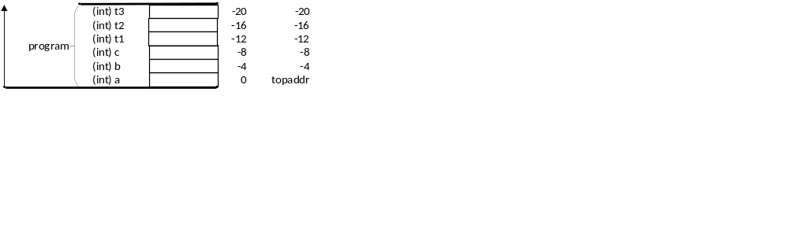
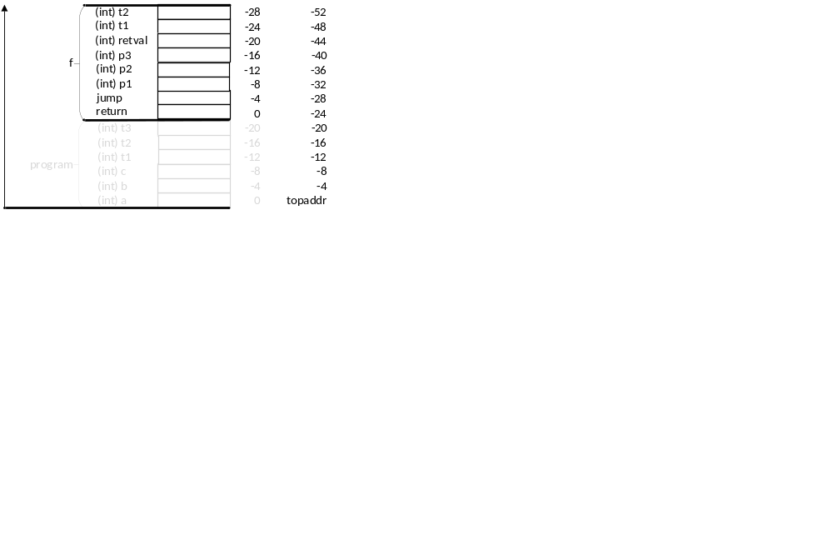
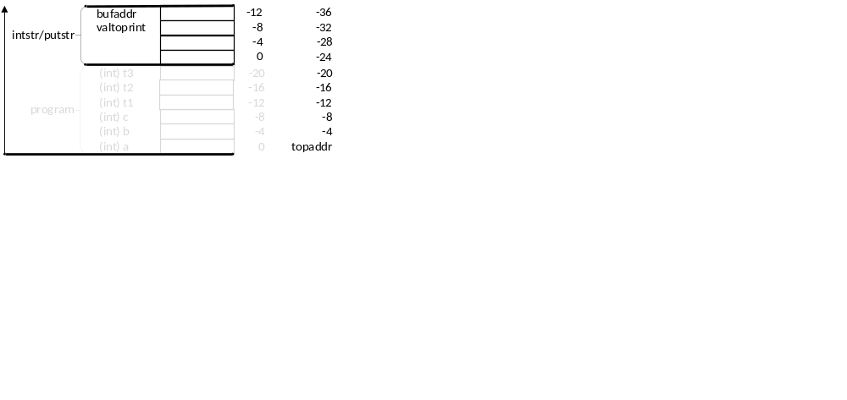
Function calls using stack: full example
COMP 442/6421 – Compiler Design
program{
int a;
int b;
int c;
a=1;
b=2;
c=3;
a=f(a,b,c)*b+c;
put(a);
}
% begin program function definition =================
entry % start program
% a=1;b=2;c=3 =======================================
addi r14,r0,topaddr
addi r1,r0,1 % a=1
sw -0(r14),r1 % a=1
addi r1,r0,2 % b=2
sw -4(r14),r1 % b=2
addi r1,r0,3 % c=3
sw -8(r14),r1 % c=3
% function call to f ================================
lw r1,0(r14) % pass a into p1
sw -32(r14),r1 % pass a into p1
lw r1,-4(r14) % pass b into p2
sw -36(r14),r1 % pass b into p2
lw r1,-8(r14) % pass c into p3
sw -40(r14),r1 % pass c into p3
addi r14,r14,-24 % increment stack frame
jl r15,f % jump to f
subi r14,r14,-24 % decrement stack frame
% a=f(a,b,c)*b+c ===================================
lw r1,-24(r14) % get return value from f
sw -12(r14),r1 % put it to t1
lw r1,-12(r14) % t2=t1*b
lw r2,-4(r14) % t2=t1*b
mul r3,r1,r2 % t2=t1*b
sw -16(r14),r3 % t2=t1*b
lw r1,-16(r14) % t3=t2+c
lw r2,-8(r14) % t3=t2+c
add r3,r1,r2 % t3=t2+c
sw -20(r14),r3 % t3=t2+c
lw r1,-20(r14) % a=t3
sw 0(r14),r3 % a=t3
% put(a) ============================================
lw r1,-0(r14) % get a from stack grame
addi r14,r14,-24 % increment stack frame
sw -8(r14),r1 % put a onto stack
addi r1,r0, buf % put adr of buf onto stack
sw -12(r14),r1 % put adr of buf onto stack
jl r15, intstr % jump to intstr
sw -8(r14),r13 % put string onto stack
jl r15, putstr % jump to putstr
subi r14,r14,-24 % decrement stack frame
hlt % stop program
% end program function definition ===================
buf res 20
Joey Paquet, 2000-2020

Slide 38

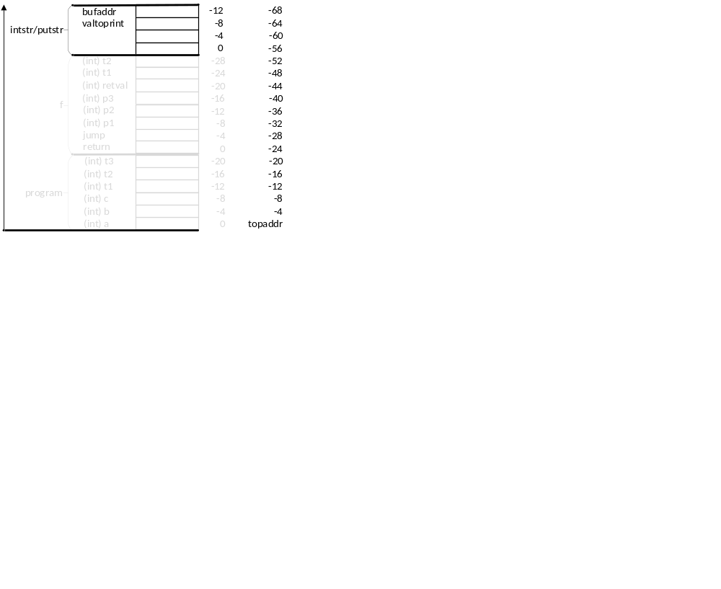
Function calls using stack: full example
COMP 442/6421 – Compiler Design
% begin function f definition ========================================
f sw -4(r14),r15 % put r15 on stack frame
% retval=p1+p2*p3
lw r1,-12(r14) % t1=p2*p3
lw r2,-16(r14) % t1=p2*p3
mul r3,r1,r2 % t1=p2*p3
sw -24(r14),r3 % t1=p2*p3
lw r1,-8(r14) % t2=p1+t1
lw r2,-24(r14) % t2=p1+t1
add r3,r1,r2 % t2=p1+t1
sw -28(r14),r3 % t2=p1+t1
lw r1,-28(r14) % retval=t2
sw -20(r14),r1 % retval=t2
% put(retval) ========================================================
lw r1,-20(r14) % get retval from stack frame
addi r14,r14,-32 % increment stack frame
sw -8(r14),r3 % put value to print on stack frame
addi r3,r0, buf % put address of buffer on stack frame
sw -12(r14),r3 % put address of buffer on stack frame
jl r15, intstr % jump to intstr subroutine
sw -8(r14),r13 % put result on stack frame for putstr
jl r15, putstr % call putstr subroutine
subi r14,r14,-32 % decrement stack frame
% return(retval) =====================================================
lw r1,-20(r14) % get value of retval from stack
sw 0(r14),r1 % put return value on stack
lw r15,-4(r14) % retrieve r15 from stack
jr r15 % jump back to calling fct
% end function f definition ==========================================
int f(int p1, int p2, int p3){
int retval;
retval=p1+p2*p3;
put (retval);
return(retval);
}
Joey Paquet, 2000-2020

Slide 39
COMP 442/6421 – Compiler Design
completion order/strategy
Joey Paquet, 2000-2020

Slide 40
Code generation: suggested sequence
COMP 442/6421 – Compiler Design
Suggested sequence:
  variable declarations (integers first)
  expressions (one operator at a time)
  assignment statement
  read and write statements
  conditional statement
  loop statement
Tricky parts:
  function calls
  expressions involving arrays and classes (offset calculation)
  floating point numbers (non-native in Moon)
  function call stack
  expressions involving access to object members (offset calculations)
  calls to member functions (access to object’s data members)
Joey Paquet, 2000-2020

Slide 41
Hints for final stages leading to the project demonstration
COMP 442/6421 – Compiler Design
You will not fail the project if you did not implement code generation for all aspects of the language.
But you might fail if your compiler is not working at all.
This is why you should proceed in stages and make sure each successive stage is correct before going further.
Be careful to not break what was previously working.
This is the main reason why you should have numerous tests in place, ideally organized in automated regression testing. Unit testing is a good way to achieve that.
Make sure you have a compiler that works properly for a subset of the problem.
For the parts that you did not implement, think of a solution. You may get some marks if you are able to clearly explain how to do what is missing during your project demonstration.
Joey Paquet, 2000-2020

Slide 42
References
COMP 442/6421 – Compiler Design
Peter Grogono. The MOON Processor. Department of Computer Science, Concordia University, 1995.
Fischer, Cytron, LeBlanc. Crafting a Compiler. Chapter 11,12,13. Addison-Wesley, 2010.
Joey Paquet, 2000-2020

