Slide 1
COMP 442 / 6421
Compiler Design
Code Generation I
Instructor: TAs:
Dr. Joey Paquet
Hamed Jafarpour
Vashisht Marhwal
paquet@cse.concordia.ca hamed.jafarpour@concordia.ca
vmarhwal97@gmail.com

Slide 2
Outline
Tag-based approach in code generation
Stack-based approach in code generation
Offset
Stack-based Function Call Mechanism
Moon Processor
Examples

Slide 3
Tag-based Approach in code generation
In this approach:
For each variable you allocate a memory for it
Associatee it with a unique tag which is stored in the symbol table.
Accessing the variable (in-memory location) can be achieved by using the tag.
Advantage: Simple
Disadvantage: Cannot achieve all required functionalities

Slide 4
Stack-based Approach in code generation
If accessing all the functionalities are needed, stack-based approach is needed.
Advantage: Can achieve all requirement
Disadvantage: Complicate

Slide 5
Offest
Offset
It represent how far a variable away from a base address;
Regarding the implementation, the value of the offset can be positive or negative
For example, a member variable of a class, offset of the variable means how far this variable’s first address away from the first address of the class;
In order to achieve code generation:
Add a new column, called offset, to your symbol table.
Calculate the offset of each data type when you add that entry into your table.

Slide 6
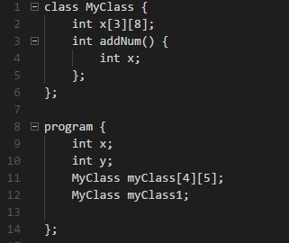
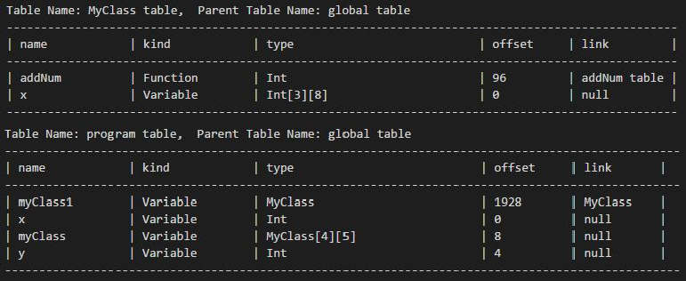
Offset Example

Slide 7
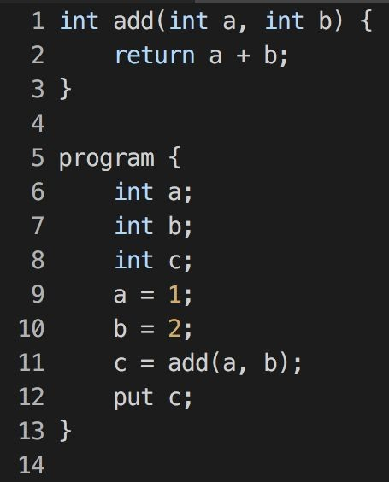
Stack-based Function Call Mechanism
Stack Pointer
Frame Pointer

Slide 8
Stack-based Function Call Mechanism
Stack Pointer
Frame Pointer
Frame pointer →current function’s base address.
Stack pointer → where the new function frame should be put.

Slide 9
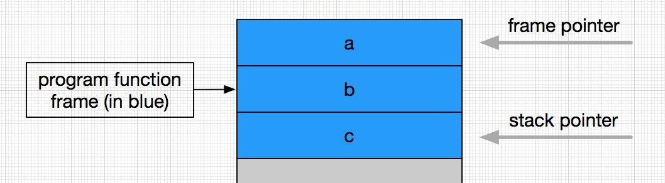
How you can know where you should put a, b, c and how to locate them?
Stack-based Function Call Mechanism

Slide 10
Stack-based Function Call Mechanism
How you can know where you should put a, b, c and how to locate them?
Solution: Using Offset
offset → the distance from the variable cell to the frame pointer (current function’s base address).
stack pointer → where the new function frame should be put.

Slide 11
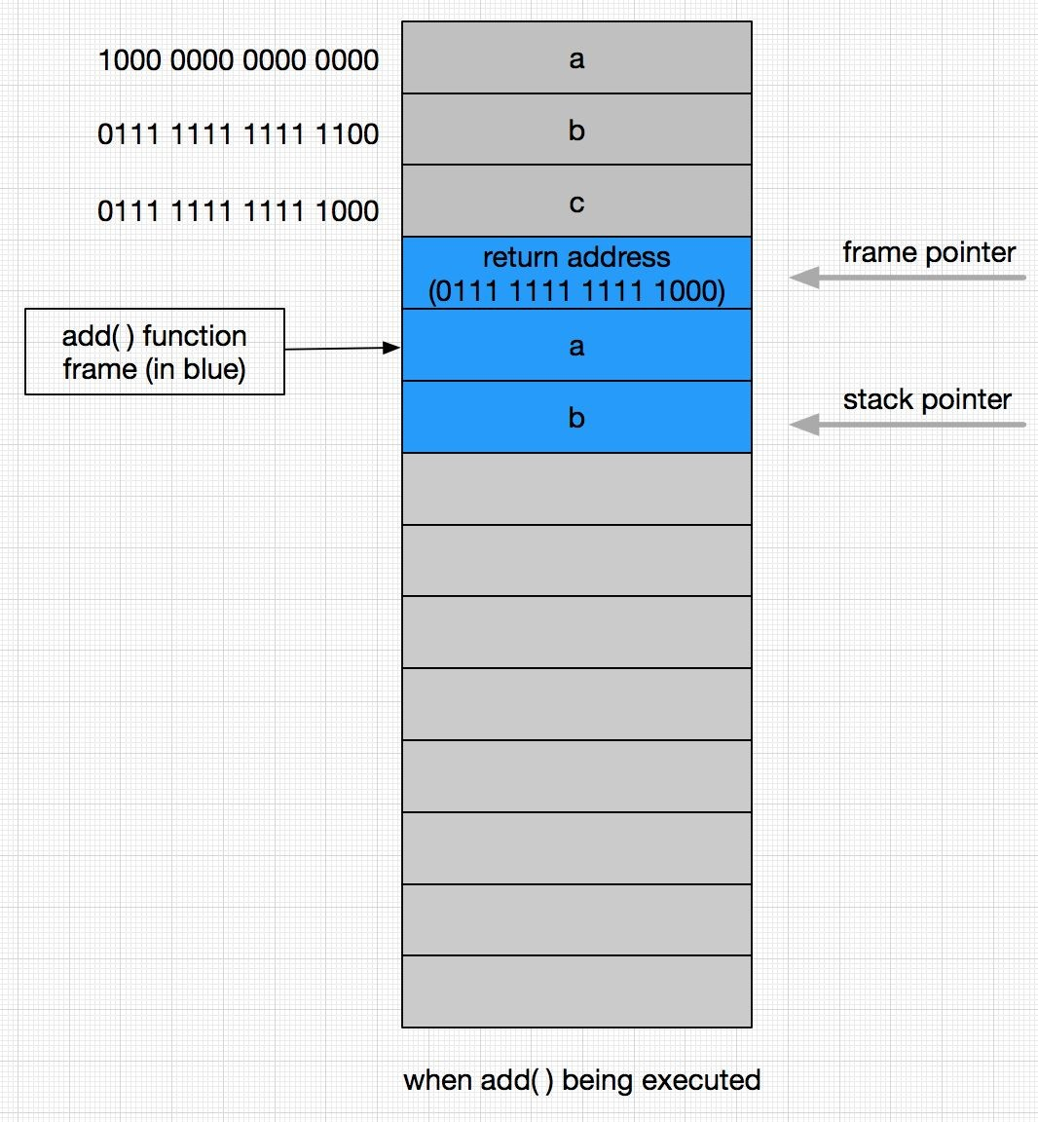
Stack-based Function Call Mechanism

Slide 12
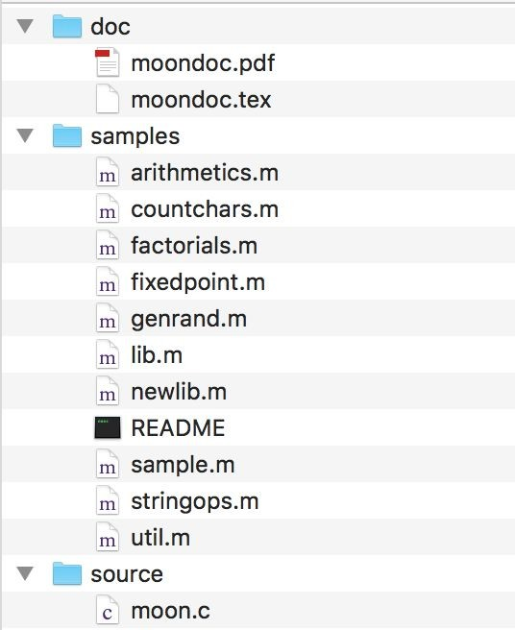
MOON Processor
The MOON processor is wrote by Dr. Peter Grogono in Concordia University.
It is a kind of “virtual machine” we used to run our generated code (assembly language)
You can get the source code of Moon in the bottom of the course website in the bellow link
https://users.encs.concordia.ca/~paquet/wiki/index.php?title=COMP442/6421_-_winter_2021
You need very basic knowledge of assembly language

Slide 13
How to compile MOON?
You need to have a C compiler (eg. gcc)
Download the source code and unzip it
Open Terminal, change your working directory to where you put the source code
Compile it using the very basic compile command
For example, if you are using gcc, just type the following command in the terminal:
gcc [-o executable_file_name] moon.c
Note: there is a PDF file accompanying with the source code, you are strongly suggested to read that file before you ask any question.

Slide 14
Important Parameters of MOON
MOON Processor
All instructions of MOON occupy one word
There are total 16 registers from R0 to R15, R0 always contains zero
Program counter is 32-bit and contains the address of next instruction to be executed
Memory address in the range of [0, 2^31], the usable memory is less than that

Slide 15
How to use MOON?
MOON Processor
There are 4 types of instruction:
Data access instructions
Arithmetic instructions
Input and output instructions
Control instructions
Terminology
M₈[K]: it denotes the byte stored at address K;
M₃₂[K]: it denotes the word stored at address K, K + 1, K + 2 and K + 3;
An address is aligned if it is a multiple of 4;
An address is legal if the address byte exists;
The name PC denotes the program counter;
The name R0, R1, … denotes the registers;
The symbol ← denotes data transfer;
Note: the slide cannot show all instructions provided by MOON, please consult the documentation for more detailed !

Slide 16
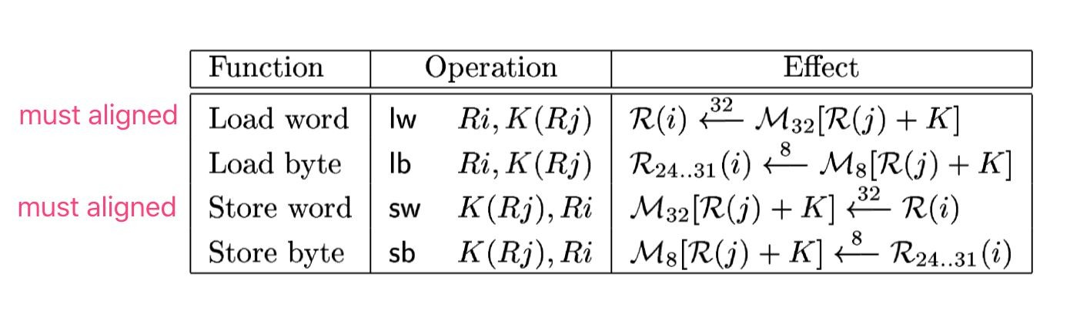
Data Access Instructions
MOON Processor
Take load word as an example:
R(i) ← ³² M₃₂[R(j) + K] means take one word data stored in the address ( R(j) + K ) and put it into register R(i)
where K is: −16384 ≤ K < 16384.

Slide 17
Arithmetic Instructions
MOON Processor
There are two types of arithmetic instructions:
Arithmetic Instructions with Register Operands
Arithmetic Instructions with an Immediate Operand
Register Operands: R ( i ) ← R ( j ) + R ( k ), sum up the second and third register’s value and put the result into the first register;
Immediate Operand: R ( i ) ← R ( j ) + k, sum up the second register’s value and the third value then put the result into the first register;

Slide 18
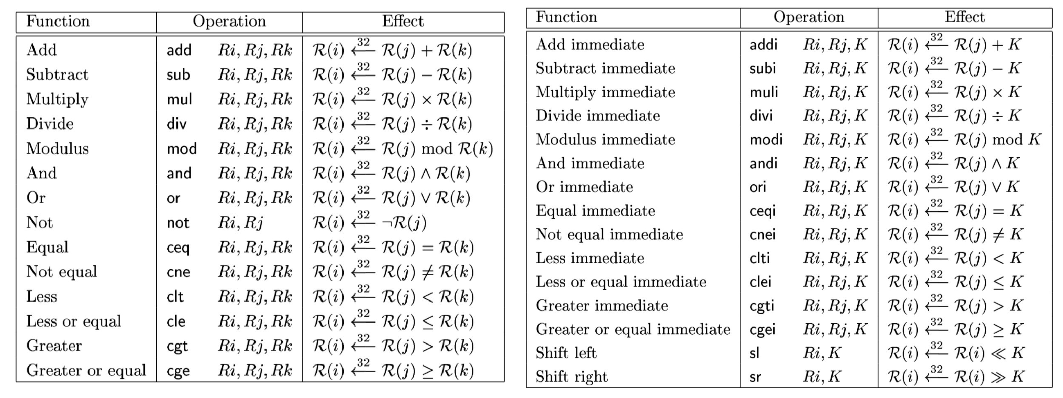
Arithmetic Instructions
MOON Processor

Slide 19
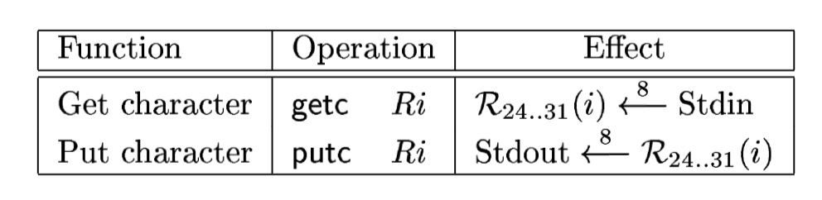
Input and Output Instructions
MOON Processor
The instruction getc reads one byte from stdin, the standard input stream. Similarly,
putc writes to stdout, the standard output stream

Slide 20
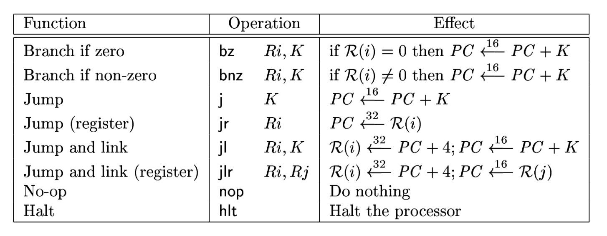
Control Instructions
MOON Processor

Slide 21
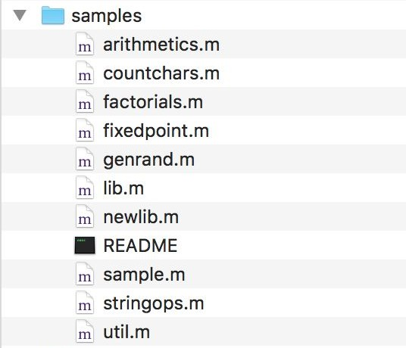
Example of MOON
As a first step for using MOON, we consider sample.m file which is the most simple example.

Slide 22
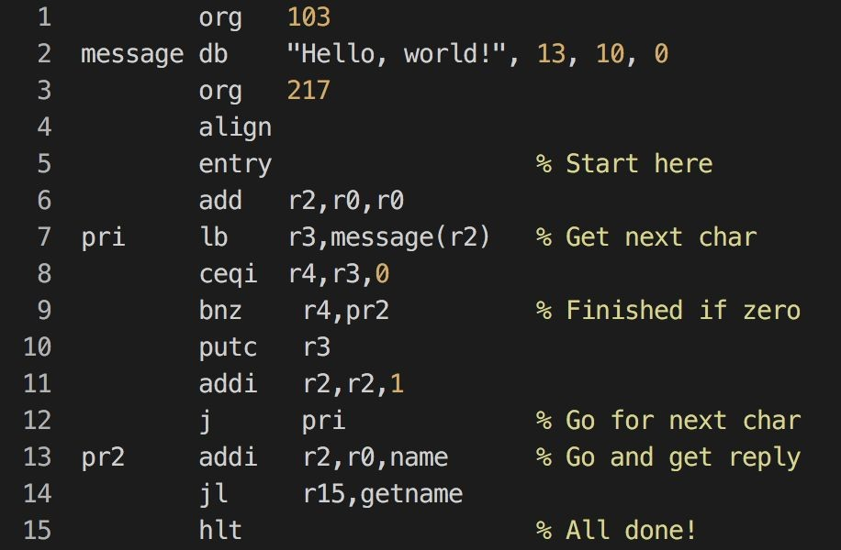
Example of MOON
Sample.m Example

Slide 23
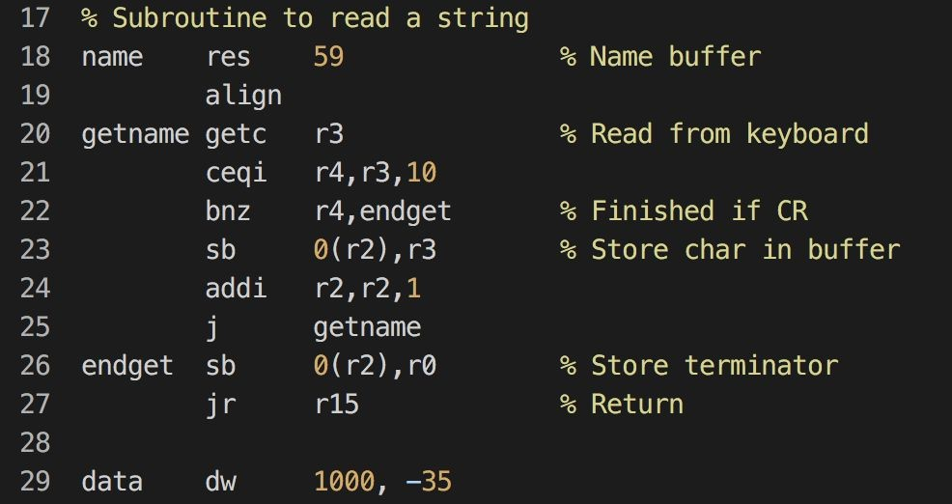
Example of MOON
Sample.m Example

Slide 24
Thanks!

