Slide 1
General Optimization Techniques and Noteworthy Applications for the Altera FPGA OpenCL SDK
Derek Z H Yan
(derek.zh.yan@stanford.edu)
MSEE Candidate Stanford University
Advanced Design Engineer, Altera Corp

Slide 2
Motivation
FPGA programming paradigm limited to RTL?
De-facto standard: Verilog HDL/VHDL
Xilinx Vivado Design Suite: v2012.2 first released May 2, 2012
Altera OpenCL SDK: v13.0 first released on May 6, 2013
Xilinx OpenCL?: announced development mid-September, 2013
High performance domain-specific-language realizations on new classes of hardware
Stanford Delite framework
This work -> Targeting DSL through Delite to FPGA
OpenCL code generation
Implementation patterns and optimizations
High-performance applications

Slide 3
Outline
Motivation
Overview of Altera OpenCL SDK Design Flow
Optimization and Implementation Strategy Guidelines for Altera OpenCL SDK
High-Performance Applications Suited for Altera OpenCL SDK
Conclusions & Recommendations

Slide 4

Conventional FGPA Design Flow
always @ (*) begin
case (sel)
2’b00: mux_out = a;
…
VHDL/Verilog HDL Design Entry
Functional Simulation
Synthesis
Place and Route
Static Timing Analysis
On-board verification
DSP
M20K
I/O
LE
t_{clk}

Slide 5



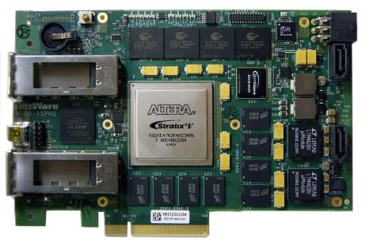


Heterogeneous Systems for Altera OpenCL SDK
OpenCL
Host Program + Kernels
AOC + Quartus II
Standard C Compiler
Bitstream
x86,Power

Slide 6
Simplified OpenCL System Architecture
External Interface
FPGA
External
Memory Controller
& PHY
External
Memory Controller
& PHY
x86 /
External Processor
PCIe
DDR*
Global Memory Interconnect
M9K
M9K
M9K
M9K
Kernel Pipeline
Kernel Pipeline
Kernel Pipeline
M9K
M9K
Local Memory Interconnect

Slide 7
Simplified External Interface
PCIe
DDR Controller
DMA
K0
K1
K2
Kn
Kernel Pipelines

Slide 8
Simplified Interconnect Architecture
Simple arbitration node
Kernel 1
load
arb2
load
arb2
store
arb2
Memory
store
arb2
Kernel 2
load
arb2
store
Customized pipelining: higher fmax → more throughput

Slide 9

Altera OpenCL Compiler Flow
host.c
kernel.cl
Front End
Parses OpenCL extensions and intrinsics – produces LLVM IR
Altera
Runtime
Library
CLANG
front end
System Description
C compiler
CLANG
front end
Unoptimized LLVM IR
Unoptimized LLVM IR
program.exe
Optimizer
Optimized LLVM IR
OpenCL
Platform
DDR*
RTL generator
Verilog
PCIe

Slide 10
Altera OpenCL Compiler Flow Ctd.
host.c
kernel.cl
Altera
Runtime
Library
CLANG
front end
C compiler
Unoptimized LLVM IR
program.exe
Middle End
~150 compiler passes such as loop fusion, auto vectorization, and branch elimination leading to more efficient HW
Optimizer
Optimizer
Optimized LLVM IR
OpenCL
Platform
DDR*
Optimized LLVM IR
RTL generator
Verilog
PCIe

Slide 11
Altera OpenCL Compiler Flow Ctd.
host.c
kernel.cl
Altera
Runtime
Library
CLANG
front end
C compiler
Unoptimized LLVM IR
program.exe
Back End
Instantiate Verilog IP for each operation in the intermediate representation
Create control flow circuitry to handle loops, memory stalls and branching
Traditional optimizations such as scheduling and resource sharing
Optimizer
Optimized LLVM IR
QSYS
Quartus
DDR*
RTL generator
Verilog
RTL generator
Verilog
PCIe

Slide 12
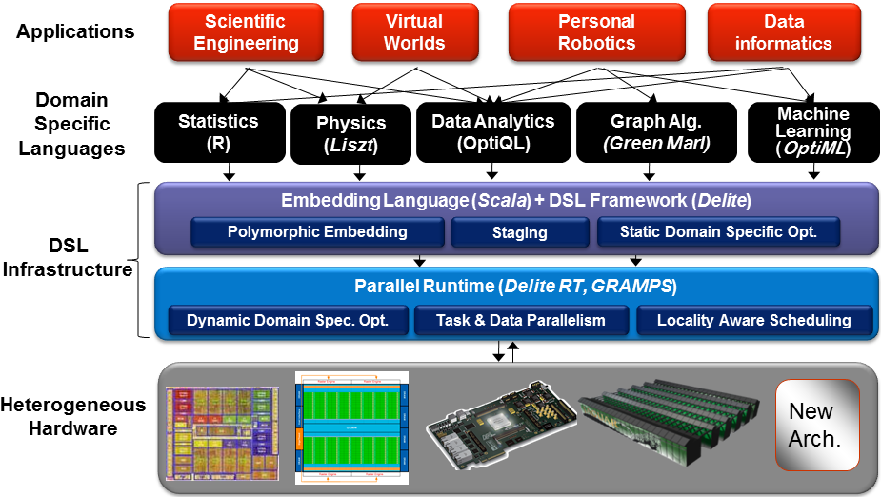
Target Heterogeneous Systems Via Delite and OpenCL

Slide 13
Possible Methods of Attack
OpenCL Code Generator
Implementation patterns for Altera OpenCL SDK
Necessary optimizations and
High-performance applications and comparisons across other heterogeneous platforms
LLVM-IR
Altera OpenCL converted to HDL through LLVM IR
Other hardware platforms also consume LLVM IR
Scripting Languages to HDL Converters
Python-HDL one stop solution

Slide 14
Altera OpenCL SDK Implementation Patterns and Optimizations
*Slides mainly based on Altera OpenCL Optimization guide and internal Altera training documentations, which can be found at here

Slide 15
Possible Optimizations:
Intro
Exploiting data-level parallelism
Exploiting task-level parallelism
Exploiting single-work item parallelism
Optimizing Memory Usage
Optimizing Channel Communications

Slide 16


Deeply Pipelined Kernel Design
GPU Architecture for OpenCL
Warps of threads of with replicated hardware
Each thread performs small and identical calculation
Hybrid of thread and memory level parallelism
FPGA Architecture for OpenCL
Limited area and complex routing
Instead, aim for deeply pipelined kernel design to reuse hardware and achieve parallelism
Pipeline level parallelism

Slide 17
Deeply Pipelined Kernel Design Ctd.
Vector Add Example:
__kernel void vectorAdd( __global const float *x,
__global const float *y,
__global float *z)
{
int index = get_global_id(0);
z[index] = x[index] + y[index];
}
GPU Implementation:
FPGA Implementation:
Thread 0
Thread n-1
Thread n-1
…
Load
Load
Load
Load
Load
1
Load
…
0
+
+
+
Store
Store
Store

Slide 18
Good Programming Practices
Avoid branches (generally*)
Avoid work-item dependent backward branching
Ex. for (size_t i = 0; i < get_global_id(0); i++) {}
Avoid pointer aliasing (use restrict flag)
May cause non-deterministic behaviors
Use small and inexpensive functions
Inexpensive functions: binary logic operations (with a constant), shift by a constant (mult/div by a power of 2)
Expensive functions: integer divide, modulo, floating point divide, atomic functions
Reuse results whenever possible

Slide 19
Good Programming Practices Ctd.
Floating point optimizations
Manually enabled and not compliant to IEEE Standard (IEEE 754-2008)
Flag: aoc –fp-relaxed=true <kernel>.cl
Apply tree balancing to reduce computation cycles
Flag: aoc –fpc <kernel>.cl
Apply rounding only at the end of tree operation
Reduce hardware
Fixed point optimizations
Always use less logic than floating point
Data resolutions limited to (char-8bit, short-16bit, int-32bit, and long-64bit)
If data resolution doesn’t comply to these bits, use appropriate masking operations to save on hardware

Slide 20
Good Programming Practices Ctd.

Slide 21
Exploiting Data Level Parallelism

Slide 22
Loop Unrolling

Slide 23
Static Memory Coalescing

Slide 24
Kernel Vectorization

Slide 25
Compute Unit Replication

Slide 26
Exploiting Task Level Parallelism

Slide 27
Simultaneous Multi-Threading by Multiple Queues

Slide 28
Synchronization Techniques

Slide 29
Profiling Tasks Using Events

Slide 30
Exploiting Single Work Item Parallelism

Slide 31
Loop Pipelining

Slide 32
Task Programming Guidelines

Slide 33
Altera OpenCL SDK Applications and their Relative Performance
*Slides based on investigations of existing OpenCL design examples, which can be found at here

Slide 34
Sobel 2D Image Filter
Exploits single-work item parallelism
Loop pipelining
Coalesced memory access

