Slide 1


Modeling and Identification of Complex Hysteretic Non-linearities Using Discrete Backlash Operator
presented by Yan Naing Aye
School of Mechanical and Aerospace Engineering
Nanyang Technological University, Singapore
2014-Oct-1

Slide 2
Motivation
Simpler hysteresis model
Less amount of calculation
Model parameters and response curve relation is intuitive
No initial loading curve
For an inverse operator controller, output range does not depend on initial backlash gear states
Limitation of input to be greater than 0 imposed by one sided property of dead zone parameter is eliminated

Slide 3
Introduction
Discrete Backlash Operator
Combining virtual elementary backlash gears called discrete backlash gears
Each gear has a bistable state (either 0 or 1)
Two properties - ∆X and ∆Y
Discrete Backlash Operator with n gears has 2^{n} possible states
Current state B = b_{n-1}….b₁b₀

Slide 4
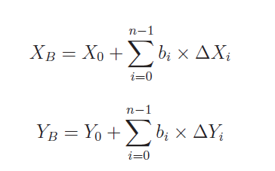
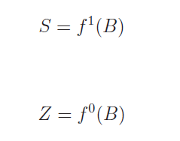
Discrete Backlash Operator
Four variables that depend on its current state

Slide 5
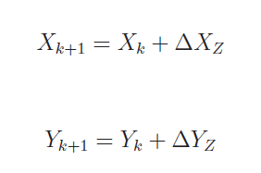
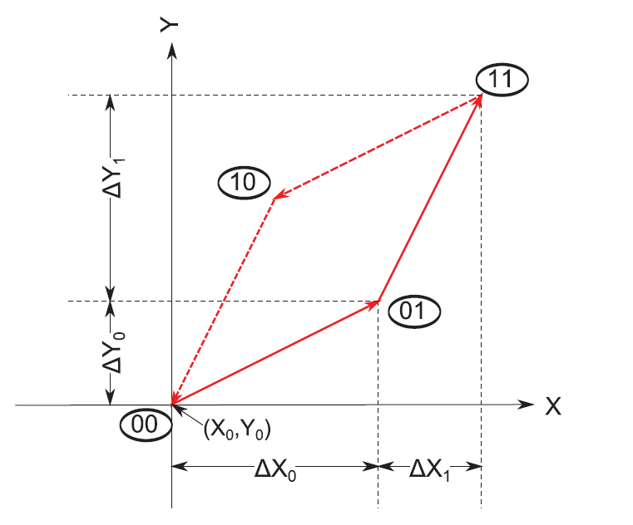
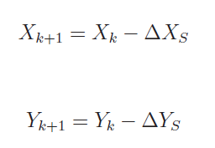
Discrete Backlash Operator
Go up, b_{Z} is set
Go down, b_{S} is cleared

Slide 6
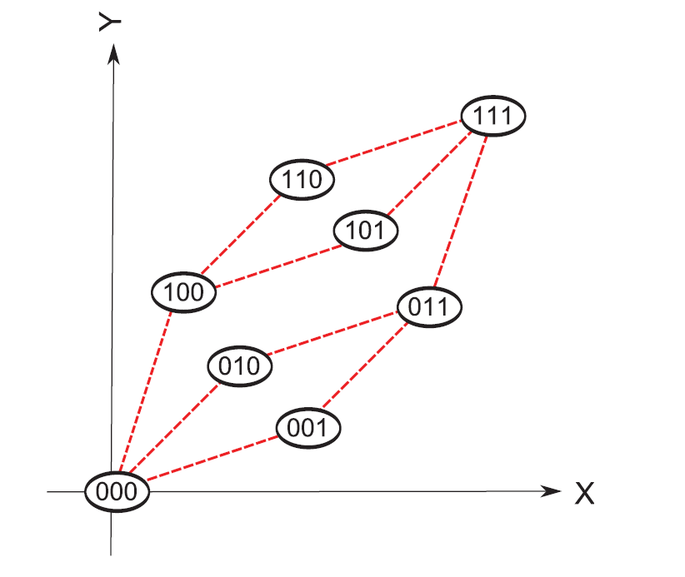
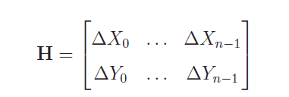

Slide 7
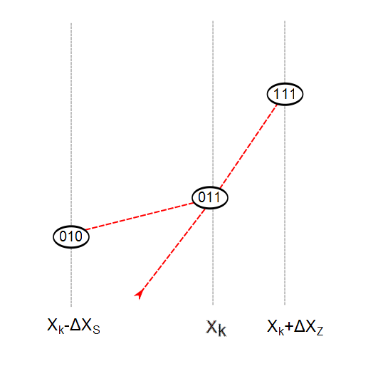
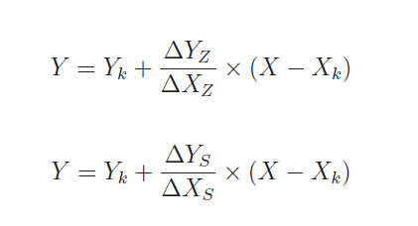
At each input sample

Slide 8
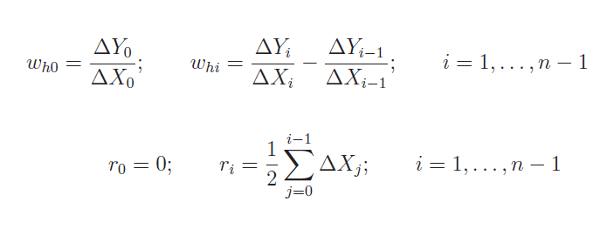
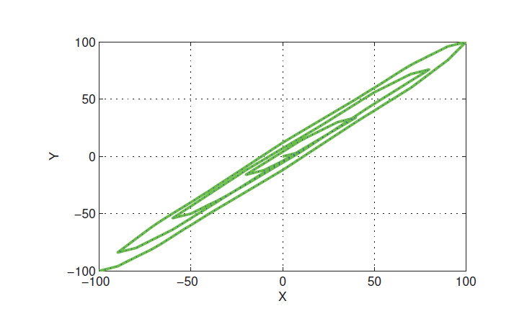
Relationship to PI Operator

Slide 9
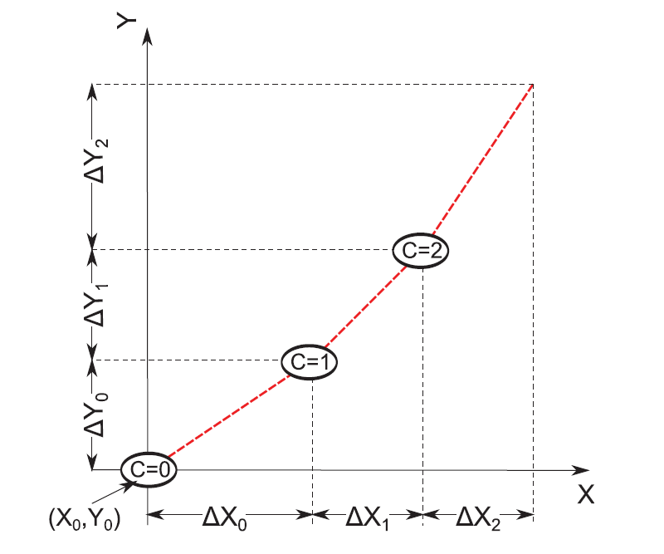
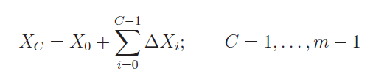

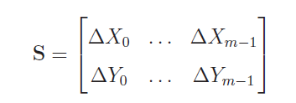
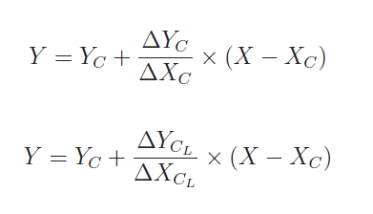
Discrete Point Operator

Slide 10
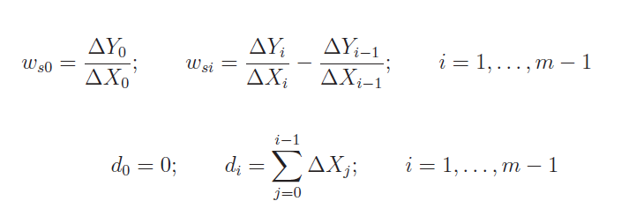
Relationship to DZ Operator

Slide 11
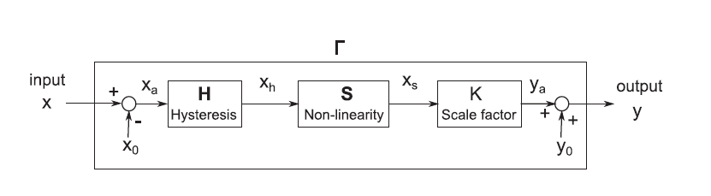
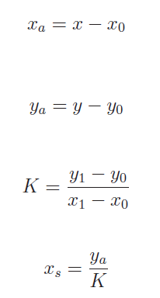
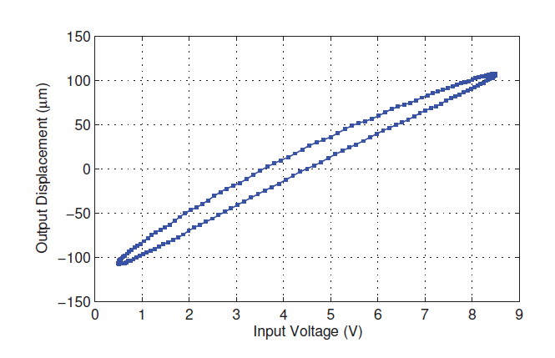
Parameter Identification
x₁, y₁
x₀, y₀

Slide 12
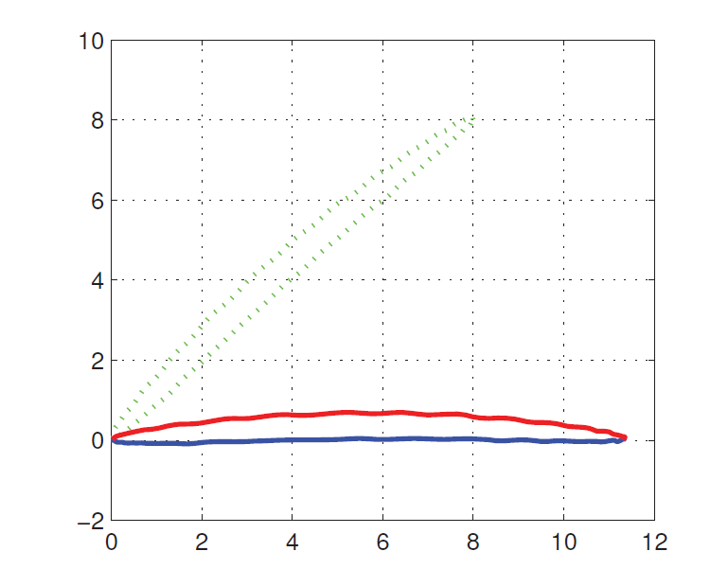
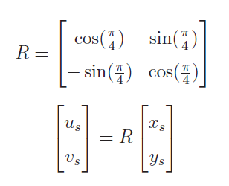
Parameter Identification

Slide 13
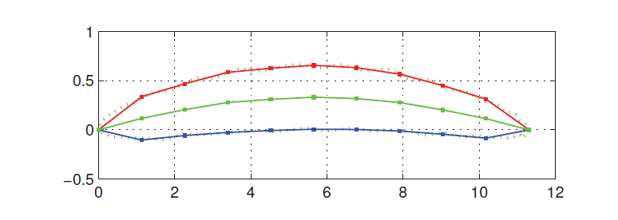

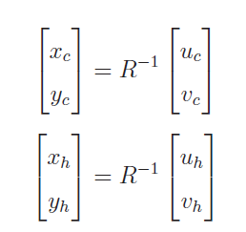

Parameter Identification

Slide 14
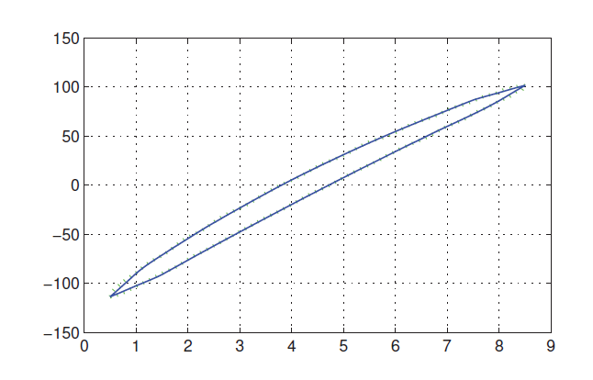
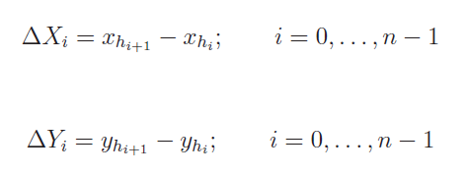
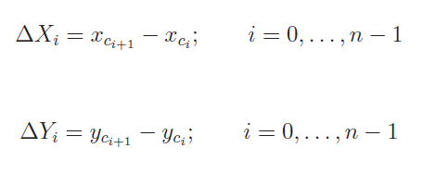
Parameter Identification

Slide 15
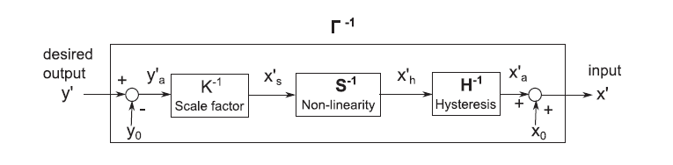


Inverse Model

Slide 16

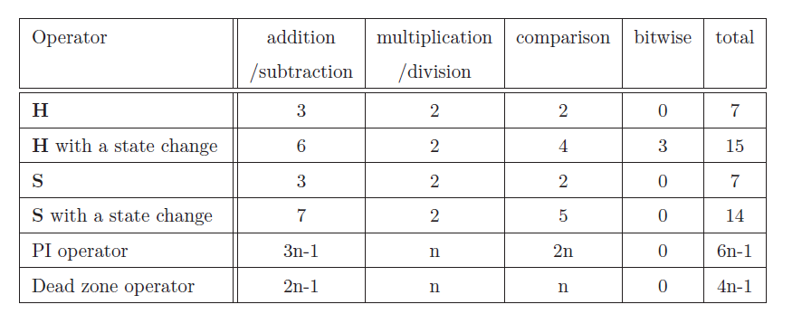
Amount of Calculation
For n=20, amount of calculation for DBO is only between
7.07% to 14.65% of that of PIO.

Slide 17
Conclusion
Alternative to PI
Simpler, more intuitive, less calculation
Easy to extend to handle out of range input, even symmetry, etc.
Larger the order n, the more effective in calculation
For small n, look up table can be implemented
Suitable for applications with very high sampling rate, systems with low-end hardware.
Notes:
Improve fusion algorithm using approaches in frequency domain
Conduct experiment to compare the two approaches
Improve focus value calculation of the vision unit
Conduct experiment for accelerometer placement configuration
Conduct experiment for accelerometer calibration
Improve BMFLC filter
Develop the ITrem2 control using different sample rate for micromanipulator
Conduct experiment for improved ITrem2
Write dissertation

Slide 18
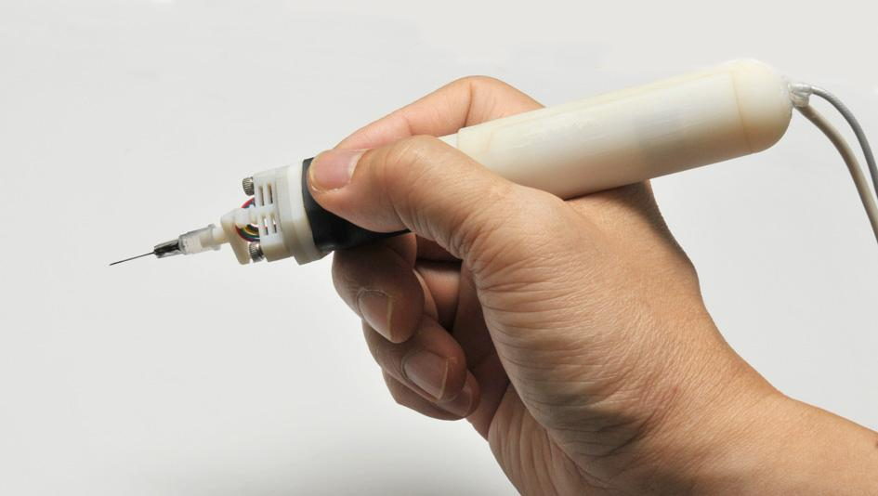
Thank you very much for your attention!
Q & A

