Slide 1

AI-Powered Family Office Portfolio Dashboard
A Controlled Document-to-Dashboard Proof of Concept
Yang Shu
2026.7.17

Slide 2
Question statement
THE PROBLEM IS NOT A LACK OF CHARTS. IT IS A LACK OF CONTROLLED DATA FLOW.
How can an AI-enabled workflow extract information from private-market documents, combine it with portfolio and market data, and support reporting, liquidity planning, and risk monitoring for a family office?

Slide 3

THE PROJECT THESIS
AI creates value when it converts fragmented documents into structured evidence. Data infrastructure creates trust when it validates that evidence, routes exceptions to people, applies approved updates only, and keeps the source-to-dashboard trail visible.

Slide 4
FINAL DELIVERY EVIDENCE
26 / 26 DATA QA PASSED
129 AUTOMATED TESTS PASSED
3 APPLIED · 3 BLOCKED

Slide 5
WHY PRIVATE-MARKET REPORTING BREAKS
DOCUMENTS ARE FRAGMENTED. DECISIONS CANNOT BE.
Capital calls, distributions, statements, and newsletters arrive in inconsistent formats and on different schedules. Their fields affect cash, NAV, commitments, reporting, and risk. The operational challenge is to interpret document meaning, reconcile it with controlled records, and escalate exceptions before they enter portfolio state.

Slide 6
A SYNTHETIC PORTFOLIO BUILT TO TEST THE HARD PARTS
USD 750M GLOBAL PORTFOLIO
APRIL BASELINE + MAY OVERLAY
Singapore-based, USD reporting, globally diversified and alternatives-heavy: 30% public equities, 13% fixed income, 49% private markets, 5% hedge funds, and 3% cash.
The official close remains 30 April 2026. Six mock May documents create a controlled overlay, separating approved projected activity from booked cash and unresolved records.

Slide 7
SYSTEM DESIGN
THE WORKFLOW CONNECTS DOCUMENT EVIDENCE TO PORTFOLIO STATE.
PDF intake → classification → schema-based extraction → structured JSON → validation rules → human review → approved-only updates → processed datasets → dashboard → public-proxy risk. Each stage produces a traceable output; no stage is allowed to silently bypass the approval boundary.

Slide 8
EXTRACTION MODES
BASELINE
INTAKE
LLM
Deterministic, API-free, and locked to expected synthetic results. It is the standard demonstration route and the basis of final delivery.
Processes PDFs staged through the dashboard using the same offline logic. Uploaded files remain outside portfolio state until reviewed.
Optional comparison path for field-level experiments. It is not required to run the dashboard or reproduce the final demo.

Slide 9
OUTCOMES
APPROVED · 3
NEEDS REVIEW · 2
REJECTED · 1
Distribution, Northstar capital statement, and Blue Horizon newsletter. These records create the processed May overlay.
Both capital calls remain blocked because commitment context or normalization requires analyst attention.
The LionRock capital statement fails consistency checks and cannot update portfolio state.

Slide 10
HUMAN REVIEW
EXTRACTION PREPARES THE DECISION.
PEOPLE CONTROL THE STATE.
Nine rule families test fund match, completeness, urgency, cash sufficiency, commitment consistency, NAV roll-forward, component sums, fuzzy naming, and confidence. Document status rolls up from these results. Only effective “approved” records can reach the portfolio update layer; all others remain visible and blocked.

Slide 11
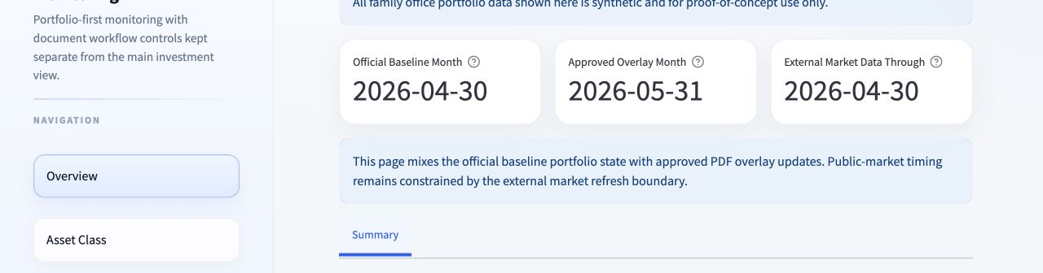
DASHBOARD OVERVIEW
ONE PAGE CONNECTS PORTFOLIO STATE AND WORKFLOW STATUS.
The Overview distinguishes the official baseline, approved overlay, external-market boundary, staged uploads, and pending documents. It combines allocation, performance, liquidity, commitments, and a compact workflow snapshot without hiding the status behind the numbers.

Slide 12
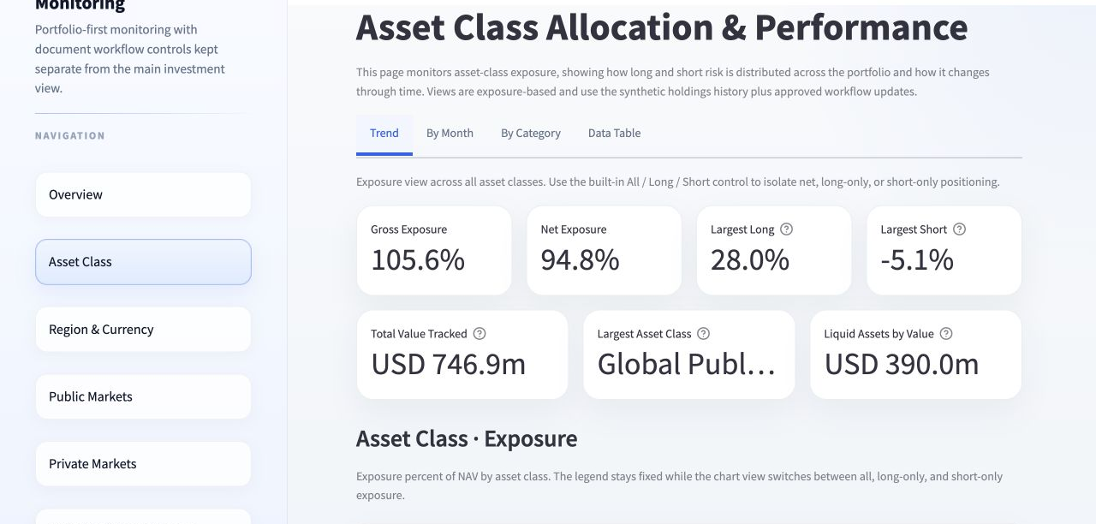
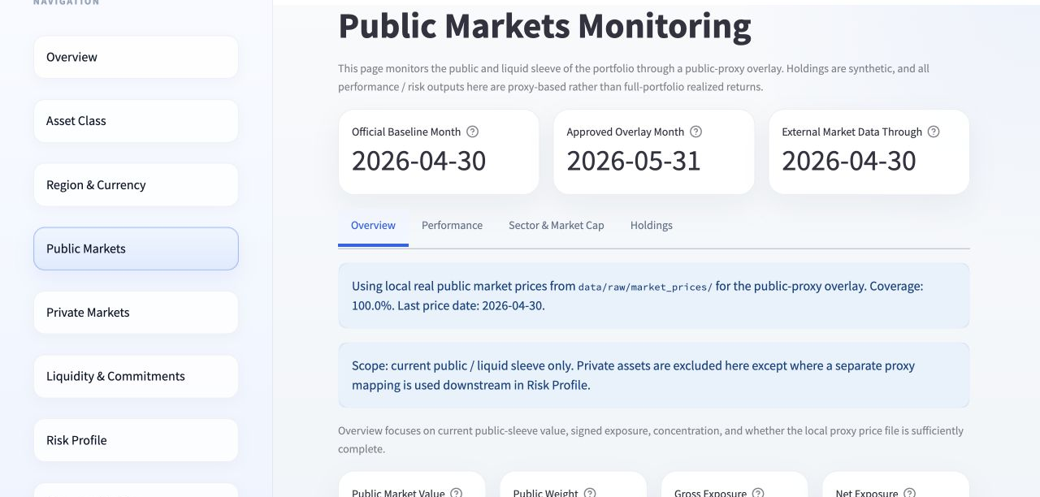
PUBLIC & LIQUID PORTFOLIO
ASSET CLASS
PUBLIC MARKETS
Allocation, monthly change, category evolution, and exposure views explain how capital is distributed and how the structure changes over time.
Holdings, sector, market cap, long/short, and market-linked performance provide observable detail for the liquid sleeve.

Slide 13
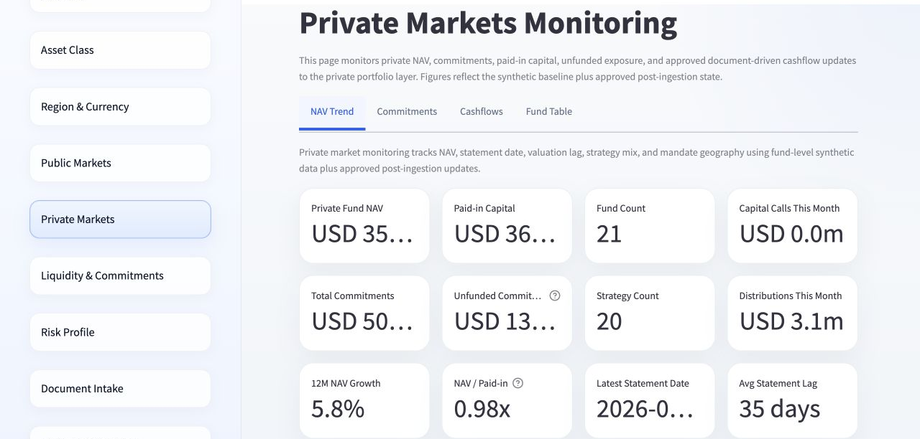
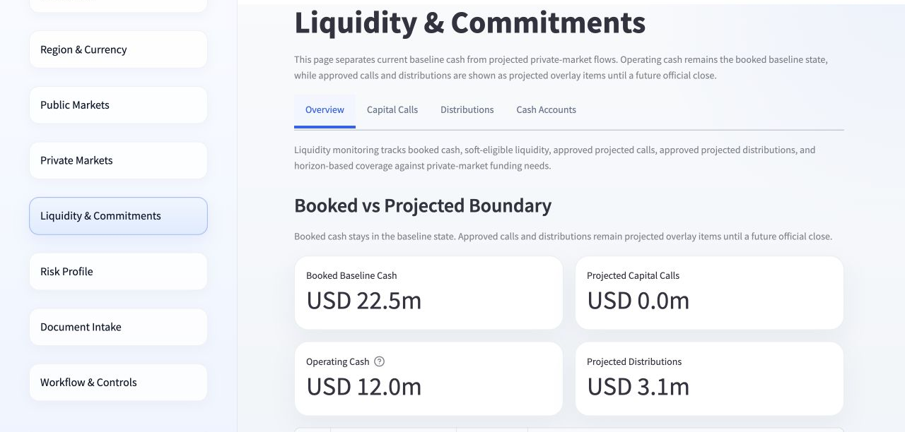
PRIVATE MARKETS & LIQUIDITY
PRIVATE MARKETS
LIQUIDITY
USD 356.9m NAV, USD 500.0m commitments, USD 365.0m paid-in, USD 135.0m unfunded, 21 funds, and 35-day average statement lag.
USD 22.5m booked cash and USD 12.0m operating cash remain separate from USD 3.1m approved projected distributions and blocked calls.

Slide 14
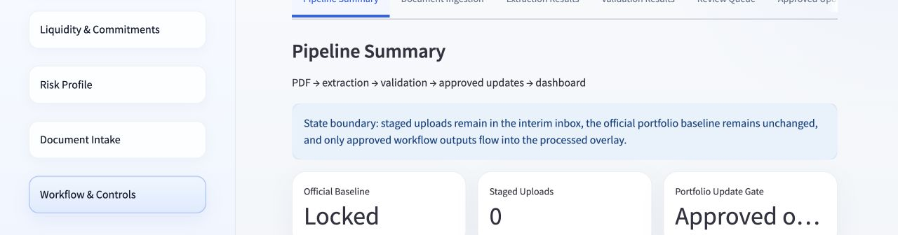
WORKFLOW & CONTROLS
EVERY UPDATE REMAINS EXPLAINABLE.
Users can inspect extraction outputs, rule-level validation, document status, review queue items, manual decisions, applied updates, and blocked records. The page turns the workflow into audit evidence rather than a hidden backend process.

Slide 15
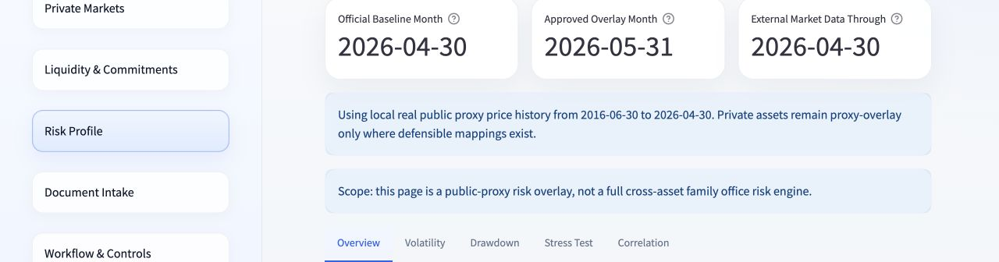
PUBLIC-PROXY RISK
REAL MARKET CONTEXT, EXPLICITLY LIMITED.
Thirty real proxy tickers support a mapped basket with 11.3% annualized volatility, -21.7% max drawdown, 1.22 Sharpe ratio, 36 mapped holdings, and five stress scenarios. It is a proxy overlay—not a complete family-office risk engine.

Slide 16
GOVERNANCE
DATA
DECISIONS
RISK
Synthetic family-office data only. Source IDs, extraction mode, validation results, and update reasons remain traceable.
Human maker-checker control remains necessary for payment, valuation, reporting, and investment authority.
Public proxies create basis risk. Private NAV smoothing, look-through gaps, and cash-flow uncertainty remain explicit limitations.

Slide 17
ROADMAP
PILOT
HARDENING
EXPANSION
Define owners, thresholds, reviewer roles, benchmark documents, and acceptance criteria before expanding scope.
Add approved source integrations, identity and access control, encryption, monitoring, retries, audit retention, and incident procedures.
Add field-level model evaluation, richer private cash-flow and liquidity models, look-through exposure, and approved risk methodology.

Slide 18
AI-ENABLED
REPORTING
CONTROL THE FLOW
AUTOMATE PREPARATION. KEEP HUMAN AUTHORITY.

