Slide 1
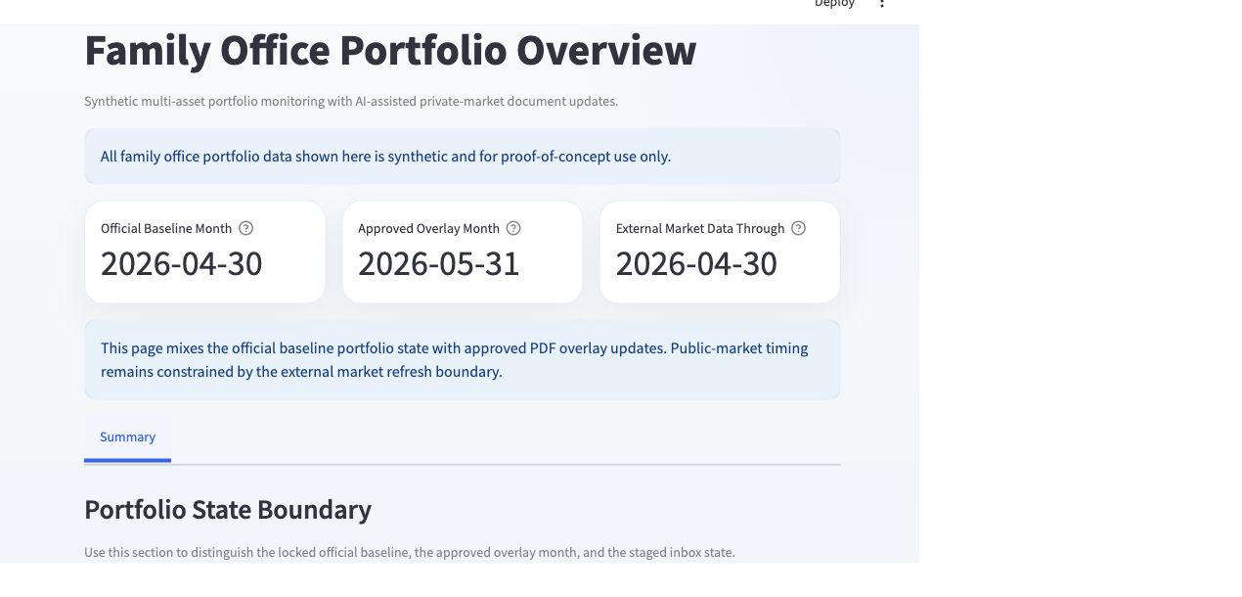

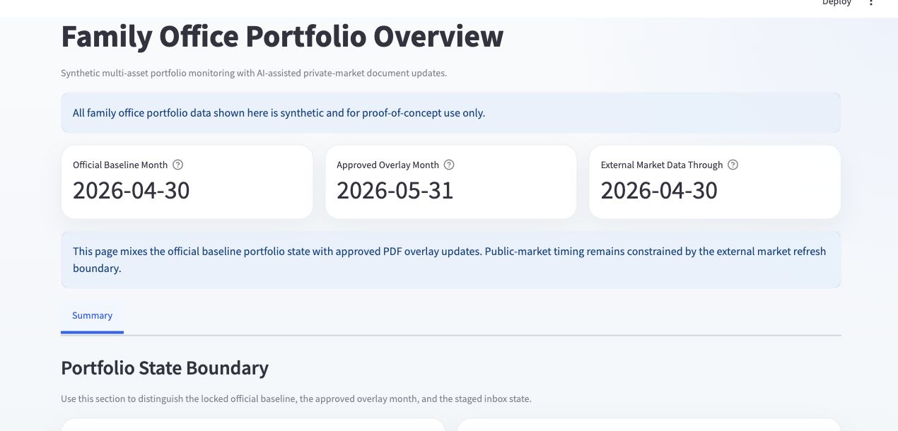
AI-Powered Family Office Portfolio Dashboard
A Controlled Document-to-Portfolio Decision-Support Proof of Concept
Yang Shu
2026.7.29
Notes:
Opening: this is a controlled document-to-portfolio proof of concept, not only a dashboard.
[Sources]
Local project repository, synthetic portfolio datasets, pipeline outputs, QA reports, validation results, and local Streamlit dashboard screenshots captured 2026-07-29.
All family-office data is synthetic. Public-risk metrics use real historical proxy prices for synthetic holdings.

Slide 2
Research question
THE CORE PROBLEM IS NOT MISSING DATA. IT IS UNCONTROLLED DATA FLOW.
How can a family office convert fragmented private-market documents into timely portfolio, liquidity, and risk information without allowing uncertain data to enter the official reporting state?
Notes:
Explain that the family office does not lack data; it lacks a controlled path from fragmented documents to decision-ready portfolio information.
[Sources]
Local project repository, synthetic portfolio datasets, pipeline outputs, QA reports, validation results, and local Streamlit dashboard screenshots captured 2026-07-29.
All family-office data is synthetic. Public-risk metrics use real historical proxy prices for synthetic holdings.

Slide 3
WHY THE MANUAL PROCESS BREAKS
DOCUMENTS ARE FRAGMENTED. DECISIONS CANNOT BE.
Capital calls, distributions, statements, and newsletters arrive in different formats and on different schedules. Analysts re-key amounts and dates, reconcile spreadsheets, and rebuild reporting views. The result is slower reporting, more transcription risk, and weak lineage between a source PDF and a portfolio number.
Notes:
Walk through the manual chain: read, re-key, reconcile, update, report. Emphasize delay, transcription risk, and weak lineage.
[Sources]
Local project repository, synthetic portfolio datasets, pipeline outputs, QA reports, validation results, and local Streamlit dashboard screenshots captured 2026-07-29.
All family-office data is synthetic. Public-risk metrics use real historical proxy prices for synthetic holdings.

Slide 4
RESEARCH FINDINGS BECAME DESIGN PRINCIPLES
STANDARDIZE
CONTROL
TRACE
Manager-specific PDFs require document classification and type-specific schemas before extracted information can be compared or validated.
Ambiguous fields require repeatable validation and human review. Extraction alone must never authorize a financial update.
Booked cash, projected events, approved overlays, and blocked records must remain separate and traceable to the source document.
Notes:
Connect the research findings directly to the system design choices: standardize, control, trace.
[Sources]
Local project repository, synthetic portfolio datasets, pipeline outputs, QA reports, validation results, and local Streamlit dashboard screenshots captured 2026-07-29.
All family-office data is synthetic. Public-risk metrics use real historical proxy prices for synthetic holdings.

Slide 5
A SYNTHETIC PORTFOLIO BUILT TO REPRODUCE REAL REPORTING DEPENDENCIES
USD 750M MULTI-ASSET OFFICE
PRIVATE-MARKET COMPLEXITY
Singapore-based and USD-reporting, with public securities, private funds, hedge funds, cash, multiple entities, currencies, geographies, and long/short exposure.
Twenty-one funds, USD 500m commitments, USD 365m paid-in capital, USD 135m unfunded commitments, statement lags, and document-driven cash flows.
Notes:
Explain why the synthetic portfolio is intentionally complex enough to create realistic NAV, commitment, cash, and reporting dependencies.
[Sources]
Local project repository, synthetic portfolio datasets, pipeline outputs, QA reports, validation results, and local Streamlit dashboard screenshots captured 2026-07-29.
All family-office data is synthetic. Public-risk metrics use real historical proxy prices for synthetic holdings.

Slide 6
THE PROJECT SEPARATES OFFICIAL PORTFOLIO STATE FROM NEW DOCUMENT EVENTS
30 APRIL OFFICIAL BASELINE
MAY APPROVED OVERLAY
The official reporting cut-off remains locked. Booked portfolio values and cash balances are not silently restated by later documents.
Six May PDFs are processed as an overlay. Approved records can update decision views; needs-review and rejected records remain visible but blocked.
Notes:
Establish the temporal boundary: April is the official close; approved May records form an overlay; blocked records do not restate the baseline.
[Sources]
Local project repository, synthetic portfolio datasets, pipeline outputs, QA reports, validation results, and local Streamlit dashboard screenshots captured 2026-07-29.
All family-office data is synthetic. Public-risk metrics use real historical proxy prices for synthetic holdings.

Slide 7
SIX MOCK PDFS TEST DIFFERENT BUSINESS EFFECTS
CASH EVENTS
POSITION UPDATES
COMMENTARY
Two capital calls and one distribution test due dates, amounts, funding obligations, distribution components, and liquidity effects.
Two capital-account statements test NAV roll-forward, commitments, paid-in capital, unfunded balances, and deliberate inconsistencies.
One manager newsletter tests qualitative extraction and proves that approved narrative information can be applied without changing financial balances.
Notes:
Introduce the six PDFs by business meaning, not only document type.
[Sources]
Local project repository, synthetic portfolio datasets, pipeline outputs, QA reports, validation results, and local Streamlit dashboard screenshots captured 2026-07-29.
All family-office data is synthetic. Public-risk metrics use real historical proxy prices for synthetic holdings.

Slide 8
END-TO-END SYSTEM DESIGN
DOCUMENT EVIDENCE BECOMES PORTFOLIO INFORMATION ONLY THROUGH A CONTROLLED GATE.
PDF intake → classification → schema-based extraction → structured JSON → validation rules → human review → approved-only updates → processed datasets → dashboard → public-proxy risk. Every stage persists evidence; no stage can silently bypass approval.
Notes:
Use this as the master system map. Extraction is not approval; approval is the gate to portfolio state.
[Sources]
Local project repository, synthetic portfolio datasets, pipeline outputs, QA reports, validation results, and local Streamlit dashboard screenshots captured 2026-07-29.
All family-office data is synthetic. Public-risk metrics use real historical proxy prices for synthetic holdings.

Slide 9
WHAT I DESIGNED AND COMPLETED
RESEARCH & SETTING
DOCUMENT WORKFLOW
DECISION PRODUCT
Defined the family-office reporting problem, research question, synthetic portfolio, reporting dates, and success criteria.
Designed six mock PDFs and built classification, extraction, schemas, validation rules, review status, and approved-only update logic.
Built the Streamlit dashboard, public-proxy risk overlay, QA checks, automated tests, documentation, and repeatable demo workflow.
Notes:
This slide makes personal contribution explicit across research, workflow engineering, dashboard, risk, QA, and delivery.
[Sources]
Local project repository, synthetic portfolio datasets, pipeline outputs, QA reports, validation results, and local Streamlit dashboard screenshots captured 2026-07-29.
All family-office data is synthetic. Public-risk metrics use real historical proxy prices for synthetic holdings.

Slide 10
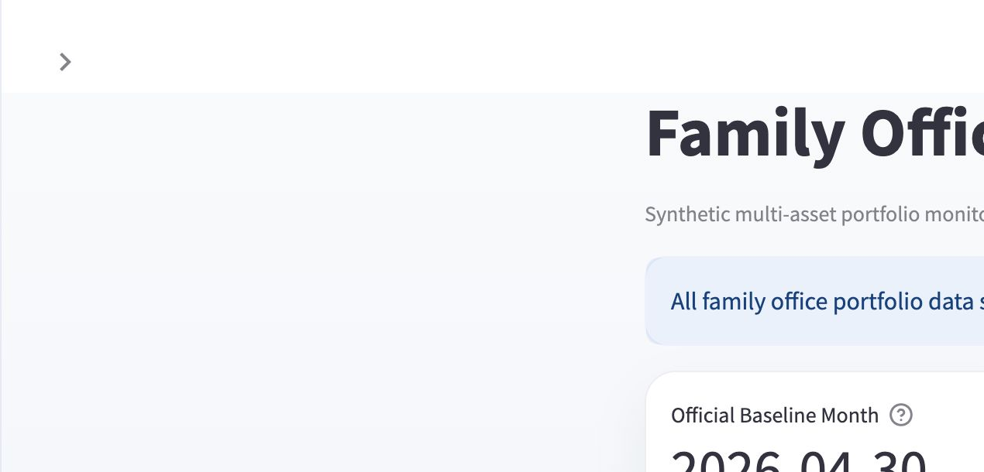
HUMAN REVIEW IS A CONTROL, NOT A FAILURE
EXTRACTION PREPARES THE DECISION.
PEOPLE CONTROL THE STATE.
The validation layer checks required fields, aliases, dates, cash sufficiency, commitment consistency, distribution components, NAV roll-forward, and confidence. Records roll up to approved, needs review, or rejected. Only approved records can change portfolio state.
Notes:
Human review is intentionally part of the target design. Mixed outcomes are evidence that the control gate works.
[Sources]
Local project repository, synthetic portfolio datasets, pipeline outputs, QA reports, validation results, and local Streamlit dashboard screenshots captured 2026-07-29.
All family-office data is synthetic. Public-risk metrics use real historical proxy prices for synthetic holdings.

Slide 11
SIX DOCUMENTS, THREE CONTROL OUTCOMES
3 APPROVED
2 NEEDS REVIEW
1 REJECTED
Harbor Peak distribution, Northstar PCAP, and Blue Horizon newsletter passed their required checks and entered the approved May overlay.
Both capital calls remain blocked because commitment context and alias/missing-field exceptions require analyst resolution.
LionRock PCAP fails the commitment/NAV consistency threshold and cannot enter portfolio state.
Notes:
Three outcome states: approved, needs review, rejected. Explain the business reason for each group.
[Sources]
Local project repository, synthetic portfolio datasets, pipeline outputs, QA reports, validation results, and local Streamlit dashboard screenshots captured 2026-07-29.
All family-office data is synthetic. Public-risk metrics use real historical proxy prices for synthetic holdings.

Slide 12
APPROVED INFORMATION CHANGES THE DASHBOARD; UNRESOLVED INFORMATION DOES NOT
PDF_003 + PDF_004
PDF_002 + PDF_005
Harbor Peak adds a projected USD 3.1m distribution; Northstar PCAP updates the private-market position. Both effects remain source-linked.
SeedSpring needs review and LionRock is rejected. Neither record changes cash, NAV, commitments, or projected approved capital calls.
Notes:
Contrast two applied records with two blocked records. This is the clearest proof of approved-only portfolio updates.
[Sources]
Local project repository, synthetic portfolio datasets, pipeline outputs, QA reports, validation results, and local Streamlit dashboard screenshots captured 2026-07-29.
All family-office data is synthetic. Public-risk metrics use real historical proxy prices for synthetic holdings.

Slide 13
FINAL DELIVERY EVIDENCE
26 / 26 DATA QA CHECKS PASSED
129 AUTOMATED TESTS PASSED
20 / 20 DEMO CHECKS · 3 APPLIED · 3 BLOCKED
Notes:
Present the final locked evidence after the audience understands what was tested.
[Sources]
Local project repository, synthetic portfolio datasets, pipeline outputs, QA reports, validation results, and local Streamlit dashboard screenshots captured 2026-07-29.
All family-office data is synthetic. Public-risk metrics use real historical proxy prices for synthetic holdings.

Slide 14
DASHBOARD INFORMATION ARCHITECTURE
EVERY PAGE DECLARES ITS DATA-STATE BOUNDARY.
The dashboard separates the 30 April official baseline, the 31 May approved overlay, projected approved events, blocked documents, and the public-proxy risk overlay. Users can see what is official, what is newly approved, and what remains uncertain.
Notes:
Before reading any metric, explain the dashboard state labels and dates.
[Sources]
Local project repository, synthetic portfolio datasets, pipeline outputs, QA reports, validation results, and local Streamlit dashboard screenshots captured 2026-07-29.
All family-office data is synthetic. Public-risk metrics use real historical proxy prices for synthetic holdings.

Slide 15
OVERVIEW & ASSET CLASS
PORTFOLIO STATE
EXPOSURE STRUCTURE
Overview establishes the official baseline, approved overlay, external-market cut-off, AUM, applied updates, and staged-document status.
Asset Class shows gross and net exposure, liquid assets, largest allocations, and change through time across long and short positioning.
Notes:
Overview answers what is official/new; Asset Class explains how exposure is distributed.
[Sources]
Local project repository, synthetic portfolio datasets, pipeline outputs, QA reports, validation results, and local Streamlit dashboard screenshots captured 2026-07-29.
All family-office data is synthetic. Public-risk metrics use real historical proxy prices for synthetic holdings.

Slide 16
PUBLIC MARKETS
THE LIQUID SLEEVE CONNECTS HOLDINGS, EXPOSURE, AND REAL MARKET CONTEXT.
Public Markets combines portfolio weights, long/short exposure, sector and market-cap views, proxy mapping, performance, and drawdown. The page is market-linked but remains a monitoring overlay for synthetic holdings.
Notes:
Explain the liquid sleeve and the limitation that market analytics are proxy-based.
[Sources]
Local project repository, synthetic portfolio datasets, pipeline outputs, QA reports, validation results, and local Streamlit dashboard screenshots captured 2026-07-29.
All family-office data is synthetic. Public-risk metrics use real historical proxy prices for synthetic holdings.

Slide 17
PRIVATE MARKETS & LIQUIDITY
PRIVATE-MARKET STATE
BOOKED VS PROJECTED CASH
USD 356.9m NAV, USD 500m commitments, USD 365m paid-in, USD 135m unfunded, 21 funds, cash flows, statement lag, and manager commentary.
USD 22.5m booked cash and USD 12m operating cash remain separate from the approved USD 3.1m projected distribution and blocked capital calls.
Notes:
Connect PDF_003 to projected distribution and PDF_004 to the private position update.
[Sources]
Local project repository, synthetic portfolio datasets, pipeline outputs, QA reports, validation results, and local Streamlit dashboard screenshots captured 2026-07-29.
All family-office data is synthetic. Public-risk metrics use real historical proxy prices for synthetic holdings.

Slide 18
WORKFLOW & CONTROLS
EVERY APPLIED OR BLOCKED UPDATE REMAINS EXPLAINABLE.
The page exposes extraction outputs, validation results, document status, review queue items, decisions, applied updates, and blocked records. It turns the workflow into audit evidence rather than a hidden backend process.
Notes:
Show that the workflow remains visible and auditable after dashboard ingestion.
[Sources]
Local project repository, synthetic portfolio datasets, pipeline outputs, QA reports, validation results, and local Streamlit dashboard screenshots captured 2026-07-29.
All family-office data is synthetic. Public-risk metrics use real historical proxy prices for synthetic holdings.

Slide 19
PUBLIC-PROXY RISK
REAL MARKET CONTEXT, WITH AN EXPLICIT MODEL BOUNDARY.
Thirty real proxy tickers support 36 mapped synthetic holdings, 11.3% annualized volatility, -21.7% maximum drawdown, a 1.22 Sharpe ratio, and five stress scenarios. It is directional monitoring—not a complete family-office risk engine.
Notes:
Use risk as contextual monitoring. Do not overstate it as a production family-office risk engine.
[Sources]
Local project repository, synthetic portfolio datasets, pipeline outputs, QA reports, validation results, and local Streamlit dashboard screenshots captured 2026-07-29.
All family-office data is synthetic. Public-risk metrics use real historical proxy prices for synthetic holdings.

Slide 20
WHO THE SYSTEM SUPPORTS
CIO
INVESTMENT ANALYST
OPS / FINANCE
Review allocation, liquidity coverage, concentration, proxy risk, approved events, and unresolved uncertainty before making portfolio decisions.
Trace fund-level NAV, commitments, cash flows, exposures, performance, proxy mapping, and manager commentary back to supporting evidence.
Monitor intake, validation exceptions, review queues, approval status, applied updates, blocked records, and booked-versus-projected cash.
Notes:
Translate features into decisions for CIO, analyst, and operations/finance.
[Sources]
Local project repository, synthetic portfolio datasets, pipeline outputs, QA reports, validation results, and local Streamlit dashboard screenshots captured 2026-07-29.
All family-office data is synthetic. Public-risk metrics use real historical proxy prices for synthetic holdings.

Slide 21
WHY THE CONTROLLED WORKFLOW IS BETTER
PREPARE
CONTROL
EXPLAIN
Replace repeated document reading and re-keying with standardized extraction into document-type schemas.
Apply repeatable checks and maker-checker review before any value can update portfolio or liquidity state.
Feed approved data into consistent decision views while preserving source IDs, validation results, status, and update reasons.
Notes:
Compare the operating model, not just the technology: prepare, control, explain.
[Sources]
Local project repository, synthetic portfolio datasets, pipeline outputs, QA reports, validation results, and local Streamlit dashboard screenshots captured 2026-07-29.
All family-office data is synthetic. Public-risk metrics use real historical proxy prices for synthetic holdings.

Slide 22
GOVERNANCE AND LIMITATIONS
DATA
DECISIONS
EVIDENCE
All family-office information is synthetic. Production use requires security architecture, permissions, encryption, retention, and audit controls.
Human approval remains necessary for payment, valuation, reporting, and investment authority. The system is decision support, not autonomous posting.
Proxy risk, deterministic extraction, and proof-of-concept QA demonstrate feasibility. Commercial ROI and production accuracy require a measured pilot.
Notes:
State proof-of-concept limitations clearly and separate demonstrated capability from future production requirements.
[Sources]
Local project repository, synthetic portfolio datasets, pipeline outputs, QA reports, validation results, and local Streamlit dashboard screenshots captured 2026-07-29.
All family-office data is synthetic. Public-risk metrics use real historical proxy prices for synthetic holdings.

Slide 23
IMPLEMENTATION ROADMAP
PILOT
HARDEN
EXPAND
Define owners, review roles, thresholds, benchmark documents, time savings, correction rates, and acceptance criteria.
Add approved source integrations, identity and access management, encryption, monitoring, retries, audit retention, and incident procedures.
Add field-level model evaluation, accounting/PMS integration, richer private cash-flow forecasts, look-through exposure, and approved risk methodology.
Notes:
Close the implementation discussion with a measured pilot, hardening, and expansion sequence.
[Sources]
Local project repository, synthetic portfolio datasets, pipeline outputs, QA reports, validation results, and local Streamlit dashboard screenshots captured 2026-07-29.
All family-office data is synthetic. Public-risk metrics use real historical proxy prices for synthetic holdings.

Slide 24
AI-ENABLED
REPORTING
CONTROL THE FLOW
AUTOMATE PREPARATION. PRESERVE HUMAN AUTHORITY.
Notes:
Final message: the most valuable outcome is the controlled information chain. Automate preparation; preserve human authority.
[Sources]
Local project repository, synthetic portfolio datasets, pipeline outputs, QA reports, validation results, and local Streamlit dashboard screenshots captured 2026-07-29.
All family-office data is synthetic. Public-risk metrics use real historical proxy prices for synthetic holdings.

