Slide 1

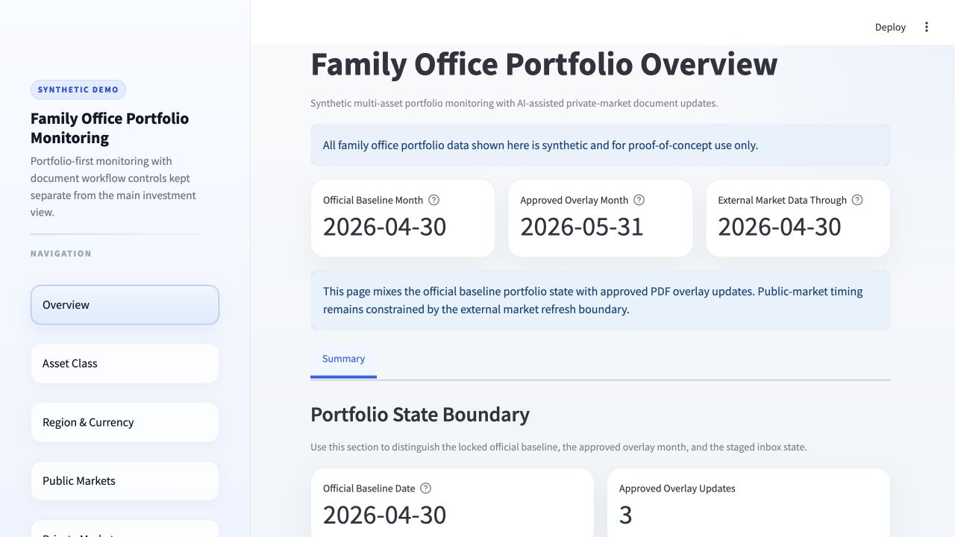
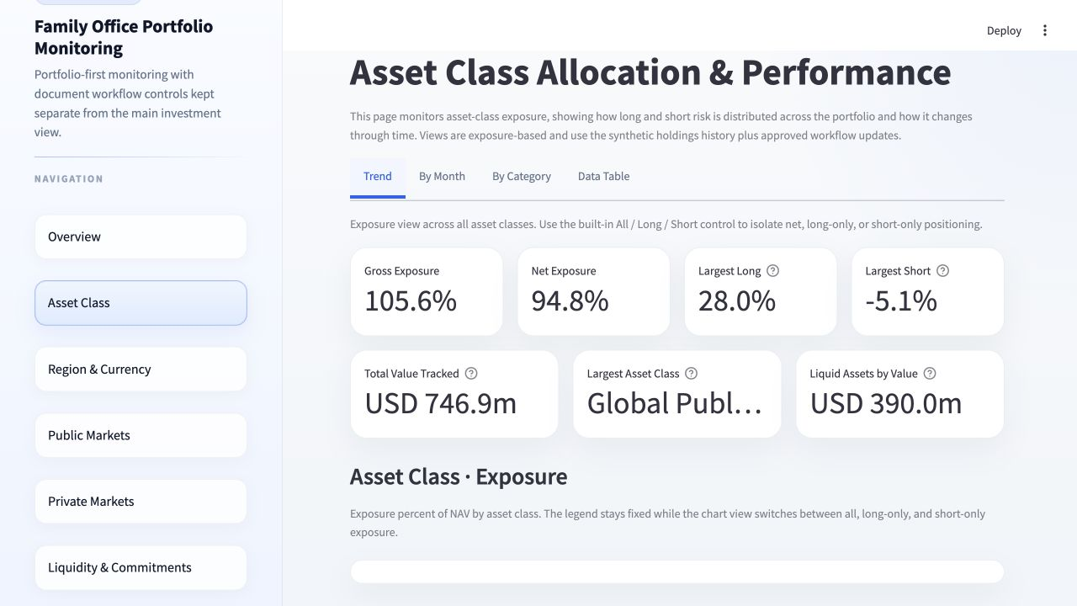
AI-Powered Family Office Portfolio Dashboard
A Controlled Document-to-Portfolio Decision-Support Proof of Concept
Yang Shu
2026.7.29
Notes:
Open with the project thesis: the value is not extraction alone; it is controlled information flow.
[Sources]
Local synthetic portfolio data, processed pipeline outputs, QA reports, risk outputs, and local Streamlit dashboard screenshots. All family-office data is synthetic.

Slide 2
1 · CORE PROBLEM
The reporting bottleneck is an uncontrolled data flow
Manager PDFs
Different formats
Different schedules
Manual re-keying
Amounts · dates · NAV
Commitments · commentary
Spreadsheet reconciliation
Multiple versions
Weak lineage
Late decision views
Liquidity and risk
arrive after the fact
The failure is not that information is unavailable.
The failure is that fragmented evidence reaches portfolio decisions through a slow, manual and weakly controlled chain.
The problem defines the requirement: the system must control the handoff, not only extract the data.
AI-POWERED FAMILY OFFICE PORTFOLIO DASHBOARD
02
Notes:
Explain why document fragmentation becomes a portfolio, liquidity, and governance problem.
[Sources]
Local synthetic portfolio data, processed pipeline outputs, QA reports, risk outputs, and local Streamlit dashboard screenshots. All family-office data is synthetic.

Slide 3
2 · PROJECT SETTING
A USD 750m synthetic portfolio reproduces real reporting dependencies
Portfolio allocation (USD m)
21 PRIVATE FUNDS
USD 500m COMMITMENTS
USD 135m UNFUNDED
MULTI-ENTITY · MULTI-CURRENCY
Why this matters
A private-market document can alter NAV, commitments, future cash requirements, liquidity coverage and the information shown to decision-makers.
Because private-market documents affect multiple portfolio views, the design must standardize, control and trace.
AI-POWERED FAMILY OFFICE PORTFOLIO DASHBOARD
03
Notes:
Use the allocation chart to establish scale and the private-market dependency.
[Sources]
Local synthetic portfolio data, processed pipeline outputs, QA reports, risk outputs, and local Streamlit dashboard screenshots. All family-office data is synthetic.

Slide 4
3 · RESEARCH CONCLUSION
Research findings became three system design rules
01
02
03
STANDARDIZE
CONTROL
TRACE
Classify each document and extract into a type-specific schema.
Validation and human review must sit between AI output and financial state.
Every dashboard value must preserve source, status and update reason.
PDF EVIDENCE
CONTROLLED DATA
DECISION VIEW
These three principles become the architecture of the workflow.
AI-POWERED FAMILY OFFICE PORTFOLIO DASHBOARD
04
Notes:
Frame these as the direct output of the research, not generic technology principles.
[Sources]
Local synthetic portfolio data, processed pipeline outputs, QA reports, risk outputs, and local Streamlit dashboard screenshots. All family-office data is synthetic.

Slide 5
4 · END-TO-END WORKFLOW
The workflow prevents uncertain extraction from becoming portfolio truth
CONTROL GATE
1
PDF INTAKE
6 documents
2
CLASSIFY
type + fund
3
EXTRACT
schema JSON
4
VALIDATE
rules + confidence
5
HUMAN REVIEW
maker-checker
6
APPLY
approved only
7
DASHBOARD
state + lineage
Evidence persists at every stage: source PDF → extracted JSON → validation result → review status → update log → dashboard.
NO APPROVAL = NO PORTFOLIO UPDATE
The workflow is the project’s central control mechanism; the next question is what was actually built.
AI-POWERED FAMILY OFFICE PORTFOLIO DASHBOARD
05
Notes:
This is the main workflow slide. Walk left to right and pause at the human review gate.
[Sources]
Local synthetic portfolio data, processed pipeline outputs, QA reports, risk outputs, and local Streamlit dashboard screenshots. All family-office data is synthetic.

Slide 6
5 · WHAT I BUILT
I designed and completed the full information chain
RESEARCH & SETTING
Problem definition · synthetic portfolio · reporting dates · success criteria
DOCUMENT PIPELINE
Classification · extraction schemas · validation rules · review decisions
PORTFOLIO UPDATES
Approved-only logic · processed datasets · booked/projected separation
DECISION PRODUCT
Streamlit dashboard · public-proxy risk · QA · tests · instructions
The completed system is tested through six documents with deliberately different business effects.
AI-POWERED FAMILY OFFICE PORTFOLIO DASHBOARD
06
Notes:
Make personal contribution explicit across research, engineering, controls, dashboard and delivery.
[Sources]
Local synthetic portfolio data, processed pipeline outputs, QA reports, risk outputs, and local Streamlit dashboard screenshots. All family-office data is synthetic.

Slide 7
6 · TEST EVIDENCE
Six PDFs were designed to test different business effects
PDF_001
Capital call
Northstar
Commitment / liquidity
PDF_002
Capital call exception
SeedSpring
Alias + missing context
PDF_003
Distribution
Harbor Peak
Cash inflow
PDF_004
PCAP
Northstar
NAV / commitment
PDF_005
PCAP exception
LionRock
Roll-forward mismatch
PDF_006
Newsletter
Blue Horizon
Qualitative update
The test is successful only if the control gate distinguishes what may and may not update the portfolio.
AI-POWERED FAMILY OFFICE PORTFOLIO DASHBOARD
07
Notes:
Explain why the six documents are a controlled test set, not merely sample files.
[Sources]
Local synthetic portfolio data, processed pipeline outputs, QA reports, risk outputs, and local Streamlit dashboard screenshots. All family-office data is synthetic.

Slide 8
7 · VALIDATION RESULT
The control gate applied 3 updates and blocked 3
3 APPROVED
PDF_003 distribution · PDF_004 PCAP · PDF_006 newsletter
2 NEEDS REVIEW
PDF_001 and PDF_002 capital calls remain blocked
1 REJECTED
PDF_005 fails commitment and NAV roll-forward checks
The 3 / 2 / 1 result matters because each status creates a different downstream effect.
AI-POWERED FAMILY OFFICE PORTFOLIO DASHBOARD
08
Notes:
The outcome is not a six-for-six automation rate. It is a controlled outcome: three applied, three blocked.
[Sources]
Local synthetic portfolio data, processed pipeline outputs, QA reports, risk outputs, and local Streamlit dashboard screenshots. All family-office data is synthetic.

Slide 9
8 · DOCUMENT IMPACT
Each document follows a visible path to portfolio, liquidity or commentary
PDF_003
Distribution
+ USD 3.1m
projected inflow
LIQUIDITY VIEW
PDF_004
PCAP
Northstar NAV /
commitment update
PRIVATE-MARKET VIEW
PDF_006
Newsletter
Approved manager
commentary
WORKFLOW & COMMENTARY
PDF_001 / 002 / 005
Blocked
Review queue /
blocked reason
Those downstream effects require explicit boundaries between official, approved and blocked information.
AI-POWERED FAMILY OFFICE PORTFOLIO DASHBOARD
09
Notes:
Trace each approved and blocked document into the exact dashboard consequence.
[Sources]
Local synthetic portfolio data, processed pipeline outputs, QA reports, risk outputs, and local Streamlit dashboard screenshots. All family-office data is synthetic.

Slide 10
9 · STATE BOUNDARIES
The dashboard separates official state, approved overlay and uncertainty
30 APRIL
OFFICIAL BASELINE
Booked portfolio + cash
31 MAY
APPROVED OVERLAY
3 applied documents
BLOCKED STATE
2 needs review
1 rejected
Locked
Visible + applied
Visible + not applied
The dashboard never collapses these states into one number.
Once the state boundaries are clear, the Dashboard can be read as evidence rather than as a collection of charts.
AI-POWERED FAMILY OFFICE PORTFOLIO DASHBOARD
10
Notes:
This is the governance logic that prevents silent restatement.
[Sources]
Local synthetic portfolio data, processed pipeline outputs, QA reports, risk outputs, and local Streamlit dashboard screenshots. All family-office data is synthetic.

Slide 11
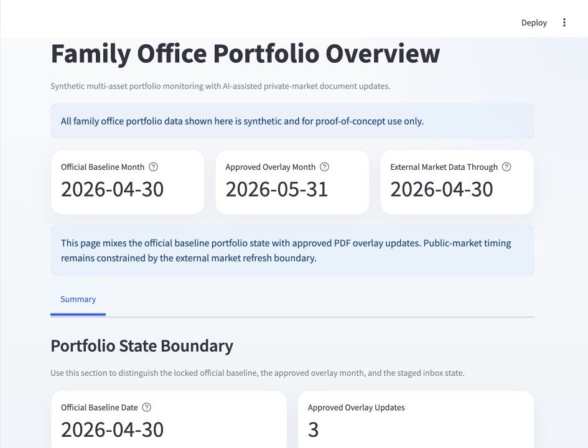
10 · DASHBOARD EVIDENCE
The overview establishes what is official before showing performance
Portfolio mix
USD 750m AUM
The overview establishes the reporting state; the next layer explains the private-market exposure behind it.
AI-POWERED FAMILY OFFICE PORTFOLIO DASHBOARD
11
Notes:
First explain the date and state boundary; then use allocation to orient the audience.
[Sources]
Local synthetic portfolio data, processed pipeline outputs, QA reports, risk outputs, and local Streamlit dashboard screenshots. All family-office data is synthetic.

Slide 12
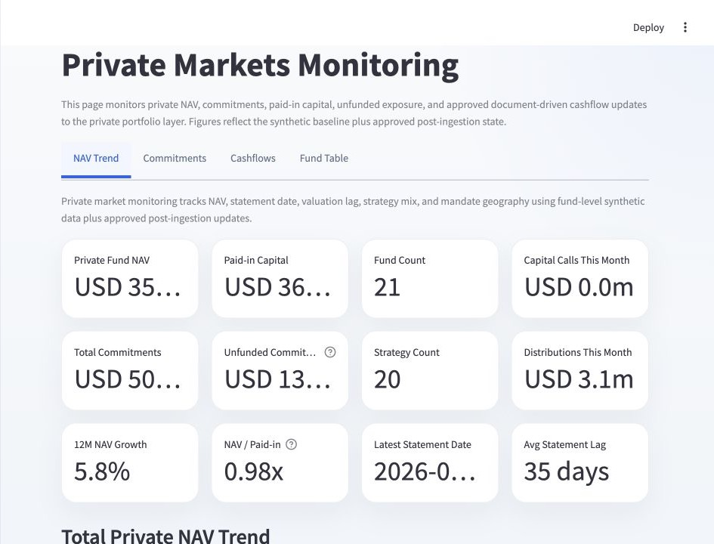
11 · PRIVATE MARKETS
Private-market commitments create the largest document dependency
USD 500m commitments
USD 365m paid-in · USD 135m unfunded
Commitments and unfunded exposure become actionable when translated into liquidity requirements.
AI-POWERED FAMILY OFFICE PORTFOLIO DASHBOARD
12
Notes:
Use the stacked bars to show why capital calls and statements matter to liquidity and exposure.
[Sources]
Local synthetic portfolio data, processed pipeline outputs, QA reports, risk outputs, and local Streamlit dashboard screenshots. All family-office data is synthetic.

Slide 13
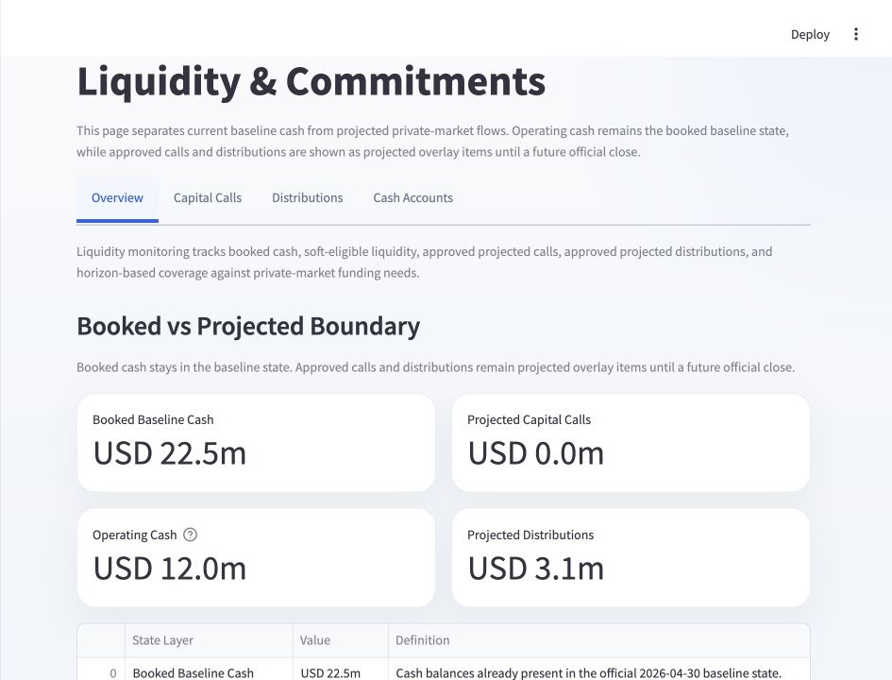
12 · LIQUIDITY
Approved and blocked cash events lead to different liquidity decisions
BOOKED CASH
USD 22.5m
APPROVED PROJECTED INFLOW
+ USD 3.1m
BLOCKED CAPITAL CALLS
USD 7.0m not applied
BOOKED ≠ PROJECTED ≠ BLOCKED
Liquidity answers near-term funding; public-proxy risk adds market context for the liquid sleeve.
AI-POWERED FAMILY OFFICE PORTFOLIO DASHBOARD
13
Notes:
Connect PDF_003 to the projected inflow and the two capital calls to blocked obligations.
[Sources]
Local synthetic portfolio data, processed pipeline outputs, QA reports, risk outputs, and local Streamlit dashboard screenshots. All family-office data is synthetic.

Slide 14
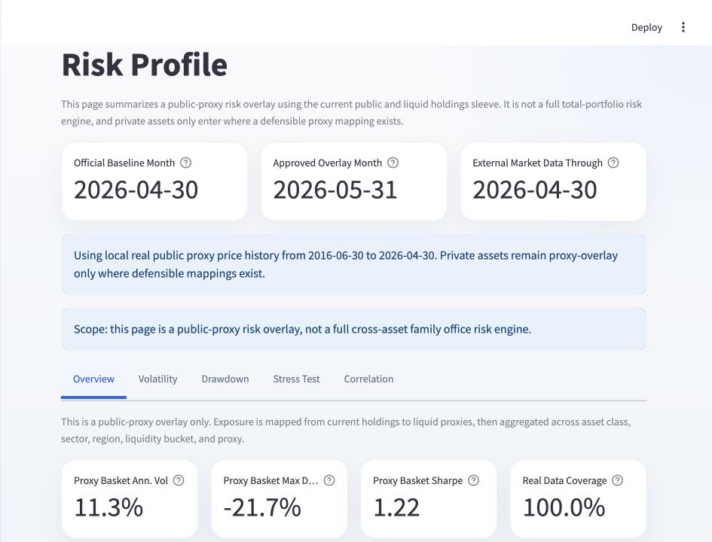
13 · RISK OVERLAY
Public-proxy risk adds market context without overstating precision
30 REAL PROXY TICKERS
Directional monitoring only — not a production family-office risk engine.
Market context is useful only when the underlying processing history remains explainable.
AI-POWERED FAMILY OFFICE PORTFOLIO DASHBOARD
14
Notes:
State the model boundary explicitly: real proxy prices, synthetic holdings, directional risk.
[Sources]
Local synthetic portfolio data, processed pipeline outputs, QA reports, risk outputs, and local Streamlit dashboard screenshots. All family-office data is synthetic.

Slide 15
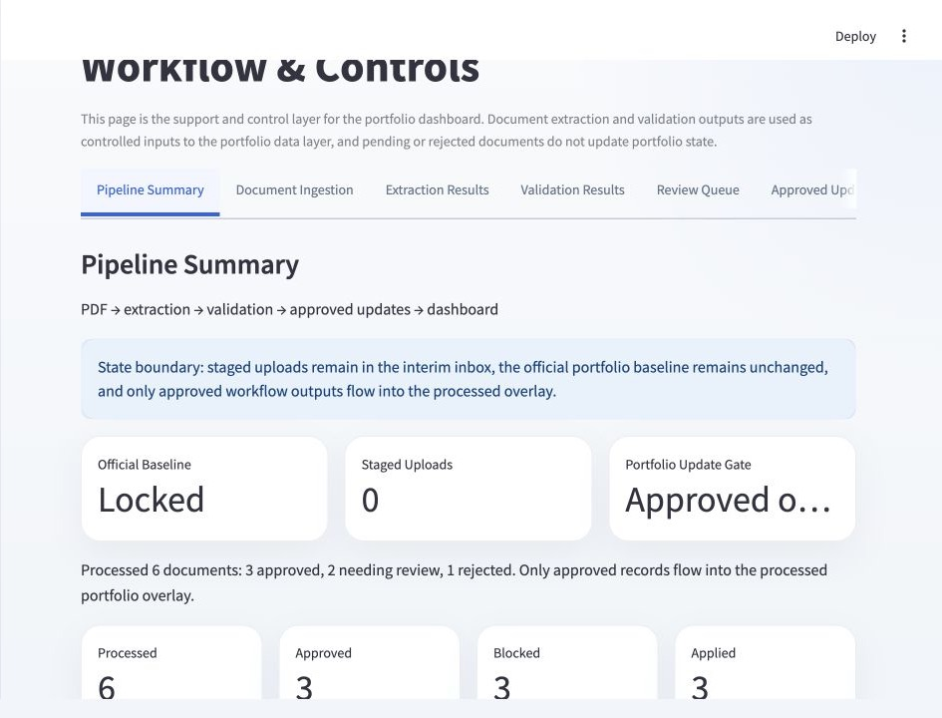
14 · DASHBOARD CONTROLS
Workflow controls turn processing history into audit evidence
6
INGESTED
3
APPLIED
3
BLOCKED
Source ID · validation rule · status · reviewer note · update reason
The same controlled state can now support different decisions across the family office.
AI-POWERED FAMILY OFFICE PORTFOLIO DASHBOARD
15
Notes:
Show that the workflow page exposes evidence rather than hiding processing in the backend.
[Sources]
Local synthetic portfolio data, processed pipeline outputs, QA reports, risk outputs, and local Streamlit dashboard screenshots. All family-office data is synthetic.

Slide 16
15 · STAKEHOLDER VALUE
One controlled information chain supports three different decisions
CIO
Allocation · liquidity coverage
concentration · uncertainty
OPERATIONS / FINANCE
Intake · exceptions · approvals
booked vs projected cash
CONTROLLED
PORTFOLIO STATE
INVESTMENT ANALYST
Fund NAV · commitments
cash flows · source evidence
Stakeholder value is the consequence of the control chain; the final step is to evaluate what the proof of concept achieved.
AI-POWERED FAMILY OFFICE PORTFOLIO DASHBOARD
16
Notes:
Translate the same controlled data into three stakeholder decisions.
[Sources]
Local synthetic portfolio data, processed pipeline outputs, QA reports, risk outputs, and local Streamlit dashboard screenshots. All family-office data is synthetic.

Slide 17
16 · RESULTS AND NEXT STEP
The proof of concept demonstrates control; production requires hardening
26 / 26
129
3 / 3
DATA QA CHECKS
AUTOMATED TESTS
APPLIED / BLOCKED
PILOT
Owners · review roles
thresholds · benchmarks
HARDEN
Integrations · permissions
monitoring · audit retention
EXPAND
More documents · forecasts
look-through · approvals
Most valuable outcome: a traceable and governed route from document evidence to decision support.
AI-POWERED FAMILY OFFICE PORTFOLIO DASHBOARD
17
Notes:
Separate what is demonstrated from what a production deployment would still require.
[Sources]
Local synthetic portfolio data, processed pipeline outputs, QA reports, risk outputs, and local Streamlit dashboard screenshots. All family-office data is synthetic.

Slide 18
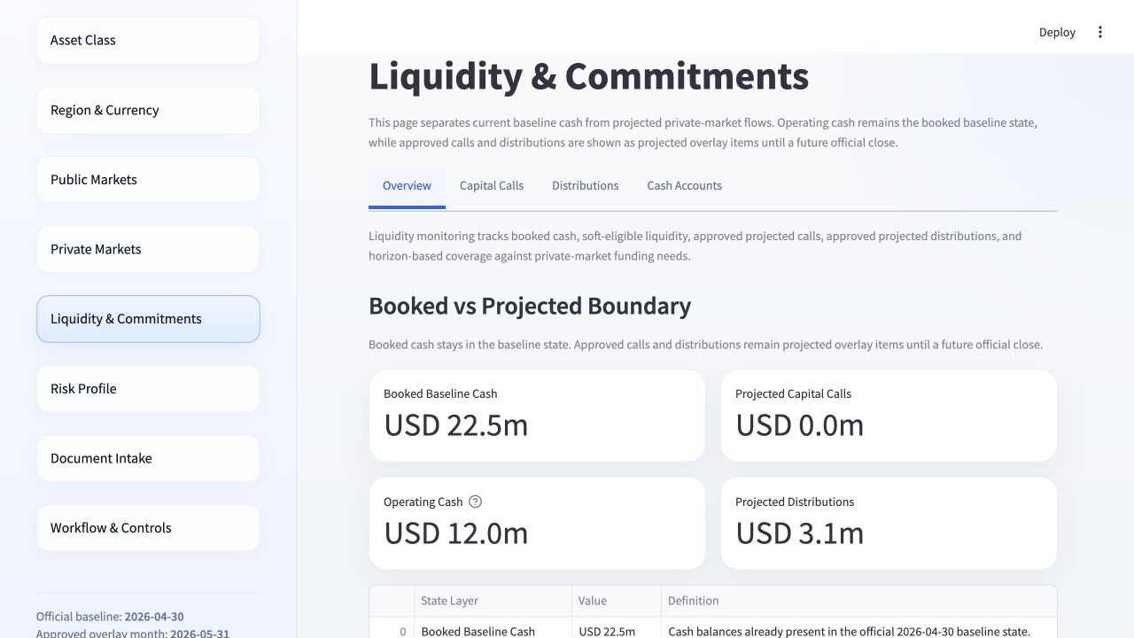
AI-ENABLED
REPORTING
CONTROL THE FLOW
AUTOMATE PREPARATION. KEEP HUMAN AUTHORITY.
Notes:
Close on the controlled information chain as the core project contribution.
[Sources]
Local synthetic portfolio data, processed pipeline outputs, QA reports, risk outputs, and local Streamlit dashboard screenshots. All family-office data is synthetic.

