Slide 1



+
haggl
Your next customer
may come with AI.
Haggl helps your business
make the offer.
A partnership for Georgia
01
Notes:
Source: Partnership details supplied by Pulsartech in this task, September 16, 2026. Haggl supplies technology. Pulsartech drives sales in Georgia. Partnership agreed. All seven sectors and Georgian-language, GEL and local payment readiness confirmed by Pulsartech.
Design assets: Official Pulsar logo from https://pulsartech.ge/pulsar-logo-cropped.png . Official Haggl mark from https://www.haggl.ai/brand/exchange-mark.svg . Custom background images created with the built-in image-generation tool, September 16, 2026. Phone and city scenes are illustrative artwork, not customer evidence.

Slide 2
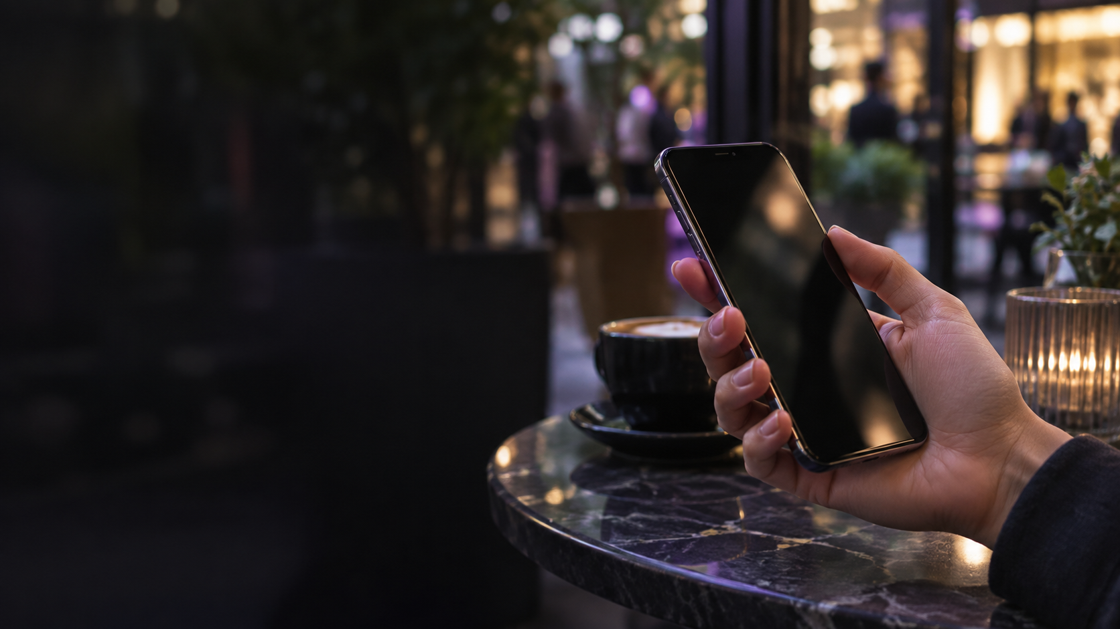
AI is part of
everyday life.
For work. For answers.
For buying decisions.
And people will use it more.
02
Notes:
Source: https://openai.com/index/how-people-are-using-chatgpt/ . Research supports broad use for everyday tasks, information and guidance. It does not establish that all Georgian consumers use AI daily. Image: supplied Pulsar website asset ai.png.
Design assets: Official Pulsar logo from https://pulsartech.ge/pulsar-logo-cropped.png . Official Haggl mark from https://www.haggl.ai/brand/exchange-mark.svg . Custom background images created with the built-in image-generation tool, September 16, 2026. Phone and city scenes are illustrative artwork, not customer evidence.

Slide 3
Shopping is changing
Today
With AI
Customers compare
websites.
AI compares
for them.
Your business needs a way to respond.
03
Notes:
Source: https://www.haggl.ai/ecom (reviewed September 16, 2026). This is the partnership’s forward-looking view, not a Georgia adoption forecast.
Design assets: Official Pulsar logo from https://pulsartech.ge/pulsar-logo-cropped.png . Official Haggl mark from https://www.haggl.ai/brand/exchange-mark.svg . Custom background images created with the built-in image-generation tool, September 16, 2026. Phone and city scenes are illustrative artwork, not customer evidence.

Slide 4
Meet Haggl
Your business’s
AI negotiator.
It talks to your customer’s AI
and makes an offer within your limits.
04
Notes:
Source: https://www.haggl.ai/ecom (reviewed September 16, 2026).
Design assets: Official Pulsar logo from https://pulsartech.ge/pulsar-logo-cropped.png . Official Haggl mark from https://www.haggl.ai/brand/exchange-mark.svg . Custom background images created with the built-in image-generation tool, September 16, 2026. Phone and city scenes are illustrative artwork, not customer evidence.

Slide 5
How it works
01
02
03
04
A customer
asks AI
AI talks
to Haggl
Haggl makes
an offer
The customer
buys
Every offer stays within the limits you set.
05
Notes:
Source: https://www.haggl.ai/ecom (reviewed September 16, 2026).
Design assets: Official Pulsar logo from https://pulsartech.ge/pulsar-logo-cropped.png . Official Haggl mark from https://www.haggl.ai/brand/exchange-mark.svg . Custom background images created with the built-in image-generation tool, September 16, 2026. Phone and city scenes are illustrative artwork, not customer evidence.

Slide 6
A simple laptop example
“Can this store make
me a better offer?”
Customer’s AI
“Here is a deal within
the store’s limits.”
Haggl
Illustrative conversation
06
Notes:
Source: https://www.haggl.ai/ecom (reviewed September 16, 2026). Illustrative conversation only. No actual customer transaction or outcome claimed.
Design assets: Official Pulsar logo from https://pulsartech.ge/pulsar-logo-cropped.png . Official Haggl mark from https://www.haggl.ai/brand/exchange-mark.svg . Custom background images created with the built-in image-generation tool, September 16, 2026. Phone and city scenes are illustrative artwork, not customer evidence.

Slide 7
Your business.
Your rules.
You choose the products.
You set the price limits.
Haggl works inside them.
07
Notes:
Source: https://www.haggl.ai/ecom (reviewed September 16, 2026).
Design assets: Official Pulsar logo from https://pulsartech.ge/pulsar-logo-cropped.png . Official Haggl mark from https://www.haggl.ai/brand/exchange-mark.svg . Custom background images created with the built-in image-generation tool, September 16, 2026. Phone and city scenes are illustrative artwork, not customer evidence.

Slide 8
A better offer.
A reason to buy.
Respond to AI shoppers.
Save time on routine negotiation.
08
Notes:
Source: https://www.haggl.ai/ecom (reviewed September 16, 2026). Potential benefits, not measured or guaranteed results.
Design assets: Official Pulsar logo from https://pulsartech.ge/pulsar-logo-cropped.png . Official Haggl mark from https://www.haggl.ai/brand/exchange-mark.svg . Custom background images created with the built-in image-generation tool, September 16, 2026. Phone and city scenes are illustrative artwork, not customer evidence.

Slide 9
One partnership for Georgia
haggl
+
The technology
The sales engine
Haggl provides the AI.
Pulsartech brings it to Georgia.
09
Notes:
Source: Partnership details supplied by Pulsartech in this task, September 16, 2026. Haggl supplies technology. Pulsartech drives sales in Georgia. Partnership agreed. All seven sectors and Georgian-language, GEL and local payment readiness confirmed by Pulsartech.
Design assets: Official Pulsar logo from https://pulsartech.ge/pulsar-logo-cropped.png . Official Haggl mark from https://www.haggl.ai/brand/exchange-mark.svg . Custom background images created with the built-in image-generation tool, September 16, 2026. Phone and city scenes are illustrative artwork, not customer evidence.

Slide 10
For products and property
Banks and financial
institutions
Ecommerce
Offers on approved service packages
Personal offers for online shoppers
Car sales platforms
and portals
Real estate
Offers on cars and related services
Offers on properties and rentals
10
Notes:
Source: Partnership details supplied by Pulsartech in this task, September 16, 2026. Haggl supplies technology. Pulsartech drives sales in Georgia. Partnership agreed. All seven sectors and Georgian-language, GEL and local payment readiness confirmed by Pulsartech. Illustrative sector use cases for discussion, not case studies. Banking example concerns approved commercial service offers, not credit decisions.
Design assets: Official Pulsar logo from https://pulsartech.ge/pulsar-logo-cropped.png . Official Haggl mark from https://www.haggl.ai/brand/exchange-mark.svg . Custom background images created with the built-in image-generation tool, September 16, 2026. Phone and city scenes are illustrative artwork, not customer evidence.

Slide 11
For everyday services
Hospitality
Room offers and booking packages
Internet and telecom
Offers on plans and bundles
SaaS solutions
Offers on software subscriptions
11
Notes:
Source: Partnership details supplied by Pulsartech in this task, September 16, 2026. Haggl supplies technology. Pulsartech drives sales in Georgia. Partnership agreed. All seven sectors and Georgian-language, GEL and local payment readiness confirmed by Pulsartech. Illustrative sector use cases, not measured outcomes. SaaS means subscription software.
Design assets: Official Pulsar logo from https://pulsartech.ge/pulsar-logo-cropped.png . Official Haggl mark from https://www.haggl.ai/brand/exchange-mark.svg . Custom background images created with the built-in image-generation tool, September 16, 2026. Phone and city scenes are illustrative artwork, not customer evidence.

Slide 12
Our model for Georgia
1–20%
Real estate
Around 1%
One combined Haggl + Pulsartech fee
per successful deal.
Smaller deals
Higher rate
The rate depends on the industry and the deal.
12
Notes:
Source: Partnership details supplied by Pulsartech in this task, September 16, 2026. Haggl supplies technology. Pulsartech drives sales in Georgia. Partnership agreed. All seven sectors and Georgian-language, GEL and local payment readiness confirmed by Pulsartech. Combined Haggl and Pulsartech fee range provided by Pulsartech. This proposed Georgia commercial model differs from Haggl’s public pricing at https://www.haggl.ai/pricing . Percentage base and settlement details require deal-specific agreement.
Design assets: Official Pulsar logo from https://pulsartech.ge/pulsar-logo-cropped.png . Official Haggl mark from https://www.haggl.ai/brand/exchange-mark.svg . Custom background images created with the built-in image-generation tool, September 16, 2026. Phone and city scenes are illustrative artwork, not customer evidence.

Slide 13
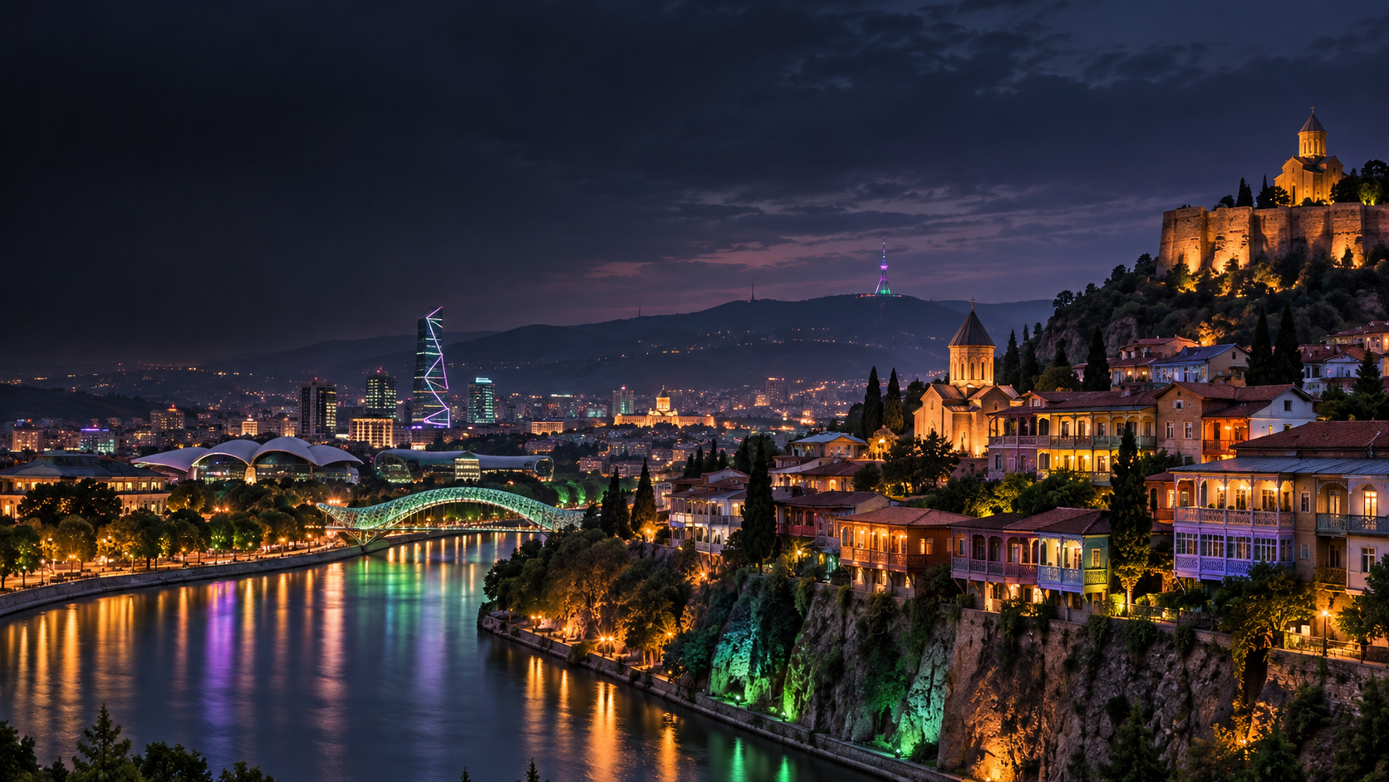
Ready for Georgia
Georgian language
Prices in GEL
Local payments
13
Notes:
Source: Partnership details supplied by Pulsartech in this task, September 16, 2026. Haggl supplies technology. Pulsartech drives sales in Georgia. Partnership agreed. All seven sectors and Georgian-language, GEL and local payment readiness confirmed by Pulsartech.
Design assets: Official Pulsar logo from https://pulsartech.ge/pulsar-logo-cropped.png . Official Haggl mark from https://www.haggl.ai/brand/exchange-mark.svg . Custom background images created with the built-in image-generation tool, September 16, 2026. Phone and city scenes are illustrative artwork, not customer evidence.

Slide 14
+
haggl
See Haggl
in your business
A demo built around your customers.
info@pulsartech.ge
+995 599 992 030
14
Notes:
Source: Partnership details supplied by Pulsartech in this task, September 16, 2026. Haggl supplies technology. Pulsartech drives sales in Georgia. Partnership agreed. All seven sectors and Georgian-language, GEL and local payment readiness confirmed by Pulsartech.
Design assets: Official Pulsar logo from https://pulsartech.ge/pulsar-logo-cropped.png . Official Haggl mark from https://www.haggl.ai/brand/exchange-mark.svg . Custom background images created with the built-in image-generation tool, September 16, 2026. Phone and city scenes are illustrative artwork, not customer evidence.

