Slide 1










The land of Nonlinear Optics
Quantum
optics
Invention of laser
Mode locking
First SHG
Quantum
advantage
Phase matching
Nanophotonic
The sea of linear optics

Slide 2
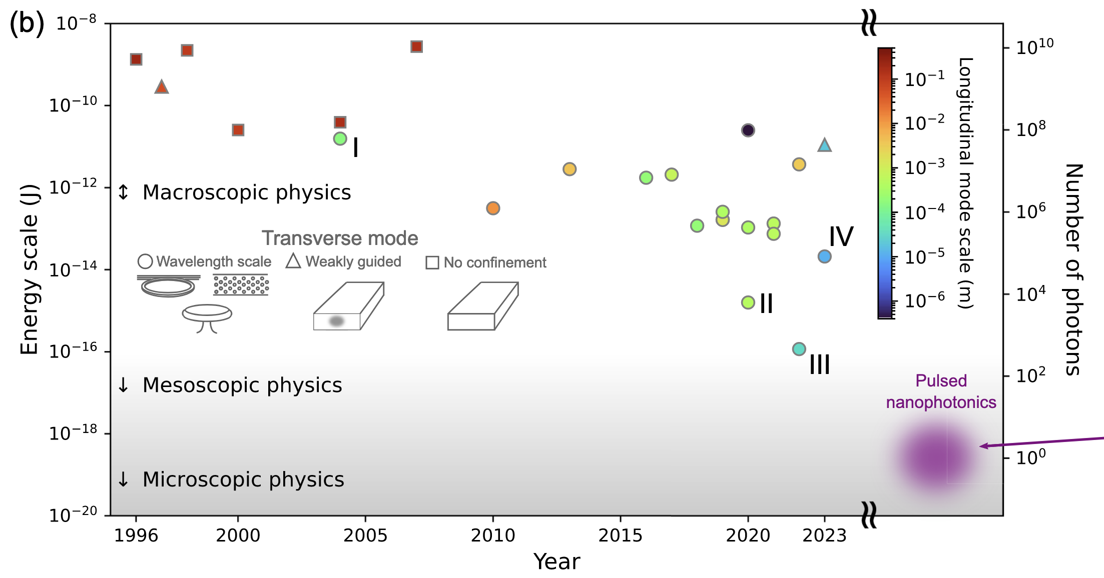
R. Yanagimoto et al., Optica 11, 896 (2024).

Slide 3
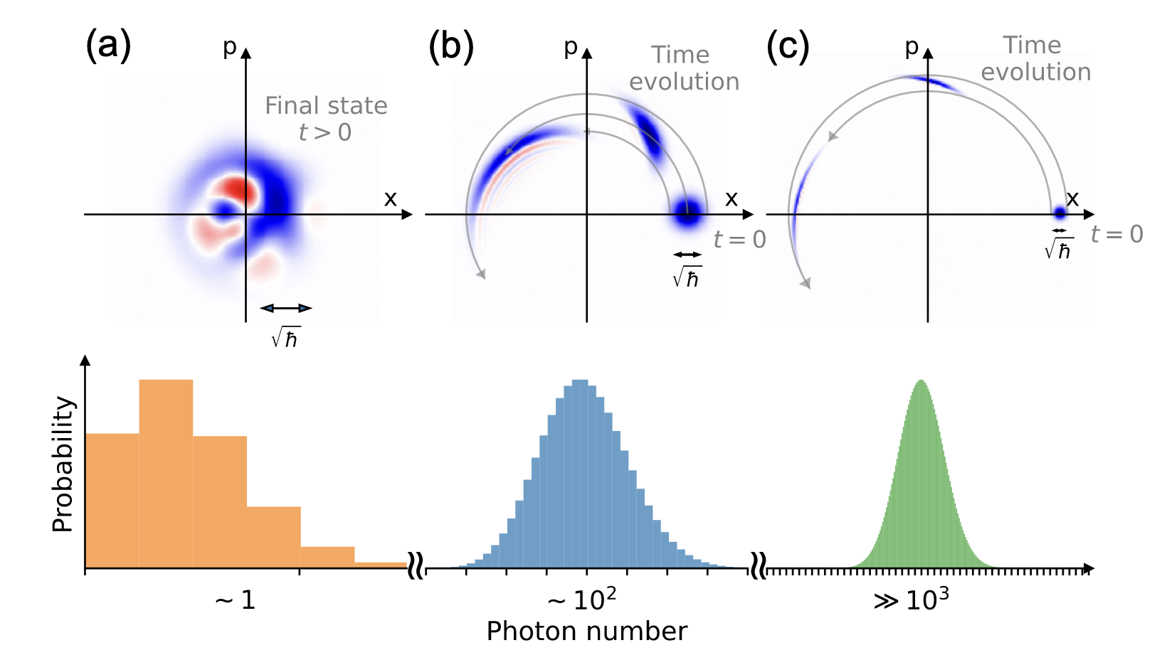
Microscopic
Mesoscopic
Macroscopic

Slide 4
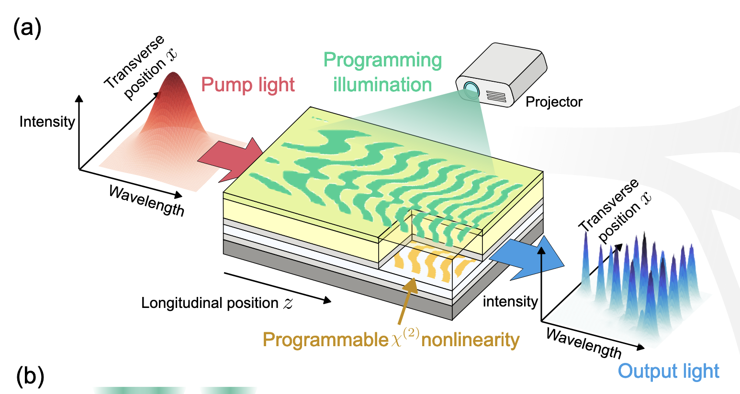
R. Yanagimoto et al., Nature (in press) (2025)

