Slide 1
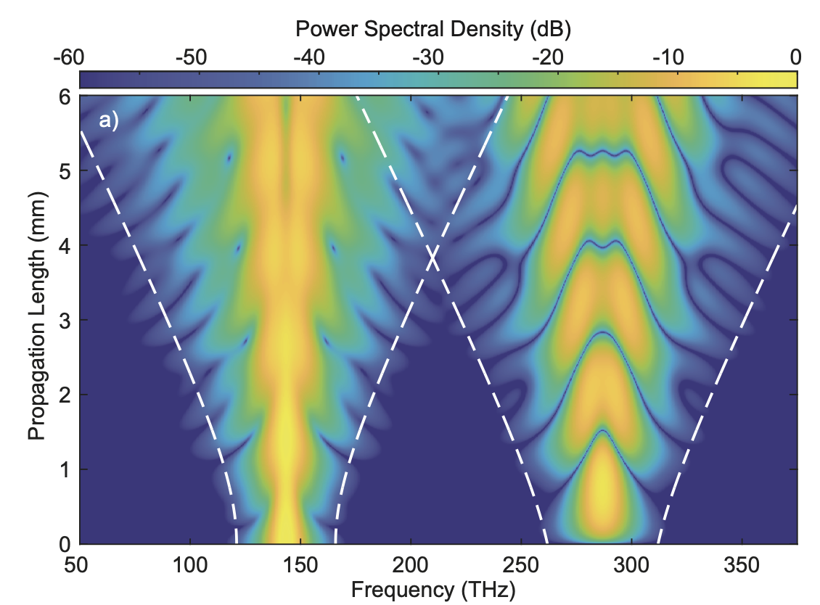
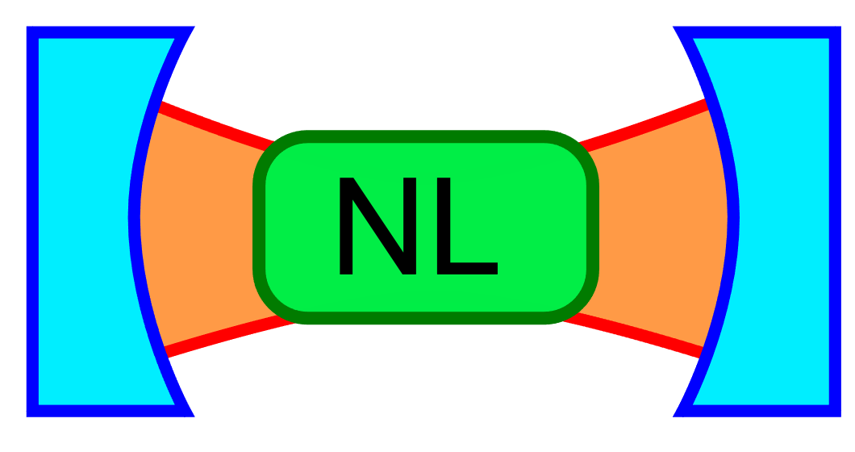
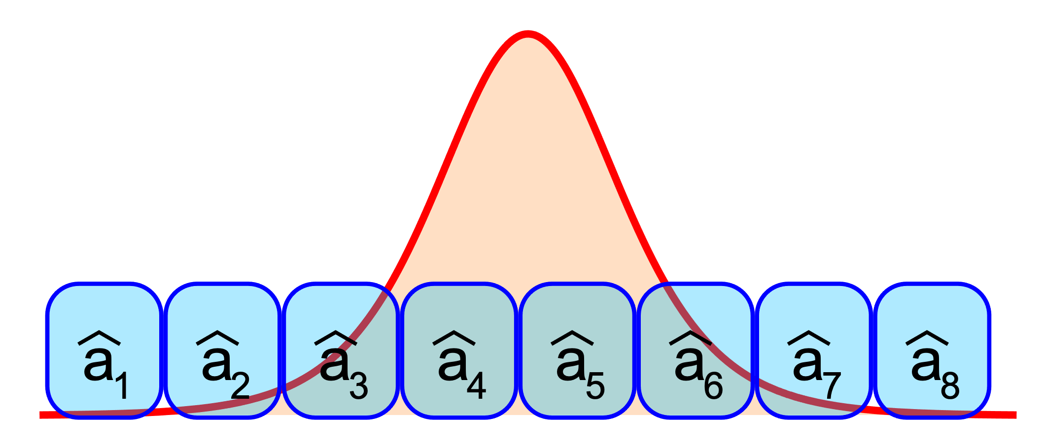

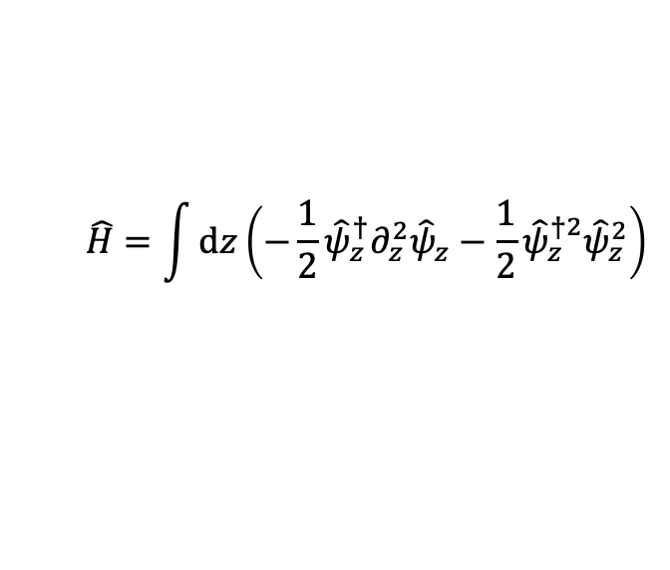
Broadband nonlinear optics
Few-mode quantum optics
$$\hat{H}=\frac{χ}{2}{\hat{a}}^{†2}{\hat{a}}^{2}+∆{\hat{a}}^{†}\hat{a}+β\left(\hat{a}+{\hat{a}}^{†}\right)$$
M. Jankowski et al., arXiv 2102.12856
Broadband quantum optics
$$\hat{H}=\int{dz\left(−\frac{1}{2}{\hat{ψ}}_{z}^{†}∂_{z}^{2}{\hat{ψ}}_{z}−\frac{1}{2}{\hat{ψ}}_{z}^{†2}{\hat{ψ}}_{z}^{2}\right)}$$
For broadband quantum optics, we need to synthesize
Many-body physics
CV quantum information
Ultrafast optics

