Slide 1
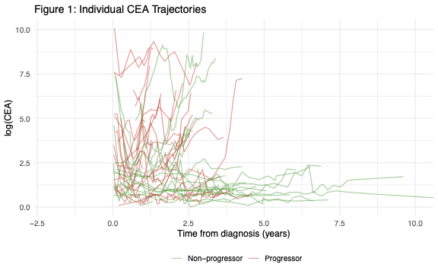
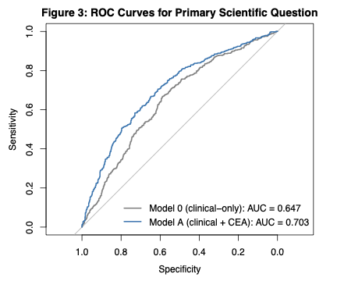
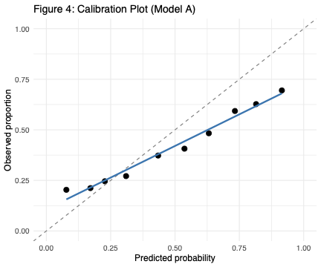
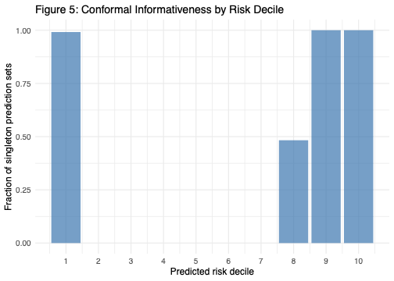
Longitudinal CEA Trajectories and Disease Progression
Prediction in Colorectal Cancer — MSK-CHORD 2024
Yanan Fang | Biostat 629: Case Studies in Health Big Data | April 2026
Motivation
Cohort: CEA Trajectories
Results: Discrimination
Colorectal cancer (CRC) is the 2nd-largest cohort in MSK-CHORD (5,543 pts).
CEA (carcinoembryonic antigen) is the standard CRC monitoring biomarker,
with rich longitudinal data (~12 measurements/patient, median).
Question: Can historical CEA trajectory features predict disease
progression within the next 6 months, beyond clinical & genomic features?
Research Design
Landmark prediction framework
Each analysis unit = a CEA measurement occasion (landmark t).
Eligible if: ≥2 prior CEA values AND ≥1 progression assessment in (t, t+180d].
Outcome Y(t) = 1 if any PROGRESSION="Y" in (t, t+180d];
= 0 if ≥1 "N" and no "Y"; excluded if only Indeterminate.
Features strictly use information up to time t — no leakage.
Fig 1. Individual log(CEA) trajectories; colored by progression status.
Fig 2. ROC curves on held-out test set: Model A vs. Model B.
Methods
Results: Calibration
Model A — Mixed-effects logistic regression (primary)
logit P(Y(t)=1) = β0 + β1·log_cea + β2·cea_slope_90d
+ β3·cea_cv + β4·time_since_dx + β5·tx_type
+ β6·age + β7·sex + β8·stage + β9·msi
+ β10·prior_med + (1 | patient_id)
Features
Model B — Penalized GEE (SCAD) with genomic covariates
Time-varying (CEA trajectory):
log(CEA) at t, 90-day slope of log(CEA), coefficient of variation
time since diagnosis, current treatment type (chemo/targeted/immuno/none)
Time-fixed (clinical):
age, sex, stage, MSI status, TMB, prior medications (3-level)
Genomic (extended model):
binary indicators for KRAS, APC, TP53, BRAF, PIK3CA, SMAD4, …
Extends Model A with TMB + top-10 recurrently mutated CRC genes.
SCAD penalty performs variable selection while accounting for
within-patient correlation (exchangeable working structure).
λ selected by BIC within training folds.
Validation: patient-level 70/30 split; test set used exactly once.
Metrics: AUC, Brier score, calibration; DeLong test for Model A vs B.
Fig 3. Calibration plot (left) and conformal singleton fraction by risk decile (right).
Conclusions
• CEA trajectory features (90-day slope, variability) carry
• predictive signal beyond the single most recent value.
•
• Adding sparse genomic covariates via penalized GEE yields
• modest AUC gains while keeping the model interpretable.
•
• Split conformal prediction provides distribution-free coverage
• and flags uncertain landmarks (prediction set = {0,1}).
•
• Framework is reusable for other biomarker–outcome pairs in CHORD.
Data: MSK-CHORD 2024 | References: ISLR Ch.6, 8, 11; Raschka (2018); Vovk et al. (conformal prediction)

