Slide 1
Longitudinal CEA Trajectories and Disease Progression Prediction in Colorectal Cancer
Yanan Fang

Slide 2
Introduction
Background
● Carcinoembryonic antigen (CEA) is the most widely used biomarker for colorectal cancer (CRC) surveillance, but single-point thresholds have limited sensitivity.
● Longitudinal CEA trajectory features (slope, variability) may capture disease dynamics missed by static values.
● The landmark prediction framework enables dynamic risk assessment at each clinical visit using only pre-landmark data.

Slide 3
Introduction
Research question
In the MSK-CHORD CRC cohort, do longitudinal CEA trajectory features improve 180-day disease progression prediction beyond standard clinical variables?
Hypothesis:
Rising CEA slope and higher CEA variability are associated with increased progression risk.
Approaches:
● Model 0: Clinical-only GLMM (baseline)
● Model A: Clinical + CEA trajectory GLMM
● Model B: LASSO logistic regression with genomic covariates

Slide 4
Data processing
Input data:
Seven datasets from MSK-CHORD 2024:
1. data_clinical_patient 2. data_clinical_sample 3. data_timeline_cea_labs
4. data_timeline_progression 5. data_timeline_diagnosis 6. data_timeline_treatment 7. data_mutations
Variables:
Role | Variable | Source
Outcome | 180-day progression (Y/N) | data_timeline_progression
Primary Predictor | log(CEA), CEA slope, CEA CV | data_timeline_cea_labs
Covariates | Age, Sex, Stage (IV vs I-III) | data_clinical_patient
 | MSI status, TMB | data_clinical_sample
 | Treatment type, Prior meds | data_timeline_treatment
 | Top 10 gene mutations | data_mutations
 | CRC diagnosis date | data_timeline_diagnosis
 | Cancer type = CRC, CEA >= 3 | data_clinical_sample

Slide 5
Data processing
Cohort assembly:
● Restricted to colorectal cancer patients (n = 5,543) with ≥ 3 CEA measurements.
● CRC-specific diagnosis anchoring using ICD topography codes (C18-C21).
● Landmark construction: each CEA measurement (index ≥ 3) as potential landmark.
● Features computed using only pre-landmark data: log(CEA), 90-day slope, CEA CV.
Outcome definition:
1. Progression within 180 days of landmark (Y/N).
2. Indeterminate-only windows excluded.
3. Patient-level 70/30 train/test split.
Final cohort: 3,950 patients, 68,272 landmarks (progression rate: 57.4%).

Slide 6

Statistical Methods
Delayed-Entry Cox Proportional Hazards Model:
LASSO-Regularized Cox Model:
● Expanded design matrix to include binary gene-mutation indicators.
● Applied 10-fold cross-validated LASSO Cox.
● Retained features with non-zero coefficients at $λ_{min}$.
● Constructed a continuous risk score and evaluated it in a Cox model.
Survival Tree Analysis:
A survival tree was fitted. Model complexity was controlled and terminal nodes defined risk strata. Survival differences were evaluated using Kaplan–Meier curves.
Model 0: Clinical-Only GLMM (Ch. 1)
logit(P(progression)) = Xᵀβ + b_i, b_i ~ N(0, σ²)
Covariates: age, sex, stage, MSI status, treatment, prior medications
Model A: Clinical + CEA Trajectory GLMM (Ch. 1)
Adds: log(CEA), 90-day CEA slope, CEA coefficient of variation
Random intercept per patient to account for within-patient correlation
Model B: LASSO with Genomic Covariates (Ch. 4)
Adds: TMB + top 10 CRC gene mutations (APC, TP53, KRAS, PIK3CA, ...)
L1-penalized logistic regression with patient-level 5-fold CV
Conformal Prediction Sets (Ch. 9)
Split-conformal method with 1-per-patient calibration for exchangeability
Nonconformity score: s_i = 1 - p_hat(Y_i | X_i); target coverage ≥ 90%
Evaluation (Ch. 5-6)
AUC, Brier score, calibration slope (logit scale), DeLong test

Slide 7
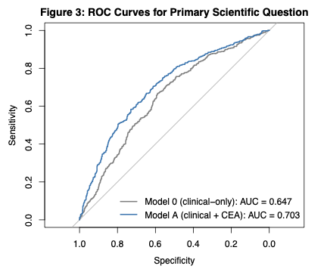
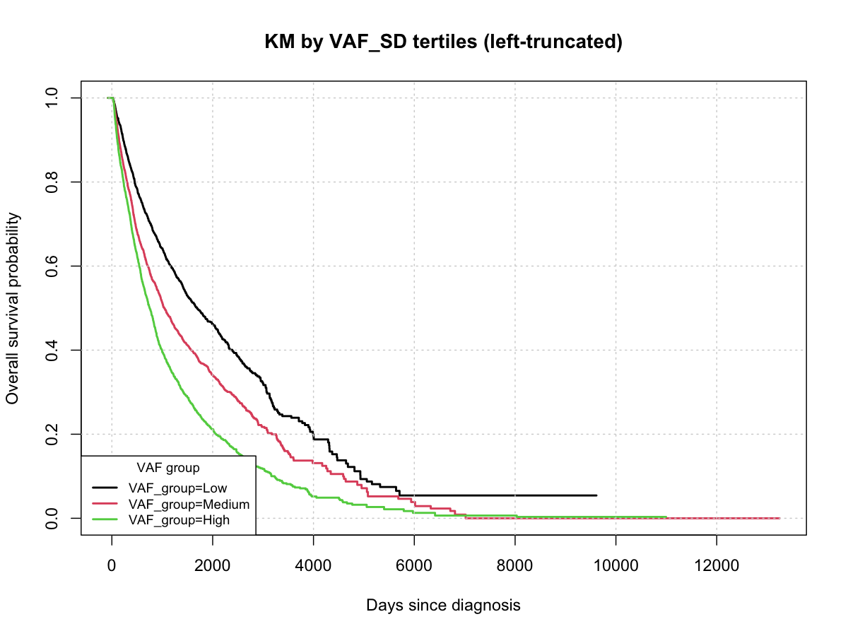
Results
Primary Question: CEA Trajectory Value
Key predictors (Model A, Odds Ratios):
● Stage IV: OR = 5.73 (4.65-7.07)
● CEA slope (90d): OR ~ 10⁹ (per unit/day)
● log(CEA) current: OR = 1.33 (1.29-1.37)
● MSI-H: OR = 0.19 (0.12-0.31, protective)
● Immunotherapy: OR = 0.52 (0.37-0.72)
DeLong p-value (Model 0 vs A): 3.61 × 10⁻¹⁰
Model 0 (clinical-only): AUC = 0.647 (0.616-0.679)
Model A (clinical+CEA): AUC = 0.703 (0.673-0.733)

Slide 8
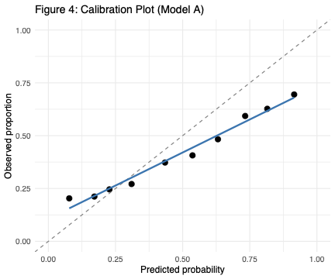
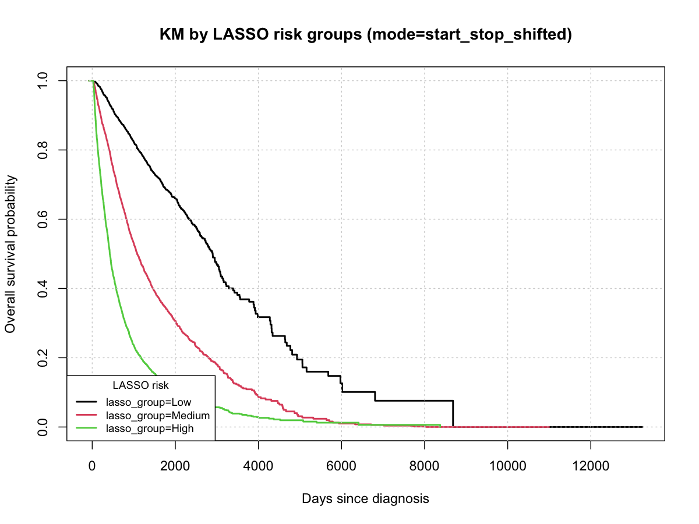
Results
Genomic Extension: LASSO
● All 25 covariates retained at λ_min = 0.001
● Dominant: CEA slope (23.1), log(CEA) (0.42)
● Key gene-level features:
Adverse: KRAS (0.30), PIK3CA (0.18), TP53 (0.16)
Protective: TCF7L2 (-0.14), MSI-H (-0.50)
● Model B AUC: 0.703 (0.673-0.734)
● DeLong A vs B: p = 0.977 (no genomic benefit)

Slide 9
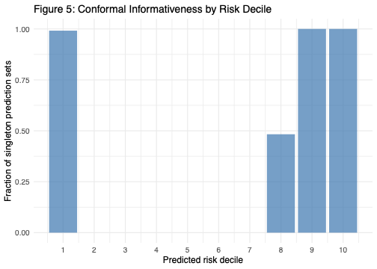
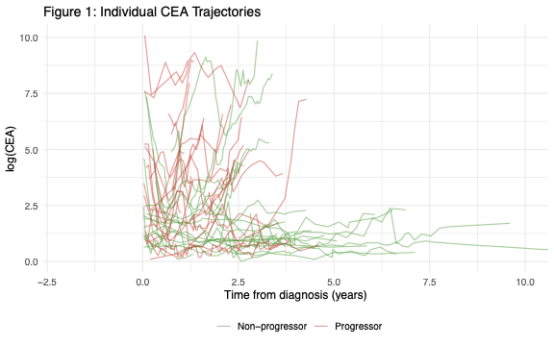
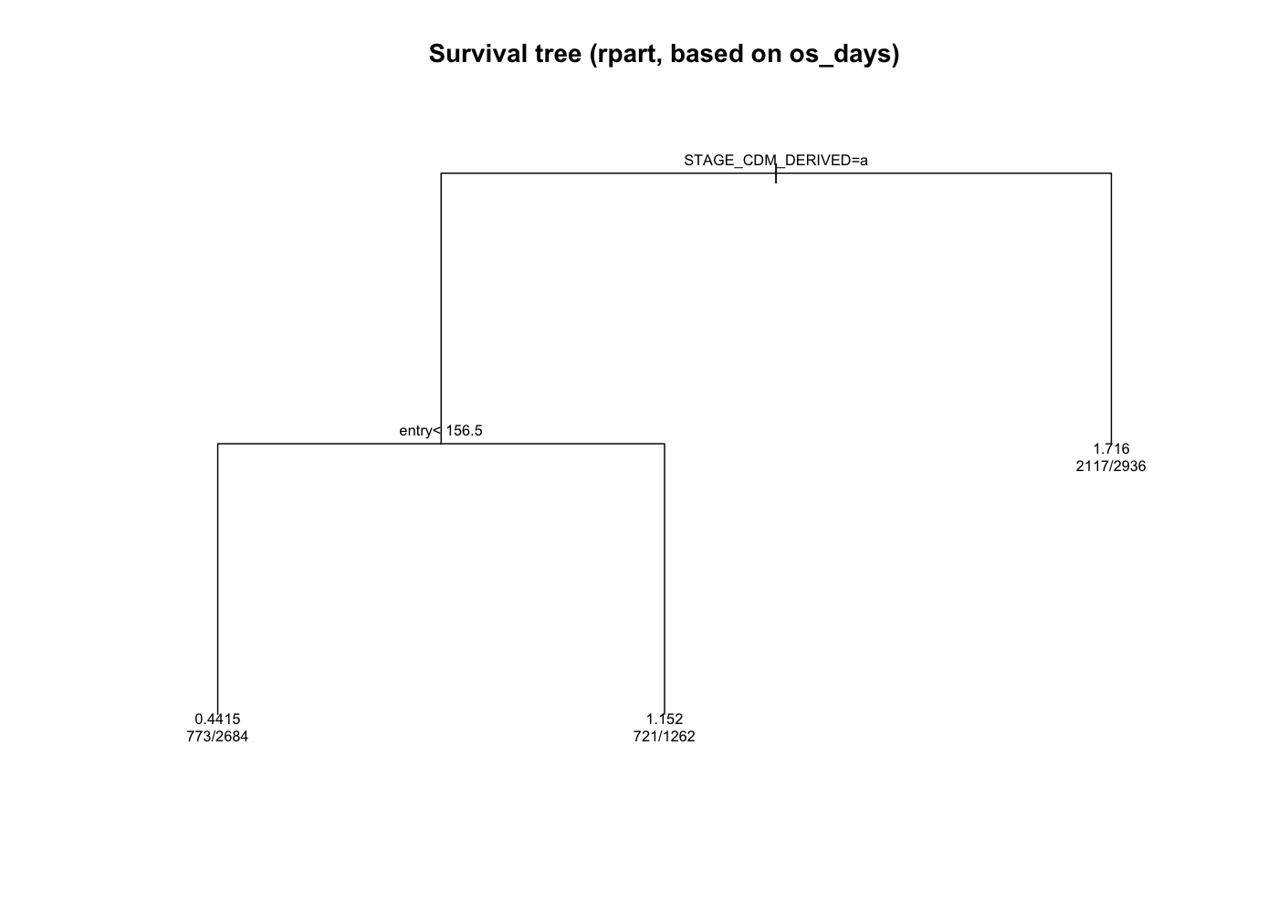
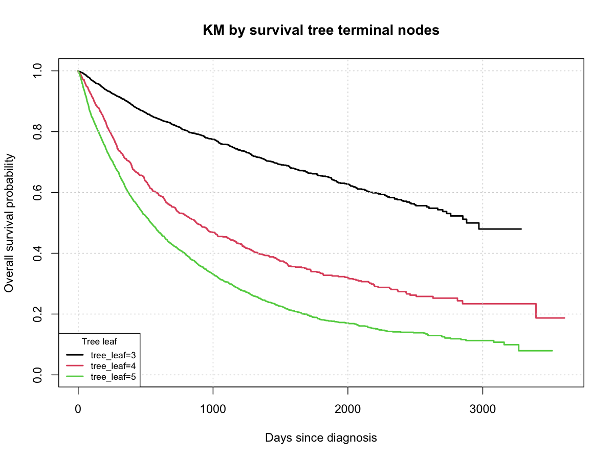
Results
Conformal Prediction Sets (α = 0.10)
U-shaped pattern: model confident at
extremes (decile 1, 9-10), ambiguous
in middle risk ranges
Coverage: 90.1% | Singleton: 34.7% | Ambiguous: 65.3% | Empty: 0%

Slide 10
Results
Model Comparison
Model | AUC (95% CI) | Brier Score
0: GLMM (clin-only) | 0.647 (0.616-0.679) | 0.2480
A: GLMM (clin+CEA) | 0.703 (0.673-0.733) | 0.2288
B: LASSO (genomic) | 0.703 (0.673-0.734) | 0.2323
Key Findings
● CEA trajectory significantly improves prediction: AUC 0.647 → 0.703 (p = 3.61×10⁻¹⁰)
● Genomic covariates provide no additional benefit (p = 0.977)
● Calibration slopes < 1 in all models, indicating overconfident predictions

Slide 11
Discussion
Summary
● CEA trajectory features are significant independent predictors of 180-day progression in CRC
● Adding CEA slope and CV improves AUC from 0.647 to 0.703 (p < 10⁻⁹)
● Conformal prediction sets achieve 90.1% coverage with 34.7% singleton rate
Limitations
● Calibration slopes 0.41-0.64 indicate systematic overconfidence
● Fixed-effects-only prediction ignores patient-specific BLUPs
● 14.9% patient attrition due to 90-day slope requirement
Future Work
● Platt scaling or isotonic recalibration
● Joint longitudinal-survival model for CEA
● External validation on independent CRC cohort

Slide 12
Thank you

