Slide 1
Assignment 4 Machine Learning-Powered Automatic Service Categorization

Slide 2
Overview
Assignment Requirements
Assignment Data
Install and Practice LDA
TMT
MALLET
Clarification
Web application
Q & A

Slide 3
Assignment Requirements
Download the paper abstracts from Canvas and store them in DB. Make sure to store at least paper title, abstract, authors, publication date, publication channel, etc the metadata you used in your previous assignments.
Develop an LDA-based categorization algorithm.
Apply LDA to categorize APIs, based on their descriptions.
Develop a simple web app to show your results.
When you show the list of APIs contained in a category, when clicking on an API, show its metadata.
Make your LDA-based service categorization as a web service.

Slide 4
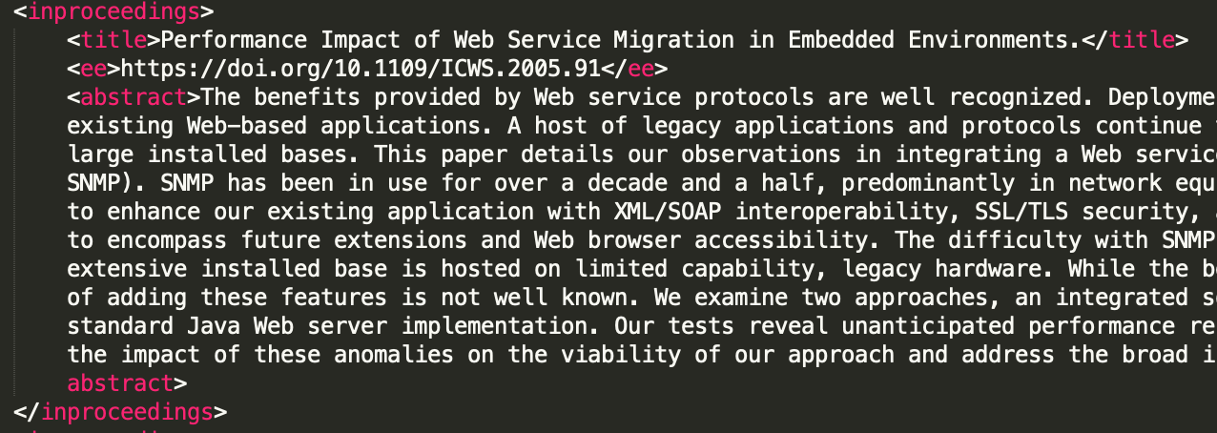
Assignment Data
Download dblp_abstract_dataset.xml from Canvas
XML format
Store metadata into MySQL

Slide 5
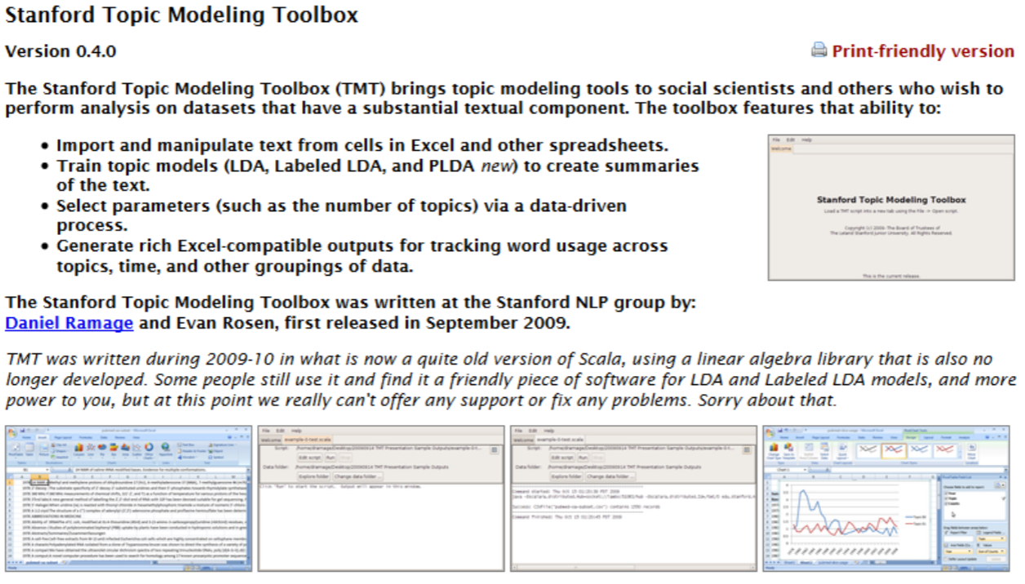
Install and Practice LDA - TMT
Use the Stanford Topic Modeling Toolbox https://nlp.stanford.edu/software/tmt/tmt-0.4/
JAVA 6
Download JAVA 6 and set environment variables(Windows) or java home path(MacOS)
Or use VM

Slide 6
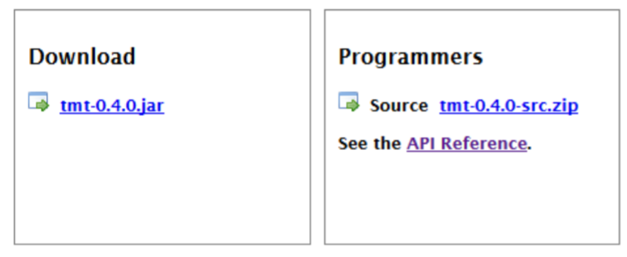
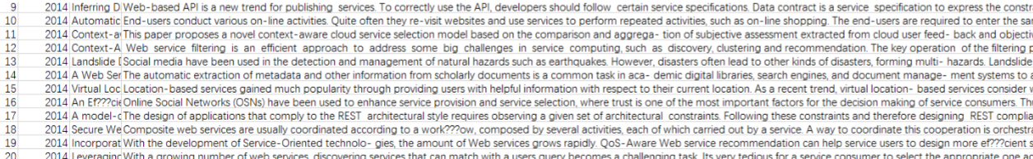
Install and Practice LDA - TMT
Jar file or API
Input file example

Slide 7
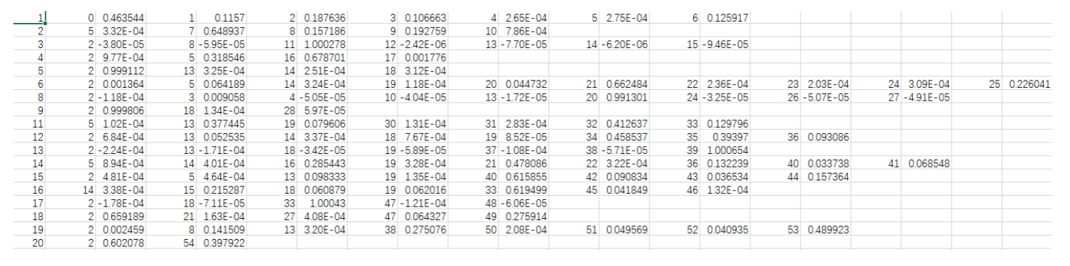
Install and Practice LDA - TMT
Output file example
summary.txt
Human readable summary of the topic model, with top-20 terms per topic and how many words instances of each have occurred.

Slide 8

Install and Practice LDA - MALLET
MALLET is a Java-based package for statistical natural language processing, document classification, clustering, topic modeling, information extraction, and other machine learning applications to text.
http://mallet.cs.umass.edu/

Slide 9
Install and Practice LDA - MALLET
Download and install MALLET
Follow the instruction on http://mallet.cs.umass.edu/topics.php
Import the data
./bin/mallet import-dir --input sample-data/abstract --output tutorial.mallet --keep-sequence --remove-stopwords
Train the model
./bin/mallet train-topics --input tutorial.mallet --num-topics 50 --output-state topic-state.gz --output-topic-keys tutorial_keys.txt --output-doc-topics tutorial_composition.txt

Slide 10
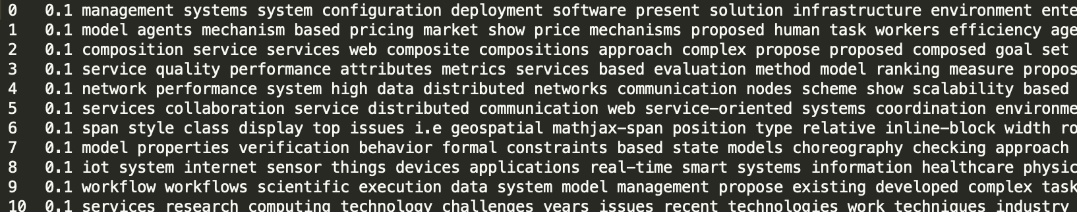
Install and Practice LDA - MALLET
Data format
One .txt file for each document
Topics
tutorial_keys.txt
This file contains a "key" consisting of the top k words for each topic.

Slide 11
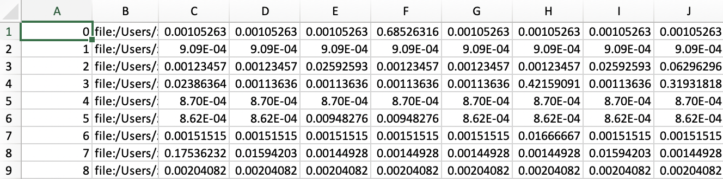
Install and Practice LDA - MALLET
Composition of documents
tutorial_composition.txt

Slide 12
Clarification
You can use any LDA package to implement the requirement, or even implement it yourself.
You don't need to provide the topic name for each group. Naming like "topic 1, topic 2" is also acceptable.

Slide 13
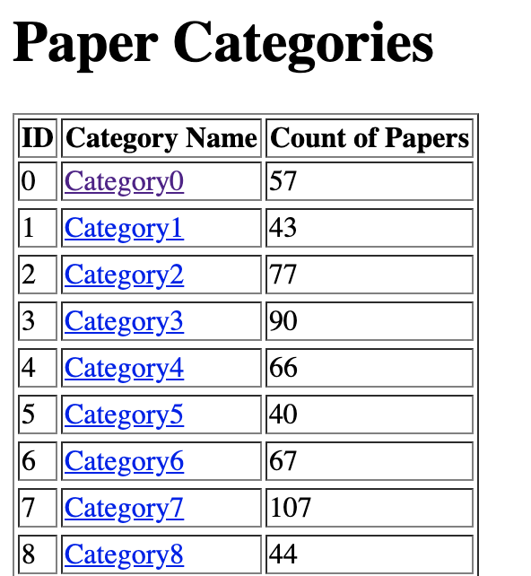
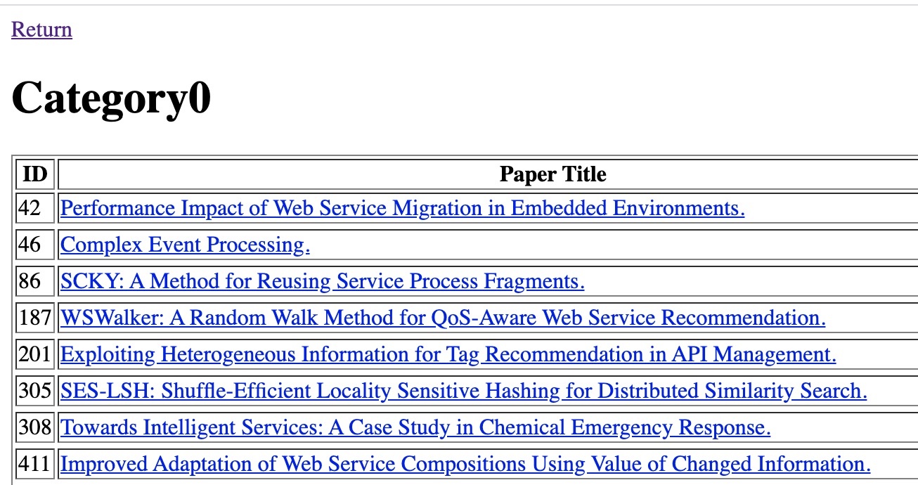
Web application

Slide 14
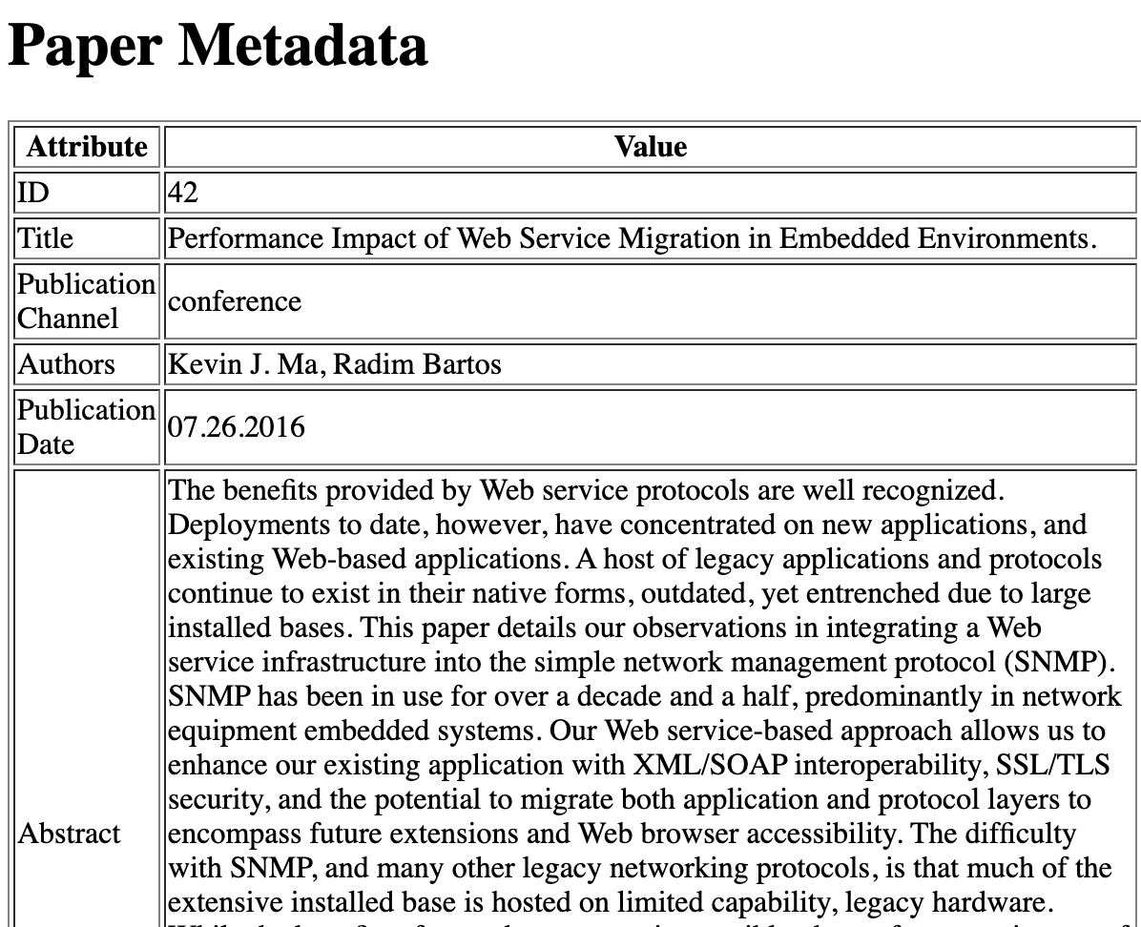
Web application

Slide 15
Q & A

