Slide 1


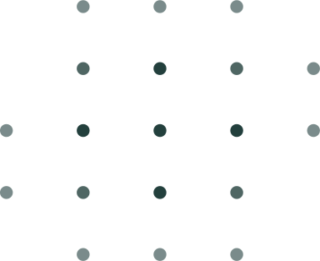



PANTHER SHUTTLE APP
https://yanarex.github.io/shuttle-app-website/
Members: Joseph Hilte, Tony Arrington, Jonathan Suo, and Chase Monigle

Slide 2






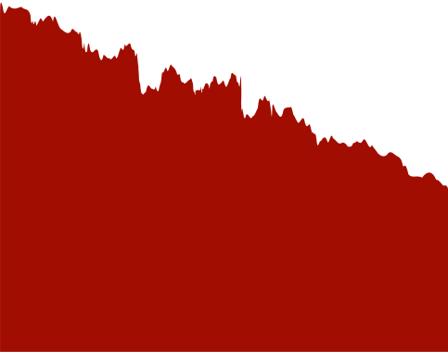
Main Objectives
Have a Running Version of the App to Showcase
Have a demoable and runnable prototype version of the app to test and showcase
Our main objectives for this milestone are to ensure a functional and presentable app version. This includes a demo-ready prototype showcasing its capabilities. We aim to implement a basic, interactive GUI to enhance user experience. Additionally, we'll establish the base framework for seamless component integration. Lastly, we'll incorporate the shuttle schedule as a viewable PDF for easy user access.
Implement a basic Graphical User Interface (GUI).
Have an interactive and usable graphical user interface for the app
Implement the base framework for our app.
Implementing the core functionality of the app is crucial for ensuring that all components work seamlessly together.
Implement Shuttle Schedule as viewable PDF.
Implementing the shuttle schedule and info to the app

Slide 3

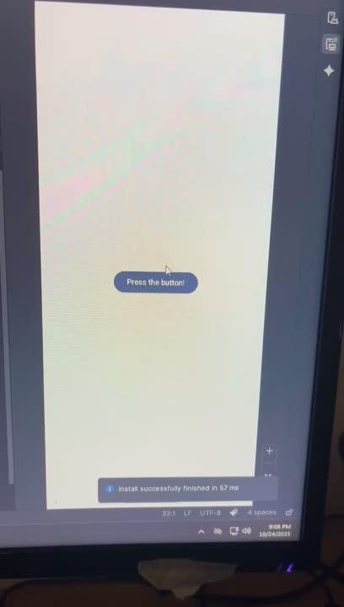



First Version of the app

Slide 4
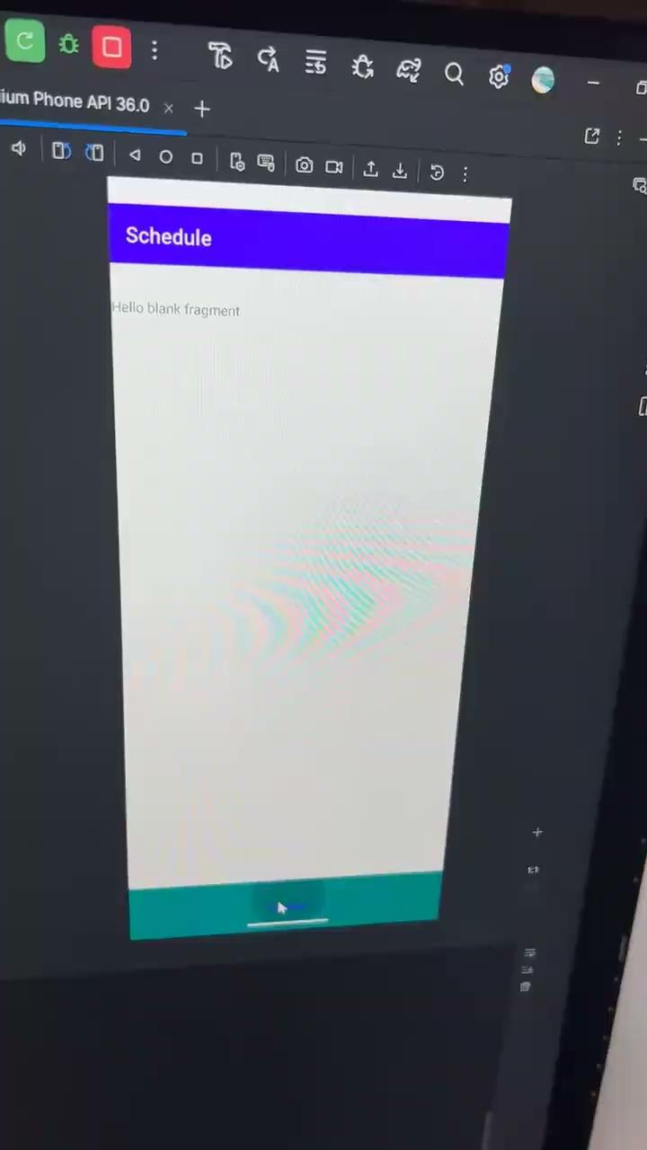

GUI/Framework

Slide 5
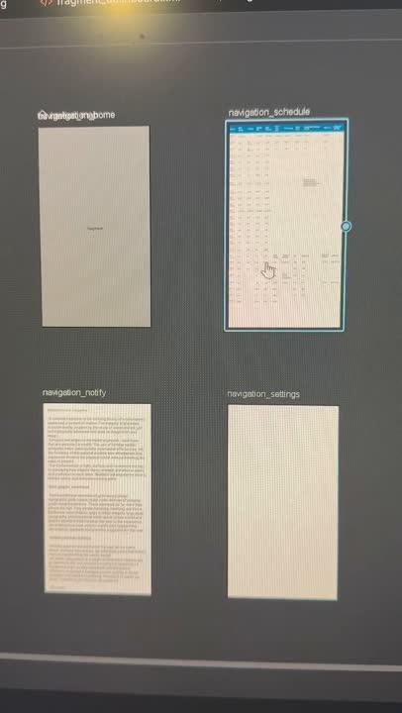

Implementing Shuttle Schedule

Slide 6

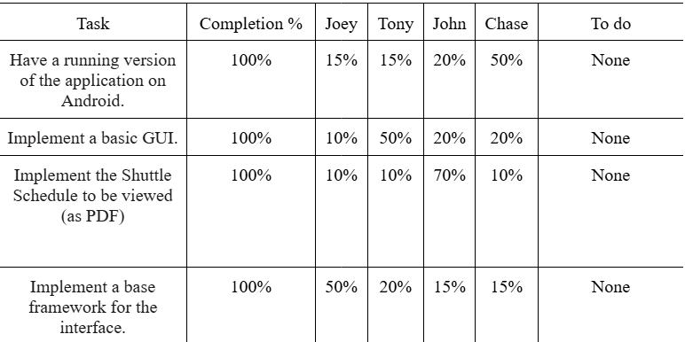

Milestone 2 Progress

Slide 7
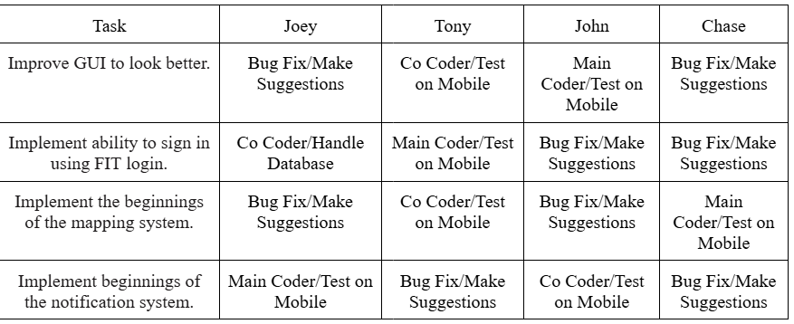
Milestone 3 Plan

Slide 8






QUESTIONS?
Visit our website
https://yanarex.github.io/shuttle-app-website/

