Slide 1
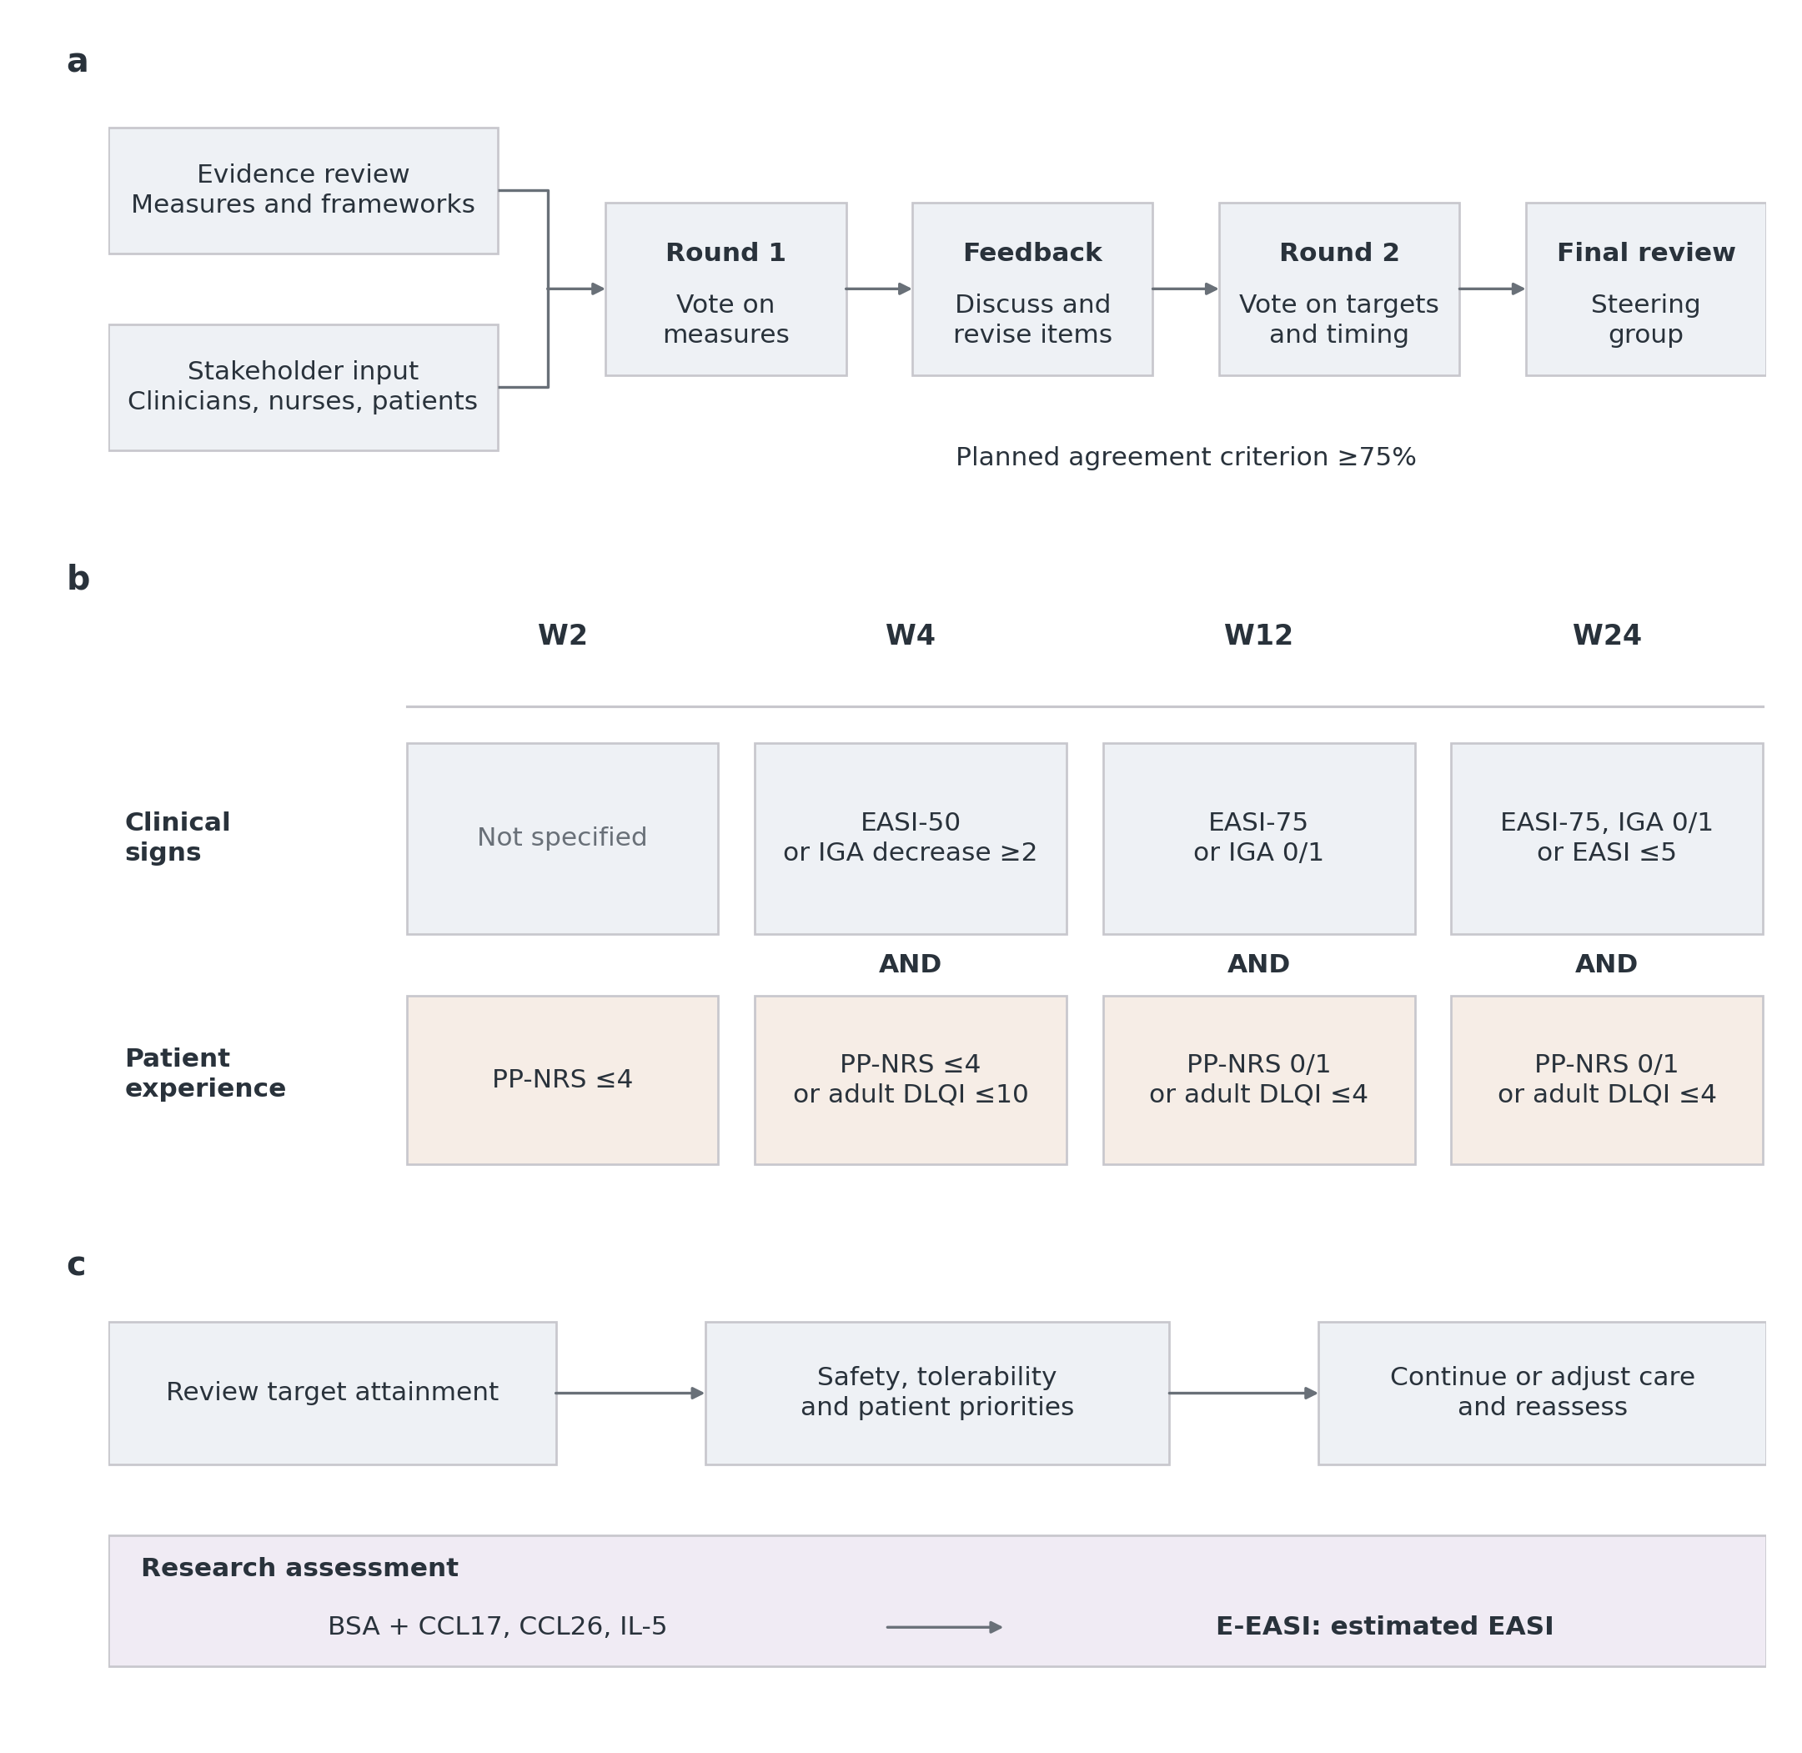
Figure 1 Main
Notes:
a, The project materials describe evidence review, clinician/nurse/patient input, two questionnaire rounds, feedback and steering-group review. The planned agreement threshold was 75%; 49 returned questionnaires were reported. Original ballots and round-specific participation and agreement are unavailable, so the diagram reconstructs the reported process rather than verifying consensus. b, Operational targets for W2/W4/W12/W24. At W2 only PP-NRS ≤4 is required. From W4 onward at least one criterion in each domain is required; “or” is within a domain and “AND” joins domains. EASI-50/75 means at least 50%/75% improvement from positive pretreatment EASI; IGA decrease ≥2 is relative to baseline. IGA 0/1 and PP-NRS 0/1 mean recorded values 0 or 1. DLQI is analysed in adults aged ≥18. Missing components remain unknown unless another observed component resolves the domain. The recorded IGA instrument and implemented framework version require investigator confirmation. Longer-term planned targets and other published frameworks are compared in Table S13. c, Target review accompanies safety and patient priorities. E-EASI is a separate, post hoc hybrid clinical–molecular research estimate; it did not determine treatment changes. This observational cohort does not establish that the framework or the research estimate improves management.
Sources
config/framework_figure_20261107.json
config/clinical_framework.json

Slide 2
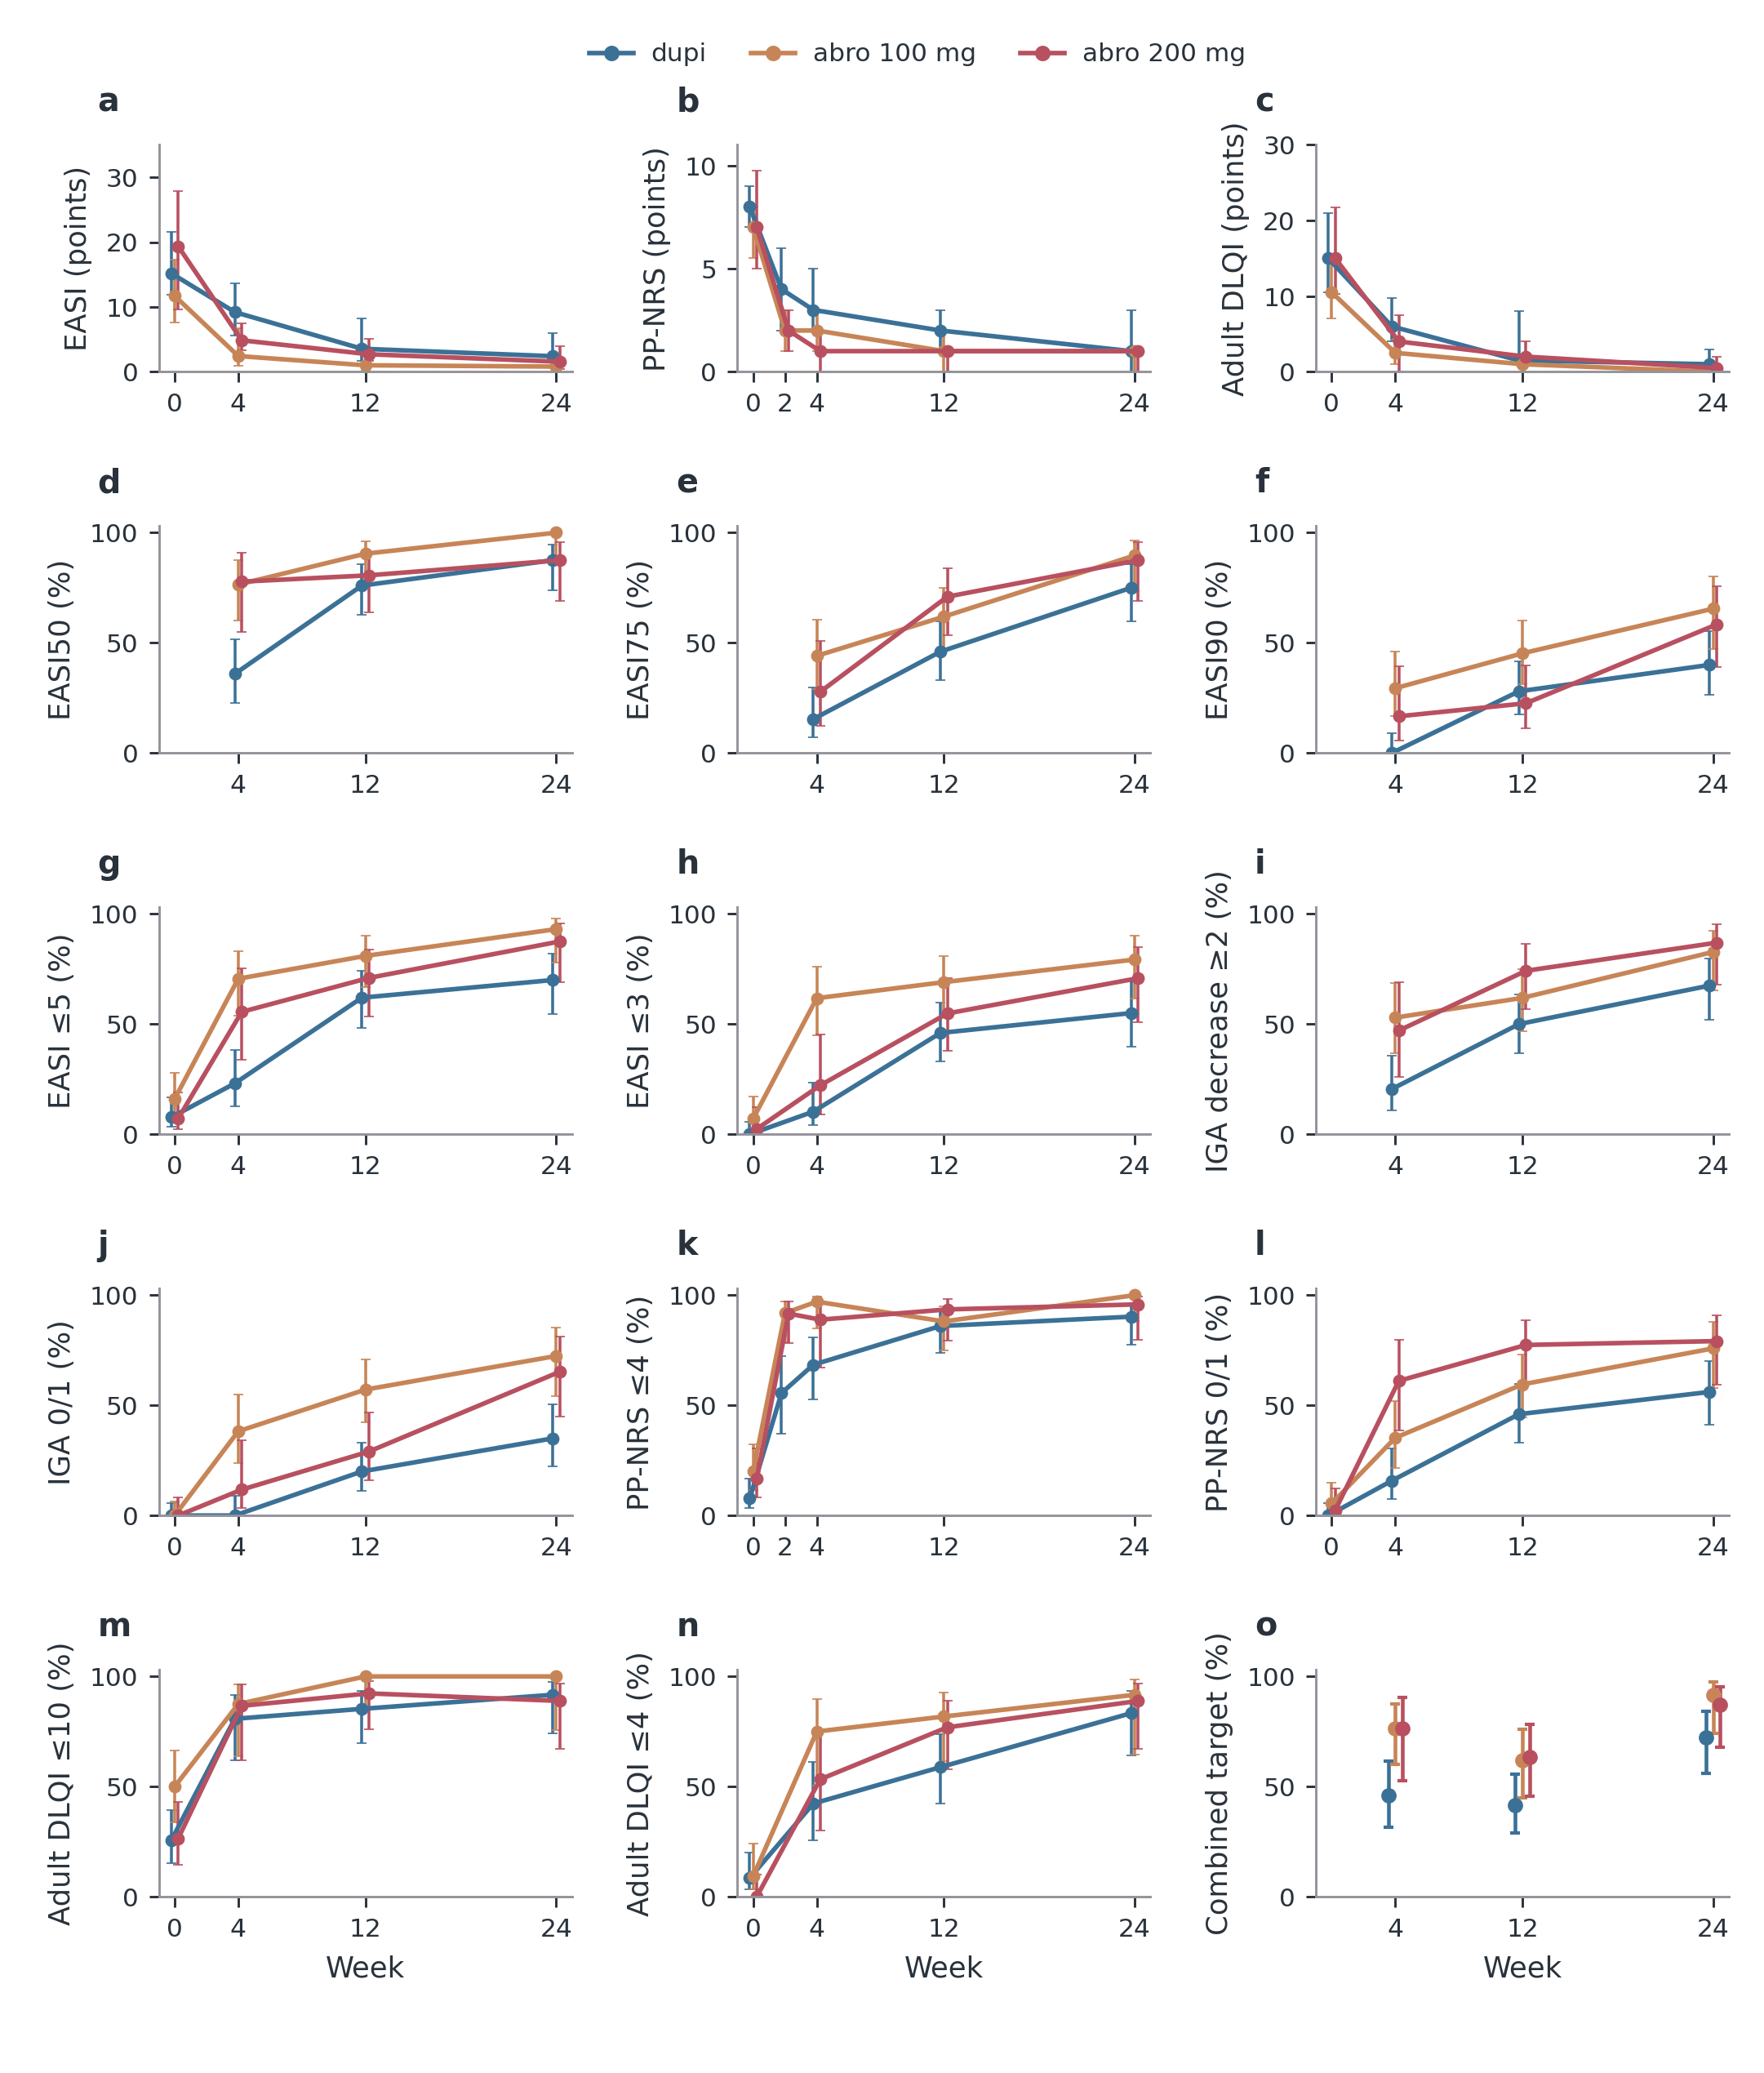
Figure 2 Main
Notes:
a–c, Observed medians and interquartile ranges for EASI, PP-NRS and adult DLQI. d–n, Clinical threshold attainment, with pointwise Wilson 95% confidence intervals. Each visit uses its available observations, not a fixed patient set. Group positions are slightly offset for legibility. Improvement thresholds require observed baseline and follow-up; adult DLQI requires age ≥18. o, Combined physician-and-patient targets from Fig. 1, with Wilson intervals. These stage-specific criteria differ, so points are not connected. Colour denotes initial treatment throughout; subsequent treatment changes do not reassign groups. No outcomes are imputed. All target numerators and denominators are in Supplementary Table S1; headline missing-outcome bounds are in Results and headline_missing_outcome_bounds.csv. Baseline-adjusted treatment comparisons are in the supplement. dupi denotes dupilumab; abro denotes abrocitinib. These available-case, observational trajectories do not establish causal treatment differences.
Sources
results/tables/update_20261017/clinical/clinical_observed.csv
results/tables/update_20261017/clinical/endpoint_rates.csv

Slide 3
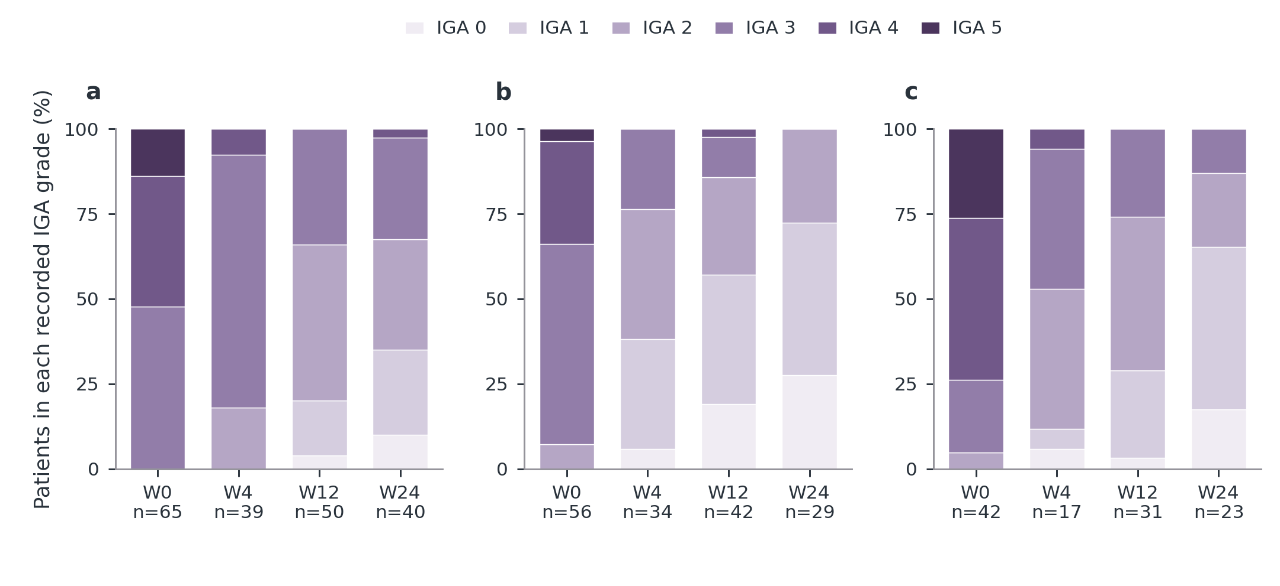
Figure 3 Main
Notes:
a–c, Distribution of recorded IGA grades within each initial treatment group at W0, W4, W12 and W24. Each bar totals 100% of the patients with an observed grade; n below the bar is that visit’s denominator. Colour identifies grade, not treatment. Patient sets may differ between visits. Grade-specific counts and proportions are provided in the source table. The local 0–5 coding is retained; correspondence to a validated IGA instrument has not been confirmed. This figure describes disease activity, not dose-reduction success. Panel key: a, dupi; b, abro 100 mg; c, abro 200 mg.
Sources
results/tables/update_20261017/clinical/IGA_composition.csv

Slide 4
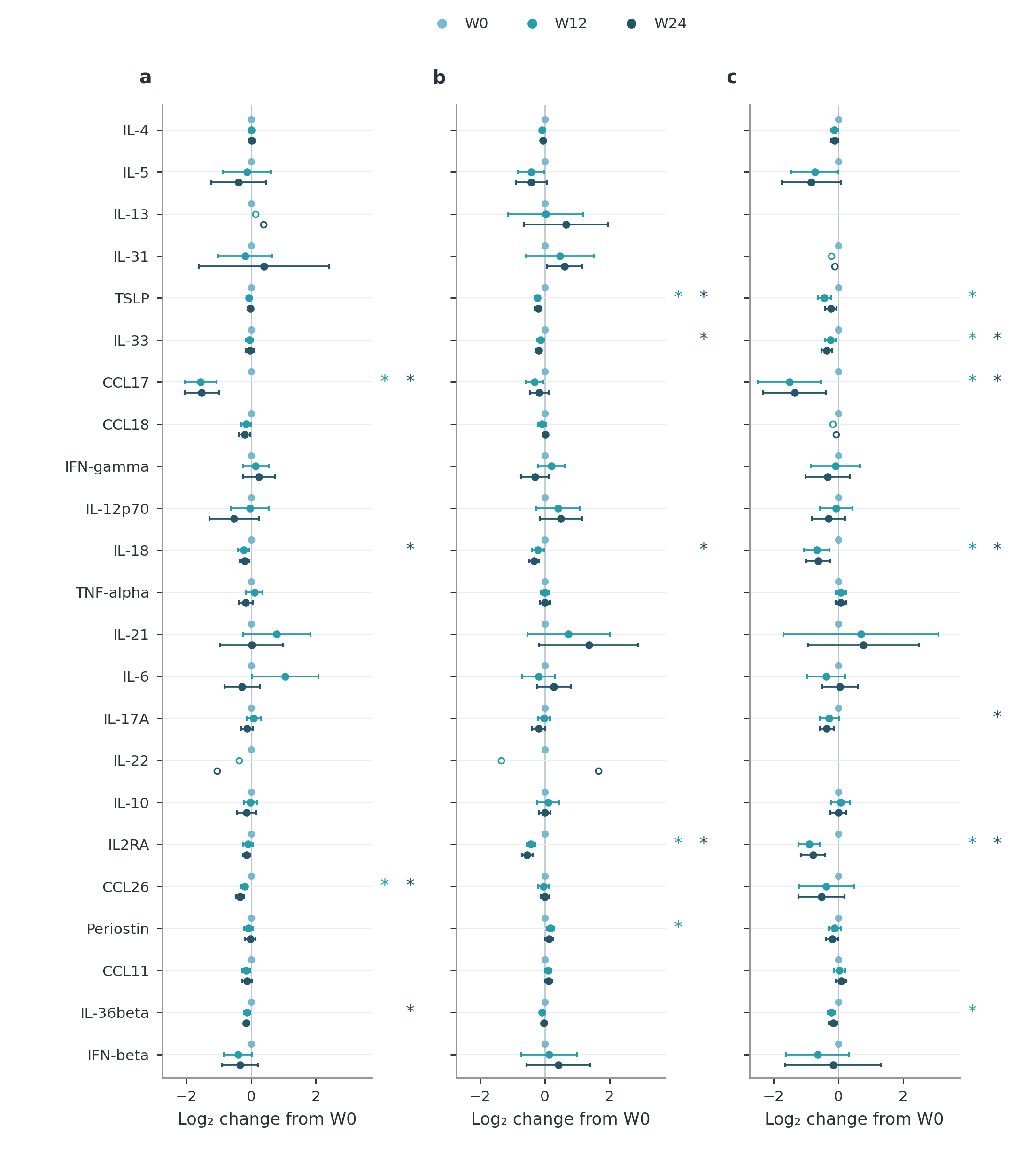
Figure 4 Main
Notes:
a–c, All 23 serum markers by initial treatment. For each marker and treatment, the same patients contribute at W0, W12 and W24; patient sets can differ between markers and treatments. W0 is the reference value zero, not zero concentration. Coloured points show mean within-person log₂ changes from W0; horizontal bars are 95% t confidence intervals for n≥5. A change of −1 means a geometric paired concentration ratio of 0.5. Hollow later-visit points denote n<5 without inference; blank rows have no complete three-visit set. A coloured star beside a marker row refers to that same-colour visit versus W0: *BH q<0.05 across all 138 planned marker-by-treatment-by-contrast tests, using paired sign-flip tests and retaining non-estimable hypotheses in the family. These stars are calculated in the displayed fixed patient sets, not copied from analyses of all available pairs. No baseline covariate adjustment is applied to this descriptive figure. Between-treatment adjusted comparisons and all available-pair windows are reported separately in the supplement. Baseline concentrations are given in Table S12; exact n, changes, intervals and q values are in the source table. Panel key: a, dupi; b, abro 100 mg; c, abro 200 mg.
Sources
results/tables/update_20261107/labs/molecular_three_visit_changes.csv

Slide 5
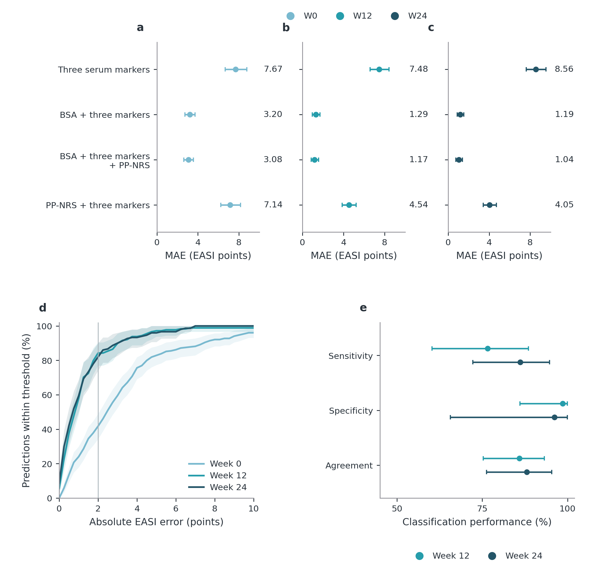
Figure 5 Main
Notes:
a–c, Post hoc input-set comparisons on the same 151/89/75 patients at W0/W12/W24. Points and labels show mean absolute error (MAE) with 95% paired-patient bootstrap intervals. Markers are CCL17, CCL26 and IL-5; clinical inputs come from the current visit. Models use the same outer patient folds, W0/W12 training, and training-only preprocessing and inner selection. The four displayed input sets contain serum markers; complete clinical-only controls and identical-input molecular comparisons remain in Table 2 and Tables S6–S7. Molecular added accuracy requires comparison at identical clinical inputs. d, The unchanged primary procedure on its original 152/89/75 patients: cumulative absolute-error proportions with pointwise bootstrap 95% intervals. W0/W12 predictions are patient-held-out. Only one W12 patient and no W24 patients have observed EASI >21. All errors enter the calculation; thresholds up to ten points are displayed. Two points is a visual reference, not an accepted interchangeability margin. e, EASI75 classification uses observed and estimated scores with their own baselines. Sensitivity uses 49/54 responders, specificity 36/13 nonresponders and agreement 85/67 paired patients at W12/W24. Conservative conditional 95% bounds average repetition-specific Clopper–Pearson limits with Bonferroni adjustment across repetitions within each endpoint, visit and metric, not all displayed metrics. The binomial working model permits dependent repetitions but does not propagate shared fitted models or development uncertainty. Metrics are scored per repetition before averaging; intervals condition on saved predictions. W24 is previously inspected same-cohort application. Separate Wilson intervals and counts are in Supplementary Table S11; additional input comparisons, CCL17 controls and marker contributions are in Tables S6–S7. Panel key: d, Individual absolute error; e, EASI75 classification.
Sources
results/tables/update_20261025/ablation/main_input_comparison.csv
manuscript/source_data/error_ecdf.csv
results/tables/update_20261017/redesign_20261018/monitoring_response_uncertainty.csv

Slide 6
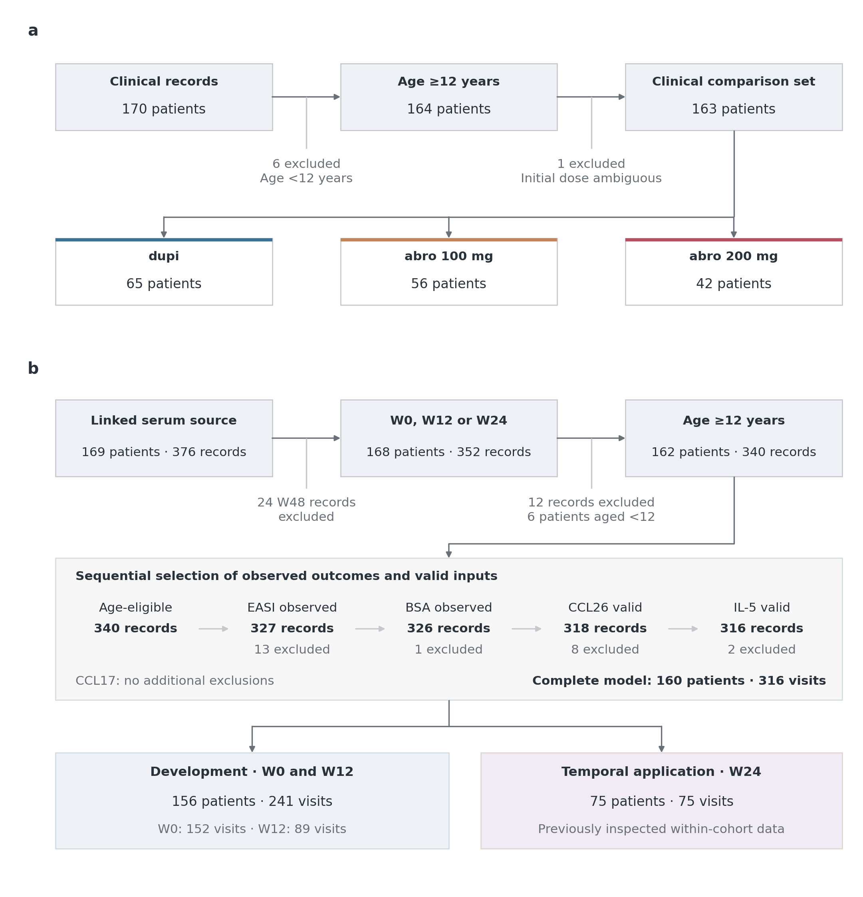
Figure S1 Supplementary
Notes:
a, The curated clinical source contains 170 patients, not a screened or consented recruitment denominator. Six patients aged <12 years and one age-eligible patient with an ambiguous initial dose are excluded, leaving 163 patients classified by initial treatment: dupi, 65; abro 100 mg, 56; and abro 200 mg, 42. b, The linked serum source is a separate entry branch; model eligibility is not conditional on membership of the clinical comparison population. Removing 24 W48 records leaves 168 patients with 352 W0/W12/W24 records; age exclusions remove 12 records from six patients. Further ordered exclusions are mutually exclusive at the record level: 13 EASI, one BSA, zero CCL17, eight CCL26 and two IL-5 inputs are unavailable, leaving 316 complete model visits from 160 patients. A valid molecular input requires an available positive concentration for the log2 transformation. Loss of a record does not necessarily remove a patient. Development uses 241 W0/W12 visits from 156 patients, with patient-level validation splits; W24 includes 75 visits from 75 patients and is previously inspected within-cohort temporal application, not external validation. Development and W24 share 71 patients, with 85 development-only and four W24-only patients. Fifty-one patients have all three complete visits. The clinical and complete-input model populations share 159 patients, with four clinical-only and one model-only patient; the treatment-free model can retain an ambiguous initial dose. Scheduled empty visit slots are not counted as observed visits, and no filled-in clinical outcome is used as validation truth. Panel key: a, Clinical comparison population; b, Serum-linked model population.
Sources
results/tables/update_20261017/redesign_20261018/flow_nodes.csv
results/tables/update_20261017/redesign_20261018/flow_edges.csv
results/tables/update_20261017/redesign_20261018/flow_exclusions.csv
results/tables/update_20261017/redesign_20261018/model_ordered_exclusions.csv
results/tables/update_20261017/redesign_20261018/cohort_overlap.csv
results/tables/update_20261017/redesign_20261018/model_visit_patterns.csv
results/tables/update_20261017/clinical/baseline_group_counts.csv

Slide 7
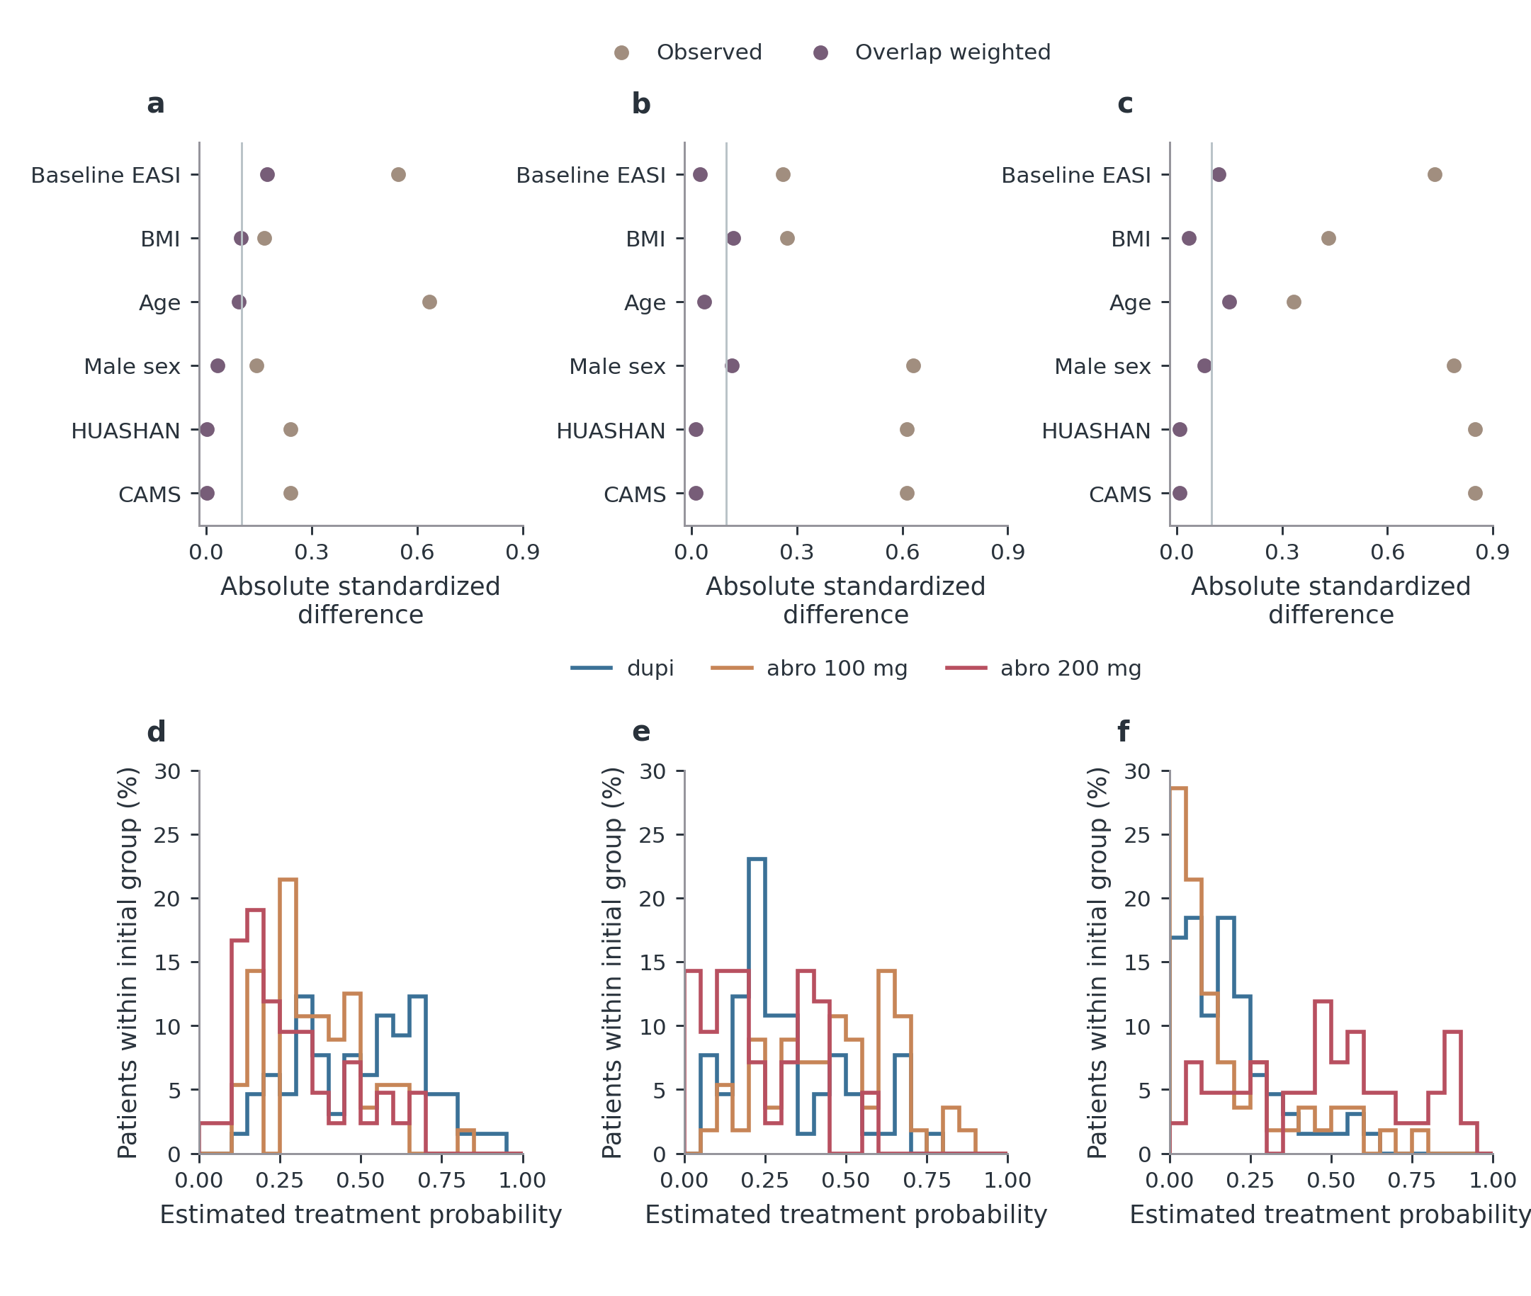
Figure S2 Supplementary
Notes:
a–c, Absolute standardized mean differences for every covariate in the initial-treatment propensity model, before and after generalized overlap weighting. Differences use the unweighted pairwise pooled standard deviation in both displays. The light 0.10 reference line is a descriptive balance guide, not a statistical significance threshold. Residual imbalance remains. d–f, Baseline multinomial treatment probabilities, stratified by actual initial treatment; each distribution uses all patients in that initial group and sums to 100%. These show common support rather than longitudinal drug exposure. The footer reports original N and effective sample size, (sum w)²/sum(w²). All centre, sex, age, BMI and EASI variables are shown. Overlap weighting targets comparable baseline patients; it cannot remove unmeasured confounding or correct outcome-driven dose changes. Endpoint- and marker-specific availability/ESS diagnostics are retained in the source tables. Panel key: a, dupi versus abro 100 mg; b, dupi versus abro 200 mg; c, abro 100 mg versus abro 200 mg; d, Probability of dupi; e, Probability of abro 100 mg; f, Probability of abro 200 mg.
Sources
results/tables/update_20261017/redesign_20261018/baseline_balance_full.csv
results/tables/update_20261017/redesign_20261018/propensity_overlap_bins.csv
results/tables/update_20261017/redesign_20261018/analysis_effective_sample_sizes.csv

Slide 8
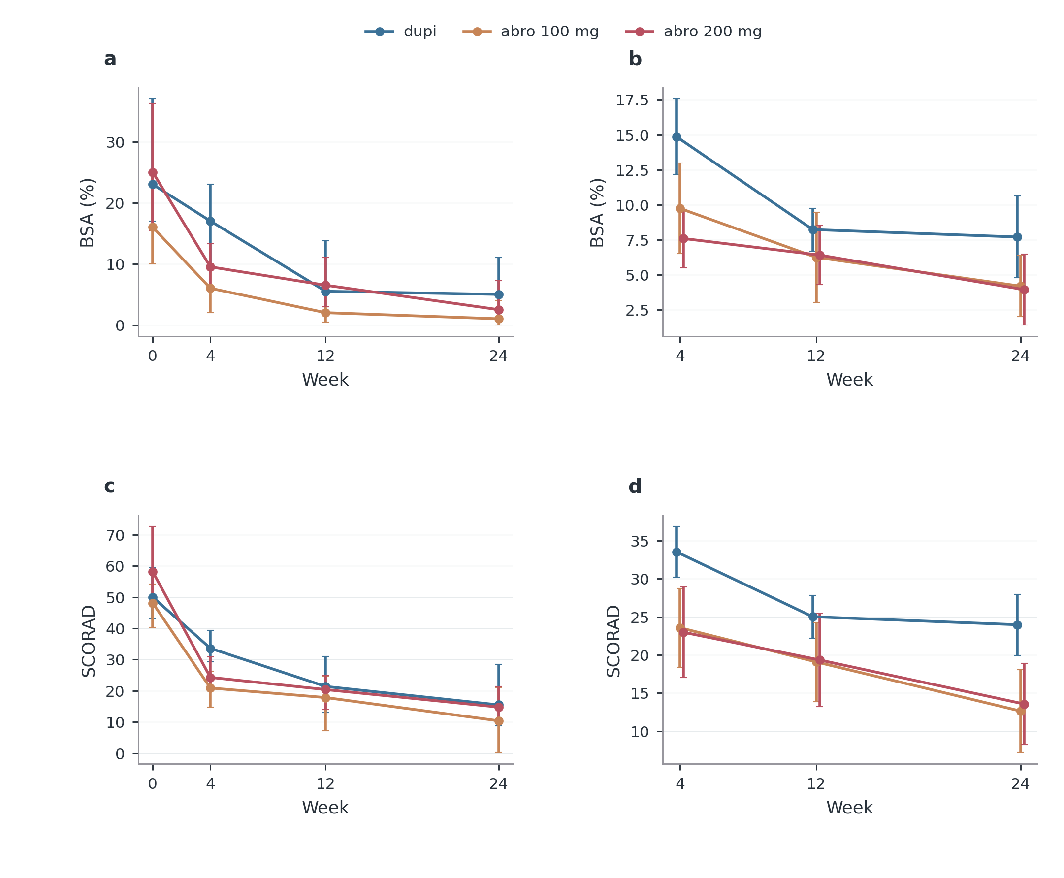
Figure S3 Supplementary
Notes:
Left, observed medians with interquartile ranges by initial treatment; all available values are used at each specified visit. Right, generalized-overlap-weighted marginal estimates with patient-cluster robust 95% confidence intervals conditional on the estimated baseline weights, adjusted for baseline outcome, age, sex, BMI and centre. Patient sets can differ between visits. Exact outcome-specific counts and numerical comparisons are in the source tables; they are not replaced by a common denominator. Initial treatment groups describe observational management strategies, including subsequent regimen changes, rather than randomized fixed-dose effects. Panel key: a, Observed median and IQR; b, Baseline-adjusted estimate and 95% CI.
Sources
results/tables/update_20261017/clinical/clinical_observed.csv
results/tables/update_20261017/clinical/clinical_trajectory_adjusted.csv

Slide 9
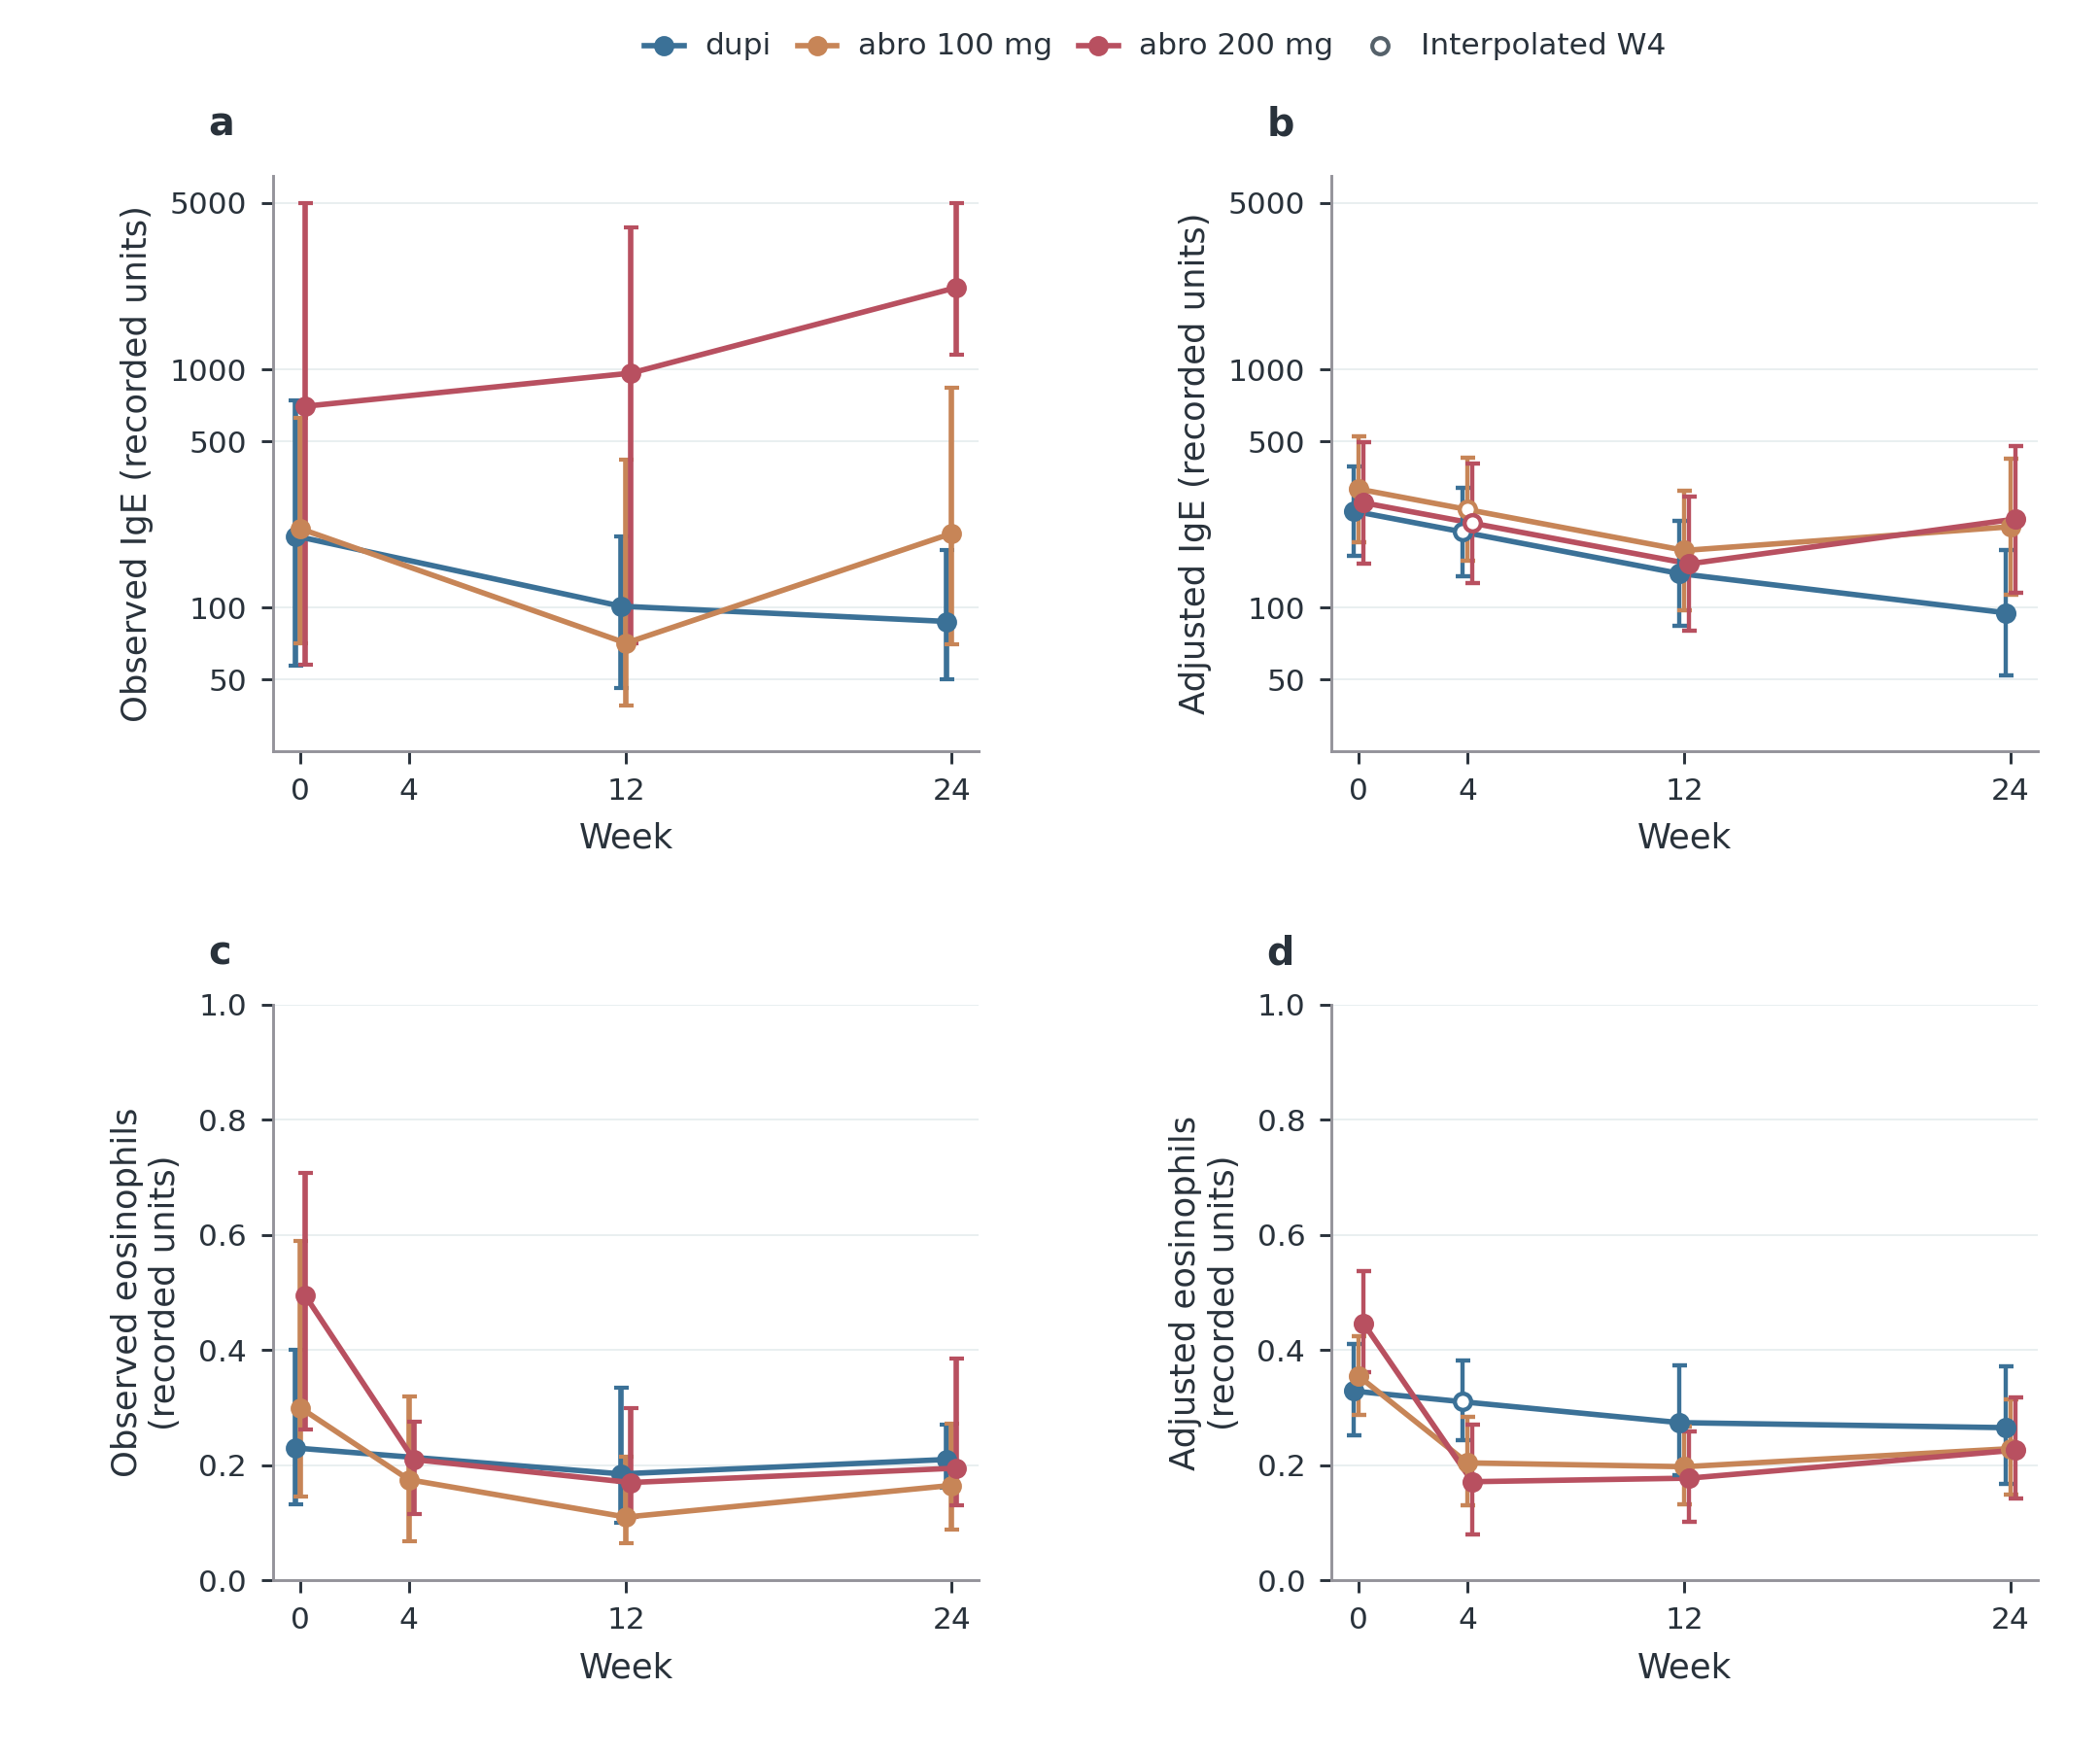
Figure S4 Supplementary
Notes:
a,c, Available-case medians and interquartile ranges at measured visits, using every eligible observed value; patients can differ between visits. Lines connect summaries and do not create measurements at unobserved visits. b,d, Maximum-likelihood random-intercept models use all available IgE or eosinophil measurements, including patients with only one recorded value. Initial treatment-by-categorical-visit terms allow treatment-specific W0 levels and changes; adjustment includes log(1+baseline EASI), age, sex, BMI and centre. Fixed-effect log(1+x) predictions are standardized over the initial cohort, then back-transformed; these are shifted geometric means, not observed medians. Bars in b,d are model-based 95% confidence intervals. Filled points are estimates at visits with measurements in the source population. Hollow points denote entirely unmeasured cells: every W4 IgE cell and dupi W4 eosinophils. They are separate temporal illustrations, obtained one-third of the way from modelled W0 to W12 on the log(1+x) scale. Their intervals propagate endpoint covariance conditional on that shape assumption; no W4 test or measurement is created. Such interpolation can miss an early transient eosinophil rise. Huashan has no follow-up dupi IgE, so pooled predictions assume transferable centre differences; CAMS-only and centre-by-visit sensitivities are provided separately. All denominators and contrasts remain in source tables. Initial treatment reflects observational management, including later regimen changes, and does not identify causal dose effects.
Sources
results/tables/update_20261017/clinical/clinical_observed.csv
results/tables/update_20261112/labs/longitudinal_levels.csv
results/tables/update_20261112/labs/coverage_by_centre.csv

Slide 10
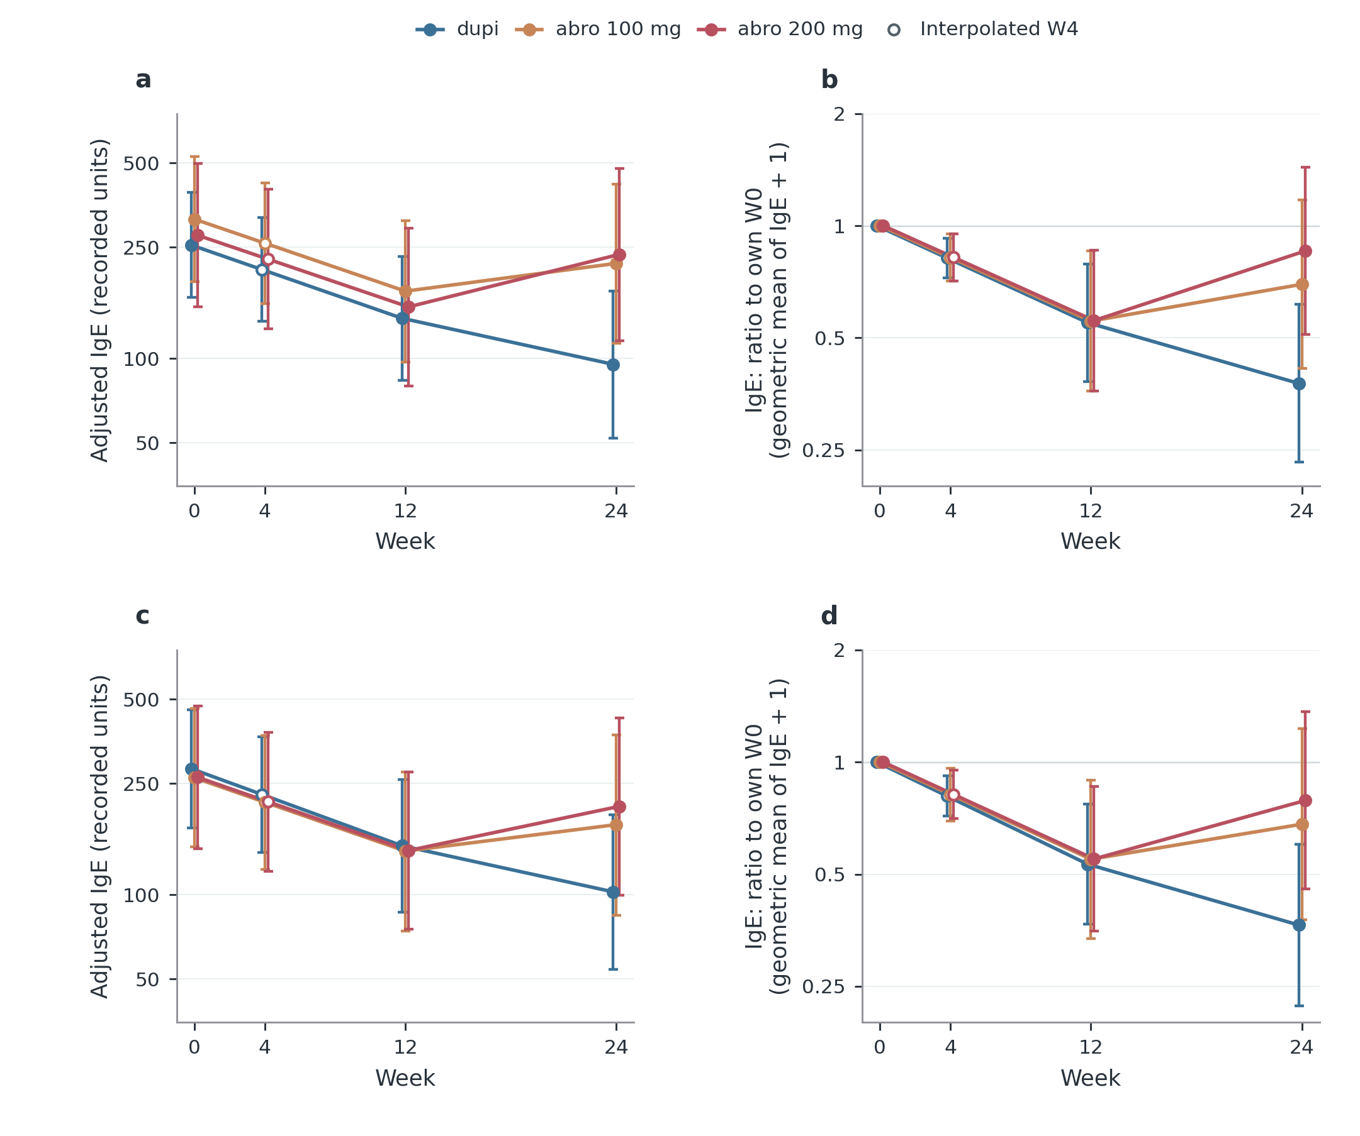
Figure S5 Supplementary
Notes:
a,b, All-centre available-data model; c,d, CAMS-only sensitivity. a,c, Adjusted shifted geometric mean IgE; b,d, The modelled ratio of geometric mean (IgE+1) to the same treatment group’s own W0 value. A ratio below one indicates a lower follow-up level. The all-centre analysis uses 258 observed values from 147 patients; CAMS uses 229 values from 125 patients. No complete-three-visit requirement is imposed; patients with only one measured visit can contribute. Models include initial treatment-by-categorical-visit effects, log(1+baseline EASI), age, sex and BMI, plus centre in a,b, with a patient random intercept. The baseline IgE response is modelled jointly, with free treatment-specific baseline means; this is not a follow-up ANCOVA that explicitly conditions on each observed baseline IgE. Predictions are standardized to the baseline population of the stated scope. Lines and 95% confidence intervals describe adjusted group trajectories, not individual prediction or causal drug effects. There are no W4 IgE measurements. Hollow W4 points are illustrative log-scale interpolations between modelled W0 and W12, with conditional intervals; no hypothesis test uses these points. Huashan has baseline and abro follow-up IgE but no dupi follow-up IgE. The all-centre model therefore assumes shared centre differences, examined using CAMS-only and centre-by-visit sensitivity. Two previous multiple-imputation methods, their differing assumptions and results remain in Table S8 and the complete source tables. Drug-curve ordering alone does not establish a dose effect. Exact coverage, model diagnostics, interpolation alternatives and baseline-relative between-treatment tests remain available in source data.
Sources
results/tables/update_20261112/labs/longitudinal_levels.csv
results/tables/update_20261112/labs/longitudinal_changes.csv
results/tables/update_20261112/labs/between_treatment_changes.csv
results/tables/update_20261112/labs/coverage_by_centre.csv

Slide 11
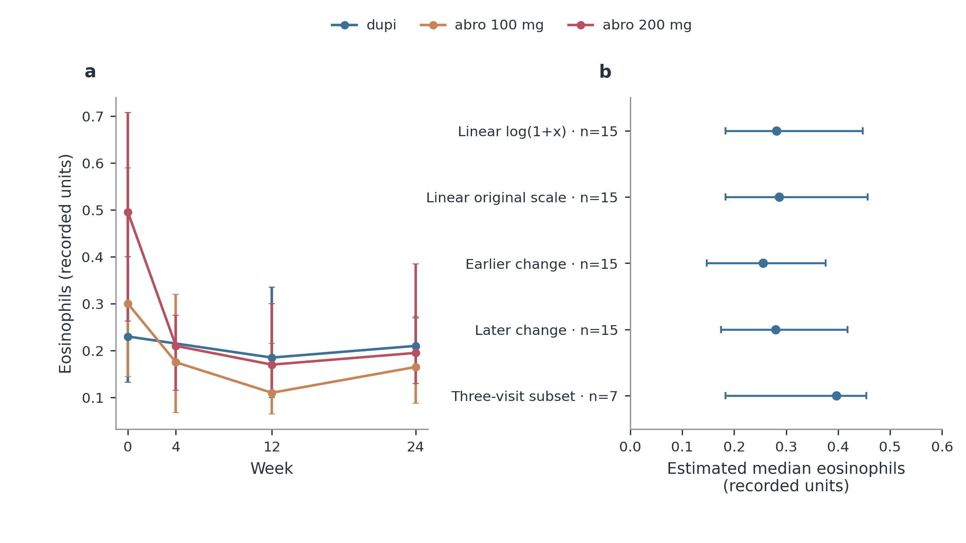
Figure S6 Supplementary
Notes:
a, Available-case medians and interquartile ranges at observed visits. The dupi line connects W0 to W12 because no W4 measurement exists; crossing the W4 position does not create an observation. No imputed value enters this panel. b, Estimated dupi W4 medians and patient-bootstrap 95% intervals under different temporal assumptions. The first four estimates use the same 15 W0/W12 pairs. Earlier/later change replaces the linear time fraction with log(1+t)/log(13) or (t/12)² at t=4. The last row restricts to seven patients also observed at W24, illustrating selection sensitivity, not a better estimate. Intervals condition on the stated assumptions and do not cover all uncertainty about the unmeasured W4 distribution. These are post hoc descriptive estimates, not multiple imputation under an identified treatment-specific W4 model. All original observations remain unchanged. Panel key: a, Observed eosinophils; b, dupi: W4 estimation sensitivity.
Sources
results/tables/update_20261017/clinical/clinical_observed.csv
results/tables/update_20261107/labs/eos_w4_estimates.csv
results/tables/update_20261107/labs/eos_interpolation_backchecks.csv

Slide 12
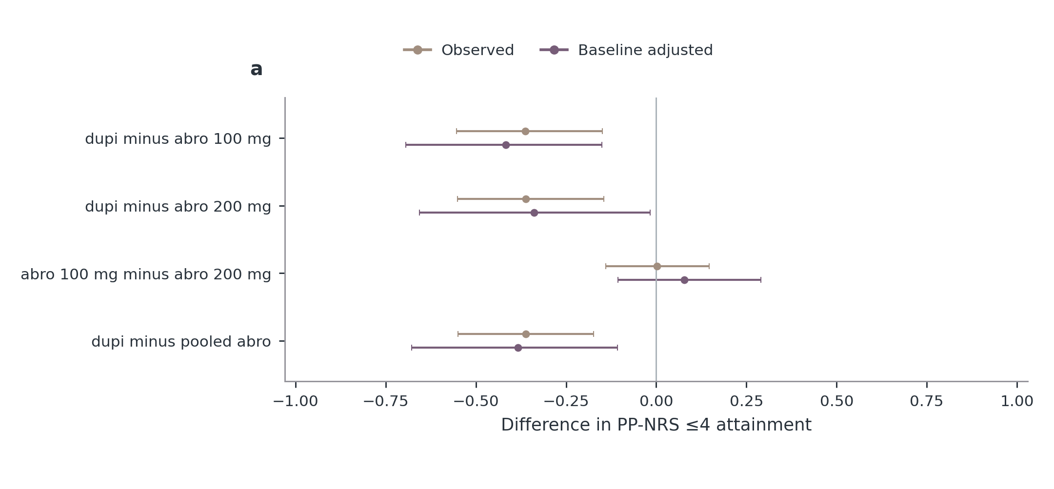
Figure S7 Supplementary
Notes:
Observed and baseline-adjusted risk differences with nominal 95% confidence intervals. Positive values favour the first named treatment for target attainment. Adjustment uses generalized overlap weights from baseline EASI, age, sex, BMI and centre; it does not estimate a randomized current-dose effect. Treatment labels refer to the initial prescribed regimen. pooled abro is supplementary. Missing estimates are left absent; all exact denominators, Fisher/weighted tests, Holm-adjusted P values and exploratory FDR values are in the source tables. Panel key: a, Week 2 itch target.
Sources
results/tables/update_20261017/clinical/endpoint_tests.csv
results/tables/update_20261017/clinical/endpoint_weighted_contrasts.csv

Slide 13
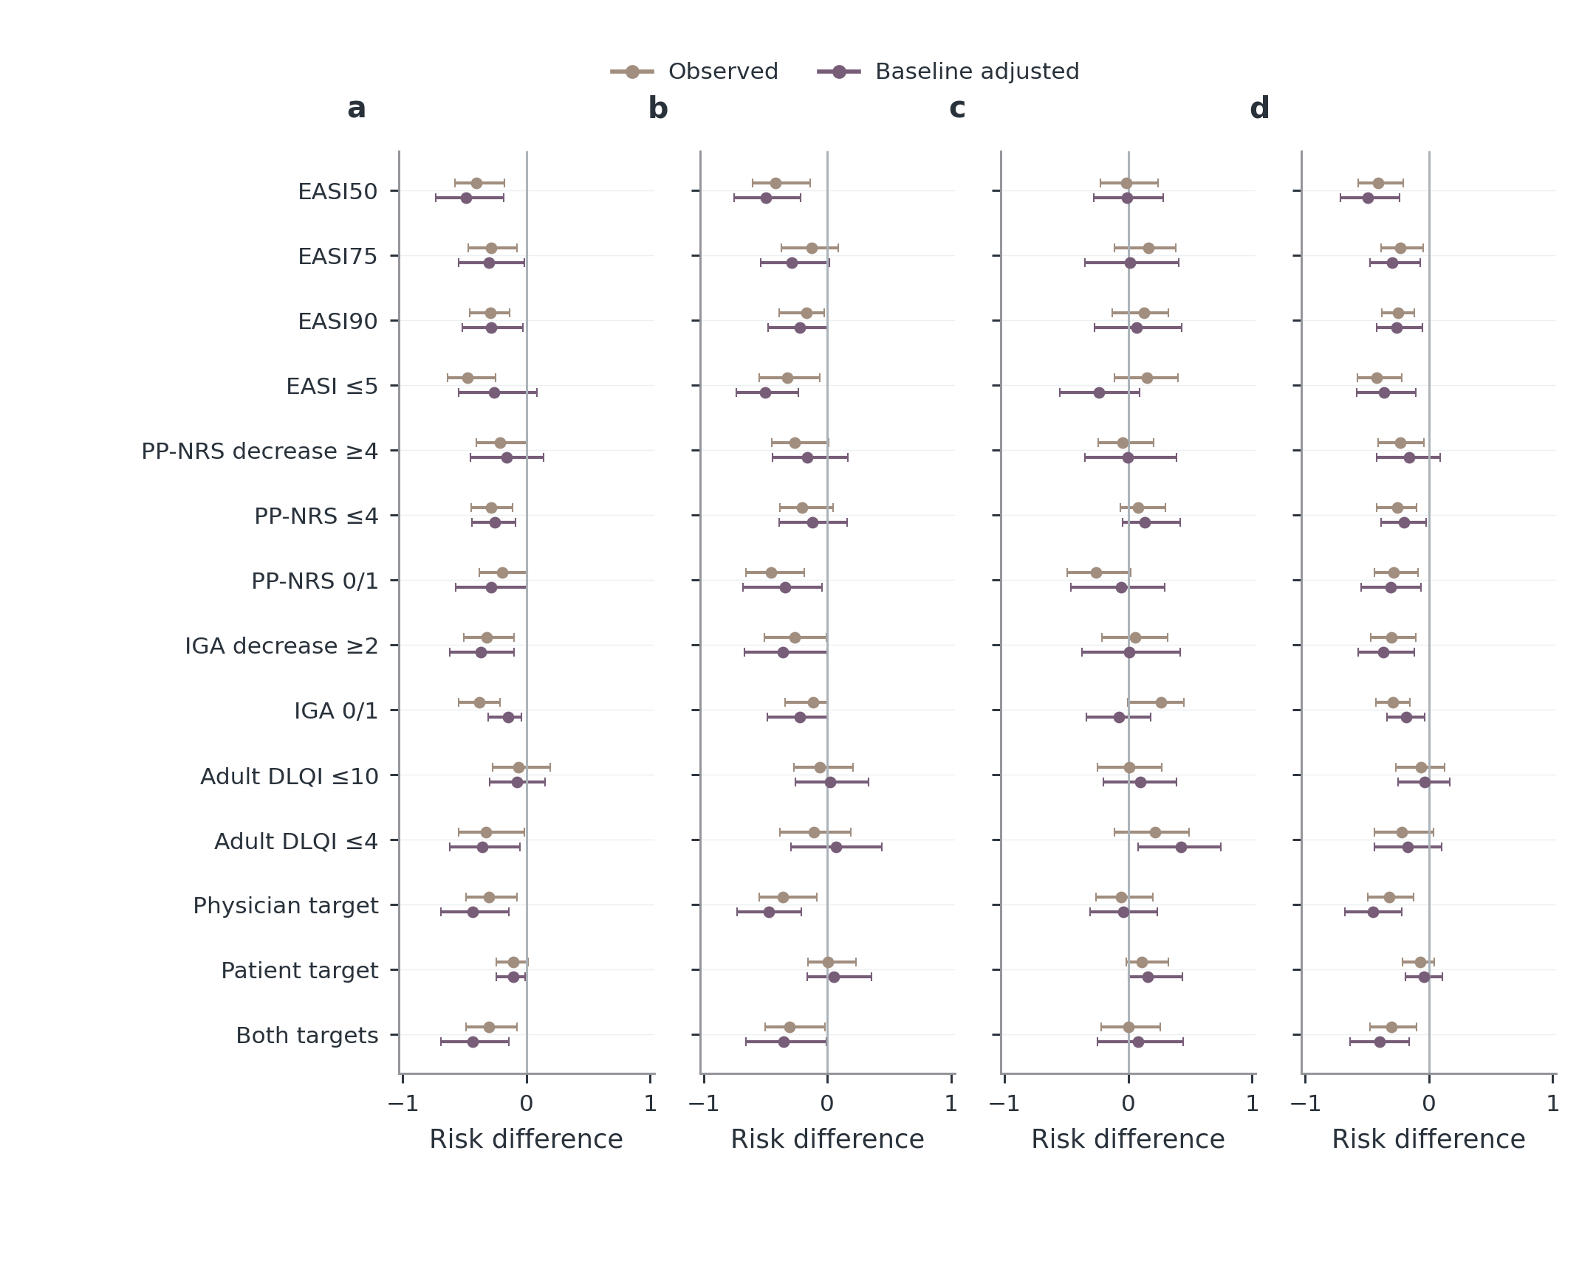
Figure S8 Supplementary
Notes:
Observed and baseline-adjusted risk differences with nominal 95% confidence intervals. Positive values favour the first named treatment for target attainment. Adjustment uses generalized overlap weights from baseline EASI, age, sex, BMI and centre; it does not estimate a randomized current-dose effect. Treatment labels refer to the initial prescribed regimen. pooled abro is supplementary. Missing estimates are left absent; all exact denominators, Fisher/weighted tests, Holm-adjusted P values and exploratory FDR values are in the source tables. Panel key: a, dupi minus abro 100 mg; b, dupi minus abro 200 mg; c, abro 100 mg minus abro 200 mg; d, dupi minus pooled abro.
Sources
results/tables/update_20261017/clinical/endpoint_tests.csv
results/tables/update_20261017/clinical/endpoint_weighted_contrasts.csv

Slide 14
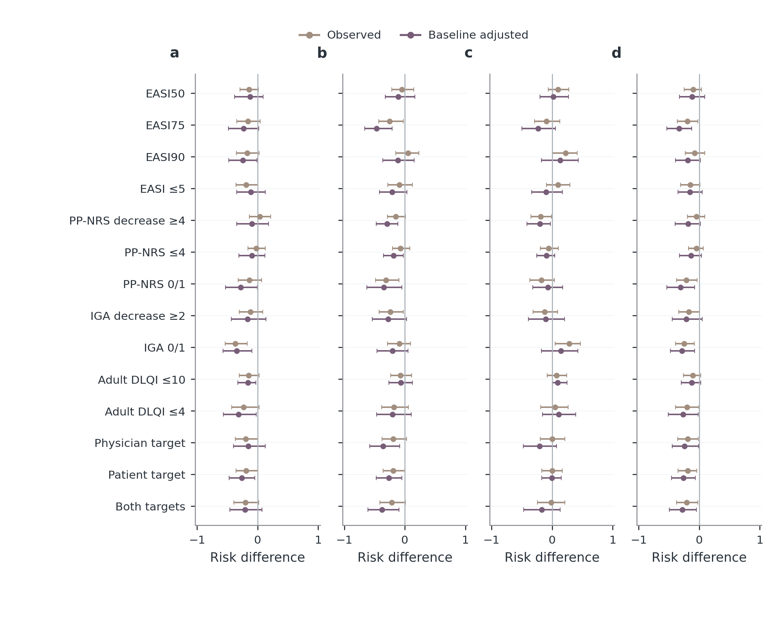
Figure S9 Supplementary
Notes:
Observed and baseline-adjusted risk differences with nominal 95% confidence intervals. Positive values favour the first named treatment for target attainment. Adjustment uses generalized overlap weights from baseline EASI, age, sex, BMI and centre; it does not estimate a randomized current-dose effect. Treatment labels refer to the initial prescribed regimen. pooled abro is supplementary. Missing estimates are left absent; all exact denominators, Fisher/weighted tests, Holm-adjusted P values and exploratory FDR values are in the source tables. Panel key: a, dupi minus abro 100 mg; b, dupi minus abro 200 mg; c, abro 100 mg minus abro 200 mg; d, dupi minus pooled abro.
Sources
results/tables/update_20261017/clinical/endpoint_tests.csv
results/tables/update_20261017/clinical/endpoint_weighted_contrasts.csv

Slide 15
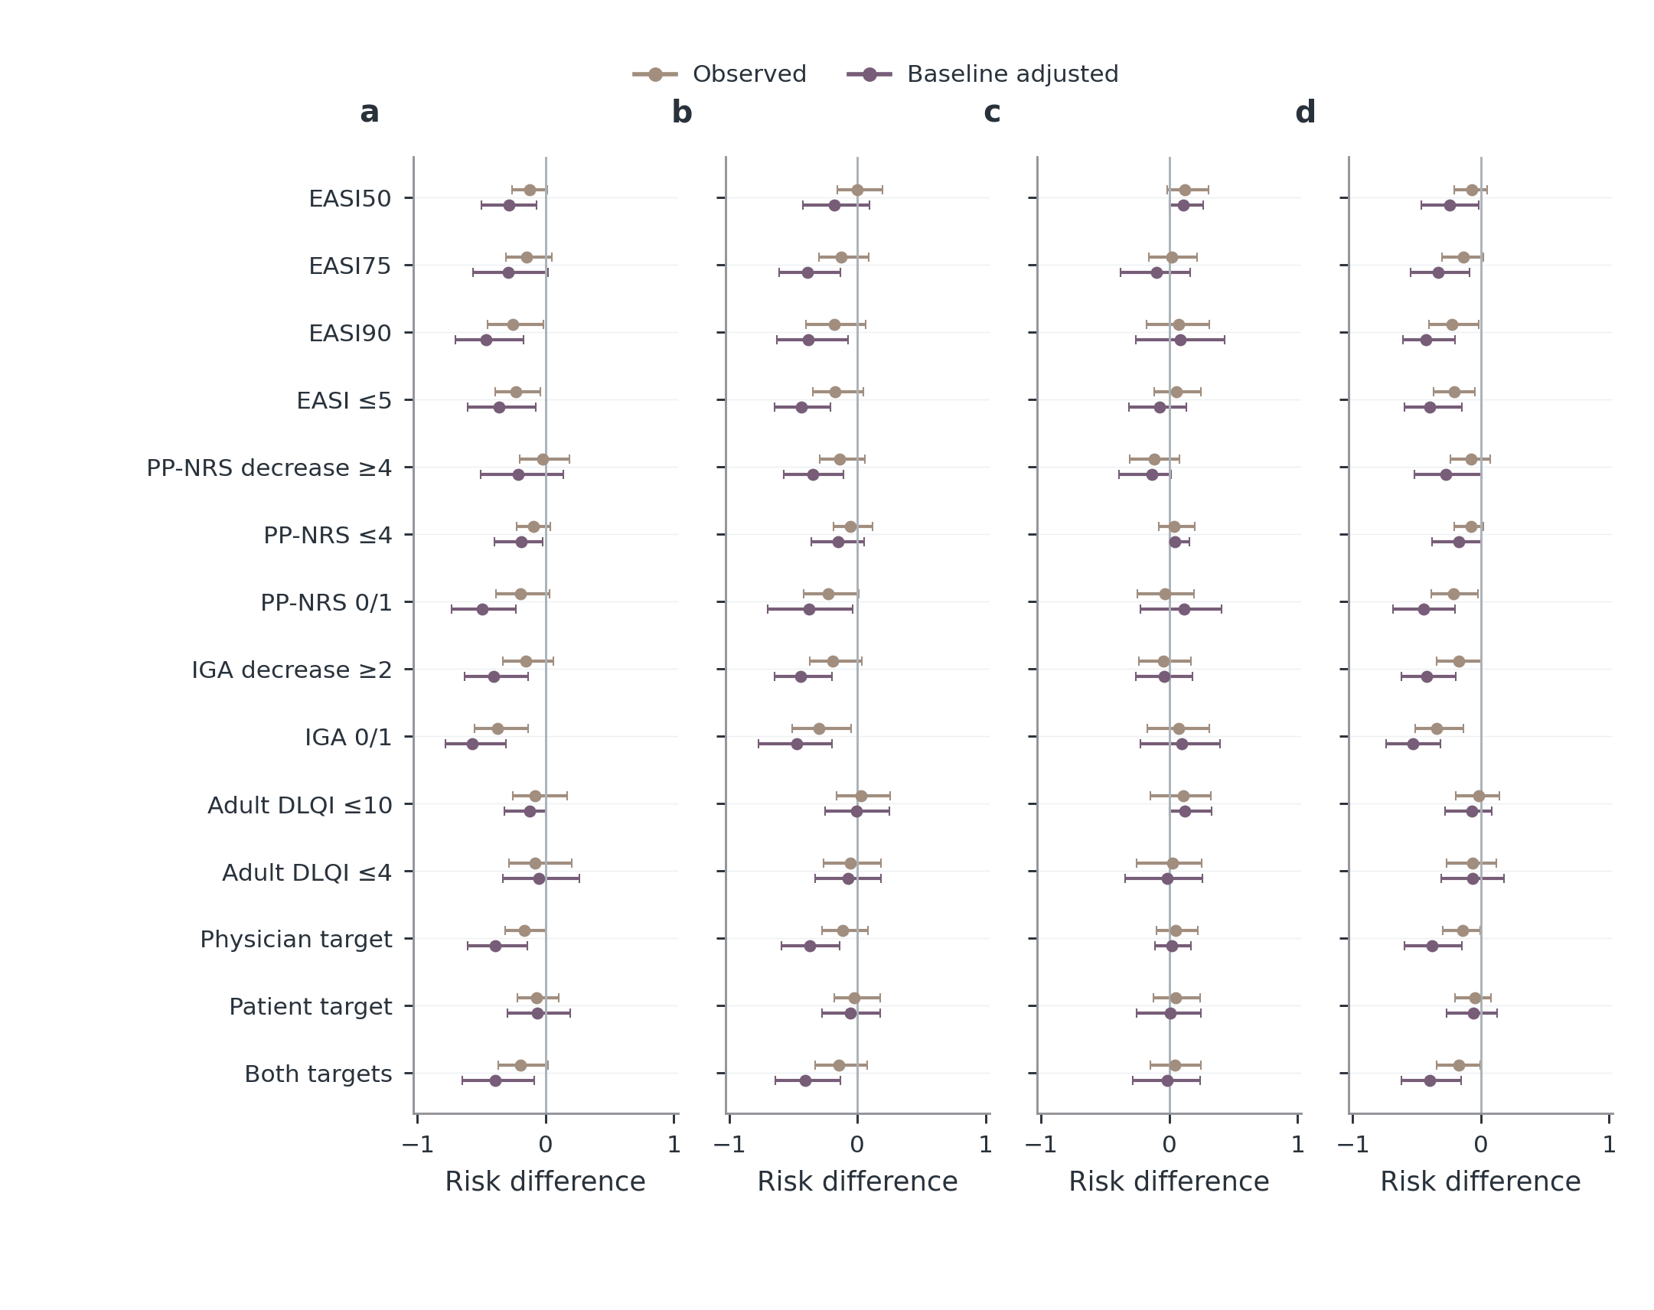
Figure S10 Supplementary
Notes:
Observed and baseline-adjusted risk differences with nominal 95% confidence intervals. Positive values favour the first named treatment for target attainment. Adjustment uses generalized overlap weights from baseline EASI, age, sex, BMI and centre; it does not estimate a randomized current-dose effect. Treatment labels refer to the initial prescribed regimen. pooled abro is supplementary. Missing estimates are left absent; all exact denominators, Fisher/weighted tests, Holm-adjusted P values and exploratory FDR values are in the source tables. Panel key: a, dupi minus abro 100 mg; b, dupi minus abro 200 mg; c, abro 100 mg minus abro 200 mg; d, dupi minus pooled abro.
Sources
results/tables/update_20261017/clinical/endpoint_tests.csv
results/tables/update_20261017/clinical/endpoint_weighted_contrasts.csv

Slide 16
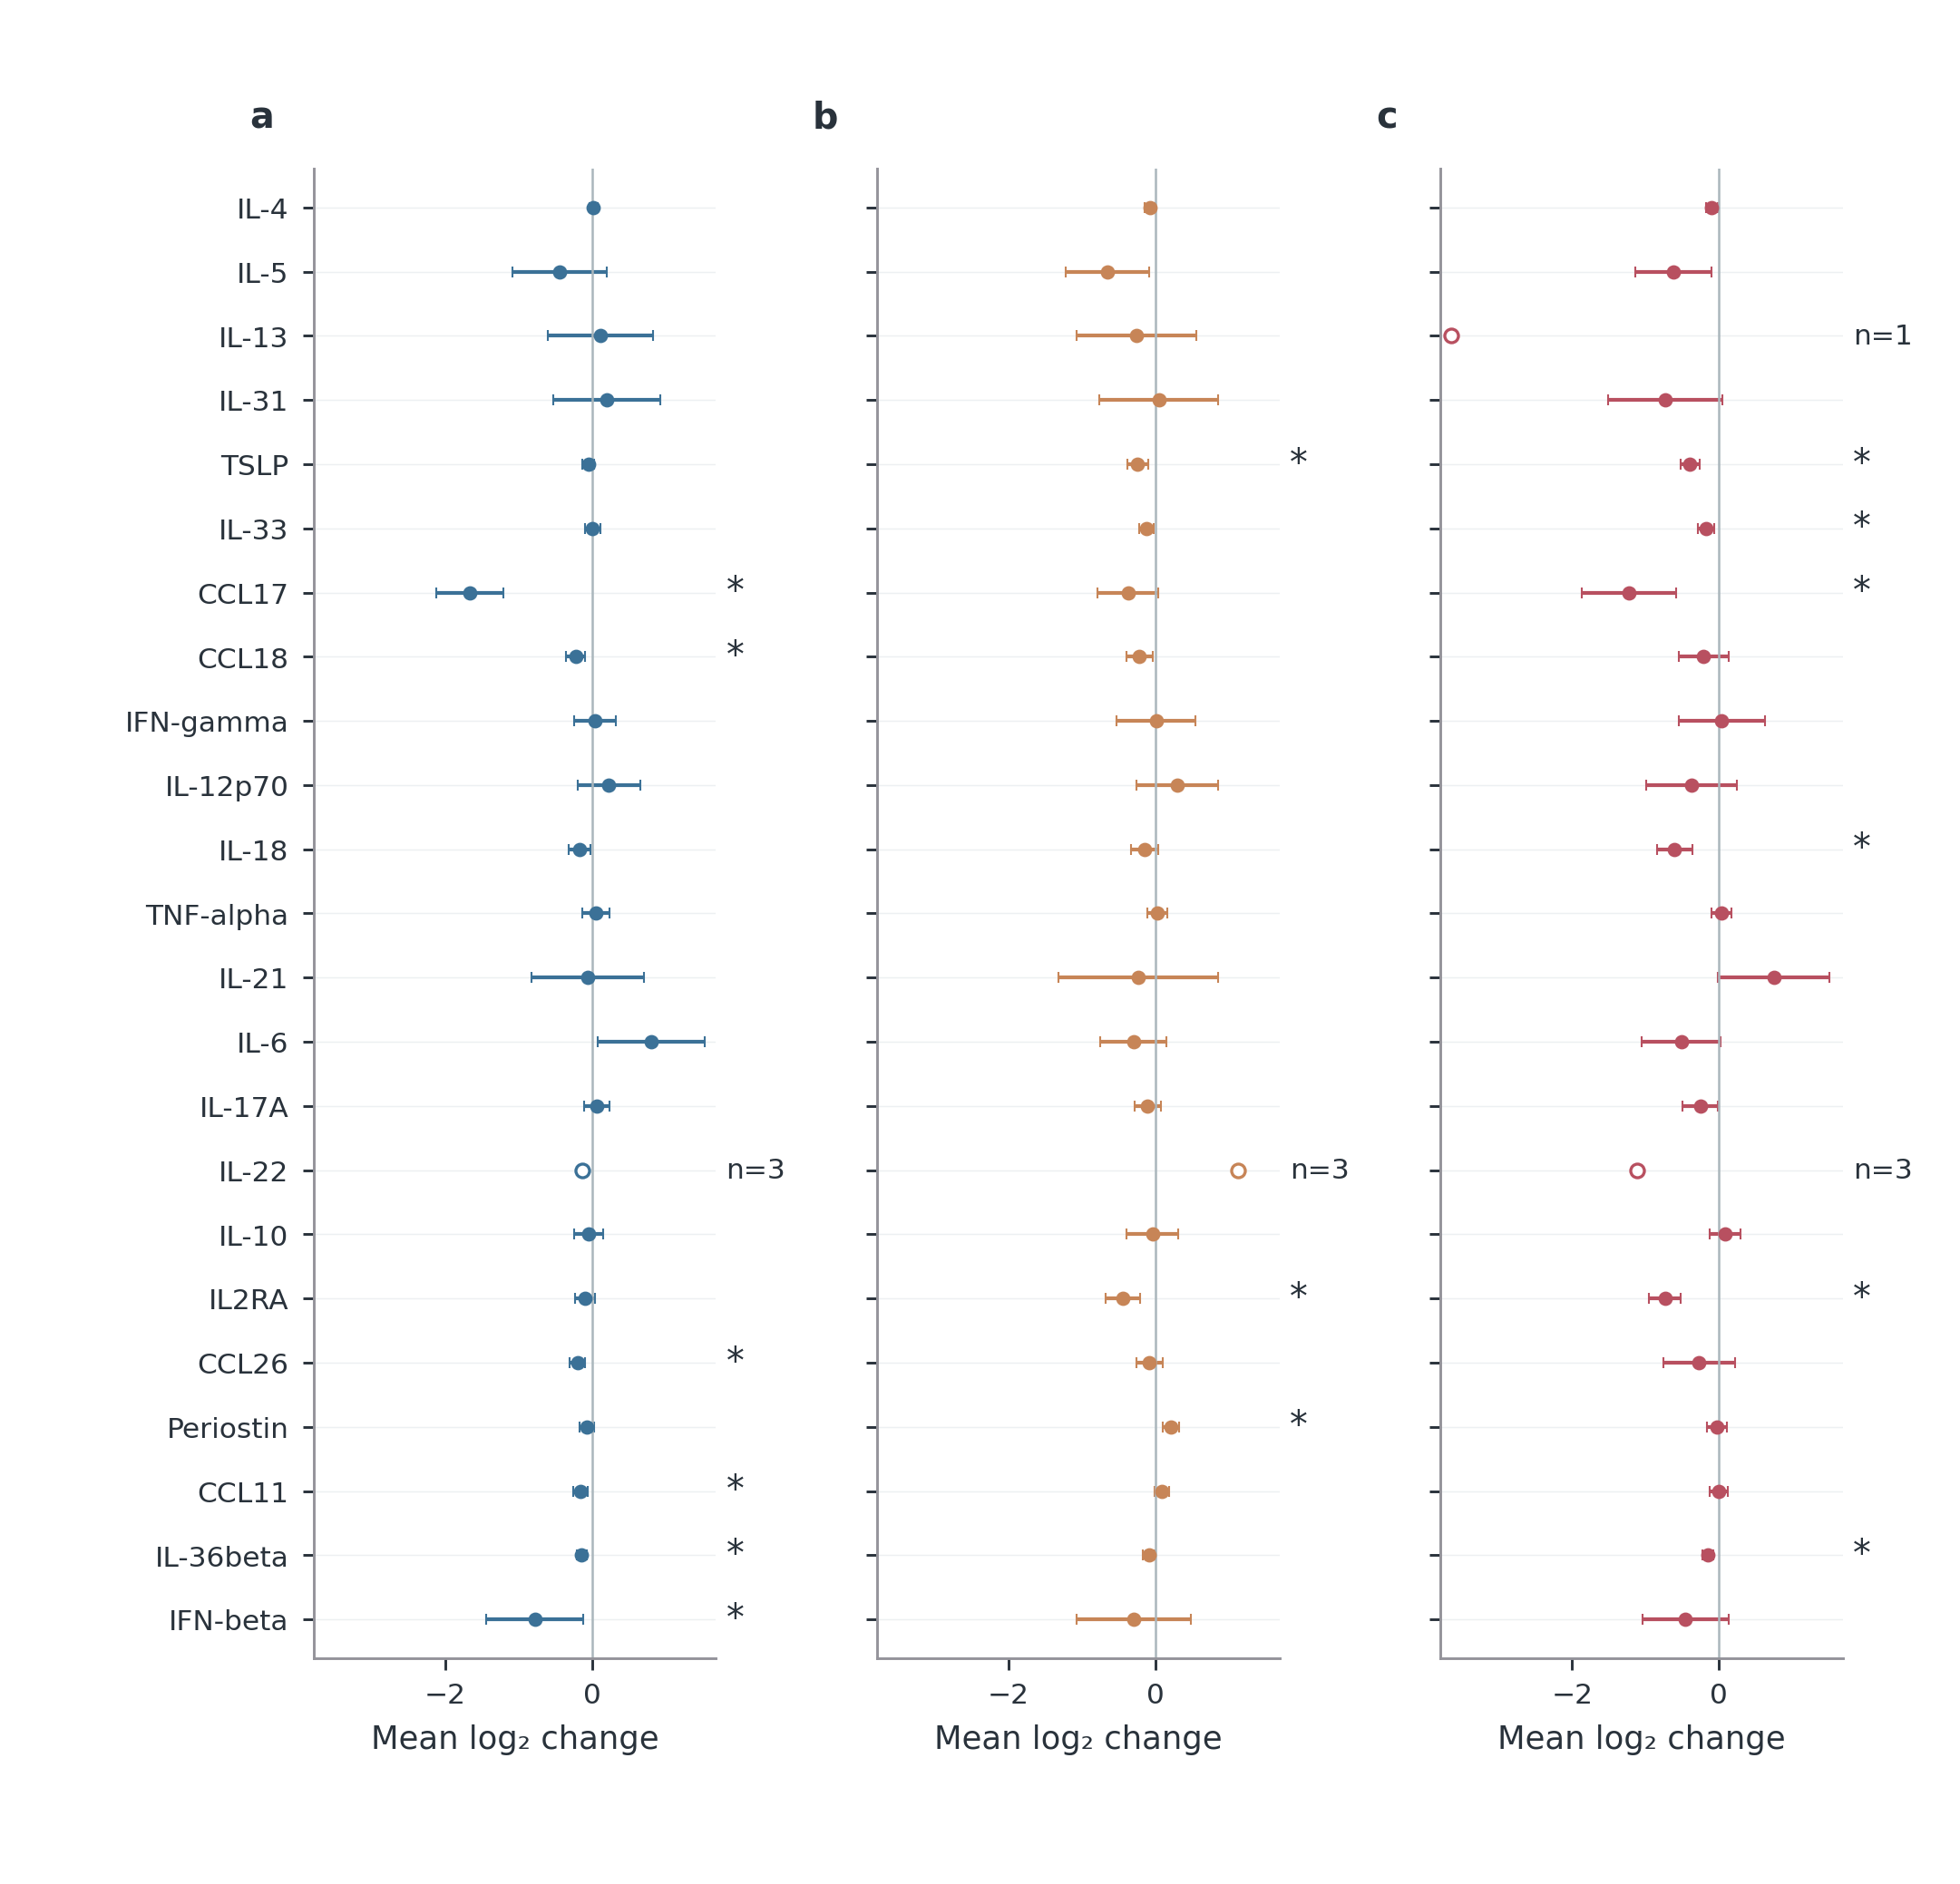
Figure S11 Supplementary
Notes:
Mean paired log₂ concentration changes with 95% t confidence intervals. Negative values indicate lower later concentration. Each marker/treatment uses all available pairs for this interval; exact counts are in the source table. All 23 measured markers are retained. Hollow circles with n labels denote fewer than five pairs; these are descriptive and have no inferential interval or star. Unavailable estimates are blank. Stars denote BH q<0.05 across the 193 estimable tests among 207 planned marker-by-treatment-by-window comparisons, not a separate family for the displayed interval. Panel key: a, dupi; b, abro 100 mg; c, abro 200 mg.
Sources
results/tables/update_20261017/clinical/molecular_paired_changes.csv

Slide 17
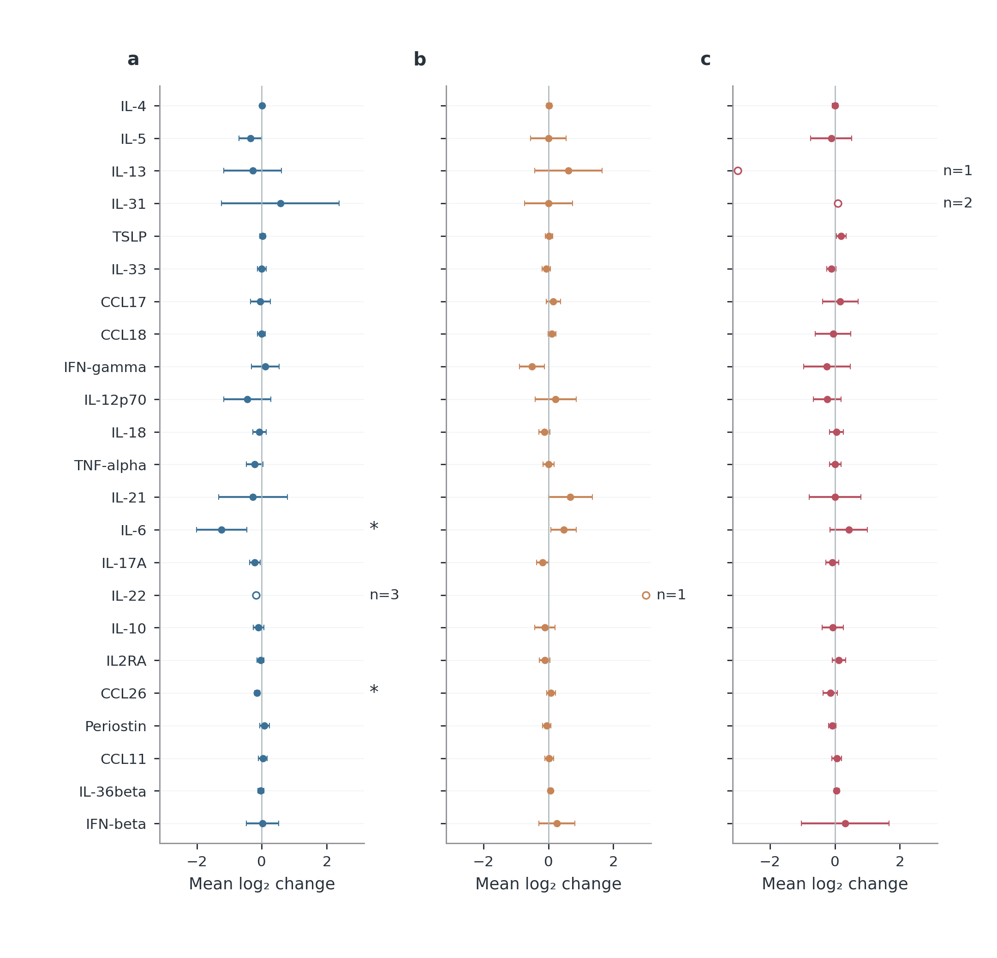
Figure S12 Supplementary
Notes:
Mean paired log₂ concentration changes with 95% t confidence intervals. Negative values indicate lower later concentration. Each marker/treatment uses all available pairs for this interval; exact counts are in the source table. All 23 measured markers are retained. Hollow circles with n labels denote fewer than five pairs; these are descriptive and have no inferential interval or star. Unavailable estimates are blank. Stars denote BH q<0.05 across the 193 estimable tests among 207 planned marker-by-treatment-by-window comparisons, not a separate family for the displayed interval. Panel key: a, dupi; b, abro 100 mg; c, abro 200 mg.
Sources
results/tables/update_20261017/clinical/molecular_paired_changes.csv

Slide 18
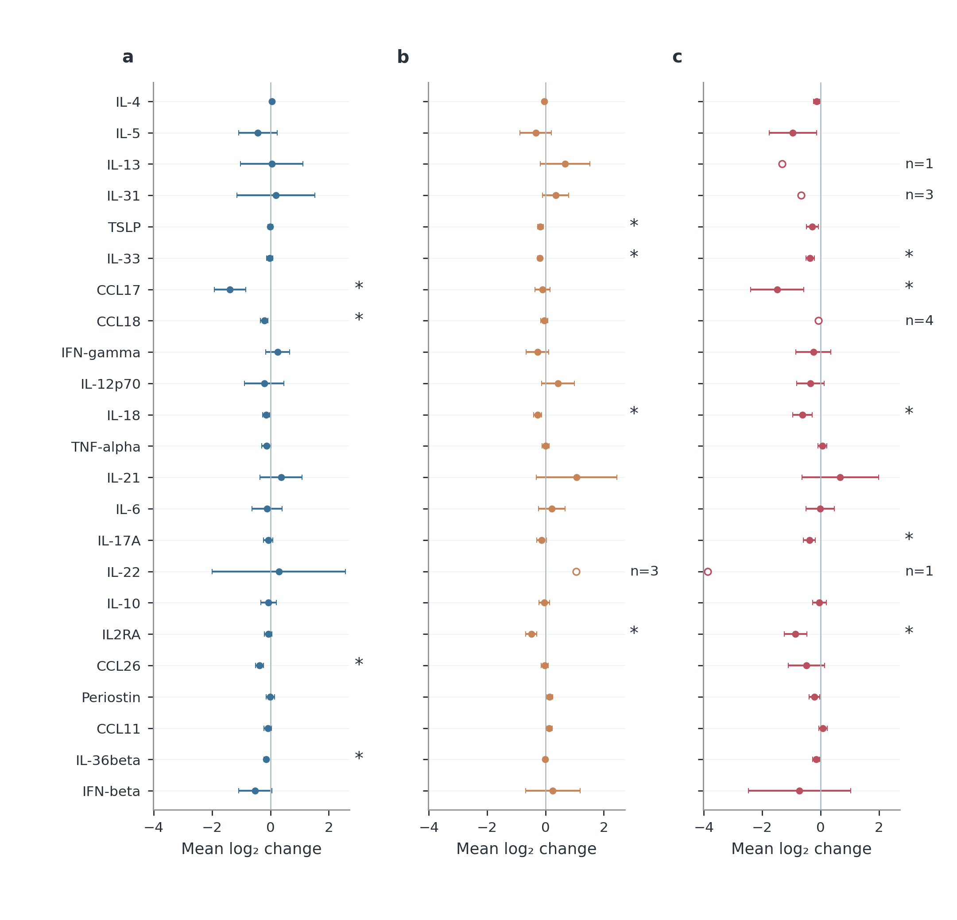
Figure S13 Supplementary
Notes:
Mean paired log₂ concentration changes with 95% t confidence intervals. Negative values indicate lower later concentration. Each marker/treatment uses all available pairs for this interval; exact counts are in the source table. All 23 measured markers are retained. Hollow circles with n labels denote fewer than five pairs; these are descriptive and have no inferential interval or star. Unavailable estimates are blank. Stars denote BH q<0.05 across the 193 estimable tests among 207 planned marker-by-treatment-by-window comparisons, not a separate family for the displayed interval. Panel key: a, dupi; b, abro 100 mg; c, abro 200 mg.
Sources
results/tables/update_20261017/clinical/molecular_paired_changes.csv

Slide 19
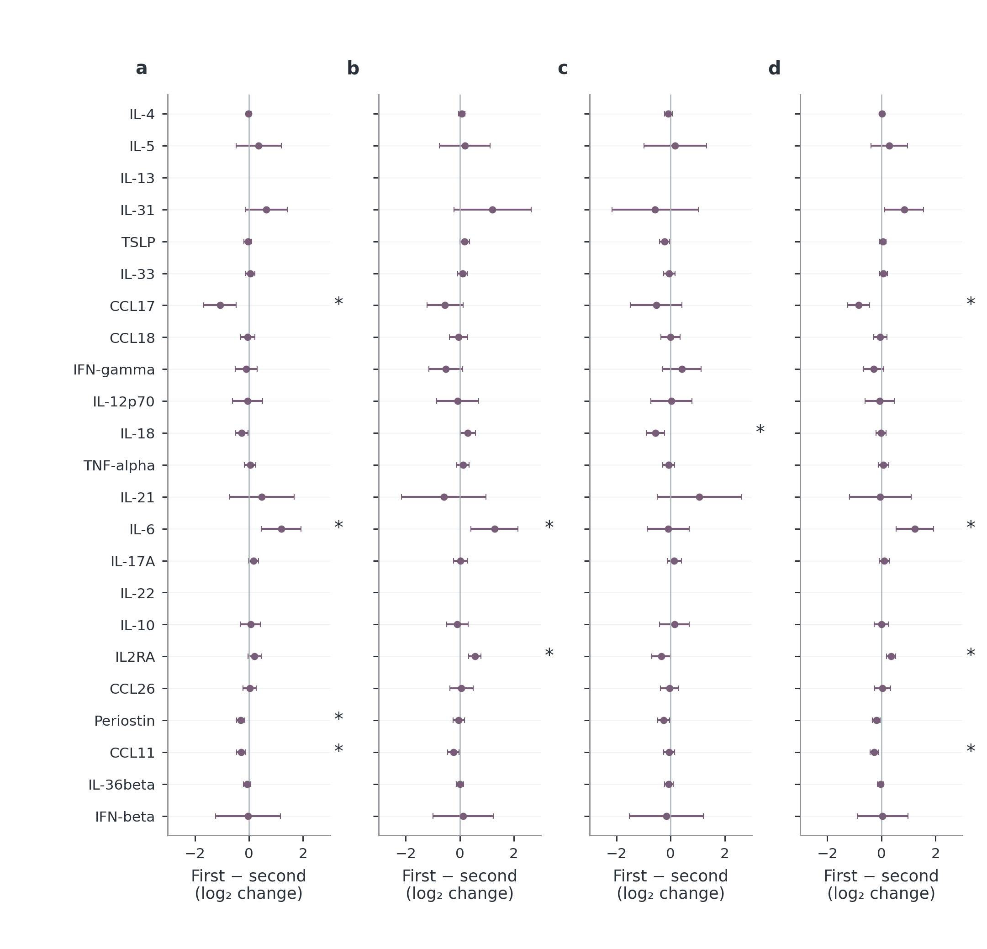
Figure S14 Supplementary
Notes:
Differences in within-patient log₂ changes with HC3 95% confidence intervals. Negative values mean a smaller, more negative change in the first named treatment. Models adjust starting log₂ concentration, baseline total EASI, age, sex, BMI and centre. dupi denotes dupilumab; abro denotes abrocitinib, with 100/200 mg identifying initial dose. pooled abro retains the observed dose mixture. Stars denote the original BH q<0.05 family; no multiplicity family is recalculated after display selection. Blank positions have no estimable contrast. Complete counts, diagnostics, centre/batch sensitivities and tests remain in the source table. These are adjusted observational associations, not randomized current-dose effects. Panel key: a, dupi minus abro 100 mg; b, dupi minus abro 200 mg; c, abro 200 mg minus abro 100 mg; d, dupi minus pooled abro.
Sources
results/tables/update_20261017/clinical/molecular_adjusted_contrasts.csv

Slide 20
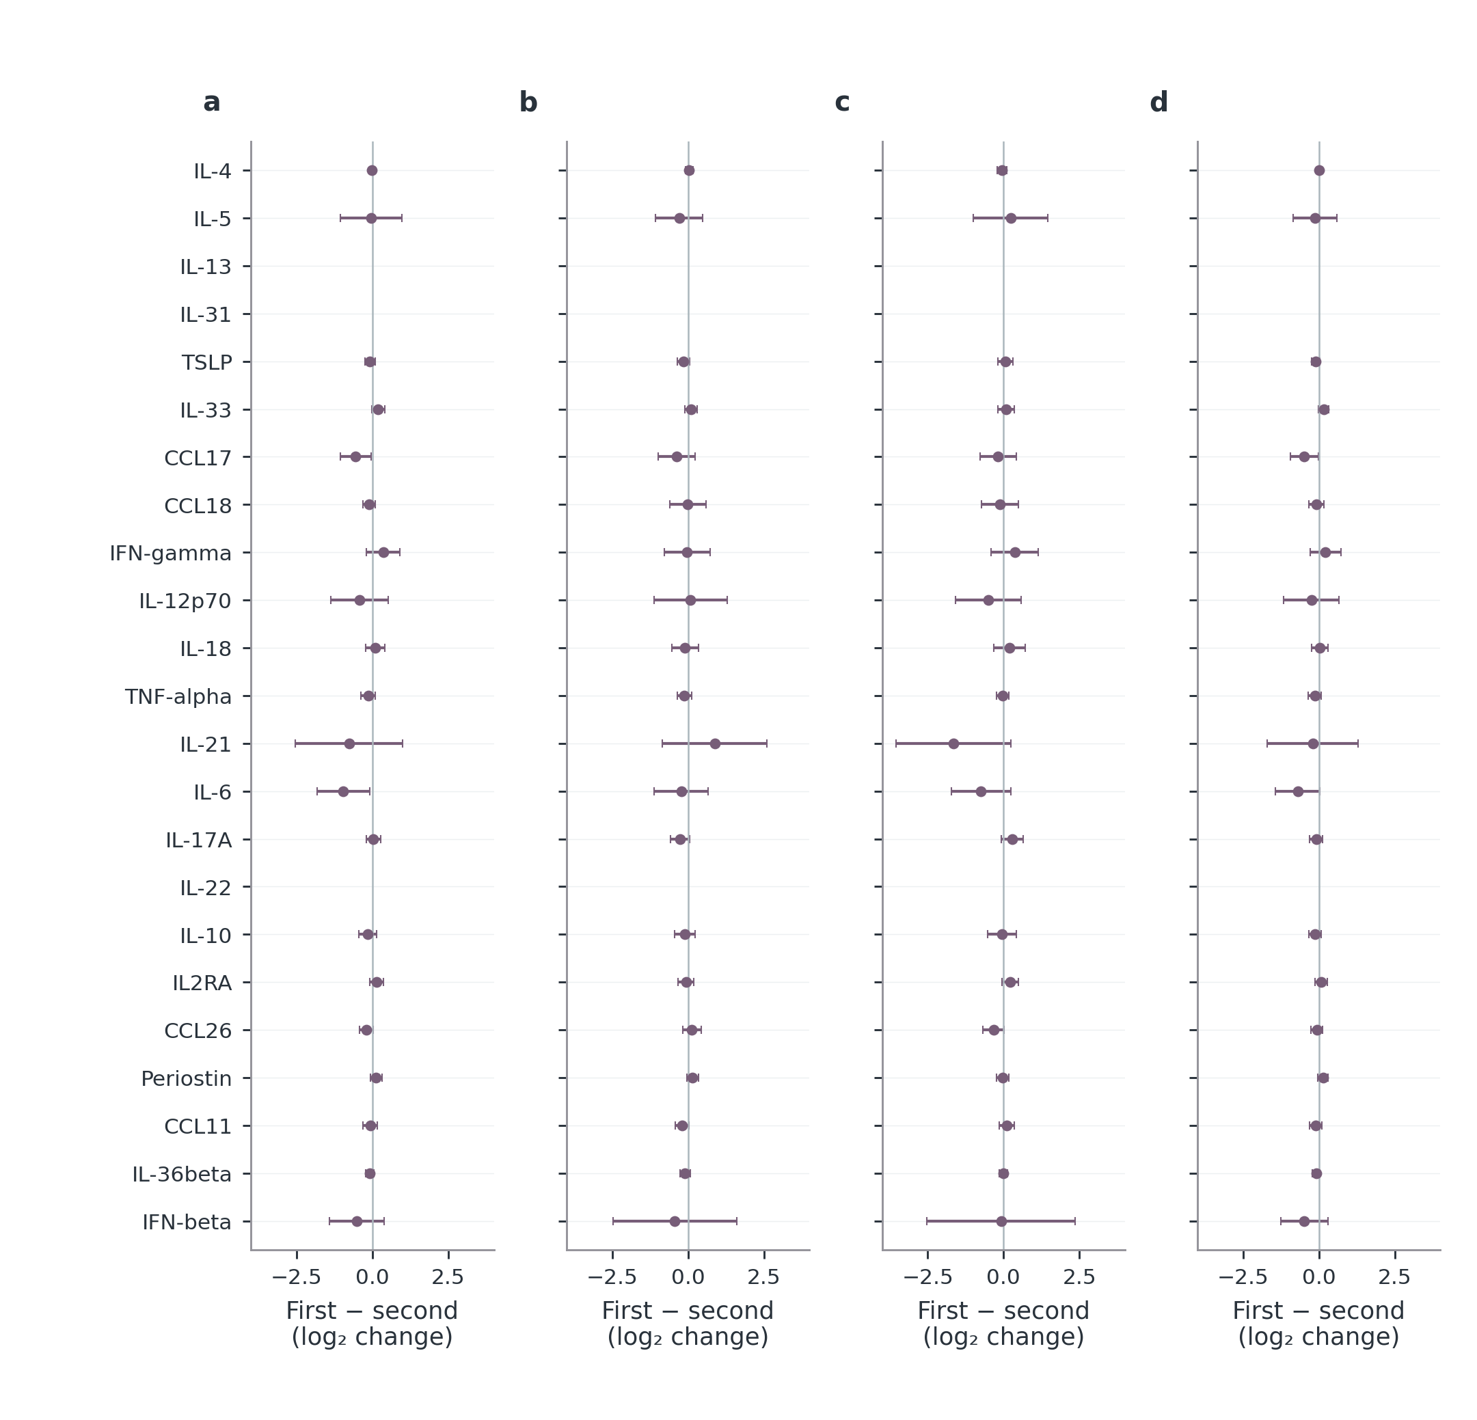
Figure S15 Supplementary
Notes:
Differences in within-patient log₂ changes with HC3 95% confidence intervals. Negative values mean a smaller, more negative change in the first named treatment. Models adjust starting log₂ concentration, baseline total EASI, age, sex, BMI and centre. dupi denotes dupilumab; abro denotes abrocitinib, with 100/200 mg identifying initial dose. pooled abro retains the observed dose mixture. Stars denote the original BH q<0.05 family; no multiplicity family is recalculated after display selection. Blank positions have no estimable contrast. Complete counts, diagnostics, centre/batch sensitivities and tests remain in the source table. These are adjusted observational associations, not randomized current-dose effects. Panel key: a, dupi minus abro 100 mg; b, dupi minus abro 200 mg; c, abro 200 mg minus abro 100 mg; d, dupi minus pooled abro.
Sources
results/tables/update_20261017/clinical/molecular_adjusted_contrasts.csv

Slide 21
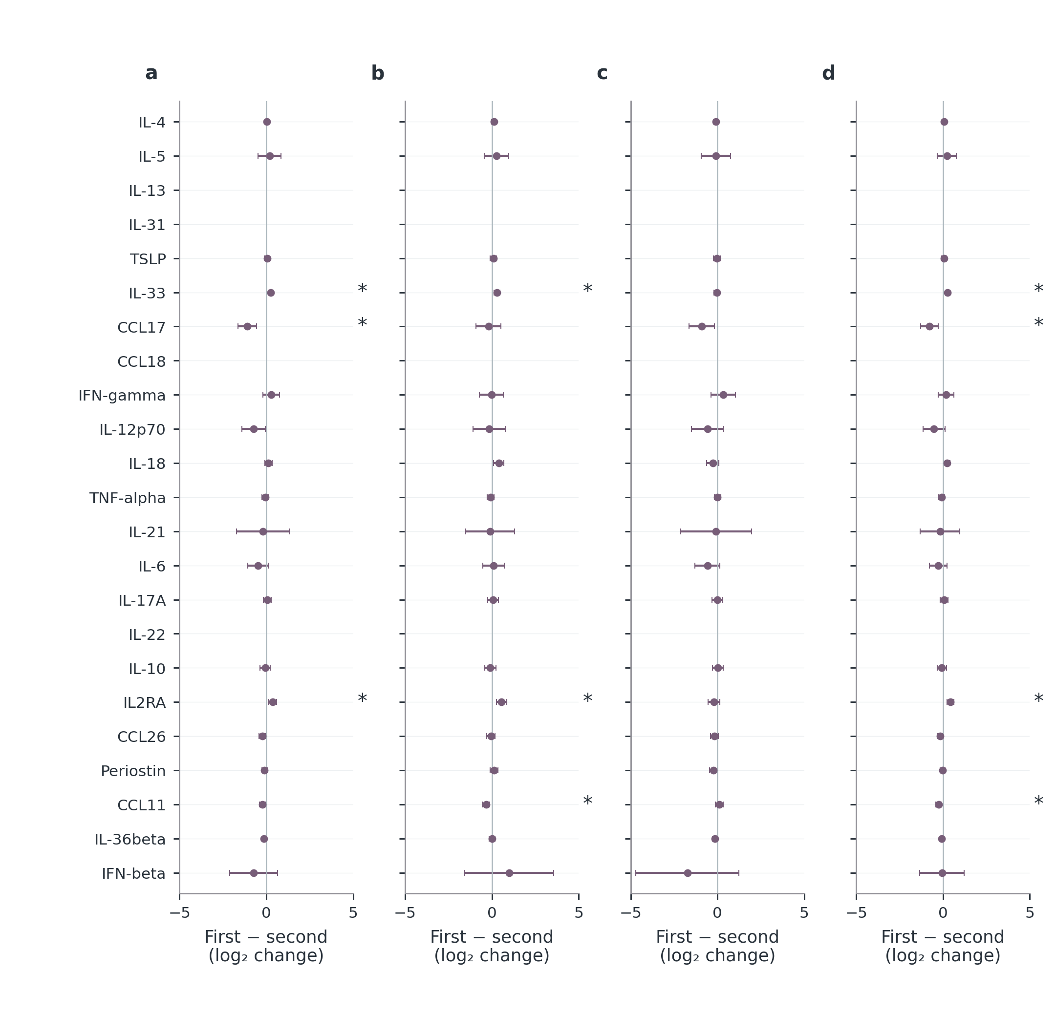
Figure S16 Supplementary
Notes:
Differences in within-patient log₂ changes with HC3 95% confidence intervals. Negative values mean a smaller, more negative change in the first named treatment. Models adjust starting log₂ concentration, baseline total EASI, age, sex, BMI and centre. dupi denotes dupilumab; abro denotes abrocitinib, with 100/200 mg identifying initial dose. pooled abro retains the observed dose mixture. Stars denote the original BH q<0.05 family; no multiplicity family is recalculated after display selection. Blank positions have no estimable contrast. Complete counts, diagnostics, centre/batch sensitivities and tests remain in the source table. These are adjusted observational associations, not randomized current-dose effects. Panel key: a, dupi minus abro 100 mg; b, dupi minus abro 200 mg; c, abro 200 mg minus abro 100 mg; d, dupi minus pooled abro.
Sources
results/tables/update_20261017/clinical/molecular_adjusted_contrasts.csv

Slide 22
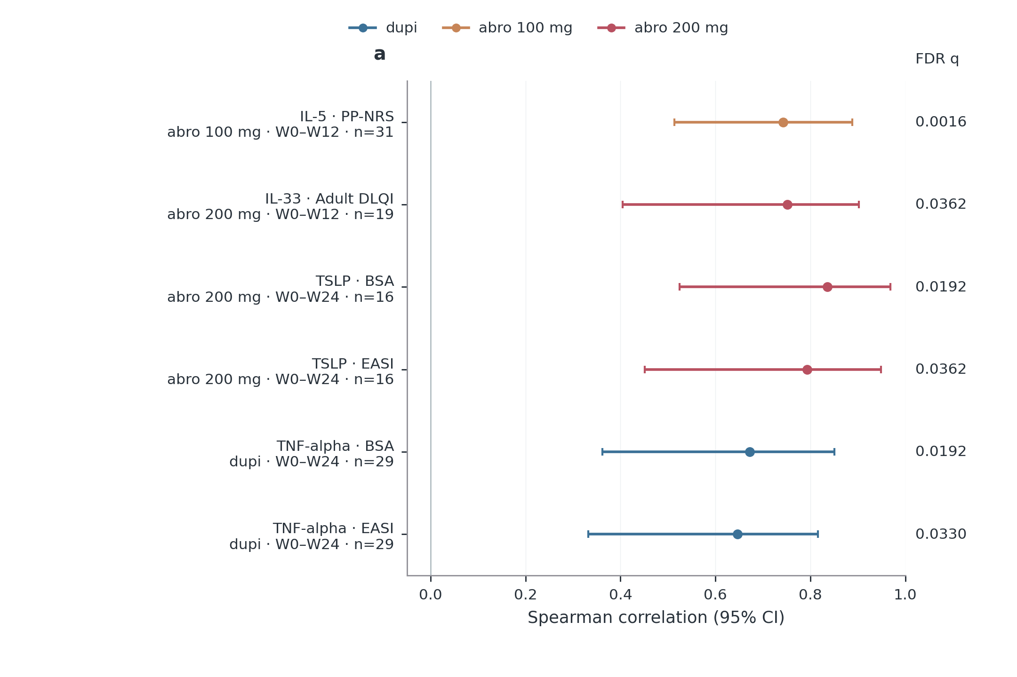
Figure S17 Supplementary
Notes:
Every association meeting BH q<0.05 in the full declared change-association family is displayed; selection spans 23 markers, five clinical outcomes, three initial treatments and three intervals. No W12–W24 association met this threshold. Points are Spearman correlations between within-patient clinical change and log₂ molecular change, both later minus earlier, with patient-bootstrap 95% confidence intervals. Positive correlations indicate changes in the same direction. Labels give paired-patient counts and the interval; colours indicate initial treatment only. Adult DLQI requires age ≥18. All tested coefficients, non-significant results and unestimable pairs remain in the complete source table. This significance-selected display is exploratory and is not independent validation, numerical agreement or a causal molecular effect.
Sources
results/tables/update_20261017/clinical/molecular_clinical_change_correlations.csv

Slide 23
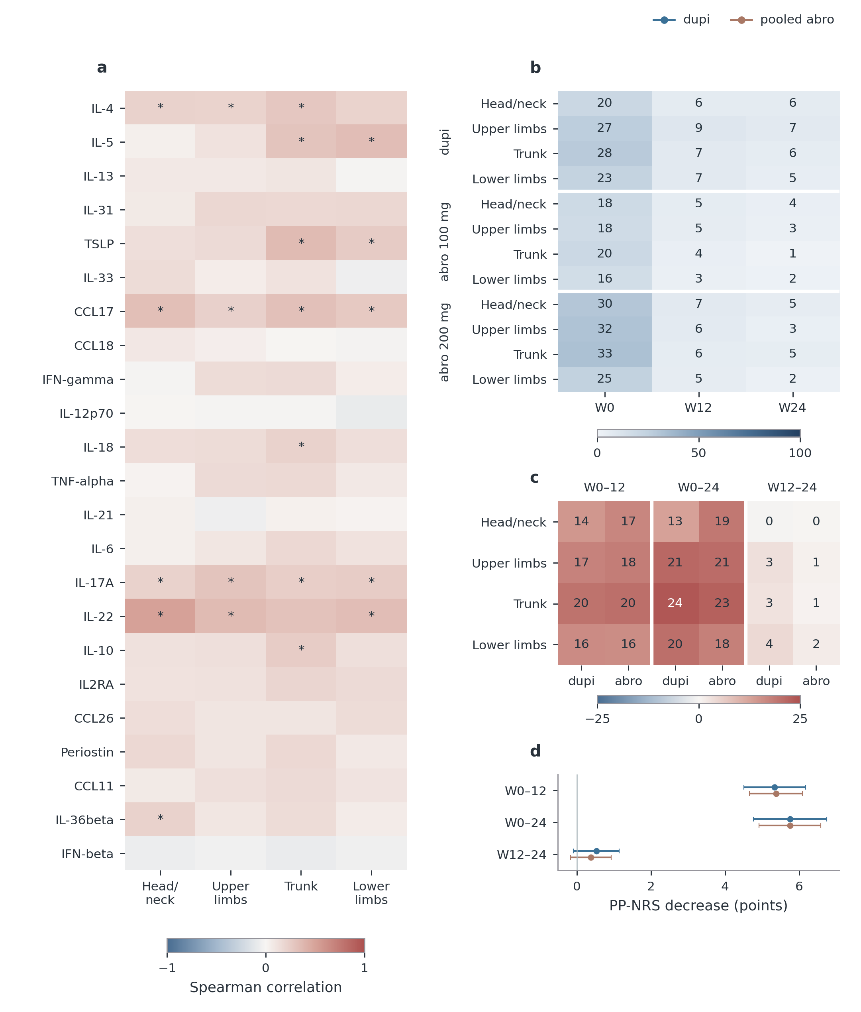
Figure S18 Supplementary
Notes:
a, Baseline Spearman associations between all 23 markers and the four regional EASI contributions; stars mark BH q<0.05, with complete coefficients, patient counts and bootstrap intervals retained in the source. b, Available-case mean regional EASI divided by its theoretical maximum and multiplied by 100; cells show percentages, not patient counts. c, Mean paired regional decrease as a percentage of the same regional maximum for three separately labelled intervals; positive values indicate improvement. The abro columns represent the observed pooled-dose mixture. These heatmaps summarize magnitude; exact 95% t intervals and counts are in the source tables. d, Whole-body PP-NRS mean decreases with 95% t intervals, not region-specific itch. Regional maxima are 7.2, 14.4, 21.6 and 28.8 for head/neck, upper limbs, trunk and lower limbs. All regional analyses require complete, bounded regional records consistent with total EASI. Intervals can share patients and are not successive cumulative effects. Colour bars encode distinct quantities and are not interchangeable. No baseline-adjusted regional treatment contrast passed the FDR threshold; full separate-dose comparisons remain available. Panel key: a, Baseline serum–region association; b, Regional burden (% of maximum); c, Paired decrease (% of maximum); d, Whole-body itch.
Sources
results/tables/update_20261017/clinical/molecular_regional_baseline_correlations.csv
results/tables/update_20261017/regional/regional_normalized_burden.csv
results/tables/update_20261017/regional/regional_paired_improvement.csv
results/tables/update_20261017/regional/whole_body_PP_NRS_improvement.csv
results/tables/update_20261017/regional/regional_treatment_contrasts.csv

Slide 24
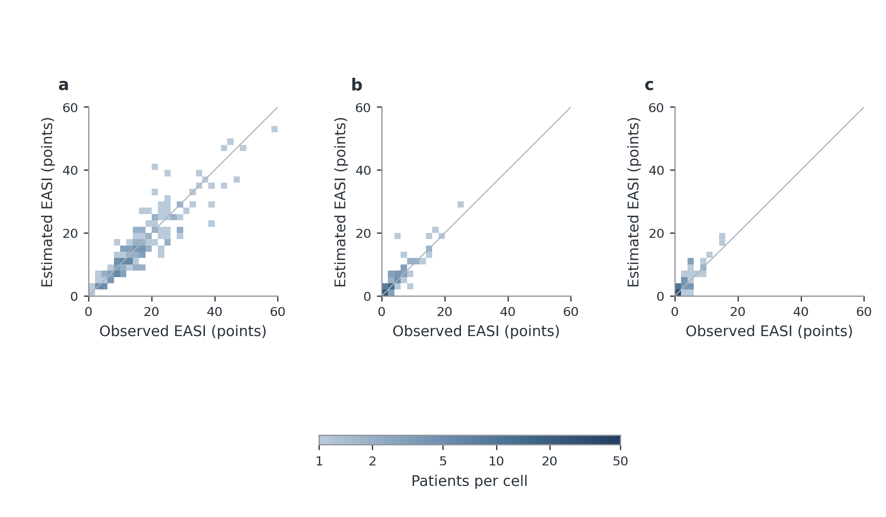
Figure S19 Supplementary
Notes:
a–c, Estimated versus observed EASI in the first patient-held-out repetition at W0/W12 and same-cohort temporal application at W24. Each fixed 2×2-EASI-point cell counts all exact score pairs within its boundaries. Colour gives patient count on one shared logarithmic scale; white cells contain no observations. All 152/89/75 eligible patients are retained. Identical axes preserve the severity-range comparison; grey diagonals denote exact agreement. W0/W12 use nested patient-level structure and penalty selection; earlier marker selection is not repeated. W24 had previously been inspected. These results assess the development procedure rather than independent validation of the final coefficient vector. Overall performance is in Table 2; the main figure displays the complete absolute-error distribution. Panel key: a, Week 0 · n=152; b, Week 12 · n=89; c, Week 24 · n=75.
Sources
manuscript/source_data/model_count_cells.csv

Slide 25
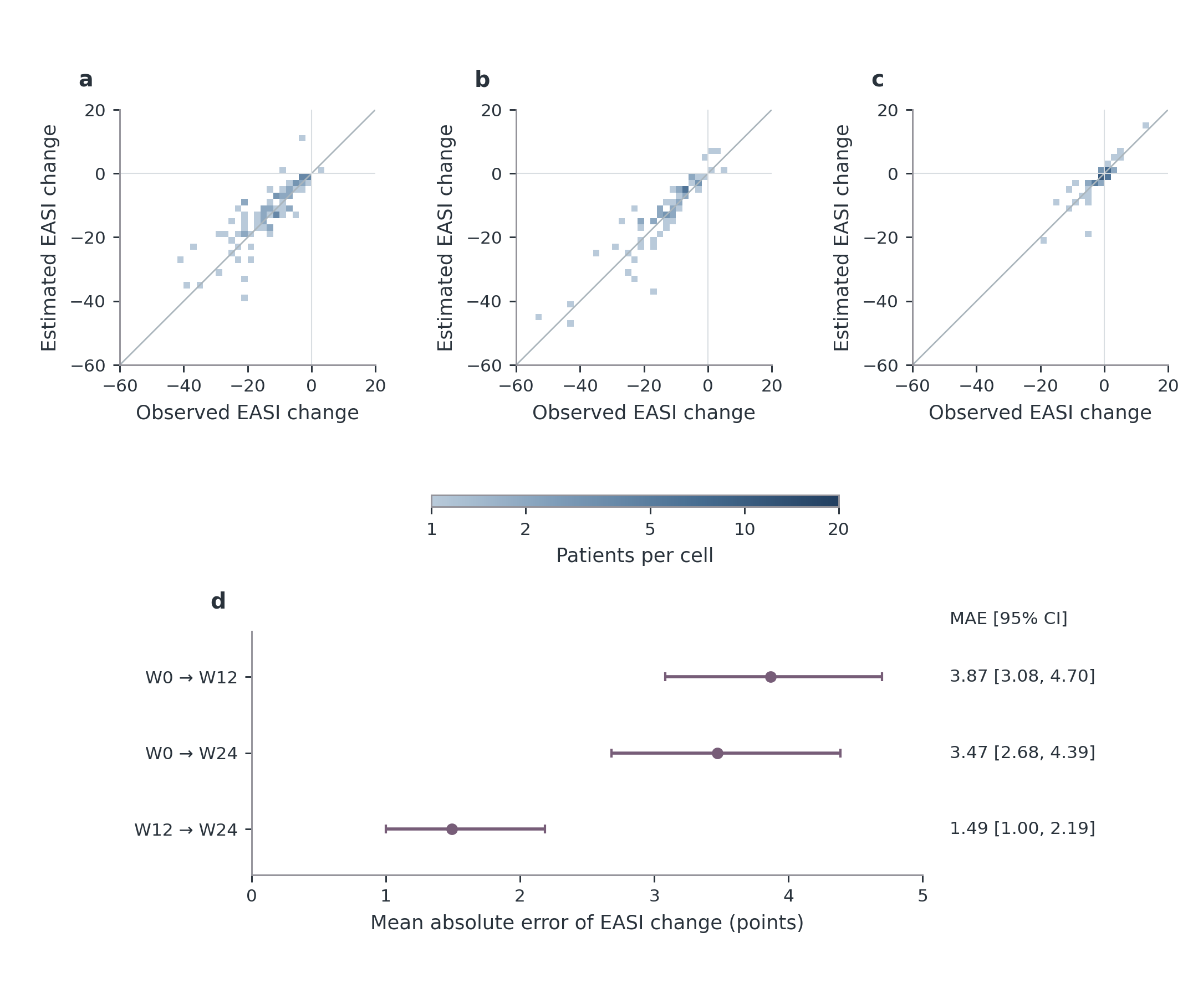
Figure S20 Supplementary
Notes:
a–c, Estimated versus observed EASI changes in the first patient-held-out repetition. Change is end minus start: negative values indicate improvement. Fixed 2×2-EASI-point cells count exact paired changes on one logarithmic count scale. Identical axes retain all 85, 67 and 55 pairs; the intervals can share patients and are not consecutive categories on a time axis. White cells contain no observations; diagonals mark exact agreement. d, Change MAE calculated within each of two repetitions before averaging, with 2,000 patient-bootstrap 95% confidence intervals conditional on saved predictions. Both scores are paired within each repetition before subtraction. W24 is previously inspected same-cohort temporal application. EASI75 classification is shown in the main model figure; complete EASI50/75/90 classifications are retained separately. Panel key: a, W0 → W12 · n=85; b, W0 → W24 · n=67; c, W12 → W24 · n=55; d, Paired-change error.
Sources
manuscript/source_data/monitoring_count_cells.csv
results/tables/update_20261017/redesign_20261018/monitoring_change_uncertainty.csv

Slide 26
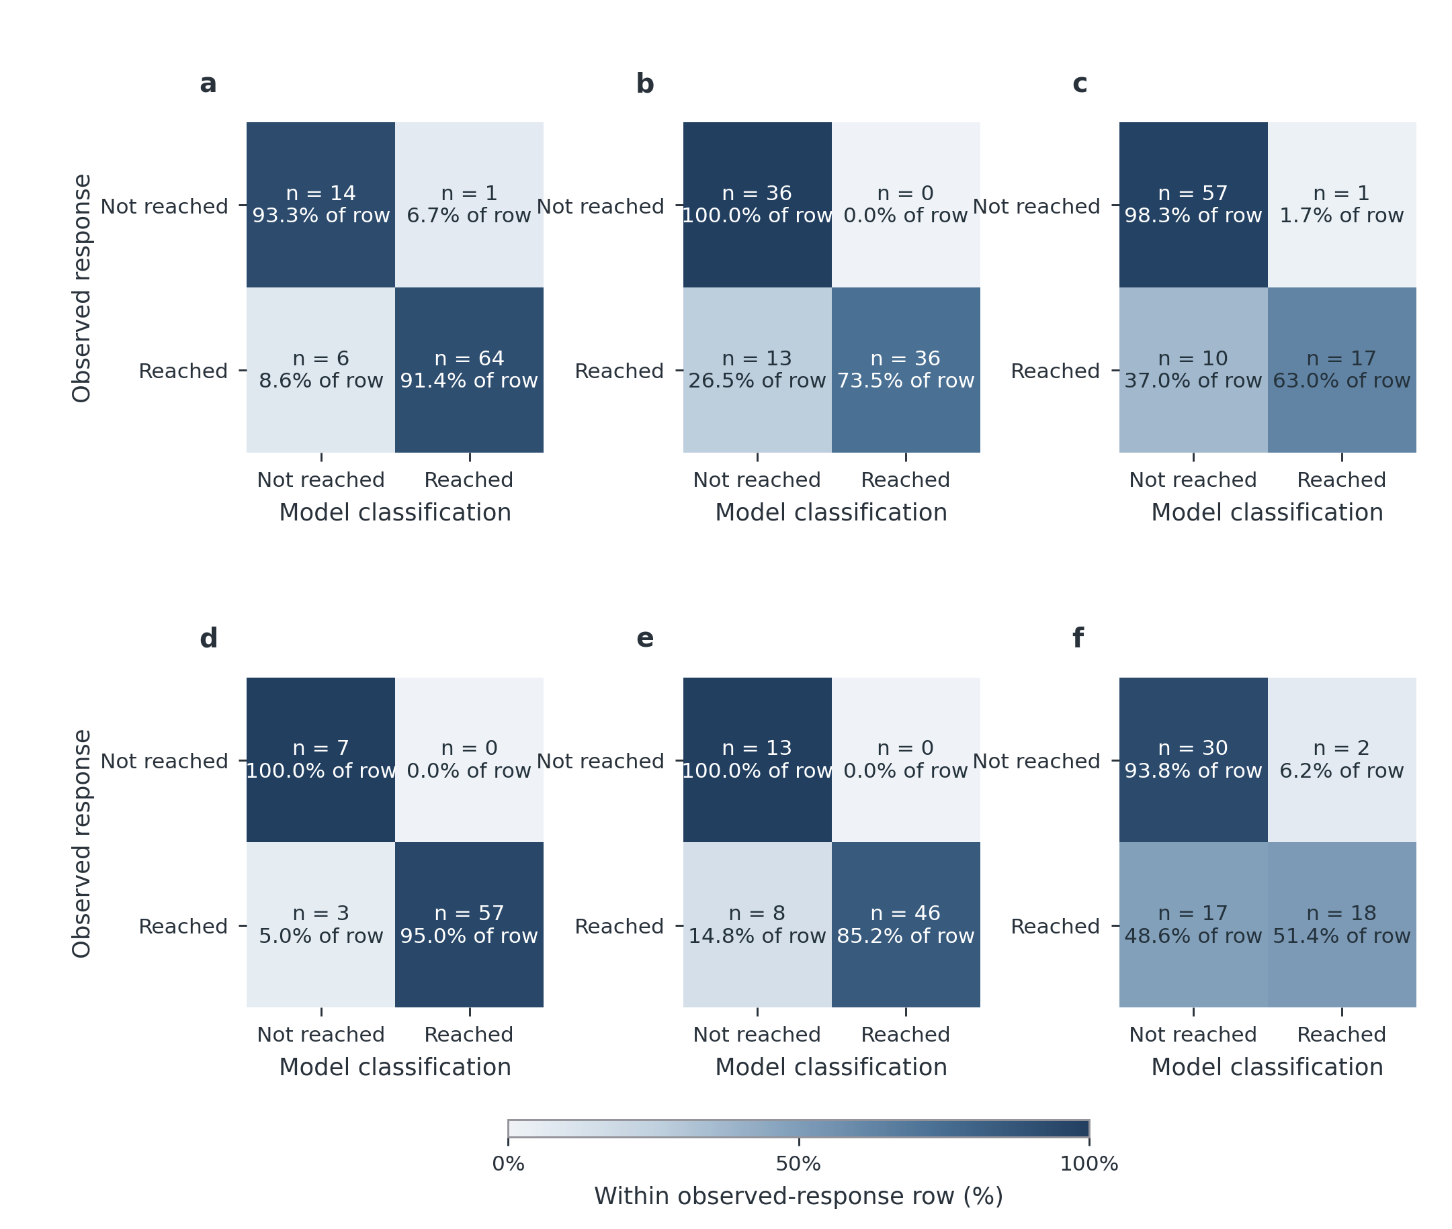
Figure S21 Supplementary
Notes:
Each panel shows actual patient counts from the first outer repetition, separately for W0→W12 and W0→W24. Rows are observed response and columns model-estimated response. Diagonal cells are correct; upper-right cells falsely indicate response and lower-left cells miss an observed responder. Percentages are within each observed-response row, so the lower-right percentage is sensitivity and the upper-left percentage specificity. Observed response uses observed baseline/follow-up scores, whereas estimated response uses predicted baseline/follow-up scores. Counts are integers from one repetition, not the primary two-repetition average; the full metrics table retains the latter. The paired denominators are 85 and 67, with no excluded pair for invalid baseline in this displayed repetition. The two intervals can share patients. This assesses response classification, not alternative-treatment outcomes or continuous-score equivalence. Panel key: a, W0 → W12 · EASI50 n=85 paired patients; b, W0 → W12 · EASI75 n=85 paired patients; c, W0 → W12 · EASI90 n=85 paired patients; d, W0 → W24 · EASI50 n=67 paired patients; e, W0 → W24 · EASI75 n=67 paired patients; f, W0 → W24 · EASI90 n=67 paired patients.
Sources
results/tables/update_20261017/redesign_20261018/monitoring_confusion_repeat0.csv
results/tables/update_20261017/model/improvement_classification.csv

