Slide 1
I-24 trajectory data process
Yanbing Wang

Slide 2
Issues of the original dataset
Object tracking is disconnected ← (I24_stitching.ipynb will fix)
No vehicle dimension information

Slide 3
Object stitching
Algorithm:
For each object obj1
Make a prediction of its future n frames of location based on its past trajectory and current speed
If Obj1’s prediction overlaps with it’s neighbor obj2 at that time range to some extend
Stitch obj1 and obj2

Slide 4
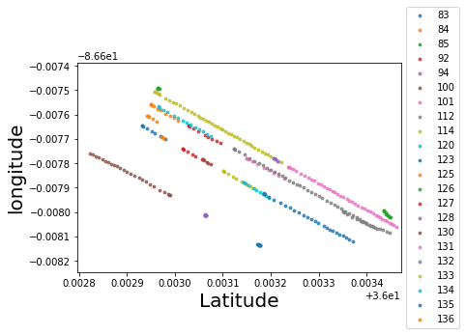
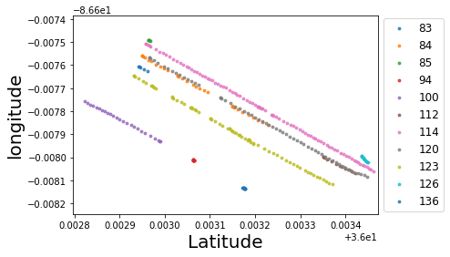
Object stitching visualization – same 5.8sec range
Object ID
Object ID
Before stitching
After stitching

Slide 5
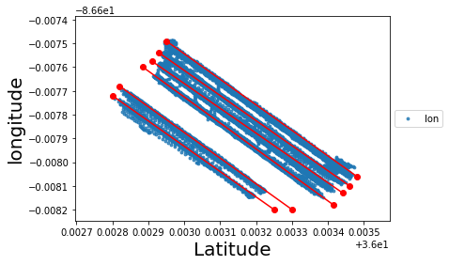
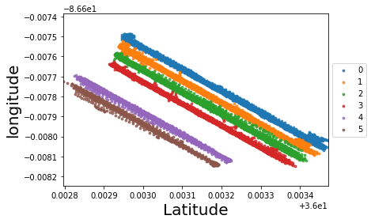
Find lanes

Slide 6
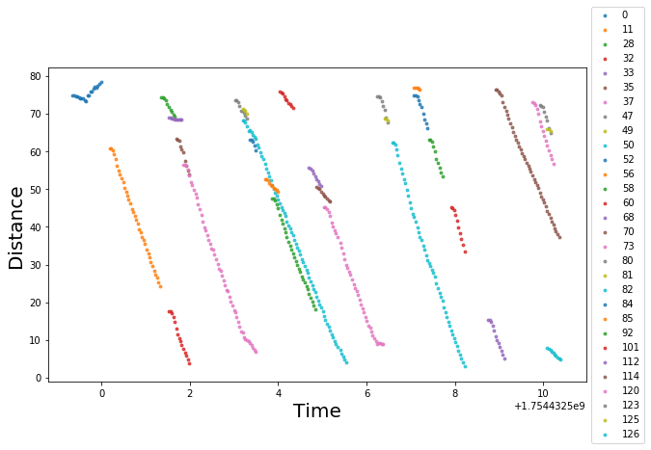
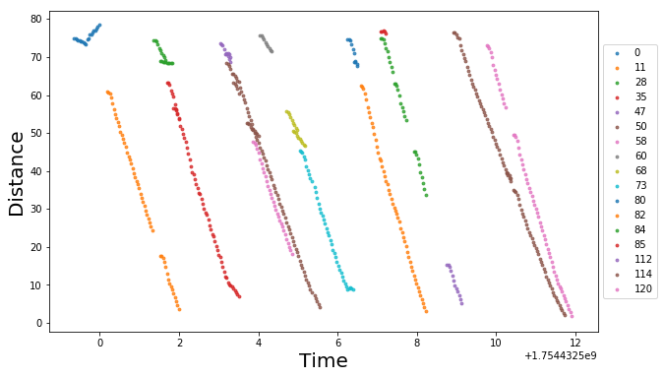
Time-space diagram
Object ID
Before stitching
After stitching
Object ID

