Slide 1
Baby & Kids Analysis
Brief on data analysis procedures

Slide 2
Overview
Data Properties
Algorithms
Results

Slide 3
Data Properties
Data Selection and Preprocessing

Slide 4
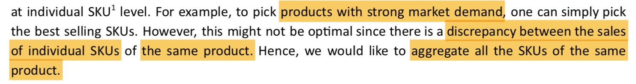
Data Properties - Task
Unsupervised Learning (No Labels)
Clustering Problem (Categorical Output)
Based on Products (Not Recommendation Problem)

Slide 5
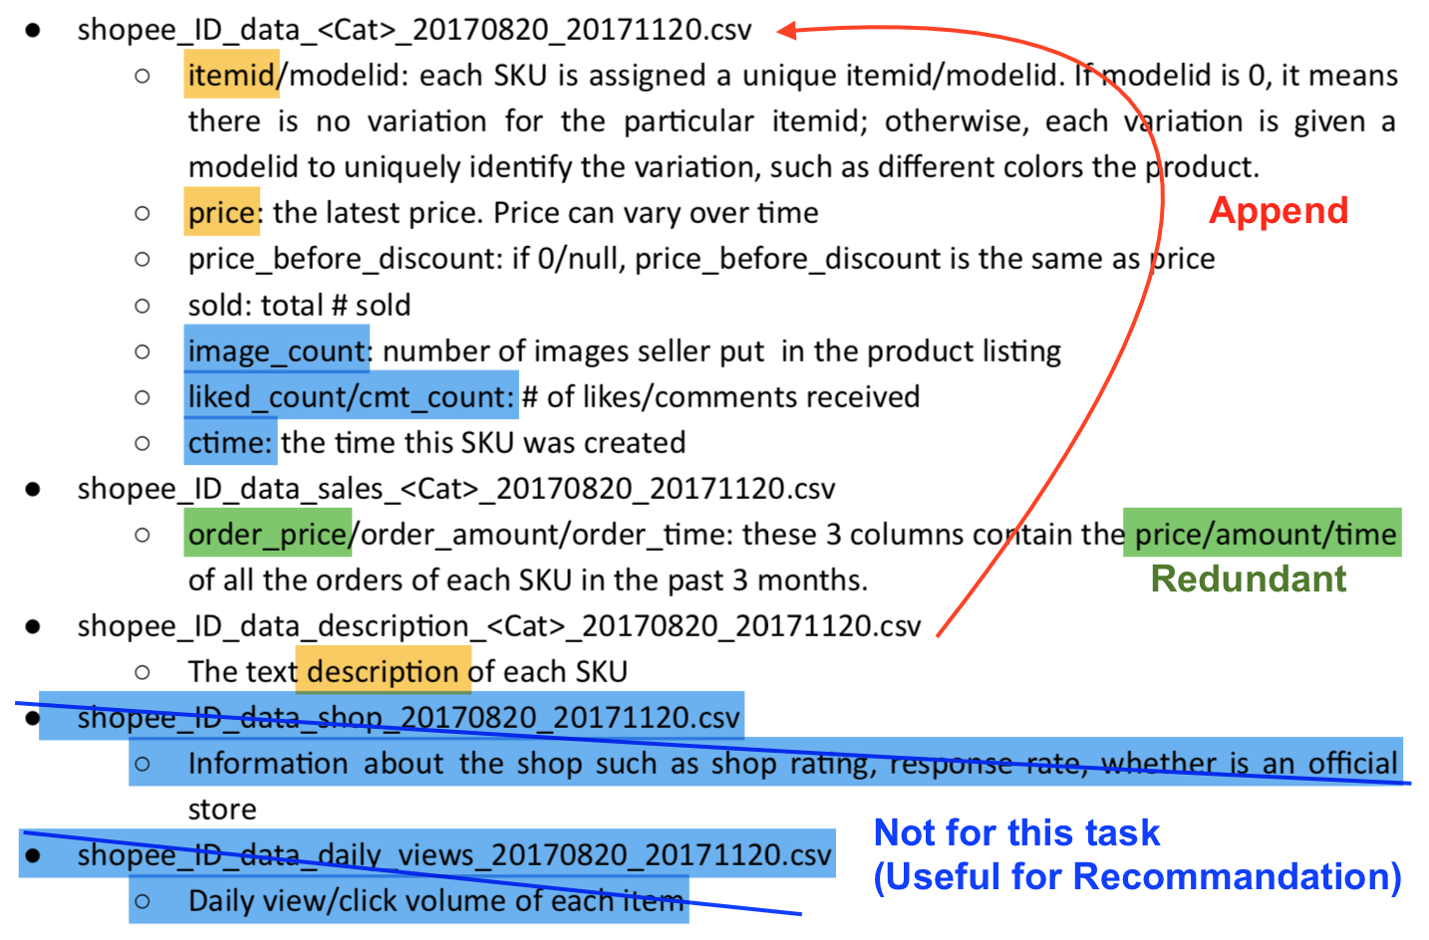
Data Properties - Data Selection

Slide 6
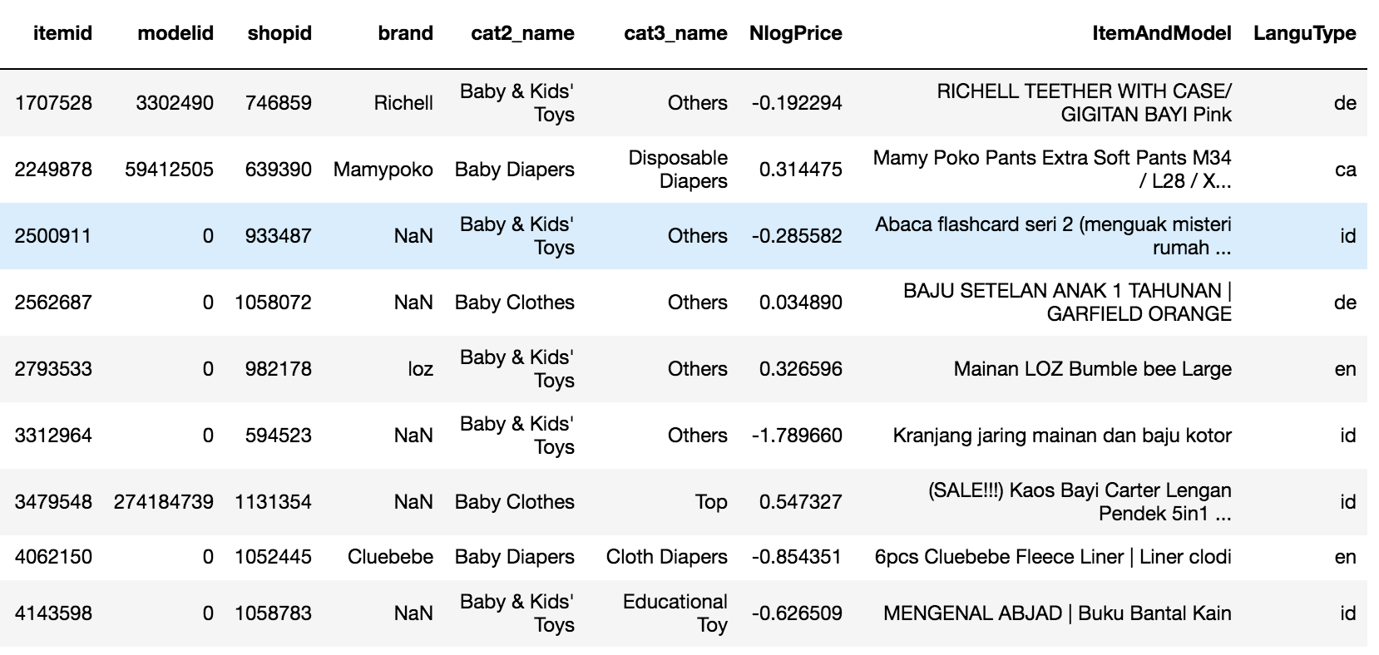
Data Properties - Text Mining
Indonesian : English ~ 150,000:250,000 (Google: $400…)
Problem like Stemmer(Bias) vs Large Data Sets & monotonous words

Slide 7
Data Properties - Preprocessing
Drop Useless Variables:
Mentioned previously
cat1_name
Encode Categorical Variables:
cat2_name,cat3_name
LabelEncoder + OnehotEncoder
Concatenate Text Variables:
item + model + description
Clean redundant information:
brand in text variables
Eliminate “Price” Bias
Logarithm
Gaussian shape
Price Histogram
LogPrice Histogram

Slide 8
Algorithms
Text Vectorization and Clustering

Slide 9
Tfidf Vecterizor
Why not CountVectorizer?
Info included: like “baby” (cat3)
Info useless: like “sale”,”hot” (des)
Brand & Shopid:
Contain info
But too large (>15000)
Min_df:
Accelerate Calculation
Criteria: 2% for item text part
Value: 600
Why not Max_df?
Contain info
Tfidf
Item text missing vs min_df
Note: if item text is missing, the k-means later will purely rely on cat2, cat3, shopid, brand and price. It is not equal to zero info.

Slide 10
K-means
Matrix:
Cat2 (6 cols)
Cat3 (36 cols)
Shopid (~40 cols)
Brand (~50 cols)
Item text (~800 cols)
LogPrice (1 cols)
k value:
Elbow (Cannot, smooth)
Silhouette score (Cannot, slow)
BIC (Ok, 37)
BIC~ Distortion + Regulation (sampe,k)
Distortion vs k
BIC vs k

Slide 11
Results
Labels and Validation

Slide 12
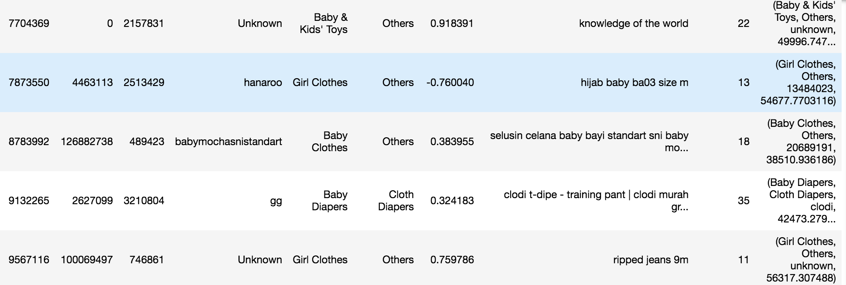
Results
Labels (group_name) was made from the coordinates of cluster centers.
(Locate the max value of each section (cat2, cat3, item, price) and the find their corresponding label. )

Slide 13
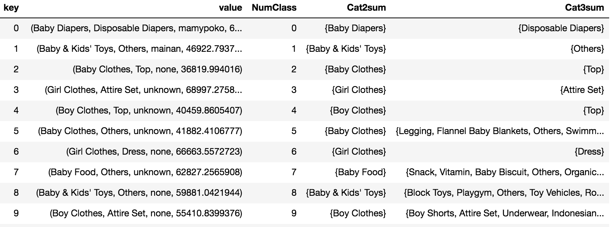
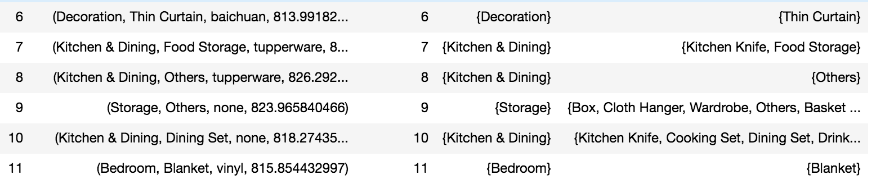

Slide 14
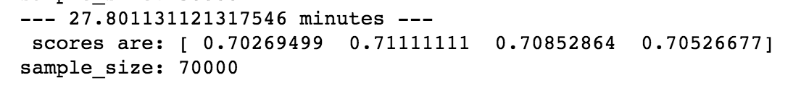
KNN Validation (for fun)
Is text mining valid?
(Whether those text is in cluster?)
Use original file to do unsupervised learning. And use description to do supervised learning.
1.Label the original file.
2. Use Tfidfvecterizor fit “item” + ”model” + ”brand” + ”cat2” + ”cat3”
3. Use Tfidfvecterizor transform ”description”
4. Use KNN to fit original file.
5. Use KNN to predict the description.
Score vs k (KNN) value.
At 400k, score~0.8, (~250min), (37categories).
Valid.
Score vs training size.

