Slide 1
Low rated places get away ASAP Yan Boromello – June 21, 2020

Slide 2
Pointing out the low rated places
Most of the apps already show you the best places to be visited, but none of them displays the ones that you shouldn’t go at all.
Now, this information can be accessed and you can also determine the minumum rating value.
You judge what is a bad experience.
Difference places in the world can be specified, you just need to enter the new address.

Slide 3
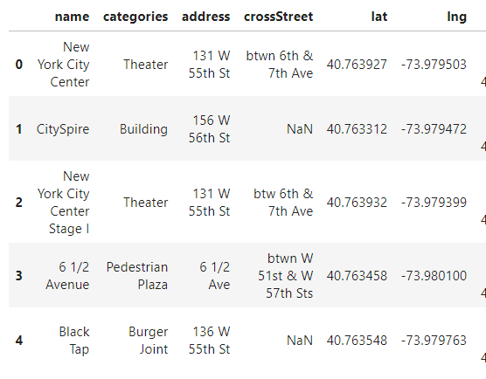
Data Acquisition
Data is being extracted from the Foursquare API;
Here is an example of some places in New York city:

Slide 4
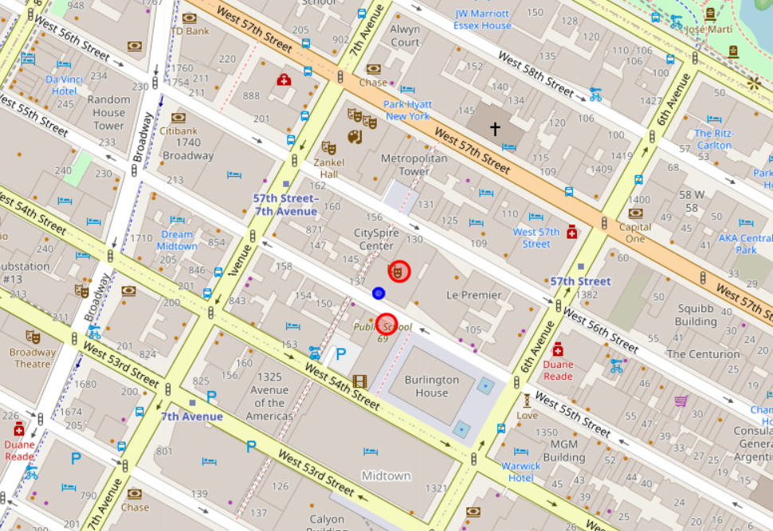
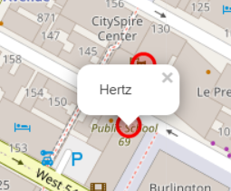
Using maps to plot the low rated places
In order to highlight the low rated places, red circles are added in the map when the venue’s rating is less than the minimum rating value specified by the user:
By clicking on the red point
you can access its name
Blue spot is the city center

Slide 5


Customizable inputs
To access any other place in the world, you just need to provide a new address:
Also, you can determine what is the minimum rating value to be considered:

Slide 6
Conclusion
Purpose of this project was to identify the areas close to center with low rating, so the user could get away of a bad experience. All kind of places is being considered. By extracting the venues from the Foursquare data, we were able to access their ratings and with that we could select only the venues with low rating in order to avoid a bad experience.
With all the low rated places in hand, we were able to highlight in the map, with red circles, which were the places to be avoid.
The sample was done with the New York city center, but can be replaced to any other place the user wants, the only thing needed it to define a new address in the beginning of the code.
With the map and visual information, the user can now avoid a bad experience.

