Slide 1
User Centered Design– CSIT226/CSIT826
CSIT226/CSIT826

Slide 2
Dr. Mark Freeman
School of Computing and Information Technology
Faculty of Engineering and Information Sciences

Slide 3
This Week
Review of HCI
User-Centered Design
Understanding Potential Users
The ‘Human’
Human Cognitive Architecture
Cognitive Load Theory
International Standard ISO 9241-210

Slide 4
 | Topic | Reading
1 | Subject Overview and Introduction to HCI | Chapter 1
2 | User-Centred Design | Chapter 2
3 | User Interaction | Chapters 3 & 4
4 | User Interfaces | Chapters 5 & 6
5 | Information Presentation and Navigation | No Readings
6 | Accessibility and Special Issues in HCI | No Readings
7 | Interaction Design and Development I: Data Gathering and Analysis | Chapters 7 & 8
8 | Interaction Design and Development II: Requirements and Modelling | Chapters 9 & 10
9 | Interaction Design and Development III: Prototyping | Chapters 11 & 12
10 | No Classes: Public Holiday | No Readings
11 | Usability Evaluation Methods I | Chapter 13
12 | Usability Evaluation Methods II | Chapters 14 & 15
13 | Future HCI & Subject Revision | No Readings

Slide 5
Subject Description
The subject provides students with an understanding of Human Computer Interaction (HCI) principles and practices, and how to apply them in the context of developing usable interactive computer applications and systems. The subject also emphasises the importance of taking into account contextual, organisational, and social factors in the design of computer systems. Students will be taken through the analysis, design, development, and evaluation of user interfaces. They will acquire hands-on design skills through an interaction design project. The subject will cover topics including user-centred design, the development process, prototyping, usability testing, measuring and evaluating the user experience and accessibility.

Slide 6
Subject Learning Outcomes (SLOs)
On successful completion of this subject, students will be able to:
Identify and describe HCI principles and design issues.
Discuss and justify HCI solutions based on design principles.
Demonstrate an understanding of the HCI design process.
Acquire skills to design and implement user-centred design.
Select and use suitable methods of measuring and evaluating the user experience.

Slide 7
Components to Consider
Human
End-user of program
Others (friends, collaborators, coworkers)
Computer
Machine program runs on
Often (clients & servers)
Interaction
User tells the computer what they want
Computer communicates results

Slide 8
User Interfaces
Part of application that allows
People to interact with computer
Computer to communicate results
Can include hardware design
Buttons, sliders, sensors
HCI = design, prototyping, implementation & evaluation of UIs

Slide 9
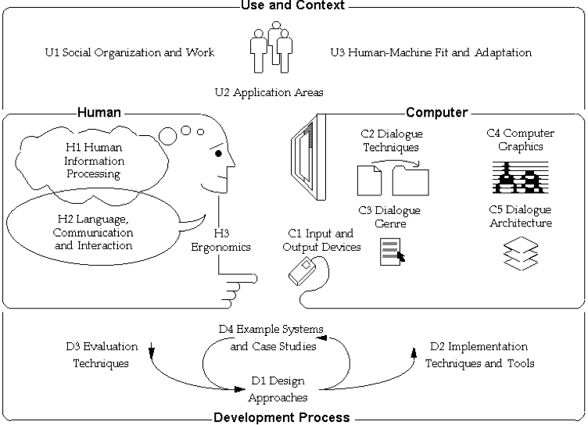
ACM SIGCHI Traditional Model

Slide 10
More Key Terms
Domain
The area of work under study (e.g., graphic design)
Goal
What you want to achieve (e.g., create a solid blue square)
Task
How you go about doing it? Ultimately in terms of operations or actions (e.g., select fill tool)
Conceptual Model: “…a high-level description of how a system is organized and operates” (Johnson and Henderson, 2002, p26)

Slide 11
Understanding Potential Users

Slide 12
The ‘Human’ (Dix et al., 2004)
Consider…
Information input/output (i/o)
Visual
Haptic
Auditory
Movement
Information storage (human memory)
Sensory
Short-term (working)
Long-term
Information processing
Reasoning
Skill level
Problem Solving
Everyone is different

Slide 13
Human i/o (Dix et al., 2004)
Vision (visual)
2 stage process (reception and interpretation of stimulus)
Context aids in resolving ambiguity
Reading
Touch (haptic)
Instant feedback about the environment
Hearing (auditory)
Environmental information and spatial awareness
Filtering
Movement
Response to stimulus (reaction time and movement time)
Individual attribute (depending on visual, haptic and auditory)

Slide 14
Human Cognitive Architecture
Sweller (2003) defines human cognitive architecture as the way cognitive structures are organized and interrelated.
Information is being stored and processed by short-term memory and long-term memory so as to be able to retrieve it for subsequent use.

Slide 15
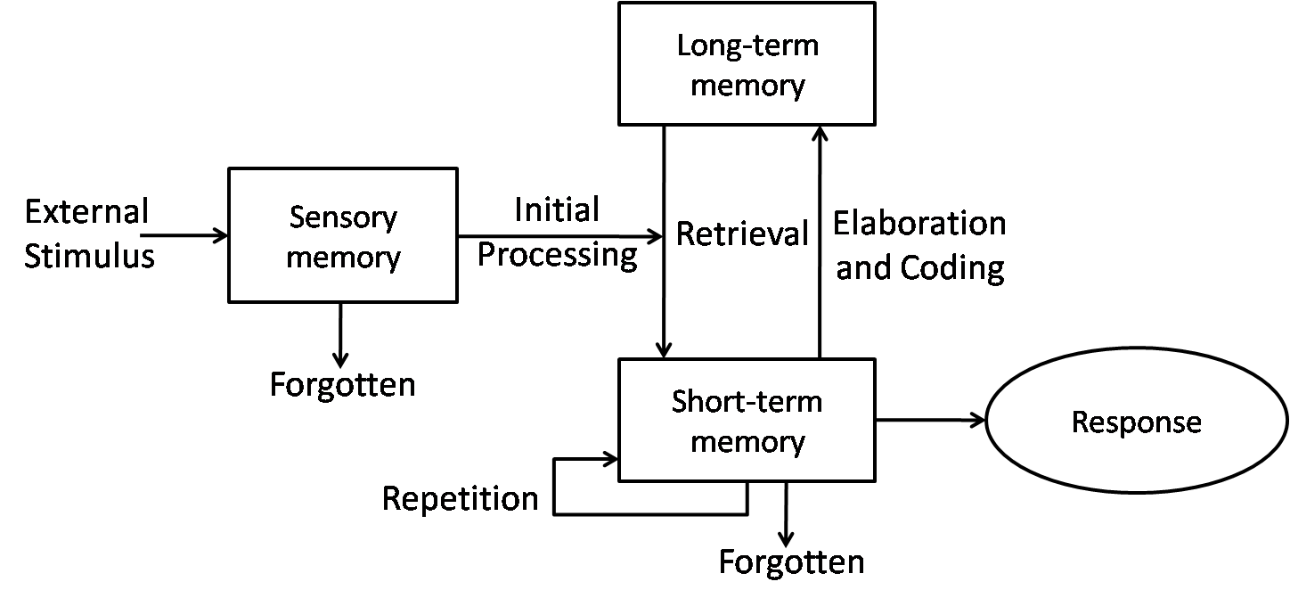
Human Cognitive Architecture

Slide 16
Layered Integrated Instruction Model of Information Processing
SENSORY REGISTER
WORKING MEMORY
LONG TERM MEMORY
when you initially view new information, it be briefly represented within your sensory register.
Long Term Memory has a huge storage capacity where information is held permanently.
INPUT
Working Memory holds information for a limited period of time (Perhaps only up to 15-20 seconds).
ENCODING
If you are paying attention to this new information, it will go into your Working Memory.
Working Memory is also very limited. It only holds between 5-9 items of new information at any time.
Infromation can be retrieved from long term memory to go back into working memory.
RETRIEVAL
The more effort you put into paying attention at this stage, the better the chance you will remember it later.
If new information is going to be remembered, it must be linked with retrieved information from long term memory.
When information is retrieved from long term memory for future use, it is called the reconstruction process.
However, if little effort is put into attending at this stage, the information maybe lost.
If new information is actively processed and made meaningful, then it can be encoded into long term memory. This is called the information construction.
Lost Information
Also, if you are trying to attend to many ideas at the same time. information maybe lost.
Lost Information
OUTPUT

Slide 17
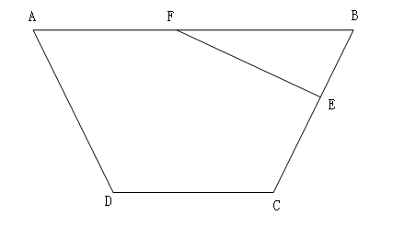
Overview of the Problem
Line AB is parallel to line DC
Angle BCD=110
Angle BFE=50
Solution:
Angle FBE=180-110=70
(Co-interior angles between parallel lines sum to 180)
Angle BEF=180-50-70=60 (Angles in a triangle sum to 180)
Cognitive LOAD
In the above diagram find the value of angle BEF when

Slide 18
CLT Way (Value of angle BEF )
Angle FBE=180-110=70
(Co-interior angles between parallel lines sum to 180)
50°
70°
60°
Angle BEF=180-50-70=60
(Angles in a triangle sum to 180)
110°

Slide 19
Cognitive Load Theory
Cognitive Load Theory is
a universal set of learning principles that are proven to result in efficient instructional environments as a consequence of leveraging human cognitive learning processes (Clark et al., 2006)

Slide 20
Cognitive Load Theory
Free Capacity
Germane Load (GL)
(Increasable by instructional design)
Total Working Memory Capacity
Extraneous Load (ECL)
(Reducible by instructional design)
Total Cognitive Load
Intrinsic Load (ICL)
(Irreducible by instructional design?)
(Paas et al. 2004)

Slide 21
Design methods (novice users)
Training-wheels method/scaffolding
Fundamental functions made initially available
Extended with increased expertise
Case-sensitive method
Hides functions not available with certain tasks
ICL supported by these concepts
Limit ECL – Focus only on the system elements needed to achieve task

Slide 22
Major Cognitive Load Effects
Split-Attention
the unnecessary splitting of a attention when trying to understand material across multiple sources
Redundancy Effect
the presentation of information in a format with both diagrams and accompanying text (information may be unnecessary or redundant)
Element Interactivity
instructional content is composed of component parts or ‘elements’; these elements may be said to interact if there is a relationship between them

Slide 23
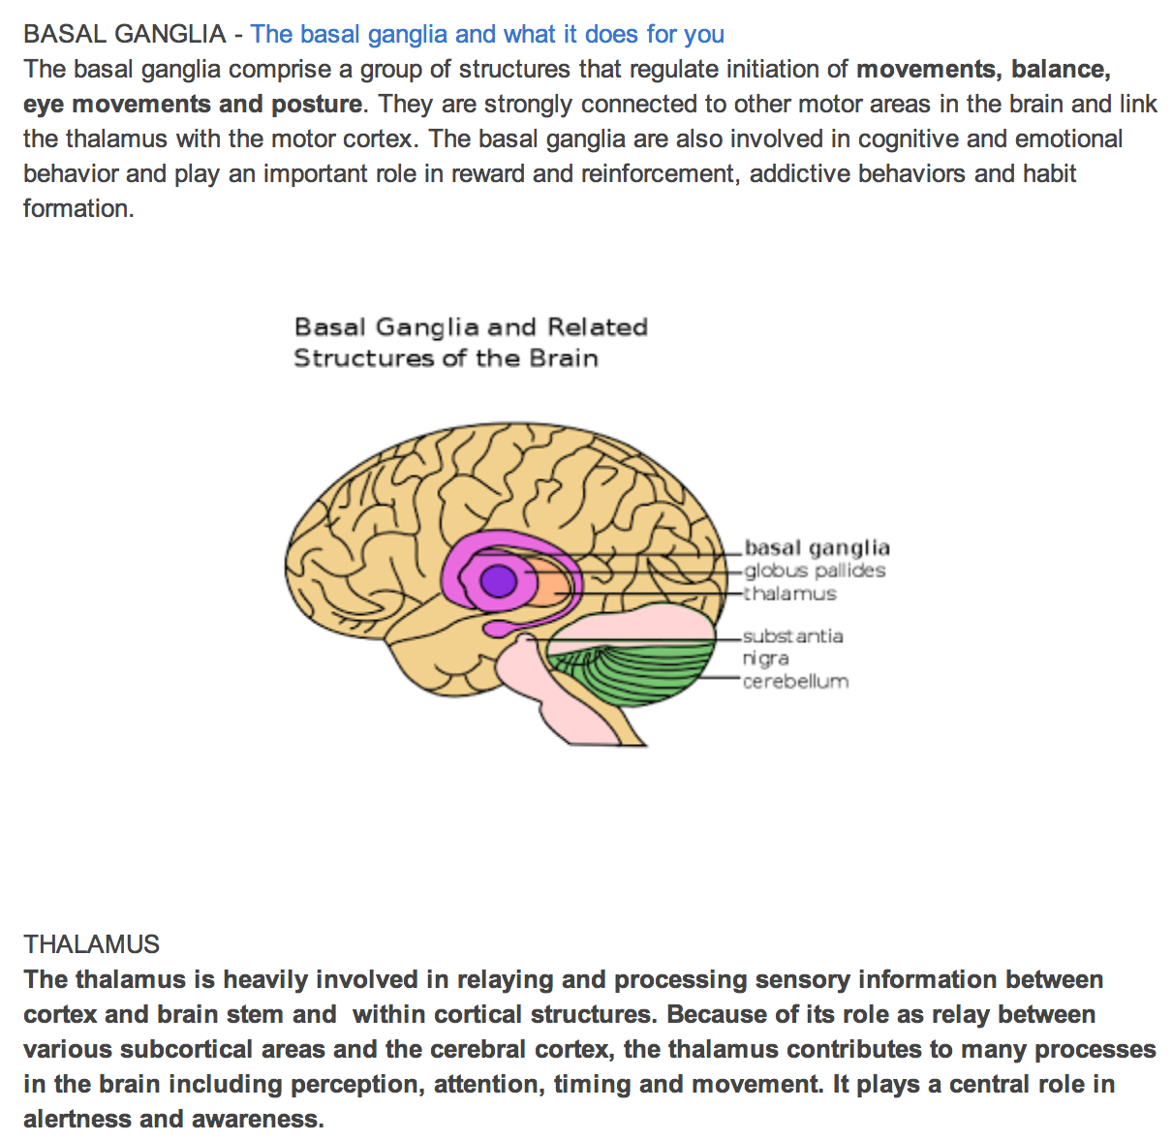
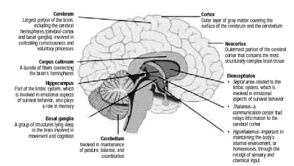
Split-attention

Slide 24
User-Centered Design

Slide 25
Conflict in Views
Expertise
Participation

Slide 26
International Standard ISO 9241-210
Ergonomics of human–system interaction — Part 210: Human-centred design for interactive systems
“Human-centred design is an approach to interactive systems development that aims to make systems usable and useful by focusing on the users, their needs and requirements, and by applying human factors/ergonomics, and usability knowledge and techniques. This approach enhances effectiveness and efficiency, improves human well-being, user satisfaction, accessibility and sustainability; and counteracts possible adverse effects of use on human health, safety and performance.”

Slide 27
Rationale for Human-Centered Design
Quality Improvement
increasing the productivity of users and the operational efficiency of organisations;
being easier to understand and use, thus reducing training and support costs;
increasing usability for people with a wider range of capabilities and thus increasing accessibility;
improving user experience;
reducing discomfort and stress;
providing a competitive advantage, for example by improving brand image;
contributing towards sustainability objectives.

Slide 28
Principles of Human-Centered Design (ISO)
Whatever the design process and allocation of responsibilities and roles adopted, a human-centred approach should follow the principles listed below (and described in the standard in sections 4.2 to 4.7):
the design is based upon an explicit understanding of users, tasks and environments (see 4.2);
users are involved throughout design and development (see 4.3);
the design is driven and refined by user-centred evaluation (see 4.4);
the process is iterative (see 4.5);
the design addresses the whole user experience (see 4.6);
the design team includes multidisciplinary skills and perspectives (see 4.7).

Slide 29
Human-Centered Design Activities
understanding and specifying the context of use
specifying the user requirements
producing design solutions
evaluating the design

Slide 30
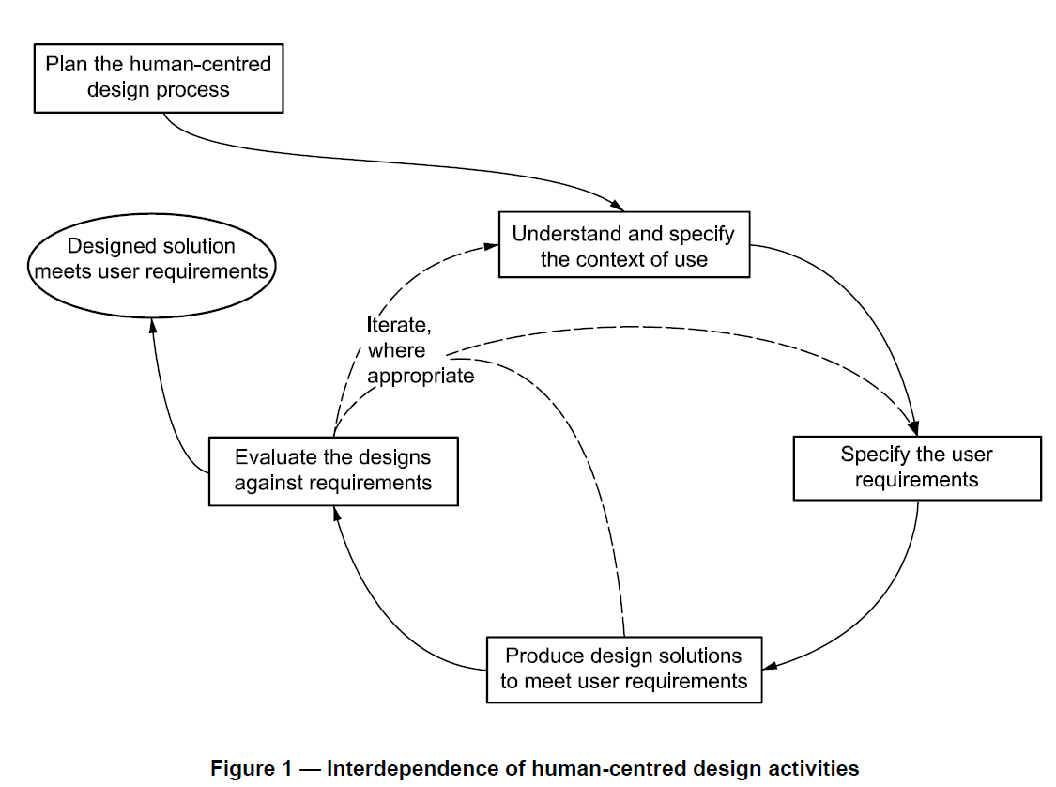

Slide 31
User-Centered Design
"development proceeds with the user as the center of focus." (Rubin, 2008)
Rubin depicts the User-Centered Design Process as follows:
The users are in the center of a double circle
The inner ring contains: Context; Objectives; Environment and Goals
The outer ring contains: Task Detail; Task Content; Task Organization and Task Flow

Slide 32
Task Detail
User
Context
Objectives
Environment
Goals
Task Flow
Task Content
Task Organisation

Slide 33
User-Centered Design
User-Centered Design (UCD) is a user interface design process that focuses on usability goals, user characteristics, environment, tasks, and workflow in the design of an interface.
UCD follows a series of well-defined methods and techniques for analysis, design, and evaluation of mainstream hardware, software, and web interfaces.
The UCD process is an iterative process, where design and evaluation steps are built in from the first stage of projects, through implementation.

Slide 34
User-Centered Design Principles (Rubin, 2008)
Early focus on users and tasks
Structured and systematic information gathering (consistent across the board)
Designers trained by experts before conducting data collection sessions
Empirical Measurement and testing of product usage
Focus on ease of learning and ease of use
Testing of prototypes with actual users
Iterative Design
Product designed, modified and tested repeatedly.
Allow for the complete overhaul and rethinking of design by early testing of conceptual models and design ideas.

Slide 35
TED Talk: David Kelly Human-Centered Design
http://www.ted.com/talks/david_kelley_on_human_centered_design?language=en

Slide 36
References
Dix, A., Finlay, J., Abowd, G. and Beale, R. 2004. Human Computer Interaction, 3rd Ed., Pearson.
Johnson, J. and Henderson, A., 2002. Conceptual models: begin by designing what to design. interactions, 9(1), pp.25-32.
Rubin, J., 2008. Handbook of usability testing: how to plan, design and conduct effective tests, 2nd Ed., Wiley.
https://www.w3.org/WAI/redesign/ucd

Slide 37
Questions

