Slide 1
User Interfaces – CSIT226/CSIT826
CSIT226/CSIT826

Slide 2
Dr. Mark Freeman
School of Computing and Information Technology
Faculty of Engineering and Information Sciences

Slide 3
This Week
Guest Presentation
Professionals Australia
Principles
Patterns
Sequences

Slide 4
 | Topic | Reading
1 | Subject Overview and Introduction to HCI | Chapter 1
2 | User-Centred Design | Chapter 2
3 | User Interaction | Chapters 3 & 4
4 | User Interfaces | Chapters 5 & 6
5 | Information Presentation and Navigation | No Readings
6 | Accessibility and Special Issues in HCI | No Readings
7 | Interaction Design and Development I: Data Gathering and Analysis | Chapters 7 & 8
8 | Interaction Design and Development II: Requirements and Modelling | Chapters 9 & 10
9 | Interaction Design and Development III: Prototyping | Chapters 11 & 12
10 | No Classes: Public Holiday | No Readings
11 | Usability Evaluation Methods I | Chapter 13
12 | Usability Evaluation Methods II | Chapters 14 & 15
13 | Future HCI & Subject Revision | No Readings

Slide 5
Subject Description
The subject provides students with an understanding of Human Computer Interaction (HCI) principles and practices, and how to apply them in the context of developing usable interactive computer applications and systems. The subject also emphasises the importance of taking into account contextual, organisational, and social factors in the design of computer systems. Students will be taken through the analysis, design, development, and evaluation of user interfaces. They will acquire hands-on design skills through an interaction design project. The subject will cover topics including user-centred design, the development process, prototyping, usability testing, measuring and evaluating the user experience and accessibility.

Slide 6
Subject Learning Outcomes (SLOs)
On successful completion of this subject, students will be able to:
Identify and describe HCI principles and design issues.
Discuss and justify HCI solutions based on design principles.
Demonstrate an understanding of the HCI design process.
Acquire skills to design and implement user-centred design.
Select and use suitable methods of measuring and evaluating the user experience.

Slide 7
Professionals Australia – Guest Presentation
Market briefing – we explain current market conditions and trends so that students have realistic expectations and are able to access appropriate information to make career decisions.
Job search – based on this information, we teach students to take a more strategic approach to job search so they can access the hidden job market that the vast majority of students fail to access.
Continuing professional development (CPD) – we help students understand the skills and technical competencies that they will need to succeed in the workplace and how to source training to address skill gaps.

Slide 8
Skeuomorphism
Skeuomorphism
Flat Design (Minimalism)

Slide 9
Common Interaction Styles
Command line interface
Menus
Natural language
Question/answer & query dialogue
Form-fills & spreadsheets
WIMP, point & click
Handwriting
3D interfaces, VR, augmented reality
Touch, gesture, eye-tracking, brain-tracking, voice control

Slide 10
How do we design effective interfaces?

Slide 11
Importance
Users typically judge a system by its interface
But, most important feature should be its functionality
Poor interfaces are a common cause of errors
Poor interfaces are a common reason for systems not being used (or not used to their full potential)
Business Legacy
Command line → graphical interfaces
WIMP (Windows, Icons, Menus and Pointing)
Remember: A UI designer must take into consideration, the user, the goals and the context of use

Slide 12
Design Principles
Familiarity
Consistency
Predictability
Recoverability
Guidance
Diversity

Slide 13
UI Basics
There are really only two problems that need to be addressed when designing an interface
How should the user enter information into the system?
How should information be presented from the system to the user?
Different system have different requirements so use different frameworks or user interface metaphors

Slide 14
Execution/Evaluation Action Cycle (EEC) SEVEN STAGES OF ACTION
Execution
Goals (user or data driven)
what we want to happen
Evaluation
Forming intention
Specifying action
Executing action
Evaluating interpretation
Interpreting perception
Perceiving world state
World

Slide 15
Interaction Styles
Command language
Menu selection
Form fill-in
Direct manipulation
Anthropomorphic (Natural language)

Slide 16
The Patterns (basic – single view) (TIDWELL, 2006)
Physical Presentation
Two-Panel Selector
Canvas Plus Palette
One-Window Drilldown
Alternative Views
Abstract Concepts
Wizard
Extras on Demand
Intriguing Branches
Multi-level help

Slide 17
Multiple Windows vs Tiled Panes

Slide 18
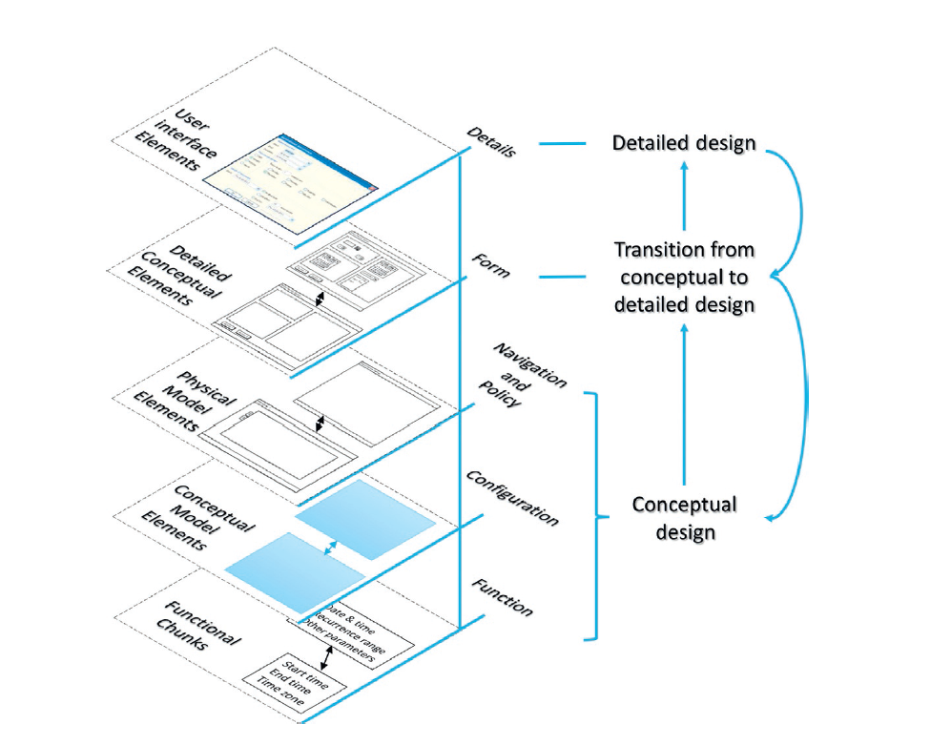
Layered Framework (Parush, 2015)

Slide 19
The framework, from the bottom up, consists of five layers:
The function level consists of functional chunks—groups of tasks and objects and their associated parameters that the user uses to accomplish goals.
The configuration level consists of the conceptual model elements—the metaphorical “places” the user must visit to perform each set of functions and the links between the “places.”
The navigation and policy level depicts the navigation and navigation rules—the “routes” the user takes between “places,” the physical elements containing one or more conceptual “places,” and the policy governing the interrelations among the physical elements.
The form level consists of detailed conceptual elements serving as the transition from conceptual to detailed design.
The details level consists of user interface elements—detailed look and feel of each UI element at each place the user visits to perform tasks.

Slide 20
Interaction Sequences
Single Sequence
Hierarchy sequence

Slide 21
Interaction Sequences
Hub and spokes
Matrix

Slide 22
Interaction Sequences
Network

Slide 23
Designing Interfaces – More Patterns
“patterns are structural and behavioral features that improve the “habitability” of something—a user interface, a web site, an object-oriented program, or even a building. They make things easier to understand or more beautiful; they make tools more useful and usable.” (Tidwell, 2006)
http://designinginterfaces.com/patterns/

Slide 24
References
Parush, A. (2015). Conceptual design for interactive systems : designing for performance and user experience, Massachusetts : Morgan Kaufmann.
Tidwell, J. (2006). Designing interfaces, CA : O'Reilly.

Slide 25
Questions

