Slide 1
Information Presentation and Navigation - CSIT226/CSIT826
CSIT226/CSIT826

Slide 2
Dr. Mark Freeman
School of Computing and Information Technology
Faculty of Engineering and Information Sciences

Slide 3
 | Topic | Reading
1 | Subject Overview and Introduction to HCI | Chapter 1
2 | User-Centred Design | Chapter 2
3 | User Interaction | Chapters 3 & 4
4 | User Interfaces | Chapters 5 & 6
5 | Information Presentation and Navigation | No Readings
6 | Accessibility and Special Issues in HCI | No Readings
7 | Interaction Design and Development I: Data Gathering and Analysis | Chapters 7 & 8
8 | Interaction Design and Development II: Requirements and Modelling | Chapters 9 & 10
9 | Interaction Design and Development III: Prototyping | Chapters 11 & 12
10 | No Classes: Public Holiday | No Readings
11 | Usability Evaluation Methods I | Chapter 13
12 | Usability Evaluation Methods II | Chapters 14 & 15
13 | Future HCI & Subject Revision | No Readings

Slide 4
Subject Description
The subject provides students with an understanding of Human Computer Interaction (HCI) principles and practices, and how to apply them in the context of developing usable interactive computer applications and systems. The subject also emphasises the importance of taking into account contextual, organisational, and social factors in the design of computer systems. Students will be taken through the analysis, design, development, and evaluation of user interfaces. They will acquire hands-on design skills through an interaction design project. The subject will cover topics including user-centred design, the development process, prototyping, usability testing, measuring and evaluating the user experience and accessibility.

Slide 5
Subject Learning Outcomes (SLOs)
On successful completion of this subject, students will be able to:
Identify and describe HCI principles and design issues.
Discuss and justify HCI solutions based on design principles.
Demonstrate an understanding of the HCI design process.
Acquire skills to design and implement user-centred design.
Select and use suitable methods of measuring and evaluating the user experience.

Slide 6
Group Projects
Don’t GO STRAIGHT TO DESIGN

Slide 7
Customer Journey
A HOLISITIC PERSPECTIVE

Slide 8
Design Principles
Familiarity
Consistency
Predictability
Recoverability
Guidance
Diversity

Slide 9
Interaction Styles
Command language
Menu selection
Form fill-in
Direct manipulation
Anthropomorphic (Natural language)

Slide 10
The Patterns (basic – single view) (TIDWELL, 2006)
Physical Presentation
Two-Panel Selector
Canvas Plus Palette
One-Window Drilldown
Alternative Views
Abstract Concepts
Wizard
Extras on Demand
Intriguing Branches
Multi-level help

Slide 11
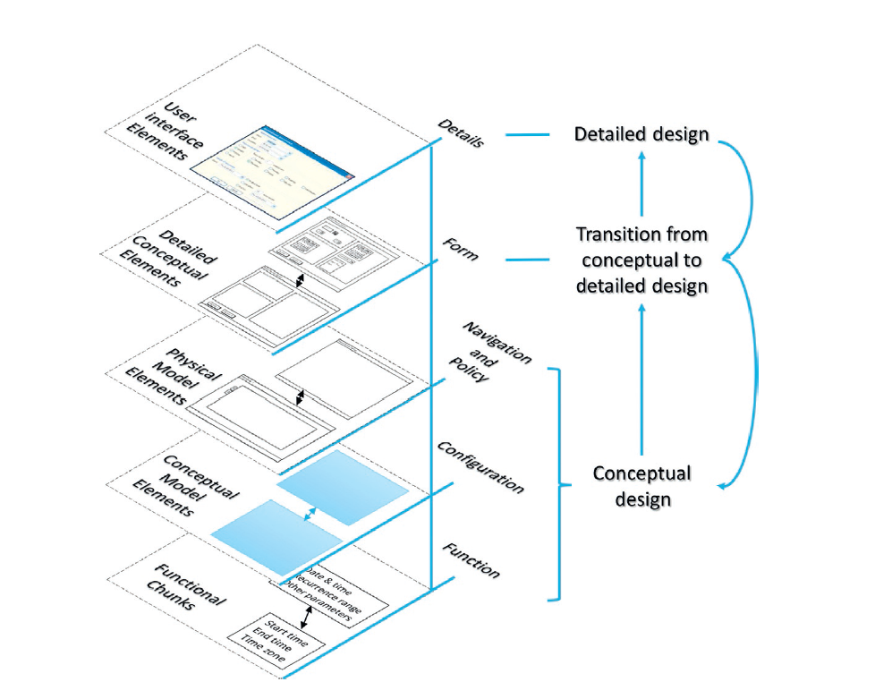
Layered Framework (Parush, 2015)

Slide 12
Model-View-Controller (MVC) Design Pattern
Notes:
Separation between the UI and the business layers

Slide 13
Model in MVC
Where the application’s data objects are stored
Used to encapsulate the data for an application
Define the logic and computation that manipulate and process the data
“Ideally, a model object should have no explicit connection to the view objects that present its data and allow users to edit that data—it should not be concerned with user-interface and presentation issues.” (Apple, 2015)
Communication: User actions in the view layer that create or modify data are communicated through a controller object and result in the creation or updating of a model object. When a model object changes (for example, new data is received over a network connection), it notifies a controller object, which updates the appropriate view objects. (Apple, 2015)

Slide 14
Controller in MVC
A decision maker
Intermediary between one or more application view objects and model objects
A conduit through which objects learn about changes
Communication: A controller object interprets user actions made in view objects and communicates new or changed data to the model layer. When model objects change, a controller object communicates that new model data to the view objects so that they can display it. (Apple, 2015)

Slide 15
View in MVC OUR FOCUS IN HCI
What is presented to the user
An application that users interact with
Draws itself and can respond to user actions
Display data from the application’s model objects and to enable the editing of that data.
Communication: View objects learn about changes in model data through the application’s controller objects and communicate user-initiated changes—for example, text entered in a text field—through controller objects to an application’s model objects. (Apple, 2015)

Slide 16
What is information?
How should It be presented on the screen

Slide 17
How can we visualise information?

Slide 18
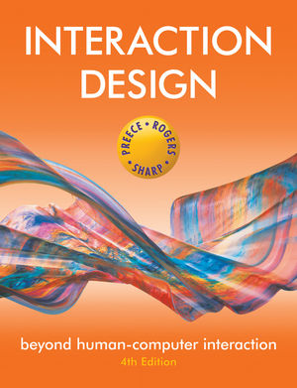
Chapter 6 - Interfaces

Slide 19
Research and design issues
Window management
enables users to move fluidly between different windows (and monitors)
How to switch attention between windows without getting distracted?
Notes:
19

Slide 20
Menus
A number of menu interface styles
flat lists, ribbon, drop-down, pop-up, contextual, and expanding, e.g., scrolling and cascading
Flat-list menus
good at displaying a small number of options at the same time and where the size of the display is small, e.g. iPods
but have to nest the lists of options within each other, requiring several steps to get to the list with the desired option
moving through previous screens can be tedious
Notes:
20

Slide 21
Expanding menus
Enables more options to be shown on a single screen than is possible with a single flat menu
More flexible navigation, allowing for selection of options to be done in the same window
Most popular are cascading ones
primary, secondary and even tertiary menus
downside is that they require precise mouse control
can result in overshooting or selecting wrong options
Notes:
21

Slide 22
Contextual menus
Provide access to often-used commands that make sense in the context of a current task
Appear when the user presses the Control key while clicking on an interface element
e.g., clicking on a photo in a website together with holding down the Control key results in options ‘open it in a new window,’ ‘save it,’ or ‘copy it’
Helps overcome some of the navigation problems associated with cascading menus
Notes:
22

Slide 23
Research and design issues
What are best names/labels/phrases to use?
Placement in list is critical
Quit and save need to be far apart
Choice of menu to use determined by application and type of system
flat menus are best for displaying a small number of options at one time
expanding menus are good for showing a large number of options
Notes:
23

Slide 24
Icon design
Icons are assumed to be easier to learn and remember than commands
Can be designed to be compact and variably positioned on a screen
Now pervasive in every interface
e.g. represent desktop objects, tools (e.g. paintbrush), applications (e.g. web browser), and operations (e.g. cut, paste, next, accept, change)
Notes:
24

Slide 25
Icon forms
The mapping between the representation and underlying referent can be:
similar (e.g., a picture of a file to represent the object file)
analogical (e.g., a picture of a pair of scissors to represent ‘cut)
arbitrary (e.g., the use of an X to represent ‘delete’)
Notes:
25

Slide 26
Activity
Sketch simple icons to represent the following operations to appear on a phone camera application:
Use
Turn image 90 degrees sideways
Auto-enhance the image
Fix red-eye
Crop the image
Show them to the person sitting next to you and compare
Notes:
26

Slide 27
Multimedia - Research and design issues
How to design multimedia to help users explore, keep track of, and integrate the multiple representations
provide hands-on interactivities and simulations that the user has to complete to solve a task
Use ‘dynalinking,’ where information depicted in one window explicitly changes in relation to what happens in another (Scaife and Rogers, 1996).
Several guidelines that recommend how to combine multiple media for different kinds of task
Notes:
27

Slide 28
Realism versus abstraction?
Challenge facing interaction designers
This means designing objects either to:
(i) give the illusion of behaving and looking like real-world counterparts or
(ii) appear as abstractions of the objects being represented.
This concern is particularly relevant when implementing conceptual models that are deliberately based on an analogy with some aspect of the real world. For example, is it preferable to design a desktop to look like a real desktop, a virtual house to look like a real house, or a virtual terrain to look like a real terrain? Or, alternatively, is it more effective to design representations as simple abstract renditions, depicting only a few salient features?

Slide 29
Information visualization and dashboards
Computer-generated interactive graphics of complex data
Amplify human cognition, enabling users to see patterns, trends, and anomalies in the visualization (Card et al, 1999)
Aim is to enhance discovery, decision-making, and explanation of phenomena
Techniques include:
3D interactive maps that can be zoomed in and out of and which present data via webs, trees, clusters, scatterplot diagrams, and interconnected nodes

Slide 30
Dashboards
Show screenshots of data updated over periods of time - to be read at a glance
Usually not interactive - slices of data that depict current state of a system or process
Need to provide digestible and legible information for users
design its spatial layout so intuitive to read when first looking at it
should also direct a user’s attention to anomalies or unexpected deviations

Slide 31
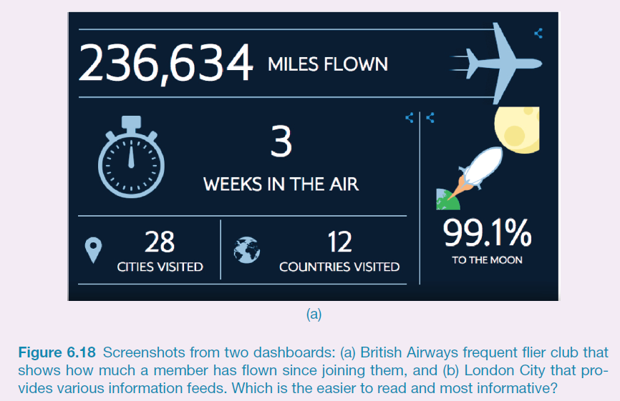
Which dashboard is best?

Slide 32
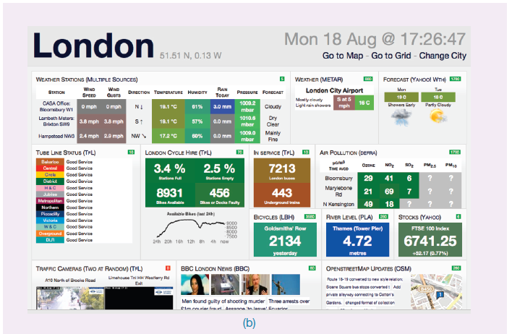

Which dashboard is best?

Slide 33
Research and design issues
Whether to use animation and/or interactivity
What form of coding to use, e.g. color or text labels
Whether to use a 2D or 3D representational format
What forms of navigation, e.g. zooming or panning,
What kinds and how much additional information to provide, e.g. rollovers or tables of text
What navigational metaphor to use

Slide 34
Consumer electronics and appliances
Everyday devices in home, public place, or car
e.g. washing machines, remotes, photocopiers, printers and navigation systems)
And personal devices
e.g. digital clock and digital camera
Used for short periods
e.g. putting the washing on, watching a program, buying a ticket, changing the time, taking a snapshot
Need to be usable with minimal, if any, learning

Slide 35
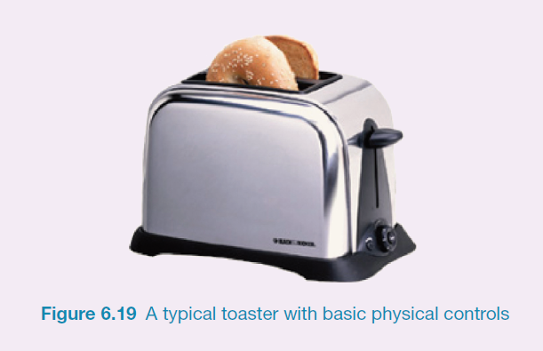
A toaster

Slide 36
Mobile
Handheld devices intended to be used while on the move
Have become pervasive, increasingly used in all aspects of everyday and working life
Apps running on mobiles have greatly expanded, e.g.
used in restaurants to take orders
car rentals to check in car returns
supermarkets for checking stock
in the streets for multi-user gaming
in education to support life-long learning
Notes:
36

Slide 37
Mobile challenges
Smaller screens, small number of physical keys and restricted number of controls
Usability and preference varies
depends on the dexterity and commitment of the user
Smartphones overcome mobile physical constraints through using multi-touch displays
Notes:
37

Slide 38
Research and design issues
Mobile interfaces can be tricky and cumbersome to use for those with poor manual dexterity or ‘fat’ fingers
Key concern is hit area
area on the phone display that the user touches to make something happen, such as a key, an icon, a button or an app
space needs to be big enough for fat fingers to accurately press
if too small the user may accidentally press the wrong key
Notes:
38

Slide 39
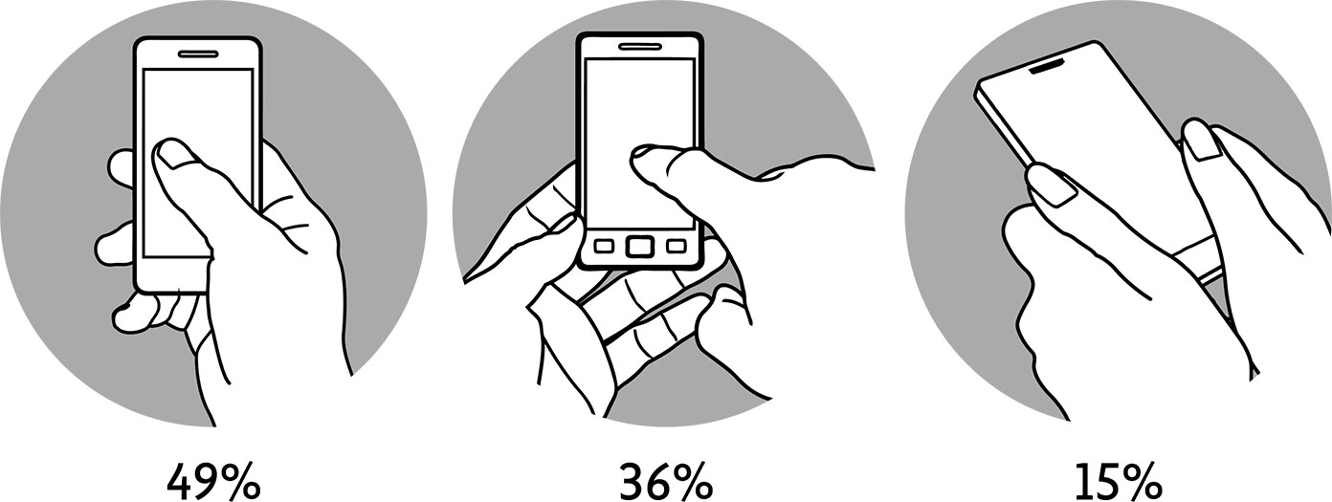
Alistapart, 2015

Slide 40
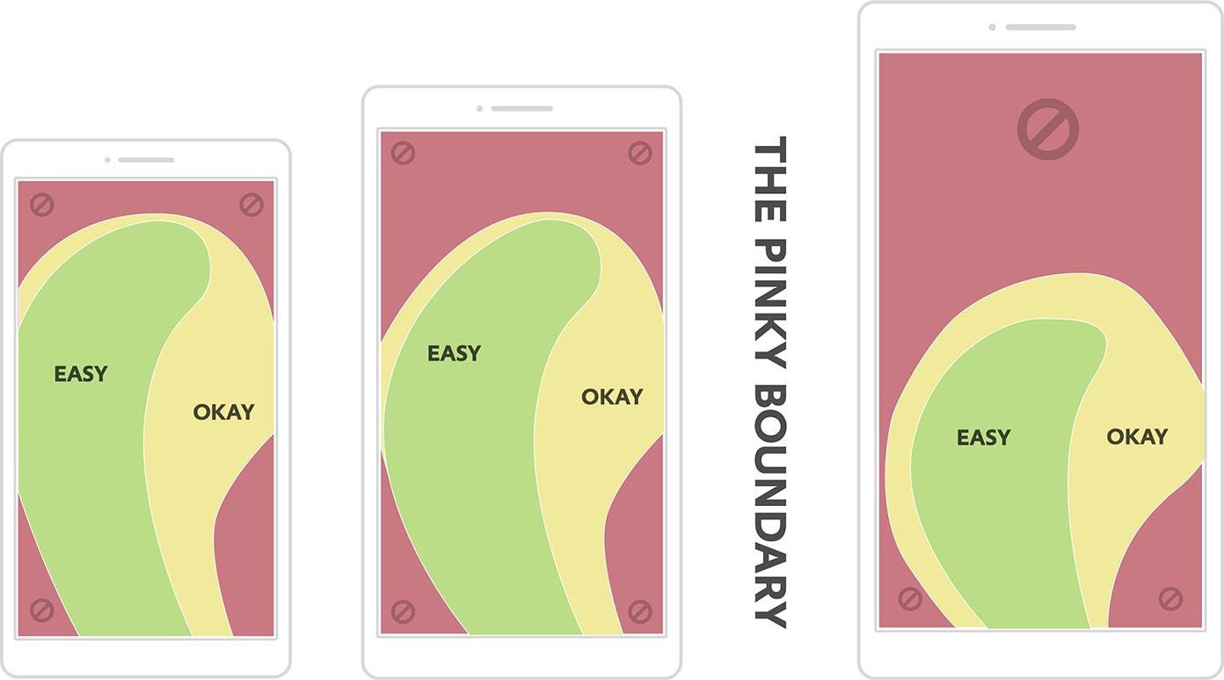
Alistapart, 2015

Slide 41
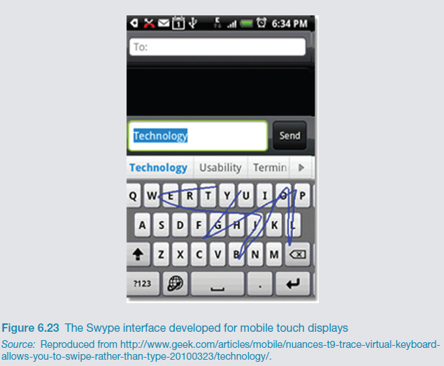
Research and design issues
Will finger-flicking, swiping, stroking and touching a screen result in new ways of consuming, reading, creating and searching digital content?

Slide 42
Which interface?
Is multimedia better than tangible interfaces for learning?
Is speech as effective as a command-based interface?
Is a multimodal interface more effective than a monomodal interface?
Will wearable interfaces be better than mobile interfaces for helping people find information in foreign cities?
Are virtual environments the ultimate interface for playing games?
Will shareable interfaces be better at supporting communication and collaboration compared with using networked desktop PCs?
Notes:
42

Slide 43
Which interface?
Will depend on task, users, context, cost, robustness, etc.
Mobile platforms taking over from PCs
Speech interfaces also being used much more for a variety of commercial services
Appliance and vehicle interfaces becoming more important
Shareable and tangible interfaces entering our homes, schools, public places, and workplaces
Notes:
43

Slide 44
References
Parush, A. (2015). Conceptual design for interactive systems : designing for performance and user experience, Massachusetts : Morgan Kaufmann.
Tidwell, J. (2006). Designing interfaces, CA : O'Reilly.
MVC
https://developer.apple.com/library/mac/documentation/General/Conceptual/DevPedia-CocoaCore/MVC.html
https://developer.chrome.com/apps/app_frameworks
http://alistapart.com/article/how-we-hold-our-gadgets

Slide 45
Questions

