Slide 1
Interaction Design and Development II: Requirements and Modelling
CSIT226/CSIT826

Slide 2
Dr. Mark Freeman
School of Computing and Information Technology
Faculty of Engineering and Information Sciences

Slide 3
 | Topic | Reading
1 | Subject Overview and Introduction to HCI | Chapter 1
2 | User-Centred Design | Chapter 2
3 | User Interaction | Chapters 3 & 4
4 | User Interfaces | Chapters 5 & 6
5 | Information Presentation and Navigation | No Readings
6 | Accessibility and Special Issues in HCI | No Readings
7 | Interaction Design and Development I: Data Gathering and Analysis | Chapters 7 & 8
8 | Interaction Design and Development II: Requirements and Modelling | Chapters 9 & 10
9 | Interaction Design and Development III: Prototyping | Chapters 11 & 12
10 | No Classes: Public Holiday | No Readings
11 | Usability Evaluation Methods I | Chapter 13
12 | Usability Evaluation Methods II | Chapters 14 & 15
13 | Future HCI & Subject Revision | No Readings

Slide 4
Final Part A: Group Project
Questions and Notes

Slide 5
This Week
Review of last week
Requirements
Modelling
Class Activities

Slide 6
Subject Description
The subject provides students with an understanding of Human Computer Interaction (HCI) principles and practices, and how to apply them in the context of developing usable interactive computer applications and systems. The subject also emphasises the importance of taking into account contextual, organisational, and social factors in the design of computer systems. Students will be taken through the analysis, design, development, and evaluation of user interfaces. They will acquire hands-on design skills through an interaction design project. The subject will cover topics including user-centred design, the development process, prototyping, usability testing, measuring and evaluating the user experience and accessibility.

Slide 7
Subject Learning Outcomes (SLOs)
On successful completion of this subject, students will be able to:
Identify and describe HCI principles and design issues.
Discuss and justify HCI solutions based on design principles.
Demonstrate an understanding of the HCI design process.
Acquire skills to design and implement user-centred design.
Select and use suitable methods of measuring and evaluating the user experience.

Slide 8
Use Case Description
Use Case Name:
Scenario:
Triggering Event:
Brief Description:
Actors:
Related Use Cases:
Stakeholders:
Pre-conditions:
Post-conditions:
Flow of Activities: | Actor | System
Exceptions:

Slide 9
User Stories
Less structure than a ‘use case’
A User Story is a one-sentence description of a work-related task done by a user to achieve some goal or result
Acceptance Criteria identify the features that must be present at the completion of the task
The template for a user story description is:
“As a <role> I want to <goal> so that <benefit>”

Slide 10
FRUPS+
Functionality
Usability
Reliability
Performance
Security
+ (context specific)
Constrains, standards, physical, other systems, etc.

Slide 11
What have we considered up to now?
What is involved in Interaction Design?
Importance of involving users
Degrees of user involvement
What is a user-centered approach?
Some more practical issues
Who are the users?
What are the user’s ‘needs’?
How do we create system alternatives?
How to choose among alternatives?
How to integrate interaction design activities in other lifecycle models?

Slide 12
Importance of involving users
Expectation management
Realistic expectations
No surprises, no disappointments
Timely training
Communication, but no hype
Ownership
Make the users active stakeholders
More likely to forgive or accept problems
Can make a big difference to acceptance and success of product
www.id-book.com

Slide 13
Degree of User Involvement
Notes:
Member of the design team
Full time: constant input, but lose touch with users
Part time: patchy input, and very stressful
Short term: inconsistent across project life
Long term: consistent, but lose touch with users
Newsletters and other dissemination devices
Reach wider selection of users
Need communication both ways
User involvement after product is released
Combination of these approaches

Slide 14
Who are the users/stakeholders?
Not as obvious as you think:
those who interact directly with the product
those who manage direct users
those who receive output from the product
those who make the purchasing decision
those who use competitor’s products
Three categories of user (Eason, 1987):
Primary: frequent hands-on
Secondary: occasional or via someone else
Tertiary: affected by its introduction, or will influence its purchase
www.id-book.com

Slide 15
What do we mean by the user’s ‘needs’? ALSO CONSIDER WHEN CONDUCTING INTERVIEWS
Users rarely know what is possible
Users can’t tell you what they ‘need’ to help them achieve their goals
Instead, look at existing tasks:
their context
what information do they require?
who collaborates to achieve the task?
why is the task achieved the way it is?
Envisioned tasks:
can be rooted in existing behaviour
can be described as future scenarios

Slide 16
How to generate alternatives
Humans stick to what they know works
But considering alternatives is important to ‘break out of the box’
Designers are trained to consider alternatives, software people generally are not
How do you generate alternatives?
‘Flair and creativity’: research and synthesis
Seek inspiration: look at similar products or look at very different products

Slide 17
How to choose among alternatives
Evaluation with users or with peers, e.g. prototypes
Technical feasibility: some not possible
Quality thresholds: Usability goals lead to usability criteria set early on and check regularly
safety: how safe?
utility: which functions are superfluous?
effectiveness: appropriate support? task coverage, information available
efficiency: performance measurements
learnability: is the time taken to learn a function acceptable to the users?
memorability: can infrequent users remember how to achieve their goal?

Slide 18
How to integrate interaction design in other models
Integrating interaction design activities in lifecycle models from other disciplines needs careful planning
Several software engineering lifecycle models have been considered
Integrating with agile software development is promising
it stresses the importance of iteration
it champions early and regular feedback
it handles emergent requirements
it aims to strike a balance between flexibility and structure

Slide 19
Overview of Chapter 10
The importance of requirements
Different types of requirements
Data gathering for requirements
Data analysis and presentation
Task description: Scenarios
Use Cases
Essential use cases
Task analysis:
HTA

Slide 20
What, how and why?
What needs to be achieved?
Understand as much as possible about users, task, context
Produce a stable set of requirements
How can this be done?
Data gathering activities
Data analysis activities
Expression as ‘requirements’
All of this is iterative

Slide 21
Establishing requirements
What do users want? What do users ‘need’?
Requirements need clarification, refinement, completion, re-scoping
Input: Requirements document (maybe)
Output: stable requirements
Why ‘establish’?
Requirements arise from understanding users’ needs
Requirements can be justified & related to data

Slide 22
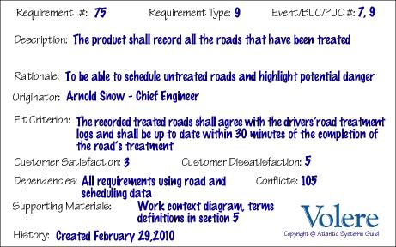
Volere shell http://www.volere.co.uk/template.htm

Slide 23
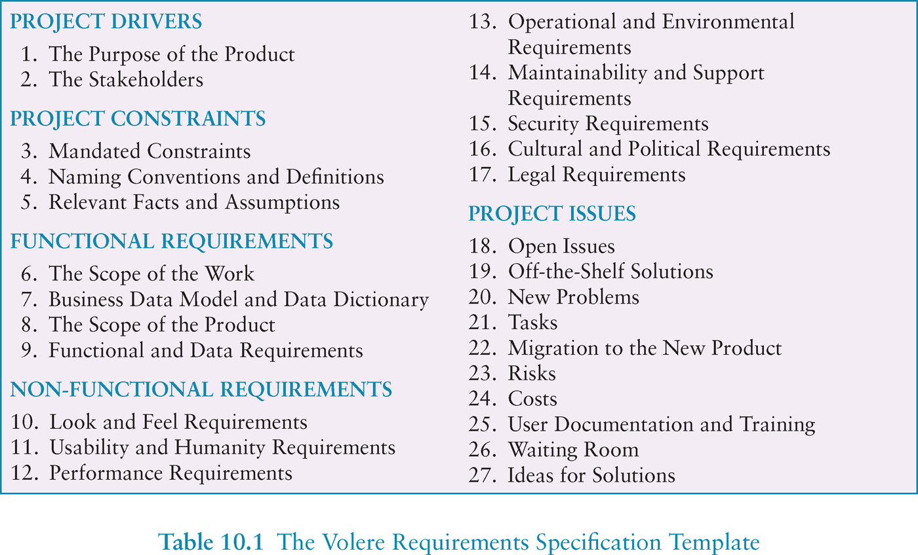
Volere requirements template

Slide 24
Different kinds of requirements
Functional:
What the system should do
Non-functional: security, response time...)
Data:
What kinds of data need to be stored?
How will they be stored (e.g. database)?
Environment or context of use:
physical: dusty? noisy? vibration? light? heat? humidity? …. (e.g. ATM)
social: sharing of files, of displays, in paper, across great distances, synchronous, privacy for client
organisational: hierarchy, IT department’s attitude and remit, user support, communications structure and infrastructure, availability of training

Slide 25
Different kinds of requirements
Users: Who are they?
Characteristics: nationality, educational background, attitude to computers
System use: novice, expert, casual, frequent
Novice: prompted, constrained, clear
Expert: flexibility, access/power
Frequent: short cuts
Casual/infrequent: clear menu paths

Slide 26
Personas
Capture a set of user characteristics (user profile)
Not real people, but synthesised from real users
Should not be idealised
Bring them to life with a name, characteristics, goals, personal background
Develop a small set of personas with one primary

Slide 27
Considerations for data gathering
Identifying and involving stakeholders:
users, managers, developers, customer reps?, union reps?, shareholders?
Involving stakeholders: workshops, interviews, workplace studies, co-opt stakeholders onto the development team
‘Real’ users, not managers
Political problems within the organisation
Dominance of certain stakeholders
Economic and business environment changes
Balancing functional and usability demands

Slide 28
Considerations for data gathering
Requirements management: version control, ownership
Communication between parties:
within development team
with customer/user
between users… different parts of an organisation use different terminology
Domain knowledge distributed and implicit:
difficult to dig up and understand
knowledge articulation: how do you walk?
Availability of key people

Slide 29
Data interpretation and analysis
Start soon after data gathering session
Initial interpretation before deeper analysis
Different approaches emphasize different elements e.g. class diagrams for object-oriented systems, entity-relationship diagrams for data intensive systems

Slide 30
Task descriptions
Scenarios
an informal narrative story, simple, ‘natural’, personal, not generalisable
Use cases
assume interaction with a system
assume detailed understanding of the interaction
Essential use cases
abstract away from the details
does not have the same assumptions as use cases

Slide 31
Scenario for travel organizer
“The Thomson family enjoy outdoor activities and want to try their hand at sailing this year. There are four family members: Sky (10 years old), Eamonn (15 years old), Claire (35), and Will (40). One evening after dinner they decide to start exploring the possibilities. They all gather around the travel organizer and enter their initial set of requirements – a sailing trip for four novices in the Mediterranean. The console is designed so that all members of the family can interact easily and comfortably with it. The system’s initial suggestion is a flotilla, where several crews (with various levels of experience) sail together on separate boats. Sky and Eamonn aren’t very happy at the idea of going on vacation with a group of other people, even though the Thomsons would have their own boat. The travel organizer shows them descriptions of flotillas from other children their ages and they are all very positive, so eventually, everyone agrees to explore flotilla opportunities. Will confirms this recommendation and asks for detailed options. As it’s getting late, he asks for the details to be saved so everyone can consider them tomorrow. The travel organizer emails them a summary of the different options available.”

Slide 32
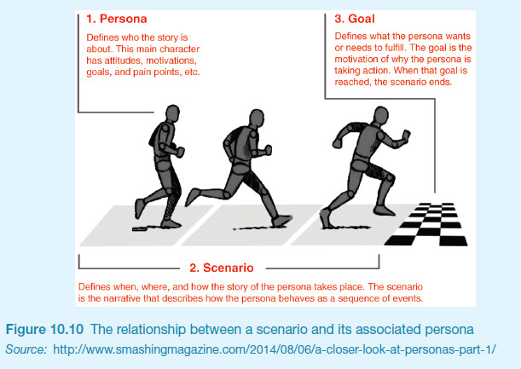
Scenarios and Personas

Slide 33
Use case for travel organizer
The system displays options for investigating visa and vaccination requirements.
The user chooses the option to find out about visa requirements.
The system prompts user for the name of the destination country.
The user enters the country’s name.
The system checks that the country is valid.
The system prompts the user for her nationality.
The user enters her nationality.
The system checks the visa requirements of the entered country for a passport holder of her nationality.
The system displays the visa requirements.
The system displays the option to print out the visa requirements.
The user chooses to print the requirements.

Slide 34
Alternative courses for travel organizer
Some alternative courses:
6. If the country name is invalid:
6.1 The system displays an error message.
6.2 The system returns to step 3.
8. If the nationality is invalid:
8.1 The system displays an error message.
8.2 The system returns to step 6.
9. If no information about visa requirements is found:
9.1 The system displays a suitable message.
9.2 The system returns to step 1.

Slide 35
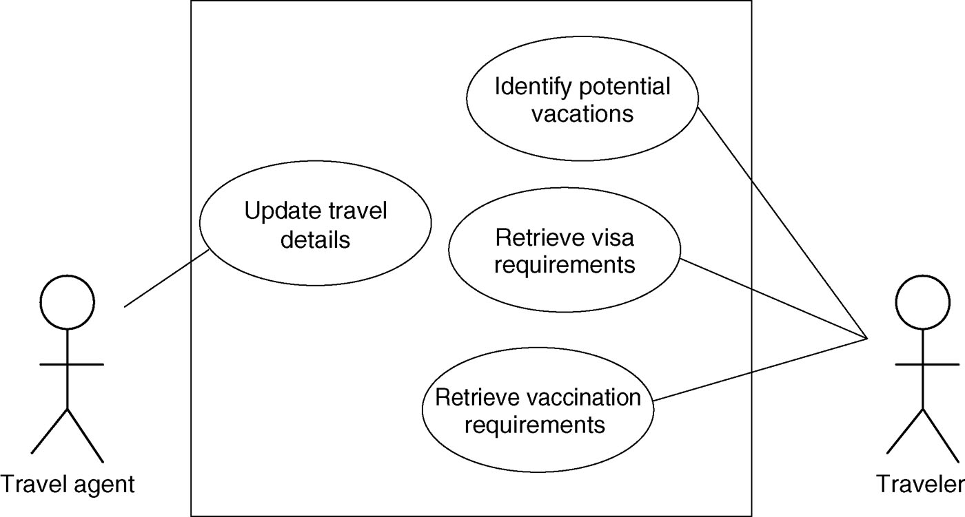
Example use case diagram for travel organizer

Slide 36
Example essential use case for travel organizer
Retrieve Visa

Slide 37
Task analysis
Task descriptions are often used to envision new systems or devices
Task analysis is used mainly to investigate an existing situation
It is important not to focus on superficial activities
What are people trying to achieve?
Why are they trying to achieve it?
How are they going about it?
Many techniques, the most popular is Hierarchical Task Analysis (HTA)

Slide 38
Hierarchical Task Analysis
Involves breaking a task down into subtasks, then sub-sub-tasks and so on. These are grouped as plans which specify how the tasks might be performed in practice
HTA focuses on physical and observable actions, and includes looking at actions not related to software or an interaction device
Start with a user goal which is examined and the main tasks for achieving it are identified
Tasks are sub-divided into sub-tasks
More information: http://www.usabilitybok.org/task-analysis

Slide 39
Example Hierarchical Task Analysis
0. In order to buy a DVD
1. locate DVD
2. add DVD to shopping basket
3. enter payment details
4. complete address
5. confirm order
Plan 0: If regular user do 1-2-5. If new user do 1-2-3-4-5.

Slide 40
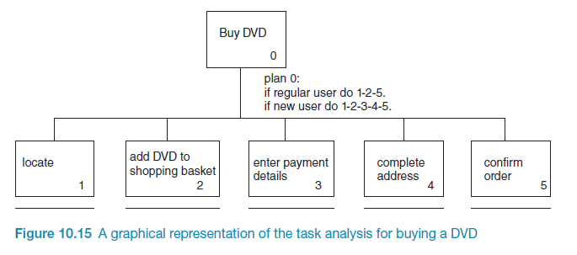
Example Hierarchical Task Analysis (graphical)

Slide 41
HTA Example
http://www.uxmatters.com/mt/archives/2010/02/hierarchical-task-analysis.php

Slide 42
Card Sorting
generate information about the associations and grouping of specific data items
Technology:
Low-tech method using index cards or post-it notes
High-tech method (e.g. uxSort or UserZoom)
Typically conducted as a:
Series of individual exercises
Concurrent activity in a small group
Mixed approach (individual then group discussion - differences)
Typically conducted early in the design phase of a project for defining a systems architecture
Open vs. Closed sorts
See:
http://measuringuserexperience.com/CardSorting/index.htm
https://www.interaction-design.org/literature/book/the-encyclopedia-of-human-computer-interaction-2nd-ed/card-sorting

Slide 43
Class Activities

Slide 44
Activity 1: Card Sort
Current Students
University management
Degree Structures
Technology
Sport
Library
Research
Study Programmes
Admissions
Study at the university
Moodle
International programmes
Directory
Services
Research Institutes
Organisation chart
Alumni
Faculties
Technological resources
Webmail
Schools

Slide 45
Activity 1: HTA – Borrow a known book
0. To borrow a book from the library
1. Go to the library
2. Find the required book
2.1 access library catalogue
2.2 access the search screen
2.3 enter search criteria 2.4 identify required book
2.5 note location
3. Go to correct shelf and retrieve book
4. Borrow book at self-check-out machine
plan 0: do 1-3-4.
If book isn’t on the expected shelf, do 2-3-4.
plan 2: do 2.1-2.4-2.5.
If book not identified do 2.2-2.3-2.4.

Slide 46
Questions

