Slide 1
Interaction Design and Development III: Prototyping
CSIT226/CSIT826

Slide 2
Dr. Mark Freeman
School of Computing and Information Technology
Faculty of Engineering and Information Sciences

Slide 3
 | Topic | Reading
1 | Subject Overview and Introduction to HCI | Chapter 1
2 | User-Centred Design | Chapter 2
3 | User Interaction | Chapters 3 & 4
4 | User Interfaces | Chapters 5 & 6
5 | Information Presentation and Navigation | No Readings
6 | Accessibility and Special Issues in HCI | No Readings
7 | Interaction Design and Development I: Data Gathering and Analysis | Chapters 7 & 8
8 | Interaction Design and Development II: Requirements and Modelling | Chapters 9 & 10
9 | Interaction Design and Development III: Prototyping | Chapters 11 & 12
10 | No Classes: Public Holiday | No Readings
11 | Usability Evaluation Methods I | Chapter 13
12 | Usability Evaluation Methods II | Chapters 14 & 15
13 | Future HCI & Subject Revision | No Readings

Slide 4
In tutorials this week you will be performing a self and peer assessment for part A.

Slide 5
Week 9 Quiz
Weeks 4 – 9 content
online at 8:30pm (2030hrs, end of lecture) until 5:00pm (1700hrs) FRIDAY

Slide 6
Subject Description
The subject provides students with an understanding of Human Computer Interaction (HCI) principles and practices, and how to apply them in the context of developing usable interactive computer applications and systems. The subject also emphasises the importance of taking into account contextual, organisational, and social factors in the design of computer systems. Students will be taken through the analysis, design, development, and evaluation of user interfaces. They will acquire hands-on design skills through an interaction design project. The subject will cover topics including user-centred design, the development process, prototyping, usability testing, measuring and evaluating the user experience and accessibility.

Slide 7
Subject Learning Outcomes (SLOs)
On successful completion of this subject, students will be able to:
Identify and describe HCI principles and design issues.
Discuss and justify HCI solutions based on design principles.
Demonstrate an understanding of the HCI design process.
Acquire skills to design and implement user-centred design.
Select and use suitable methods of measuring and evaluating the user experience.

Slide 8
Task analysis
Task descriptions are often used to envision new systems or devices
Task analysis is used mainly to investigate an existing situation
It is important not to focus on superficial activities
What are people trying to achieve?
Why are they trying to achieve it?
How are they going about it?
Many techniques, the most popular is Hierarchical Task Analysis (HTA)

Slide 9
Card Sorting
generate information about the associations and grouping of specific data items
Technology:
Low-tech method using index cards or post-it notes
High-tech method (e.g. uxSort or UserZoom)
Typically conducted as a:
Series of individual exercises
Concurrent activity in a small group
Mixed approach (individual then group discussion - differences)
Typically conducted early in the design phase of a project for defining a systems architecture
Open vs. Closed sorts
See:
http://measuringuserexperience.com/CardSorting/index.htm
https://www.interaction-design.org/literature/book/the-encyclopedia-of-human-computer-interaction-2nd-ed/card-sorting

Slide 10
Information Architecture (IA)
Focus:
Organisation, Structuring and labelling of content
Allows an understanding for users to find information and compete the tasks on a system
https://www.usability.gov/what-and-why/information-architecture.html
http://www.uxbooth.com/articles/complete-beginners-guide-to-information-architecture/

Slide 11
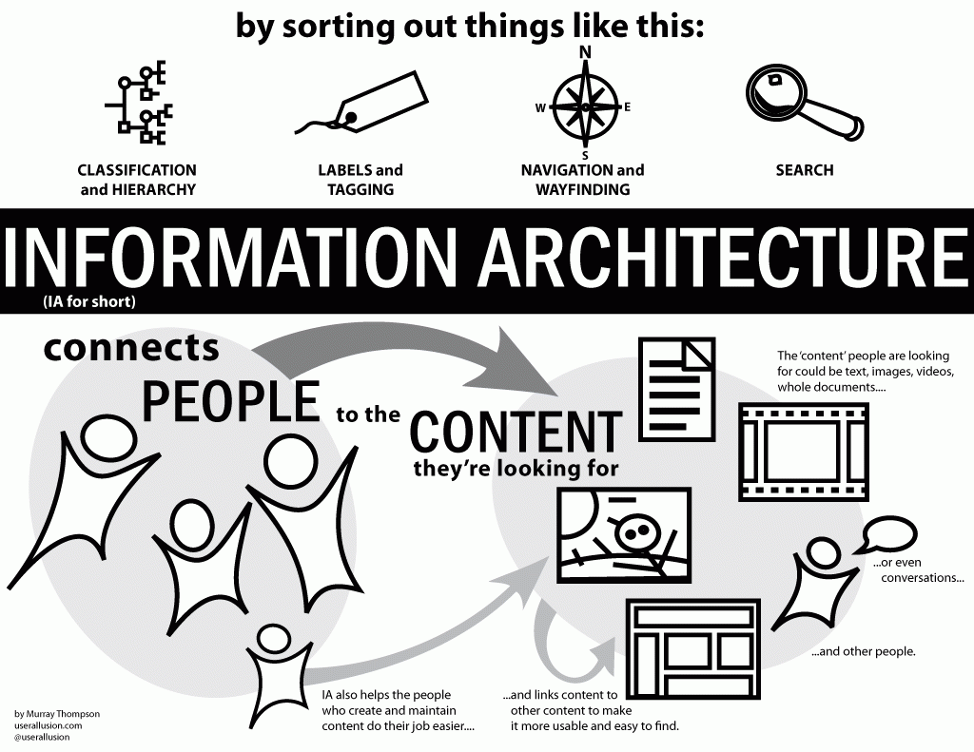

Slide 12
Wireframing

Slide 13
Wireframes
2D illustration of a page’s interface
Focus:
Space allocation
Functions
Content sections
Intended behaviours
Traditionally
No styling
No colour
No graphics
Designed to develop relationships with a systems templates

Slide 14
The value of Wireframing
Identify the interfaces functionality
Identify a pages space allocation
Ensure consistency for particular elements in an interface
Links between a systems information architecture and its visual design

Slide 15
What elements do you want to be consistent?
Logo
Search
Headers
Menus
Footers
…

Slide 16
Demo in Draw.io and Balsamiq

Slide 17
Storyboards
Designed to illustrate the interaction between the user and the product
Drawings, sketches and pictures that tell a story
Creates meaning beyond a typical technical drawing (e.g. flowchart)
https://blogs.msdn.microsoft.com/crm/2006/11/02/using-storyboard-prototypes-in-your-design-process/
http://www.usabilitybok.org/storyboard
https://uxmag.com/articles/storyboarding-in-the-software-design-process

Slide 18
Chapter 11: DESIGN, PROTOTYPING and CONSTRUCTION
Prototyping
Conceptual design
Concrete design
Using scenarios
Generating prototypes
Construction

Slide 19
Prototyping
What is a prototype?
Why prototype?
Different kinds of prototyping
Low fidelity
High fidelity
Compromises in prototyping
Vertical: provide a wide range of functions, but with little detail
Horizontal: provide a lot of detail for only a few functions
Final product needs to be engineered

Slide 20
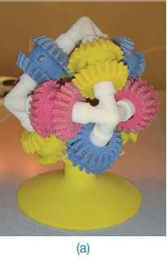
What is a prototype?
In other design fields a prototype is a small-scale model:
a miniature car
a miniature building or town
the examples here come from a 3D printer
www.id-book.com

Slide 21
What is a prototype?
In interaction design it can be (among other things):
a series of screen sketches
a storyboard, i.e. a cartoon-like series of scenes
a PowerPoint slide show
a video simulating the use of a system
a lump of wood (e.g. PalmPilot)
a cardboard mock-up
a piece of software with limited functionality written in the target language or in another language
www.id-book.com

Slide 22
Why prototype?
Evaluation and feedback are central to interaction design
Stakeholders can see, hold, interact with a prototype more easily than a document or a drawing
Team members can communicate effectively
You can test out ideas for yourself
It encourages reflection: very important aspect of design
Prototypes answer questions, and support designers in choosing between alternatives
www.id-book.com

Slide 23
What to prototype?
Technical issues
Work flow, task design
Screen layouts and information display
Difficult, controversial, critical areas
www.id-book.com

Slide 24
Low-fidelity Prototyping
Uses a medium which is unlike the final medium
e.g. paper, cardboard
Is quick, cheap and easily changed
Examples:
sketches of screens, task sequences, etc.
‘post-it’ notes
storyboards

Slide 25
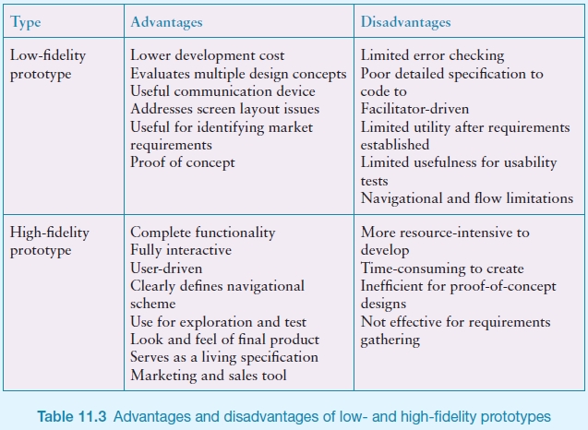

Slide 26
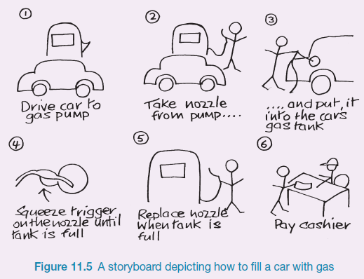
Sketching
Sketching is important to low-fidelity prototyping
Don’t be inhibited about drawing ability. Practice simple symbols

Slide 27
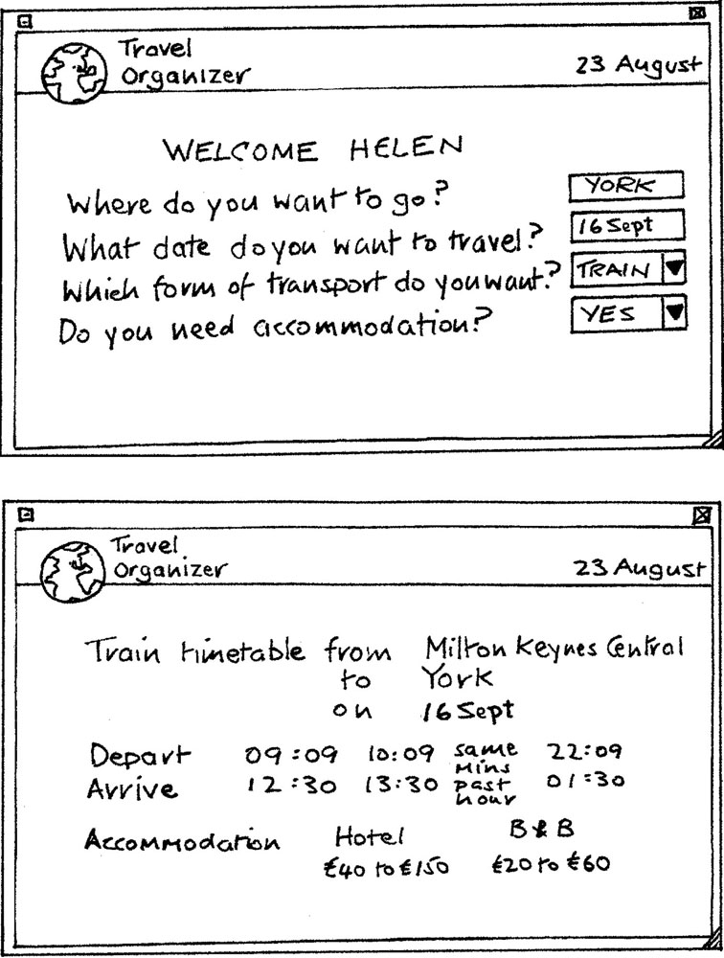
Card-based prototypes
Each card represents one screen or part of screen

Slide 28
High-fidelity prototyping
Uses materials that you would expect to be in the final product
Prototype looks more like the final system than a low-fidelity version
High-fidelity prototypes can be developed by integrating existing hardware and software components
Danger that users think they have a complete system…….see compromises

Slide 29
Conceptual design
Transform user requirements/needs into a conceptual model
A conceptual model is an outline of what people can do with a product and what concepts are needed to understand and interact with it
Mood board may be used to capture feel
Consider alternatives: prototyping helps

Slide 30
Concrete design
Many aspects to concrete design
Color, icons, buttons, interaction devices etc.
User characteristics and context
Accessibility, cross-cultural design
Cultural website guidelines
successful products “are … bundles of social solutions. Inventors succeed in a particular culture because they understand the values, institutional arrangements, and economic notions of that culture.”

Slide 31
Using scenarios
Express proposed or imagined situations
Used throughout design in various ways
as a basis for overall design
scripts for user evaluation of prototypes
concrete examples of tasks
as a means of co-operation across professional boundaries
Plus and minus scenarios to explore extreme cases

Slide 32
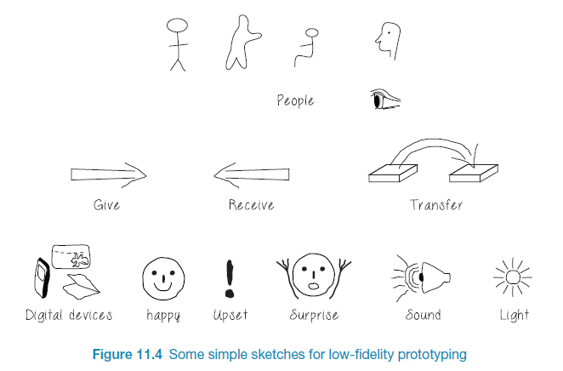
Generate storyboard from scenario

Slide 33
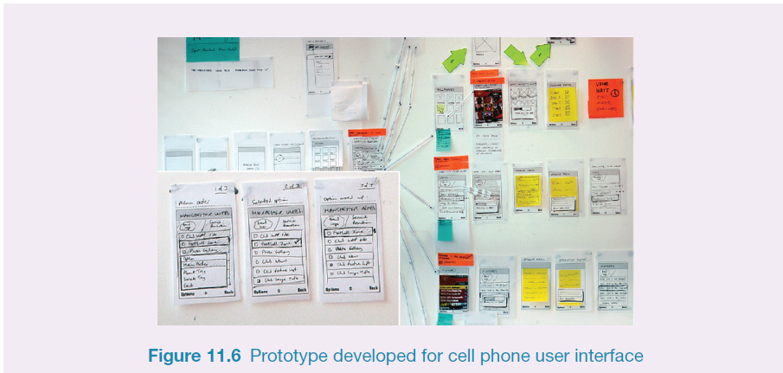
Generate card-based prototype from use case
26

Slide 34
Explore the user’s experience
Use personas, card-based prototypes or post-it-notes to model the user experience
Visual representation called:
design map
customer/user journey map
experience map
Two common representations
wheel
timeline
27

Slide 35
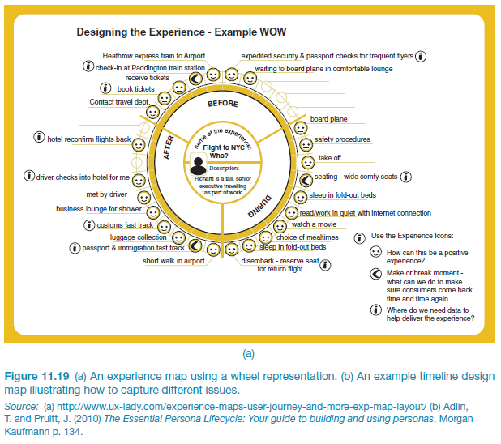
An experience map drawn as a wheel

Slide 36
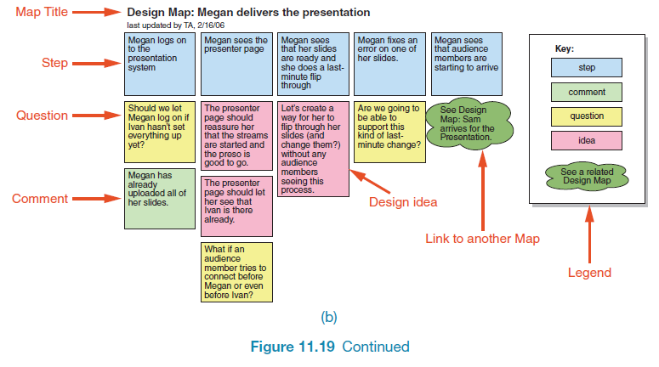
An experience map drawn as a timeline
29

Slide 37
Construction: physical computing
Build and code prototypes using electronics
Toolkits available include
Arduino
LilyPad (for fabrics)
Senseboard
MaKey MaKey
Raspberry Pi
Partice
Designed for use by wide range of people
30

Slide 38
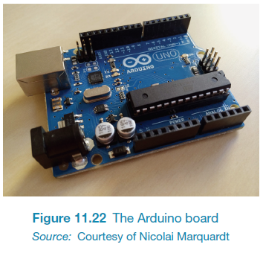
Physical computing kits

Slide 39
Chapter 12: INTERACTION DESIGN IN PRACTICE
AgileUX
Open Source Resources
Design Patterns (in text – we have discussed these before)
Tools for Interaction Design (in text – we have discussed throughout the session)

Slide 40
AgileUX
Integrates techniques from interaction design and Agile software development
AgileUX requires a change of mindset
In Agile, as implementation proceeds:
requirements are elaborated
requirements are re-prioritised
All techniques in UX are still relevant but when and how much needs re-thinking
focus on product, not design, as deliverable
cross-functional teams
Three practical areas: user research, aligning work practices, documentation

Slide 41
User research
Aims to characterise users through data collection and analysis
Agile’s timeboxing approach does not support long periods of user research
User evaluations and some detailed work can be fitted within a timebox
Some user research can be performed in iteration 0 (zero), before implementation starts
Ongoing programme of user research

Slide 42
Aligning work practices
Designing a complete product upfront causes problems because of re-prioritisation
Some upfront work is needed (technical and UX)
Use a parallel tracks approach:
create product vision before development starts
do design work one iteration ahead of development
some teams work two iterations ahead

Slide 43
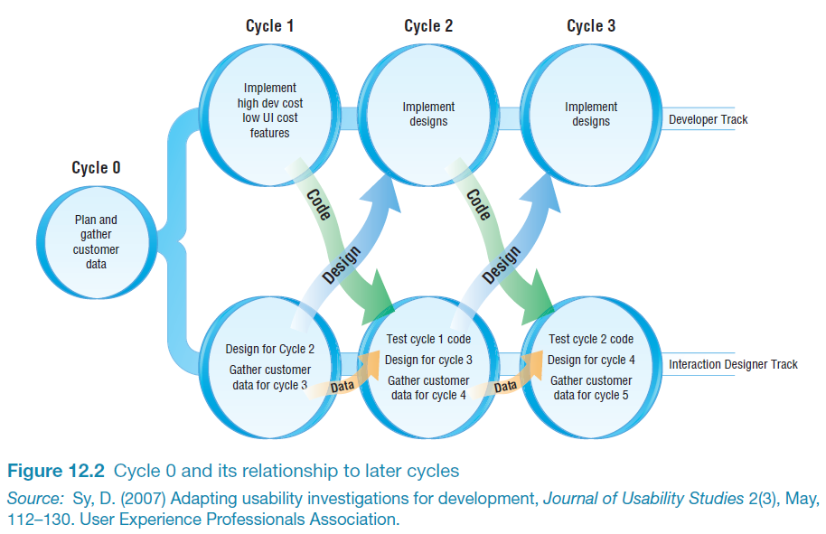
Parallel tracks approach to AgileUX

Slide 44
Aligning work practices
Advantages of parallel tracks approach:
no design time wasted on features not implemented
usability testing and contextual inquiry could be done on the same customer visit, saving time
timely feedback on the designs was received from developers and customers
Agile flexibility supports schedule changes if a problem is found
Parallel tracks is commonly used

Slide 45
Documentation
Most common communication approach for UX designers
Agile discourages this kind of communication, in favour of discussion
Only use documentation where needed. Ask:
Who will read it?
Who will use it?
What is the minimum needed?
Is there duplication anywhere?
How polished does it need to be?

Slide 46
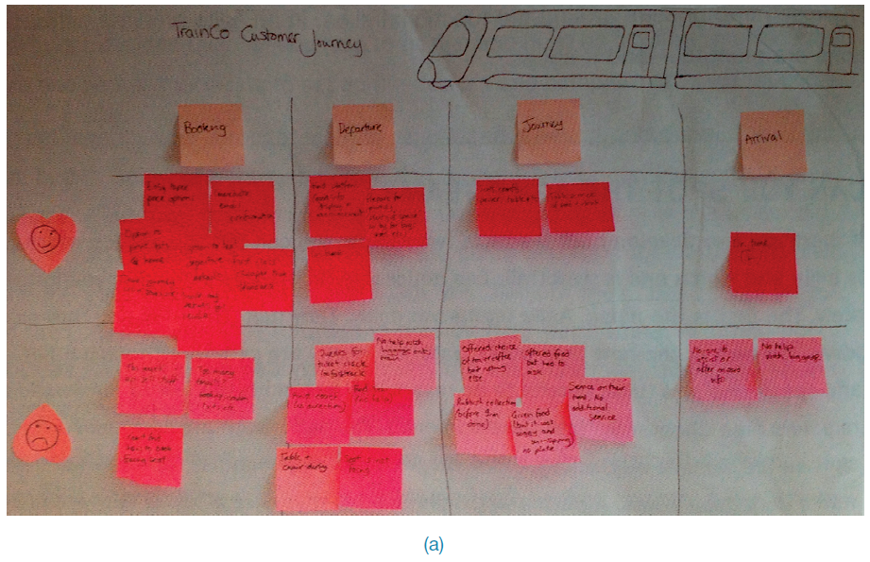
Documentation: how polished?

Slide 47
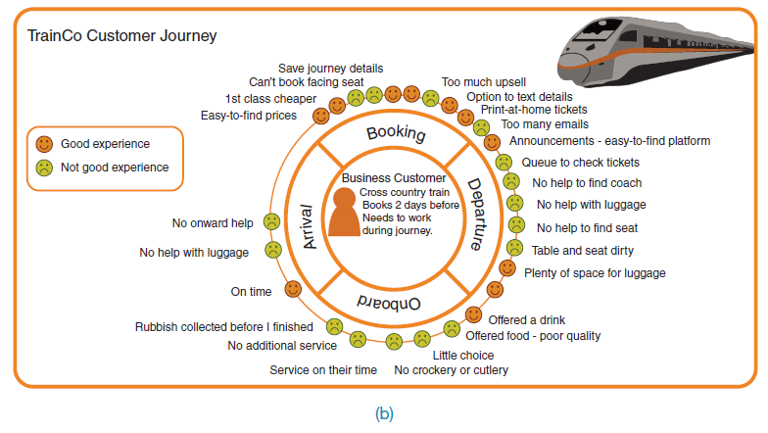
Documentation: how polished?

Slide 48
Remember:
No Lecture or Tutorials in Week 10
Due to the public holiday on Monday (3/10/16) there will be no classes for csit226/826 in week 10.

Slide 49
Questions

