Slide 1
Usability Evaluation Methods
WEEKS 11 & 12
CSIT226/CSIT826

Slide 2
Dr. Mark Freeman
School of Computing and Information Technology
Faculty of Engineering and Information Sciences

Slide 3
 | Topic | Reading
1 | Subject Overview and Introduction to HCI | Chapter 1
2 | User-Centred Design | Chapter 2
3 | User Interaction | Chapters 3 & 4
4 | User Interfaces | Chapters 5 & 6
5 | Information Presentation and Navigation | No Readings
6 | Accessibility and Special Issues in HCI | No Readings
7 | Interaction Design and Development I: Data Gathering and Analysis | Chapters 7 & 8
8 | Interaction Design and Development II: Requirements and Modelling | Chapters 9 & 10
9 | Interaction Design and Development III: Prototyping | Chapters 11 & 12
10 | No Classes: Public Holiday | No Readings
11 | Usability Evaluation Methods I | Chapter 13
12 | Usability Evaluation Methods II | Chapters 14 & 15
13 | Future HCI & Subject Revision | No Readings

Slide 4
Subject Description
The subject provides students with an understanding of Human Computer Interaction (HCI) principles and practices, and how to apply them in the context of developing usable interactive computer applications and systems. The subject also emphasises the importance of taking into account contextual, organisational, and social factors in the design of computer systems. Students will be taken through the analysis, design, development, and evaluation of user interfaces. They will acquire hands-on design skills through an interaction design project. The subject will cover topics including user-centred design, the development process, prototyping, usability testing, measuring and evaluating the user experience and accessibility.

Slide 5
Subject Learning Outcomes (SLOs)
On successful completion of this subject, students will be able to:
Identify and describe HCI principles and design issues.
Discuss and justify HCI solutions based on design principles.
Demonstrate an understanding of the HCI design process.
Acquire skills to design and implement user-centred design.
Select and use suitable methods of measuring and evaluating the user experience.

Slide 6
After a system has been developed…

Slide 7
Usability Evaluation Methods (UEMs)
Quick and Dirty Evaluations
Usability Testing
Field Studies
Predictive Evaluation
Informal (throughout UCD)
Measuring user performance
In natural settings
Expertise

Slide 8
Usability Evaluation Methods (UEMs)
User-Based Evaluation
Performance, non-verbal behaviour, attitude, cognition, stress and motivation
user experience and the interconnectivity that exists between usability and user experience (Vermeeren et al., 2010)
(Quick and Dirty, Usability Testing, Field Studies)
Expert-Based Evaluation
Conformance and attitude
(Quick and Dirty, Predictive Evaluation)
Theory Based Evaluation
Performance (idealised)
(Predictive Evaluation)
(Sweeney et al. 1993)

Slide 9
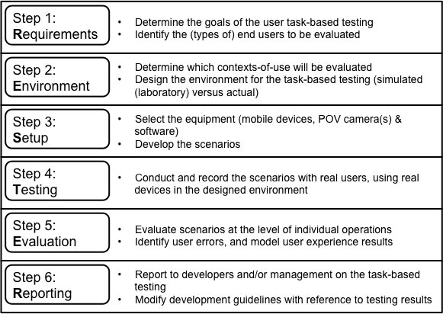
An approach…

Slide 10
errāre hūmānum est
(to err is human)

Slide 11
Human error
“Error will be taken as a generic term to encompass all those occasions in which a planned sequence of mental or physical activities fails to achieve its intended outcome, and when these failures cannot be attributed to the intervention of some chance agency.” (Reason, 1990)
Slip
Understand system and goal
Correct formulation of action
Incorrect action
Mistake
May not even have right goal
How can we fix?
Slip --- better interface design
Mistake --- better understanding of system

Slide 12

Hotplate Example
Think about this question
You have just moved into a new place and need to cook something to eat. Which control turns on which hotplate?
B
C
A

Slide 13
Suitability
“The most crucial property of any interactive system is its support for human activity. This is what makes it worth having. It may enable us to do things faster, with fewer errors, with less prior learning, with greater resultant quality, or perhaps just with greater fun and satisfaction.” (Newman & Lamming 1995, p.6)

Slide 14
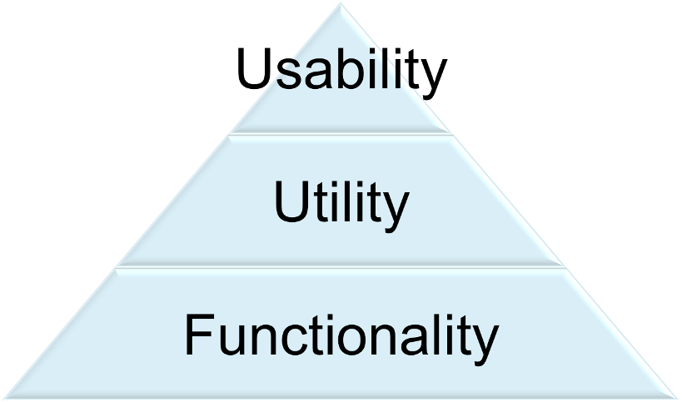
User and the System
Visible
Interface

Slide 15
Remember, Task Analysis
Task Analysis is used to identify the sequence of tasks required to complete an activity.
It involves breaking down tasks into discrete steps, and noting the order in which they occur.
This is most useful when designing a new system as the computerised version should mimic the manual system in the type of and ordering of tasks as closely as possible, so that users can easily make the transition to the new computerised system.
It should also expose areas of under productivity which a computerised system could automate.
Any of the following methods can be used to collect information about a system:
Observation (ethnography)
Interviews with users
User logging

Slide 16
Task Analysis
Who is going to use system?
What tasks do they now perform?
What tasks are desired?
How are the tasks learned?
Where are the tasks performed?
What’s the relationship between user & data?
What other tools does the user have?
How do users communicate with each other?
How often are the tasks performed?
What are the time constraints on the tasks?
What happens when things go wrong?
How can these then be evaluatied?

Slide 17
Testing Concepts
Testing – the process of examining a component, subsystem, or system to determine its operational characteristics and whether it contains any defects
Test case – a formal description of a starting state, one or more events to which the software must respond, and the expected response or ending state
Defined based on well understood functional and non-functional requirements
Must test all normal and exception situations
Test data – a set of starting states and events used to test a module, group of modules, or entire system
The data that will be used for a test case

Slide 18
Testing
Unit test – tests of an individual method, class, or component before it is integrated with other software
Integration test – tests of the behavior of a group of methods, classes, or components
Integration testing of object-oriented software is very complex because an object-oriented program consists of a set of interacting objects
System test – an integration test of an entire system or independent subsystem
Performance test or stress test – an integration and usability test that determines whether a system or subsystem can meet time-based performance criteria
Usability test – a test to determine whether a method, class, subsystem, or system meets user requirements
User acceptance test – a system test performed to determine whether the system fulfills user requirements

Slide 19
What is Interaction Design? CHAPTER 13
Explain the key concepts and terms used in evaluation
Introduce different types of evaluation methods
Show how different evaluation methods are used for different purposes at different stages of the design process and in different contexts of use.
Show how evaluators mix and modify methods to meet the demands of evaluating novel systems.
Discuss some of the challenges that evaluators have to consider when doing evaluation.
Notes:
19

Slide 20
Why, what, where and when to evaluate
Iterative design & evaluation is a continuous process that examines:
Why: to check users’ requirements and that they can use the product and they like it.
What: a conceptual model, early prototypes of a new system and later, more complete prototypes.
Where: in natural and/or laboratory settings.
When: throughout design; finished products can be evaluated to collect information to inform new products.
Notes:
20

Slide 21
Types of evaluation
Controlled settings involving users, e.g. usability testing & experiments in laboratories and living labs.
Natural settings involving users, e.g. field studies and in the wild studies to see how the product is used in the real world.
Settings not involving users, e.g. to predict, analyze & model aspects of the interface analytics.

Slide 22
What is a Living Lab?
Living Labs are defined as user-centred, open innovation ecosystems based on a systematic user co-creation approach integrating research and innovation processes in real life communities and settings. In practice, Living Labs place the citizen at the centre of innovation, and have thus shown the ability to better mould the opportunities offered by new ICT concepts and solutions to the specific needs and aspirations of local contexts, cultures, and creativity potentials.
http://openlivinglabs.eu/aboutus

Slide 23
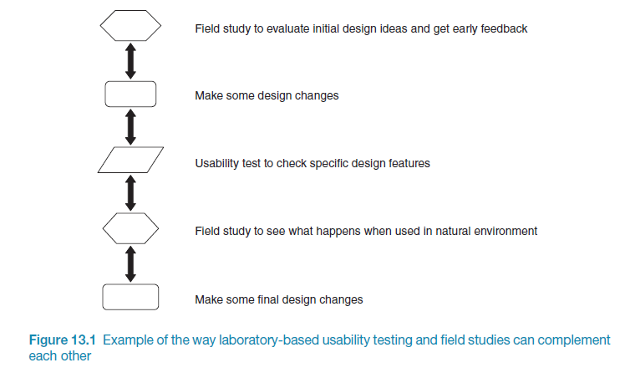
Usability testing & field studies can compliment

Slide 24
Evaluation case studies
Experiment to investigate a computer game
In the wild field study of skiers
Crowdsourcing
Notes:
24

Slide 25
Challenge & engagement in a collaborative immersive game
Physiological measures were used.
Players were more engaged when playing against another person than when playing against a computer.
What precautionary measures did the evaluators take?
Notes:
25

Slide 26
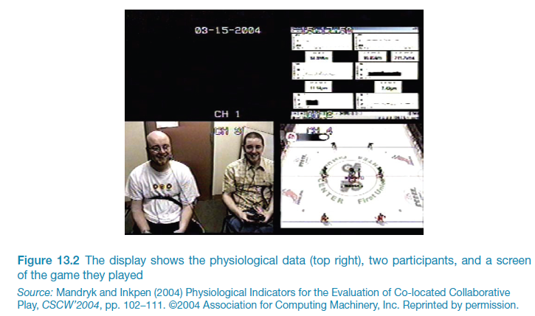
Challenge & engagement in a collaborative immersive game
Notes:
26

Slide 27
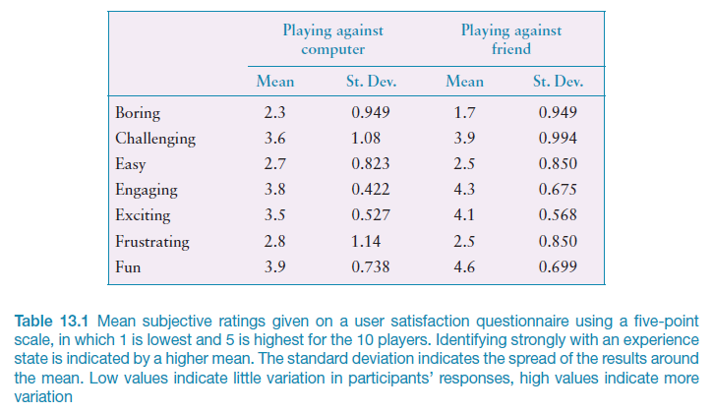
What does this data tell you?
Notes:
27

Slide 28
What did we learn from the case studies?
How to observe users in natural settings.
Unexpected findings resulting from in the wild studies.
Having to develop different data collection and analysis techniques to evaluate user experience goals such as challenge and engagement.
The ability to run experiments on the Internet that are quick and inexpensive using crowdsourcing.
How to recruit a large number of participants using Mechanical Turk.Test text

Slide 29
Evaluation methods
Method | Controlled settings | Natural settings | Without users
Observing | x | x
Asking users | x | x
Asking experts |  | x | x
Testing | x
Modeling |  |  | x
Notes:
29

Slide 30
Participants’ rights and getting their consent
Participants need to be told why the evaluation is being done, what they will be asked to do and their rights.
Informed consent forms provide this information.
The design of the informed consent form, the evaluation process, data analysis and data storage methods are typically approved by a high authority, e.g. Institutional Review Board.
At UOW: http://www.uow.edu.au/research/ethics/human/index.html

Slide 31
Things to consider when interpreting data
Reliability: does the method produce the same results on separate occasions?
Validity: does the method measure what it is intended to measure?
Ecological validity: does the environment of the evaluation distort the results?
Biases: Are there biases that distort the results?
Scope: How generalizable are the results?

Slide 32
Key points CHAPTER 13
Evaluation and design are very closely integrated.
Some of the same data gathering methods are used in evaluation as for establishing requirements and identifying users’ needs, e.g. observation, interviews, and questionnaires.
Evaluations can be done in controlled settings such as laboratories, less controlled field settings, or where users are not present.
Usability testing and experiments enable the evaluator to have a high level of control over what gets tested, whereas evaluators typically impose little or no control on participants in field studies.

Slide 33
Evaluation Studies: From Controlled to Natural Settings CHAPTER 14
Explain how to do usability testing
Outline the basics of experimental design
Describe how to do field studies
Notes:
33

Slide 34
Usability testing
Involves recording performance of typical users doing typical tasks.
Controlled settings.
Users are observed and timed.
Data is recorded on video & key presses are logged.
The data is used to calculate performance times, and to identify & explain errors.
User satisfaction is evaluated using questionnaires & interviews.
Field observations may be used to provide contextual understanding.
Notes:
34

Slide 35
Experiments & usability testing
Experiments test hypotheses to discover new knowledge by investigating the relationship between two or more variables.
Usability testing is applied experimentation.
Developers check that the system is usable by the intended user population for their tasks.
Notes:
35

Slide 36
Usability testing & research
Usability testing
Improve products
Few participants
Results inform design
Usually not completely replicable
Conditions controlled as much as possible
Procedure planned
Results reported to developers
Notes:
36

Slide 37
Usability testing
Goals & questions focus on how well users perform tasks with the product.
Comparison of products or prototypes is common.
Focus is on time to complete task & number & type of errors.
Data collected by video & interaction logging.
Testing is central.
User satisfaction questionnaires & interviews provide data about users’ opinions.
Notes:
37

Slide 38
Testing conditions
Usability lab or other controlled space.
Emphasis on:
selecting representative users;
developing representative tasks.
5-10 users typically selected.
Tasks usually around 30 minutes
Test conditions are the same for every participant.
Informed consent form explains procedures and deals with ethical issues.
Notes:
38

Slide 39
Types of data
Time to complete a task.
Time to complete a task after a specified time away from the product.
Number and type of errors per task.
Number of errors per unit of time.
Number of times online help and manuals accessed.
Number of users making an error.
Number of users successfully completing a task.
Notes:
39

Slide 40
How many participants is enough for user testing?
The number is a practical issue.
Depends on:
schedule for testing;
availability of participants;
cost of running tests.
Typically 5-10 participants.
Some experts argue that testing should continue until no new insights are gained.
Notes:
40

Slide 41
Experiments
Test hypothesis
Predict the relationship between two or more variables.
Independent variable is manipulated by the researcher.
Dependent variable influenced by the independent variable.
Typical experimental designs have one or two independent variables.
Validated statistically & replicable.
Notes:
41

Slide 42
Experimental designs
Different participants - single group of participants is allocated randomly to the experimental conditions.
Same participants - all participants appear in both conditions.
Matched participants - participants are matched in pairs, e.g., based on expertise, gender, etc.
Notes:
42

Slide 43
Different, same, matched participant design
Design | Advantages | Disadvantages
Different | No order effects | Many subjects & individual differences a problem
Same | Few individuals, no individual differences | Counter-balancing needed because of ordering effects
Matched | Same as different participants but individual differences reduced | Cannot be sure of perfect matching on all differences
Notes:
43

Slide 44
Field studies
Field studies are done in natural settings.
“In the wild” is a term for prototypes being used freely in natural settings.
Aim to understand what users do naturally and how technology impacts them.
Field studies are used in product design to:
identify opportunities for new technology;
determine design requirements;
decide how best to introduce new technology;
evaluate technology in use.
Notes:
44

Slide 45
Data collection & analysis
Observation & interviews
Notes, pictures, recordings
Video
Logging
Analyzes
Categorized
Categories can be provided by theory
Grounded theory
Activity theory
Notes:
45

Slide 46
Data presentation
The aim is to show how the products are being appropriated and integrated into their surroundings.
Typical presentation forms include:
Vignettes,
Excerpts,
Critical incidents,
Patterns, and narratives.

Slide 47
Key points CHAPTER 14
Usability testing takes place in controlled usability labs or temporary labs.
Usability testing focuses on performance measures, eg. how long and how many errors are made when completing a set of predefined tasks. Indirect observation (video and keystroke logging), user satisfaction questionnaires and interviews are also collected.
Affordable, remote testing systems are more portable than usability labs. Many also contain mobile eye-tracking and other devices.
Experiments test a hypothesis by manipulating certain variables while keeping others constant.
The experimenter controls independent variable(s) in order to measure dependent variable(s).
Field studies are evaluation studies that are carried out in natural settings to discover how people interact with technology in the real world.
Field studies that involve the deployment of prototypes or technologies in natural settings may also be referred to as ‘in the wild’.
Sometimes the findings of a field study are unexpected, especially for in the wild studies in which explore how novel technologies are used by participants in their own homes, places of work, or outside.
Notes:
47

Slide 48
Evaluation: Inspections, Analytics & Models CHAPTER 15
Describe the key concepts associated with inspection methods.
Explain how to do heuristic evaluation and walkthroughs.
Explain the role of analytics in evaluation.
Notes:
48

Slide 49
Inspections
Experts use their knowledge of users & technology to review software usability.
Expert critiques can be formal or informal.
Heuristic evaluation is a review guided by a set of heuristics.
Walkthroughs involve stepping through a pre-planned scenario noting potential problems.
Notes:
49

Slide 50
Heuristic evaluation
Developed by Jacob Nielsen in the early 1990s.
Based on heuristics distilled from an empirical analysis of 249 usability problems.
These heuristics have been revised for current technology by Nielsen and others for:
mobile devices,
wearables,
virtual worlds, etc.
Design guidelines form a basis for developing heuristics.
Notes:
50

Slide 51
Revised version (2014) of Nielsen’s original heuristics
Visibility of system status
Match between system and real world
User control and freedom
Consistency and standards
Error prevention
Recognition rather than recall
Flexibility and efficiency of use
Aesthetic and minimalist design
Help users recognize, diagnose, recover from errors.
Help and documentation
Notes:
51

Slide 52
Jakob Nielsen’s Ten Usability Characteristics
Visibility of system status
The system should always keep users informed about what is going on, through appropriate feedback within reasonable time.
Match between system and the real world
The system should speak the users' language, with words, phrases and concepts familiar to the user, rather than system-oriented terms. Follow real-world conventions, making information appear in a natural and logical order.
User control and freedom
Users often choose system functions by mistake and will need a clearly marked "emergency exit" to leave the unwanted state without having to go through an extended dialogue. Support undo and redo.
Consistency and standards
Users should not have to wonder whether different words, situations, or actions mean the same thing. Follow platform conventions.

Slide 53
Jakob Nielsen’s Ten Usability Characteristics
Error prevention
Even better than good error messages is a careful design which prevents a problem from occurring in the first place. Either eliminate error-prone conditions or check for them and present users with a confirmation option before they commit to the action.
Recognition rather than recall
Minimize the user's memory load by making objects, actions, and options visible. The user should not have to remember information from one part of the dialogue to another. Instructions for use of the system should be visible or easily retrievable whenever appropriate.
Flexibility and efficiency of use
Accelerators -- unseen by the novice user -- may often speed up the interaction for the expert user such that the system can cater to both inexperienced and experienced users. Allow users to tailor frequent actions.
Aesthetic and minimalist design
Dialogues should not contain information which is irrelevant or rarely needed. Every extra unit of information in a dialogue competes with the relevant units of information and diminishes their relative visibility.

Slide 54
Jakob Nielsen’s Ten Usability Characteristics
Help users recognize, diagnose, and recover from errors
Error messages should be expressed in plain language (no codes), precisely indicate the problem, and constructively suggest a solution.
Help and documentation
Even though it is better if the system can be used without documentation, it may be necessary to provide help and documentation. Any such information should be easy to search, focused on the user's task, list concrete steps to be carried out, and not be too large.

Slide 55
Number of evaluators
Nielsen suggests that on average 5 evaluators identify 75-80% of usability problems.
Cockton and Woolrych (2001) point out that the number of users needed to find 75-80% of usability problems depends on the context and nature of the problems.
Notes:
55

Slide 56
Heuristics for websites focus on key criteria (Budd, 2007)
Clarity
Minimize unnecessary complexity & cognitive load
Provide users with context
Promote positive & pleasurable user experience

Slide 57
3 stages for doing heuristic evaluation
Briefing session to tell experts what to do.
Evaluation period of 1-2 hours in which:
Each expert works separately
Take one pass to get a feel for the product
Take a second pass to focus on specific features
Debriefing session in which experts work together to prioritize problems.
Notes:
57

Slide 58
Advantages and Problems
Few ethical & practical issues to consider because users not involved.
Can be difficult & expensive to find experts.
Best experts have knowledge of application domain & users.
Biggest problems:
Important problems may get missed;
Many trivial problems are often identified;
Experts have biases.
Notes:
58

Slide 59
Cognitive walkthroughs
Focus on ease of learning.
Designer presents an aspect of the design & usage scenarios.
Expert is told the assumptions about user population, context of use, task details.
One or more experts walk through the design prototype with the scenario.
Experts are guided by 3 questions.
Notes:
59

Slide 60
The 3 questions
Will the correct action be sufficiently evident to the user?
Will the user notice that the correct action is available?
Will the user associate and interpret the response from the action correctly? As the experts work through the scenario they note problems.
Notes:
60

Slide 61
Pluralistic walkthrough
Variation on the cognitive walkthrough theme.
Performed by a carefully managed team.
The panel of experts begins by working separately.
Then there is managed discussion that leads to agreed decisions.
The approach lends itself well to participatory design.
Notes:
61

Slide 62
Predictive models
Provide a way of evaluating products or designs without directly involving users.
Less expensive than user testing.
Usefulness limited to systems with predictable tasks - e.g., telephone answering systems, mobiles, cell and smart phones.
Based on expert error-free behavior.
Notes:
62

Slide 63
Key points CHAPTER 15
Inspections can be used to evaluate requirements, mockups, functional prototypes, or systems.
User testing & heuristic evaluation may reveal different usability problems.
Design guidelines can be used to develop heuristics
Walkthroughs are focused so are suitable for evaluating small parts of a product.
Analytics involves collecting data about users activity on a website or product
Notes:
63

Slide 64
System Usability Scale (SUS)
The SUS is a 10 item questionnaire.
I think that I would like to use this system frequently.
I found the system unnecessarily complex.
I thought the system was easy to use.
I think that I would need the support of a technical person to be able to use this system.
I found the various functions in this system were well integrated.
I thought there was too much inconsistency in this system.
I would imagine that most people would learn to use this system very quickly.
I found the system very cumbersome to use.
I felt very confident using the system.
I needed to learn a lot of things before I could get going with this system.

Slide 65
Standardized User Experience Percentile Rank Questionnaire (SUPR-Q)
Usability
This website is easy to use.
It is easy to navigate within the website.
Credibility (Trust, Value & Comfort)
The information on the website is credible.
The information on the website is trustworthy.
I feel comfortable purchasing from this website. (Alternate for eCommerce websites)
I feel confident conducting business with this website. (Alternate eCommerce websites)
Loyalty
How likely are you to recommend this website to a friend or colleague?
I will likely visit this website in the future.
Appearance
I found the website to be attractive.
The website has a clean and simple presentation.

Slide 66
Questions

