Slide 1
Future HCI & Subject Revision
WEEKS 11 & 12
CSIT226/CSIT826

Slide 2
Dr. Mark Freeman
School of Computing and Information Technology
Faculty of Engineering and Information Sciences

Slide 3
 | Topic | Reading
1 | Subject Overview and Introduction to HCI | Chapter 1
2 | User-Centred Design | Chapter 2
3 | User Interaction | Chapters 3 & 4
4 | User Interfaces | Chapters 5 & 6
5 | Information Presentation and Navigation | No Readings
6 | Accessibility and Special Issues in HCI | No Readings
7 | Interaction Design and Development I: Data Gathering and Analysis | Chapters 7 & 8
8 | Interaction Design and Development II: Requirements and Modelling | Chapters 9 & 10
9 | Interaction Design and Development III: Prototyping | Chapters 11 & 12
10 | No Classes: Public Holiday | No Readings
11 | Usability Evaluation Methods I | Chapter 13
12 | Usability Evaluation Methods II | Chapters 14 & 15
13 | Future HCI & Subject Revision | No Readings

Slide 4
Subject Description
The subject provides students with an understanding of Human Computer Interaction (HCI) principles and practices, and how to apply them in the context of developing usable interactive computer applications and systems. The subject also emphasises the importance of taking into account contextual, organisational, and social factors in the design of computer systems. Students will be taken through the analysis, design, development, and evaluation of user interfaces. They will acquire hands-on design skills through an interaction design project. The subject will cover topics including user-centred design, the development process, prototyping, usability testing, measuring and evaluating the user experience and accessibility.

Slide 5
Subject Learning Outcomes (SLOs)
On successful completion of this subject, students will be able to:
Identify and describe HCI principles and design issues.
Discuss and justify HCI solutions based on design principles.
Demonstrate an understanding of the HCI design process.
Acquire skills to design and implement user-centred design.
Select and use suitable methods of measuring and evaluating the user experience.

Slide 6
Human-Computer Interaction (HCI)
What is HCI?
What happens when A human and a computer interact?
Why are we studying HCI?

Slide 7
What is the future of HCI?

Slide 8
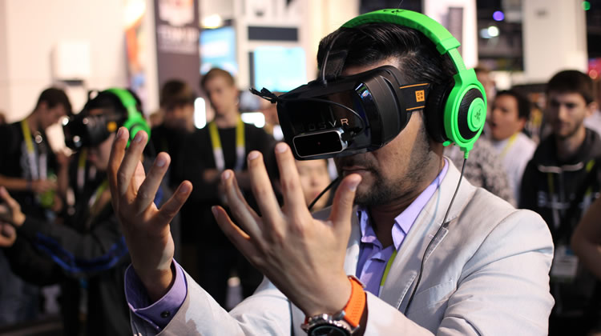
VR

Slide 9
“Designing for VR should not mean transferring 2D practices to 3D, but finding a new paradigm.” (Ravasz 2016)
https://uxdesign.cc/design-practices-in-virtual-reality-f900f5935826#.gzsz7n9rr

Slide 10
VR Interface Guidelines
Still in development
Individual companies have their own ideas
Google:
https://www.google.com/design/spec-vr/designing-for-google-cardboard/a-new-dimension.html
Oculus:
https://developer3.oculus.com/documentation/mobilesdk/latest/concepts/mobile-ui-guidelines-intro/
https://developer3.oculus.com/documentation/intro-vr/latest/concepts/bp_intro/
Unity:
https://unity3d.com/learn/tutorials/topics/virtual-reality/user-interfaces-vr
Leap Motion
https://developer.leapmotion.com/assets/Leap%20Motion%20VR%20Best%20Practices%20Guidelines.pdf

Slide 11
Accedo – UX Guidelines
The 7 UX guidelines
Place the UI so it is comfortable to interact with
Place visual feedback to selections within the immediate interaction area
Keep information dense areas interaction-free
Use dwell times of various lengths
Avoid using time-limited information
Never force users to interpret information in movement
Use standards and affordances

Slide 12
Future Interfaces
SENSORS
WEARABLE
Gesture
BRAIN-COMPUTER INTERFACES
Flexible SCREENS
TANGIBLE

Slide 13
Exam

Slide 14
Structure
2 hours in length
50% of your final mark for ISIT226/826
No materials allowed in the exam room

Slide 15
CSIT226 - Exam
Question 1 (20 marks)
Short Answer
Key concepts from the subject
Question 2 (20 marks)
Interaction Styles
Explanation of different interfaces
Question 3 (10 marks)
Accessibility
Question 4 (30 marks)
Interaction Styles
Development of a basic system
Question 5 (20 marks)
Usability

Slide 16
CSIT826 - Exam
Question 1 (30 marks)
Short Answer
Key concepts from the subject
Question 2 (10 marks)
Interaction Styles
Explanation of different interfaces
Question 3 (15 marks)
Accessibility
Question 4 (45 marks)
Usability Report
Minimum 3 page response required
Correct report structure

Slide 17
Exam Tips
Make sure that you read the instructions for the questions
For Question 1 (both exams) dot point answers are acceptable
Make sure you read the entire question
Many questions have multiple parts
CSIT826 students – make sure that you address Question 4 in your exam as a report
Spend a few minutes developing an outline

Slide 18
Subject Revision
THIS SHOULD NOT BE THE ONLY MATERIAL USED IN YOUR REVISION
This is a starting point to use to refresh what we have covered over the session!

Slide 19
Definitions
“Human-computer interaction is a discipline concerned with the design, evaluation and implementation of interactive computing systems for human use and with the study of major phenomena surrounding them.” (Hewett, Baecker, Card, Carey, Gasen, Mantei, Perlman, Strong and Verplank 1992)
Usability: “The extent to which a product can be used by specified users to achieve specified goals with effectiveness, efficiency and satisfaction in a specified context of use.” ISO 9241-11
“User experience (UX) is an approach to product development that incorporates direct user feedback throughout the development cycle (human-centered design) in order to reduce costs and create products and tools that meet user needs and have a high level of usability (are easy to use).” (UXPA 2013)

Slide 20
Definitions
“Human-centered design is characterised by: the active involvement of users and a clear understanding of user and task requirements; an appropriate allocation of function between users and technology; the iteration of design solutions; multi-disciplinary design.”- ISO 13407
Interaction Design: “Designing interactive products to support the way people communicate and interact in their everyday and working lives.” (Preece, Sharp and Rogers 2015)

Slide 21
User Experience (UX)
How a product behaves and is used by people in the real world
the way people feel about it and their pleasure and satisfaction when using it, looking at it, holding it, and opening or closing it
“every product that is used by someone has a user experience: newspapers, ketchup bottles, reclining armchairs, cardigan sweaters.” (Garrett, 2010)
“all aspects of the end-user's interaction with the company, its services, and its products. (Nielsen and Norman, 2014)
Cannot design a user experience, only design for a user experience

Slide 22
User Experience
Interaction design is concerned with designing interactive products to support the way people communicate and interact in their everyday and working lives
It is concerned with how to create quality user experiences
It requires taking into account a number of interdependent factors, including context of use, type of activities, cultural differences, and user groups
It is multidisciplinary, involving many inputs from wide-reaching disciplines and fields

Slide 23
The ‘Human’ (Dix et al., 2004)
Consider…
Information input/output (i/o)
Visual
Haptic
Auditory
Movement
Information storage (human memory)
Sensory
Short-term (working)
Long-term
Information processing
Reasoning
Skill level
Problem Solving
Everyone is different

Slide 24
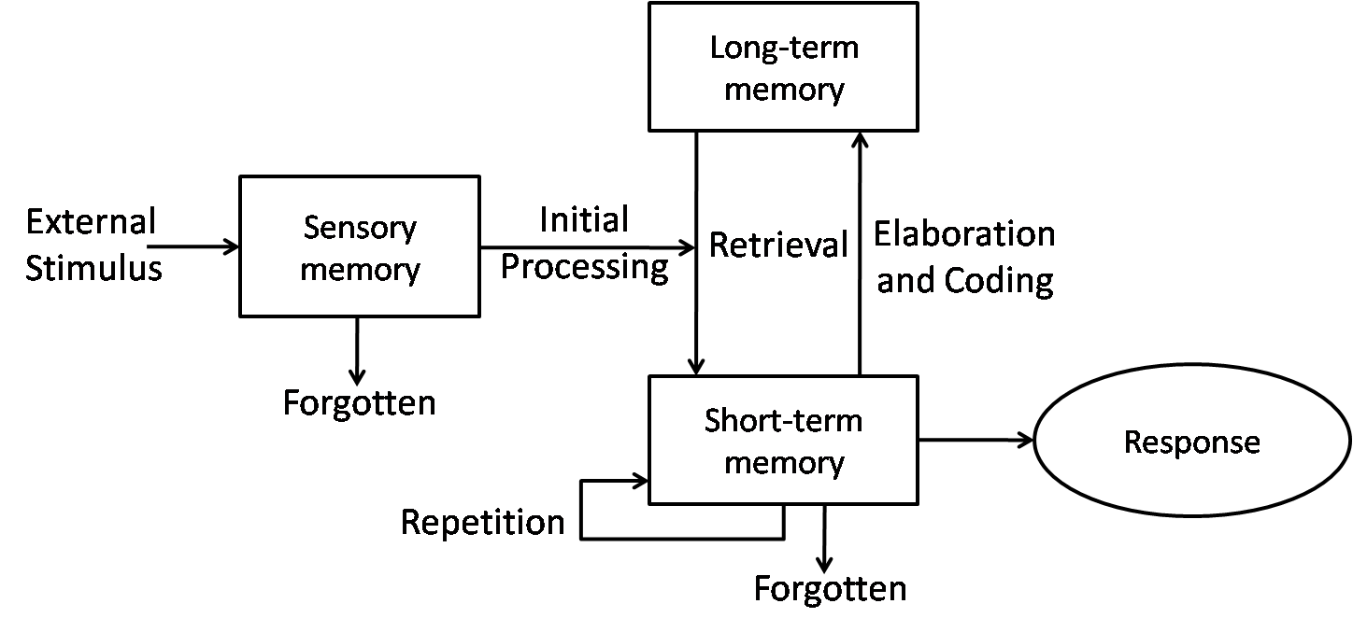
Human Cognitive Architecture

Slide 25
Conflict in Views
Expertise
Participation

Slide 26
International Standard ISO 9241-210
Ergonomics of human–system interaction — Part 210: Human-centred design for interactive systems
“Human-centred design is an approach to interactive systems development that aims to make systems usable and useful by focusing on the users, their needs and requirements, and by applying human factors/ergonomics, and usability knowledge and techniques. This approach enhances effectiveness and efficiency, improves human well-being, user satisfaction, accessibility and sustainability; and counteracts possible adverse effects of use on human health, safety and performance.”

Slide 27
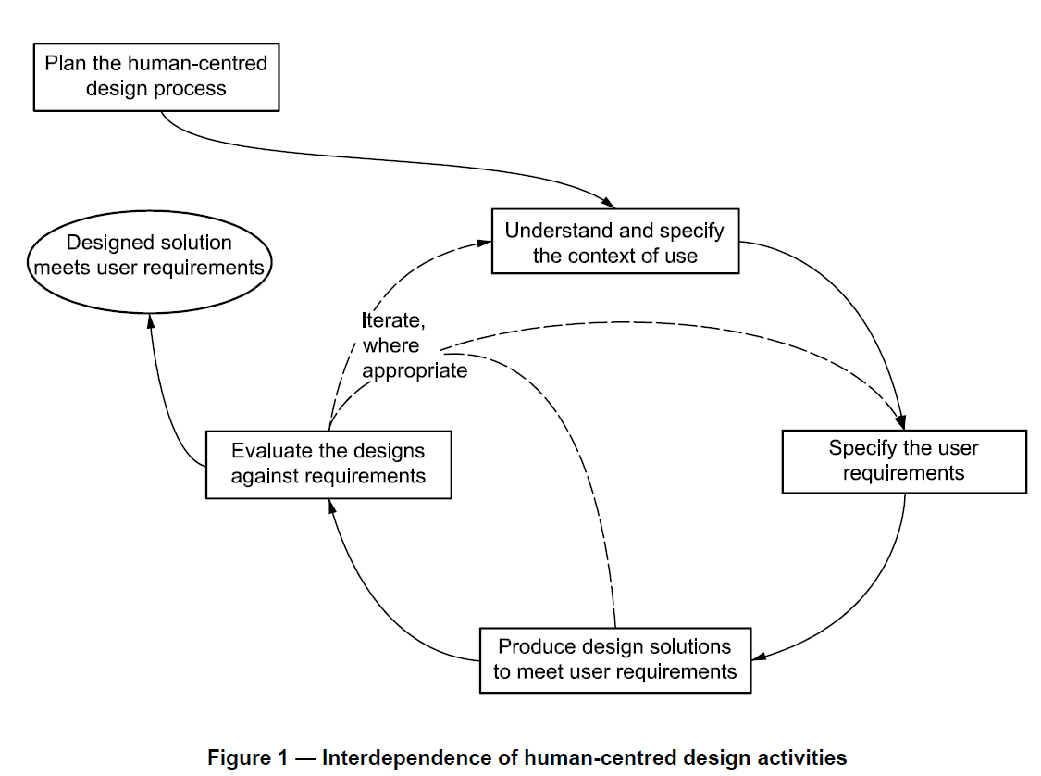

Slide 28
User-Centered Design
"development proceeds with the user as the center of focus." (Rubin, 2008)
Rubin depicts the User-Centered Design Process as follows:
The users are in the center of a double circle
The inner ring contains: Context; Objectives; Environment and Goals
The outer ring contains: Task Detail; Task Content; Task Organization and Task Flow

Slide 29
Task Detail
User
Context
Objectives
Environment
Goals
Task Flow
Task Content
Task Organisation

Slide 30
User-Centered Design
User-Centered Design (UCD) is a user interface design process that focuses on usability goals, user characteristics, environment, tasks, and workflow in the design of an interface.
UCD follows a series of well-defined methods and techniques for analysis, design, and evaluation of mainstream hardware, software, and web interfaces.
The UCD process is an iterative process, where design and evaluation steps are built in from the first stage of projects, through implementation.

Slide 31
History
Command Line Interfaces (CLI)
Graphical User Interfaces (GUI)
Natural User Interfaces (NUI)

Slide 32
Skeuomorphism
Skeuomorphism
Flat Design (Minimalism)

Slide 33
Communication aided by technology

Slide 34
The Patterns (basic – single view) (TIDWELL, 2006)
Physical Presentation
Two-Panel Selector
Canvas Plus Palette
One-Window Drilldown
Alternative Views
Abstract Concepts
Wizard
Extras on Demand
Intriguing Branches
Multi-level help

Slide 35
Multiple Windows vs Tiled Panes

Slide 36
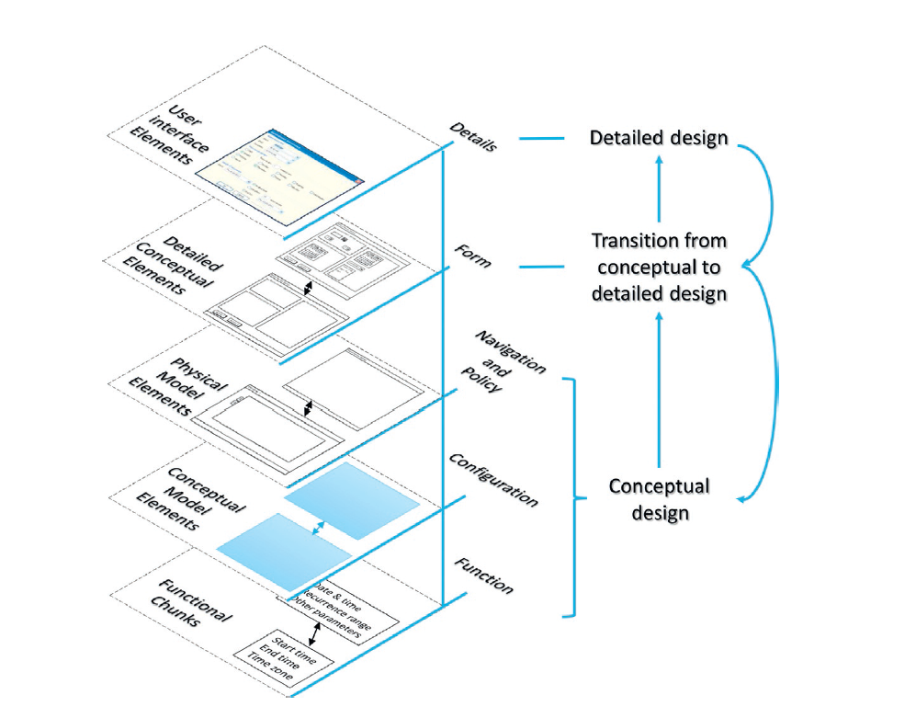
Layered Framework (Parush, 2015)

Slide 37
Interaction Sequences
Single Sequence
Hierarchy sequence

Slide 38
Interaction Sequences
Hub and spokes
Matrix

Slide 39
Interaction Sequences
Network

Slide 40
Model-View-Controller (MVC) Design Pattern
Notes:
Separation between the UI and the business layers

Slide 41
Menus
A number of menu interface styles
flat lists, ribbon, drop-down, pop-up, contextual, and expanding, e.g., scrolling and cascading
Flat-list menus
good at displaying a small number of options at the same time and where the size of the display is small, e.g. iPods
but have to nest the lists of options within each other, requiring several steps to get to the list with the desired option
moving through previous screens can be tedious
Notes:
41

Slide 42
Expanding menus
Enables more options to be shown on a single screen than is possible with a single flat menu
More flexible navigation, allowing for selection of options to be done in the same window
Most popular are cascading ones
primary, secondary and even tertiary menus
downside is that they require precise mouse control
can result in overshooting or selecting wrong options
Notes:
42

Slide 43
Contextual menus
Provide access to often-used commands that make sense in the context of a current task
Appear when the user presses the Control key while clicking on an interface element
e.g., clicking on a photo in a website together with holding down the Control key results in options ‘open it in a new window,’ ‘save it,’ or ‘copy it’
Helps overcome some of the navigation problems associated with cascading menus
Notes:
43

Slide 44
Visualisations and Dashboards

Slide 45
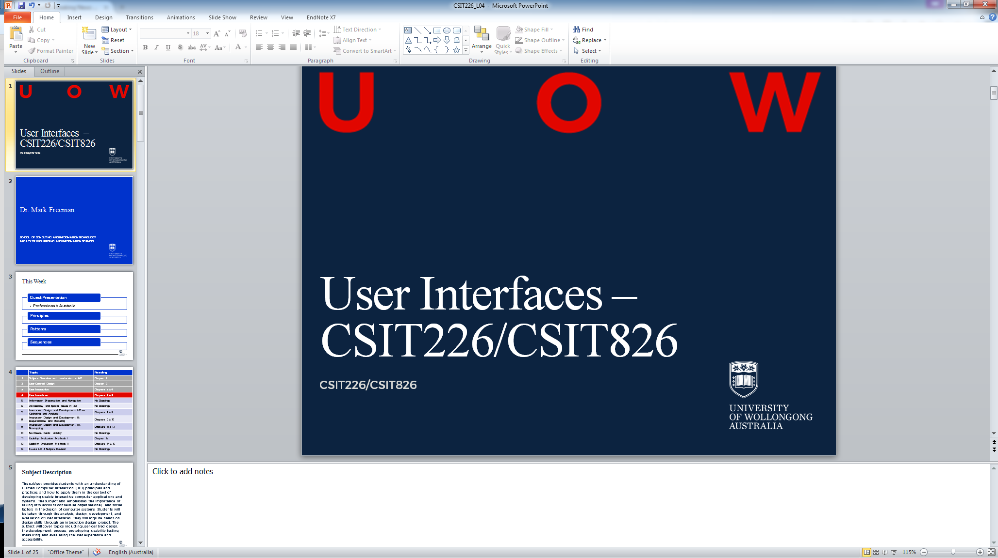
User Interfaces

Slide 46
Accessibility and Special Issues in HCI

Slide 47
Disabilities affecting computer accessibility
Visual impairments
Blindness, low vision, colour blindness
Hearing disabilities
Speech impairments
Mobility impairments
Cognitive impairments
literacy

Slide 48
Assistive Technologies
Devices designed to provide people with solutions to allow them to perform typical activities that they would not have otherwise be unable to do.
US – IDEA (Individuals with Disabilities Education Act) 2004: Assistive technology device means any item, piece of equipment, or product system, whether acquired commercially off the shelf, modified, or customized, that is used to increase, maintain, or improve the functional capabilities of a child with a disability. The term does not include a medical device that is surgically implanted, or the replacement of such device.
Can be: Low Tech, Medium Tech, High Tech

Slide 49
Web Content Accessibility Guidelines (WCAG) 2.0
https://www.w3.org/TR/WCAG20/
Stable, referenceable technical Stranded.
12 Guidelines
Organised under 4 principles
Perceivable
Operable
Understandable
Robust
Testable Criteria
Three levels
A, AA and AAA

Slide 50
WCAG 2 at a Glance https://www.w3.org/WAI/WCAG20/glance/
Perceivable
Provide text alternatives for non-text content.
Provide captions and other alternatives for multimedia.
Create content that can be presented in different ways, including by assistive technologies, without losing meaning.
Make it easier for users to see and hear content.
Operable
Make all functionality available from a keyboard.
Give users enough time to read and use content.
Do not use content that causes seizures.
Help users navigate and find content.
Understandable
Make text readable and understandable.
Make content appear and operate in predictable ways.
Help users avoid and correct mistakes.
Robust
Maximize compatibility with current and future user tools.

Slide 51
Usability Evaluation Methods (UEMs)
Quick and Dirty Evaluations
Usability Testing
Field Studies
Predictive Evaluation
Informal (throughout UCD)
Measuring user performance
In natural settings
Expertise

Slide 52
Usability Evaluation Methods (UEMs)
User-Based Evaluation
Performance, non-verbal behaviour, attitude, cognition, stress and motivation
user experience and the interconnectivity that exists between usability and user experience (Vermeeren et al., 2010)
(Quick and Dirty, Usability Testing, Field Studies)
Expert-Based Evaluation
Conformance and attitude
(Quick and Dirty, Predictive Evaluation)
Theory Based Evaluation
Performance (idealised)
(Predictive Evaluation)
(Sweeney et al. 1993)

Slide 53

What is DESIGN? What are we DESIGNING?

Slide 54
Consider…What features would you put in a smartphone?
Big Screen
Long battery life
Size
Big screen
Long battery life
Size
THE ART OF TRADEOFF

Slide 55
NEVER one single solution
If any algorithm could generate a perfect solution to multi-dimensional constraint satisfaction problem…
THEN…
There’d be NO engineers, architects or designers

Slide 56
So… What is “DESIGN”?
It is a series of TRADE-OFF’s
To SATISFY all of a project’s NEEDS (requirements)
AND
A maximal subset of WANTS
WITHIN a bunch of Constraints
Time
Money (construction, operation, maintenance)
Material
Personnel (stakeholders, users, staffs)
Legal (Regulation, standards, copyrights)
Technical
…

Slide 57
Chapter 7: Gathering Data AIMS
Discuss how to plan and run a successful data gathering program.
Enable you to plan and run an interview.
Enable you to design a simple questionnaire.
Enable you to plan and carry out an observation.

Slide 58
Five key issues
Setting goals
Decide how to analyze data once collected
Identifying participants
Decide who to gather data from
Relationship with participants
Clear and professional
Informed consent when appropriate
Triangulation
Look at data from more than one perspective
Collect more than one type of data, eg qualitative from experiments and qualitative from interviews
Pilot studies
Small trial of main study

Slide 59
Interviews
Unstructured - are not directed by a script. Rich but not replicable.
Structured - are tightly scripted, often like a questionnaire. Replicable but may lack richness.
Semi-structured - guided by a script but interesting issues can be explored in more depth. Can provide a good balance between richness and replicability.
Focus groups – a group interview

Slide 60
Enhancing Interviews
Tell me more…
Why?
silence

Slide 61
Chapter 8: Data Analysis, Interpretation and Presentation AIMS
Discuss the difference between qualitative and quantitative data and analysis.
Enable you to analyze data gathered from:
Questionnaires.
Interviews.
Observation studies.
Make you aware of software packages that are available to help your analysis.
Identify common pitfalls in data analysis, interpretation, and presentation.
Enable you to interpret and present your findings in appropriate ways.
www.id-book.com

Slide 62
Quantitative and qualitative
Quantitative data – expressed as numbers
Qualitative data – difficult to measure sensibly as numbers, e.g. count number of words to measure dissatisfaction
Quantitative analysis – numerical methods to ascertain size, magnitude, amount
Qualitative analysis – expresses the nature of elements and is represented as themes, patterns, stories
Be careful how you manipulate data and numbers!
www.id-book.com

Slide 63
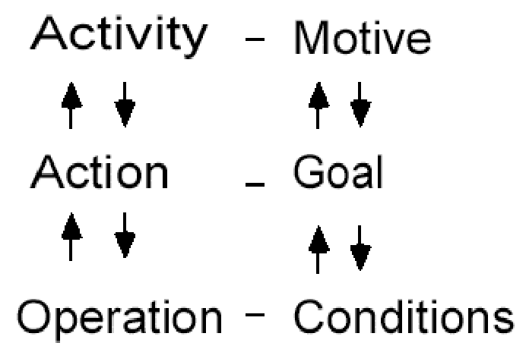
Individual model
www.id-book.com
16

Slide 64
Presenting the Findings
Only make claims that your data can support
The best way to present your findings depends on the audience, the purpose, and the data gathering and analysis undertaken
Graphical representations can be appropriate for presentation
Other techniques are:
Rigorous notations, e.g. UML
Persona Development
Using stories, e.g. to create scenarios
Summarizing the findings
What needs to be changed in the system – CRUD (Create, Read, Update, Delete)
www.id-book.com

Slide 65
Use Case Description
Use Case Name:
Scenario:
Triggering Event:
Brief Description:
Actors:
Related Use Cases:
Stakeholders:
Pre-conditions:
Post-conditions:
Flow of Activities: | Actor | System
Exceptions:

Slide 66
User Story
Less structure than a ‘use case’
A User Story is a one-sentence description of a work-related task done by a user to achieve some goal or result
Acceptance Criteria identify the features that must be present at the completion of the task
The template for a user story description is:
“As a <role> I want to <goal> so that <benefit>”

Slide 67
FRUPS+
Functionality
Usability
Reliability
Performance
Security
+
Constrains, standards, physical, other systems, etc.

Slide 68
Who are the users/stakeholders?
Not as obvious as you think:
those who interact directly with the product
those who manage direct users
those who receive output from the product
those who make the purchasing decision
those who use competitor’s products
Three categories of user (Eason, 1987):
Primary: frequent hands-on
Secondary: occasional or via someone else
Tertiary: affected by its introduction, or will influence its purchase
www.id-book.com

Slide 69
What do we mean by the user’s ‘needs’? ALSO CONSIDER WHEN CONDUCTING INTERVIEWS
Users rarely know what is possible
Users can’t tell you what they ‘need’ to help them achieve their goals
Instead, look at existing tasks:
their context
what information do they require?
who collaborates to achieve the task?
why is the task achieved the way it is?
Envisioned tasks:
can be rooted in existing behaviour
can be described as future scenarios

Slide 70
What, how and why?
What needs to be achieved?
Understand as much as possible about users, task, context
Produce a stable set of requirements
How can this be done?
Data gathering activities
Data analysis activities
Expression as ‘requirements’
All of this is iterative

Slide 71
Personas
Capture a set of user characteristics (user profile)
Not real people, but synthesised from real users
Should not be idealised
Bring them to life with a name, characteristics, goals, personal background
Develop a small set of personas with one primary

Slide 72
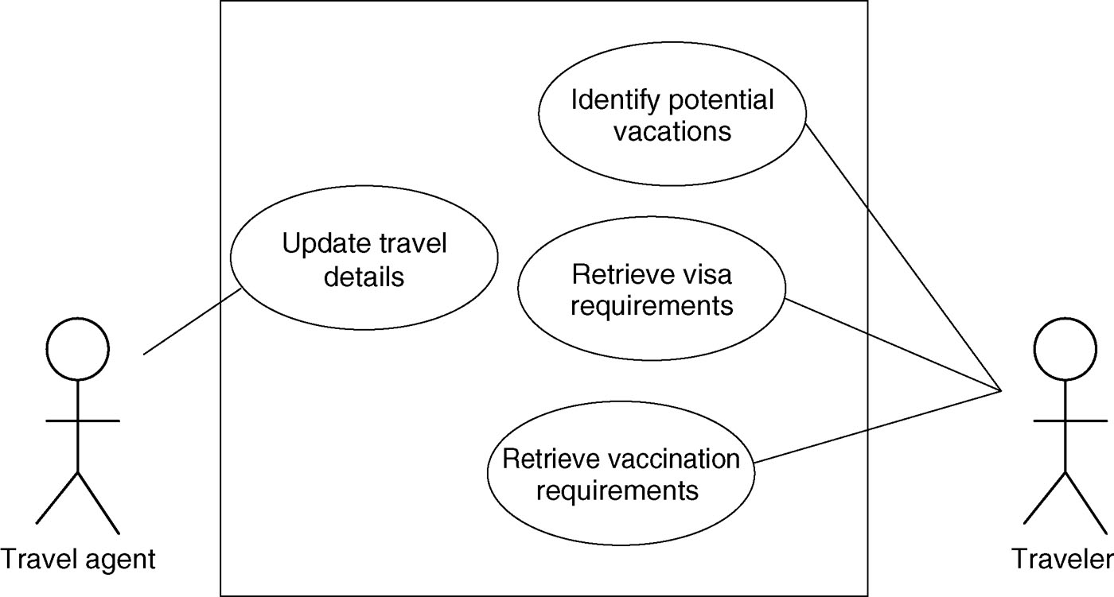
Example use case diagram for travel organizer

Slide 73
Task analysis
Task descriptions are often used to envision new systems or devices
Task analysis is used mainly to investigate an existing situation
It is important not to focus on superficial activities
What are people trying to achieve?
Why are they trying to achieve it?
How are they going about it?
Many techniques, the most popular is Hierarchical Task Analysis (HTA)

Slide 74
Example Hierarchical Task Analysis
0. In order to buy a DVD
1. locate DVD
2. add DVD to shopping basket
3. enter payment details
4. complete address
5. confirm order
Plan 0: If regular user do 1-2-5. If new user do 1-2-3-4-5.

Slide 75
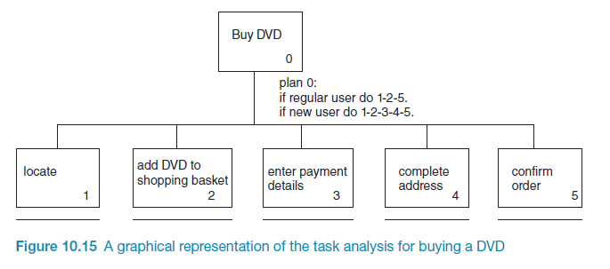
Example Hierarchical Task Analysis (graphical)

Slide 76
Card Sorting
generate information about the associations and grouping of specific data items
Technology:
Low-tech method using index cards or post-it notes
High-tech method (e.g. uxSort or UserZoom)
Typically conducted as a:
Series of individual exercises
Concurrent activity in a small group
Mixed approach (individual then group discussion - differences)
Typically conducted early in the design phase of a project for defining a systems architecture
Open vs. Closed sorts
See:
http://measuringuserexperience.com/CardSorting/index.htm
https://www.interaction-design.org/literature/book/the-encyclopedia-of-human-computer-interaction-2nd-ed/card-sorting

Slide 77
Wireframing

Slide 78
The value of Wireframing
Identify the interfaces functionality
Identify a pages space allocation
Ensure consistency for particular elements in an interface
Links between a systems information architecture and its visual design

Slide 79
Storyboards
Designed to illustrate the interaction between the user and the product
Drawings, sketches and pictures that tell a story
Creates meaning beyond a typical technical drawing (e.g. flowchart)
https://blogs.msdn.microsoft.com/crm/2006/11/02/using-storyboard-prototypes-in-your-design-process/
http://www.usabilitybok.org/storyboard
https://uxmag.com/articles/storyboarding-in-the-software-design-process

Slide 80
Prototyping
What is a prototype?
Why prototype?
Different kinds of prototyping
Low fidelity
High fidelity
Compromises in prototyping
Vertical: provide a wide range of functions, but with little detail
Horizontal: provide a lot of detail for only a few functions
Final product needs to be engineered

Slide 81
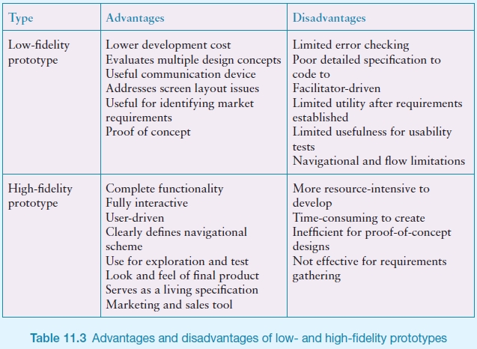

Slide 82
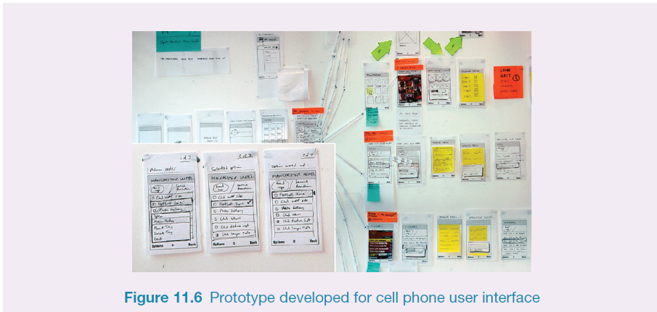
Generate card-based prototype from use case
26

Slide 83
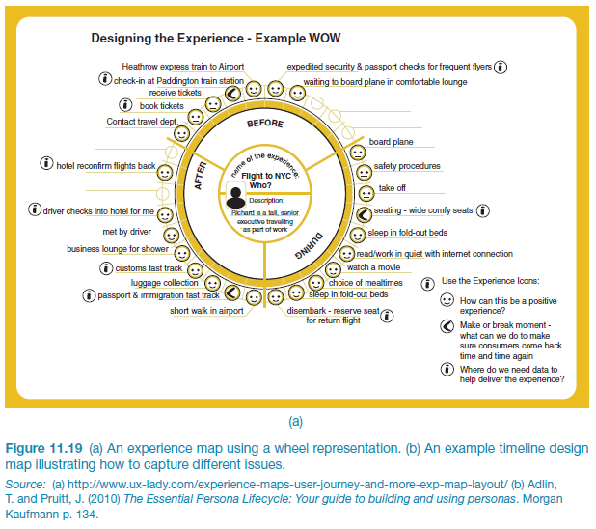
An experience map drawn as a wheel

Slide 84
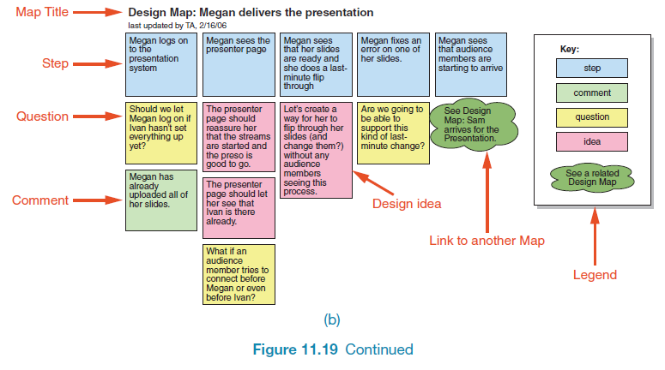
An experience map drawn as a timeline
29

Slide 85
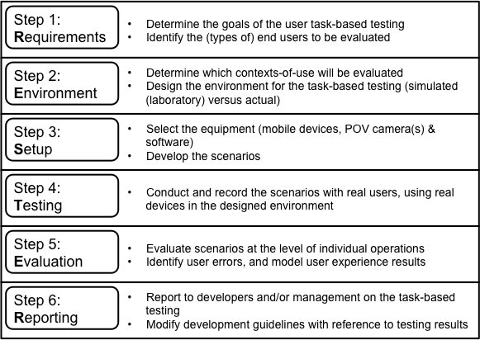
An approach…

Slide 86
errāre hūmānum est
(to err is human)

Slide 87
Testing Concepts
Testing – the process of examining a component, subsystem, or system to determine its operational characteristics and whether it contains any defects
Test case – a formal description of a starting state, one or more events to which the software must respond, and the expected response or ending state
Defined based on well understood functional and non-functional requirements
Must test all normal and exception situations
Test data – a set of starting states and events used to test a module, group of modules, or entire system
The data that will be used for a test case

Slide 88
Testing
Unit test – tests of an individual method, class, or component before it is integrated with other software
Integration test – tests of the behavior of a group of methods, classes, or components
Integration testing of object-oriented software is very complex because an object-oriented program consists of a set of interacting objects
System test – an integration test of an entire system or independent subsystem
Performance test or stress test – an integration and usability test that determines whether a system or subsystem can meet time-based performance criteria
Usability test – a test to determine whether a method, class, subsystem, or system meets user requirements
User acceptance test – a system test performed to determine whether the system fulfills user requirements

Slide 89
Evaluation methods
Method | Controlled settings | Natural settings | Without users
Observing | x | x
Asking users | x | x
Asking experts |  | x | x
Testing | x
Modeling |  |  | x
Notes:
89

Slide 90
Key points CHAPTER 13
Evaluation and design are very closely integrated.
Some of the same data gathering methods are used in evaluation as for establishing requirements and identifying users’ needs, e.g. observation, interviews, and questionnaires.
Evaluations can be done in controlled settings such as laboratories, less controlled field settings, or where users are not present.
Usability testing and experiments enable the evaluator to have a high level of control over what gets tested, whereas evaluators typically impose little or no control on participants in field studies.

Slide 91
Key points CHAPTER 14
Usability testing takes place in controlled usability labs or temporary labs.
Usability testing focuses on performance measures, eg. how long and how many errors are made when completing a set of predefined tasks. Indirect observation (video and keystroke logging), user satisfaction questionnaires and interviews are also collected.
Affordable, remote testing systems are more portable than usability labs. Many also contain mobile eye-tracking and other devices.
Experiments test a hypothesis by manipulating certain variables while keeping others constant.
The experimenter controls independent variable(s) in order to measure dependent variable(s).
Field studies are evaluation studies that are carried out in natural settings to discover how people interact with technology in the real world.
Field studies that involve the deployment of prototypes or technologies in natural settings may also be referred to as ‘in the wild’.
Sometimes the findings of a field study are unexpected, especially for in the wild studies in which explore how novel technologies are used by participants in their own homes, places of work, or outside.
Notes:
91

Slide 92
Revised version (2014) of Nielsen’s original heuristics
Visibility of system status
Match between system and real world
User control and freedom
Consistency and standards
Error prevention
Recognition rather than recall
Flexibility and efficiency of use
Aesthetic and minimalist design
Help users recognize, diagnose, recover from errors.
Help and documentation
Notes:
92

Slide 93
Key points CHAPTER 15
Inspections can be used to evaluate requirements, mockups, functional prototypes, or systems.
User testing & heuristic evaluation may reveal different usability problems.
Design guidelines can be used to develop heuristics
Walkthroughs are focused so are suitable for evaluating small parts of a product.
Analytics involves collecting data about users activity on a website or product
Notes:
93

Slide 94
Good luck in your exams Questions

