Slide 1
Applications
Chapter 8
A Semantic Web Primer
Grigoris Antoniou
Frank van Harmelen
A Semantic Web Primer

Slide 2
This lecture has three parts:
1] Part 1: Reminding you of some important
materials you have already learned,
2] Applications of Web Sematic,
3] Some further examples of SPARQL.

Slide 3
Part 1: Reminding you of some important materials you have already learned,

Slide 4




What are the problems with the current Keyword-Based Search Engines ?
Chapter 1
A Semantic Web Primer

Slide 5
Problems of Keyword-Based
Search Engines
High recall, low precision.
Low or no recall
Results are highly sensitive to vocabulary
Results are single Web pages
Human involvement is necessary to interpret and combine results
Results of Web searches are not readily accessible by other software tools
Chapter 1
A Semantic Web Primer

Slide 6
The Key Problem of Today’s Web
The meaning of Web content is not machine-accessible: lack of semantics
It is simply difficult to distinguish the meaning between these two sentences:
I am a lecturer of information Technology.
I am a lecturer of information Technology,
you may think. Well, . . .
Chapter 1
A Semantic Web Primer

Slide 7
Syntax vs Sematic
Syntax is about how a sentence is created whereas Semantic is about the meaning of the sentence.
Web has originally been about syntax!
Efforts have been made to push it towards semantic.
This subject is about these efforts.

Slide 8
The Semantic Web Approach
Represent Web content in a form that is more easily machine-processable.
Use intelligent techniques to take advantage of these representations.
The Semantic Web will gradually evolve out of the existing Web, it is not a competition to the current WWW.
Chapter 1
A Semantic Web Primer

Slide 9
Triplets, Classes, Subclasses, and Constraints, are the core of RDF and OWL.

Slide 10
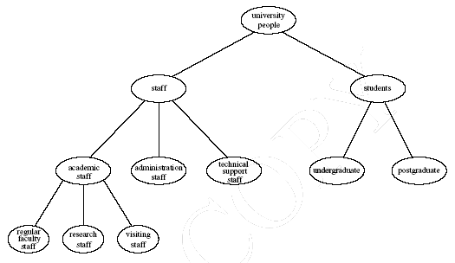
Example of a Class Hierarchy
A Semantic Web Primer

Slide 11
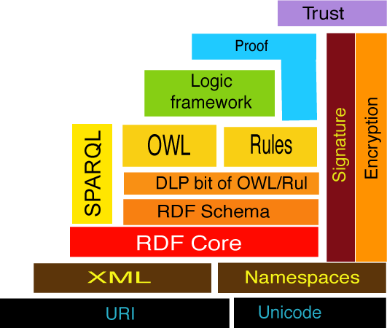
As you know in Specific Semantic Web Layer, Logic is on the top of OWL and SPARQL is used for query of RDF and OWL documents:

Slide 12
Logic and Inference
Logic is the discipline that studies the principles of reasoning
Formal languages for expressing knowledge
Well-understood formal semantics
  Declarative knowledge: we describe what holds without caring about how it can be deduced
Automated reasoners can deduce (infer) conclusions from the given knowledge
Chapter 1
A Semantic Web Primer

Slide 13
Tradeoff between Expressive Power and Computational Complexity
The more expressive a logic is, the more computationally expensive it becomes to draw conclusions
  Drawing certain conclusions may become impossible if non-computability barriers are encountered.
Chapter 1
A Semantic Web Primer

Slide 14
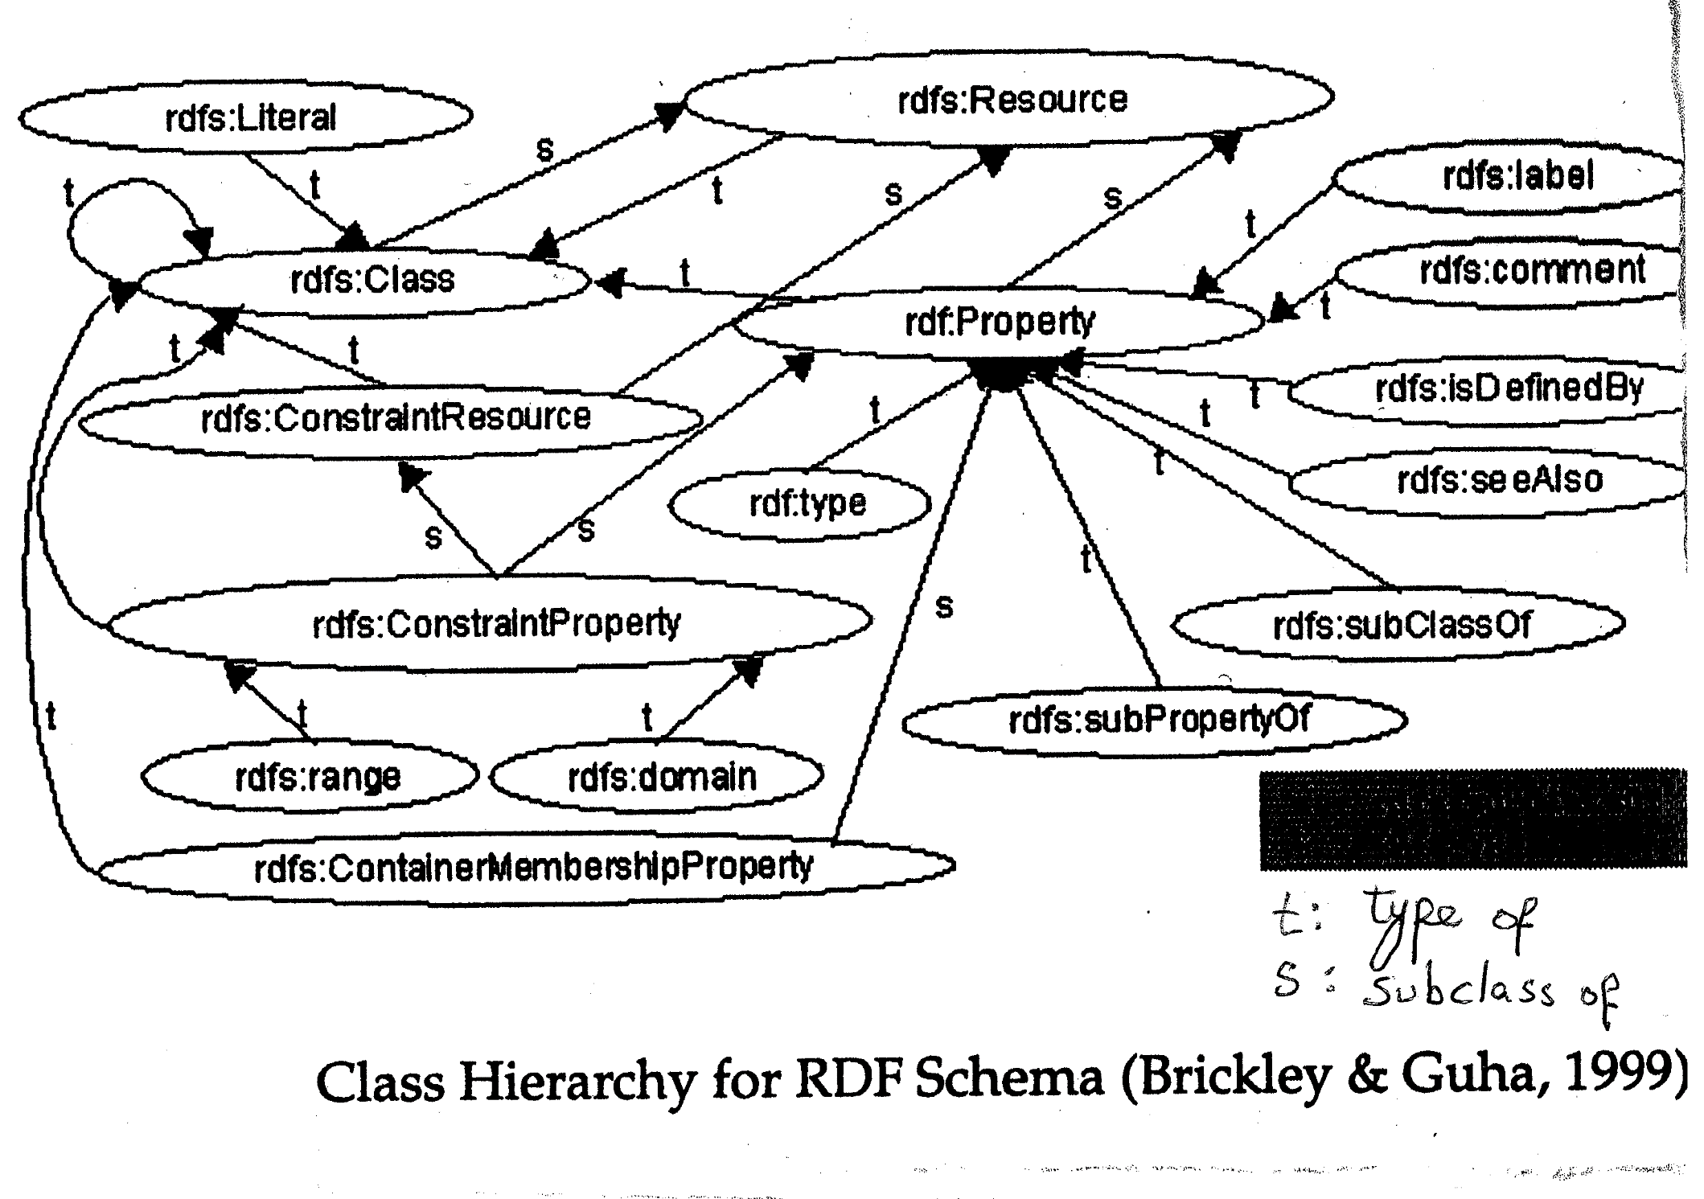
Class Hierarchy for RDF Schema (Source: Brickley & Guha 1999)

Slide 15
For instances, in Protégé if you add the following statement to General Class Axiom:
Disease and (causedBy some A)
SubClassOf: (hutrs only B)
The Debugger will prevent inconsistency by not allowing a disease caused by some A to hurt somewhere outside B !

Slide 16
Part 2] Applications of Web Sematic

Slide 17
Main Application Areas
Looking at industrial events, either dedicated events or co-organized with the major international scientific Semantic Web conferences, we observe that a healthy uptake of Semantic Web technologies is beginning to take shape in the following areas :
  Knowledge management, mostly in intranets of large corporations
  Data integration (Boeing, Verizon, and other)
  E-science, in particular the life sciences
  Convergence with Semantic Grid
Chapter 8
A Semantic Web Primer

Slide 18
Main Application Areas (2)
If we look at the profiles of companies active in this area, we see a transition from small start-up companies such as
  Aduna
  Ontoprise
  Network Inference
  Top Quadrant
To large vendors such as
  IBM (Snobase ontology Management System)
  HP (Jena RDF platform)
  Adobe (RDF-based XMP metadata framework)
  Oracle (support for RDF storage and querying in their datavase product)
Chapter 8
A Semantic Web Primer

Slide 19
The difference between successful and unsuccessful applications
A difference that seems to emerge between the successful and unsuccessful application areas is that the successful are all aimed at closed communities, whereas the applications aimed at the general public are still in the laboratory phase at best
The underlying reason for this could well be the difficulty of the ontology mapping
Chapter 8
A Semantic Web Primer

Slide 20
Applications:
Horizontal Information Products at Elsevier
Openacademia: Distributed Publication Management
Bibster: Data Exchange in a P2P System
Data Integration at Audi
Skill Finding at Swiss Life
Think Tank Portal at EnerSearch
E-Learning
Web Services
Other Scenarios
Chapter 6
A Semantic Web Primer

Slide 21
1-Elsevier – The Setting
Elsevier is a leading scientific publisher.
Its products are organized mainly along traditional lines:
  Subscriptions to journals
Online availability of these journals has until now not really changed the organisation of the productline
Customers of Elsevier can take subscriptions to online content
Chapter 6
A Semantic Web Primer

Slide 22
2-Openacademia – The Setting
Information about scientific publications is often maintained by individual researchers
Reference management software such as EndNote and BibTeX helps researchers to maintain personal collections of bibliographic references
Most researchers have to maintain a Web page about publications for interested peers from other institutes
Often personal reference management and the maintenance of Web pages are isolated efforts
The author of a new publication adds the reference to his own collection and updates his Web page
Chapter 6
A Semantic Web Primer

Slide 23
There is also AJAX-based interface for browsing and searching the publication collection which builds queries and displays the results
This interface offers a number of visualizations (e.g. see publications along a time line that can be scrolled using a mouse)
Chapter 6
A Semantic Web Primer

Slide 24
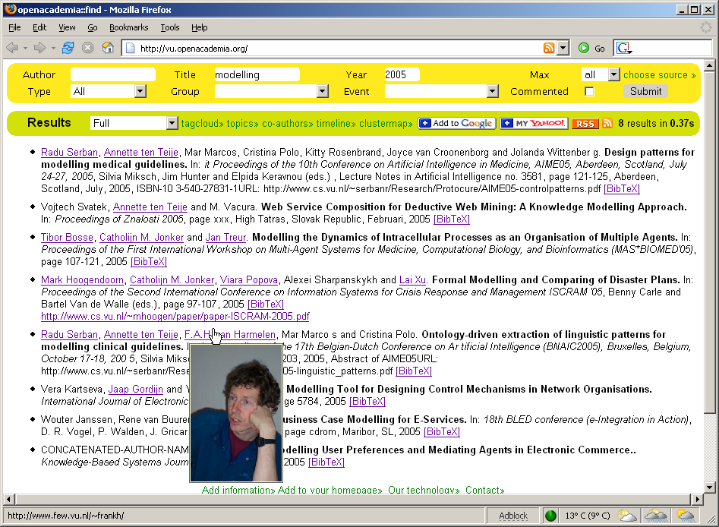
AJAX-based Query interface
Chapter 6
A Semantic Web Primer

Slide 25
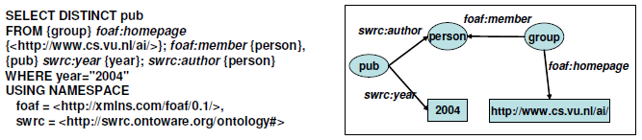
EXAMPLE of SPARQL
Chapter 6
A Semantic Web Primer

Slide 26
3-Bibster – The Setting
The openacademia system uses a semicentralized solution for collecting, storing and sharing bibliographic information
Centralized, because it harvests data into a single centralized repository.
Semi-centralized because it harvests the bibliographic data from the files of individual researchers
In this section we describe a fully distributed approach to the same problem.
Chapter 6
A Semantic Web Primer

Slide 27
4-Audi – The Problem
Data integration is also a huge problem internal to companies
  It is the highest cost factor in the information technology budget of large companies
  Audi operates thousands of databases
Traditional middleware improves and simplifies the integration process but it misses the sharing of information based on the semantics of the data
Chapter 6
A Semantic Web Primer

Slide 28
5-Swiss Life – The Setting
Swiss Life is one of Europe’s leading life insurers
  11,000 employees, $14 billion of written premiums
  Active in about 50 different countries
The most important resources of any company for solving knowledge intensive tasks are:
  The tacit knowledge, personal competencies, and skills of its employees
Chapter 6
A Semantic Web Primer

Slide 29
6-EnerSearch – The Setting
An industrial research consortium focused on information technology in energy
EnerSearch has a structure very different from a traditional research company
  Research projects are carried out by a varied and changing group of researchers spread over different countries
  Many of them are not employees of EnerSearch
Chapter 6
A Semantic Web Primer

Slide 30
7-E-Learning – The Setting
Traditionally learning has been characterized by the following properties:
  Educator-driven
  Linear access
  Time- and locality-dependent
  Learning has not been personalized but rather aimed at mass participation
Chapter 6
A Semantic Web Primer

Slide 31
8-Web Services
Web sites that do not merely provide static information, but involve interaction with users and often allow users to affect some action
Simple Web services involve a single Web-accessible program, sensor, device
Complex Web services are composed of simpler services
  Often they require ongoing interaction with the user
  The user can make choices or provide information conditionally
Chapter 6
A Semantic Web Primer

Slide 32
9-Device Interoperability at Nokia
These devices should be able to:
  Discover each others’ functionality
  Take advantage of it
Devices must be able to “understand” other devices and reason about their functionality
Ontologies are required to make such understanding of functionalities possible
Chapter 6
A Semantic Web Primer

Slide 33
Key Research Challenges
The following three items on the research agenda have had a crucial impact on the feasibility of the Semantic Web vision:
  Interaction between machine-processable representations and the dynamics of social networks of human users
  Mechanisms to deal with trust, reputation, integrity and provenance in a semiautomated way
  Inference and query facilities that are sufficiently robust to work in the face of limited resources (computational time, network latency, memory, or storage space) and that can make intelligent trade-off decisions between resource use and output quality
Chapter 8
A Semantic Web Primer

Slide 34
Applications:
https://www.youtube.com/watch?v=bsNcjya56v8

Slide 35
Web 1:
https://differential.com/insights/14-technologies-every-web-developer-should-be-able-to-explain/
Web 2: http://whatis.techtarget.com/definition/Web-20-or-Web-2
Web 3:
http://www.expertsystem.com/web-3-0/
https://1stwebdesigner.com/what-is-web-3-0/

Slide 36
Part 3: Some Practice on SPARQL

Slide 37
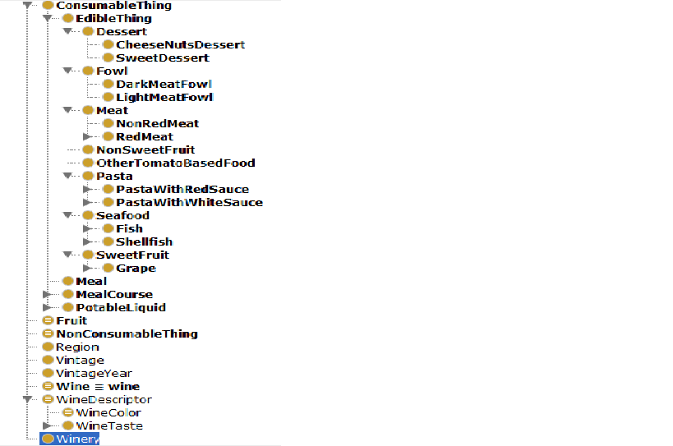
The Structure of food.rdf

Slide 38
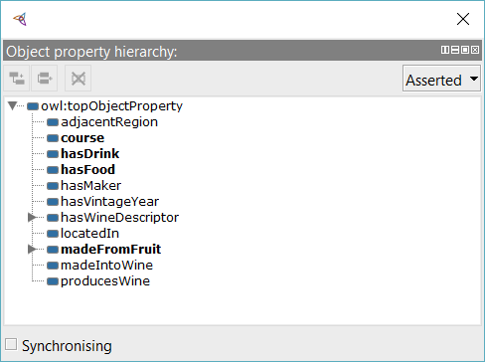
The Structure of food.rdf

Slide 39
Object Property Domain Range
course Meal MealCourse
hasDrink MealCourse PotableLiquid
hasFood MealCourse EdibleThing
LocatedIn Thing Region

Slide 40
Before Trying to use SPARQL in the food.rdf, do not forget to add default name space as its name space with the following line
PREFIX : <http://www.w3.org/TR/2003/PR-owl-guide-20031209/food#>

Slide 41
SELECT *
WHERE {
?individual rdf:type :SweetDessert .
}
ORDER BY ?individual
Result Should be:
Cake
Pie

Slide 42
Write a SPARQL command that can find the number of triplets (in food.rdf or any other rdf file)

Slide 43
Answer
SELECT ( count (?property) as ?numPro)
WHERE {
?subject ?property ?object .
}

Slide 44
Write the code for finding how many times each property has appeared in triplets.

Slide 45
ANSWER
SELECT ?property ( count (?property) as ?numPro)
WHERE {
?subject ?property ?object .
}
GROUP BY ?property

Slide 46
Write the code to find the individuals in each class.

Slide 47
Answer:
SELECT distinct ?individual ?class
WHERE {?individual rdf:type ?class }
ORDER BY ?class
You need to wait for several seconds depending on your computer speed!

Slide 48
A SPARQL command for displaying the individuals of subclasses of each class!
SELECT *
WHERE {
?individual rdf:type ?type .
?type rdfs:subClassOf ?class
}
ORDER BY ?class

Slide 49
Change the previous command so that not only the individuals of subclasses of each class are displayed but its own individuals are also displayed.

Slide 50
Answer
SELECT *
WHERE {
?individual rdf:type ?type .
OPTIONAL { ?type rdfs:subClassOf ?class }
}
ORDER BY ?class

Slide 51
Individuals Belonging to SubClasses of Dessert :
SELECT *
WHERE {
?individual rdf:type ?type .
?type rdfs:subClassOf :Dessert
}
ORDER BY ?class

Slide 52
Note that in majority of situations the prefixes for owl, rdf, rdfs, etc in your rdf file and that in SPARQL dispalay of Protégé is not the same and that is why many of your SPARQL queries in Protégé stop working!
You need to make them consistent for your queries to work.
Also most probably there are other prefixes used in your RDF files which are not present in your SPARQL, and these prefixes should also be added!

Slide 53
In your food.rdf you have
<rdf:RDF
xmlns = "http://www.w3.org/TR/2003/PR-owl-guide-20031209/food#"
xmlns:food= "http://www.w3.org/TR/2003/PR-owl-guide-20031209/food#"
xml:base = "http://www.w3.org/TR/2003/PR-owl-guide-20031209/food#"
xmlns:vin = "http://www.w3.org/TR/2003/PR-owl-guide-20031209/wine#"
xmlns:owl = "http://www.w3.org/2002/07/owl#"
xmlns:rdf = "http://www.w3.org/1999/02/22-rdf-syntax-ns#"
xmlns:rdfs= "http://www.w3.org/2000/01/rdf-schema#">

Slide 54
Hence the namespaces introduced at the start of your SPARQL display, in Protégé, should be something like the following !!
PREFIX food: <http://www.w3.org/TR/2003/PR-owl-guide-20031209/food#>
PREFIX : <http://www.w3.org/TR/2003/PR-owl-guide-20031209/food#>
PREFIX vin: <http://www.w3.org/TR/2003/PR-owl-guide-20031209/wine#>
PREFIX owl: <http://www.w3.org/1999/02/22-rdf-syntax-ns#>
PREFIX rdf: <http://www.w3.org/1999/02/22-rdf-syntax-ns#>
PREFIX rdfs: <http://www.w3.org/2000/01/rdf-schema#>

Slide 55
Suppose you have three classes of
Director, (ii) Movie, and (iii) Actor.
Also assume you have the following properties:
Played-in, and (ii) directed,
Played-in → Domain (Actor) , Range (Movie)
Directed → Domain (Director), Range (Movie)

Slide 56
Write a SPARQL statement for writing the number of movies in which each actor has played
Hint: use GROUP BY

Slide 57
Answer:
SELECT ?actor (count(?movie) as ?movieCount)
Where {
?actor played-in ?movie
}
GROUP BY ?actor

