Slide 1
Chapter 5
Logic and Inference
Grigoris Antoniou
Frank van Harmelen

Slide 2
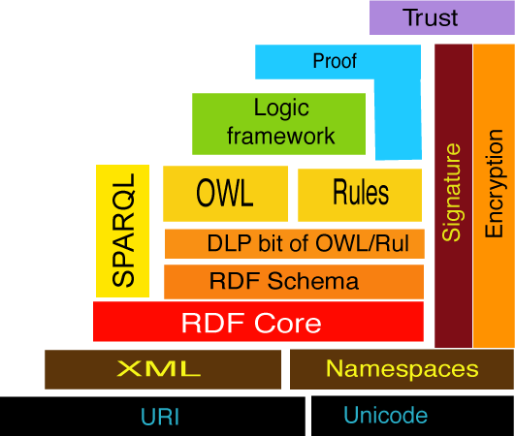
As you know in Specific Semantic Web Layer, Logic is on the top of OWL and SPARQL is used for query of RDF and OWL documents:

Slide 3
Nesting of Boolean Operators
<owl:Class rdf:ID="adminStaff">
<owl:intersectionOf rdf:parseType="Collection">
<owl:Class rdf:about="#staffMember"/>
<owl: Class>
<owl:complementOf>
<owl: Class>
<owl:unionOf rdf:parseType="Collection">
<owl:Class rdf:about="#faculty"/>
<owl:Class rdf:about=#techSupportStaff"/>
</owl:unionOf>
</owl: Class>
</owl:complementOf>
</owl: Class>
</owl:intersectionOf>
</owl:Class>
Staff = admin+faculty+technical
Chapter 4
A Semantic Web Primer

Slide 4
Also you learned how in OWL you can express concepts like FacultySCIT:
<owl:Class rdf:ID="facultyInSCIT">
<owl:intersectionOf rdf:parseType="Collection">
<owl:Class rdf:about="#faculty"/>
<owl:Restriction>
<owl:onProperty
rdf:resource="#belongsTo"/>
<owl:hasValue rdf:resource= "#SCIT"/>
</owl:Restriction>
</owl:intersectionOf>
</owl:Class>

Slide 5
Intersection of Horn Logic and OWL is called DLP (Description Logic Program).

Slide 6
Logic is the foundation of Knowledge Representation.

Slide 7
The Importance of Logic
High-level language for expressing knowledge
High expressive power
Well-understood formal semantics
Precise notion of logical consequence
Proof systems that can automatically derive statements syntactically from a set of premises

Slide 8
The Importance of Logic (2)
There exist proof systems for which semantic logical consequence coincides with syntactic derivation within the proof system
  Soundness & completeness
Predicate logic is unique in the sense that sound and complete proof systems do exist.
  Not for more expressive logics (higher-order logics)
trace the proof that leads to a logical consequence.
Logic can provide explanations for answers
  By tracing a proof

Slide 9
Specializations of Predicate Logic:
RDF and OWL (1)
The languages of RDF and OWL can be viewed as specializations of predicate logic (first order logic).
More expressive logics (higher order logics) do not have such proof systems.
Predicate logic and its special cases are monotonic, in the sense that, if a conclusion can be drawn, it remains valid even if new knowledge becomes available.

Slide 10
Specializations of Predicate Logic:
RDF and OWL (2)
RDF/S and OWL (Lite and DL) as specializations of predicate logic correspond roughly to a description logic (DL).
They define reasonable subsets of logic
Trade-off between the expressive power and the computational complexity:
  The more expressive the language, the less efficient the corresponding proof systems

Slide 11
Horn Logic
In Horn Logic
a rule is represented as:
A1, . . ., An → B

Slide 12
Specializations of Predicate Logic:
Horn Logic
A rule has the form: A1, . . ., An → B
  Ai and B are atomic formulas
In Horn logic, there are 2 ways of reading such a rule:
  Deductive rules: If A1,..., An are known to be true, then B is also true
  Reactive rules: If the conditions A1,..., An are true, then carry out the action B

Slide 13
Description Logics vs. Horn Logic
Neither of them is a subset of the other
It is impossible to assert that a person X who is brother of Y is uncle of Z (where Z is child of Y) in OWL
  This can be done easily using rules:
  brother(X,Y), childOf(Z,Y) → uncle(X,Z)
Rules cannot assert the information that a person is either a man or a woman
  This information is easily expressed in OWL using disjoint union

Slide 14
Monotonic vs. Non-monotonic Rules
Example: An online vendor wants to give a special discount if it is a customer’s birthday
Solution 1
R1: If birthday, then special discount
R2: If not birthday, then not special discount
But what happens if a customer refuses to provide his birthday due to privacy concerns?

Slide 15
Monotonic vs. Non-monotonic
Rules (2)
Solution 2
R1: If birthday, then special discount
R2’: If birthday is not known, then not special discount
Solves the problem but:
  The premise of rule R2' is not within the expressive power of predicate logic
  We need a new kind of rule system

Slide 16
Monotonic vs. Non-monotonic
Rules (3)
The solution with rules R1 and R2 works in case we have complete information about the situation
The new kind of rule system will find application in cases where the available information is incomplete
R2’ is a nonmonotonic rule

Slide 17
Exchange of Rules
Exchange of rules across different applications
  E.g., an online store advertises its pricing, refund, and privacy policies, expressed using rules
The Semantic Web approach is to express the knowledge in a machine-accessible way using one of the Web languages we have already discussed
We show how rules can be expressed in XML-like languages (“rule markup languages”)

Slide 18
Information of a logic program can be provided from different websites.
A crawler is a compute program which visits Web sites and reads their pages and then parses the information in these web site to visit other websites!!

Slide 19
Crawlers can create entries for a search engines
All search engines on the Web have such a program.

Slide 20
The term crawler signifies the fact that they crawl through an entire site a page at a time. A crawler crawls different sites following the links to other sites.
For doing such a highly sophisticated task, they can be programmed in an extremely easy recursive fashion.

Slide 21
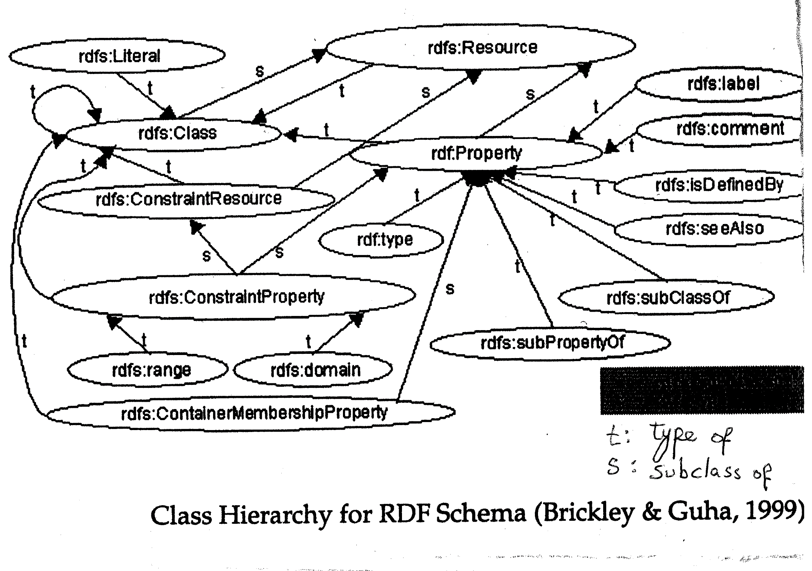
Class Hierarchy for RDF Schema (Source: Brickley & Guha 1999)

Slide 22
XPATH and SPARQL are for searching RDF files. Whereas XPATH works for all XML files, including RDF, SPARQL cannot search any XML files and needs triplets to search:
Subject, Property ,Object
I LIKE RDF
YOU GET THE-CD
FRED PUSHED THE-TABLE
THE-RACE-CAR HAS_SPEED_OF 300_KM/HOUR

Slide 23
If you are not already familiar with AJAX, please have a quick review on it, as XPATH is used in AJAX.
AJAX XML File

Slide 24
Source:_x000b_http://www.w3schools.com/xsl/xpath_intro.asp
What is XPath?
XPath is a syntax for defining parts of an XML document
XPath uses path expressions to navigate in XML documents
XPath contains a library of standard functions
XPath is a major element in XSLT
XPath is a W3C recommendation

Slide 25

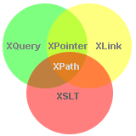
You may be already familiar with XPath, as it is used for searching XML files.
As you know RDF files are of XML type!
https://www.w3schools.com/xml/xpath_intro.asp

Slide 26
Assume you have a Person class and property called parent. Both the domain and range of parent is Person.In the following we write DL query to display the grandparents of “Jim” which is a member of Person class:
Person and parent some (parent value Jim)
Note to the usage of and, some, and value in DL

Slide 27
As you know, OWL and RDF do not make the Unique Name Assumption:
If you assert p(a,b) and p(a,c) and then ask for p min 2 in DL, you will not obtain a , because it could be that b=c , and in that case “a” may not have necessarily two values for p !!
However if you assert that b ≠ c, then p min 2 in DL will result to a.

Slide 28
If you go to “Edit” menu item and select
“Make all individuals Distinct”,
then all of your current individuals will become distinct from one another.
Try not to do so, as this makes some reasoners confused!

Slide 29
Team
Player
Position
team1 employs player1
player1 plays position1

Slide 30
Assume you have the following ontology
:hasPet a owl:ObjectProperty;
rdfs:domain :Human;
rdfs:range :Animal;
:Tim a :Human;
hasPet :dogy.

Slide 31
hasPet exactly 1 Animal
does not return Tim because if we do know that he has dogy, it does not mean that he has not any other animal. This is Open World Assumptions OWL sticks to ! Maybe we are not aware of:
:Tom hasPet :catten, mousy.
In other words, OWL and RDF doe not assume that the provided data are exhaustive enumeration of everything in the world and that there may be many things that are true and are not in the owl (or rdf) document

Slide 32
More Plainlely:
The absence of an assertion of p (a, c) does not imply that
not( p (a, c) ),
but rather just that there is no judgment yet on
p (a, c)
In fact, unlike in databases, in open world reasoning nothing is assumed to be false unless it has explicitly been stated !

Slide 33
Go to the Individuals tab, select Tim, click the "+" button next to Types, go to the Class expression editor tab, and enter,
hasPet only { Dogy }
And the problem will be solved. Now
hasPet excatly 1
Will result to Tim !
The reason is that not only Tim is in the class Person but in the class:
hasPet only { Dogy }
As well !

Slide 34
Assume there are three colours:
Colours :{red, white, blue}
And in the set Flower, every flower can have one or more colour(s).
The following DL query
Flower and hasColor value red
does return any flower with red colour but not every flower with ONLY red colour.
Even changing it to
Flower and (hasColor only {red})
does not solve the problem. WHY?

Slide 35
ANSWER
Because OWL uses the open world assumption. and if we know that a flower has red colour, it does not mean that it does not have other colour. It can have other colours not stated in the dataset.
Again the solution is to go to the Individuals tab, select flower1, click the "+" button next to Types, go to the Class expression editor tab, and enter,
hasColour only { red }

Slide 36
In DL, the difference between some and only is as follows:
when we say that we look for a flower that has some colour red and white, if a flower is white and yellow is selected, however,
when we say that we look for a flower that has only colour red and white then a flower which is red or white or (red and white) is selected but a flower which has some extra colour is not slected !
In fact ”only” is about closure and closes off extra options, whereas ”some” does not do so.

Slide 37
Assume that you have the following classes:
Manual
Document
Instruction
Product
Camera
Watch
Weight ( light, medium, heavy)
As you notice, the class Weight has three individuals ( light, medium, heavy), and class Product has two subclasses (Camera, Watch), with their corresponding individuals, not represented here. The class Manual has two subclasses Document and Instruction.
Also you have two properties:
hasWeight (Doamain:Product, Range:Weight) &
about (Domain: Manual , Range:Product)
Based on the above information, write the necessary DL statement in Protégé to display the list of instructions for light weight cameras:

Slide 38
Answer:
Instruction and about some (Camera and hasWeight value light)

Slide 39
You can make a class, the subclass of one or several anonymous classes. An anonymous class can be simply created by DL statements:
property exactly 1 class or { , , , }
property only class or { , , , }
property min 3 class or { , , , }
property max 5 class or { , , , }
property some class or { , , , }

Slide 40
Example:
Team and employs min 3 (Player and hasPosition some {striker, rightBack})

Slide 41
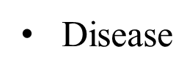
Assume that in Protégé you have the classes of (i) Disease,
(ii) Symptom, and (iii) Source.
and the following properties:
hasSymptom (Domain: Disease , Range : Symptom)
causedBy (Domain: Disease , Range : Source)
Also assume, each of these three classes have several items.
Two of the items of Symptoms are:
fever, and (ii) headache,
and two of the items of Source are
(i) genes and (ii) environment.
Write a DL query for displaying diseases which are caused by genes and have the full combination headache and fever as their symptoms.

Slide 42
Answer:
Disease and (causedBy value genes)
and (hasSymptom value fever)
and (hasSymptom value headache)

Slide 43
Assume you have a class DogLike and you intend to state that if something runs like a Dog, and smells like a Dog, then it is a DogLike:
((runsLike some Dog) and
(smellsLike some Dog)) SubClassOf Dog
As you notice the left hand side is a complex class expression (General Class Axiom). In Protégé, under the Active Ontology tab (the first tab in Protégé 5), you can find General Class Axiom to enter the above statement.

Slide 44
Note that what we did in General Class Axiom, was not to introduce a sub-class of a class through some DL expression. This could be done by introducing a class, say CameraPart, and writing the expression as the name of super-class combined with extra expression in its Equivalence part:
Equivalent Of : Part and belongs some Camera
What we did in General Class Axiom, in fact, was to implicitly place some individuals in our class !
In a nutshell, in a General Class Axiom you say things about complex descriptions of entities without using any naming.

Slide 45
If you add the following statement to General Class Axiom:
Disease and (causedBy some A)
SubClassOf: (hutrs only B)
The Debugger will prevent inconsistency by not allowing a disease caused by some A to hurt somewhere outside B !

