Slide 1
Who’s line is it?
By: Yaniv Bronshtein

Slide 2
Problem: What can we learn from a movie script?
Relationships between characters
Character growth(if we have data from multiple movies/books)
Who said the line -> NLP -> Multi-category text classification!

Slide 3
The Datasets

Slide 4
Lord of The Rings
Source:
https://www.kaggle.com/paultimothymooney/lord-of-the-rings-data
About:
Two csv files of which only lotr_scripts.csv was used
Based on the trilogy containing the Fellowship of the Ring, Two Towers, and The Return of the King
Lotr_scripts.csv contains 3 columns: ‘char’, ‘dialog’, and ‘movie’ where ‘char’ is the character name, ‘dialog’ is their line, and Movie is one of three values

Slide 5
Data Cleaning
Load Data From csv files
Look at values in columns to note necessary transformations
Removing garbage characters
Fixing Spelling
Changing Case
Removing Stopwords

Slide 6
2. Building a dictionary
Character | Lines | Movie
Frodo | Bloop bleh bloop | Fellowship…
Gollum | My precious precious | Two Towers
Frodo | Ipsum ipsum ipsum | Return of The King
Character | Lines | Movie | Vocab
Frodo | Bloop bleh bloop | Fellowship… | {bloop:2, bleh:1}
Gollum | My precious precious | Two Towers | {my:1, precious:2}
Frodo | Ipsum ipsum ipsum | Return of the King | {ipsum:3}

Slide 7
THE MEGADICT
{
Frodo: {
bloop:2,
bleh:1,
Ipsum:3
},
Gollum: {
my:1,
precious:2
}
}

Slide 8
Relationships between characters
For each character in the top 10, use consolidate_char_vocab() to get their “mega corpus”
Use depth first search to create a graph using the networkx library
In the get_relationships() function, there is a threshold parameter that allows for choosing the criteria to create in edge
For example, if thresh=4, an edge(relationship) is created between two characters if a character references another character at least 4 times throughout a given movie

Slide 9
Relationships:
Fellowship of the Ring

Slide 10
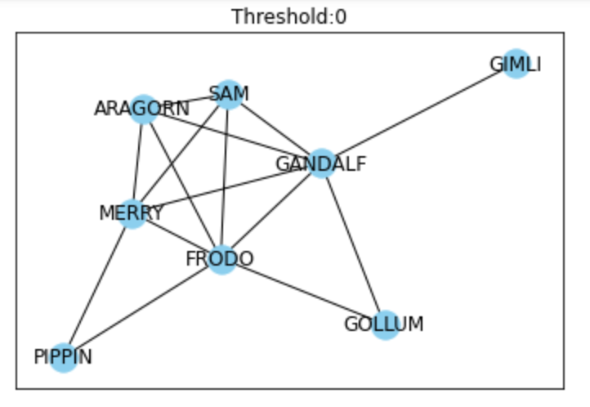

Slide 11
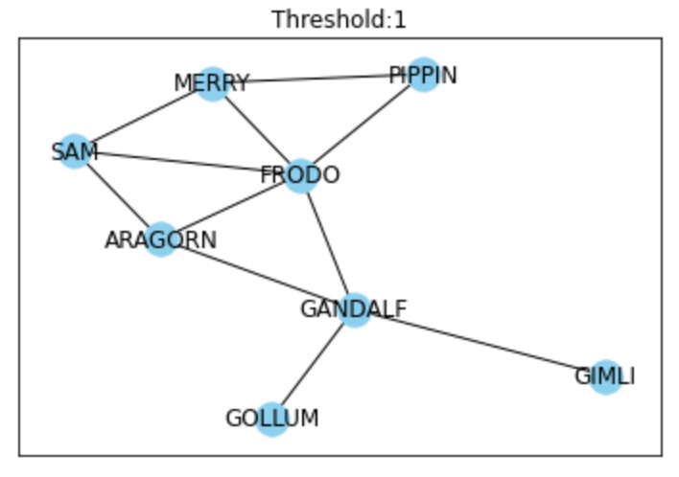

Slide 12
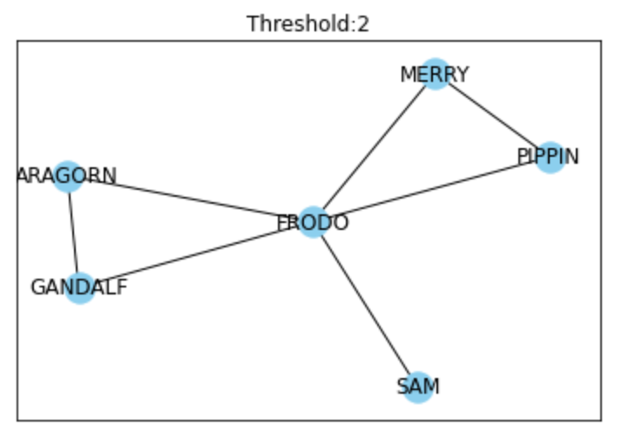

Slide 13
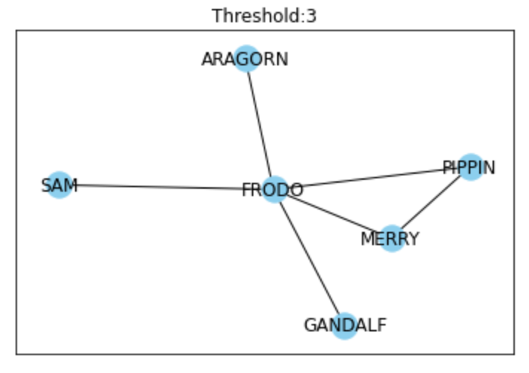

Slide 14
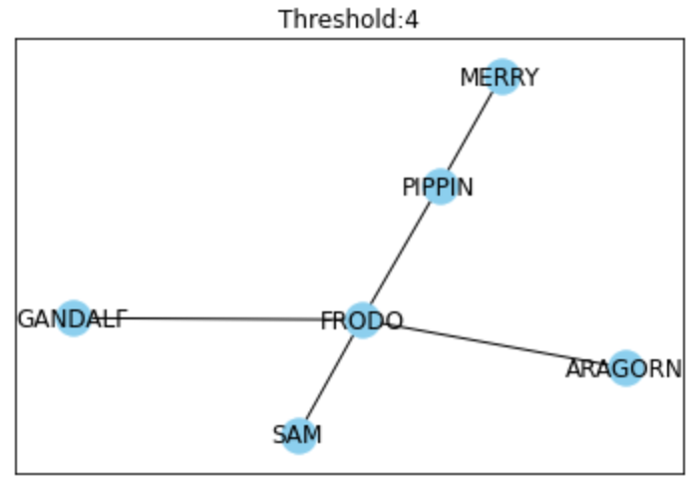

Slide 15
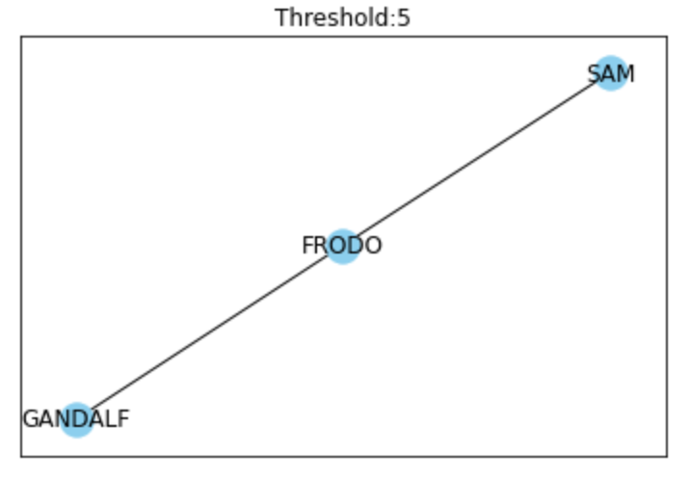

Slide 16
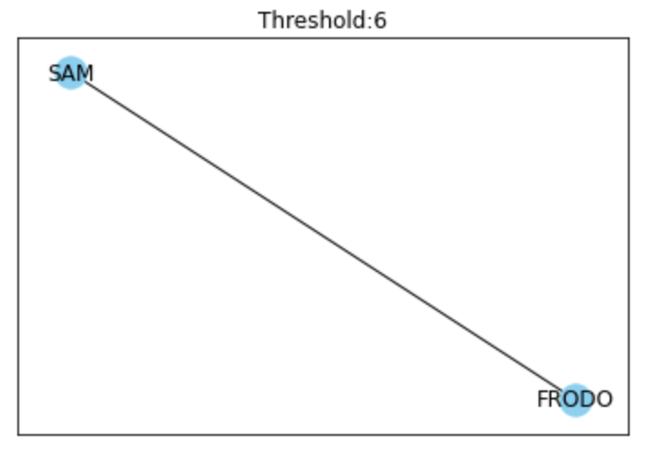

Slide 17
Relationships:
The Two Towers

Slide 18
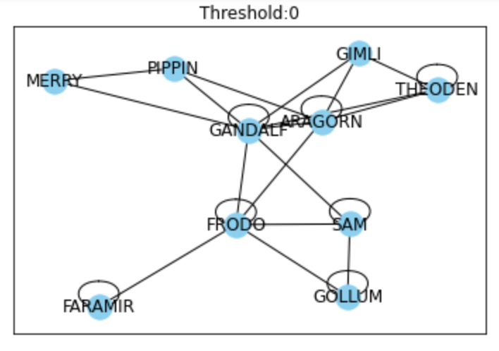

Slide 19
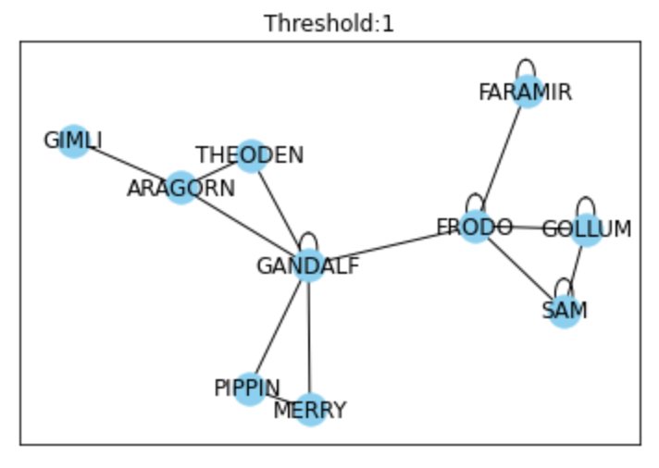

Slide 20
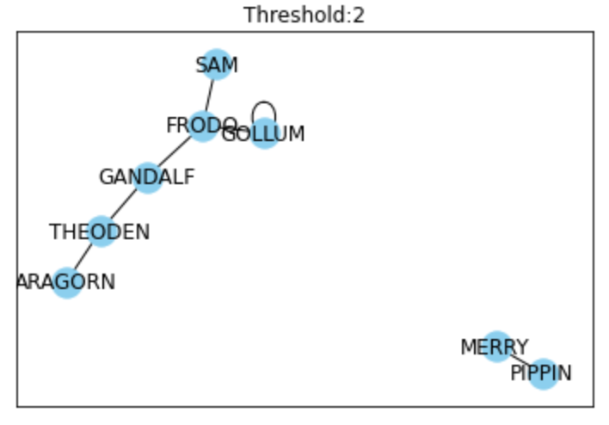

Slide 21
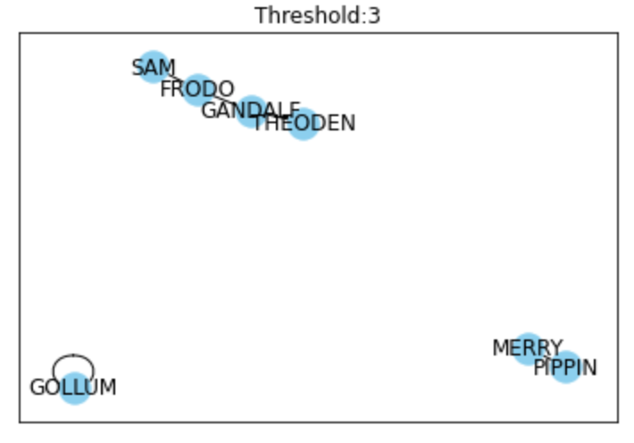

Slide 22
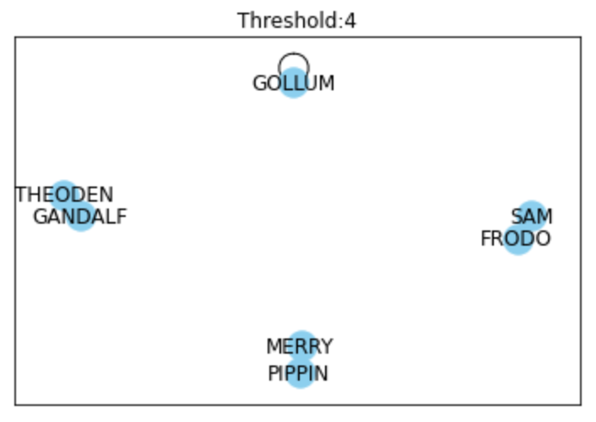

Slide 23
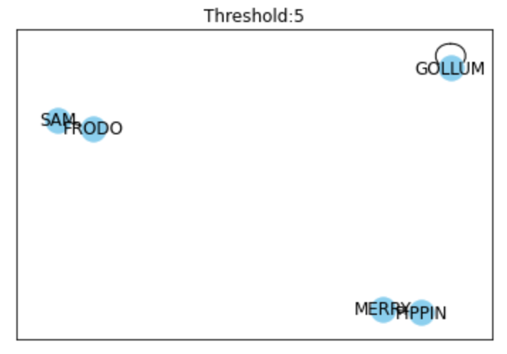

Slide 24
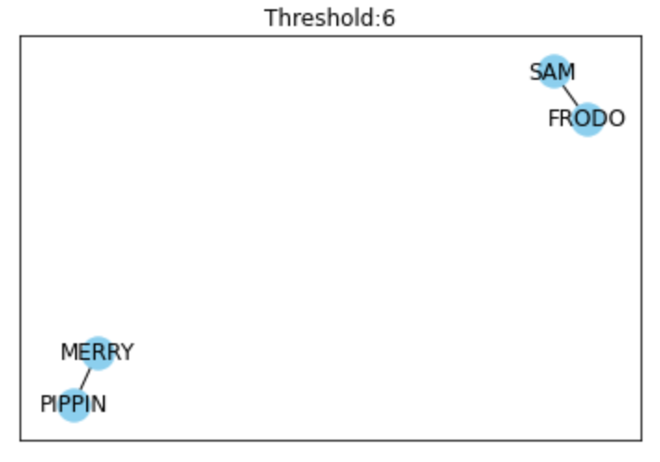

Slide 25
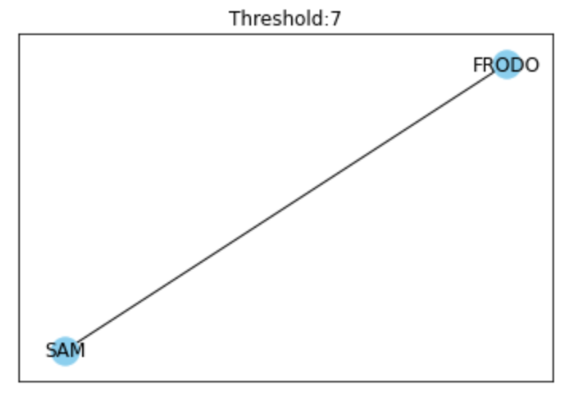

Slide 26
Relationships:
The Return of The King

Slide 27
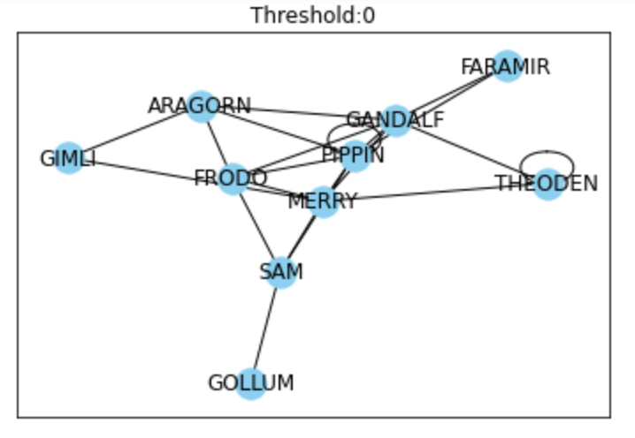

Slide 28
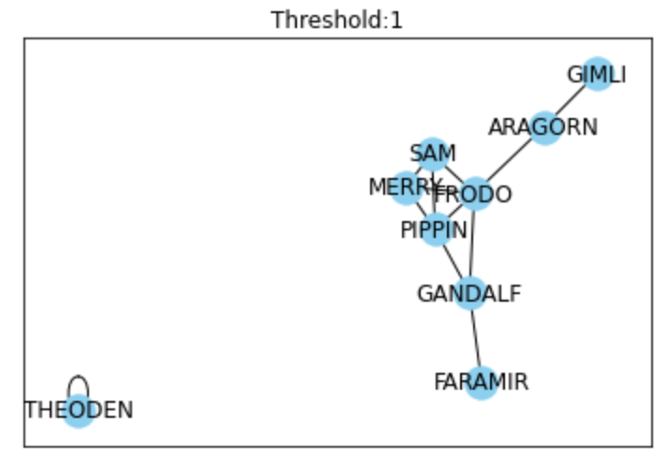

Slide 29
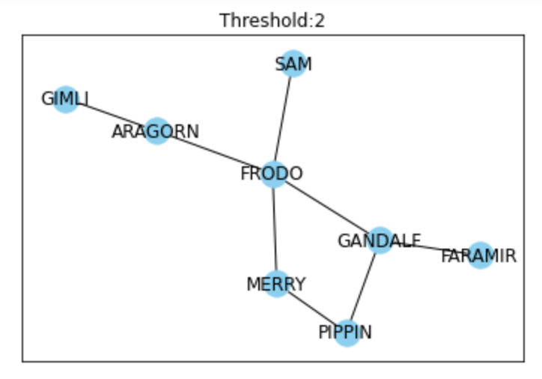

Slide 30
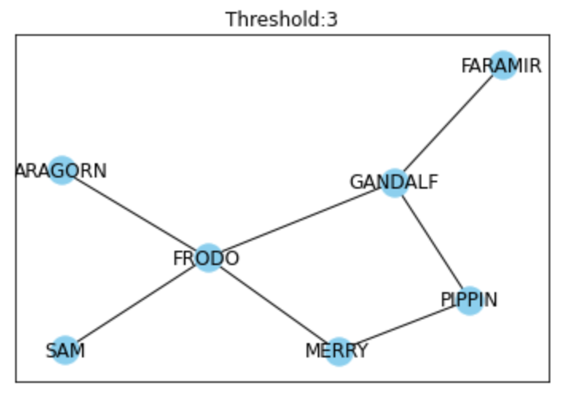

Slide 31
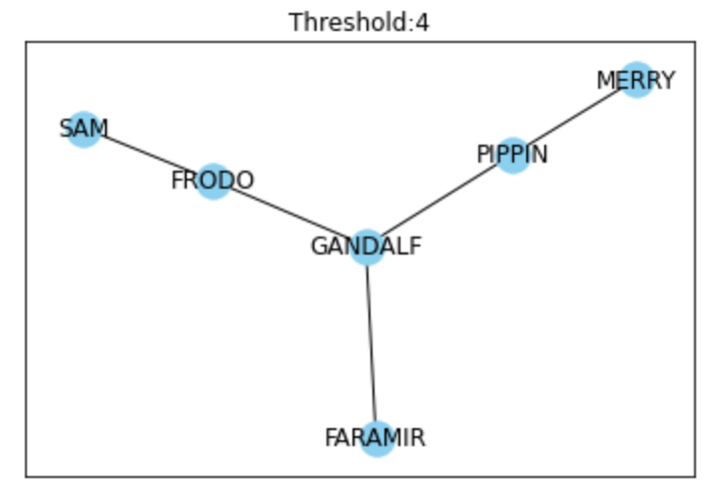

Slide 32
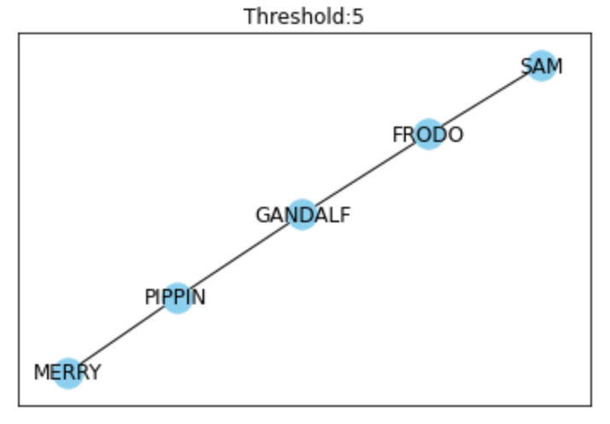

Slide 33
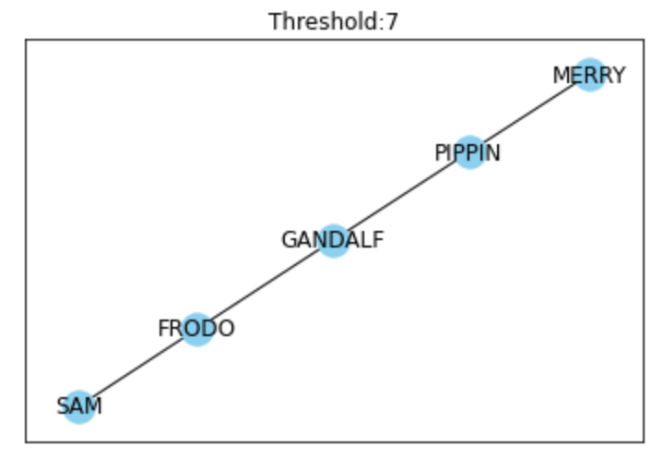

Slide 34
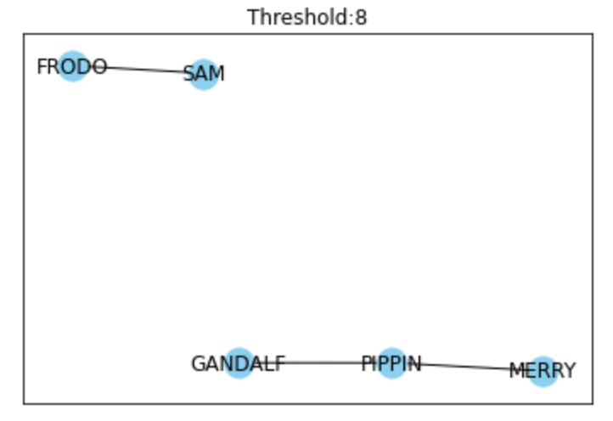

Slide 35
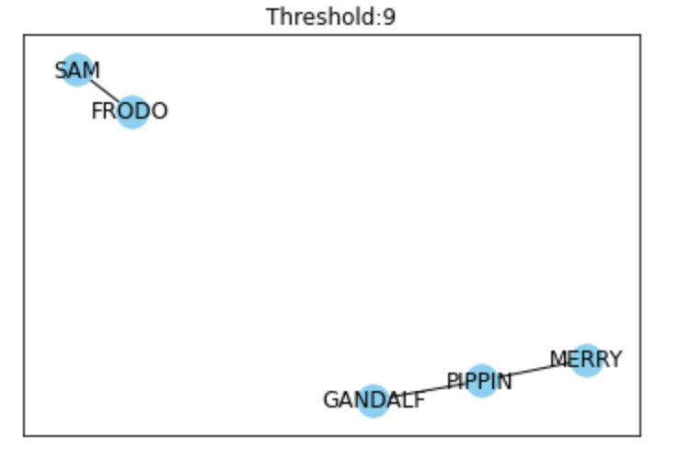

Slide 36
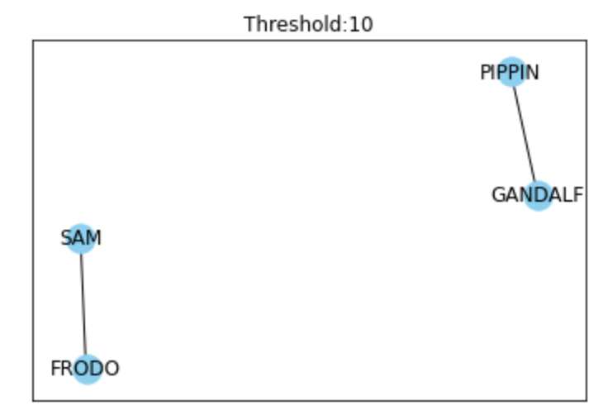

Slide 37
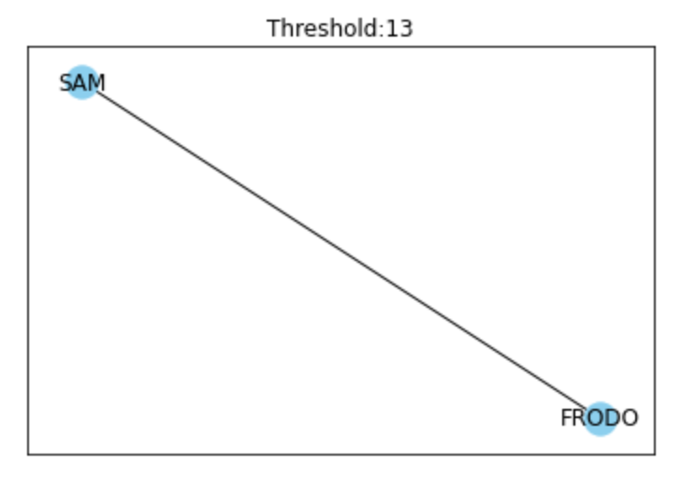

Slide 38
Summary Stats
 | Max Thresh | Chars at Max Thresh | Comments
Movie #1 | 6 | Sam, Frodo | Has the smallest # of chars
Movie #2 | 7 | Sam, Frodo | Has cycles
Movie #3 | 13 | Sam, Frodo | Has highest thresh

Slide 39
2. Character Growth
Previously, bar plots were used to analyze the top 5 words for a character for the entire trilogy
Problem? Some characters do not have lines in all the movies
Character growth can mean change of vocabulary or even just more speaking lines

Slide 40
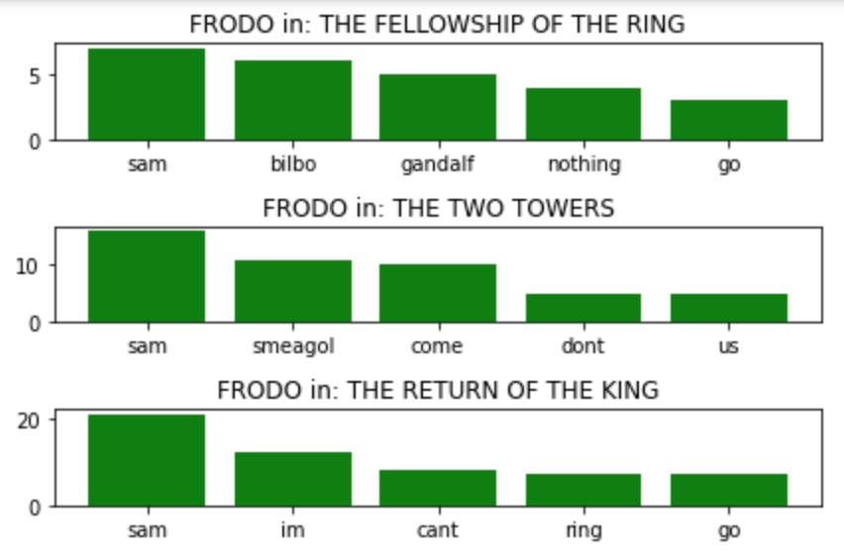
Notes:
Starts relying on Sam more as the movies progress

Slide 41
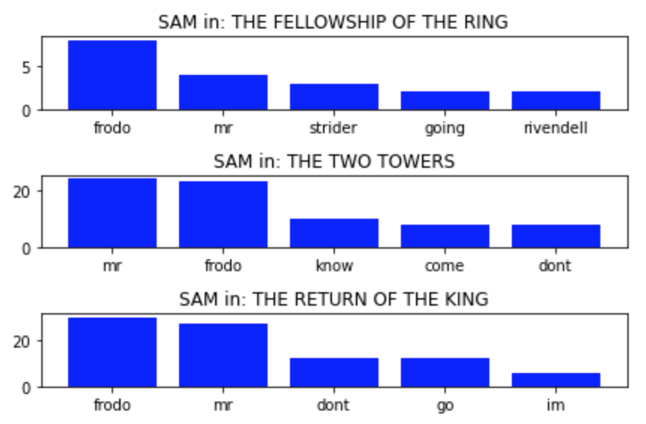
Notes:
Subservient and deeply loyal to Frodo

Slide 42
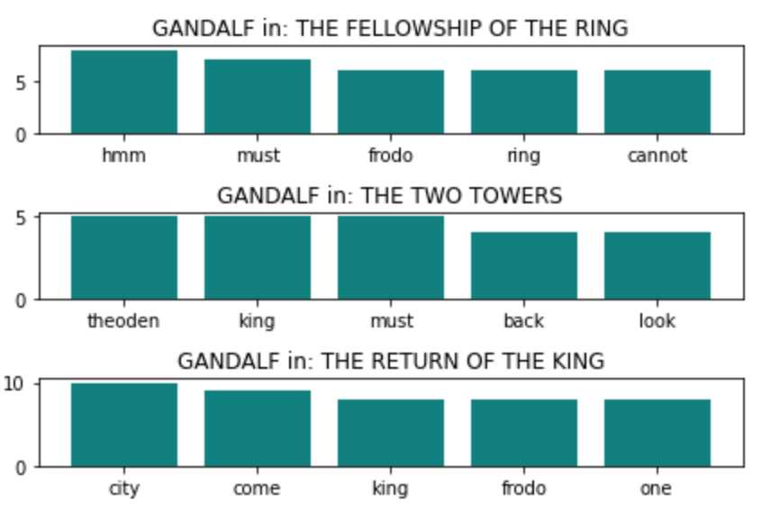

Slide 43
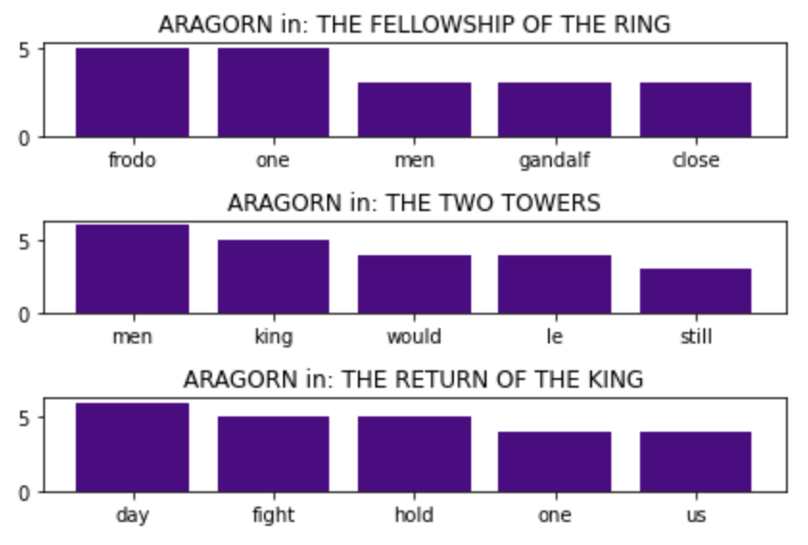
Notes:
Becomes more confident as a King

Slide 44
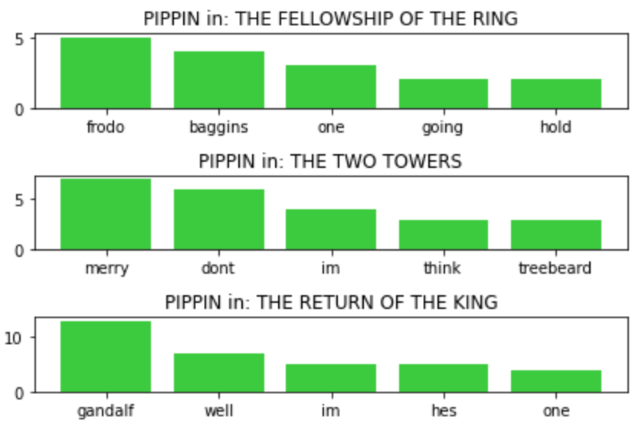
Notes:
Comes to rely on Gandalf more towards the end

Slide 45
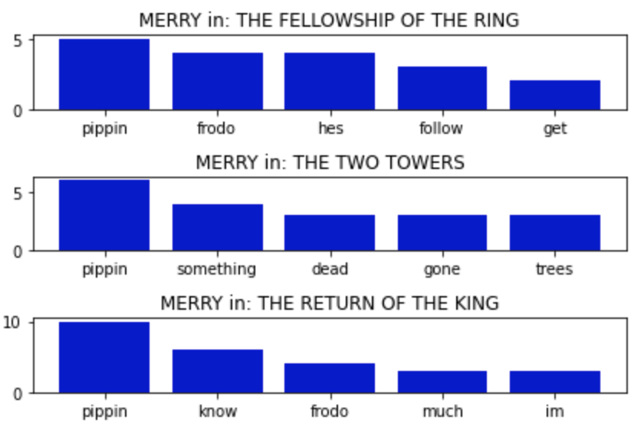
Notes:
Obsessed with Pippin

Slide 46
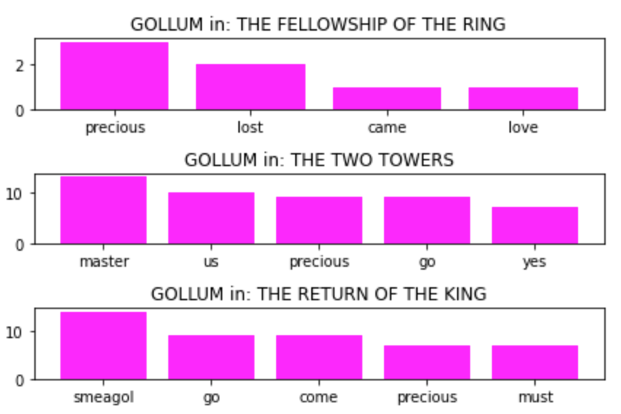

Slide 47
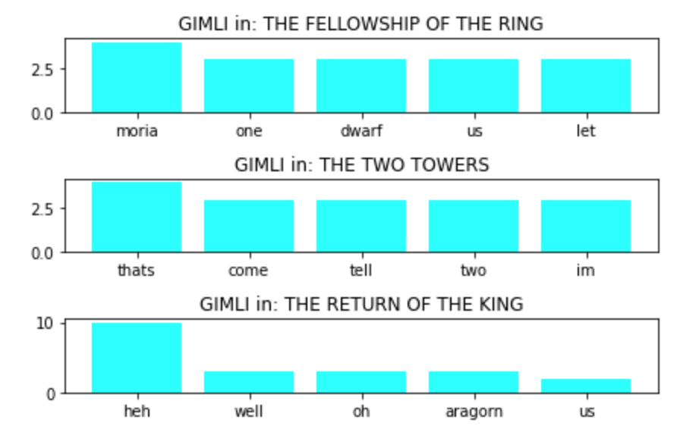

Slide 48
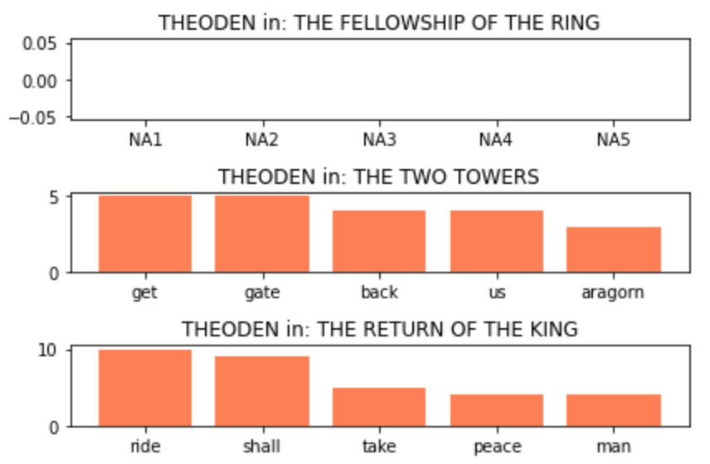

Slide 49
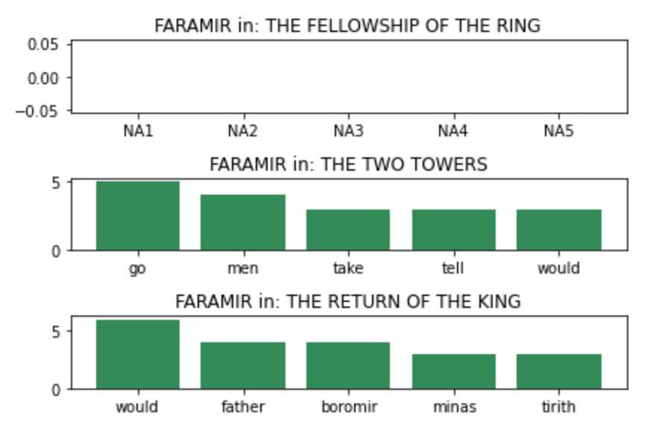

Slide 50
3. Who said it? ML
Used Random Forest Classifier trained on optimal inputs derived using RandomizedSearchCV
Used accuracy as scoring metric

Slide 51
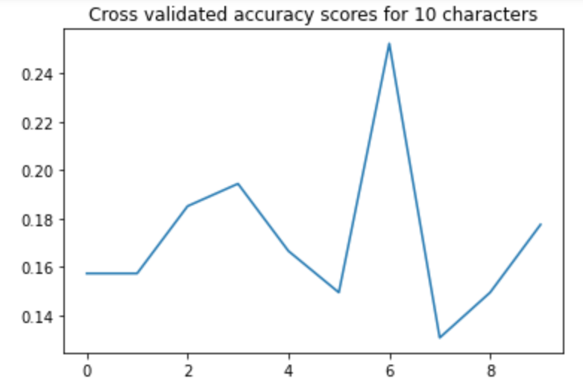

Slide 52
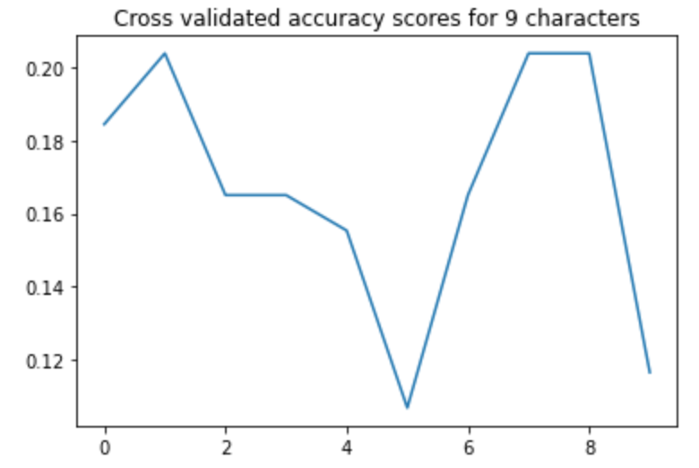

Slide 53
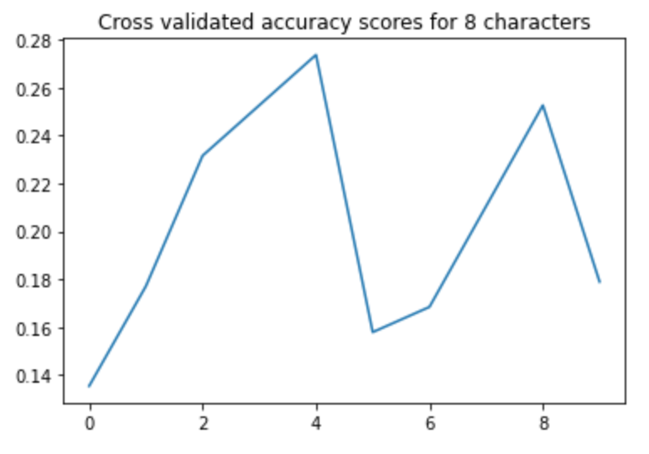

Slide 54
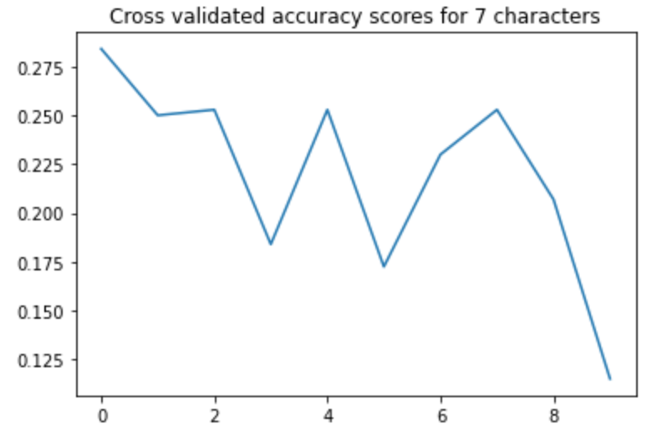

Slide 55
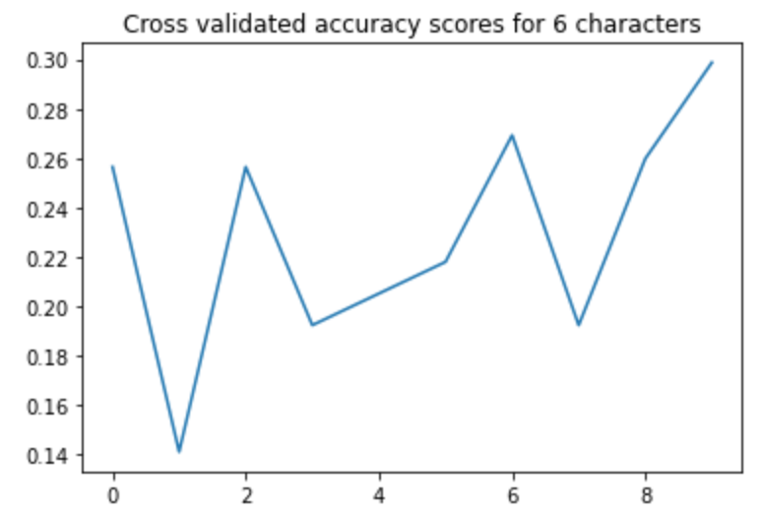

Slide 56
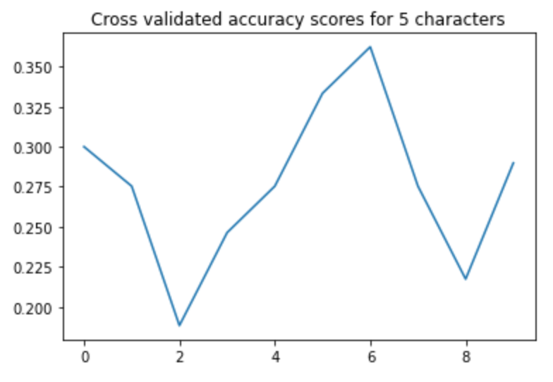

Slide 57
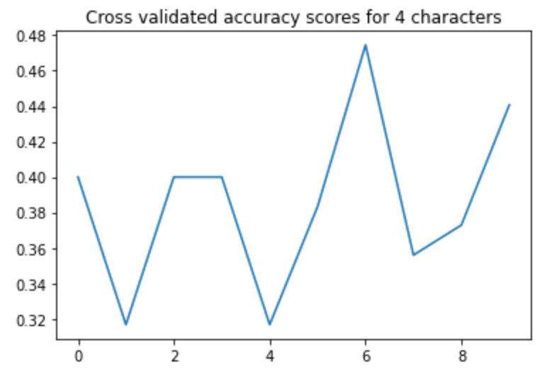

Slide 58
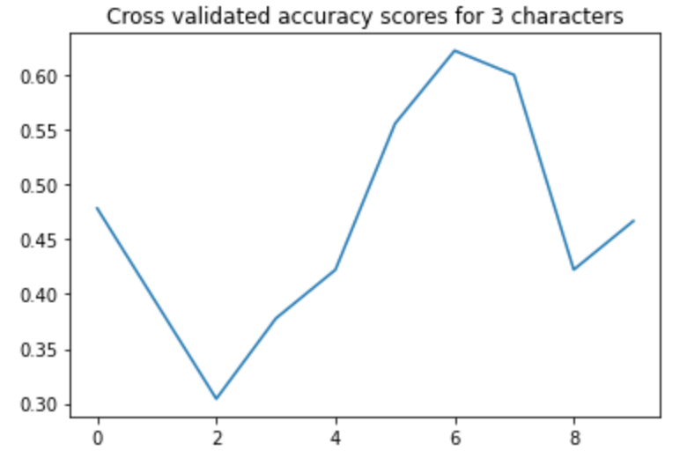

Slide 59
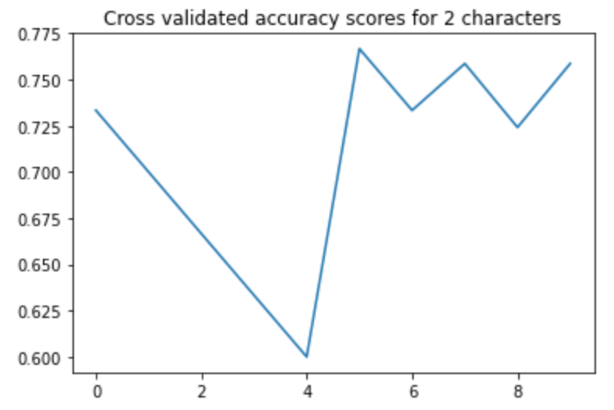

Slide 60
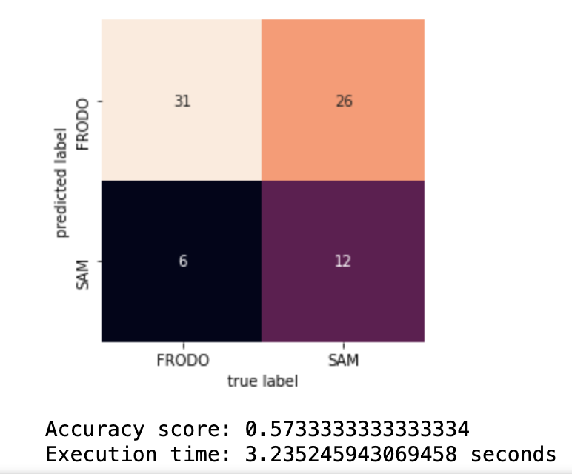
Confusion matrix for 2 class model

Slide 61
ML Summary
# Classes | 10 | 9 | 8 | 7 | 6 | 5 | 4 | 3 | 2
Max Accuracy | .25 | .21 | .27 | .30 | .30 | .37 | .47 | .65 | .76

Slide 62
Conclusion
With datasets that are not specifically designed for text classification or where there are multiple languages involved, text classification using standard techniques does not perform as well as one would like
Even after hyperparameter tuning, every model had erratic CV scores
For two classes, the best performance was under 80%

Slide 63
That’s all folks!

