Slide 1
Who’s line is it?
By: Yaniv Bronshtein

Slide 2
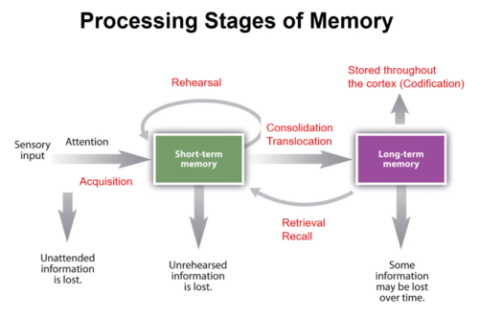
Problem
One of the most ubiquitous problems in the world of Broadway/Hollywood is an actor remembering their line. It actually often takes many cuts for a scene to be just right
What if we could engineer the mapping to aid in long term mapping?

Slide 3
Solution
This is an NLP(Natural Language Processing) Problem!
For the sake of this midterm project, we will focus on all the steps but deliberately stop short of model building
Goal: Analyze two movie scripts to figure out if given the vocabulary, one can deduce the character

Slide 4
The Datasets

Slide 5
Lord of The Rings
Source:
https://www.kaggle.com/paultimothymooney/lord-of-the-rings-data
About:
Two csv files of which only lotr_scripts.csv was used
Based on the trilogy containing the Fellowship of the Ring, Two Towers, and The Return of the King
Lotr_scripts.csv contains 3 columns: ‘char’, ‘dialog’, and ‘movie’ where ‘char’ is the character name, ‘dialog’ is their line, and Movie is one of three values

Slide 6
Harry Potter
Source:
https://www.kaggle.com/gulsahdemiryurek/harry-potter-dataset
About:
7 csv files of which only ‘Harry Potter 1.csv’, ‘Harry Potter 2.csv’, and ‘Harry Potter 3.csv’ being used for this analysis
Based on the first three Harry Potter movies
Each csv file contains columns: ‘Character’ and ‘Sentence’

Slide 7
Pipeline/Methodology

Slide 8
Data Cleaning
Load Data From csv files
Look at values in columns to note necessary transformations
Removing garbage characters
Fixing Spelling
Changing Case
Removing Stopwords

Slide 9
2. Building a dictionary
Character | Lines | Movie
Frodo | Bloop bleh bloop | Fellowship…
Gollum | My precious precious | Two Towers
Frodo | Ipsum ipsum ipsum | Return of The King
Character | Lines | Movie | Vocab
Frodo | Bloop bleh bloop | Fellowship… | {bloop:2, bleh:1}
Gollum | My precious precious | Two Towers | {my:1, precious:2}
Frodo | Ipsum ipsum ipsum | Return of the King | {ipsum:3}

Slide 10
THE MEGADICT
{
Frodo: {
bloop:2,
bleh:1,
Ipsum:3
},
Gollum: {
my:1,
precious:2
}
}

Slide 11
Additional Intermediate Steps
Used value_counts() to get top 10 characters in each movie by the number of times their name appeared in the dataframe
Used the line below to get the top 5 words for each character
top5_words = sorted(data, key=data.get, reverse=True)[:5]
Merging the three Harry Potter movie dataframes
Creating extra Movie column for future analysis in Harry Potter dataframe

Slide 12
Results: Lord of The Rings

Slide 13
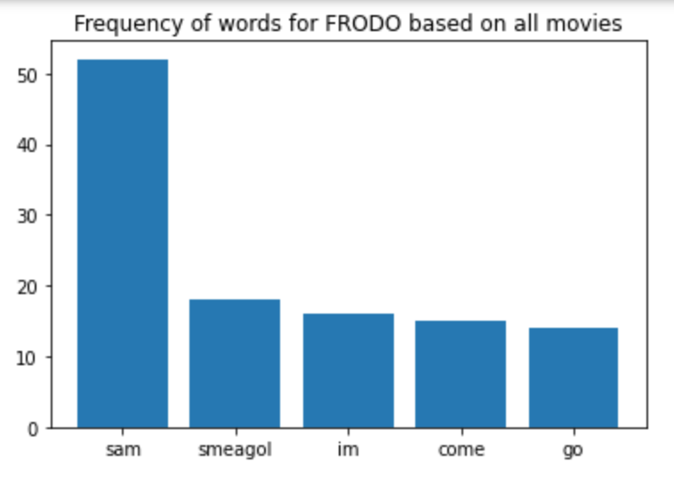
Loves Sam, Scared of Gollum, Crippled with Fear

Slide 14
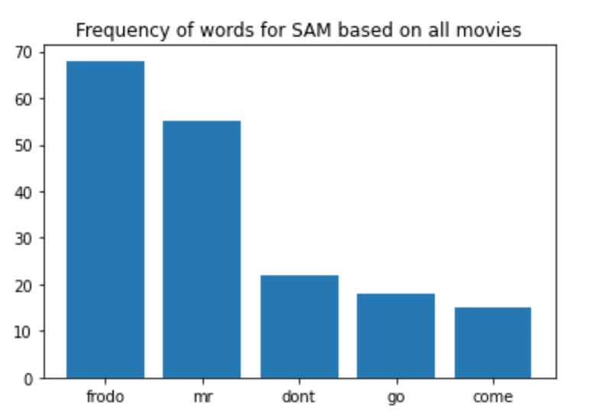
Loves Frodo, Separation Anxiety

Slide 15
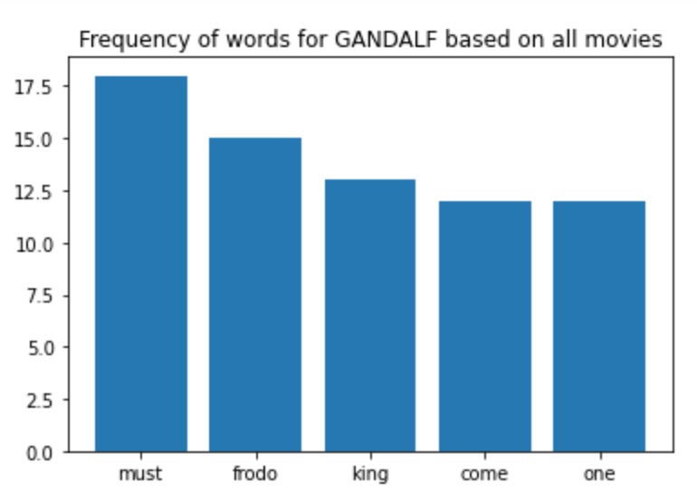
Very Demanding, Loves Frodo, Grandiose thoughts

Slide 16
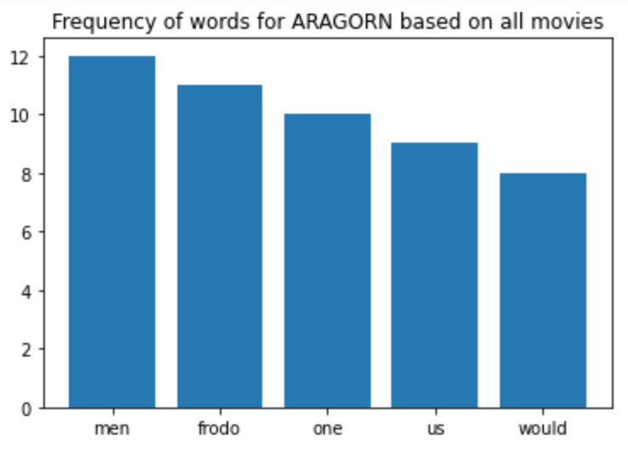
Unifying figure, Always saving Frodo

Slide 17
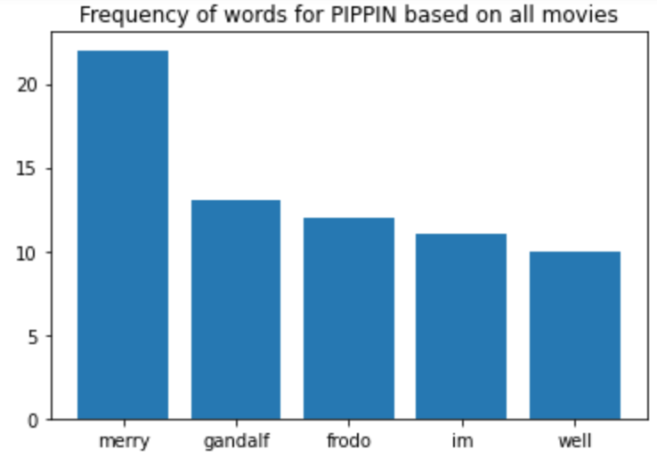
Loves Merry alot, Optimistic

Slide 18
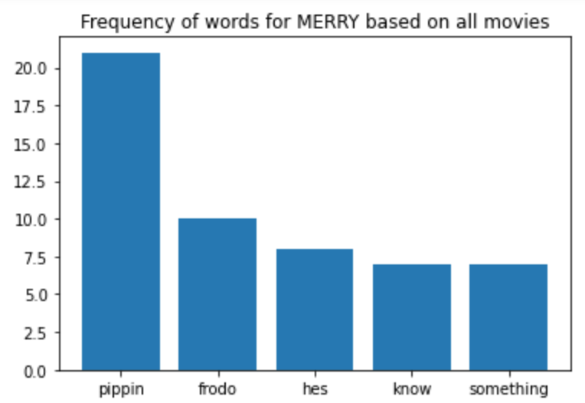
Loves Pippin, Very paranoid

Slide 19
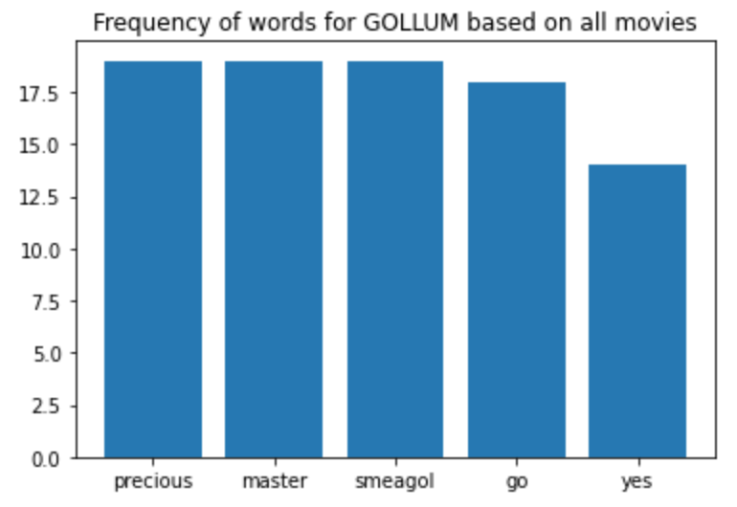
Loves his precious

Slide 20
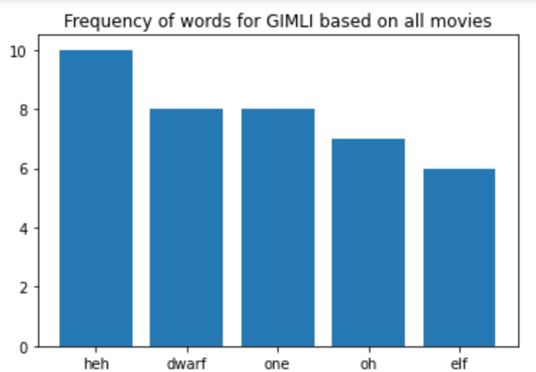
Loves himself and Legolas

Slide 21
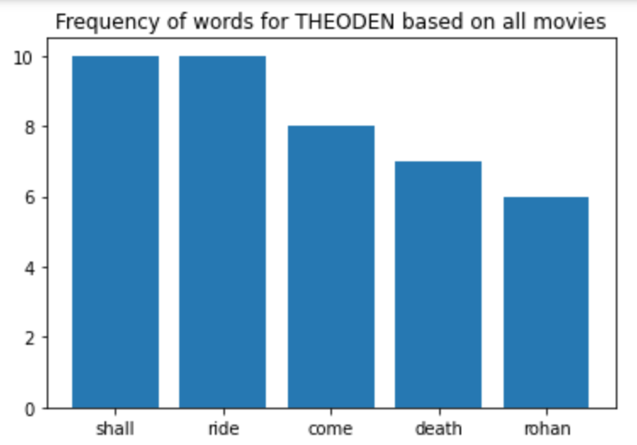
Definition of true grit

Slide 22
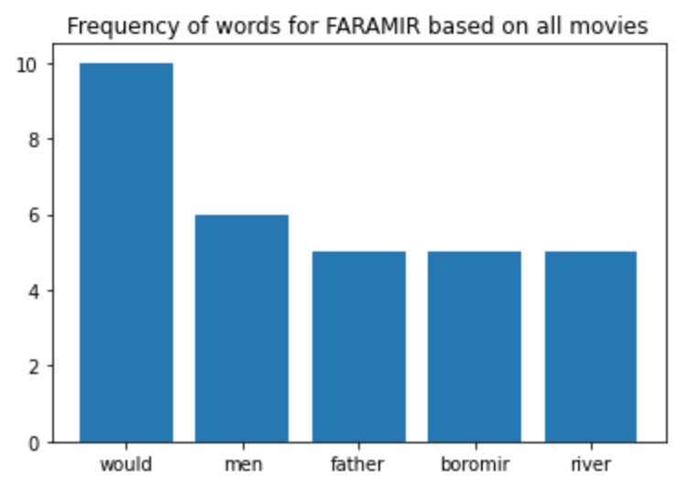
Very masculine

Slide 23
Results: Harry Potter

Slide 24
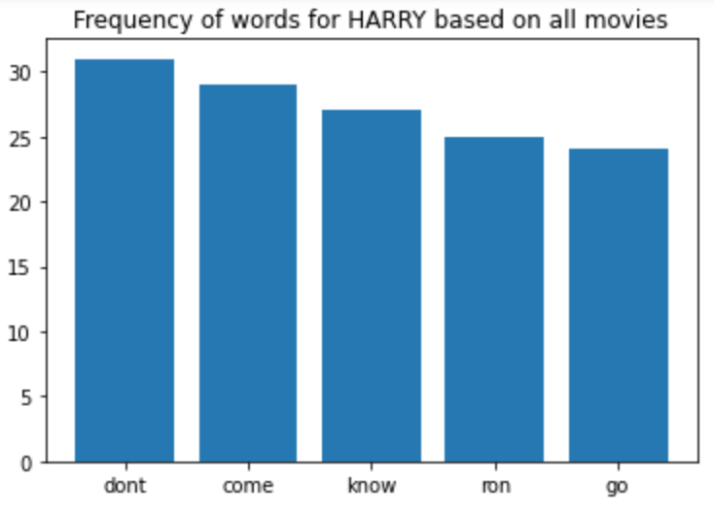
Always says no before saying yes

Slide 25
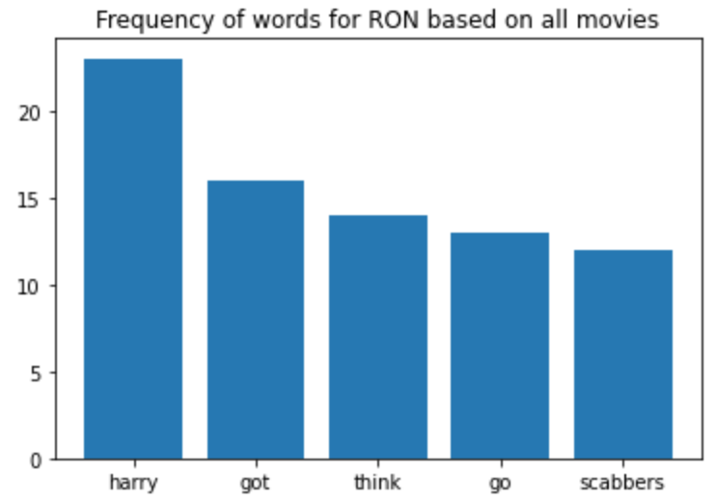
Follows Harry around like a lapdog

Slide 26
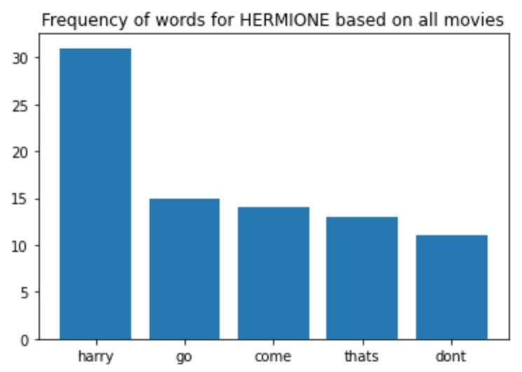
Married the wrong guy

Slide 27
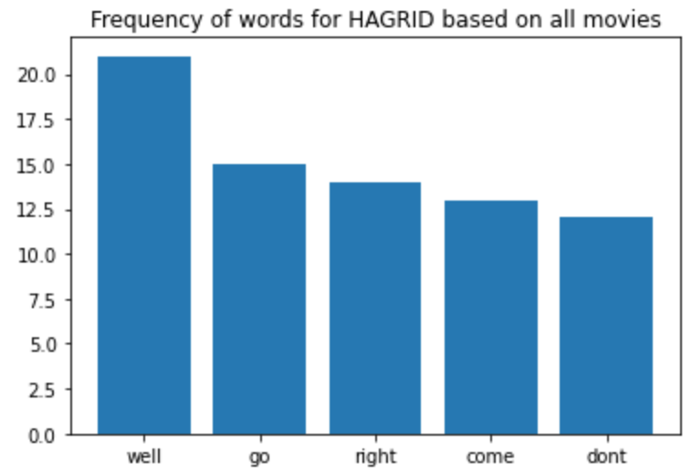
Good old Hagrid

Slide 28

Uses many of the same words as Hagrid

Slide 29
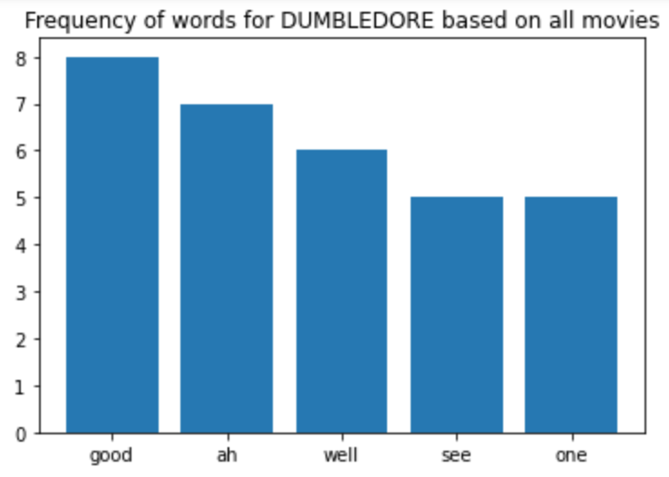
Uses similar words to Hagrid and Lupin

Slide 30
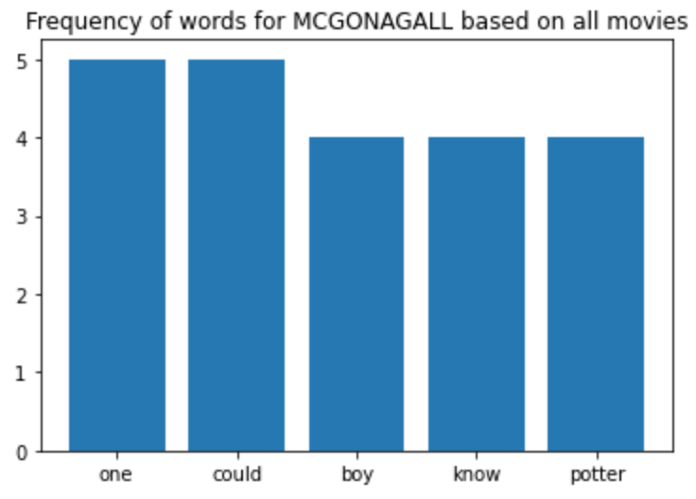
Tired of Harry, Ron, and Hermione’s shenanigans

Slide 31
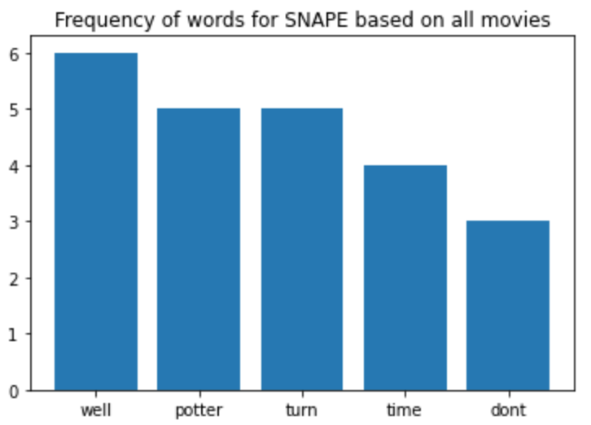
Has bad blood with Harry that goes deep

Slide 32
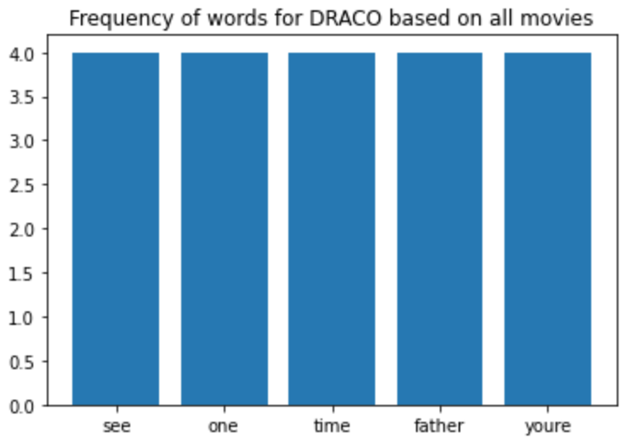
Relies on his dad to bail him out of sticky situations

Slide 33
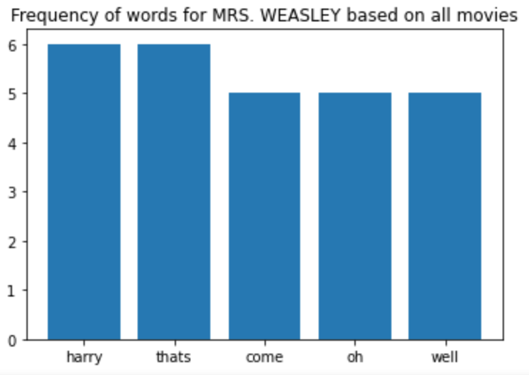
Wishes Harry was her son

Slide 34
Conclusion
Basic Data Analysis provided useful but not rigorously quantifiable data-> Need ML
Should try observing changes over time as part of sentiment analysis
Merging the lotr_scripts.csv data with lotr_characters.csv data would create a more complicated ML problem of determining whether environmental factors contributed to characters utilizing certain words(e.g Elven language)
The same can be said for the Harry Potter dataset

Slide 35
That’s all folks!

