Slide 1
Hurricane Data Analysis
Venkata Raju Datla(vkd20)
Yaniv Bronshtein (yb262)

Slide 2
Data Sources

Slide 3
What are Hurricanes?
A hurricane otherwise known as a tropical cyclone is a naturally occurring process that starts over tropical/subtropical waters.
There are many factors that increase the likelihood of a hurricane including AMO(Atlantic Multi-decadal Index) which is related to surface water temperature, light winds, rotation, and spin
Hurricane-like phenomena are classified as follows:
Tropical Depression ( < 62.4 km/h)
Tropical Storms( 62.4km/h – 118.4 km/h)
Hurricane(> 118.4 km/h)

Slide 4
Hurricane Categories
Category 1:
119-153 km/h
Category 2:
154-177 km/h
Category 3:
178-208 km/h
Category 4(Major Hurricane):
209-251 km/h
Category 5(Major Hurricane):
>252 km/h

Slide 5
What are we focusing on?
We care about Category 4 and Category 5 Hurricanes as they cause the most devastating damage that can sometimes takes months or even years to recover from taking out even the sturdiest of infrastructure and exacting deaths in the thousands
By performing unbiased analysis of hurricane data, we can extract data trends that will hopefully improve hurricane preparedness in the face of climate change

Slide 6
How did we collect and process our data?
1. Manually copied entries into Microsoft Excel from the two Wikipedia links, appending category 5 data directly below category 4 data
2. Perform basic data wrangling in Excel to arrive at data in tidy form
3. Save the data as hurricane_data.csv and not .xlsx
4. Read the csv using tidyverse read_csv() function

Slide 7
How did we collect and process our data? (Cont’d)
5. Create a calculated column for the DECADE using the mutate() function from tidyverse to perform per decade analysis
6. Split the main hurricane data into category 4 and category 5 data by applying a filter
7. To perform per-decade analysis of wind data, perform an aggregation by taking the median of wind speeds by decade
8. Use the count() function to extract hurricane frequency data to fit distributions

Slide 8
Results

Slide 9
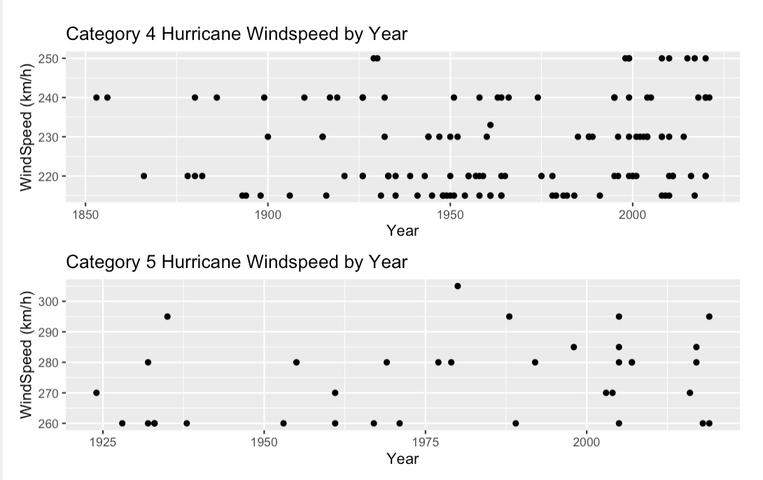
Basic Scatterplots (Per Year)

Slide 10
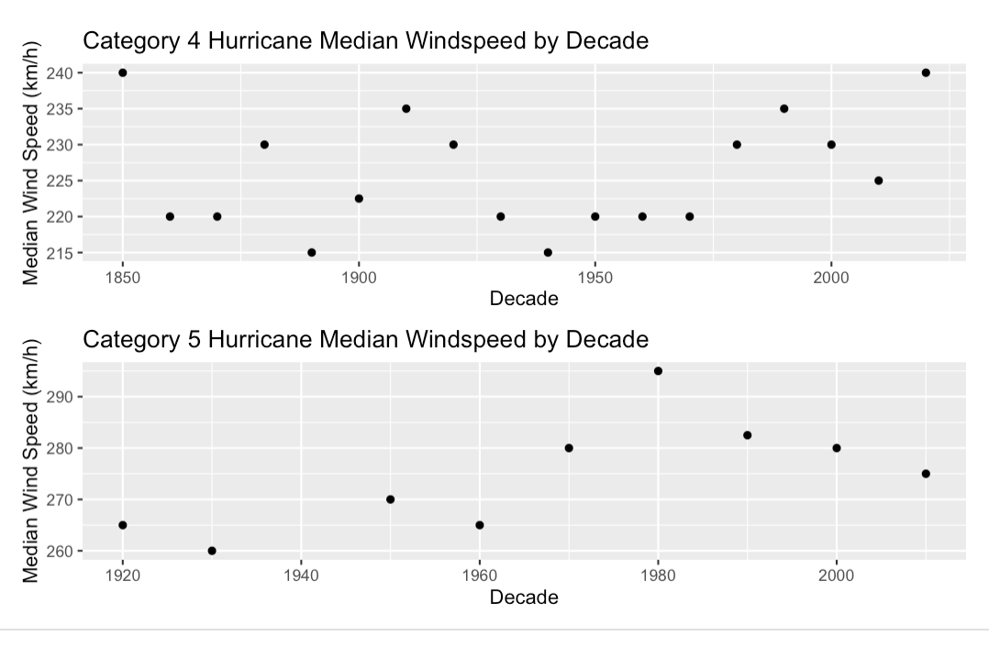
Basic Scatterplots (Per decade)

Slide 11
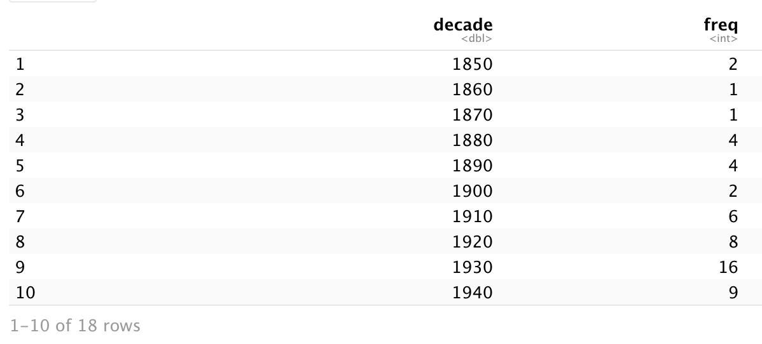
Hurricane Frequencies

Slide 12
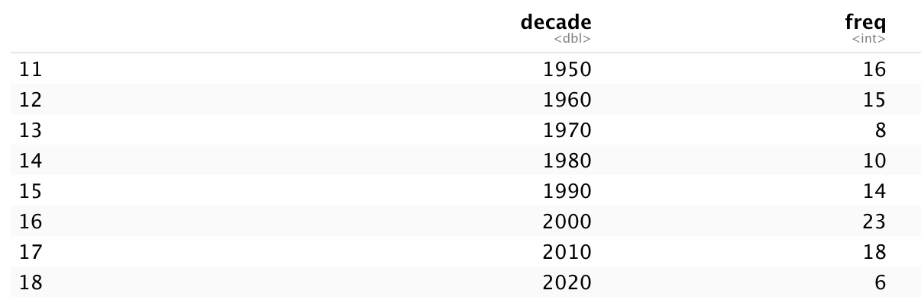
Hurricane Frequencies (Cont’d)

Slide 13
What do the frequencies tell us?
The frequency of Category 4 and Category 5 Hurricanes is not a linear relationship.
In fact over the decades, there is significant oscillation

Slide 14
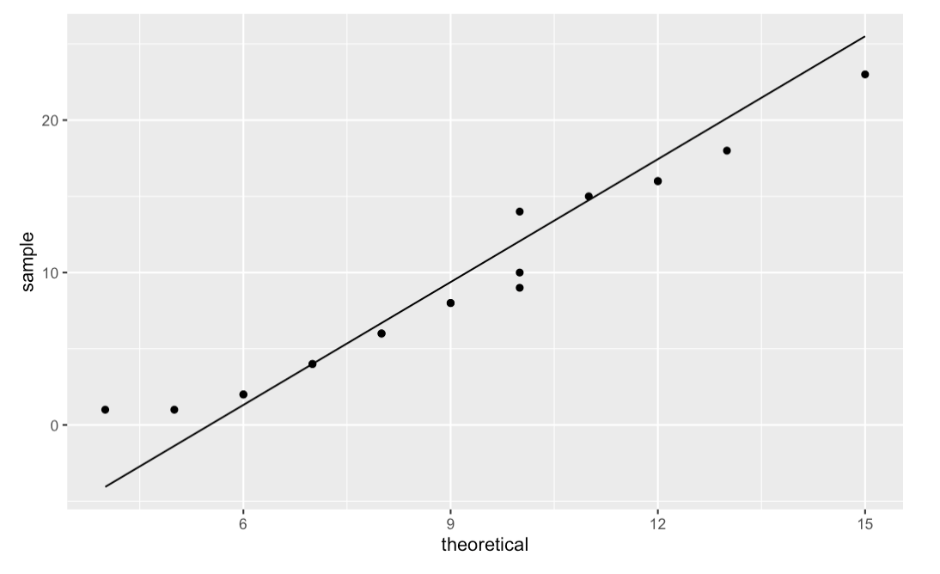
Poisson Distribution QQ-Plot

Slide 15
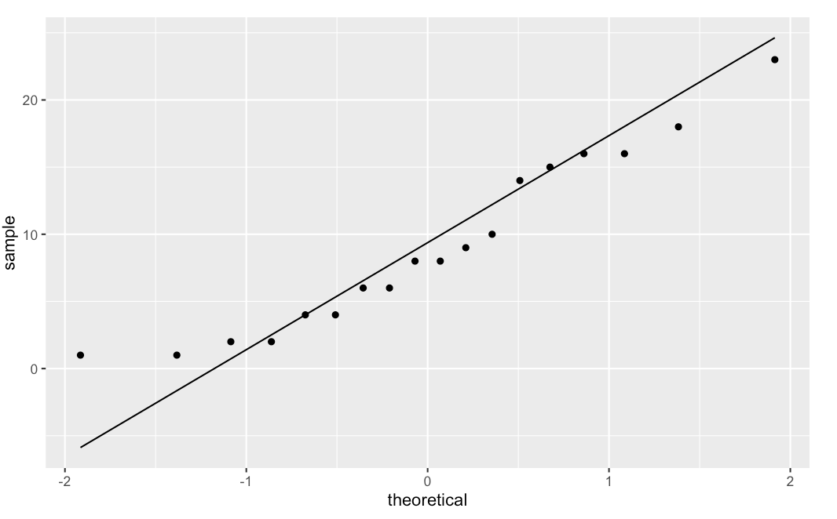
Normal Distribution QQ-Plot

Slide 16
What do the QQ-Plots tell us?
QQ-Plots are probability plots that allow statisticians to compare two probability distributions by plotting their quantile functions against each other
Thus, Poisson Distribution models the frequency data better as the points lie closer to the 45 degree line
Intuitively, the Poisson Distribution models relatively rare data like hurricanes better than a normal distribution
Notes:
In statistics, a Q–Q plot is a probability plot, which is a graphical method for comparing two probability distributions by plotting their quantiles against each other.

Slide 17
Wikipedia Data
https://en.wikipedia.org/wiki/List_of_Category_4_Atlantic_hurricanes
https://en.wikipedia.org/wiki/List_of_Category_5_Atlantic_hurricanes

Slide 18
Bibliography
US Department of Commerce, N. O. and A. A. (2013, June 28). What is a hurricane? NOAA's National Ocean Service. Retrieved September 23, 2021, from https://oceanservice.noaa.gov/facts/hurricane.html.
Saffir-Simpson hurricane wind scale. (n.d.). Retrieved September 23, 2021, from https://www.nhc.noaa.gov/aboutsshws.php.

